Slide 1

The Cultures of New Media
Prepared by
Dr. Mohamed Owies
Lecture No.3
The Cultures of New Media

Slide 2


Lecture 3
The content of Lecture 2
The third lecture sheds light on a number of important topics, including the following:
Technological Determinism and Internet Centrism
Digital divides
The Surrender of Culture To Technology
Digital natives?
Collective intelligence
Interaction and Identity
Active Users, Mutual Relations

Slide 3
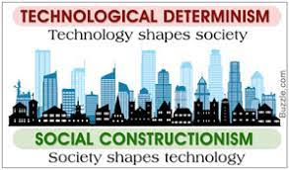
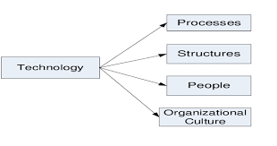
Lecture 3
Technological Determinism and Internet Centrism
In parallel to the development towards increased commercialisation and control, a counter-movement was deployed through what Curran (2012b) calls ‘the revolt of the nerds’. This consisted, in a first wave, of computer scientists and programmers during the 1980s and 1990s who resisted the idea that software should be restricted by patents and copyright. Instead, in the hacker tradition of open disclosure of information, they created and promoted free and open source software that could be used, distributed, and changed by anyone.

Slide 4
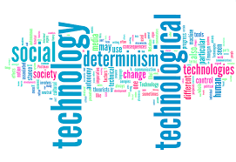
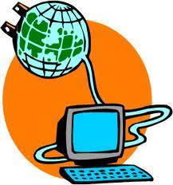
Lecture 3
Technological Determinism and Internet Centrism
In a second wave of the nerd revolution, the revival of user participation was spearheaded by the launch of Wikipedia in 2001. This openly editable and collaborative encyclopaedia soon became hugely popular as a source of information, and also quite popular among certain groups as a place to edit and contribute.
This was around the same time that social media platforms such as Facebook (2004) and YouTube (2005) exploded onto the web 2.0 scene. While these, and most other popular platforms, are still free to use, they have subsequently either evolved into, or have been acquired by, big corporations.

Slide 5
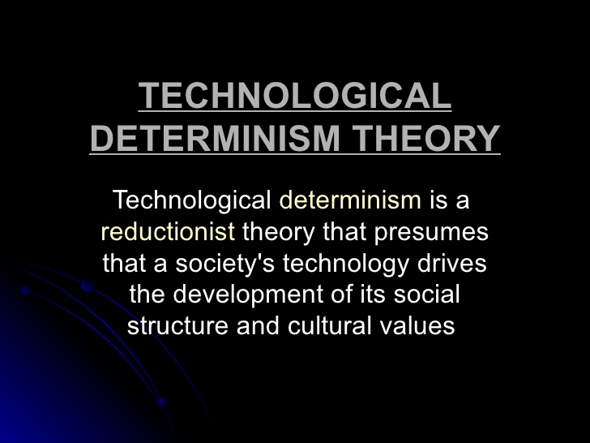
Lecture 3
Technological Determinism and Internet Centrism

Slide 6
Lecture 3
Technological Determinism and Internet Centrism
The term ‘technological determinism’ was coined by Thorstein Veblen and this theory revolves around the proposition that technology in any given society defines its nature. Technology is viewed as the driving force of culture in a society, and it determines its course of history.
Karl Marx believed that technological progress lead to newer ways of production in a society and this ultimately influenced the cultural, political and economic aspects of a society, thereby inevitably changing society itself. He explained this statement with the example of how a feudal society that used a hand mill slowly changed into an industrial capitalist society with the introduction of the steam mill.

Slide 7
Lecture 3
Technological Determinism and Internet Centrism
WINNER’S HYPOTHESES
Langdon Winner provided two hypotheses for this theory:
The technology of a given society is a fundamental influencer of the various ways in which a society exists
Changes in technology are the primary and most important source that leads to change in the society

Slide 8
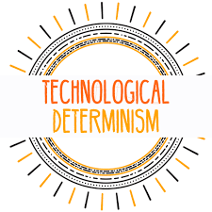
Lecture 3
Technological Determinism and Internet Centrism
Internet diffusion and adoption has been uneven globally, inevitably leading to digital divides on several geographical, cultural, and social levels. Furthermore, Digital media, like any other media, are entangled in a mesh of identity politics, permeated by race, gender, sexuality, place, nationality, and numerous other stratification.
The world is an unequal place divided by economics, language, class, gender, race, national borders, access to technology, and electricity, as well as conflicts over values, beliefs, and interests.

Slide 9
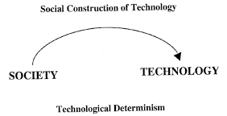
Lecture 3
Technological Determinism and Internet Centrism

Slide 10
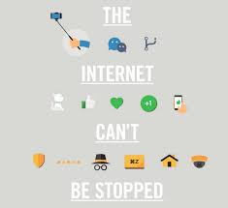
Lecture 3
Technological Determinism and Internet Centrism
The predictions in the 1990s that the internet would make the world a much better place were based on the wrongful assumption that technological changes and shifts in human relationships to these technologies were bound to generate certain forms of progressive social, cultural, and political change.
This form of thinking is known as technological determinism. This concept fits well with a Western history of thought, which emphasises development, enlightenment, and scientific rationality. But, as argued by writer and researcher Evgeny Morozov (2011: 291):

Slide 11
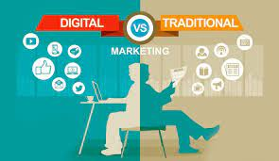
Lecture 3
Technological Determinism and Internet Centrism
Criticism of Technological Determinism
A critique of technological determinism is that technology never forces itself on members of the society. Man creates technology and chooses to use them. He invents television and chooses to view it. There is no imposition on the part of the technology to be used rather technology requires people to participate or involve themselves at some point or another to use a car or a microwave. The choice of using technology and experiencing its effects therefore lies in the hand of a human being.

Slide 12
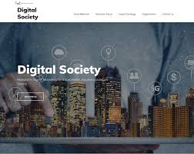
Lecture 3
Technological Determinism and Internet Centrism
Technological Determinism and Media
New media are not only an addition to existing media, they are also new technologies and therefore do have a deterministic factor as well. Marshall McLuhan made a famous statement that “the medium is the message.” This means that the medium used to communicate influences the mind of the receiver. The introduction of news print, television and the internet have all shown how technological advances have an impact on the society in which we live in.

Slide 13
Lecture 3
Digital divides
The digital divide is a term that refers to the gap between demographics and regions that have access to modern information and communications technology (ICT), and those that don't or have restricted access. This technology can include the telephone, television, personal computers and internet connectivity.
Indeed, massive forces such as global capitalism, flows of migration, religion, the environment, international tourism, peoples’ identities, and so on — that exist regardless of ‘the digital’ — shape society.

Slide 14
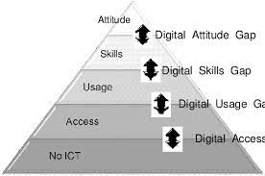
Lecture 3
Digital divides
What is the digital divide today?
According to studies and reports, the digital divide is still very much a reality today. According to a 2019 report, approximately 5 million rural American households and 15.3 million urban or metro areas still don't access broadband internet.
Meanwhile, a study by the Pew Research Center noted that 24% of adults with household incomes below $30,000 a year don't own a smartphone and 40% of those with lower incomes don't have home broadband services or a computer.

Slide 15
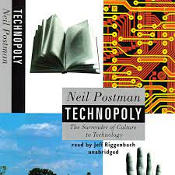
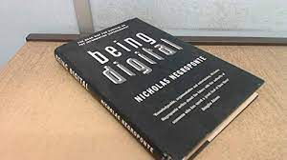
Lecture 3
The Surrender of Culture To Technology
The clash between cyberpessimism and cyberoptimism can be traced back to two books published in the early to mid-1990s: Technopoly (1992) by Neil Postman and Being Digital (1995) by Nicholas Negroponte.
The subtitle of Technopoly was The Surrender of Culture to Technology, and within its pages Postman presented a very negative outlook on the emerging digital society and what would become of it. Reading his book presents the image that he did not like technology at all, and neither did he like those who glorified it.

Slide 16
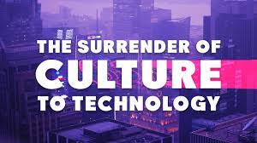
Lecture 3
The Surrender of Culture To Technology
He certainly believed, however, that it plays an important role in society:
New technologies alter the structure of our interests: the things we think about.
They alter the character of our symbols: the things we think with.
They alter the nature of community: the arena in which thoughts develop. (Postman 1992: 20)
These attitudes towards technology are clearly in line with Postman’s media ecological perspective.

Slide 17
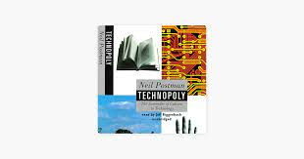
Lecture 3
The Surrender of Culture To Technology
Similar to McLuhan, Postman saw media (technologies) as ‘extensions of man’ — as what we think through and with. But in his 1992 book he feared that this extension would take us over completely.
When writing about ‘technopoly’ he defines it as ‘the submission of all forms of cultural life to the sovereignty of technique and technology’ (1992: 52).
In his dystopian vision of what would happen if the technologisation of society was to advance unfettered, he painted a grim picture where technology commands culture, the defences that protect us from the masses of information ‘generated by technology’ have crumbled.

Slide 18
Lecture 3
The Surrender of Culture To Technology
This critique of the mindless embracing of digital solutions to systemic problems was later to be echoed in Evgeny Morozov’s book To Save Everything, Click Here (2013), in which he warns of the dangers of technological solutions.
Back in 1992, Postman worried that people had started to believe that technological progress was the same thing as human progress.
One of his main concerns was that technopoly would erase the moral centre of society and replace it with a one-sided focus on efficiency and economic advancement. He wrote (1992: 179) that it ‘casts aside all traditional narratives and symbols that suggest stability and orderliness, and tells, instead, of a life of skills, technical expertise, and the ecstasy of consumption.

Slide 19
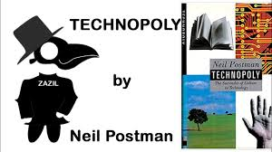
Lecture 3
The Surrender of Culture To Technology
In stark contrast to Postman’s ideas of a technopoly, Negroponte’s Being Digital stands as one of the early key texts of cyberoptimism. Programmatically, Negroponte formulated many of the positive and hopeful ideas about digital media that were floating around at the time.
He stated (1995: 230) that when people are ‘being digital’, ‘previously impossible solutions become viable’. Decentralisation would become the organising principle and defining logic for all of society, and a participatory mindset would flood every corner of the world.
Society was to become harmonised: there would be collaboration instead of competition, and everyone — so it seemed — was to become empowered.

Slide 20
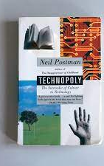
Lecture 3
The Surrender of Culture To Technology
For Negroponte, there are three key components to this recipe for success: access, mobility, and the ability to effect change. He wrote that being digital was not simply about retrieving various types of information from online repositories. Instead, it was much more about the emergence of communities that would create ‘a totally new, global social fabric’ 1995: 183).

Slide 21
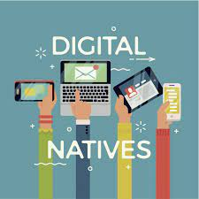
Lecture 3
Digital natives?
In a famous article, education consultant Marc Prensky (2001) coined the term ‘digital native’. His main point was that young people at the time, people born in the early 1980s and later, were ‘native speakers’ of the ‘language’ of digital platforms — computers, video games, social media, etc.
Prensky argued that there would be clashes between the digital natives and members of older generations — the ‘digital immigrants’ — in the home, in schools, and in the workplace. He said that this poses challenges for education in the 21st century.

Slide 22
Lecture 3
Digital natives?
one can’t be sure that a person’s digital skills are the sole result of which generation he or she belongs to. Many other divides, such as education, social class, geographical place, and so on, may play just as big a part.
It is not necessarily the case that people born before the 1980s will be generally slower in mastering the digital. Early exposure to a given technology is no guarantee that you will be highly skilled at it. Still, Prensky’s conceptual pair underlines the important social division that some people were in fact born into a world where the internet already existed, while others were not.
We expect many readers of this book to be ‘digital natives’ in Prensky’s sense, and to you some of the debates introduced in this chapter may seem outdated. I will argue, however, that these disputes still live on today to put their mark on digital society.

Slide 23
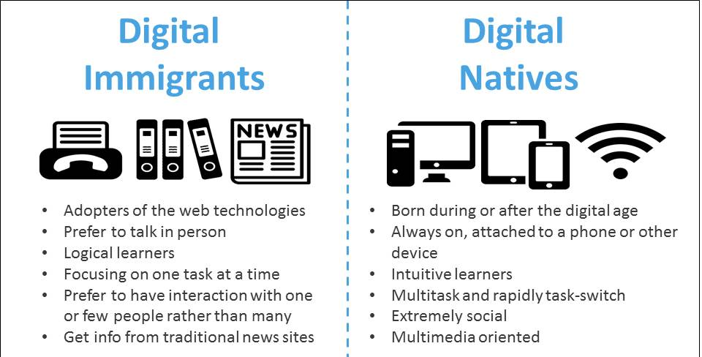
Lecture 3
Digital natives?

Slide 24
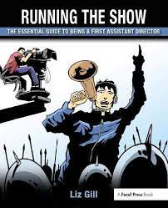
Monkeys Running the Show
Lecture 3
Digital natives?
There is a clearly identifiable genre of literature following in the Postman technopoly tradition. The writers of these books generally conceive digital media as contributing to a number of negative things: An abundance of information will be generated as an end in itself, in volumes that people will not be able to process. The digital platforms will most likely be (mis)used for abusive purposes. Society will become more fragmented and polarised.

Slide 25
Monkeys Running the Show
Lecture 3
Monkeys Running the Show
In his book Digital Vertigo (2012), Andrew Keen writes about how social media have not actually empowered people. Rather, they have contributed to weakening and dividing us.
He argues that being connected through the often superficial networks on social media platforms only makes us lonelier.

Slide 26
Lecture 3
Monkeys Running the Show
A similar view was expressed more than ten years earlier by Clifford Stoll in the book HighTech Heretic (1999). Here, Stoll claims that the use of computers and the internet will make people isolated, addicted, unhappy, and generally dissatisfied with life. What connections we make online might merely be illusions of any real companionship.
Technology researcher Sherry Turkle writes in Alone Together (2011) about how mobile phones and other gadgets make people focus on their devices instead of face-to-face interactions, even when they are in physical places ‘together’ with other people.

Slide 27
Monkeys Running the Show
Lecture 3
Monkeys Running the Show
She writes that digital communication used to be a substitute for other more direct forms — we could send an email instead of talking to someone directly if they happened to be unavailable at the time.
Today, she argues, digital communication has become the mode of choice even for communication within families or among people who share the same office space.

Slide 28
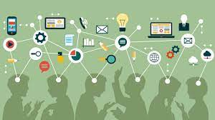
Lecture 3
Collective intelligence
Philosopher and media scholar Pierre Lévy (1997) is known for using the term collective intelligence to refer to the product of people pooling their resources, in the form of knowledge and agency, online.
In The Wisdom of Crowds (2004), James Surowiecki drew further on Lévy’s key idea and argued that collective thinking will always give better results than individual thinking. He argued that no matter how brilliant or skilled a person may be, insights, solutions, and decisions will always be better if we are thinking and acting collectively.

Slide 29
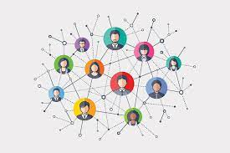
Lecture 3
Collective intelligence
People connect and share resources and creativity to generate what writer and consultant Clay Shirky (2010) calls a cognitive surplus. When defining ‘collective intelligence’, Pierre Lévy (1997) starts from the idea that no one knows everything, but everyone knows something, and argues that this collective knowledge can be
harnessed through digital media.
When people are networked and share things, it results in a form of intelligence that, according to Lévy, is universally distributed, coordinated in real time, and constantly enhanced. This enables an effective mobilisation of people’s skills for political as well as other creative purposes. Lévy’s vision is similar to what actually seemed to become a reality some four years after the publication of his book, when Wikipedia was launched. The open and collectively editable online encyclopaedia is in several respects a prime example of his vision.

Slide 30
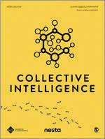
Lecture 3
Collective intelligence
Lévy wrote that digital media would make people members of a shared virtual universe of knowledge that they would foster together. The social tie was to become the most important
currency in the society of the future. He argued that collective intelligence will disrupt the power of government and lead to a diversification of knowledge and motivations.
The utopian result would be a form of real-time democracy, where knowledge is no longer ‘padlocked like a treasure’ but instead ‘pervades everything, is distributed, mediatized, [and] spreads innovation wherever it is found’ (1997: 212). This prophecy may or may not have become a reality in different settings in digital society throughout the last couple of decades.

Slide 31
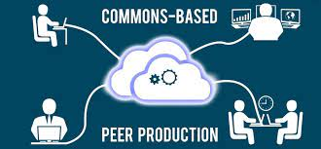
Lecture 3
Peer production
In his book The Wealth of Networks (2006), legal scholar Yochai Benkler describes the changes in terms of a more general development towards a form of ‘peer production’. He argues that this form of non-professional and non-market production has been enabled by the digitally networked environment.
The internet and social media enable ‘radically decentralized, collaborative, and nonproprietary’ forms of production wherein individuals that are loosely connected with each other make things together, beyond things like ‘market signals or managerial commands’ (2006: 60).

Slide 32
Lecture 3
Peer production
People have always been engaged in non-market production, but the significantly lowered thresholds for acquiring the tools to do so, as well as connecting with large numbers of other people, sees a huge upscaling of this phenomenon.
Networked publics can perform much more complex tasks than their analogue predecessors. People participate and contribute based on their own interests, as they are motivated not by money, but by social and psychological forces.

Slide 33

Lecture 3
Peer production
They think that it’s fun, exciting, or in other ways rewarding. Naturally, the motivations and rewards can differ widely from contributor to contributor.
According to Benkler, the quintessential example of this form of production can be found in free software and open source movements, but Wikipedia is also a good example. Today, the peer production model is expanding into every domain of economy, society, and culture. Benkler predicts that peer production will change the dominant mode of market production.

Slide 34
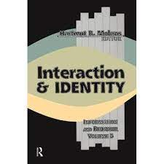
Lecture 3
Interaction and Identity
Interaction is one of those concepts which are often used, but seldom very well defined. From a sociological perspective, as stated by classic social psychologist George Herbert Mead, interaction is what goes on when people do things in relation to each other. Social actions were defined by Weber as behaviour that is oriented towards the behaviour of others.
Mead (1934: 45) draws on that perspective when writing about ‘the social act’ as ‘the interaction of different forms, which involves, therefore, the adjustment of the conduct of these different forms to each other, in carrying out the social process’.

Slide 35
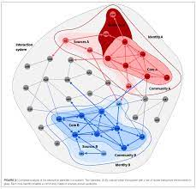
Lecture 3
Interaction and Identity
In other words, interaction is mutual. It goes in both, or many, directions. This mutuality may come from how the communication medium is structured, from the communication setting, or from how users think and act. Interactivity will be seen in somewhat different ways, and is studied from different perspectives, depending on which of these dimensions one is interested in.
In sum, when a communication environment is interactive, it implies that participants can control — modify the form and content of — the environment, and that the roles of sender and receiver are interchangeable.

Slide 36
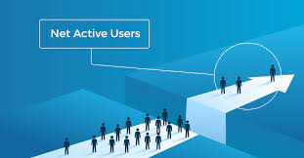
Lecture 3
Active Users, Mutual Relations
When computer-mediated communication is defined in relation to older and other forms of communication, the characteristic that is most often highlighted is its interactivity. Media that are interactive offer their users the ability and potential to directly intervene in the content in different ways.
Traditional mass communication is not very interactive at all, whereas telephone conversations are highly interactive, but with a very small audience. In digital society, the internet and social media enable interactive forms of communication among a large number of people.

Slide 37
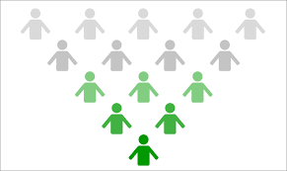
Lecture 3
Active Users, Mutual Relations
First, people can interact with the content of digital media. Even though the internet has plentiful content that can simply be passively absorbed, it also offers a variety of content that enables, or even demands, that the user actively does something with it, or to it.
The things that we can do range from navigating, playing, experimenting, and exploring, to actually creating things such as images, edits, status updates, comments, tags, and so on.
Even if the word ‘interaction’, or ‘interactivity’, might be used to refer to things like human-computer interaction, and in fields such as multimedia and game design.

Slide 38
Lecture 3
Active Users, Mutual Relations
In other words, we focus here on the ‘social interactivity’ of digital media — their ability to enable groups and individuals to communicate with, and relate to, each other (Baym 2010: 7).
New media researcher Martin Lister and colleagues (2009: 50) write that even though different users will not all share the same experience of any specific content, they collectively construct ‘the text’ through their discussions about it.
The internet and social media enable such processes of making meaning to include larger groups of people and ever more refined ways to transform the content.

Slide 39
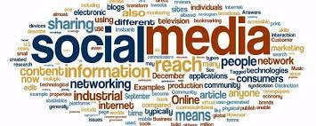
Lecture 3
From Body to Content
These interactive patterns are key to understanding how the widespread use of digital media and the internet changed the fabric of society around the end of the 20th century. This was obviously the case, even though perspectives differ on how dramatic the change was, and whether it was and is a good or a bad thing.
the studies have shown how this transformation was not only about the tools and platforms — email, online forums, chatrooms, blogs, social network sites, the web, etc. — but about the emergence of new social and cultural phenomena and patterns.

Slide 40
Lecture3
From Body to Content
phenomena such as ‘the online forum’, ‘the social network site’, ‘the tweet’, ‘the link’, and ‘the like’ are purely digital, which have changed the nature of communication, and thus culture and society Sociologist Tim Jordan (2013: 1) writes about how internet technologies have given rise to ‘different identities, bodies, and types of messages.
In society before electronic media, people who communicated at a distance — while not being face-to-face, that is — used written language on a variety of media. Things like signatures, personal seals, particular salutations, or recognisable styles of handwriting and language use compensated for the physical body not being tangibly present.

Slide 41

Lecture 3
From Body to Content
Once the telephone was introduced, new means of substituting for the presence of a physical body became relevant, such as the sound, intonation, or other characteristics of someone’s voice.
Jordan explains how these methods stand in contrast to what happens with communication through digital media. He argues that in communicative practices that are dependent on the internet, the identity markers, and the traces of the nonpresent body are much more unstable.
While the handwriting or voice of a person has a natural connection to their physical body, things like email addresses, Twitter sernames, or forum nicknames do not.

Slide 42
Lecture 3
Thank You

