Slide 1


Forecasting in
business
Prepared by Dr. Nagwan Al-Qershi
Lecture 3

Slide 2


Forecasting
www.midocean.ae

Slide 3

Forecast – a statement about the future value of a variable of interest
  We make forecasts about such things as weather, demand, and resource availability
  Forecasts are important to making informed decisions
  The shorter the forecast period, the more accurately the forecasts tend to track what happens

Slide 4

Two Important Aspects of Forecasts
Expected level of demand
  The level of demand may be a function of some structural variation such as trend or seasonal variation
2. Accuracy
  Related to the potential size of forecast error

Slide 5
Forecasting in
business
www.midocean.ae

Slide 6

Forecasting in business is a decision-making tool used by many businesses to help in budgeting, planning, and estimating future growth. In the simplest terms, forecasting is the attempt to predict future outcomes based on past events and management insight.

Slide 7
Forecasts in Business Organizations
Accounting. New product/process cost estimates, profit projections, cash management.
Finance. Equipment/equipment replacement needs, timing and number of funding/borrowing needs.
Human resources. Hiring activities, including recruitment, interviewing, and training; layoff planning, including outplacement counseling.
Marketing. Pricing and promotion, e-business strategies, global competition strategies.
MIS. New/revised information systems, internet services.
Operations. Schedules, capacity planning, work assignments and workloads, inventory planning, make-or-buy decisions, outsourcing, project management.
Product/service design. Revision of current features, design of new products or services.

Slide 8
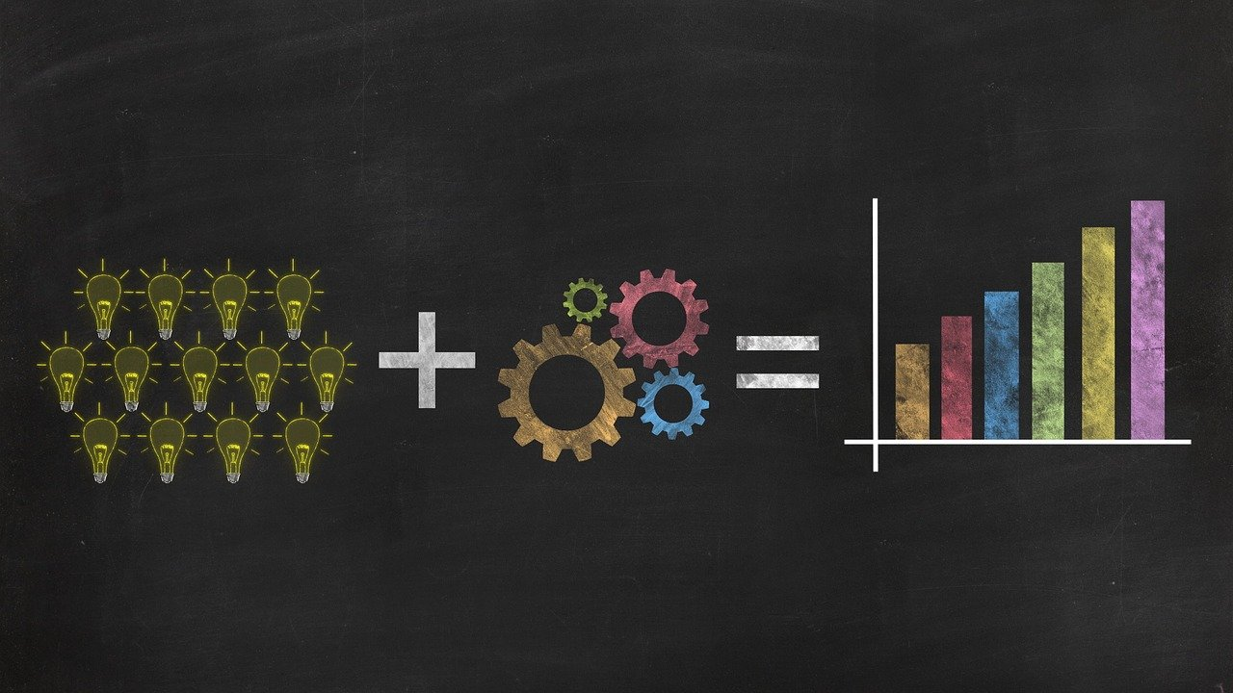
Forecast Uses
Plan the system
  Generally, involves long-range plans related to:
    Types of products and services to offer
    Facility and equipment levels
    Facility location
Plan the use of the system
  Generally, involves short- and medium-range plans related to:
    Inventory management
    Workforce levels
    Purchasing
    Production
    Budgeting
    Scheduling
3-8

Slide 9

Features Common to All Forecasts
Techniques assume some underlying causal system that existed in the past will persist into the future
Forecasts are not perfect
Forecasts for groups of items are more accurate than those for individual items
Forecast accuracy decreases as the forecasting horizon increases
When choosing a forecasting technique, a critical trade-off that must be considered is that between cost and accuracy

Slide 10
Forecasts Are Not Perfect
    Random variation is always present, there will always be some residual error, even if all other factors have been accounted for.
    Lack of Data – Without enough data to draw from, making accurate predictions is impossible. Businesses must collect as much data as possible and leverage this knowledge to create reliable forecasts.
    Poor Quality Data – Even if businesses have access to plenty of data, it won't do them any good if the quality is poor.

Slide 11
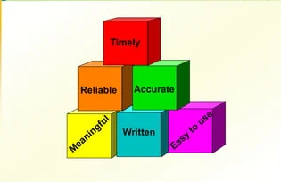
Elements of a Good Forecast
The forecast
Should be timely
Should be accurate
Should be reliable
Should be expressed in meaningful units
Should be in writing
Technique should be simple to understand and use
Should be cost-effective

Slide 12
Steps in the Forecasting Process
Determine the purpose of the forecast
Establish a time horizon
Obtain, clean, and analyze appropriate data
Select a forecasting technique
Make the forecast
Monitor the forecast errors

Slide 13
Forecasting Approaches
Qualitative forecasting
  Qualitative techniques permit the inclusion of soft information such as:
    Human factors
    Personal opinions
    Hunches
  These factors are difficult, or impossible, to quantify
Quantitative forecasting
  These techniques rely on hard data
  Quantitative techniques involve either the projection of historical data or the development of associative methods that attempt to use causal variables to make a forecast

Slide 14
Qualitative Forecasts
Forecasts that use subjective inputs such as opinions from consumer surveys, sales staff, managers, executives, and experts
  Executive opinions
    A small group of upper-level managers may meet and collectively develop a forecast
  Salesforce opinions
    Members of the sales or customer service staff can be good sources of information due to their direct contact with customers and may be aware of plans customers may be considering for the future

Slide 15
Qualitative Forecasts cont.
  Consumer surveys
    Since consumers ultimately determine demand, it makes sense to solicit input from them
    Consumer surveys typically represent a sample of consumer opinions
  Other approaches
    Managers may solicit 0pinions from other managers or staff people or outside experts to help with developing a forecast.
    The Delphi method is an iterative process intended to achieve a consensus

Slide 16
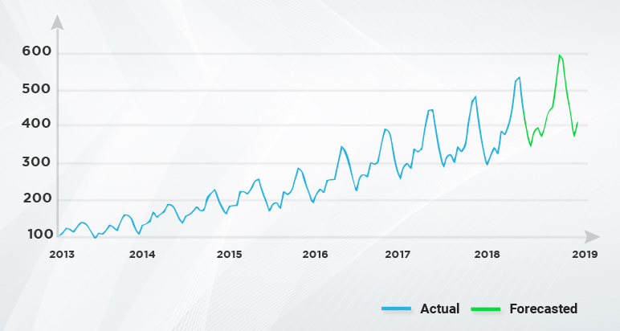
Time-Series Forecasts
Forecasts that project patterns identified in recent time-series observations
  Time-series – a time-ordered sequence of observations taken at regular time intervals
Assume that future values of the time-series can be estimated from past values of the time-series

Slide 17
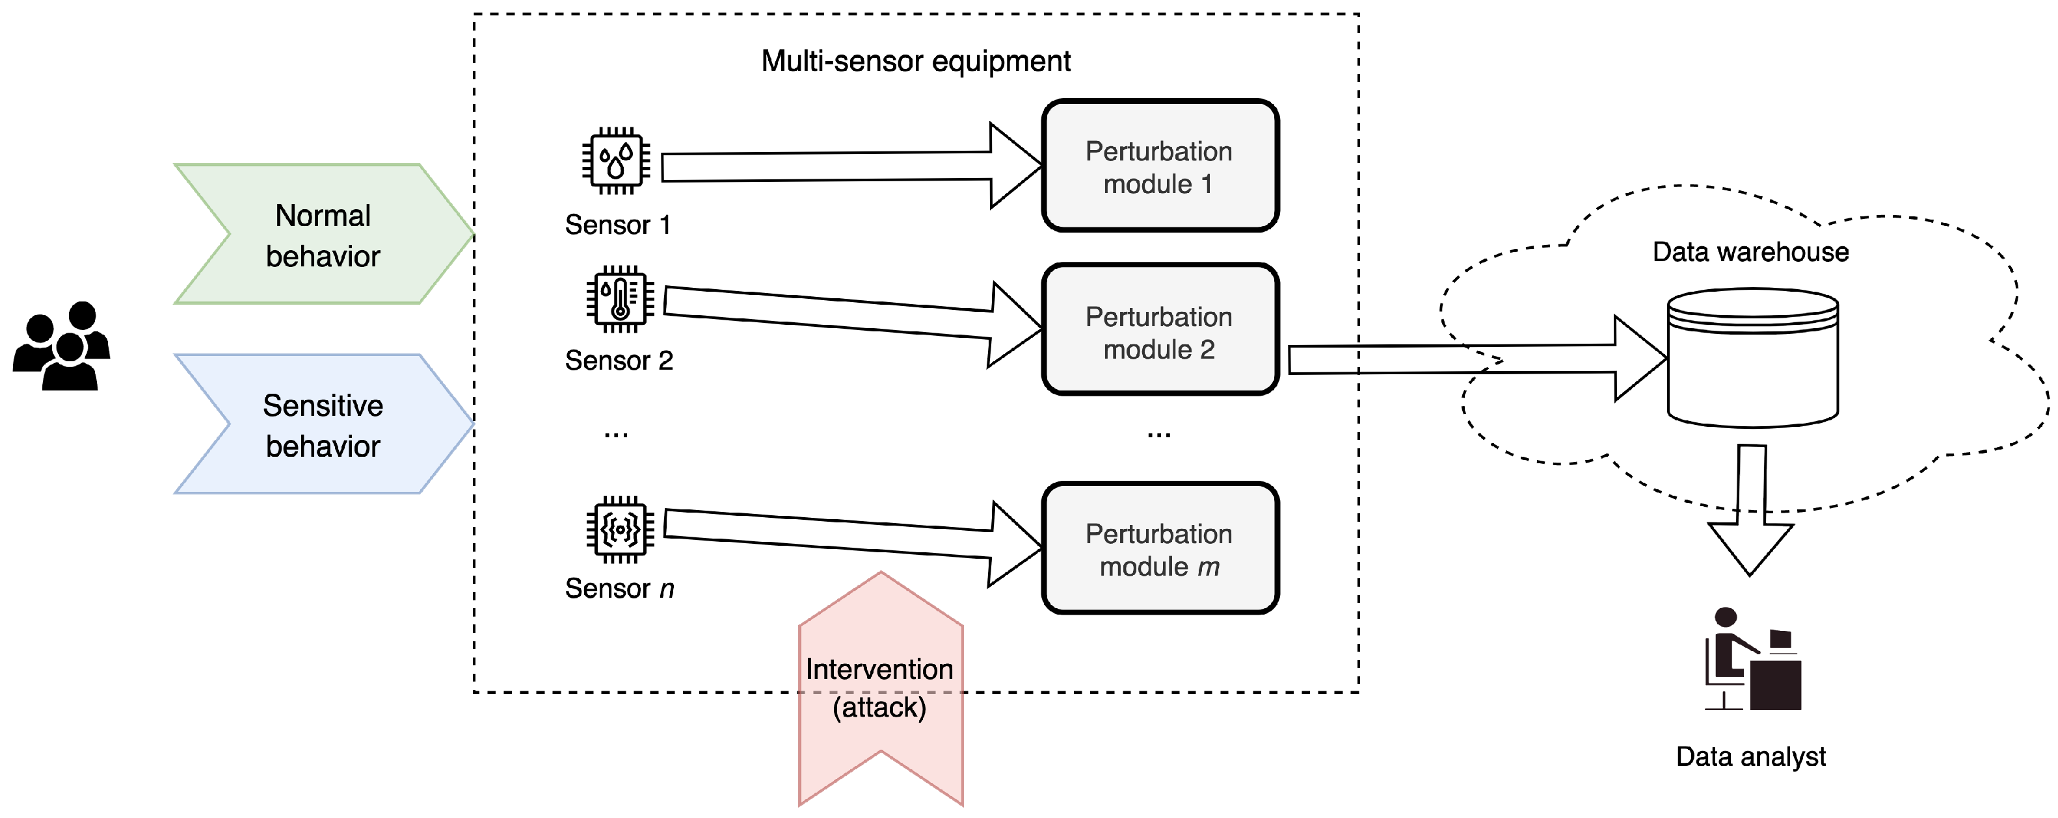
Time-Series Behaviors
Time series data is a collection of observations (behavior) for a single subject (entity) at different time intervals (generally equally spaced as in the case of metrics, or unequally spaced as in the case of events).
Trend
Seasonality
Cycles
Irregular variations
Random variation
3-17

Slide 18
Trends and Seasonality
Trend
  A long-term upward or downward movement in data
    Population shifts
    Changing income
Seasonality
  Short-term, regular variations related to the calendar or time of day
  Restaurants, service call centers, and theaters all experience seasonal demand
3-18

Slide 19
Cycles and Variations
Cycle
  Wavelike variations lasting more than one year
    These are often related to a variety of economic, political, or even agricultural conditions
Irregular variation
  Due to unusual circumstances that do not reflect typical behavior
    Labor strike
    Weather event
Random Variation
  Residual variation that remains after all other behaviors have been accounted for
3-19

Slide 20
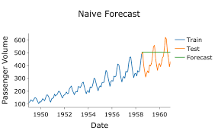
Time-Series Forecasting - Naïve Forecast
Naïve forecast
  Uses a single previous value of a time series as the basis for a forecast
    The forecast for a time is equal to the previous time period’s value
  Can be used with
    A stable time series
    Seasonal variations
    Trend
3-20

Slide 21
Time-Series Forecasting - Averaging
These techniques work best when a series tends to vary about an average
  Averaging techniques smooth variations in the data
  They can handle step changes or gradual changes in the level of a series
  Techniques
    Moving average
    Weighted moving average
    Exponential smoothing
3-21

Slide 22
What is the averaging technique?
The objectives of various averaging methods are twofold:
(1) to define the average properties for the multiphase system and correlate the experimental data
(2) to obtain solvable governing equations that can be used to predict the macroscopic properties of the multiphase system.

Slide 23
What is averaging strategy?
Averaging is a set of trading strategies that involve adjusting the average price of the shares held by buying or selling more shares when the market fluctuates.
Averaging can be used in different market scenarios and with different objectives.

Slide 24
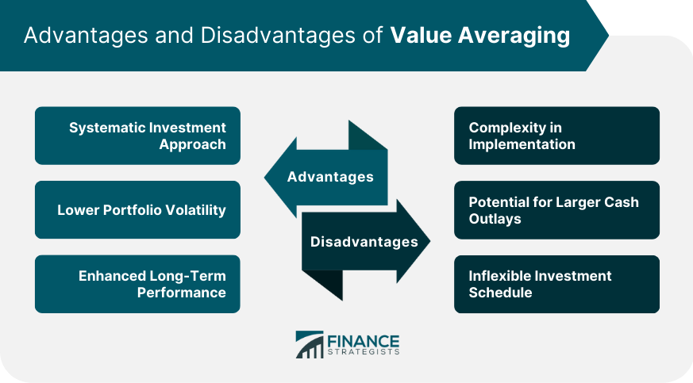
What is the advantage of averaging?
Measuring a value several times and then calculating its average value reduces the error in the measured value. If we take the average of averages, it will further reduce the error and thus we will be closer to the true value.

Slide 25
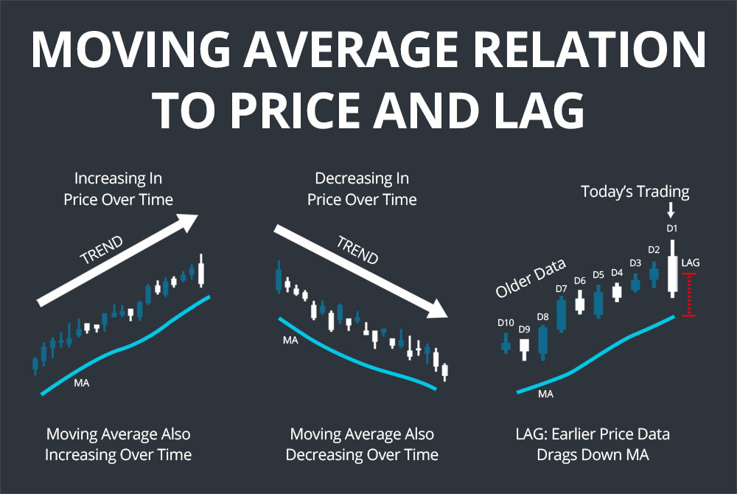
1. Moving Average
A moving average is a technical indicator that investors and traders use to determine the trend direction of securities.
Technique that averages several of the most recent actual values in generating a forecast
3-25

Slide 26
Moving Average (cont.)
As new data become available, the forecast is updated by adding the newest value and dropping the oldest and then re-computing the average
The number of data points included in the average determines the model’s sensitivity
  Fewer data points used—more responsive
  More data points used—less responsive
3-26

Slide 27
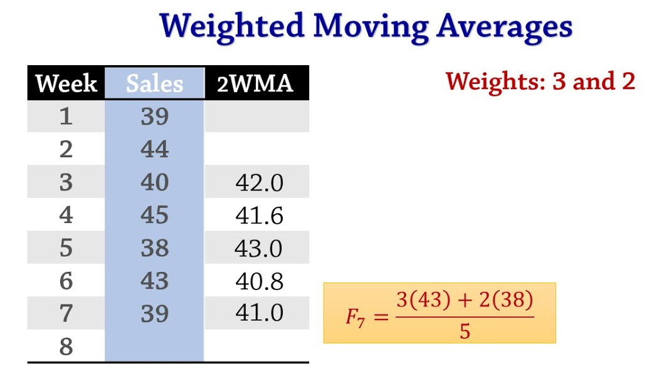
2. Weighted Moving Average
The most recent values in a time series are given more weight in computing a forecast
  The choice of weights, w, is somewhat arbitrary and involves some trial and error
3-27

Slide 28
3. Exponential Smoothing
Exponential smoothing is a time series forecasting method that uses an exponentially weighted average of past observations to predict future values.
A weighted averaging method that is based on the previous forecast plus a percentage of the forecast error
3-28

Slide 29
Techniques for Seasonality
Seasonality – regularly repeating movements in series values that can be tied to recurring events
  Expressed in terms of the amount that actual values deviate from the average value of a series
  Models of seasonality
    Additive
      Seasonality is expressed as a quantity that gets added to or subtracted from the time-series average to incorporate seasonality
    Multiplicative
      Seasonality is expressed as a percentage of the average (or trend) amount which is then used to multiply the value of a series to incorporate seasonality
3-29

Slide 30
Seasonal Relatives
  The seasonal percentage used in the multiplicative seasonally adjusted forecasting model
Using seasonal relatives
  To deseasonalize data
    Done to get a clearer picture of the nonseasonal (e.g., trend) components of the data series
    Divide each data point by its seasonal relative
  To incorporate seasonality in a forecast
    Obtain trend estimates for desired periods using a trend equation
    Add seasonality by multiplying these trend estimates by the corresponding seasonal relative
3-30

Slide 31
Associative Forecasting Techniques
Associative techniques are based on the development of an equation that summarizes the effects of predictor variables
  Predictor variables – variables that can be used to predict values of the variable of interest
    Home values may be related to such factors as home and property size, location, number of bedrooms, and number of bathrooms
3-31

Slide 32
Simple Linear Regression
Regression – a technique for fitting a line to a set of data points
  Simple linear regression – the simplest form of regression that involves a linear relationship between two variables
    The object of simple linear regression is to obtain an equation of a straight line that minimizes the sum of squared vertical deviations from the line (i.e., the least squares criterion)
3-32

Slide 33
Simple Linear Regression Assumptions
Variations around the line are random
Deviations around the average value (the line) should be normally distributed
Predictions are made only within the range of observed values

Slide 34
Issues to Consider:
Always plot the line to verify that a linear relationship is appropriate
The data may be time-dependent
  If they are
    use analysis of time series
    use time as an independent variable in a multiple regression analysis
A small correlation may indicate that other variables are important
3-34

Slide 35
Forecast Accuracy and Control
Allowances should be made for forecast errors
  It is important to provide an indication of the extent to which the forecast might deviate from the value of the variable that happens
Forecast errors should be monitored
  Error = Actual – Forecast
  If errors fall beyond acceptable bounds, corrective action may be necessary
3-35

Slide 36
Monitoring the Forecast
Tracking forecast errors and analyzing them can provide useful insight into whether forecasts are performing satisfactorily
Sources of forecast errors:
  The model may be inadequate due to
    error of an important variable
    a change or shift in the variable the model cannot handle
    the appearance of a new variable
  Random variation

Slide 37
Choosing a Forecasting Technique
Factors to consider
  Cost
  Accuracy
  Availability of historical data
  Availability of forecasting software
  Time needed to gather and analyze data and prepare a forecast
  Forecast horizon

Slide 38
Operations Strategy
The better forecasts are, the more able organizations will be to take advantage of future opportunities and reduce potential risks
  A worthwhile strategy is to work to improve short-term forecasts
    Accurate up-to-date information can have a significant effect on forecast accuracy:
      Prices
      Demand
      Other important variables
  Reduce the time horizon forecasts must cover
  Sharing forecasts or demand data through the supply chain can improve forecast quality
3-38

Slide 39



Thank You

