Slide 1

Digital
Consumer Behavior
Dr. Perihan Salah
MKT713
Master of Digital Marketing
5

Slide 2

Consumer Attitude Formation and Change
Lecture 5
MKT713
Master of Digital Marketing

Slide 3

05
To understand what attitudes are, how they are formed, and their role in consumer behavior.
To understand the tri-component attitude model and its applications.
To understand the structures of multi-attribute models and their use in altering consumers’ attitudes.
To understand how to alter consumers’ attitudes by making particular needs prominent.
To understand the role of cognitive elaboration in altering attitudes.
To understand how attitudes can precede behavior in the form of cognitive dissonance and the resolution of conflicting attitudes.
To understand the ways people assign causality to events and apply this knowledge to consumer behavior.

Slide 4



Slide 5

Attitude
A learned predisposition to behave in a consistently favorable or unfavorable manner with respect to a given object.

Slide 6
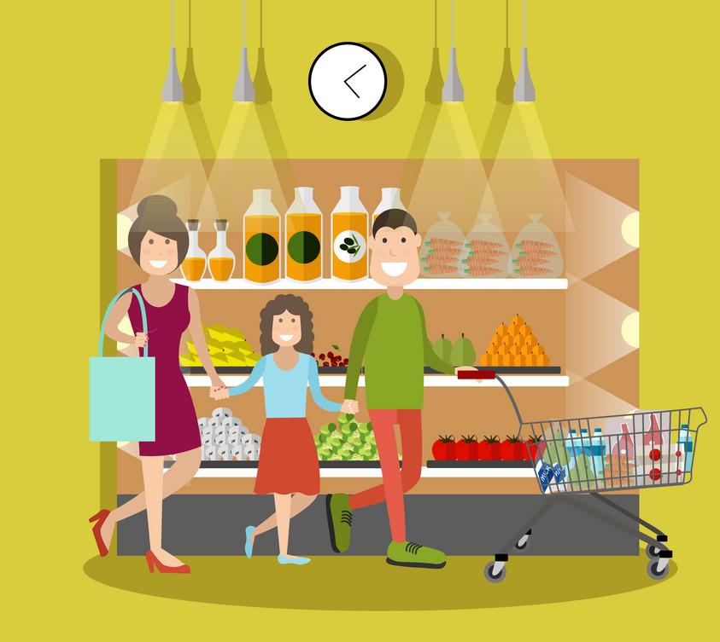
Attitude Formation
Consumers learn attitudes when they try new products, product models, and different brands.
If such trial purchases meet or exceed their expectations, then they develop favorable attitudes toward those objects.
Generally, the more information consumers have about a product or service, the more likely they are to process information and form attitudes about it, either positive or negative.

Slide 7

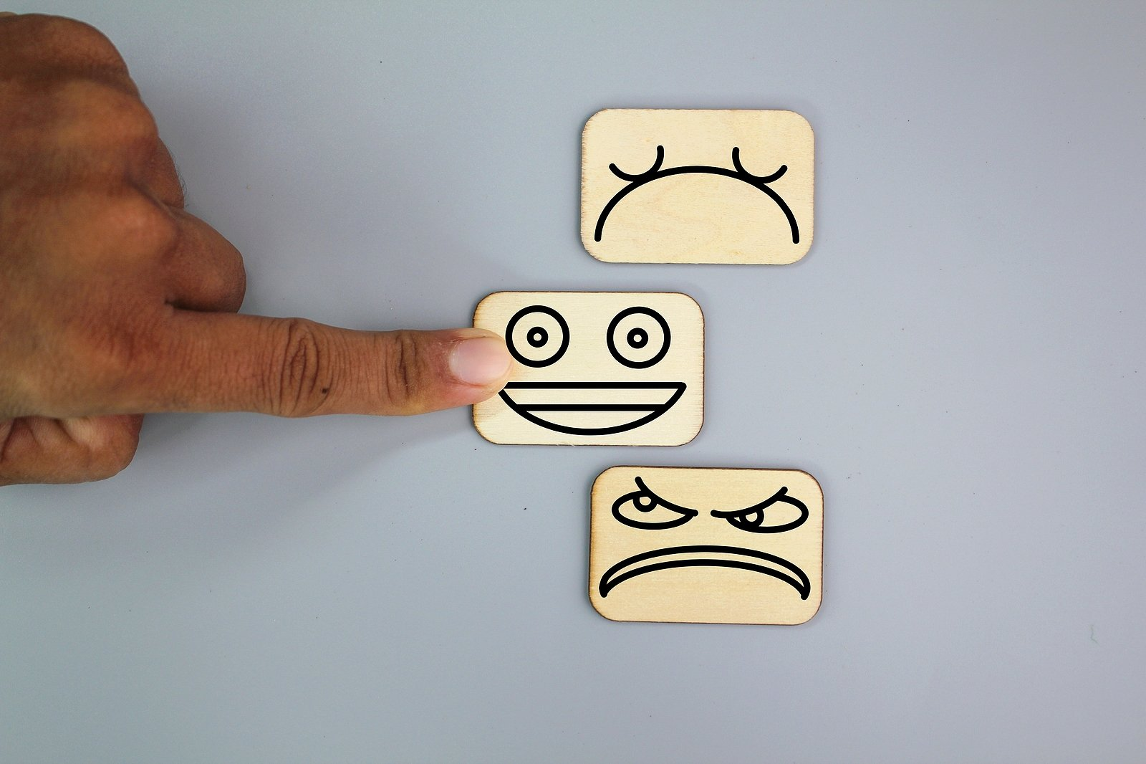
Attitude Formation
Sources that strongly affect attitudes formation
Experience
Family and friends
Media/Internet/Social Media (increasingly)
A primary source of attitudes toward products is the consumers’ direct experiences in trying and evaluating them.

Slide 8



Role of Personality Factors in Attitude
Need for cognition
Consumers with high need for cognition form positive attitudes with promotions that include a lot of detailed, product-related information.
Consumers with low need for cognition form positive attitudes in response to ads that feature attractive models or celebrities, or other peripheral cues about the products advertised.
Innovativeness
Is relevant in the context
of new product adoption.
Personalities that like to adopt new products

Slide 9



Attitude Formation
Personality traits like need for cognition (craving information and enjoyment of thinking) and innovativeness affect consumer behavior.

Slide 10

High or low need for cognition?

Slide 11

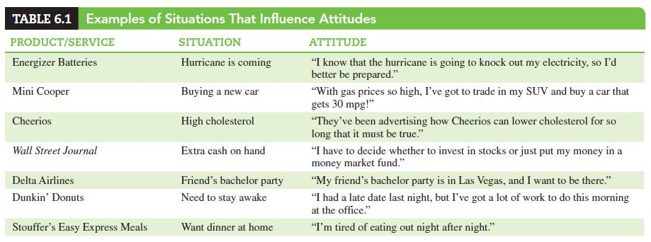
Role of Attitude
Attitudes occur within and are affected by situations.
“Situations” are events and circumstances that influence the relationships between attitudes and behaviors at particular times.
Situations can cause consumers to behave in ways seemingly inconsistent with their attitudes.

Slide 12

Situation

Slide 13

Situation

Slide 14

Situation

Slide 15

Situation

Slide 16
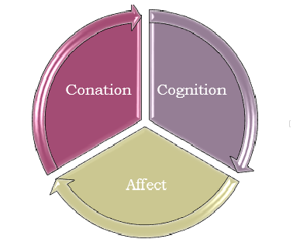
Tri-component Attitude Model

Slide 17
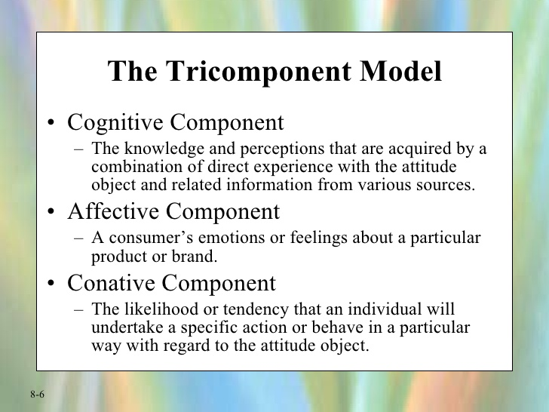
Tri-component Attitude Model

Slide 18
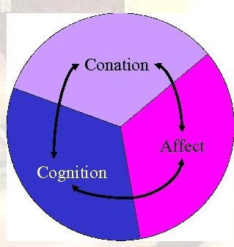
Tri-component Attitude Model
Cognitive Component – The knowledge and perceptions that are acquired by a combination of direct experience with the attitude object and related information from various sources.
Affective Component – A consumer’s emotions or feelings about a particular product or brand.
Conative Component – The likelihood or tendency that an individual will undertake a specific action or behave in a particular way with regard to the attitude object.

Slide 19
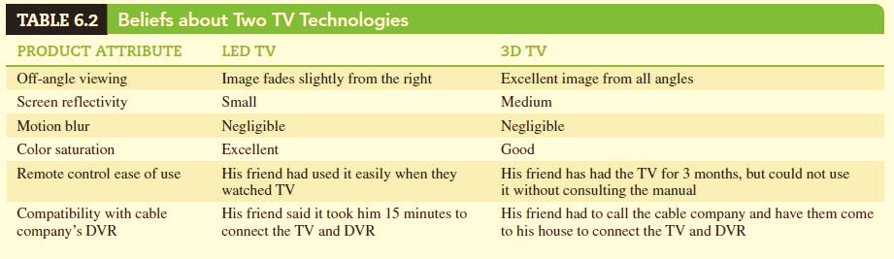
The Cognitive Component

Slide 20

The Cognitive Component

Slide 21
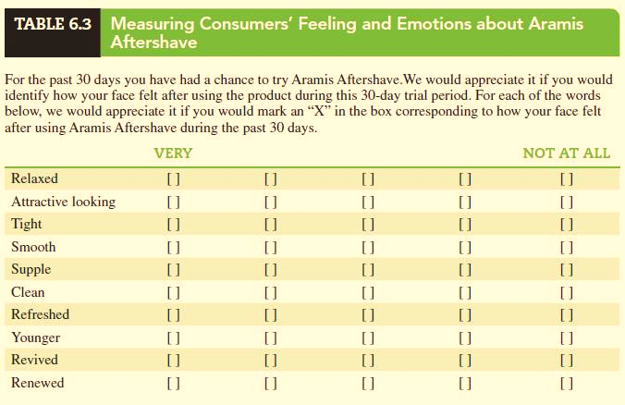
The Affective Component

Slide 22

The Affective Component

Slide 23

The Conative Component

Slide 24


Altering Consumer Attitudes

Slide 25

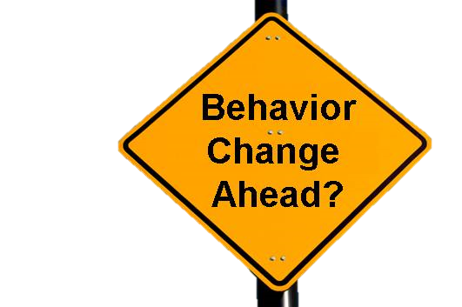


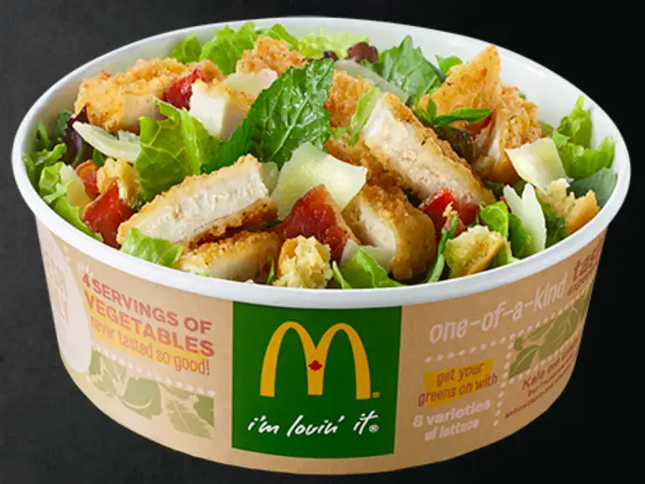
Altering Consumer Attitudes
Changing beliefs about products
Changing brand image
Changing beliefs about competing brands

Slide 26

Altering Consumer Attitudes

Slide 27

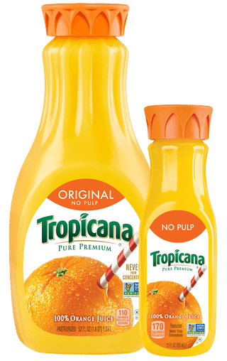
Attitude-Toward-Object Model
Maintains that a consumer’s evaluation of a product is a function of:
1. The extent to which the product has (or lacks) each of a given set of attributes.
2. The importance of each of these attributes to the consumer.
Ways (how you do this)
Add an attribute
Change perceived importance of an
attribute
Develop new products

Slide 28

Attitude-Toward-Object Model

Slide 29
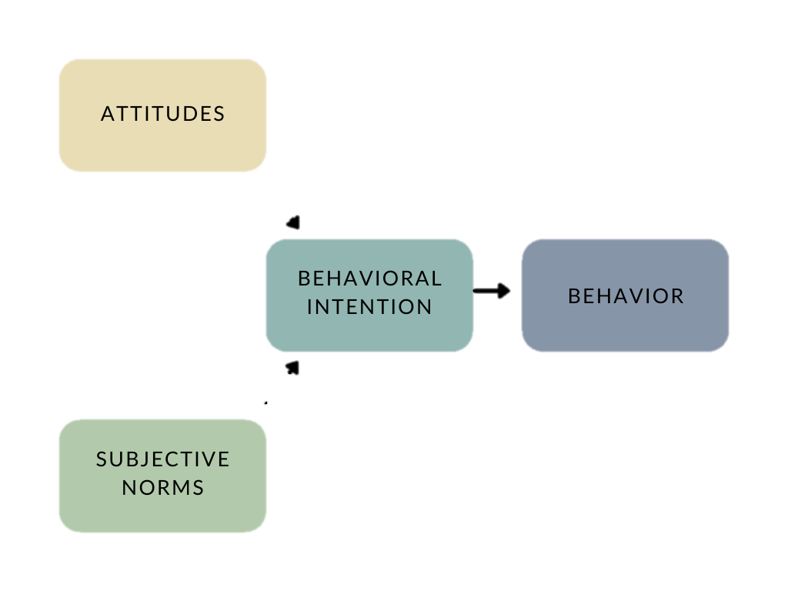
Theory of Reasoned Action (TRA )
Like the tri-component model,
it incorporates the cognitive, affective, and conative components.
It adds the measurement of subjective norms (feelings about what relevant others would think about the action) that influence a person’s intention to act before gauging the level of intention.

Slide 30


Slide 31
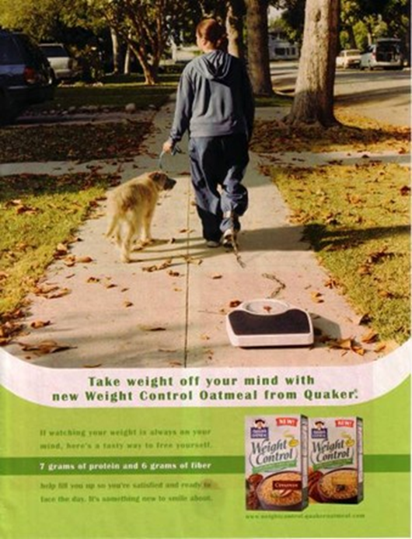
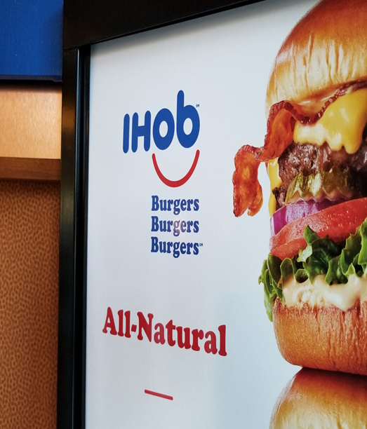
Theory of Trying-to-consume
Represents cases where the outcome of a contemplated action (e.g., a purchase), stemming from a positive attitude, but is still being pursued by the consumer.
A person trying to consume faces two types of obstacles that may prevent the desired outcome:
1. Personal impediments (obstacle)
2. Environmental impediments.

Slide 32
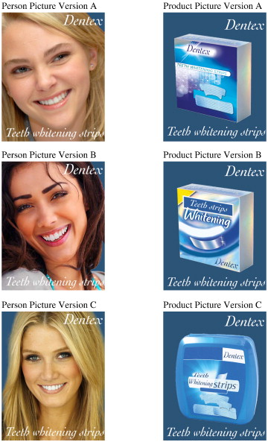
Attitude-toward-the-ad Model
Proposes that the feelings consumers form when they see and hear ads significantly impact their attitudes towards the brands advertised.

Slide 33

Attitude-toward-the-ad Model
Proposes that the feelings consumers form when they see and hear ads significantly impact their attitudes towards the brands advertised.

Slide 34

Attitude-toward-the-ad Model
Proposes that the feelings consumers form when they see and hear ads significantly impact their attitudes towards the brands advertised.

Slide 35
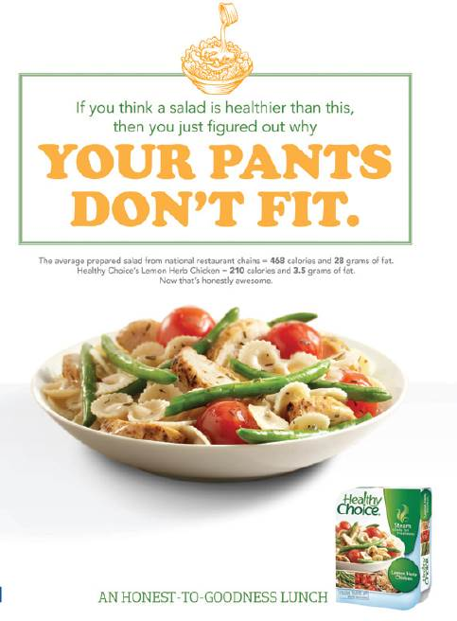
Functional Approach
Utilitarian function
Ego-defensive function
Value-expressive function
Knowledge function
Associate brands with worthy causes and events
To which functions do the ad appeal?

Slide 36
Functional Approach
Changing attitudes by appealing to consumers’ motivations/reasons or functions behind their attitudes .
1. The utilitarian function stems from the belief that consumers’ attitudes reflect the utilities that brands provide.
When a product has been useful or enabled us to perform certain tasks in the past, our attitude toward it tends to be favorable.
2. The ego-defensive function maintains that people form attitudes in order to protect themselves from sensing doubt and to replace uncertainty with feelings of security and confidence.
3. The value-expressive function maintains that attitudes reflect consumers’ values and beliefs.
4. The knowledge function holds that people form attitudes because they have a strong need to understand the characters of the people, events, and objects they encounter.

Slide 37
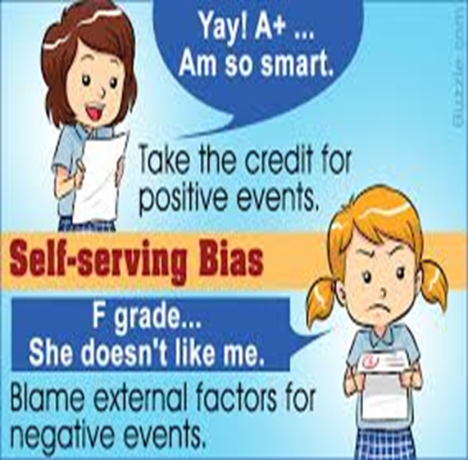
Defensive Attitude Attribution
People generally accept (or take) credit for success (internal attribution),
but
assign failure to others or outside events (external attribution)

Slide 38

Defensive Attribution
internal or external attribution?

Slide 39
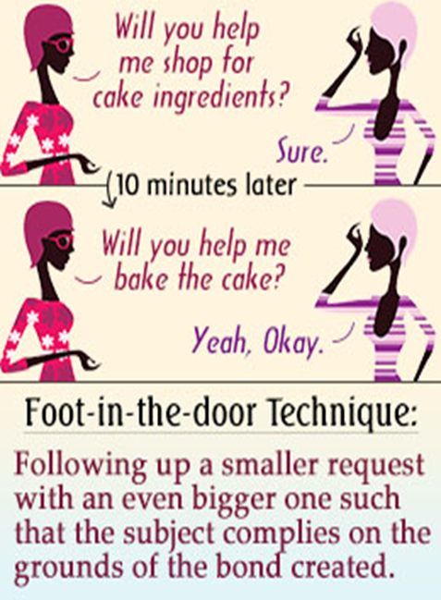
Foot-in-the-door Technique
Consists of getting people to agree to large requests after convincing them to agree to a small and modest request first.
The rationale behind this method is that agreeing to a small request creates a bond between the requester and the requestee.
The requestee does not want to disappoint the requestor, with whom he feels he has bonded.
The requestee also becomes interested in the objective of the request.

Slide 40
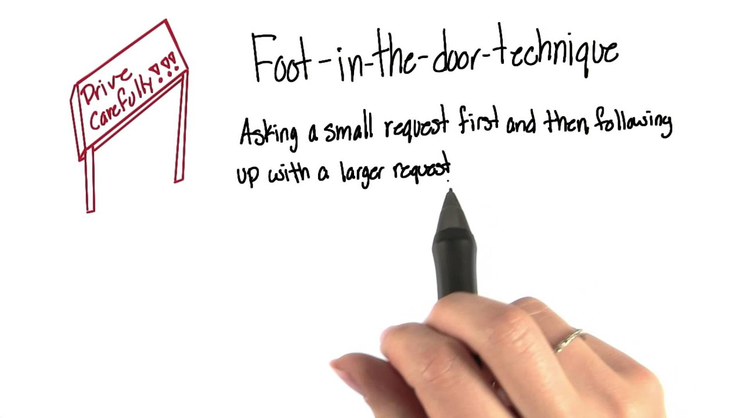
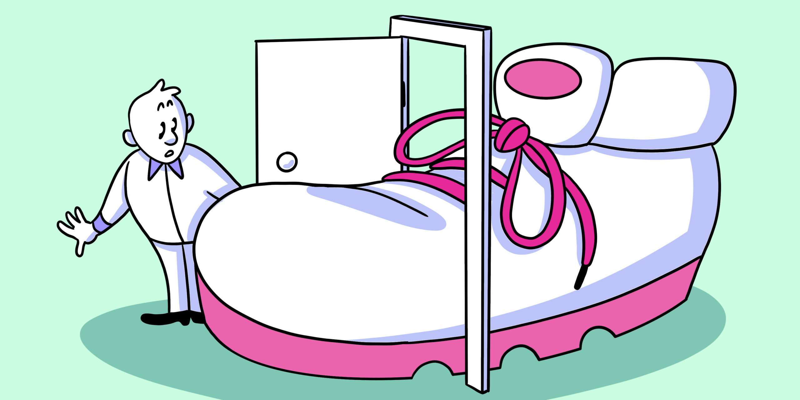
Foot-in-the-door Technique
People tend to develop attitudes to justify prior actions.
So, when people look at their prior behavior (e.g., compliance with minor requests), they conclude that they are the kind of persons who generally agree to requests from others (i.e., an internal attributions), which increases their compliance with the larger request.

Slide 41
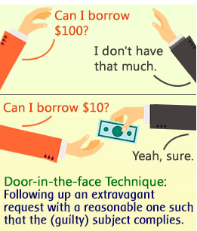

Door-in-the-face Technique
A large, costly first request that is likely to be refused, then is followed by a second, more realistic, and less costly request.

Slide 42

To understand what attitudes are, how they are formed, and their role in consumer behavior.
To understand the tri-component attitude model and its applications.
To understand the structures of multi-attribute models and their use in altering consumers’ attitudes.
To understand how to alter consumers’ attitudes by making particular needs prominent.
To understand the role of cognitive elaboration in altering attitudes.
To understand how attitudes can precede behavior in the form of cognitive dissonance and the resolution of conflicting attitudes.
To understand the ways people assign causality to events and apply this knowledge to consumer behavior.
05

Slide 43


