Slide 1



Digital Content Direction
Prepared by Dr. Sherihan Mohamed
DGM 733
Lecture 5

Slide 2




Lecture 5
Lecture 4 Conclusion:
Remember the last Lecture we talk about:
* What Is Freelancing?
* Understanding Freelancers.
* Benefits and Drawbacks of Being a Freelancer.
* Types of Freelancers.
* Conclusion
* References

Slide 3

Lecture 5
Lecture Outlines:
(Podcasting)
* What Are Podcasts?
* Types of Podcasts.
* Why Podcasts?
(Vlogging)
* Vlogs: Definition and a Brief History.
* Why Vlogging?
* Who Are the Vloggers?
* Conclusion
* References

Slide 4
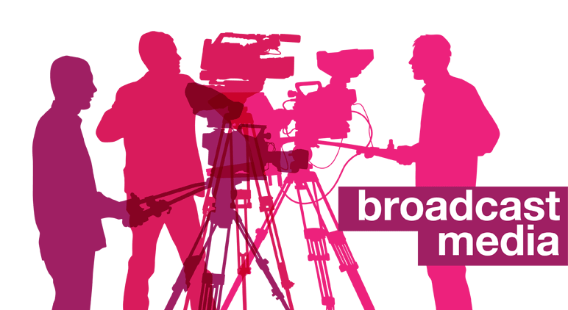
Digital Content: production media
Lecture 5

Slide 5

Lecture 5
Digital Content Direction
What Are Podcasts?

Slide 6

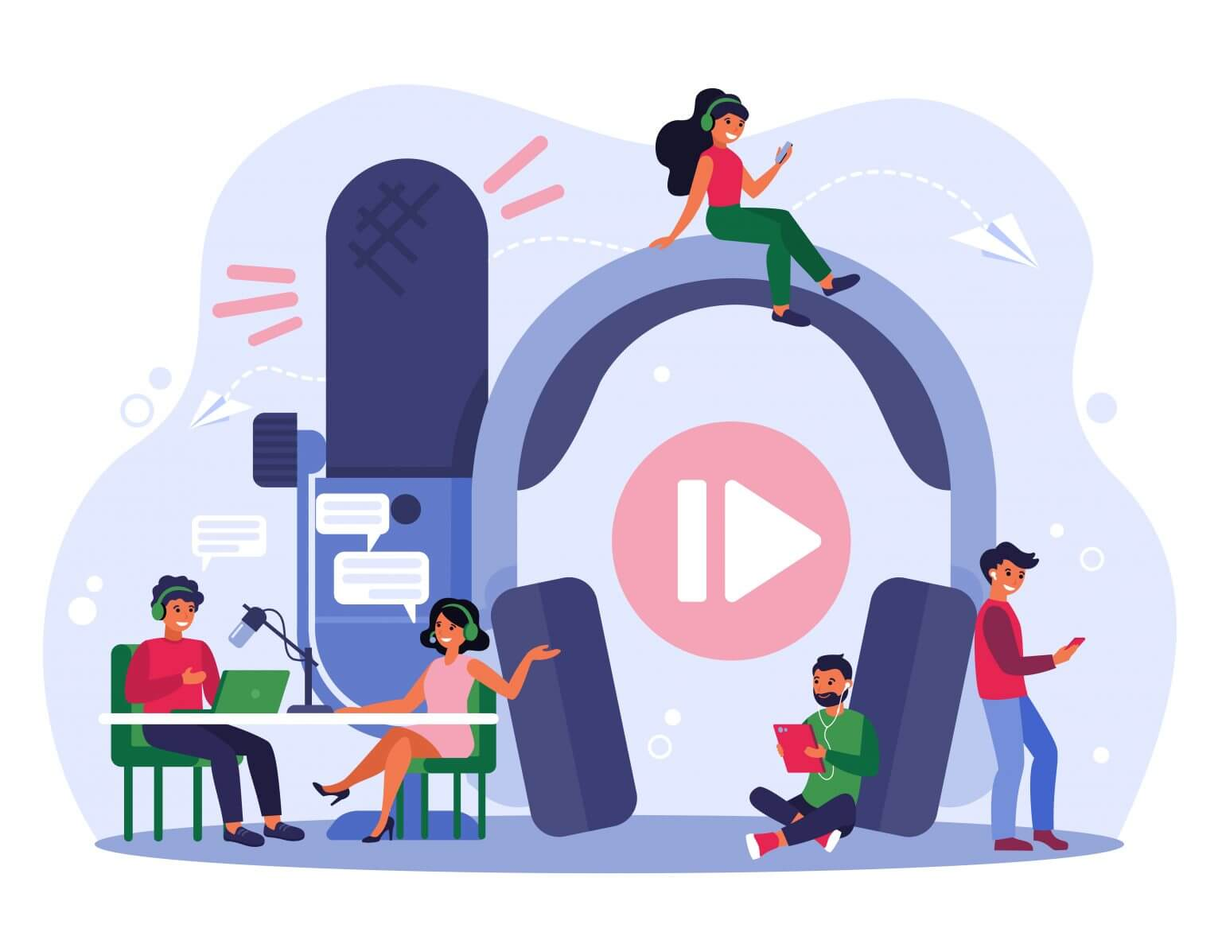
A podcast is a digital audio file, usually a series of files, that can be downloaded via the Internet.
Podcasts humanise the news, allowing people to tell news their way.
Podcasting is an intimate medium mainly listened to via headphones.

Slide 7

Podcasts literally take storytelling, both fictional and non-fiction and informed conversation inside listeners’ heads.
Some podcasts run for years, while others come and go before they’re even noticed.

Slide 8
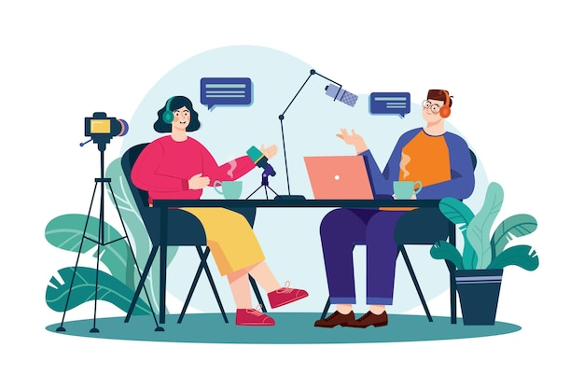
In 2000, when DaveWiner launched RSS (Really Simple Syndication) 0.92, which allowed for ‘audioblogs’, as podcasts were then called, to be shared, curated and in effect subscribed to, the media landscape was very different.

Slide 9
At that time, podcasting was largely the preserve of the tech-savvy enthusiast who knew how to record and produce audio and manipulate RSS.
This knowledgeable enthusiasm was necessary both on the part of the creator of the content and the listener, as these audio files had to be searched for, downloaded and then played on a computer.

Slide 10
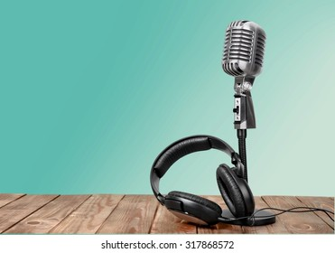
RSS allowed listeners to track audioblogs and to be alerted to new episodes, but it was not until the 2004 launch of the client, iPodder, which automatically downloaded podcasts to an iPod, followed by the introduction of, podcast-friendly, iTunes 4.9 in 2005 that it became possible to easily find and listen to podcasts. The term ‘podcast itself’ was first coined in 2004 by Guardian journalist Ben Hammersley.

Slide 11
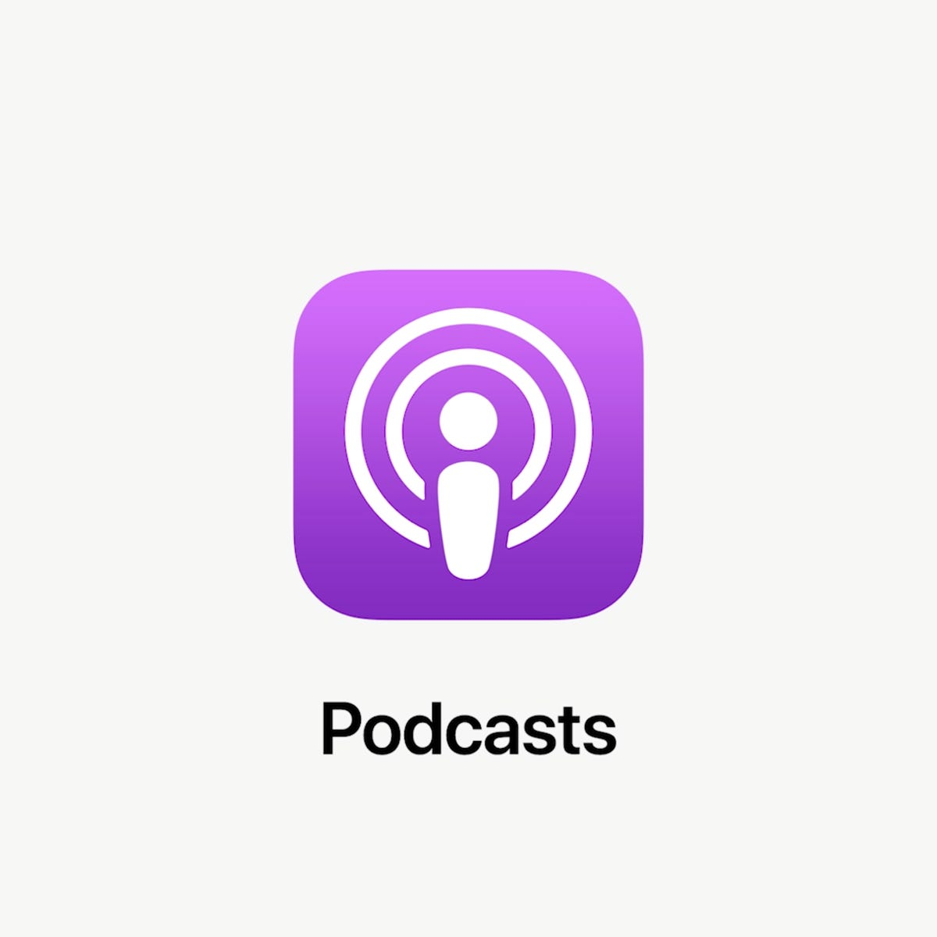
Even so, the medium remained on the margin, until the 2012 launch of Apple’s native podcast app, Apple Podcasts, which made it easier to source, download and listen to podcasts on iOS mobile devices and the arrival of the podcast Serial in 2014.

Slide 12
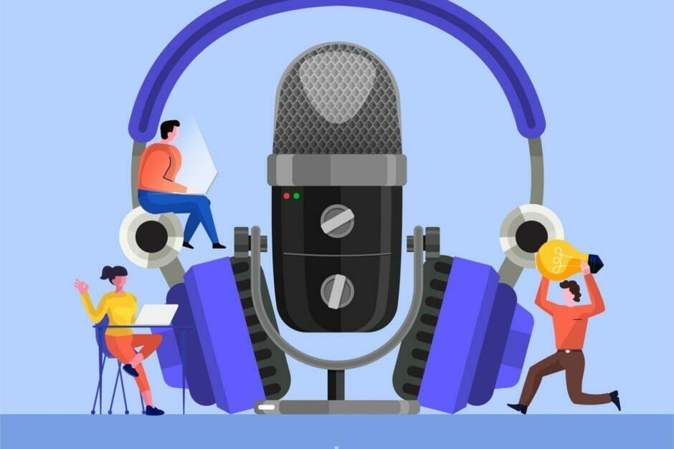
The true crime serialised radio documentary podcast, a side shoot of National Public Radio’s (NPR’s) This American Life was the first podcast to go viral, creating a market for podcasting, encouraging many to make podcasts and also alerting mainstream media companies to the potential of this medium.

Slide 13
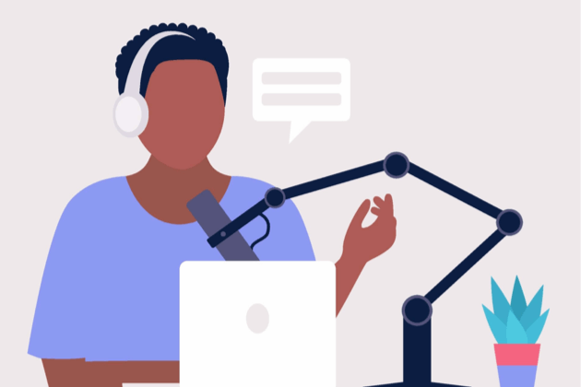
Globally, by March 2021, there were 1,950,000 podcasts featuring over 45 million episodes twice the number seen in 2018 (Podcast Insights, 2021) In 2020, ‘over 1.6 million Australians … download audio or video podcasts in an average week, up from under 1 million just four years ago.

Slide 14
Lecture 5
Digital Content Direction
Types of Podcasts

Slide 15

Podcasts can be loosely grouped into three types. There are overlaps between them.
* The serialised narrative: This can be fiction, but is dominated by investigative, human interest journalism, Examples (Australian True Crime , Radiolab).

Slide 16
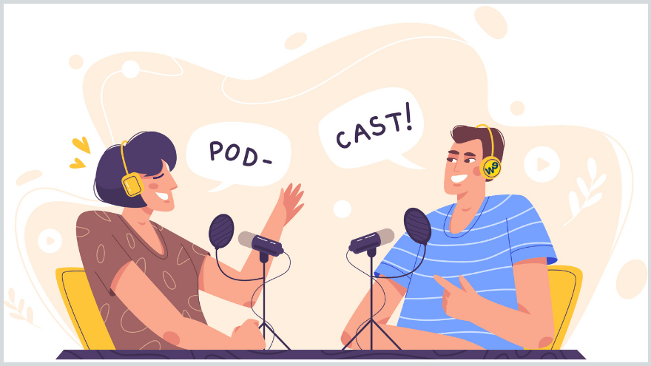
* The chumcast1 or gabfest: where like-minded enthusiasts gather to essentially chat and riff on a subject in more or less scripted ways; Examples (The Beatles Naked; Culture Gabfest).

Slide 17
* The information-focused type of podcast: These are podcasts that take deep dives into their particular areas of expertise, delivering insights, hard to find intel, hints, tips and how to’s for audiences keen to know more, or just simply nerd out. Examples of information-focused podcasts include (Hard Core History; 50 Things that made the Modern Economy; Download this Show).

Slide 18
Lecture 5
Digital Content Direction
Why Podcasts?

Slide 19
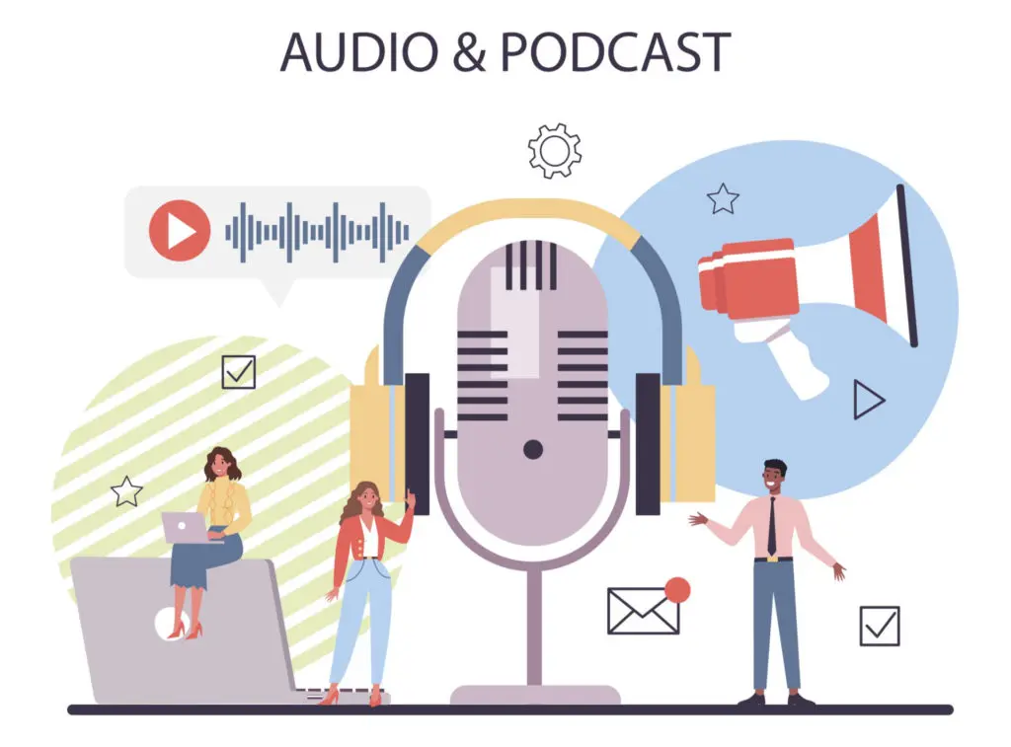
Podcasting’s role in the digital communication environment continues to expand as increased platformisation allows for a more streamlined experience and as the potential to monetise podcasts increases. Consequently, established media organisations with big budgets and celebrity drawing power are moving in to the space, normalising the medium in the eyes of users who might not have previously engaged with it.

Slide 20
Podcasting is thus no longer just the preserve of amateurs or fan groups, brought together by ‘The Long Tail’,2 once disparate small-scale interest sectors, brought together by web 2.0 connectivity keen to keen to engage with niche topics of interest, although it still can be. Rather, it is becoming an essential business development tool for companies, communities and organisations of all sizes.

Slide 21
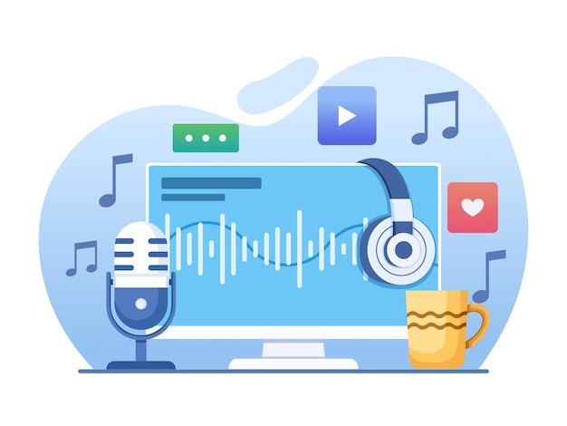
Many businesses use podcasts ‘to generate good content, develop relation ships in their industries and attract prospects.
Audiences for these podcasts may be relatively tiny, depending on the size of the operation, or they may consist of several physically isolated populations scattered across the world.

Slide 22
Regardless, podcasting allows these organisations to take advantage of The Long Tail by providing regular unifying, informative and, importantly, humanised communications.
As smart and mobile device use continues to grow, so does the need for content that can be consumed, usually via headphones, while walking down the street, sitting on the train or mowing the lawn.

Slide 23
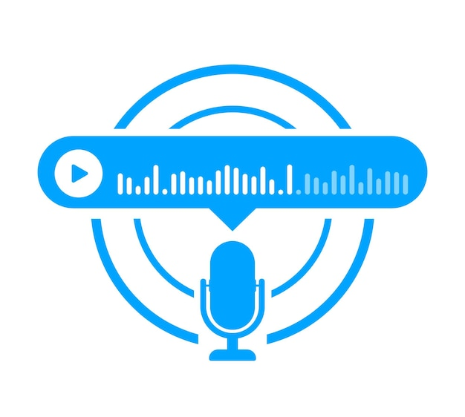
Podcasting is especially suited to this kind of delivery as it is engaging and immersive, yet it doesn’t require users to focus on a screen. Those who listen to podcasts on smartphones are the fastest growing sector of the podcast community, growing some 154% since 2014.

Slide 24
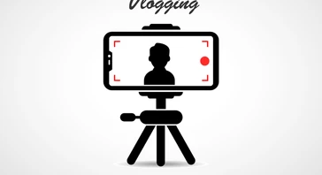
Digital Content: production media
Lecture 5

Slide 25
Lecture 5
Digital Content Direction
Vlogs: Definition
and a Brief History

Slide 26
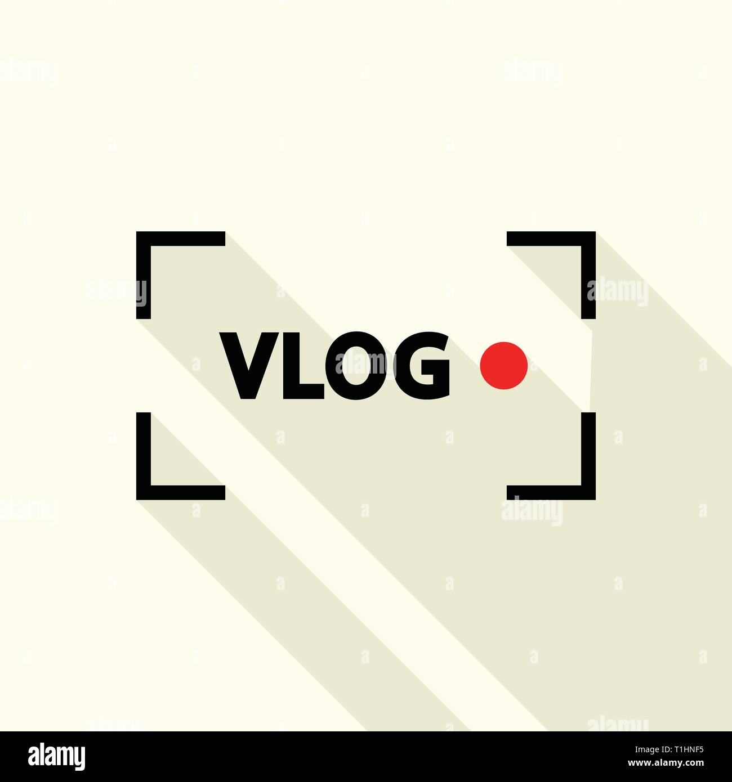
The term ‘vlog’ is a portmanteau of the words ‘video’ and ‘log’ (as in, ‘log of the web’) and was coined in November 2000 to describe a short video that was posted online by media scholar Adrian Miles.

Slide 27
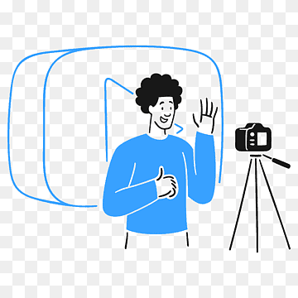
The vlog is essentially a video version of the blog.
Vlogs have running times that range from several seconds to several hours, depending on their subject matter, and the platform(s) upon which they are published.

Slide 28
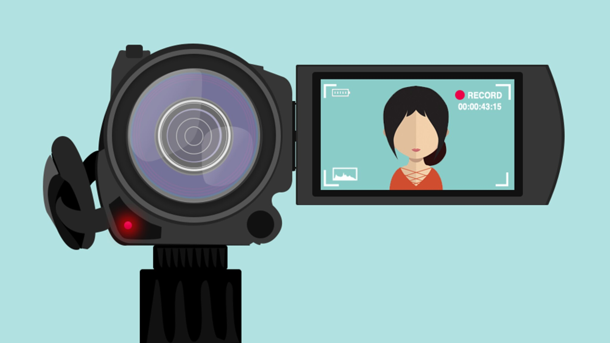
For example, TikTok enables users to record videos that are up to sixty seconds in length; in December 2020, the app trialled the recording of videos that ran up to three minutes (Alexander, 2020). Videos of longer than three minutes can be uploaded to the app from elsewhere.

Slide 29
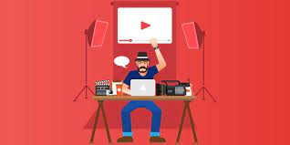
The rise of vlogging as a media genre is linked to increased sophistication in digital video software, programmes and platforms. This includes the emergence of webcam technology and cameras on smartphones.
In terms of publicly broadcasting vlogs, the genre was bolstered by the emergence of YouTube in 2005 and other streaming platforms.

Slide 30
Since 2010, a number of social networking sites have incorporated video streaming. Examples include:
• TikTok, which went live in 2016, and upon which users can post videos of up to one minute in length.
• In 2013, video was incorporated into the Instagram app.
• In 2016, Facebook introduced Facebook Live, which allowed users to livestream videos from the platform’s app.

Slide 31
Lecture 5
Digital Content Direction
Why Vlogging?

Slide 32
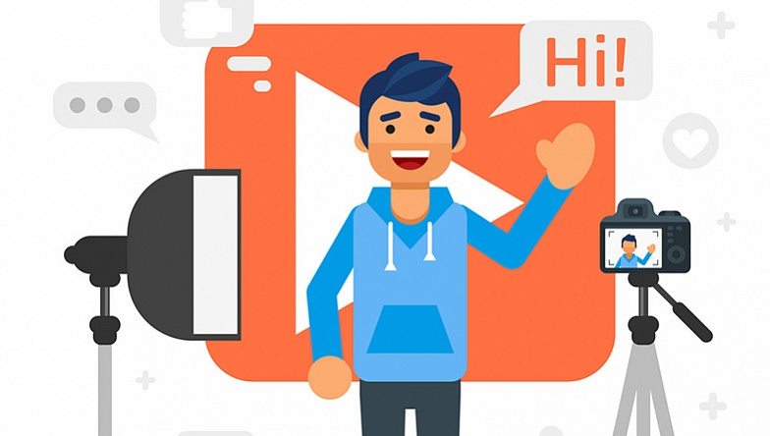
So why exactly has vlogging proven to be such a popular medium through which to distribute information to a diverse audience?
One reason could be its visuality. Historically, visuality has commonly been understood as providing access to ‘the truth’ of a particular matter. And, truth is ‘intimately linked to trust.

Slide 33
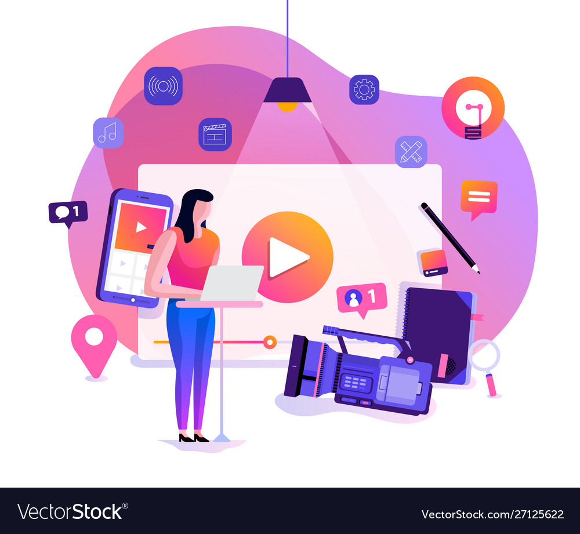
This is presumably why people wish to see each other even if there is no real advantage in securing veracity’. Seeing, as the old proverb goes, is believing. Truth, veracity and authenticity are central to the following uses of vlogging:

Slide 34
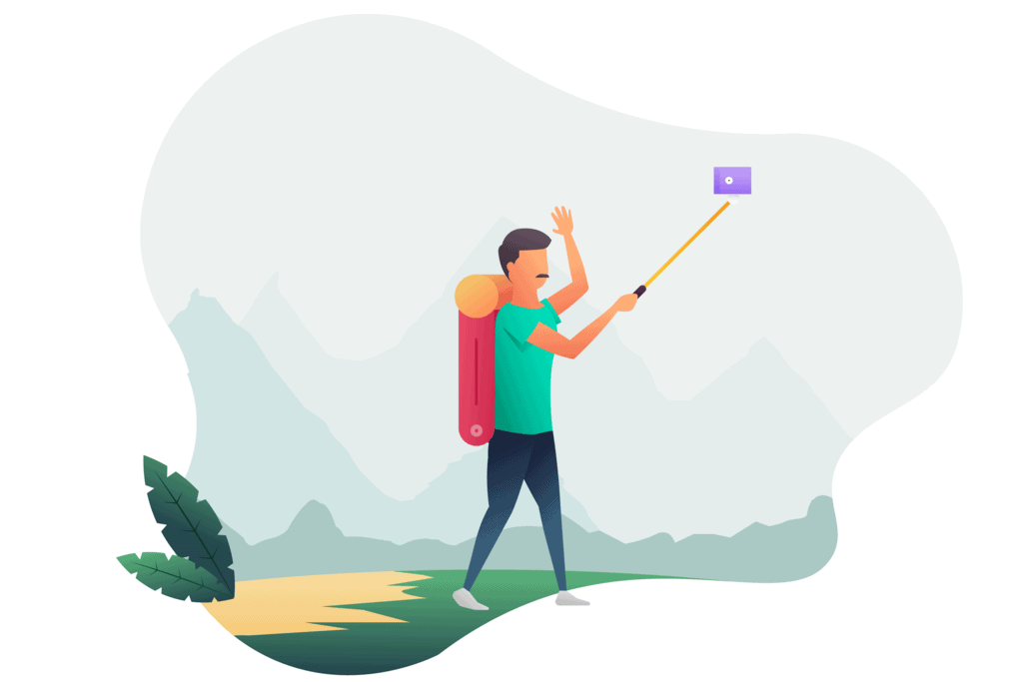
• Invoking a sense of intimacy between the vlogger and their audience.
• Promoting products and services, especially those that have a particularly ‘aesthetic’ dimension (e.g., fashion, athletics, arts and craft, travel).
• Lending credibility to one’s claims about their products or services.

Slide 35
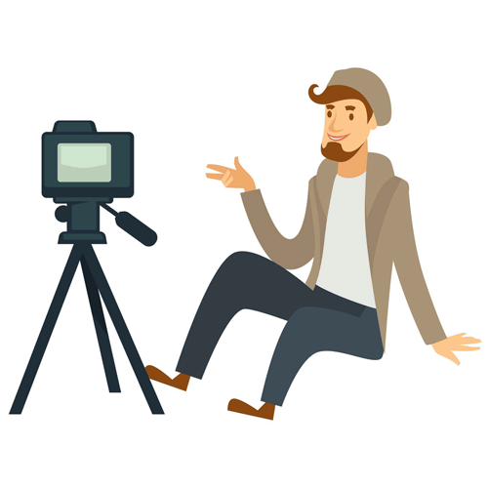
• Explain information that might be difficult to convey only through text or audio, e.g., a personal trainer demonstrating the latest upper body exercise. There are further reasons why a media professional or organisation might choose to produce vlogs. These include the following:

Slide 36

•Vlogs can be shared across and within social media platforms.
•Vlogs are ‘more like face-to-face interaction[s] than many other modes of digital content production.
•Vlogs help establish an ‘imagined community’ of followers, sometimes from around the world.

Slide 37
Lecture 5
Digital Content Direction
Who Are the Vloggers?

Slide 38
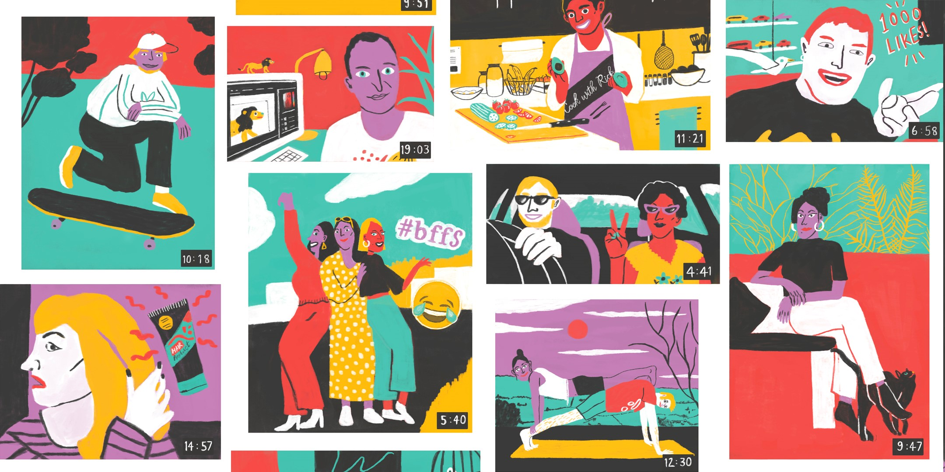
Broadly speaking, regular vloggers tend to belong to one or more of the following categories: influencers, micro-celebrities and experts.

Slide 39
Social Media Influencers:
social media influencers (SMIs) are individuals who earn a living influencing the purchasing trends of consumers. They perform the roles of ‘everyday, ordinary Internet users who accumulate a relatively large public following on blogs and social media, principally through the textual and visual narration of their personal lives and lifestyles.

Slide 40
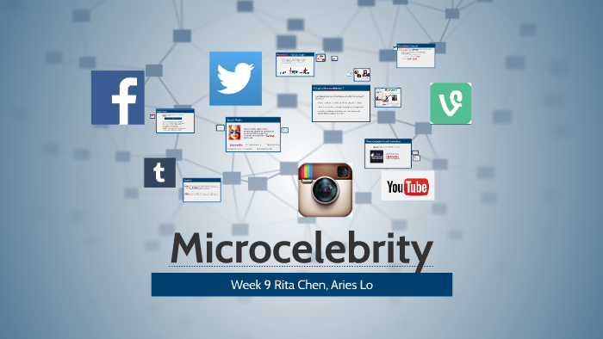
Microcelebrities:
The term ‘microcelebrity’ refers to an individual who has achieved a level of fame in a small and/or niche section of the population. In scholarly writing, SMIs tend to be placed into this category.

Slide 41
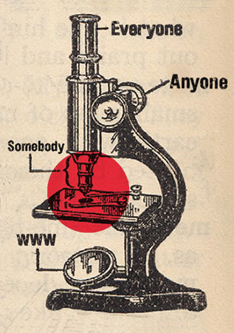
The microcelebrity phenomenon appears to be a largely internet-based; indeed, the very term ‘microcelebrity’ was coined by US scholar Theresa Senft in a study of camgirls, that is, women who broadcast their lives to online audiences. These individuals might be well-known among followers of the trend they are commentating on, but not so much in the broader community.

Slide 42

Experts:
The term ‘expert’ has been applied to individuals who are particularly well-learned in a specific topic. This ‘expertise’ has generally been accumulated over a considerable time period, through evidence-based research and/or practice.

Slide 43
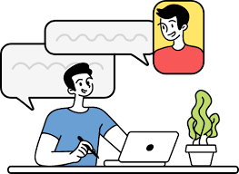
Historically, the term ‘expert’ has been most commonly assigned to academic researchers. Academics are paid to spend large chunks of time researching a particular topic—combing archives, reading every book on the topic.

Slide 44

In recent years, the advent of digital technologies such as webcams and streaming platforms have meant that ‘expertise’ is no longer the exclusive province of the highly educated. Anybody with access to those technologies can potentially fashion themselves as an expert on a particular topic.

Slide 45
Lecture 5
Lecture Outlines:
(Podcasting)
* What Are Podcasts?
* Types of Podcasts.
* Why Podcasts?
(Vlogging)
* Vlogs: Definition and a Brief History.
* Why Vlogging?
* Who Are the Vloggers?

Slide 46


Lecture 5
Lecture References:
* Jenkins, H., Ford, S., & Green, J. (2013), Spreadable media: Creating value and meaning in a networked culture, New York University Press.
* Jay Daniel Thompson & John Weldon (2022), Content Production for Digital Media: An Introduction, Springer Nature Singapore.

Slide 47


Thank You

Slide 48

Digital Content
Direction
Lecture 5
DGM 733
Prepared by:
Dr. Sherihan Mohamed

