Slide 1



Graduation Project-1
Orientation Day
PMG496
Introduction
Prepared by
Dr. Mona Moustafa Elashry
www.midocean.ae

Slide 2

Lecture Outline
About The Instructor
Academic Agenda
Course Description
Course Objectives
Learning Outcomes
Assessment Method
Project Delivery
Delivery Schedule
Project Delivery Rules
Attendance
Student Guide. Pdf.
Interactive Technology
www.midocean.ae

Slide 3

About The Instructor
www.midocean.ae
www.midocean.ae

Slide 4
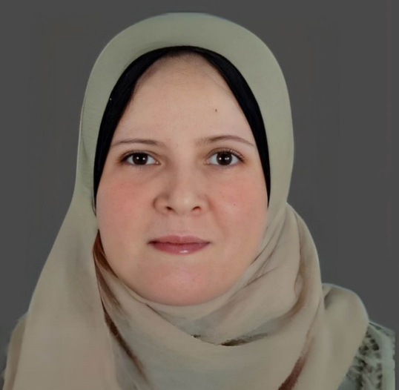
Education:
Doctorate of Business Administration2021
Master of Business Administration 2016
Postgraduate Diploma in Business Administration 2011
Bachelor degree in Economics 1999
Experiences:
Teaching different courses in management
Teaching research methodology & Statistical Analysis
Name: Dr. Mona Mostafa Elashry
Nationality: Egyptian
Email: mona.mostafa@midocean.edu.km
www.midocean.ae
www.midocean.ae

Slide 5

My Favorite Quote
www.midocean.ae
www.midocean.ae

Slide 6
Academic Agenda
www.midocean.ae
www.midocean.ae

Slide 7
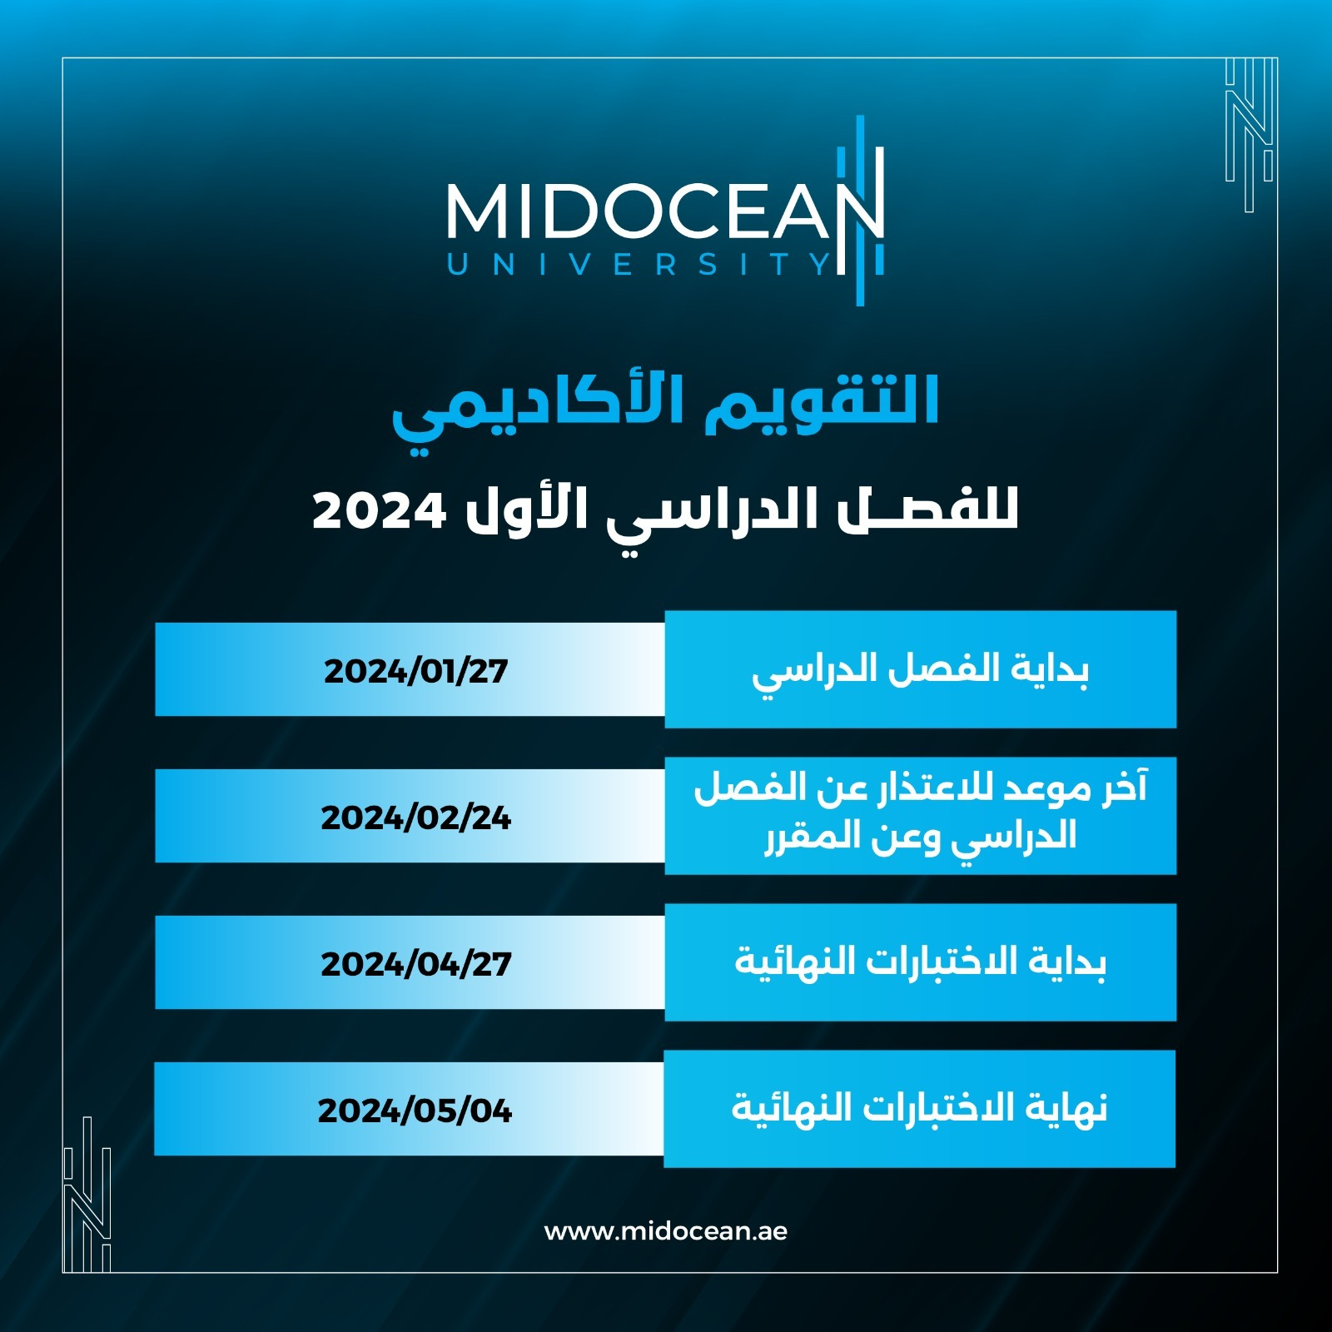

Slide 8


Slide 9
ميعاد محاضرة النقاش لمقرر PMG496
Course Code | Course | Prof. | Course director | Day | Time
PMG496 | Final Project 1 المشروع النهائي 1 | Dr. Mona Moustafa Elashry | Dr. Shaimaa Shalan | Sunday | 06:00 - 07:00
www.midocean.ae

Slide 10
Course Description
www.midocean.ae
www.midocean.ae

Slide 11
This course is designed for senior-level students pursuing a Bachelor's degree in faculty of Management.
The course focuses on developing the skills necessary to write effective research proposals in their chosen area of study.
Through a series of 10 lectures, students will learn the fundamental elements of a research proposal, including the objectives, methodology, literature review, and ethical considerations.
www.midocean.ae

Slide 12
Course Objectives
www.midocean.ae
www.midocean.ae

Slide 13
By the end of this course, students will be able to:
Understand the purpose and significance of writing a research proposal.
Identify and evaluate appropriate research topics in their field of study.
Conduct a thorough literature review and critically analyze existing research.
Develop a research question and hypothesis.
Create a research methodology and timeline.
Uphold ethical standards in research.
Demonstrate effective academic writing and communication skills in the research proposal.
www.midocean.ae

Slide 14
Course Outcome
www.midocean.ae
www.midocean.ae

Slide 15
Upon completion of this course, students will have the skills and knowledge necessary to write a comprehensive and well-structured research proposal.
They will understand the importance of conducting research in their field of study and demonstrate proficiency in choosing relevant research topics, conducting literature reviews, formulating research objectives and questions, developing a research methodology, analyzing data, and writing effectively.
www.midocean.ae

Slide 16
Assessment Method
www.midocean.ae
www.midocean.ae

Slide 17
Students will be assessed through a certain number of assignments that they will be given during the semester.
The student must submit 3 required assignments during the semester, starting from the 4th week until the 11th week.
Note: the 4th assignment is the entire project that will be submitted in 12th week (not included in the assessment).
www.midocean.ae

Slide 18
Individual Work:
Every student will be required to write and deliver all assignments individually; there will not be group assignments.
www.midocean.ae

Slide 19
Project Delivery
www.midocean.ae
www.midocean.ae

Slide 20
Starting from week 4 student will be asked to submit the required assignments
Students will be asked to deliver four submissions for the project.
Final research delivery (12th submission) will cover all the course guides (not included in the assessment)
www.midocean.ae

Slide 21
Delivery Schedule
www.midocean.ae

Slide 23
Assignment 1
Delivered in week 4
Assignment 2
Delivered in week 8
Assignment 3
Delivered in week 11
Assignment 4
Failed
  Delivered in week 12

Slide 24
Assignment 1
Delivered in week 4
Assignment 2
Delivered in week 8
Assignment 3
Delivered in week 11
Assignment 4
Failed
  Delivered in week 12

Slide 25
Assignment 1
Delivered in week 4
Assignment 2
Delivered in week 8
Assignment 3
Delivered in week 11
Assignment 4
Failed
  Delivered in week 12

Slide 26
Assignment 1
Delivered in week 4
Assignment 2
Delivered in week 8
Assignment 3
Delivered in week 11
Assignment 4
Failed
  Delivered in week 12

Slide 27
Assignment 1
Delivered in week 4
Assignment 2
Delivered in week 8
Assignment 3
Delivered in week 11
Assignment 4
Pass
  Delivered in week 12

Slide 28
Assignment 1
Delivered in week 4
Assignment 2
Delivered in week 8
Assignment 3
Delivered in week 11
Assignment 4
Pass
  Delivered in week 12

Slide 29
Assignment 1
Delivered in week 4
Assignment 2
Delivered in week 8
Assignment 3
Delivered in week 11
Assignment 4
Pass
  Delivered in week 12

Slide 30
Assignment 1
Delivered in week 4
Assignment 2
Delivered in week 8
Assignment 3
Delivered in week 11
Assignment 4
Pass
  Delivered in week 12

Slide 31
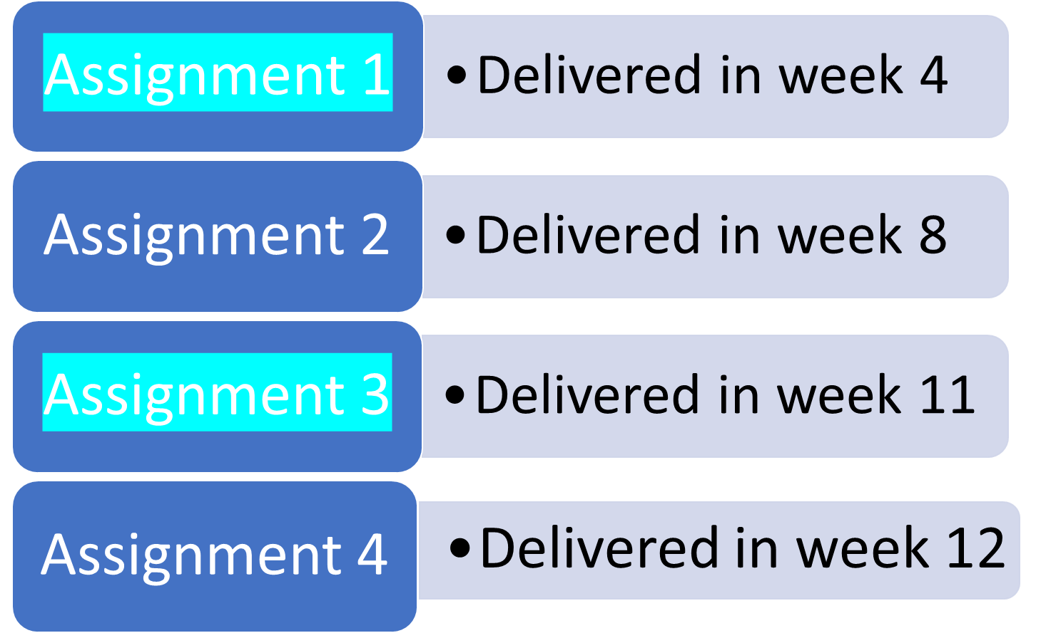
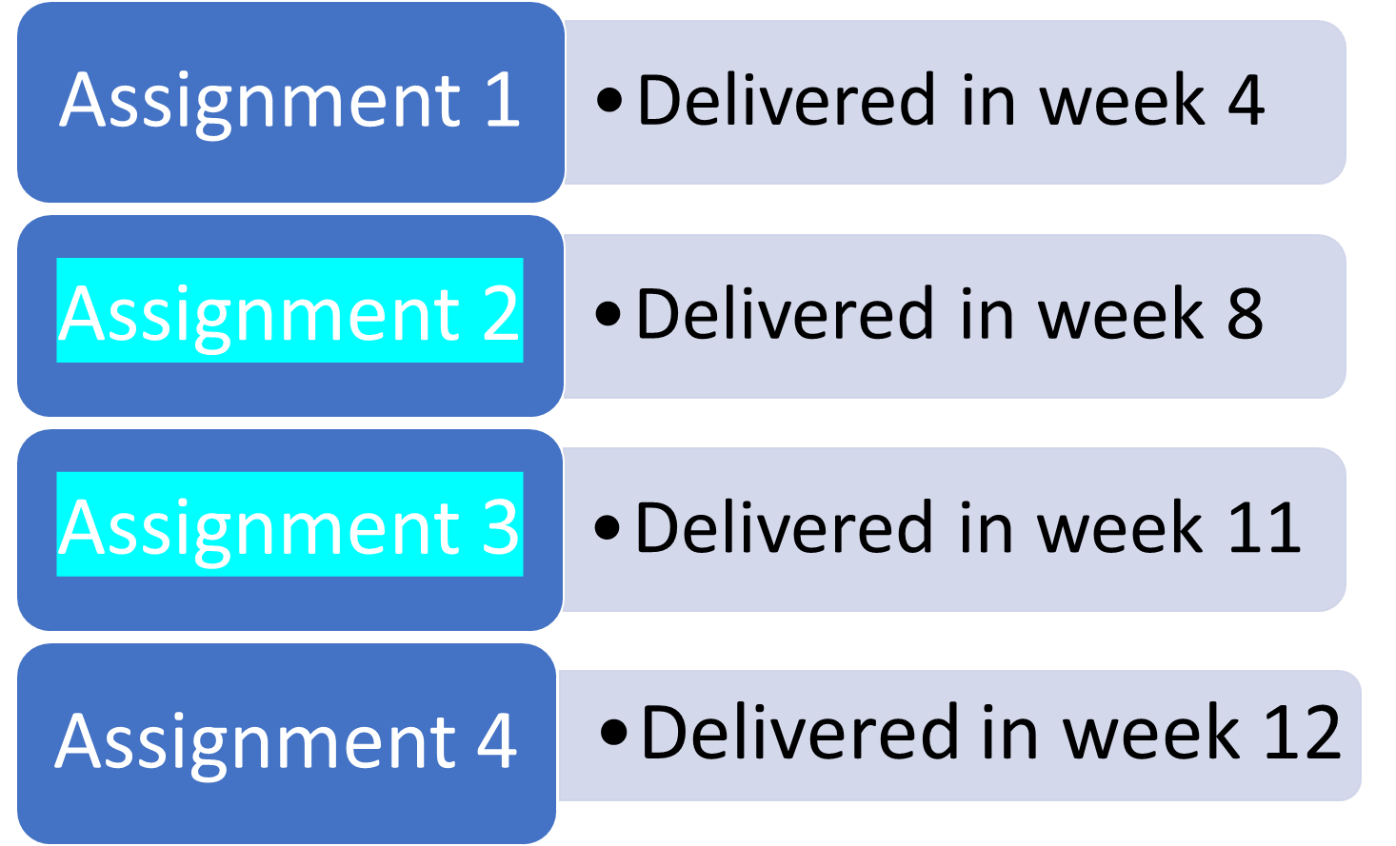
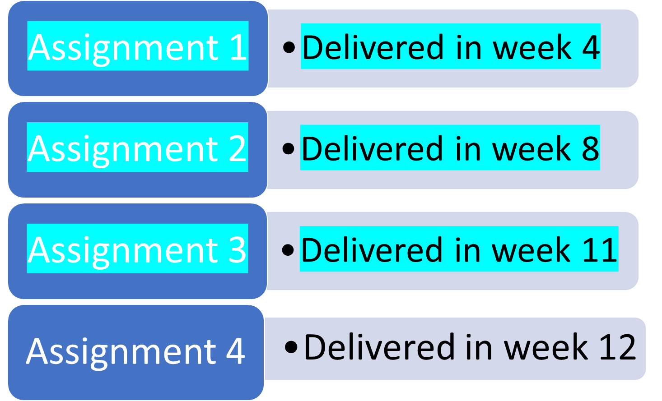
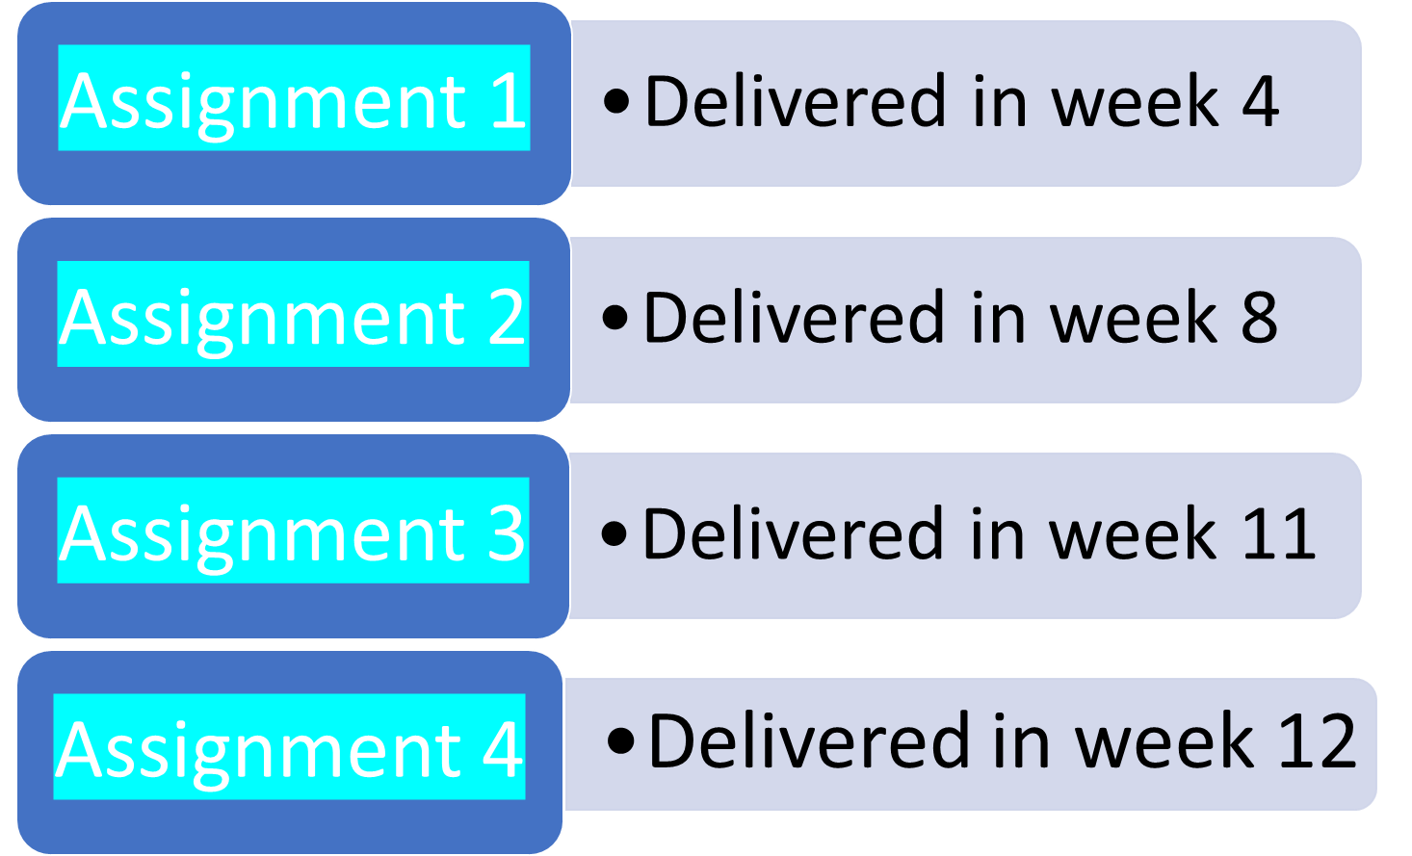
Pass

Slide 32
To ensure the student's success, they should do one of the following:
1. Submit all the three assignments
2. Submit the first and third assignments,
3. Submit the second and third assignments.
It is highly recommended to submit all four assignments
www.midocean.ae

Slide 33
Attendance
www.midocean.ae
www.midocean.ae

Slide 34
Students are required to watch all the recorded lectures.
While it may not be mandatory for students to attend online lectures, it is still extremely important for them to do so in order to gain a complete understanding of the course material and to engage with the learning process.
Attending lectures can help students grasp important concepts, participate in discussions, and receive valuable clarification from the instructors
www.midocean.ae

Slide 35
Project Delivery Rules
www.midocean.ae
www.midocean.ae

Slide 36
All projects should follow the academic writing characteristics which are:
Planned and focused: Delivering research according to the guidance of the scientific research methodologies.
Structured: is coherent, written in scientific research methodologies, and brings together related points and material.
Evidenced: demonstrates knowledge of the scientific research steps, supports opinions and arguments with evidence, and is referenced accurately.
Formal in tone and style: uses appropriate scientific language and tenses and is clear, concise, and balanced.
www.midocean.ae

Slide 37
Interactive Technology
www.midocean.ae

Slide 38

Online Lecture
https://kahoot.com/schools-u/
www.midocean.ae

Slide 39

Online Lecture
https://padlet.com/
www.midocean.ae

Slide 40

Online Lecture
https://www.mentimeter.com/
https://www.menti.com/
www.midocean.ae

Slide 41
Student Guide. Pdf.
www.midocean.ae

Slide 42




Thank You

