Slide 1


Strategic and Operational
Management
Lecture 7
MGM 630 (part 2)
Prepared by
Dr. Ahmed Al-Naimi

Slide 2
Lecture
LECTURE OUTLINE
07
7.1 What Is Corporate Strategy? (-Why Firms Need to Grow- Three Dimensions of Corporate Strategy)
7.2 The Boundaries of the Firm: (-Firms vs. Markets: Make or Buy?, Alternatives on the Make-or-Buy Continuum)
7.3 Vertical Integration along the Industry Value Chain: (- Types of Vertical Integration-Benefits and Risks of Vertical Integration- When Does Vertical Integration Make Sense? - Alternatives to Vertical Integration)
7.4 Corporate Diversification: Expanding Beyond a Single Market, (- Types of Corporate Diversification- Leveraging Core Competencies for Corporate – Diversification- Corporate Diversification and Firm Performance)
www.midocean.ae

Slide 3
Lecture
07
LEARNING OBJECTIVES
1. Define corporate strategy and describe the three dimensions along which it is assessed.
2. Explain why firms need to grow, and evaluate different growth motives.
3. Describe and evaluate different options firms have to organize economic activity.
4. Describe the two types of vertical integration along the industry value chain: backward and forward vertical integration.
5. Identify and evaluate benefits and risks of vertical integration.
www.midocean.ae

Slide 4

Lecture
TITLE OF LECTURE
Diversification Corporate Strategy: Vertical Integration and
07
6. Describe and examine alternatives to vertical integration.
7. Describe and evaluate different types of corporate diversification.
8. Apply the core competence–market matrix to derive different diversification strategies.
9. Explain when a diversification strategy creates a competitive advantage and when it does not
www.midocean.ae

Slide 5
TITLE OF LECTURE
Corporate Strategy: Vertical Integration and Diversification
Lecture
07
7.1 What Is Corporate Strategy?
Strategy formulation centers around the key questions of where and how to compete. Business strategy concerns the question of how to compete in a single product market. As discussed in Chapter 6, the two generic business strategies that firms can pursue their quest for competitive advantage are to increase differentiation (while containing cost) or lower costs (while maintaining differentiation). If trade-offs can be reconciled, some firms might be able to pursue a blue ocean strategy by increasing differentiation and lowering costs.
www.midocean.ae

Slide 6

TITLE OF LECTURE
Corporate Strategy: Vertical Integration and Diversification
Lecture
07
As firms grow, they are frequently expanding their business activities through seeking new markets both by offering new products and services and by competing in different geographies. When this happens, managers must formulate a corporate strategy. To gain and sustain competitive advantage, therefore, any corporate strategy must align with and strengthen a firm’s business strategy, whether it is a differentiation, cost-leadership, or blue ocean strategy.
www.midocean.ae

Slide 7

TITLE OF LECTURE
Corporate Strategy: Vertical Integration and Diversification
Lecture
07
Corporate strategy comprises the decisions that senior management makes and the goal-directed actions it takes in the quest for competitive advantage in several industries and markets simultaneously. It provides answers to the key question of where to compete. Corporate strategy determines the boundaries of the firm along three dimensions: vertical integration (along the industry value chain), diversification (of products and services), and geographic scope (regional, national, or global markets). Executives must determine their corporate strategy by answering three questions:
www.midocean.ae

Slide 8

Lecture
TITLE OF LECTURE
Corporate Strategy: Vertical Integration and Diversification
07
1. In what stages of the industry value chain should the company participate (vertical integration)?The industry value chain describes the transformation of raw materials into finished goods and services along distinct vertical stages.
2. What range of products and services should the company offer (diversification)?
3. Where should the company compete geographically in terms of regional, national, or international markets (geographic scope)?
www.midocean.ae

Slide 9

TITLE OF LECTURE
Corporate Strategy: Vertical Integration and Diversification
Lecture
07
- Why firms need to grow?
Several reasons explain why firms need to grow. These can be summarized as follows:
1. Increase profits.
Lower costs.
3. Increase market power.
4. Reduce risk.
5. Motivate management.
www.midocean.ae

Slide 10

TITLE OF LECTURE
Corporate Strategy: Vertical Integration and Diversification
Lecture
07
- Three dimensions of Corporate Strategy
All companies must navigate the three dimensions of vertical integration, diversification, and geographic scope. Although many managers provide input, the responsibility for corporate strategy ultimately rests with the CEO. Jeff Bezos, Amazon’s CEO, determined in what stages of the industry value chain Amazon would participate (question 1).With its prevalent delivery lockers in large metropolitan areas and its first brick-and-mortar retail store opened in New York City, Amazon moved forward in the industry value chain to be closer to its end customer. With its offering of Amazon-branded electronics and more recently groceries, it also moved backward in the industry value chain toward manufacturing and production.
www.midocean.ae

Slide 11
TITLE OF LECTURE
Corporate Strategy: Vertical Integration and Diversification
Lecture
07
Bezos also chooses what range of products and services to offer, and which not (question 2). Finally, Bezos also decided to customize certain country-specific websites despite the instant global reach of e-commerce firms. With this strategic decision, he decided where to compete globally in terms of different geographies beyond the United States. In short, Bezos determined where Amazon competes geographically (question 3).
www.midocean.ae

Slide 12
TITLE OF LECTURE
Corporate Strategy: Vertical Integration and Diversification
Lecture
07
7.2 The Boundaries of the Firm
Determining the boundaries of the firm so that it is more likely to gain and sustain a competitive advantage is the critical challenge in corporate strategy. A theoretical framework in strategic management called transaction cost economics explains and predicts the boundaries of the firm. Insights gained from transaction cost economics help managers decide what activities to do in-house versus what services and products to obtain from the external market.
www.midocean.ae

Slide 13
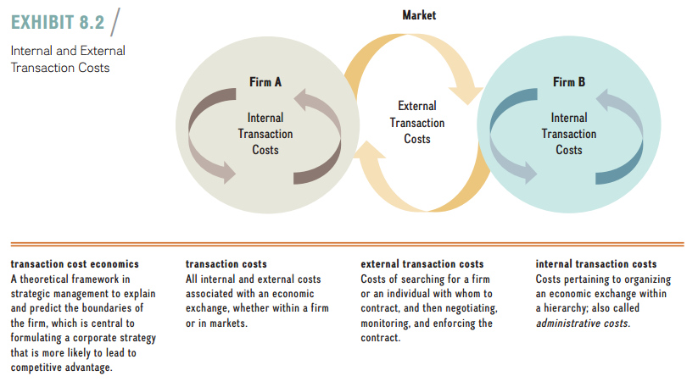
Lecture
TITLE OF LECTURE
Corporate Strategy: Vertical Integration and Diversification
07
Transaction costs are all internal and external costs associated with an economic exchange, whether it takes place within the boundaries of a firm or in markets. Exhibit 8.2 visualizes the notion of transaction costs. It shows the respective internal transactions costs within Firm A and Firm B, as well as the external transactions that occur when Firm A and Firm B do business with one another. The total costs of transacting consist of external and internal transaction costs, as follows:
www.midocean.ae

Slide 14
Lecture
TITLE OF LECTURE
Corporate Strategy: Vertical Integration and Diversification
07
■ When companies transact in the open market, they incur external transaction costs: the costs of searching for a firm or an individual with whom to contract, and then negotiating, monitoring, and enforcing the contract.
■ Transaction costs can occur within the firm as well. Considered internal transaction costs, these include costs pertaining to organizing an economic exchange within a firm.
www.midocean.ae

Slide 15
Lecture
TITLE OF LECTURE
Corporate Strategy: Vertical Integration and Diversification
07
- Firms vs. Markets: make or buy?
Transaction cost economics allows us to explain which activities a firm should pursue in-house (“make”) versus which goods and services to obtain externally (“buy”). These decisions help determine the boundaries of the firm. In some cases, costs of using the market such as search costs, negotiating and drafting contracts, monitoring work, and enforcing contracts when necessary may be higher than integrating the activity within a single firm and coordinating it through an organizational hierarchy.
www.midocean.ae

Slide 16
Lecture
TITLE OF LECTURE
Corporate Strategy: Vertical Integration and Diversification
07
When the costs of pursuing an activity in-house are less than the costs of transacting for that activity in the market (C in-house < C market), then the firm should vertically integrate by owning production of the needed inputs or the channels for the distribution of outputs. In other words, when firms are more efficient in organizing economic activity than are markets, which rely on contracts among many independent actors, firms should vertically integrate.
www.midocean.ae

Slide 17
Lecture
TITLE OF LECTURE
Corporate Strategy: Vertical Integration and Diversification
07
- Alternatives on the make-or-buy continuum
The “make” and “buy” choices anchor each end of a continuum from markets to firms, as depicted in Exhibit 8.4. Several alternative hybrid arrangements are available between these two extremes. Moving from transacting in the market (“buy”) to full integration (“make”), alternatives include short-term contracts as well as various forms of strategic alliances (long-term contracts, equity alliances, and joint ventures) and parent–subsidiary relationships.
www.midocean.ae

Slide 18
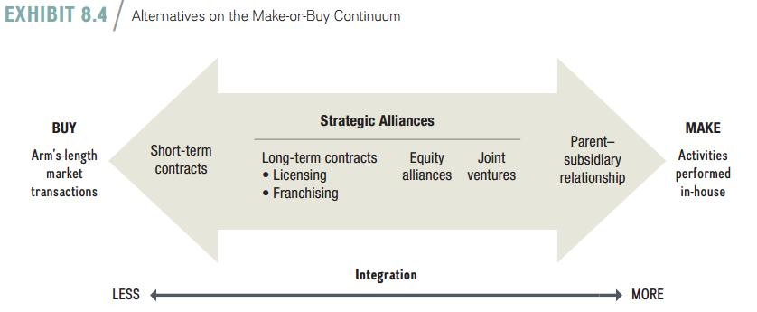
Lecture
TITLE OF LECTURE
Corporate Strategy: Vertical Integration and Diversification
07
www.midocean.ae

Slide 19
Lecture
TITLE OF LECTURE
Corporate Strategy: Vertical Integration and Diversification
07
7.3 Vertical Integration along the Industry Value Chain
The first key question when formulating corporate strategy is: In what stages of the industry value chain should the firm participate? Deciding whether to make or buy the various activities in the industry value chain involves the concept of vertical integration. Vertical integration is the firm’s ownership of its production of needed inputs or of the channels by which it distributes its outputs. Vertical integration can be measured by a firm’s value-added: What percentage of a firm’s sales is generated within the firm’s boundaries? The degree of vertical integration tends to correspond to the number of industry value chain stages in which a firm directly participates.
www.midocean.ae

Slide 20
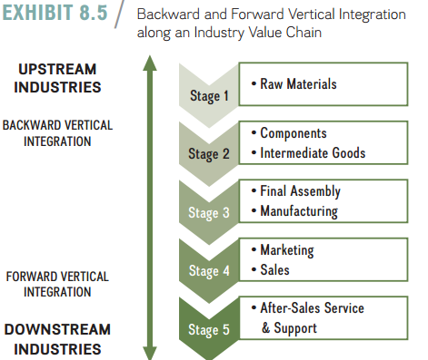
Lecture
TITLE OF LECTURE
Corporate Strategy: Vertical Integration and Diversification
07
Exhibit 8.5 depicts a generic industry value chain. Industry value chains are also called vertical value chains, because they depict the transformation of raw materials into finished goods and services along distinct vertical stages. Each stage of the vertical value chain typically represents a distinct industry in which a number of different firms are competing. This is also why the expansion of a firm up or down the vertical industry value chain is called vertical integration.
www.midocean.ae

Slide 21
Lecture
TITLE OF LECTURE
Corporate Strategy: Vertical Integration and Diversification
07
- Types Of vertical integration
Along the industry value chain, there are varying degrees of vertical integration. Some firms participate in only one or a few stages of the industry value chain, while others comprise many if not all stages.
www.midocean.ae

Slide 22
Lecture
TITLE OF LECTURE
Corporate Strategy: Vertical Integration and Diversification
07
In doing so, HTC engaged in backward vertical integration—moving ownership of activities upstream to the originating inputs of the value chain. Moreover, by moving downstream into sales and increasing its branding activities, HTC has also engaged in forward vertical integration—moving ownership of activities closer to the end customer.
www.midocean.ae

Slide 23
Lecture
TITLE OF LECTURE
Corporate Strategy: Vertical Integration and Diversification
07
- Benefits and risks of vertical integration
To decide the degree and type of vertical integration to pursue, managers need to understand the possible benefits and risks of vertical integration. At a minimum, executives need to proceed with caution, and carefully consider the countervailing risks at the same time they consider the benefits.
www.midocean.ae

Slide 24
Lecture
TITLE OF LECTURE
Corporate Strategy: Vertical Integration and Diversification
07
Benefits of vertical integration. Vertical integration, either backward or forward, can have a number of benefits, including
■ Lowering costs.
■ Improving quality.
■ Facilitating scheduling and planning.
■ Facilitating investments in specialized assets.
■ Securing critical supplies and distribution channels.
www.midocean.ae

Slide 25
Lecture
TITLE OF LECTURE
Corporate Strategy: Vertical Integration and Diversification
07
Risks of vertical integration. It is important to note that the risks of vertical integration can outweigh the benefits. Depending on the situation, vertical integration has several risks, some of which directly counter the potential benefits, including
■ Increasing costs.
■ Reducing quality.
■ Reducing flexibility.
■ Increasing the potential for legal repercussions.
www.midocean.ae

Slide 26
Lecture
TITLE OF LECTURE
Corporate Strategy: Vertical Integration and Diversification
07
- Alternatives to vertical integration
Ideally, one would like to find alternatives to vertical integration that provide similar benefits without the accompanying risks. Taper integration and strategic outsourcing are two such alternatives.
1. Taper Integration. One alternative to vertical integration is taper integration. It is a way of orchestrating value activities in which a firm is backwardly integrated, but it also relies on outside-market firms for some of its supplies, and/or is forwardly integrated but also relies on outside-market firms for some if its distribution.
www.midocean.ae

Slide 27
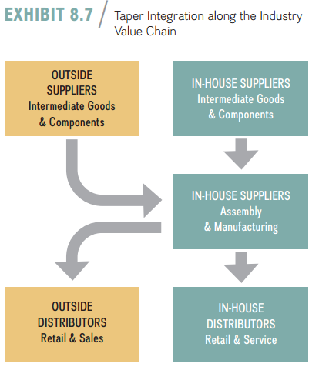
Lecture
TITLE OF LECTURE
Corporate Strategy: Vertical Integration and Diversification
07
Exhibit 8.7 illustrates the concept of taper integration along the vertical industry value chain. Here, the firm sources intermediate goods and components from in-house suppliers as well as outside suppliers. In a similar fashion, a firm sells its products through company-owned retail outlets and through independent retailers. Both Apple and Nike, for example, use taper integration: They own retail outlets but also use other retailers, both the brick-and-mortar type and online.
www.midocean.ae

Slide 28
Lecture
TITLE OF LECTURE
Corporate Strategy: Vertical Integration and Diversification
07
Taper integration has several benefits:
■ It exposes in-house suppliers and distributors to market competition so that performance comparisons are possible. Rather than hollowing out its competencies by relying too much on outsourcing, taper integration allows a firm to retain and fine-tune its competencies in upstream and downstream value chain activities.
www.midocean.ae

Slide 29
Lecture
TITLE OF LECTURE
Corporate Strategy: Vertical Integration and Diversification
07
■ Taper integration also enhances a firm’s flexibility. For example, when adjusting to fluctuations in demand, a firm could cut back on the finished goods it delivers to external retailers while continuing to stock its own stores.
■ Using taper integration, firms can combine internal and external knowledge, possibly paving the path for innovation.
www.midocean.ae

Slide 30
Lecture
TITLE OF LECTURE
Corporate Strategy: Vertical Integration and Diversification
07
2. Strategic outsourcing. Another alternative to vertical integration is strategic outsourcing, which involves moving one or more internal value chain activities out-side the firm’s boundaries to other firms in the industry value chain. A firm that engages in strategic outsourcing reduces its level of vertical integration.
www.midocean.ae

Slide 31
Lecture
TITLE OF LECTURE
Corporate Strategy: Vertical Integration and Diversification
07
7.4 Corporate Diversification: Expanding Beyond a Single Market
A firm that engages in diversification increases the variety of products and services it offers or markets and the geographic regions in which it competes. A non-diversified company focuses on a single market, whereas a diversified company competes in several different markets simultaneously. There are various general diversification strategies:
www.midocean.ae

Slide 32
Lecture
TITLE OF LECTURE
Corporate Strategy: Vertical Integration and Diversification
07
■ A firm that is active in several different product markets is pursuing a product diversification strategy.
■ A firm that is active in several different countries is pursuing a geographic diversification strategy.
■ A company that pursues both a product and a geographic diversification strategy simultaneously follows a product–market diversification strategy.
www.midocean.ae

Slide 33
Lecture
TITLE OF LECTURE
Corporate Strategy: Vertical Integration and Diversification
07
Types Of Corporate Diversification
To understand the different types and degrees of corporate diversification, Richard Rumelt developed a helpful classification scheme that identifies four main types of diversification by looking at two variables:
■ The percentage of revenue from the dominant or primary business.
■ The relationship of the core competencies across the business units.
www.midocean.ae

Slide 34
TITLE OF LECTURE
Corporate Strategy: Vertical Integration and Diversification
Lecture
07
Just knowing the percentage of revenue of the dominant business immediately, (the first variable), lets us identify the first two types. Asking questions about the relationship of core competencies across business units allows us to identify the last two types. The four main types of business diversification are
1. Single business.
2. Dominant business.
3. Related diversification.
4. Unrelated diversification: the conglomerate.
www.midocean.ae

Slide 35
TITLE OF LECTURE
Corporate Strategy: Vertical Integration and Diversification
Lecture
07
Single business. A single-business firm derives more than 95 percent of its revenues from one business.
Dominant business. A dominant-business firm derives between 70 and 95 percent of its revenues from a single business, but it pursues at least one other business activity that accounts for the remainder of revenue.
www.midocean.ae

Slide 36
TITLE OF LECTURE
Corporate Strategy: Vertical Integration and Diversification
Lecture
07
Related diversification. A firm follows a related diversification strategy when it derives less than 70 percent of its revenues from a single business activity and obtains revenues from other lines of business linked to the primary business activity.
Unrelated diversification: the conglomerate. A firm follows an unrelated diversification strategy when less than 70 percent of its revenues comes from a single business and there are few, if any, linkages among its businesses.
www.midocean.ae

Slide 37
TITLE OF LECTURE
Corporate Strategy: Vertical Integration and Diversification
Lecture
07
- Leveraging core competencies For corporate Diversification
In Chapter 4, when looking inside the firm, we introduced the idea that competitive advantage can be based on core competencies. Core competencies are unique strengths embedded deep within a firm. They allow companies to increase the perceived value of their product and service offerings and/or lower the cost to produce them. Examples of core competencies are:
www.midocean.ae

Slide 38
TITLE OF LECTURE
Corporate Strategy: Vertical Integration and Diversification
Lecture
07
■ Walmart’s ability to effectively orchestrate a globally distributed supply chain at low cost.
■ Infosys’ ability to provide high-quality information technology services at a low cost by leveraging its global delivery model. This implies taking work to the location where it makes the best economic sense, based on the available talent and the least amount of acceptable risk and lowest cost.
www.midocean.ae

Slide 39
Lecture
TITLE OF LECTURE
Corporate Strategy: Vertical Integration and Diversification
07
Four Options to Formulate Corporate Strategy via Core Competencies:
1. Leverage existing core competencies to improve current market position.
2. Build new core competencies to protect and extend current market position.
3. Redeploy and recombine existing core competencies to compete in markets of the future.
4. Build new core competencies to create and compete in markets of the future.
www.midocean.ae

Slide 40
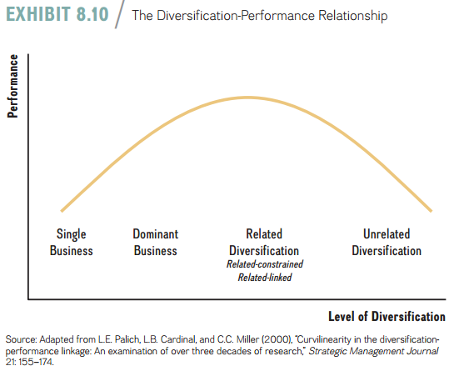
TITLE OF LECTURE
Corporate Strategy: Vertical Integration and Diversification
Lecture
07
- Corporate Diversification and firm performance
The diversification-performance relationship is a function of the underlying type of diversification. A cumulative body of research indicates an inverted U-shaped relationship between the type of diversification and overall firm performance, as depicted in Exhibit 8.10. High and low levels of diversification are generally associated with lower overall performance, while moderate levels of diversification are associated with higher firm performance.
www.midocean.ae

Slide 41
TITLE OF LECTURE
Corporate Strategy: Vertical Integration and Diversification
Lecture
07
Other potential benefits to firm performance when following a diversification strategy include financial economies, resulting from restructuring and using internal capital markets.
1. Restructuring. Restructuring describes the process of reorganizing and divesting business units and activities to refocus a company in order to leverage its core competencies more fully.
www.midocean.ae

Slide 42
TITLE OF LECTURE
Corporate Strategy: Vertical Integration and Diversification
Lecture
07
Corporate executives can restructure the portfolio of their firm’s businesses, much like an investor can change a portfolio of stocks. One helpful tool to guide corporate portfolio planning is the Boston Consulting Group (BCG) growth-share matrix, shown in Exhibit 8.12. This matrix locates the firm’s individual SBUs in two dimensions: relative market share (horizontal axis) and speed of market growth (vertical axis). The firm plots its SBUs into one of four categories in the matrix: dog, cash cow, star, and question mark.
Each category warrants a different investment strategy. All four categories shape the firm’s corporate strategy.
www.midocean.ae

Slide 43
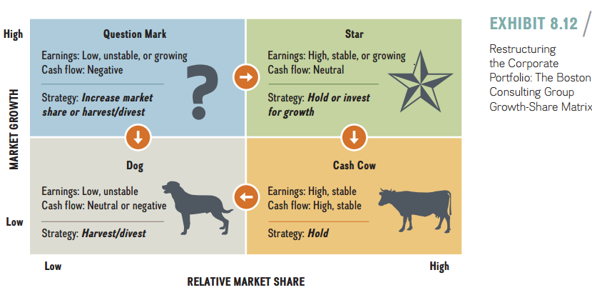
TITLE OF LECTURE
Corporate Strategy: Vertical Integration and Diversification
Lecture
07
SBUs identified as dogs are relatively easy to identify: They are the underperforming businesses. Dogs hold a small market share in a low-growth market; they have low and unstable earnings, combined with neutral or negative cash flows. The strategic recommendations are either to divest the business or to harvest it. This implies stopping investment in the business and squeezing out as much cash flow as possible before shutting it or selling it. Cash cows, in contrast, are SBUs that compete in a low-growth market but hold considerable market share. Their earnings and cash flows are high and stable. The strategic recommendation is to invest enough into cash cows to hold their current position and to avoid having them turn into dogs (as indicated by the arrow).
www.midocean.ae

Slide 44
TITLE OF LECTURE
Corporate Strategy: Vertical Integration and Diversification
Lecture
07
A corporation’s star SBUs hold a high market share in a fast-growing market. Their earnings are high and either stable or growing. The recommendation for the corporate strategist is to invest sufficient resources to hold the star’s position or even increase investments for future growth. As indicated by the arrow, stars may turn into cash cows as the market in which the SBU is situated slows after reaching the maturity stage of the industry life cycle. Finally, some SBUs are question marks: It is not clear whether they will turn into dogs or stars
www.midocean.ae

Slide 45
TITLE OF LECTURE
Corporate Strategy: Vertical Integration and Diversification
Lecture
07
2. Internal Capital Markets. Internal capital market scan be a source of value creation in a diversification strategy if the conglomerate’s headquarters does a more efficient job of allocating capital through its budgeting process than what could be achieved in external capital markets. Based on private information, corporate managers are in a position to dis-cover which of their strategic business units will provide the highest return on invested capital. In addition, internal capital markets may allow the company to access capital at a lower cost.
www.midocean.ae

Slide 46


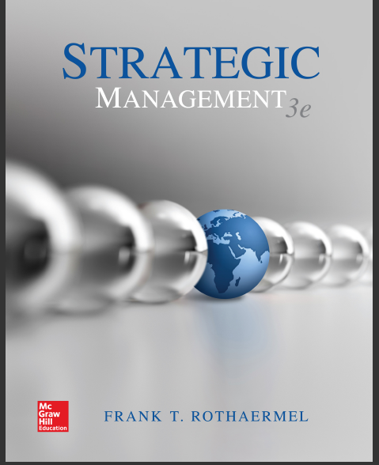

TITLE OF LECTURE
Corporate Strategy: Vertical Integration and Diversification
Strategic management, third edition, 2017 By Frank t. Rothaermel
Georgia Institute of Technology.
Thank You
www.midocean.ae

