Slide 1


Ethical Hacking Essentials (EHE)
Master of Science in Cybersecurity
Dr. Kamal Alieyan
Everyone Smart University
Faculty of IT – 2022/2023

Slide 2


Module 04
Password Cracking Techniques and Countermeasures

Slide 3
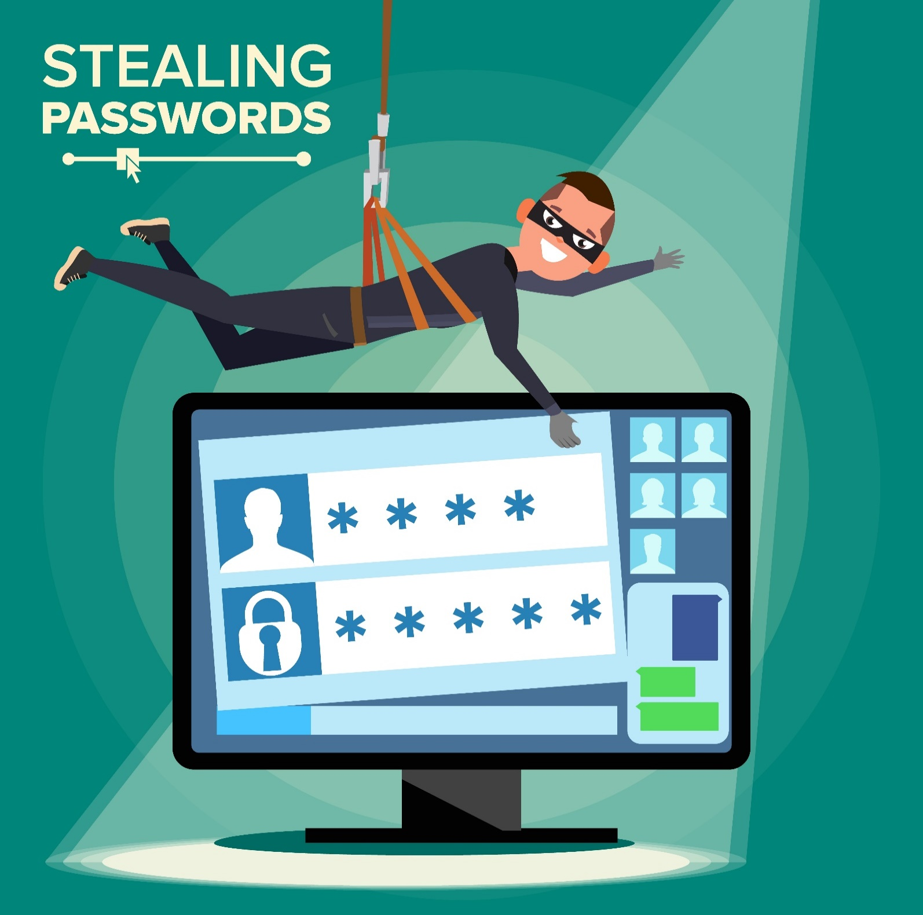
Module Objectives
Creative idea
1
Understanding the Password Cracking and Password Complexity
2
Understanding Microsoft Authentication
3
Understanding Various Types of Password Attacks
4
Overview of Password Cracking Tools
5
Understanding Countermeasures against Password Attacks

Slide 4

Module Flow
1
Discuss Password Cracking Techniques
2
Discuss Password Cracking Tools
3
Discuss Password Cracking Countermeasures

Slide 5

Password Cracking
Password cracking techniques are used to recover passwords from computer systems
Attackers use password cracking techniques to gain unauthorized access to vulnerable systems
Most of the password cracking techniques are successful because of weak or easily guessable passwords

Slide 6

Password Complexity
1
5
Passwords that contain letters, special characters, and numbers ap1@52
Passwords that contain only letters POTHMYDE
2
6
Passwords that contain only numbers 23698217
Passwords that contain only letters and special characters bob@&ba
3
4
7
Passwords that contain only special characters &*#@!(%)
Passwords that contain letters and numbers meet123
Passwords that contain only special characters and numbers 123@$45

Slide 7
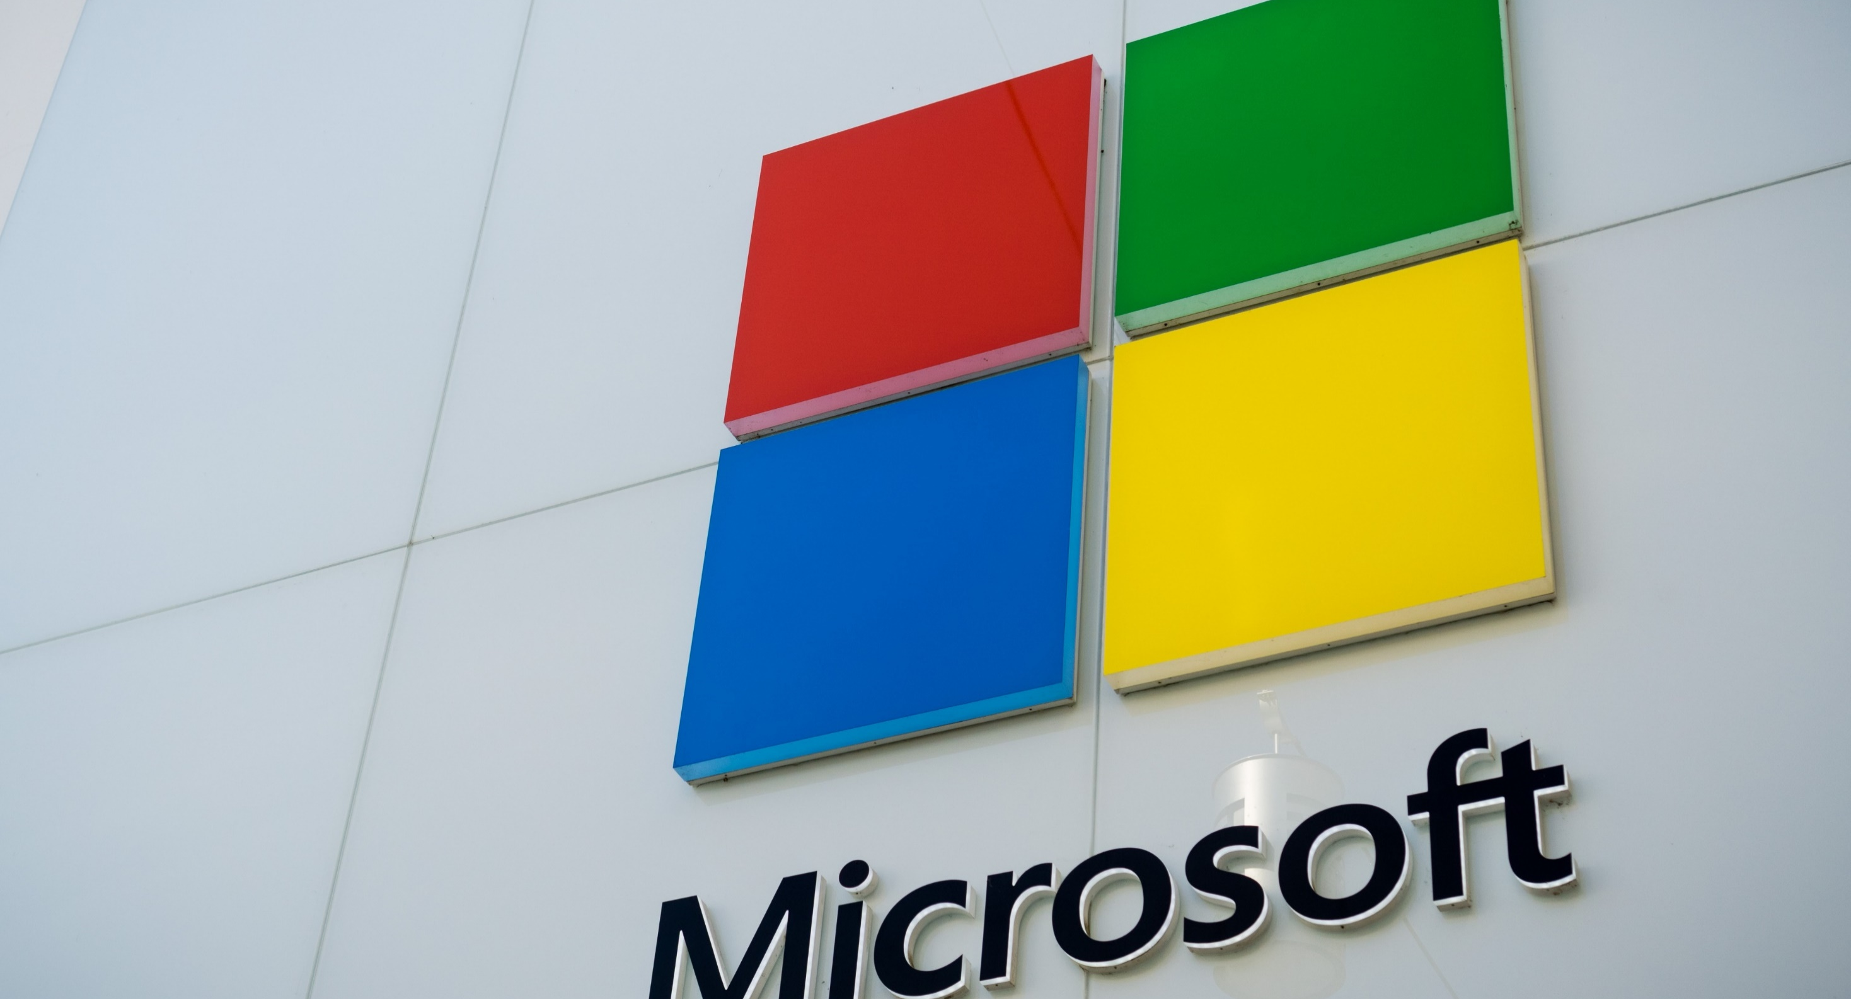
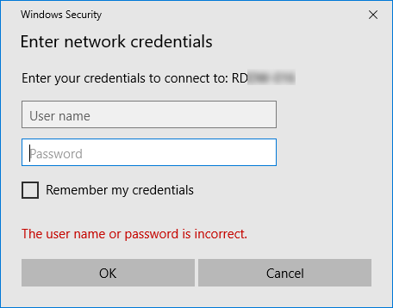
Microsoft Authentication
Security Accounts Manager (SAM) Database
S
Windows stores user passwords in SAM, or in the Active Directory database in domains
Passwords are never stored in clear text and are hashed, and the results are stored in the SAM
NTLM Authentication
N
The NTLM authentication protocol types are as follows: NTLM authentication protocol and LM authentication protocol
These protocols store the user’s password in the SAM database using different hashing methods
Kerberos Authentication
K
Microsoft has upgraded its default authentication protocol to Kerberos which provides a stronger authentication for client/server applications than NTLM

Slide 8
Types of Password Attacks
Non-Electronic Attacks
The attacker does not need technical knowledge to crack the password, hence it is known as a non-technical attack
Shoulder Surfing
Social Engineering
Dumpster Diving
01
Active Online Attacks
The attacker performs password cracking by directly communicating with the victim’s machine
Dictionary, Brute Forcing, and Rule-based Attack
Hash Injection Attack
LLMNR/NBT-NS Poisoning
Trojan/Spyware/Keyloggers
Password Guessing
02

Slide 9
Types of Password Attacks (Cont’d)
Passive Online Attacks
The attacker performs password cracking without communicating with the authorizing party
Wire Sniffing
Man-in-the-Middle Attack
Replay Attack
03
Offline Attacks
The attacker copies the target’s password file and then tries to crack passwords on his own system at a different location
Rainbow Table Attack (Pre-Computed Hashes)
Distributed Network Attack
04

Slide 10
Dictionary, Brute-Force, and Rule-based Attack
Dictionary Attack
Brute-Force Attack
Rule-based Attack
per year
A dictionary file is loaded into the cracking application that runs against user accounts
The program tries every combination of characters until the password is broken
This attack is used when the attacker gets some information about the password

Slide 11

Password Guessing
The attacker creates a list of all possible passwords from the information collected through social engineering or any other way and manually inputs them on the victim’s machine to crack the passwords
Frequency of attacks is less
Failure rate is high
1
2
3
4
Find a valid user
Create a list of possible passwords
Rank passwords from high to low probability
Key in each password, until the
correct password is discovered

Slide 12
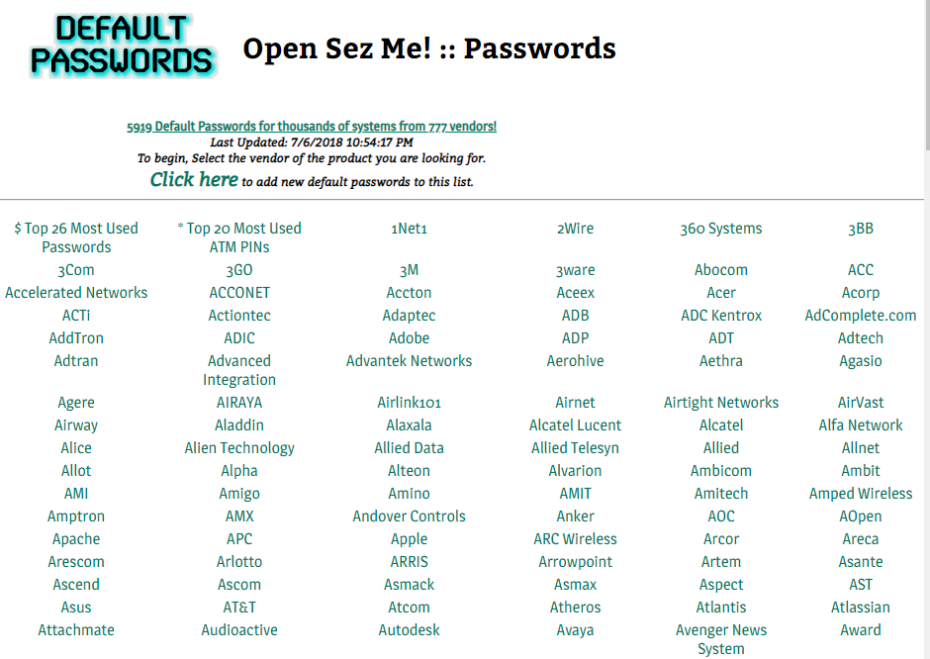
Default Passwords
A default password is a password supplied by the manufacturer with new equipment (e.g., switches, hubs, routers) that is password protected
Attackers use default passwords present in the list of words or dictionary to perform password guessing attack
Online Tools to Search Default Passwords
https://www.fortypoundhead.com
https://cirt.net
http://www.defaultpassword.us
https://www.routerpasswords.com
https://default-password.info
https://open-sez.me

Slide 13










Trojans/Spyware/Keyloggers
Attacker infects victim’s local PC
with Trojan/spyware/keylogger
Victim logs on to the domain server with his/her credentials
Trojan/spyware/keylogger sends login credentials to attacker
Attacker
Victim
Domain Server
Attacker gains access to domain server
The attacker installs a Trojan/Spyware/Keylogger on the victim's machine to collect the victim's usernames and passwords
The Trojan/Spyware/Keylogger runs in the background and sends back all user credentials to the attacker

Slide 14








Hash Injection/Pass-the-Hash (PtH) Attack
A hash injection/PtH attack allows an attacker to inject a compromised hash into a local session and use the hash to validate network resources
The attacker finds and extracts a logged-on domain admin account hash
The attacker uses the extracted hash to log on to the domain controller
Compromises server
using a local/remote exploit
Logged-on hashes are stored in the SAM file
User logs on
Extracts a logged-on domain
admin account hash
User Server
(Domain Controller)
Inject a compromised hash into a local session
User Computer
Attacker

Slide 15




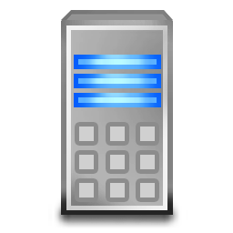


LLMNR/NBT-NS Poisoning
LLMNR and NBT-NS are the two main elements of Windows operating systems that are used to perform name resolution for hosts present on the same link
The attacker cracks the NTLMv2 hash obtained from the victim’s authentication process
The extracted credentials are used to log on to the host system in the network
User performs LLMNR/NBT-NS broadcast
to find out if anyone knows \\DtaServr
Host 1
User sends incorrect host name – \\DtaServr
Host 2
Data Server
\\DtaServr – NOT FOUND
User
Attacker responds saying that he knows \\DtaServr, accepts NTLMv2 hash and then sends an ERROR MSG
Host 3
Attacker

Slide 16
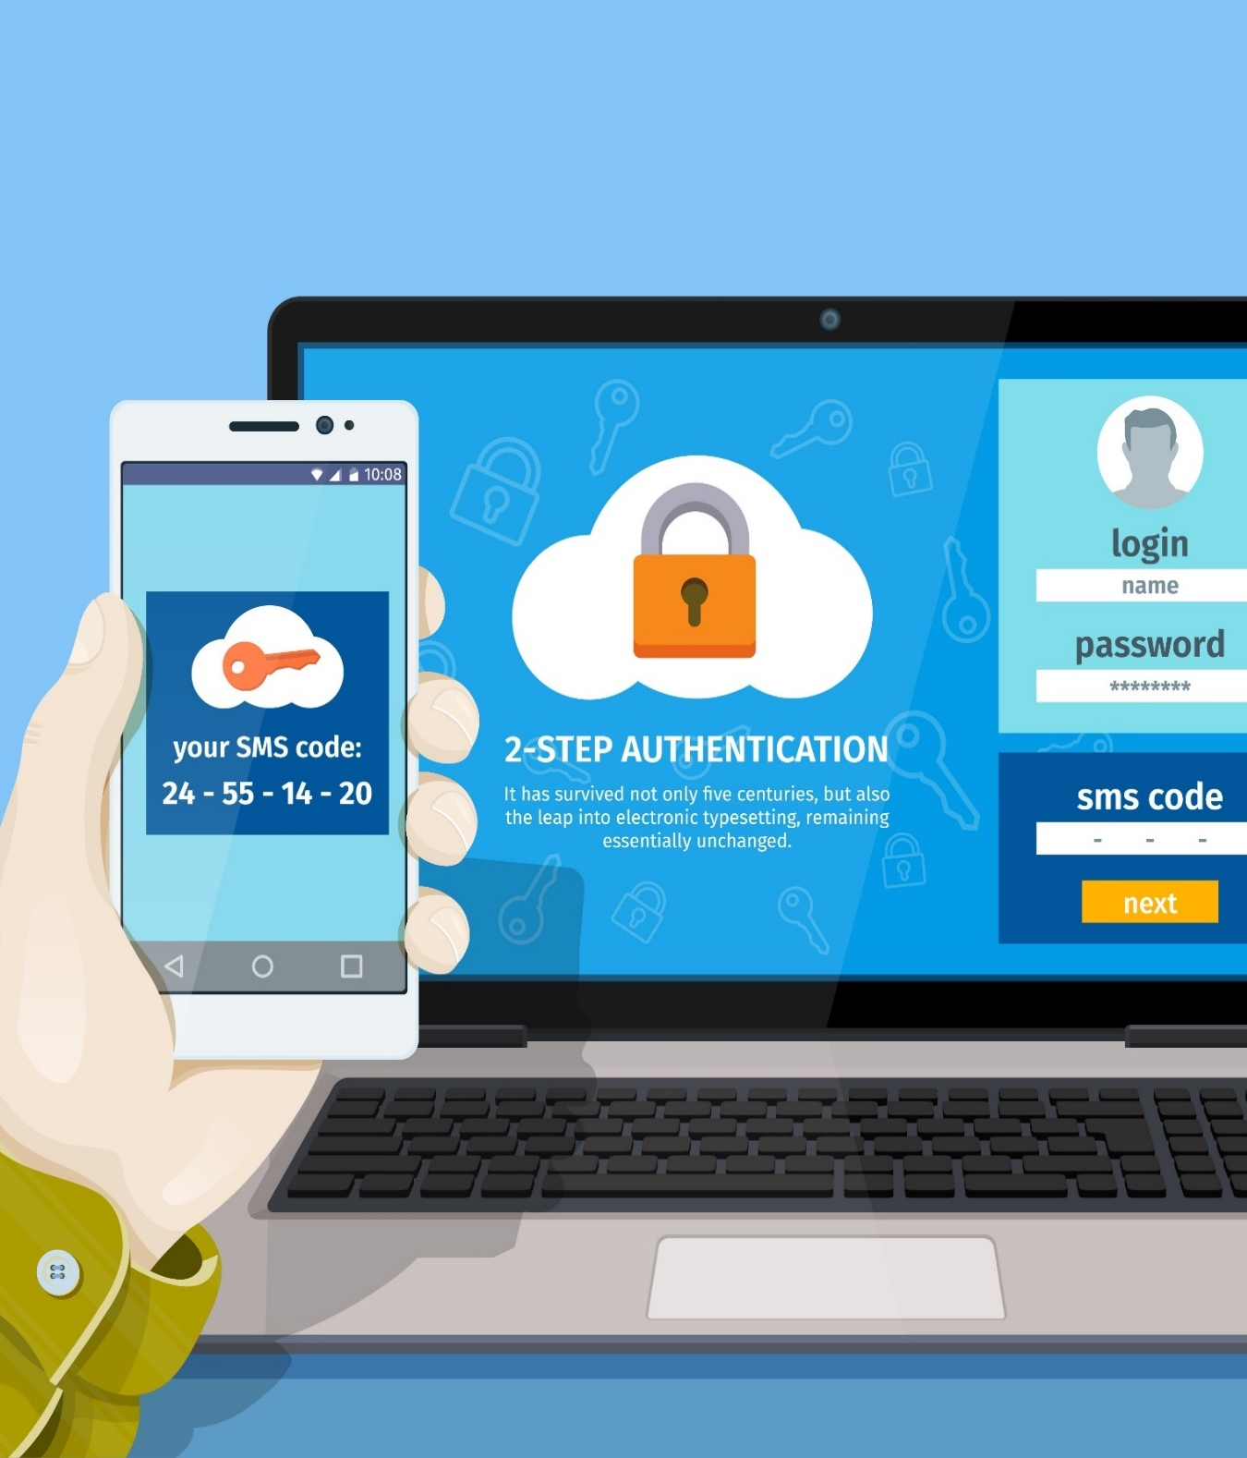
Pass the Ticket Attack
Pass the Ticket is a technique used for authenticating a user to a system that is using Kerberos without providing the user’s password
To perform this attack, the attacker dumps Kerberos tickets of legitimate accounts using credential dumping tools
The attacker then launches a pass the ticket attack either by stealing the ST/TGT from an end-user machine, or by stealing the ST/TGT from a compromised Authorization Server
The attacker uses the retrieved ticket to gain unauthorized access to the target network services
Tools such as Mimikatz, Rubeus, and Windows Credentials Editor are used by attackers to launch such attacks
Notes:
https://www.shutterstock.com/image-vector/pair-yellow-red-movie-ticket-icons-657272176

Slide 17





Wire Sniffing
Attackers run packet sniffer tools on the local area network (LAN) to access
and record the raw network traffic
The captured data may include sensitive information such as passwords
(FTP, rlogin sessions, etc.) and emails
Sniffed credentials are used to gain unauthorized access to the target system
Tools Available
Wire Sniffing
Computationally Complex
Hard to Perpetrate
Victim
Victim
Attacker

Slide 18




Man-in-the-Middle and Replay Attacks
Considerations
In an MITM attack, the attacker acquires access to the communication channels between the victim and the server to extract the information needed
In a replay attack, packets and authentication tokens are captured using a sniffer. After the relevant information is extracted, the tokens are placed back on the network to gain access
Relatively hard to perpetrate
Must be trusted by one or both sides
Can sometimes be broken by invalidating traffic
Original Connection
Sniff
MITM/Replay Traffic
Victim
Web Server
Attacker

Slide 19


Rainbow Table Attack
1
Rainbow Table
A precomputed table that contains word lists like dictionary files, brute force lists, and their hash values
2
Compare the Hashes
The hash of passwords is captured and compared with the precomputed hash table. If a match is found, then the password gets cracked
3
Easy to Recover
It is easy to recover passwords by comparing the captured password hashes to the precomputed tables
Precomputed Hashes
1qazwed
4259cc34599c530b28a6a8f225d668590
hh021da
c744b1716cbf8d4dd0ff4ce31a177151
9da8dasf
3cd696a8571a843cda453a229d741843
sodifo8sf
c744b1716cbf8d4dd0ff4ce31a177151

Slide 20

Module Flow
1
Discuss Password Cracking Techniques
2
Discuss Password Cracking Tools
3
Discuss Password Cracking Countermeasures

Slide 21
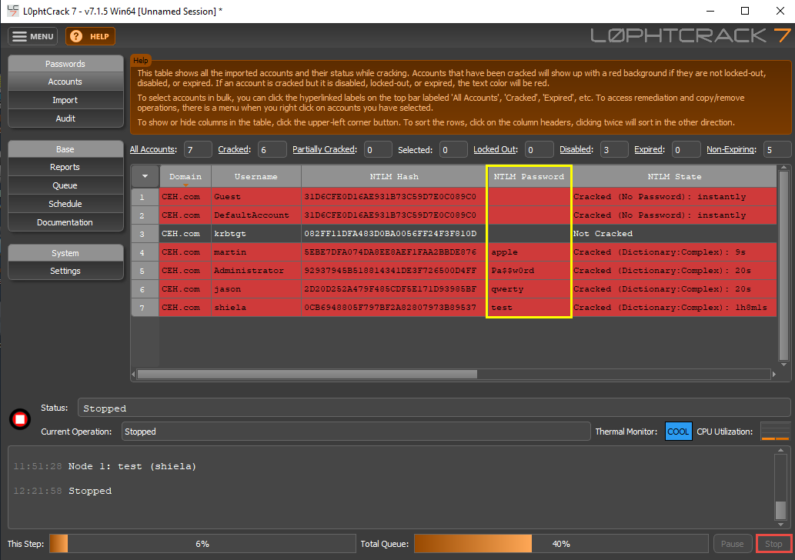
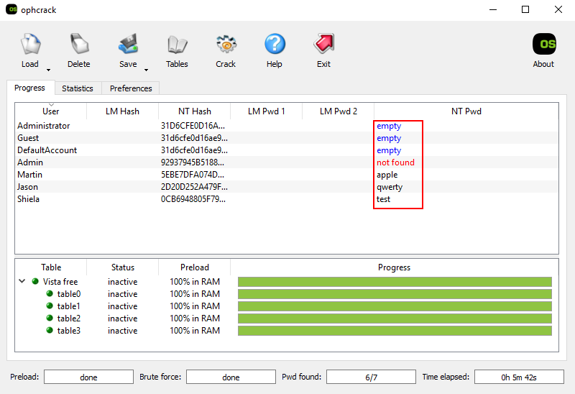
Password-Cracking Tools: L0phtCrack and ophcrack
L0phtCrack
A tool designed to audit passwords and recover applications
ophcrack
A Windows password cracker based on rainbow tables. It comes with a Graphical User Interface and runs on multiple platforms
https://www.l0phtcrack.com
https://ophcrack.sourceforge.io

Slide 22
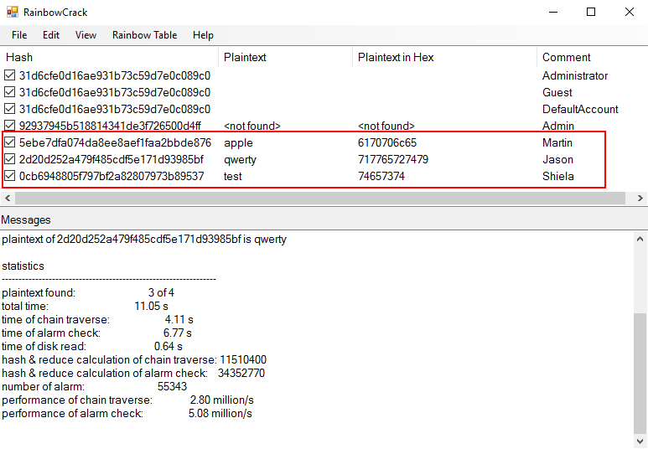
Password-Cracking Tools
RainbowCrack
RainbowCrack cracks hashes with rainbow tables. It uses a time-memory tradeoff algorithm to crack hashes
John the Ripper
https://www.openwall.com
hashcat
https://hashcat.net
THC-Hydra
https://github.com
Medusa
http://foofus.net
http://project-rainbowcrack.com

Slide 23
Module Flow
1
Discuss Password Cracking Techniques
2
Discuss Password Cracking Tools
3
Discuss Password Cracking Countermeasures

Slide 24
Password Cracking Countermeasures
1
Disallow use of the same password during a password change
2
Disallow password sharing
Disallow the use of passwords that can be found in a dictionary
Do not use cleartext protocols and protocols with weak encryption
3
4
5
Set the password change policy to 30 days
6
Do not use any system default passwords

Slide 25
Password Cracking Countermeasures (Cont’d)
Make passwords hard to guess by requiring 8-12 alphanumeric characters consisting of a combination of uppercase and lowercase letters, numbers, and symbols
7
10
Disallow the use of passwords such as date of birth, spouse, child’s, or pet’s name
Ensure that applications neither store passwords in memory nor write them to disks in clear text
8
11
Lockout an account subjected to too many incorrect password guesses
Use two-factor or multi-factor authentication, for example, using CAPTCHA to prevent automated attacks
9
Use a random string (salt) as a prefix or suffix to the password before encryption
12

Slide 26
Module Summary
This module has discussed the password cracking and password complexity
It has covered the Microsoft authentication mechanisms
It also discussed in detail on various types of password attacks
It demonstrated on how to use password cracking tools
Finally, this module ended with a detailed discussion on various countermeasures against password attacks
In the next module, we will discuss in detail on various social engineering techniques and countermeasures

