Slide 1


Risk and Decision Analysis
Prepared by Dr. Sami Alzahrani
PMG 621
Lecture 1

Slide 2




Risk and Decision Analysis
Lecture 1
PMG 621
Prepared by Dr. Sami Alzahrani
www.midocean.ae

Slide 3

Chapter
Introduction
01
Decision analysis (DA), sometimes called risk analysis, is the discipline for helping decision makers choose wisely under conditions of uncertainty. The techniques are applicable to all types of project decisions and valuations. Committing to fund a project does not end the decision making, for deci- sions continue to be made throughout the project life cycle. The quality of these decisions impacts cost, schedule, and performance.
www.midocean.ae

Slide 4
Chapter
Introduction
01
This book explores the approach and principal techniques of DA. These methods explicitly recognize uncertainties in project forecasts. This analysis technology, on the leading edge in the 1970s and earlier, is becoming main- stream practice. The methodology is proven, accessible, and-I hope you will agree-easily understood
www.midocean.ae

Slide 5
Decision Problems:
Most decision problems are about resource allocation: Where do we put our money, time, and other resources? DA involves concepts borrowed from probability theory, statistics, psychology, finance, and operations research. The formal discipline is called decision science, a subset of operations research (also called management science). Operations Research/Management Science (OR/MS or ORMS) is the broad discipline of applying quantitative methods to problems of business and other organizations.
www.midocean.ae

Slide 6
Applying the DA approach requires:
Capturing judgments about risks and uncertainty as probability distributions
- Having a single measure of value or the quality of the result Putting these together with expected value calculations.
www.midocean.ae

Slide 7
DA provides the only logical, consistent way to incorporate judgments about risks and uncertainties into an analysis. When uncertainties are significant, these techniques are the best route toward credible project decisions. Decisionscience emerged as a subcategory of management science during the 1960s. Yet still, evaluation practices and decision policy remain a weak link in many organizations (see Figure 1.1). This is despite great sophistication in the technical science and engineering disciplines. The purpose of this book is to strengthen that weak link.
www.midocean.ae

Slide 8
Increasing business complexity, speed, and competition pressure us to improve decision making. People are maturing in traditional planning and evaluation practices, and dealing with uncertainty seems a logical improvement. Sophisticated decision making doesn't mean more complicated. We can solve many decision problems on the back of an envelope; however, low- and moderate-cost computer software is now available to implement the methods described in this book. Applying these techniques should lead to faster, more confident decisions.
www.midocean.ae

Slide 9
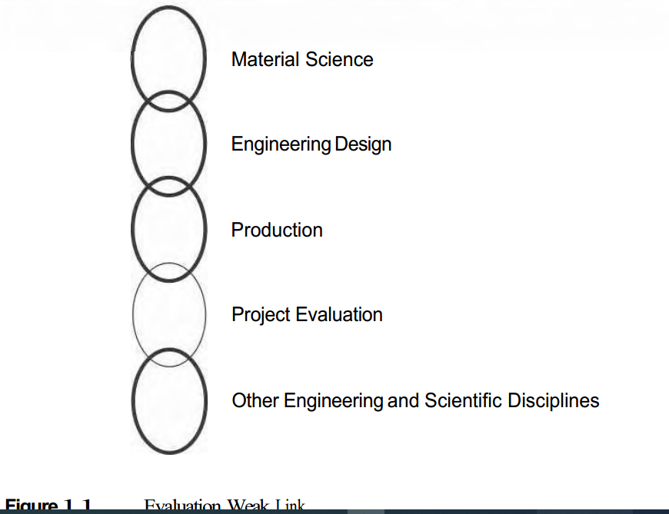
www.midocean.ae

Slide 10
Credible Analysis
Your job may involve estimating project or activity costs. How would you evaluate the quality of your estimates? Most forecast users recognize two principal, desirable characteristics in a credible analysis: Objectivity: Over a number of projects, estimates proving neither too high nor too low on average. Unbiased. Precision: Reasonable closeness between estimates and actual values that is, minimal random "noise" in the estimates.
Forecast accuracy is a composite of low bias and high precision.
www.midocean.ae

Slide 11

Objectivity lack of bias-tells us about the error of estimations compared to what error of approximately zero. Precision tells us about the magnitude of the errors, and we desire small errors, of course. In competitive situations, both bias and precision are important. For most internal purposes-where we're competing against nature, for ex- ample-objectivity is more important.
Applying the expected value (EV) concept enables more accurate forecasts and estimates. Understanding a few things about probability distributions will be helpful before introducing EV later in this chapter.
www.midocean.ae

Slide 12
Risk and Uncertainty
Risk and uncertainty describe the possibility of different potential outcomes. Some systems feature inherent randomness, such as games of chance. In business, the risks and uncertainties reflect unknowns and variability in nature, materials, and human systems.
Risk is the quality of a system that relates to the possibility of different
outcomes. Informally, "risk is used when there is a large, usually unfavorable, potential impact. Typically, the contingency event either happens or does not for example, risk of failure.
www.midocean.ae

Slide 13
Because there is no good antonym in English for a "good risk," many of us allow "risk" to encompass either undesirable or desirable outcomes, or both. In project management, especially, we often classify risk events as either "threats" or "opportunities." This taxonomy, shown in Figure 1.2, is consistent with SWOT analysis, where a situation analysis focuses in turn on Strengths, Weaknesses, Opportunities, and Threats.
.
www.midocean.ae

Slide 14
(This is a good process for creating decision-making opportunities.) This classification is useful in project risk management, where we want to reduce the probability and impact of a threat and increase the probability and impact of an opportunity.
For many people, risk is approximately synonymous with uncertainty. It is sometimes helpful to make a distinction. Uncertainty refers to variability in some value. An informal distinction is that uncertainty applies to when the outcome is variable, such as a future commodity price. We know there is going to be a price; the uncertainty is how much.
.
www.midocean.ae

Slide 15
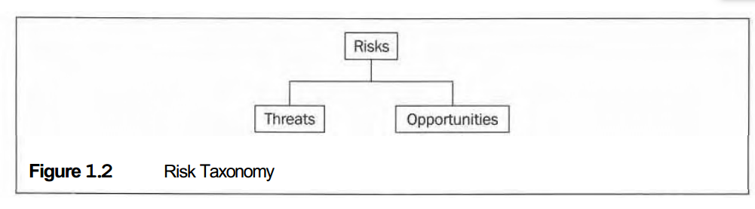
www.midocean.ae

Slide 16
Frequency and Probability Distributions
Suppose that you and forty-nine other professionals estimate Project Cost. The collected values range from $26.7 million to $76.0 million. We can dis- play the fifty estimates as frequency histogram, as illustrated in Figure 1.3. Here is the procedure for charting a frequency histogram. First divide the range of values into (typically) five to fifty intervals (segments, bins) of equal width. Next, count the number of values occurring within each interval.
www.midocean.ae

Slide 17
Now, draw a bar graph-one bar per interval-with the bar heights proportional to the number (or frequency) of occurrences within each interval. If you desire, label the y-axis with either numbers of values in the interval or percents of the total. Labeling the y-axis is optional, because anyone viewing such a cinsteadhart expects that all of the data values are represented. Suppose that,, we have 500 data points. More data and smaller value segment partitions provide the additional detail shown in Figure 1.4. We obtain a more accurate estimate of a central, average value as the number of data points increases.
www.midocean.ae

Slide 18
If we obtain a great many data points and use smaller intervals, the frequency distribution converges into a smooth and continuous curve, a probability density function (p .d. f.), or, simply, a probability distribution.
A probability distribution can completely represent one's judgment about a chance event. If one or more inputs to an analysis are probability distributions, then project cost and other outputs will be probability distributions also.
www.midocean.ae

Slide 19
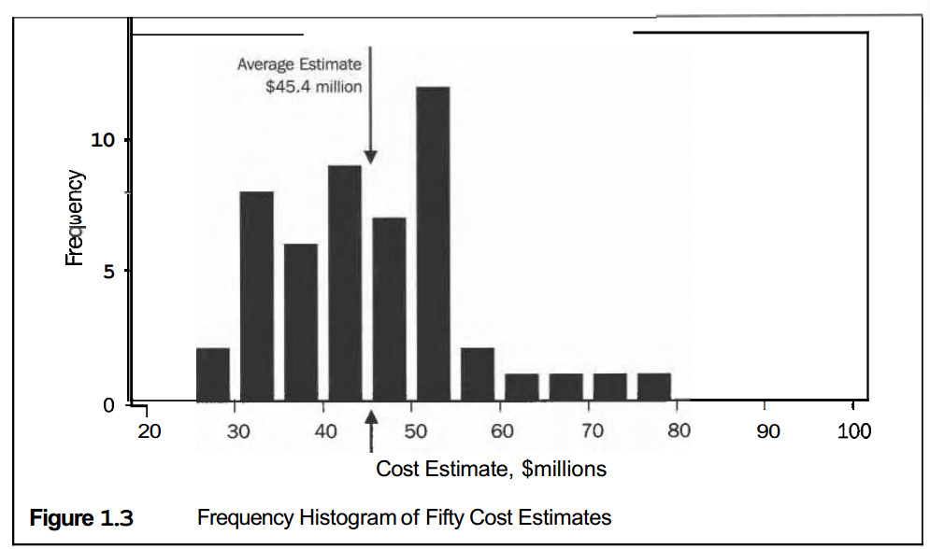
www.midocean.ae

Slide 20
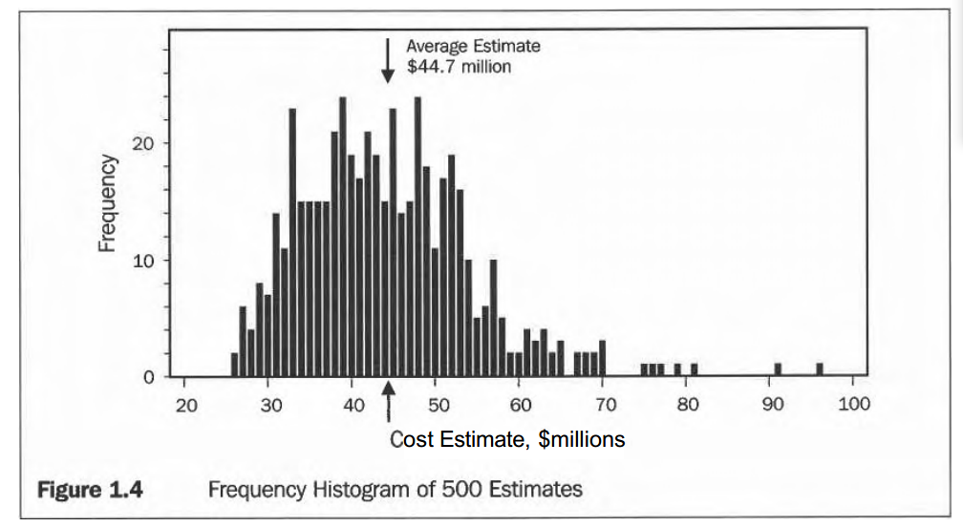
www.midocean.ae

Slide 21
A p.d.f. represents the population of aLl possible outcomes. Suppose that we want to judge the uncertainty in a new cost estimate coming from the same population as values obtained for Figures 1.3 and 1.4. Figure 1.5 shows a probability distribution for the next sample for a Project Cost estimate. The units of the y-axis are not important; the y-axis is scaled so that the area under the curve equals 1. This figure shows the relative likelihood of estimate values along the x-axis.
www.midocean.ae

Slide 22
Fitting such a curve to lots of representative data, this function would represent our best judgment of the distribution of cost estimates. As such, the p.d.f. represents a judgment about uncertainty. In the case of Figure 1.5, it represents a judgment about new cost estimates. Unlike a frequency distribution, the p.d.f. is not representing data.
www.midocean.ae

Slide 23
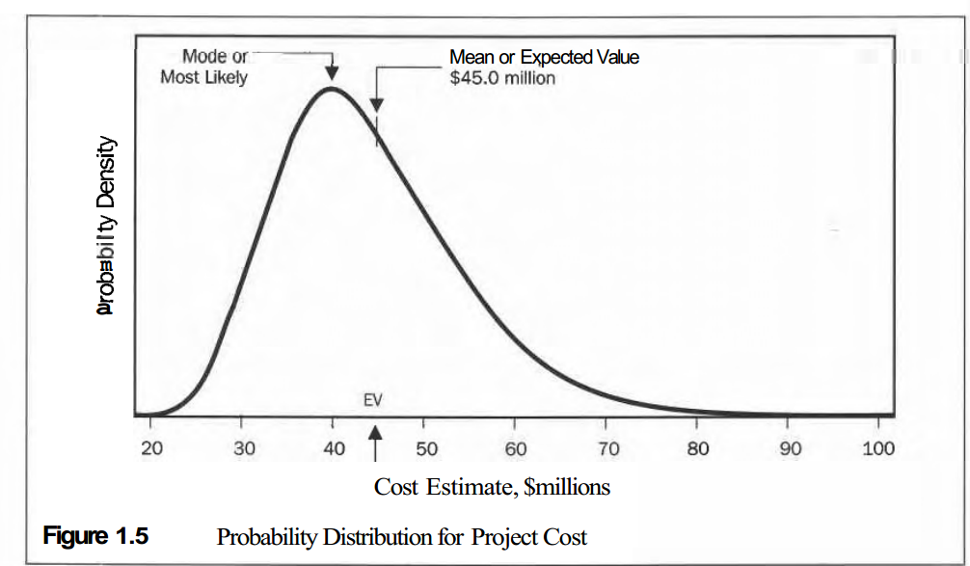
www.midocean.ae

Slide 24
Popular Central Measures
There are two especially important statistics annotated in Figure 1.5: I The most likely value is about $40 don. Statisticians call this peak the mode. The mode is more probable than any other value, and we expect more data samples to be near this value than any other point. This statistic is useful in describing a distribution's shape, yet has little application in decision making.
www.midocean.ae

Slide 25
The expected value, $45 million, is the probability-weighted average. Statisticians call this the mean, and use a Greek letter p symbol. It represents the average of many values sampled from the population of project cost estimates represented by this probability distribution. If we know the probability distribution, then we know that the EV is the probability- weighted average of the distribution. This is the most important and most useful statistic: It is the best single measure of value under uncertainty.
www.midocean.ae

Slide 26
Cumulative Probability Density Curve
The p.d.f., shown in Figure 1.5, is easily converted into a cumulative (probability) ~tyfunctim (c.d.f.) curve. Figure 1.6 shows two versions of mulative distributions. The solid curve sloping upward to the right is the c.d.f. To translate the p.d.f. distribution in Figure 1.5, sum the area under the curve, moving from left to right. This is equivalent to progressively integrating the p.d.f. Notice that the cumulative distribution ranges from 0 to 1 on the y-axis. The dotted curve in Figure 1.6, sloping downward to the right, is the re- verse cumulative distribution.
www.midocean.ae

Slide 27
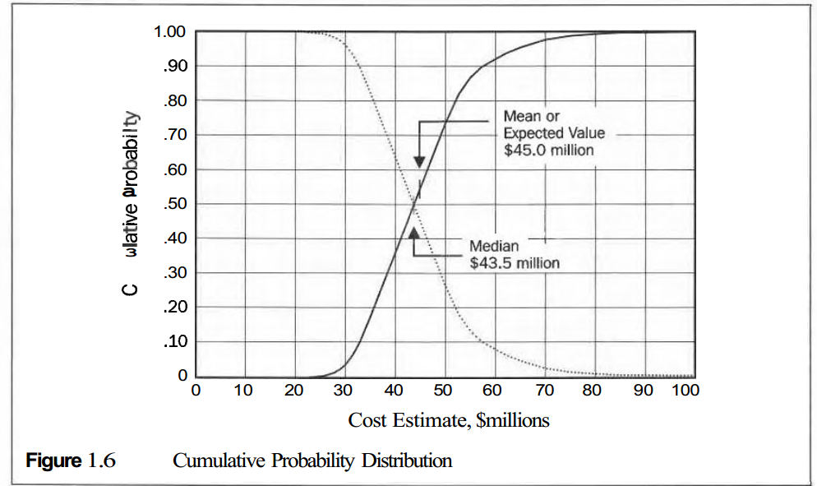
www.midocean.ae

Slide 28
Discrete Events
Thus far, we have been examining continuous distributions, where there is a continuum of possible outcomes. In many situations, a risk is a binary event. Either something happens, or it does not. This is the simplest form of chance event. We have a discrete (probability) distribution when we have two to many (usually countable) possible specific outcomes.
www.midocean.ae

Slide 29
Often we have a project contingency, an event that either happens or not. If this risk event occurs, then there is an impact on the project. Project risk management is mostly about considering discrete risk events and their impacts, and determining what actions are cost effective in mitigating such risks. We will discuss this process in Chapter 8 about project risk management.
www.midocean.ae

Slide 30
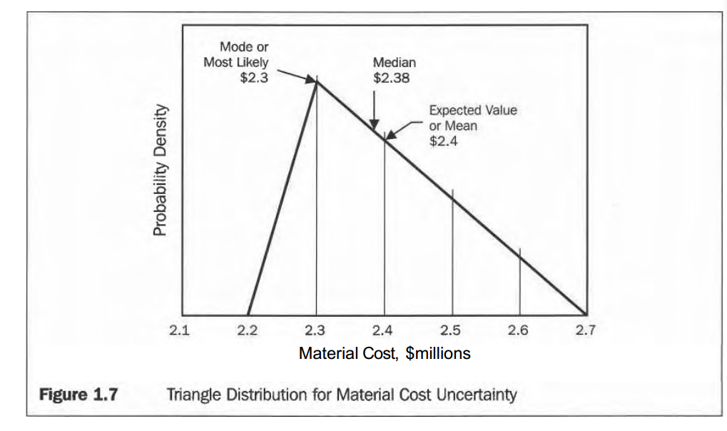
www.midocean.ae

Slide 31
Expected Value
Suppose in estimating Material Cost, an expert judges that the outcome could range from $2.2 million to $2.7 million, with a most likely value of $2.3 million. She further believes that the p.d.f. changes linearly between these points. We then have three points: low, most likely, and high values. These three parameters are sufficient to completely and uniquely describe the triangle distribution, illustrated in Figure 1.7.
www.midocean.ae

Slide 32
This probability distribution, or its cumulative equivalent, completely expresses her material cost assessment. The judged distribution comes from subjective judgment, comparable historical data, modeling, or some combination. Regardless of how it comes about, a probability distribution fully discloses someone's judgment about the value of a project model input variable.
www.midocean.ae

Slide 33
Converts to a Single Value
How should you respond if your boss or the client insists on a single-value estimate instead of a distribution? The best single-point estimate is the expected value (EV), because EV is the objective (unbiased) value to represent a probability distribution. Of course, the model and judgments that go into it must be unbiased. For Material Cost, the case shown in Figure 1.7, $2.4 million would be the single-point estimate.
One would be confident that:
www.midocean.ae

Slide 34
- Performing many similar projects (independent and no learning) would result in an average material cost of approximately $2.4 million.
Over the long run, the average estimate error will approach zero.
Thus, EV is the only unbiased single-point forecast.
Note that forecasts that use the most likely (peak) or median (50 percent confidence) values would systematically understate Material Cost.
www.midocean.ae

Slide 35
Objective Project Estimates
One key to improving project estimates is performance feedback. It is important to compare forecasts to what actually occurs. Project data that verify an objective estimating process will have these characteristics:
The average estimate error approaches zero over many projects.
www.midocean.ae

Slide 36
- This relationship (bullet above) holds for any classification subset of the data (e.g., stratified by project size or type). Even if sufficient data are not available, we intend these features to be in an objective evaluation process. Let's see how this works with synthetic project data.
- There is about a 60 percent confidence that the actual result will be within the range of 0.75 to 1.20 times the estimate.
.
www.midocean.ae

Slide 37
Recourse:
RISK and DECISION ANALYSIS in Projects
Second Edition
By: John Schuyler
Chapter 1
.
www.midocean.ae

Slide 38



Thank You

