Slide 1




The Role of IoT in Monitoring Patients with Diabetes in COVID-19
Submitted in fulfillment of the requirements for the degree Master of Science in Artificial Intelligence
Prepared By
Name: Sami Lotfi Almaghrabi ID No. 251002918
Name: Mohammed Ayidh Almalki ID No. 251002537
August 2025

Slide 2


Agenda Overview
01
Background of the Project
06
Methodology
02
Previous Studies
07
Project Timeline
03
Problem Statement
08
Expected Results
04
Research Questions
09
Resources Needed
05
Project Goal
10
Conclusion

Slide 3
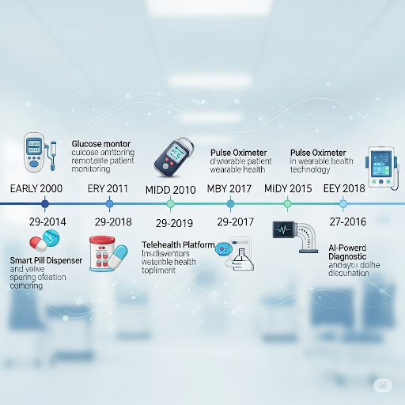

Background of the Project
  COVID-19 disproportionately affects diabetic patients due to immune compromise and glycemic instability.
  IoT sensors enable continuous monitoring (glucose, SpO₂, heart rate, temperature).
  Prior solutions: rule-based alerts → faster detection but limited personalization and prone to false alarms.
  Need: adaptive, patient-specific, AI-driven monitoring.

Slide 4

Previous Studies
Reference | Study Description | Methodology | Key Results | Limitations
Alotaibi et al. (2021) | Pilot of wrist‑worn IoT device measuring glucose (Dexcom G6) and SpO₂ (MAX30102), BLE‑streamed to an Android app for real‑time clinician alerts. | Data Collection: Minute‑level BLE streams to Firebase. Preprocessing: Timestamp alignment, noise filtering. Model: Rule‑based threshold alerts; Firebase Cloud Messaging. Evaluation: RCT (n=60) comparing visit rates & alert latency. | 25% fewer visits; 30 min faster alerts | Static thresholds limit adaptive warnings.
Singh & Verma (2020) | Six‑month LoRaWAN‑based CGM (Medtronic Guardian) and temperature monitoring in quarantined diabetics, with remote insulin adjustment. | Data Collection: CGM & DS18B20 sensors → LoRaWAN/MQTT. Preprocessing: Moving average smoothing, outlier removal. Model: Statistical trend analysis; rule‑based alerts (>180 mg/dL, >37.5 °C). Evaluation: Observational cohort (n=120) measuring HbA1c and alert lead time. | HbA1c ↓1.1%; alerts 2 days earlier | Lack of ML models reduces personalization; potential false positives.
Patel et al. (2021) | Feasibility of adhesive microfluidic glucose patch and IR thermal sensor in quarantined diabetics. | Data Collection: Patch & thermal sensor data → ESP8266. Preprocessing: Moving-average smoothing. Model: Threshold-based anomaly detection. Evaluation: Lab assay comparison & thermometry accuracy (n=30). | Glucose accuracy 95%; fever detected 2 h early | Small sample size; brief trial period limits generalizability.
Zhang et al. (2023) | Retrospective cohort using XGBoost on NB‑IoT-collected vitals for COVID‑19 severity stratification in diabetics. | Data Collection: NB‑IoT modules feeding InfluxDB. Preprocessing: Missing-value imputation; feature engineering. Model: XGBoost classifier; SHAP interpretability. Evaluation: 5‑fold cross-validation (n=500). | AUC=0.88; precision 85% | Retrospective design may introduce selection bias; prospective validation needed.

Slide 5
Previous Studies
There are two main types of previous IoT-AI studies:
    Rule-Based Alerts: Simple threshold triggers (like glucose >180 mg/dL) speed up response time but give false positives and don't let you customize them.
    Predictions based on ML: 1D-CNNs and XGBoost make predictions more accurate, but they only work with past or simulated data and don't handle missing data very well.
Some of the main problems are:
    Lack of personalization, which leads to high false alarm rates.
    Problems with data integrity can cause sensor readings to be noisy or missing.
    Concerns about privacy, such as sharing raw data and regulatory barriers.
    Limitations on scalability mean small groups and short pilots.

Slide 6
Problem Statement
The COVID-19 pandemic has highlighted the vulnerability of diabetic patients, who are at greater risk of severe complications due to impaired immune response and unstable blood glucose levels. Ensuring effective and timely monitoring for this group is therefore a pressing healthcare priority. However, current IoT-based remote monitoring systems face key challenges: they rely on static, rule-based thresholds that fail to account for patient-specific variability, often resulting in delayed or false alerts, and they also struggle with noisy or missing sensor data that undermines predictive accuracy. Previous studies have demonstrated that IoT devices and rule-based alerts can improve glucose and vital sign tracking, but these approaches have shown limitations in adaptability, reliability, and handling real-world data complexity. Building on these insights, the purpose of this study is to investigate how dynamic, AI-enabled, and privacy-preserving IoT monitoring systems can overcome these challenges, reduce false alarms, and deliver more personalized and reliable care for high-risk diabetic patients.

Slide 7

Research Questions
The project seeks to answer the following questions:
• How does a hybrid edge-cloud ML architecture improve real-time prediction accuracy compared to rule-based alerts?
• How can dynamic, patient-specific thresholds reduce false positives and improve reliability?
• What methods can be used to clean and fill in sensor data to enhance model accuracy?

Slide 8
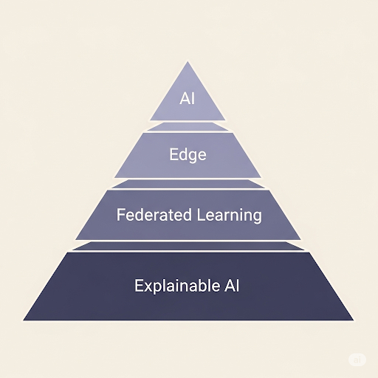
Project Goal
The project goals are to:
• Create and implement an edge 1D-CNN/LSTM-based architecture for real-time inference with a delay of less than 100 ms, replacing rule-based systems.
• Design a dynamic thresholding system using z-score and EWMA, tailored per patient profile, to reduce false alarms.
• Combine noise reduction and imputation pipelines (e.g., Kalman filtering, KNN-imputation) to ensure data quality and improve predictions

Slide 9
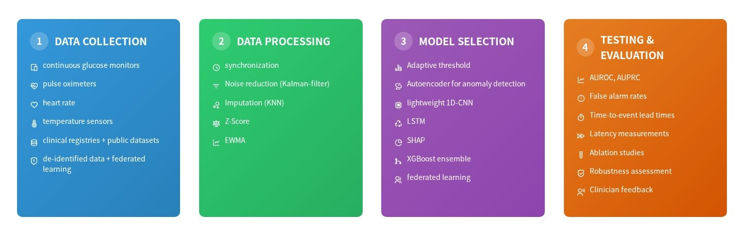
Methodology

Slide 10
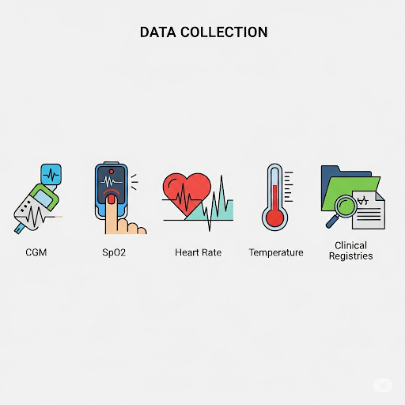
Methodology - Data Collection
  Utilize multimodal sensor data from diabetic patients, including continuous glucose monitors, pulse oximeters, heart rate, and temperature sensors.
  Integrate diversity by matching clinical partner registries with public datasets (e.g., PhysioNet).
  Ensure all clinical data is de-identified and privacy concerns are met through training in a federated learning function

Slide 11
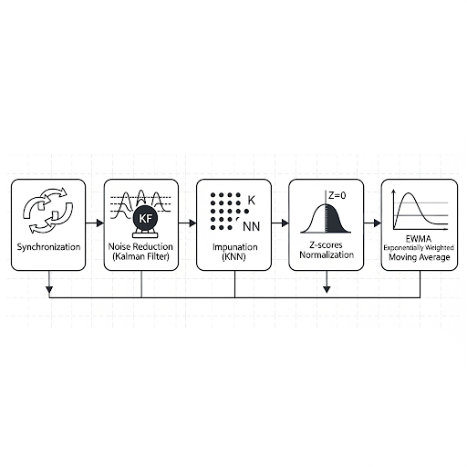
Methodology - Data Processing
  Synchronize sensor streams and resample at a consistent frequency.
  Implement noise reduction strategies using Matlab Kalman filters and/or median smoothing.
  Impute missing values using KNN-type latent based techniques.
  Normalize data against the patient’s baseline.
  Create sliding windows with extracted features, such as z-scores with EWMA interval trend indicators and rate-of-change indicators

Slide 12
Methodology - Model / Method Selection
  Model: A lightweight 1D-CNN + LSTM capable of running on edge devices (e.g., Raspberry Pi) with inference latency less than 100 ms.
  Personalization: Patient-specific alerts through adaptive dynamic thresholding of z-scores and EWMA values.
  Anomaly Detection: When data and labels permit, an autoencoder will provide non-discriminatory anomaly detection.
  Robustness: Utilize federated learning and XGBoost to create ensembles, enhancing robustness across institutional strategies and making the system "anti-fragile".
  Explainable Alerts: Alerts will include an additional level of explanation via clinical usage by generating explainable alerts through SHAP

Slide 13
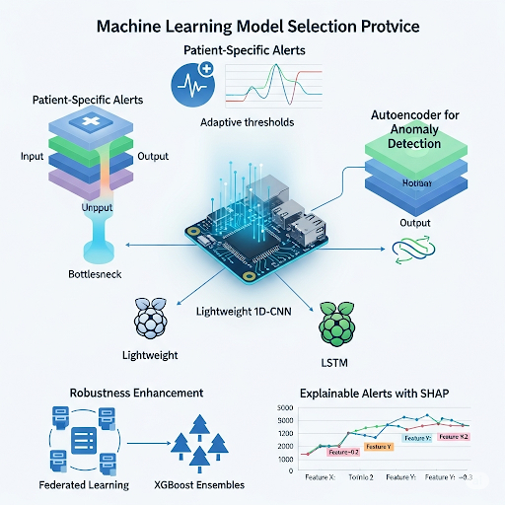
Methodology - Model / Method Selection

Slide 14
Methodology - Testing and Evaluation
The system will be evaluated based on the following metrics:
  Prediction Performance: AUROC (Area Under the Receiver Operating Characteristic) and AUPRC (Area Under the Precision-Recall Curve).
  False Alarms: Measured per patient-day.
  Time-to-Event Lead Times.
  Latency: Measured on edge devices to ensure real-time feasibility (<100ms).
  Ablation Studies: Compare static thresholds, dynamic thresholds, and hybrid AI models.
  Robustness: Assessment on noisy and missing data.
  Clinician Feedback: Surveys to evaluate usefulness and interpretability of alerts

Slide 15
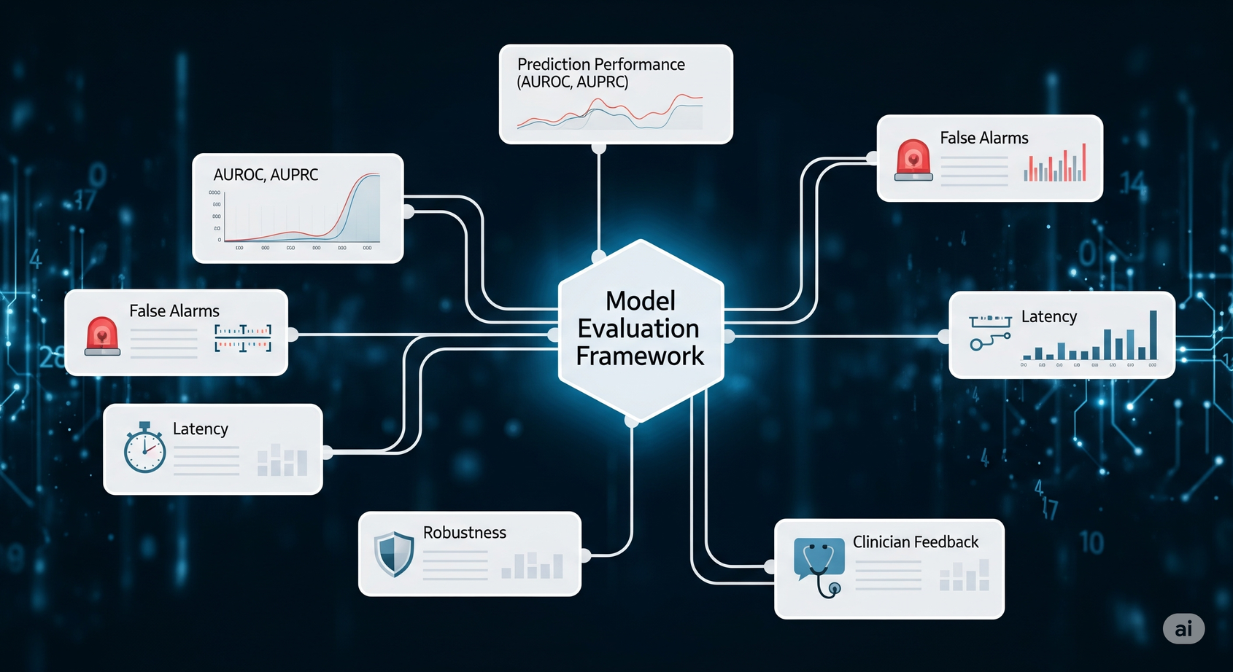
Methodology - Testing and Evaluation

Slide 16
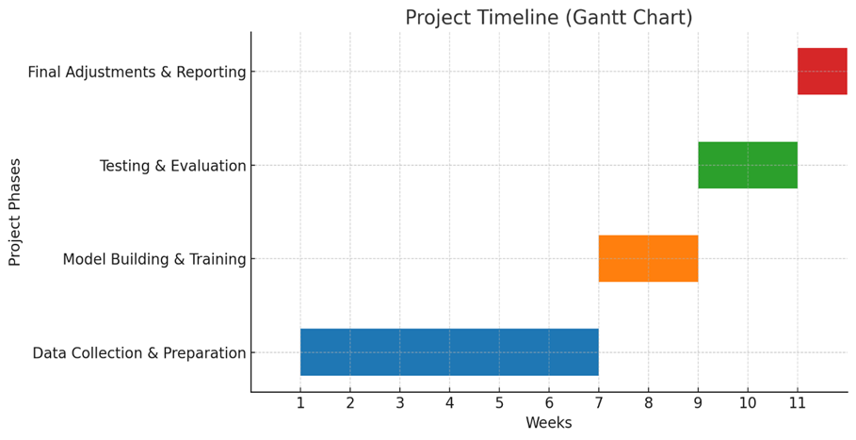
Project Timeline
  Weeks 1–6: Data Collection and Preparation
  Weeks 7–8: Model Building and Training
  Weeks 9–10: Testing and Evaluation
  Week 11: Final Adjustments and Reporting

Slide 17
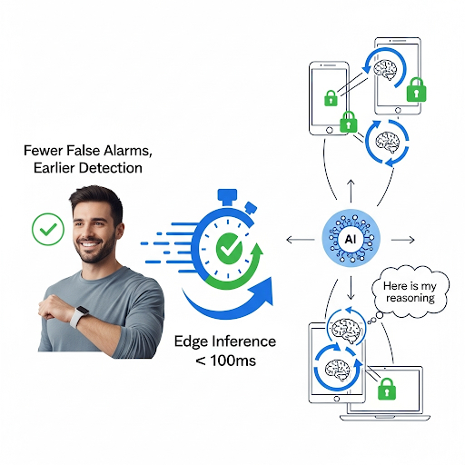
Expected Results
This project is expected to deliver an adaptive, privacy-preserving IoT monitoring framework with the following key outcomes:
  Improved Patient Outcomes: Diabetic patients will experience fewer false alarms and earlier detection of health deterioration.
  Operational Efficiency: Edge inference under 100 ms will ensure real-time usability.
  Trust and Privacy: Explainable outputs and federated training will enable clinical use of Protected Health Information (PHI) without centralizing its storage

Slide 18
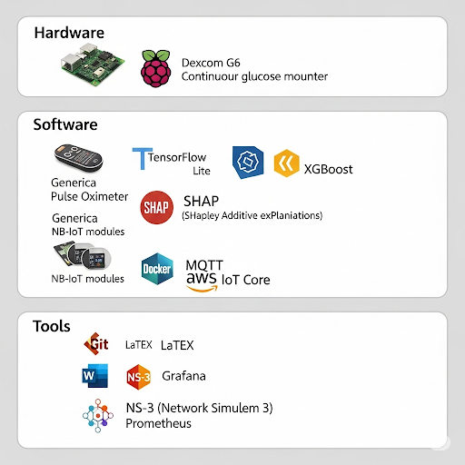
Resources Needed
  Hardware: Raspberry Pi, Dexcom G6, pulse oximeters, NB-IoT modules.
  Software: TensorFlow Lite, XGBoost, SHAP, MQTT, Docker, AWS IoT Core.
  Tools: Git, LaTeX/Word, Grafana, NS-3, Prometheus.

Slide 19

Conclusion
  AI-enabled IoT has the potential to transform chronic disease monitoring.
  The project creates a dynamic, reliable, and explainable framework.
  Expected outcome: safer, more effective care for diabetic patients during pandemics and beyond.

Slide 20

Thank You
August, 2025

