Slide 1



ORG 123 Organizational
Behavior
Lecture 6
Prepared by
Dr. Walid K. El Leithy
www.midocean.ae

Slide 2
Communication
After studying this chapter, you should be able to:
  1. Identify the main functions of communication.
  2. Describe the communication process and
  3. distinguish between formal and informal communication.
  4. Contrast downward, upward, and lateral communication with examples.
  5. Contrast oral, written, and nonverbal communication.
  6.Compare and contrast formal communication networks and the grapevine.

Slide 3
Communication
  7. Analyze the advantages and challenges of electronic communication.
  8. Show how channel richness underlies the choice of communication channel.
  9. Identify common barriers to effective communication.

Slide 4
Functions of Communication
Communication
  The transference and understanding of meaning
Communication Functions
  Foster motivation and stimulate members to perform.
  Provide a release for emotional expression
  Provide information needed to make decisions
  Sort of control

Slide 5
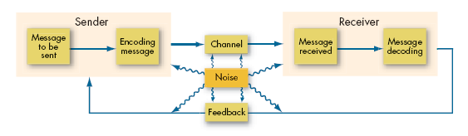
The Communication Process
Communication Process
  The steps between a source and a receiver that result in the transference and understanding of meaning.

Slide 6
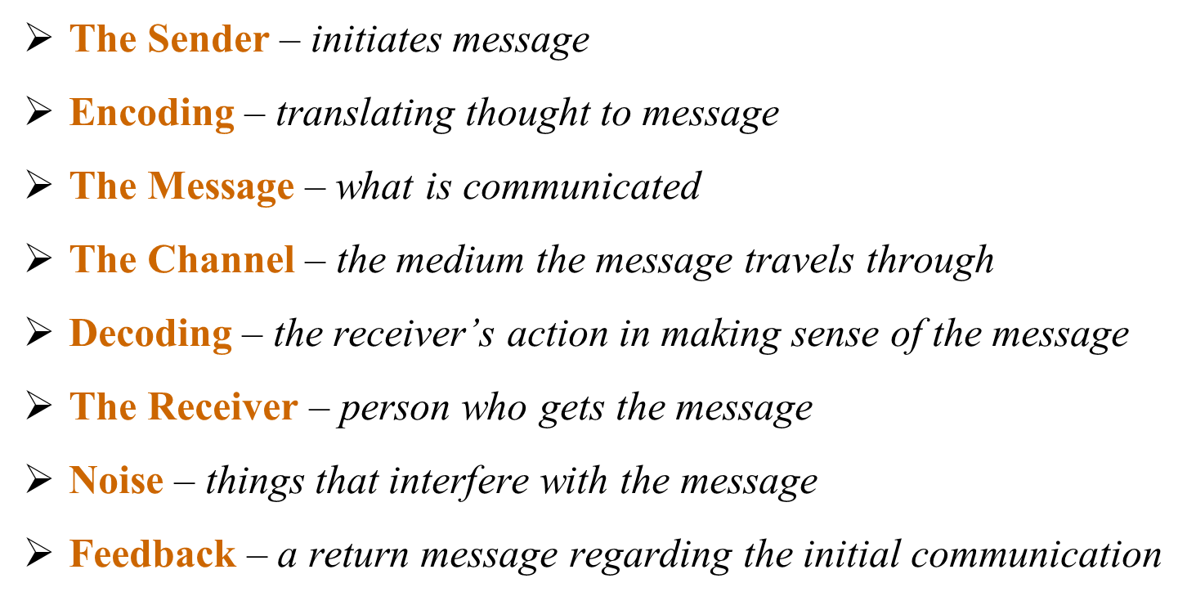
Key Parts of Communication Process

Slide 7
Communication Channels
Channel
  The medium selected by the sender through which the message travels to the receiver
Types of Channels
  Formal Channels
    Are established by the organization and transmit messages that are related to the professional activities of members
  Informal Channels
    Used to transmit personal or social messages in the organization. These informal channels are spontaneous and emerge as a response to individual choices

Slide 8
Direction of Communication
CEO
VP
Mgr
Mgr
VP
Mgr
Mgr
UPWARD
DOWNWARD
LATERAL

Slide 9
Interpersonal Communication
Oral Communication
  Advantages: Speed and feedback
  Disadvantage: Distortion of the message
Written Communication
  Advantages: Tangible and verifiable
  Disadvantages: Time-consuming and lacks feedback
Nonverbal Communication
  Advantages: Supports other communications and provides observable expression of emotions and feelings
  Disadvantage: Misperception of body language or gestures can influence receiver’s interpretation of message

Slide 10
Non -Verbal Communication
Body Movement
  Unconscious motions that provide meaning
  Shows extent of interest in another and relative perceived status differences
Intonations and Voice Emphasis
  The way something is said can change meaning
Facial Expressions
  Show emotion
Physical Distance between Sender and Receiver
  Depends on cultural norms
  Can express interest or status

Slide 11
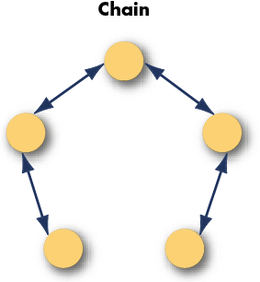
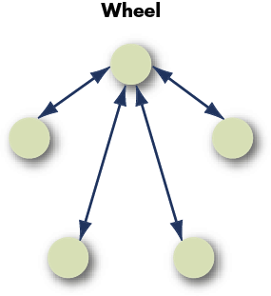
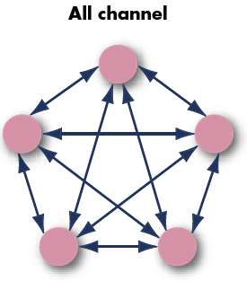
Three Common Formal Organizations Small- Group Networks
Chain:
  Rigidly follows the chain of command
Wheel:
  Relies on a central figure to act as the conduit (a pipe or tube through which something such as water or wire) passes for all communication
  Team with a strong leader
All Channel:
  All group members communicate actively with each other
  Self-managed teams

Slide 12
The Grapevine as an informal way of Communication
Within a business, there are two types of internal communication, formal and informal. Formal communication spreads through newsletters, manuals, emails, memos, staff meetings, conferences and official notices (chain-wheel-all channel). Informal communication occurs through the grapevine, which is generally word-of-mouth communication

Slide 13
The Grapevine
Three Main Grapevine Characteristics
  Informal, not controlled by management
  Perceived by most employees as being more believable and reliable than formal communications
  Largely used to serve the self-interests of those who use it
Results from:
  Desire for information about important situations
  Ambiguous conditions
  Conditions that cause anxiety
Insightful to managers
Serves employee’s social needs

Slide 14
Reducing Rumors
Announce timetables for making important decisions
Explain decisions and behaviors that may appear inconsistent or secretive
Emphasize the downside, as well as the upside, of current decisions and future plans

Slide 15
Barriers to Effective Communication
Filtering
Filtering is the distortion or withholding of information to manage a person’s reactions. An example of filtering include a manager’s keeping a division’s negative sales figures from a superior.
filtering prevents members of an organization from getting the complete picture of a situation.
filtering can lead to miscommunications in business. Listeners translate messages into their own words, each creating a unique version of what was said (Alessandra, 1993).

Slide 16
Selective Perception
refers to filtering what we see and hear to suit our own needs.
This process is often unconscious. we pick and choose according to our own needs.
Selective perception is a time-saver, a necessary tool in a complex culture. But it can also lead to mistakes.
For example, the boss asked his assistant to order more toner cartridges .Since the assistant found the to-do list from his boss to be unreasonably demanding, he assumed the request could wait. The boss, assuming

Slide 17
Information Overload
Messages reach us in countless ways every day.
Adding these together and it’s easy to see how we may be receiving more information than we can take in.
This state of imbalance is known as information overload, which occurs “when the information processing demands on an individual’s time to perform interactions exceed the capacity of time available for such processing” .

Slide 18
Emotional Disconnection
An effective communication requires a sender and a receiver who are open to speaking and listening to one another, despite possible differences in opinion or personality.
One or both parties may have to put their emotions aside to achieve the goal of communicating clearly.
A receiver who is emotionally upset tends to ignore or distort what the sender is saying.
A sender who is emotionally upset may be unable to present ideas or feelings effectively.

Slide 19
Language
Communicated message must be understandable to the receiver. Words mean different things to different people. Language reflects not only the personality of the individual but also the culture of society in which the individual is living.
Age, education and cultural background are three of the more obvious variables that influence the language a person uses and the definitions he or she gives to words. Therefore, use simple, direct, declarative language.

Slide 20
Foundation of Organizational Structure
After studying this chapter, you should be able to:
  Identify the six elements of an organization’s structure.
  Identify the characteristics of a bureaucracy.
  Describe a matrix organization.
  Identify the characteristics of a virtual organization.
  Show why managers want to create boundaryless organizations.

Slide 21
Foundation of Organizational Structure
  Demonstrate how organizational structures differ, and contrast mechanistic and organic structural models.
  Analyze the behavioral implications of different organizational designs.
  Show how globalization affects organizational structure.

Slide 22
What is Organizational Structure?
Organizational Structure
How job tasks are formally divided, grouped, and coordinated, managers need to address six key elements when they design their organization’s structure:
  Key Elements in Organizational Structure :
    Work specialization
    Departmentalization
    Chain of command
    Span of control
    Centralization and decentralization
    Formlization

Slide 23
Work Specialization
The degree to which tasks in the organization are subdivided into separate jobs
Division of Labor
  Makes efficient use of employee skills
  Increases employee skills through repetition
  Specialized training is more efficient
  Allows use of specialized equipment

Slide 24
Departmentalization
The basis by which jobs are grouped together
Grouping Activities by:
Functional departmentalization - Grouping activities by functions performed. Activities can be grouped according to function (work being done) to pursue economies of scale by placing employees with shared skills and knowledge into departments for example human resources, IT, accounting, manufacturing, logistics, and engineering.

Slide 25
Departmentalization
Product departmentalization - Grouping activities by product line. Tasks can also be grouped according to a specific product or service, thus placing all activities related to the product or the service under one manager.
Customer departmentalization - Grouping activities on the basis of common customers or types of customers. Jobs may be grouped according to the type of customer served by the organization.

Slide 26
Departmentalization
Geographic departmentalization - Grouping activities on the basis of territory. If an organization's customers are geographically dispersed, it can group jobs based on geography.
Divisional departmentalization - When the firm develops independent lines of business that operate as separate companies, all contributing to the corporation profitability.

Slide 27
Chain of Command
Authority
  The rights inherent in a managerial position to give orders and to expect the orders to be obeyed
Chain of Command
  The unbroken line of authority that extends from the top of the organization to the lowest level and clarifies who reports to whom
Unity of Command
  A subordinate should have only one superior to whom he or she is directly responsible

Slide 28
Span of Control
The number of subordinates a manager can efficiently and effectively direct
Wider spans of management increase organizational efficiency and leads to :
Faster decision-making due to fewer levels of approvals required for a specific decision, which allows the company to respond more quickly to business issues.

Slide 29
Span of Control
Better and more frequent communication between higher-level managers and staffers, so the staff is more knowledgeable about company goals and the higher-level managers are more knowledgeable about daily operational issues faced by staff.
Reduced costs relative to a taller organization, since there are fewer management layers needing compensation.

Slide 30
Span of Control
  Narrow span drawbacks:
    Expense of additional layers of management
    Increased complexity of vertical communication
    Encouragement of overly tight supervision and discouragement of employee autonomy

Slide 31
Centralization and Decentralization
Centralization
  The degree to which decision making is concentrated at a single point in the organization.
Decentralization
  The degree to which decision making is spread throughout the organization

Slide 32
Formalization
Formalization refers to the degree to which jobs within the organization are standardized.
Formalization in organizational structure is a process in which managers specify (in writing), procedures, rules and responsibilities for the individual employees, organizational units, groups, teams and the organization as a whole, which leads to the development of processes, relationships, and operating procedures.
Employees can be expected always to handle the same input in exactly the same way, resulting in a consistent and uniform output. There are explicit job descriptions, lots of organizational rules, and clearly defined procedures covering work processes in organizations in which there is high formalization.

Slide 33
Formalization
  Where formalization is low, job behaviors are relatively unprogrammed, and employees have a great deal of freedom to exercise discretion in their work. Standardization not only eliminates the possibility of employees engaging in alternative behaviors, but it even removes the need for employees to consider alternatives.

Slide 34
Common Organization Designs: Function Structure
Functional Structure
A functional organizational structure is a structure that consists of activities such as coordination, supervision and task allocation. The organizational structure determines how the organization performs or operates. The term organizational structure refers to how the people in an organization are grouped and to whom they report.

Slide 35
Common Organization Designs: Function Structure
Functional Structure
One traditional way of organizing people is by function. Some common functions within an organization include production, marketing, human resources, and accounting.

Slide 36
Common Organization Designs
Divisional Structure
The divisional structure or product structure consists of self-contained divisions. A division is a collection of functions which produce a product. It also utilizes a plan to compete and operate as a separate business or profit center.

Slide 37
Common Organization Designs: Function Structure
The matrix structure groups employees by both function and product. This structure can combine the best of both separate structures. A matrix organization frequently uses teams of employees to accomplish work, in order to take advantage of the strengths, as well as make up for the weaknesses, of functional and decentralized forms.

