Slide 1



DIGITAL MARKETING
APPLICATIONS
Prepared by Dr. HEBA ZIAD
COURSE CODE - MKT720
lecture 9

Slide 2
MARKETING COMMUNICATIONS USING DIGITAL MEDIA CHANNELS
Chapter at a glance
Main topics
What is SEO?
What does SEO stand for?
Benefits of SEO
Types of SEO
How does SEO work?
SEO ranking factors
On-page optimization
Off-page optimization
Technical SEO
SEO tools
SEO strategies and best practices
lecture 9
COURSE CODE - MKT720

Slide 3

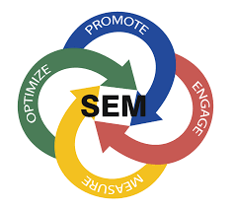

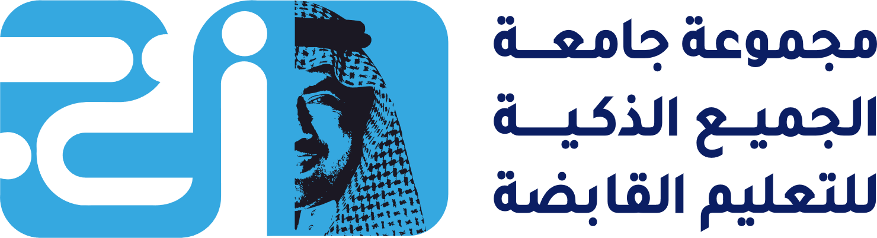
Search engine marketing (SEM) is a key technique for generating quality visitors to a web-site, We all now naturally turn to a search engine when we are seeking a new product, service or entertainment. The main options include Google, Bing, the Google-owned YouTube, which is the second-largest search engine by volumes of searches in many countries, or other regional search engines. We also turn to search engines when we are familiar with a brand, shortcutting site navigation by searching for a brand appending a brand name to a product or typing a URL into Google. This is known as navigational (or brand) search. Given the obvious importance of reaching an audience during their consideration process for a product or when they are locating a brand, search engine marketing (SEM) has become a fiercely competitive area of digital marketing
Search engine marketing (SEM)Promoting an organization through search engines to meet its objectives by delivering relevant content in the search listings for searchers and encouraging them to click through to a destination site.
Navigational (or brand)search Searchers use a search engine such as Google to find information deeper within a company site by appending a qualifier such as a product name to the brand or site name. Organizations need to check that relevant pages are available in the search results pages for these situations.

Slide 4
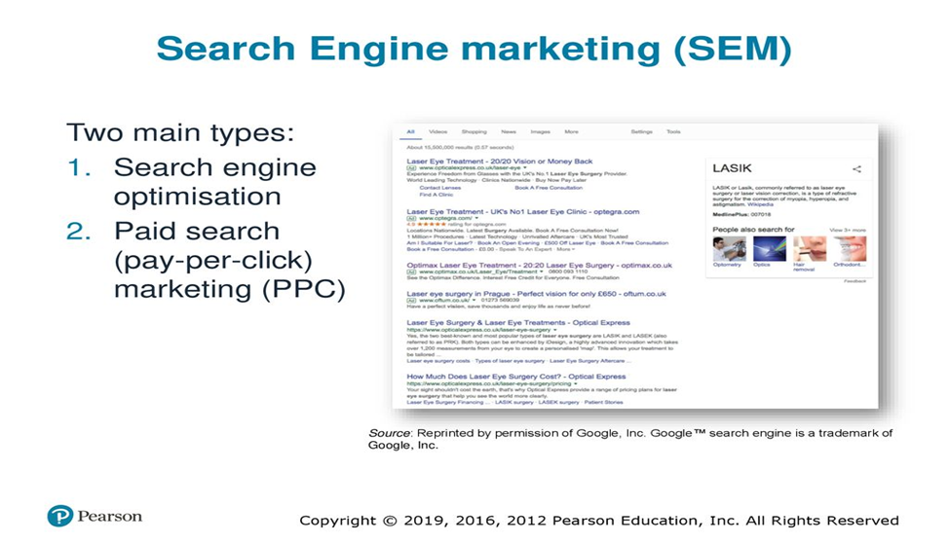
There are two main types of SEM that are quite distinct in the marketing activities needed to manage them, so we will study them separately, although in practice they should be integrated
Search engine optimization (SEO) involves achieving the highest position or ranking practical in the natural or organic listings, shown in Figure as the main body of the search engine results pages (SERPS) across a range of specific combinations of keywords entered by search engine users. You can see there are a limited number of organic search results (Organic search engine optimization (organic SEO) describes actions to improve your search engine rankings without paying for ads. paid search refers to text ads placed through a service like Google Ads, while organic search refers to the non-paid results that appear on a search engine result page (SERP).) compared to the four ads at the top of the SERPs. As well as listing pages that the search engine determines as relevant for the search performed based on the text it contains and other factors, such as links to the page, the SERPs also contain other tools that searchers may find useful.
Natural or organic listings The pages listing results from a search engine query, which are displayed in a sequence according to relevance of match between the keyword phrase typed into a search engine and a web page according to a ranking algorithm used by the search engine.
Search engine results pages (SERPS)The page(s) containing the results after a user types a key phrase into a search engine. SERPS contain both natural or organic listings and paid or sponsored listings.
What Is SERP Analysis? SERP analysis is the process of examining the top-ranking webpages in search engine results for a particular keyword to understand what makes those webpages rank higher and whether you can rank, too. With a SERP checker tool, SEO professionals can understand the opportunities and difficulties associated with targeting a certain keyword.

Slide 5
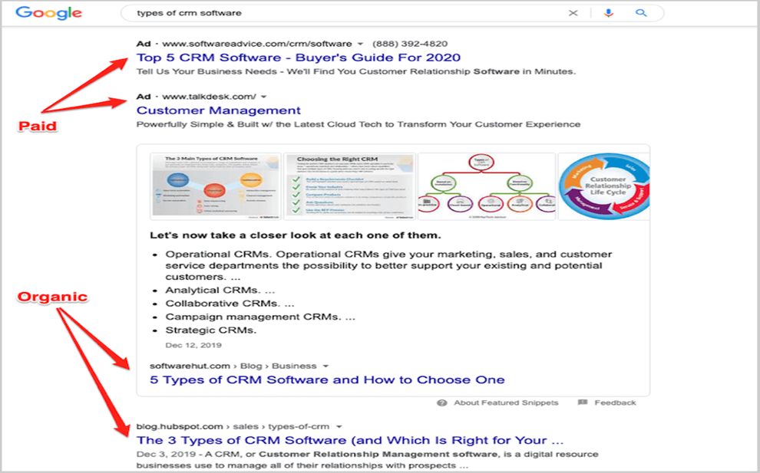
2. Paid search (pay-per-click) marketing (PPC) is similar to conventional advertising; here a relevant text ad with a link to a company page is displayed when the user of a search engine types in a specific phrase. A series of text ads usually labelled as 'sponsored links' are displayed above or to the right of the natural listings, Although many searchers prefer to click on the natural listings, a sufficient number do click on the paid listings (typically around a quarter or a third to a half of all clicks) such that they are: highly profitable for companies such as Google, and a well-designed paid-search campaign can drive a significant amount of business for companies.
There are also opportunities to create awareness and response from pay-per-click ads displayed on third-party sites, The importance of effective search engine marketing Figure 9.4, which shows that generating the highest rankings for a company in the search engine results pages (SERPs) can generate many more visits because of a higher click-through rate. Note that click-through rate according to position will vary dramatically by type of keyword such as brand or generic keyword,
Universal search The natural listings incorporate other relevant results from vertical searches related to a query, such as video, books, news, real-time social media recommendations, site links and images.
Paid search (pay-per-click) marketing (PPC)A relevant text ad with a link to a company page is displayed on the SERPs when the user of a search engine types in a specific phrase. A fee is charged for every click of each link, with the amount bid for the click mainly determining its position. Additionally, PPC may involve advertising through a display network of third-party sites (which may be on a CPC, CPM or CPA basis).

Slide 6
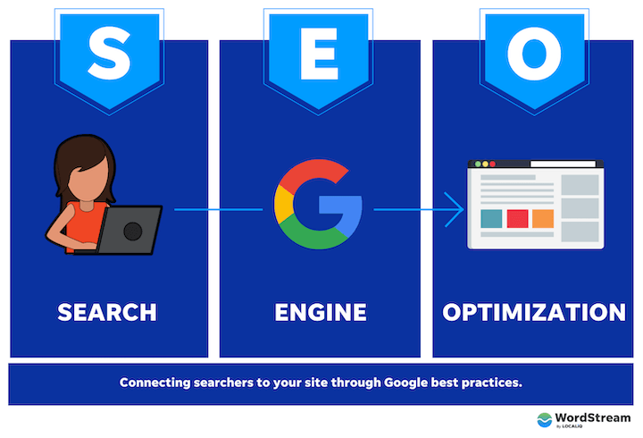
What does SEO stand for?
SEO stands for search engine optimization. Let’s break that down in the context of your website.
Search: What people do when they want to find an answer to a question or a product or service that meets their needs.
Search engine: A site (like Google or Bing) where a person can perform said search.
Search engine optimization: What you do to get said search engine to connect said search with your site.
What is SEO?
search engine optimization?
A formal definition of SEO:
Search engine optimization is a set of technical and content practices aimed at aligning a website page with a search engine’s ranking algorithm so it can be easily found, crawled, indexed, and surfaced in the SERP for relevant queries.
Robots or spiders are software processes, technically known as robots, employed by search engines to index web pages of registered sites on a regular basis. They follow or crawl links between pages and record the reference URL of a page for future analysis.
RPA stands for robotic process automation

Slide 7
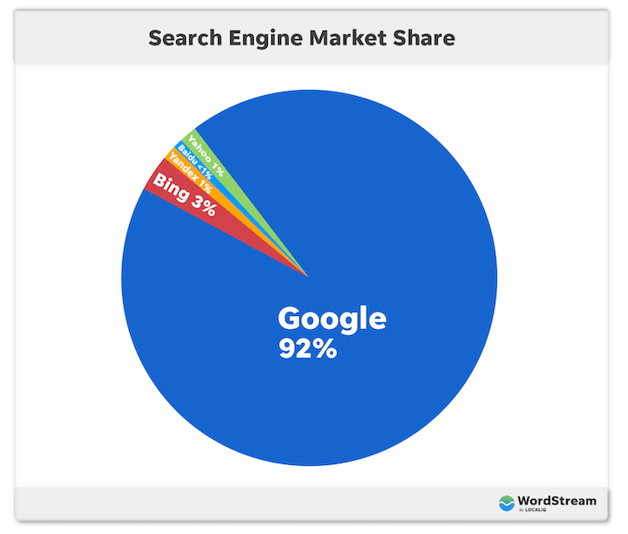
A simpler definition of SEO:
SEO is about making improvements to your website’s structure and content so its pages can be discovered by people searching for what you have to offer, through search engines.
The simplest definition of SEO:
SEO is what you do to rank higher on Google and get more traffic to your site.
Yes, Google is just one search engine of many. There’s Bing. Directory search engines. Even Instagram is a search engine. But capturing 92% of the market share,

Slide 8

WHAT IS SEO?
Improving positions in the natural listings is dependent on marketers understanding the process whereby search engines compile an index by sending out spiders or robots to crawl around sites that are registered with that search engine (Figure 9.5). The figure shows that the technology harnessed to create the natural listings involves these main processes:
Crawling. The purpose of the crawl is to identify relevant pages for indexing and assess whether they have changed. Crawling is performed by robots (bots) that are also known as spiders. These access web pages and retrieve a reference URL of the page for later analysis and indexing. Although the terms 'bot' and 'spider' give the impression of something physical visiting a site, the bots are simply software processes running on a search engine's server that request pages, follow the links contained on that page and create a series of page references with associated URLs. This is a recursive process, so each link followed will find additional links that then need to be crawled.
Crawling is the discovery process in which search engines send out a team of robots (known as crawlers or spiders) to find new and updated content.

Slide 9
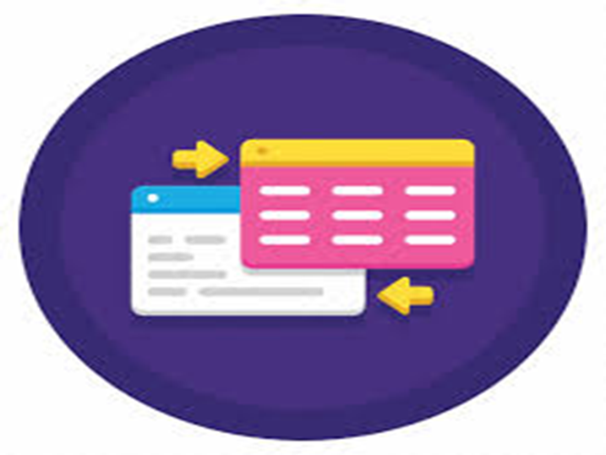
2. Indexing. An index is created to enable the search engine to rapidly find the most relevant pages containing the query typed by the searcher. Rather than searching each page for a query phrase, a search engine "inverts' the index to produce a lookup table of documents containing particular words. Marketers can use Google's Search Console (formerly Web. master Tools) to understand which pages are indexed and get recommendations about potential duplicate content. The index information consists of phases stored within a document and also other information characterizing a page such as the document's title, meta description, PageRank, trust or authority, spam rating, etc. For the keywords in the document, additional attributes will be stored such as semantic markup (<h1>, <h2> headings denoted within HTML), occurrence in link anchor text, proximity, frequency or density and position in document, etc. The words contained in link anchor text 'pointing' to a page are particularly important in determining search rankings.
Link anchor text The text used to form the blue underlined hyperlink viewed in a web browser defined in the HTML source.
Indexing is how search engines organize the information and the websites that they know about. Indexing is part of a normal search engine process –, content that is not in the index has no possibility of ranking for a search result.
The process of adding a webpage to an index is called indexing. It means Google analyzes the page and its content and adds it to a database of billions of pages (called the Google index).

Slide 10
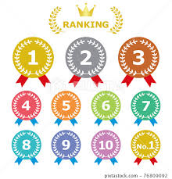
Ranking or scoring. The indexing process has produced a lookup of all the pages that contain particular words in a query, but they are not sorted in terms of relevance. Ranking of the document to assess the most relevant set of documents to return in the SERPs occurs in real time for the search query entered. First, relevant documents will be retrieved from a runtime version of the index at a particular data Centre, then a rank in the SERPs for each document will be computed based on parsing many ranking factors,
Query request and results serving. The familiar search engine interface accepts the searcher's query. The user's location is assessed through their IP address and the query is then passed to a relevant data Centre for processing. Ranking then occurs in real time for a particular query to return a sorted list of relevant documents and these are displayed on the search results page.
SEO Score is a measure of how well the user-facing and technical aspects of your site contribute to search engine optimization, and ultimately, higher rankings and organic traffic.
A search query or search term is the actual word or string of words that a search engine user types into the search box.

Slide 11
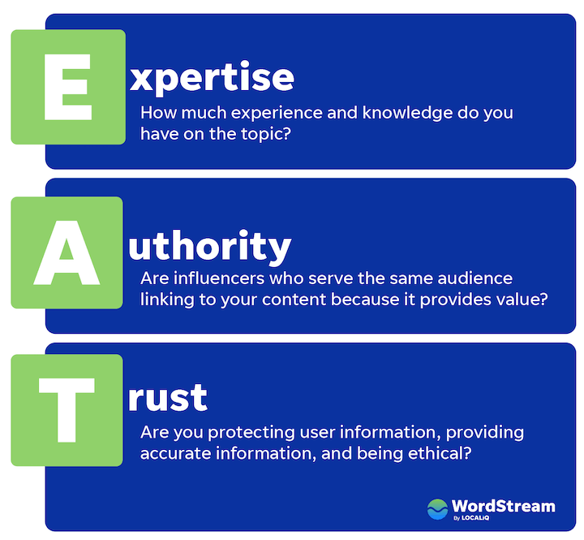
What are Google ranking factors?
SEO is the process of optimizing your website to rank as high as possible in organic search engine results (and yes, you can aim for the first page). When talking about search, we use the term “organic” to refer to search results that are unpaid. This is different from paid results, which come from PPC advertising.
Organic rankings on Google are determined by an algorithm that takes into account various characteristics and SEO metrics —and these are your ranking factors.
There are over 200 Google ranking factors, while ranking factors and algorithms may shift, the characteristics Google is trying to parse out through them are expertise, authority, and trust (E-A-T).
These include positive ranking factors that help boost position, and negative factors or filters that are used to remove search engine spam (also known as web spam) from the index where SEO companies have used unethical approaches such as automatically creating links to mislead the Google algorithms. The importance of ranking factors are much disputed by SEOs, since with so many factors it is difficult to isolate their impact to prove a correlation or, more importantly, a causative relationship between.

Slide 12
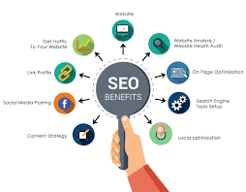
Benefits & importance of SEO
People are searching for any manner of things both loosely and directly related to your business. These are all opportunities to connect with these people, answer their questions, solve their problems, and become a trusted resource for them.
More website traffic: When your site is optimized for search engines, it gets more traffic which equates to increased brand awareness, as well as…
More customers: To get your site optimized, it has to target keywords—the terms your ideal customers/visitors are searching—meaning you’ll get more relevant traffic.
Better reputation: Ranking higher on Google builds instant credibility for your business. If Google trusts you, then people trust you.
Higher ROI: You put money into your website, and into the marketing campaigns that lead back to your website pages. A top-performing site improves the fruits of those campaigns, making your investment worth it.
So whether you want more brand awareness, online visibility, leads, sales, or loyal customers, SEO is your answer.

Slide 13
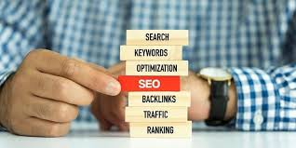
SEO is your chance to get in front of potential customers at any stage of their customer journey.
Types of SEO
Google and other search engines take several factors into account when ranking content, and as such SEO has many facets. The core three types of SEO are on-page, off-page, and technical SEO:
On-page SEO: Optimizing the quality and structure of the content on a page. Content quality, keywords, and HTML tags are the key players for on-page SEO.
Off-page SEO: Getting other sites, and other pages on your site to link to the page you are trying to optimize. Backlinks, internal linking, and reputation are your off-page MVPs.
Technical SEO: Improving your site’s overall performance on search engines. Site security (SSL certificates), UX, and structure are key here.
The above three types of SEO are used for websites and blogs, but they also apply to three subtypes of SEO:
Local SEO: Getting your business to rank as high as possible in Google Maps and on the local results of the SERP. Reviews, listings, and Google Business profile optimization are most important here.
Image SEO: A mix of on-page and technical strategies to get images on your website pages to rank in Google image search.
Video SEO: A mix of on-page, technical, and off-page strategies to get your videos to rank in YouTube or Google video results.
While all three subtypes require all three core types of SEO, they do vary in how heavily they rely on each core type.

Slide 14
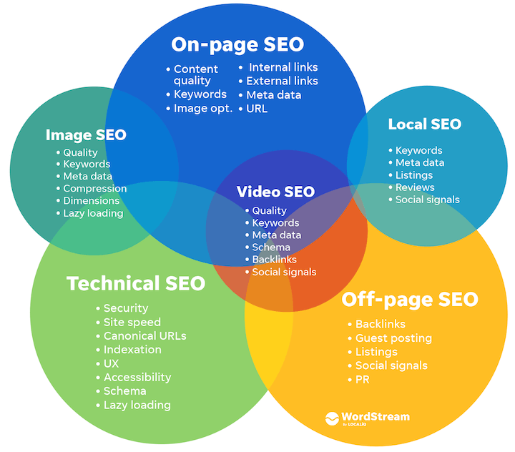
Image SEO relies heavily on technical and on-page optimizations while local SEO is more about off-page and on-page optimizations.

Slide 15
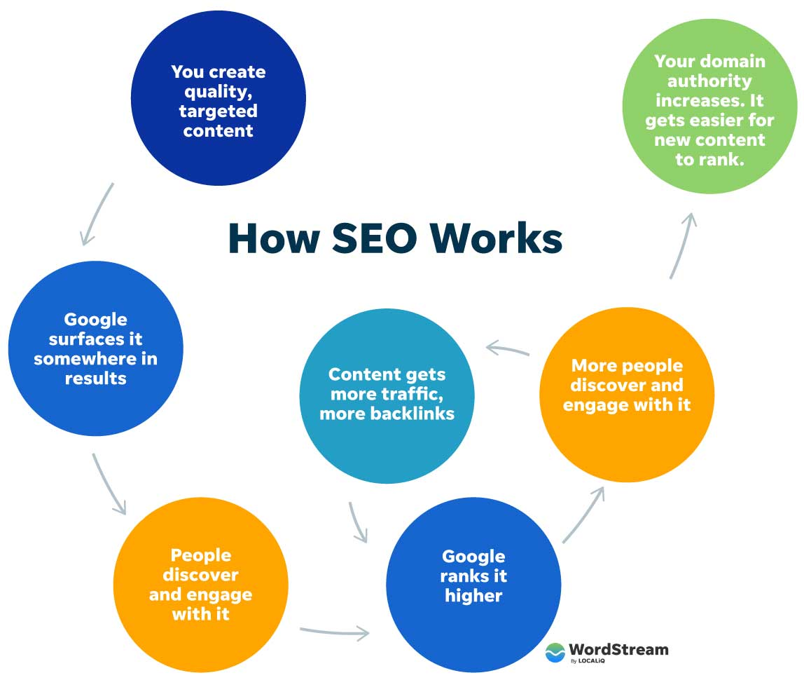
How does SEO work?
So how does Google determine which pages to surface in the search engine results page (SERP) for any given query? How does this translate into traffic to your website? Let’s take a look at how SEO works.
Google’s search crawlers constantly scan the web, gathering, categorizing, and storing the billions of web pages out there in its index. When you search for something and Google pulls up results, it’s pulling from its index, not the web itself.
Google uses a complex formula (called an algorithm) to order results based on a number of criteria (ranking factors—which we’ll get into next) including the quality of the content, its relevance to the search query, the website (domain) it belongs to, and more.
How people interact with results then further indicates to Google the needs that each page is (or isn’t) satisfying, which also gets factored into the algorithm.

Slide 16
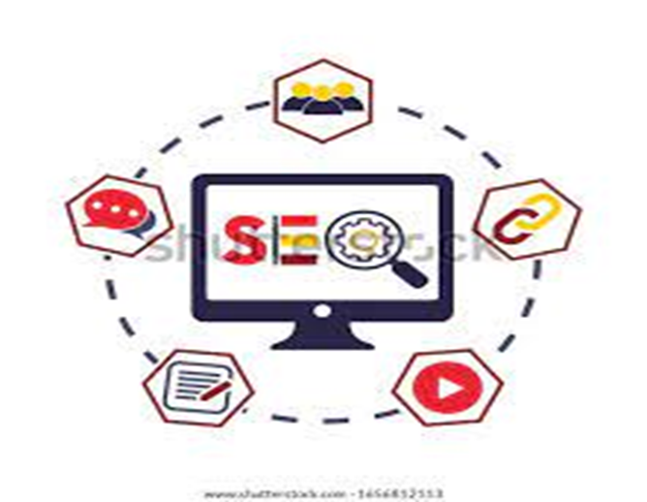
In other words, SEO works like a complex feedback system—to surface the most accurate, trustworthy, and relevant results for any given search using input from you, Google, and searchers. Your role is to produce content that satisfies Google’s expertise, authority, and trust requirements (E-A-T), which satisfy its searchers’ requirements.
How to do SEO: On-page optimization
Now it’s time to talk about how to actually do SEO—how to optimize your website for these factors so you can rank higher on Google and get more traffic. This requires a combination of on-page, off-page, and technical optimizations, so we’re going to organize the steps in that manner. Here are your on-page optimization steps:
Start with keyword research
Create quality content targeting those keywords
Place your keywords
Optimize your titles
Optimize your meta descriptions
Include and optimize images
Internal and external links

Slide 17
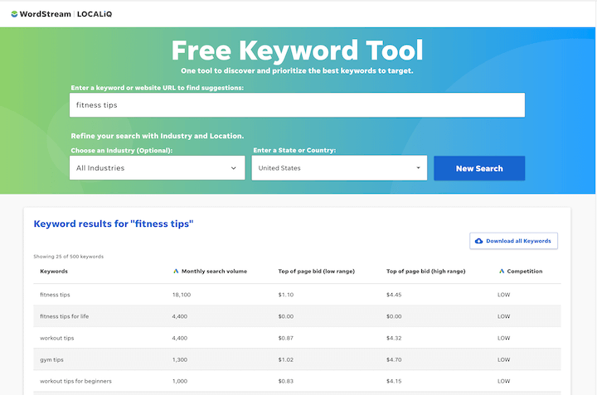
1. Start with SEO keyword research
The first step in search engine optimization is to determine what keywords you’re optimizing for. These are terms that your ideal website visitors are likely to type into Google or other search engines, and each page on your site should target a different keyword cluster so they don’t compete with each other.
How to do keyword research for SEO
These are your basic steps for finding the best keywords to target with your organic content:
Create your seed list: Start by listing out the words and phrases your ideal customers are typing into Google. Think about their interests, desires, pain points, and goals, and think in terms of the language they’re using, which may be different from what you (as the expert) use.
Plug them into a keyword research tool: Keyword research tools will give you data around these keywords so you can see which terms you can conceivably rank for and where the best opportunities actually lie. Metrics include:
Search volume: How many times that term is searched per month.
Competition: How difficult it is to rank for that keyword.

Slide 18
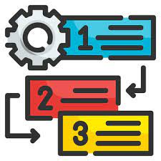
Sort and prioritize: Put the resulting terms and data into a spreadsheet. Now you can group them into core themes and also prioritize them. Ideally, you’ll want to target keywords with a high enough search volume to give you decent reach, but not so high that the keyword becomes too competitive to rank for. Better to show up on page one for a lower volume, lower competition keyword than to not rank at all for a high volume, high competition keyword.

Slide 19
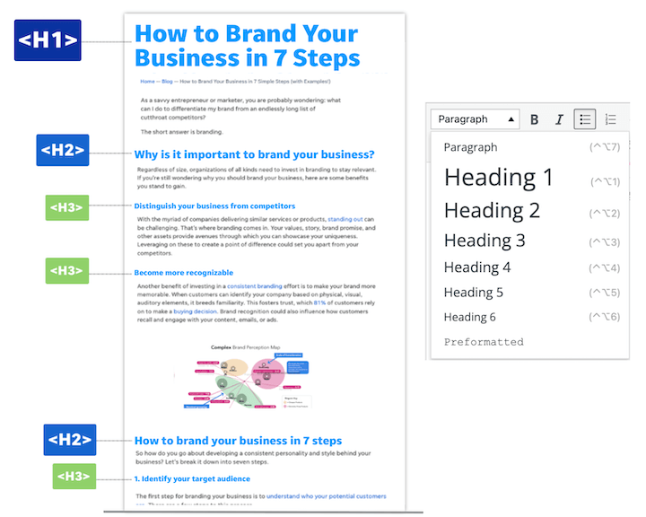
2. Create quality content targeting those keywords
Your main navigation pages (homepage, about us, contact, products, services) will target keywords, but the bulk of your keyword targeting will come from long-form content in the form of blog posts. Quality, SEO content is:
Aligned with the keyword’s intent: Make sure your content provides the information people are seeking when they search this keyword. This is why you should always search the keyword on Google first.
Provides a good experience: It’s free of overly aggressive pop-ups or CTAs or other distracting elements; uses images to depict concepts, and loads quickly and properly on all devices (more on this later in the technical SEO section).
Reads naturally: Don’t keyword-stuff. Write like a human being speaking to your audience; not a content writer trying to optimize for a search engine.
In-depth: Google isn’t interested in thin, duplicate, or low-value pages. This means 1,500-2,500 words of accurate, up-to-date, information.
Organized: Use your heading tags to indicate the hierarchy of information on the page.

Slide 20
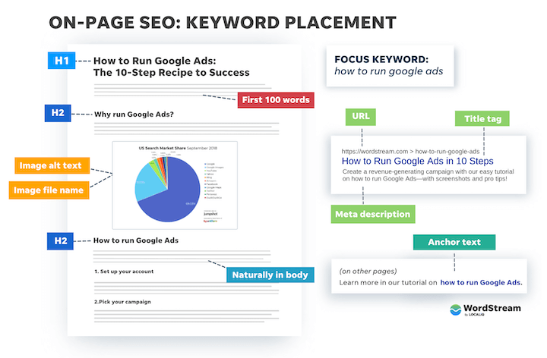
3. Place your keywords
In addition to naturally in the body of your content, you’ll want to place your keyword into specific spots on the page to indicate to Google what you’re looking to rank for. This includes:
SEO title (title tag)
Page title (H1 tag)
At least two H2 headings
Image alt text
Image file name
Naturally in the body
URL
Meta description

Slide 21
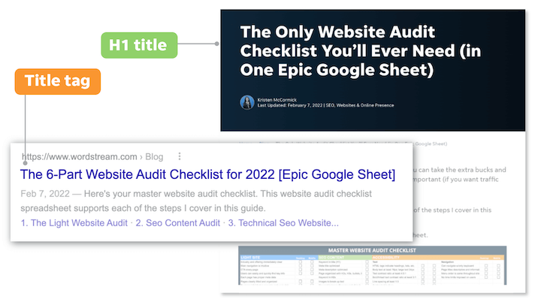
4. Optimize your titles
For any page on your website, you actually have two titles. The title tag is the title that appears on the SERP and is the single most impactful place you can put your keyword. The H1 tag is the title that appears on the page when you click into it. Whether or not these are the same depends on the page.
To optimize your titles, be sure to:
Include the keyword: If you can do it in a natural and compelling way, add some related modifiers around that term as well.
Have only one H1 per page: This should be your main headline, and H2s should be used to label your main sections.
Keep title tags to 55-60 characters: How much Google will show varies (it’s based on pixels, not character counts), so frontload with the keyword.
Indicate value: What does a user get out of the page? This influences whether they click on it in the SERP or on your site, and whether they keep reading.

Slide 22
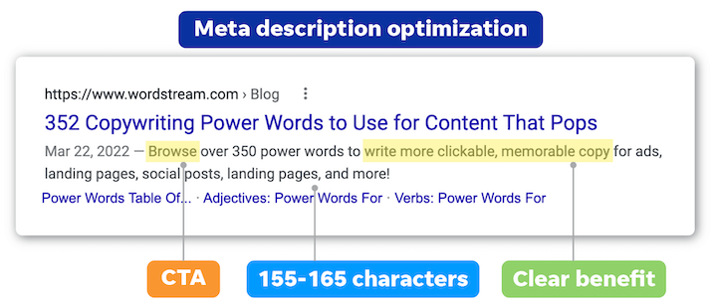
Optimize your meta descriptions
The meta description is the description that appears on the SERP below the title tag. Google doesn’t always show the one you’ve provided in the SERP; it likes to build its own based on the query, but it’s still important to optimize for SEO. Google reads this description when crawling the page to understand what it’s about.
To optimize your meta description:
Include the keyword and related keywords if you can do so in a natural and compelling way.
Keep it short: Ideal meta description length is 155-165 characters.
Make it compelling: Remember, showing up in search results is just the first step! You still need to get searchers to click. Include a concise description, a clear benefit, and a call to action, like ad copy!
A meta description (sometimes called a meta description attribute or tag) is an HTML element that describes and summarizes the contents of your page for the benefit of users and search engines.
A meta description is a webpage summary that can show in search engine results. Meta descriptions should let users know what they’ll find on the page and encourage them to click through (rather than click another result).
Google often (but doesn’t always) displays a page’s meta description below its URL and title.

Slide 23
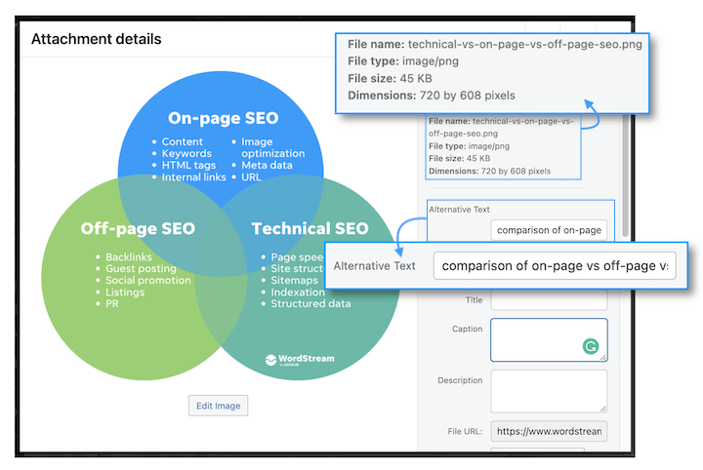
Image optimization (Include and optimize images)
Images are a key player in SEO optimization. They keep users engaged with your pages, enhance the quality of the information, and provide opportunities for you to rank and generate traffic to their host pages through image results. Plus, Google has increasingly been making the SERP more visual—especially on mobile. Here’s how to optimize your images for SEO:
Assign alt text: This is the text alternative of an image, and the only way that Google can “see” them. Be short but descriptive and include the keyword. This also makes your website accessible to visually-impaired readers who rely on screen readers to browse the internet, and will show if the image fails to load.
Compress and resize: Use an image compressor to keep your image file sizes to 70-100KB or less if you can. Often, saving as JPG instead of PNG helps. Also, images rarely need to be more than 1,000px wide. Though a responsive website will resize the images automatically, the less requests your site needs to make to the server, the better for page speed.
Add value: If you can, avoid using empty stock images and graphics in your blog posts and instead use screenshots, examples, charts, and illustrations that depict concepts. This improves the quality of the content and keeps users engaged longer.
Include the keyword: Not just in the alt text, but the file name. And replace spaces with dashes in the file name, otherwise your CMS will replace them with “%20” which creates an untrustworthy-looking image link.

Slide 24

7. Internal and external links
What Is an External Link?
An external link is a hyperlink on a domain that points to another domain.
External links are valuable for the receiving domain’s SEO because Google and other major search engines see them as votes of confidence in the linked webpage. And each vote suggests the content on that page is credible, valuable, and useful.
Which means:
Pages with lots of external links pointing to them (also called backlinks) from authoritative sites tend to rank higher in search results.
Tip: You can quickly see how many external links point to your site by running it through Backlink Analytics.
Internal vs. External Links
Internal links are the opposite of external links. They’re hyperlinks that point to another page on the same website.
External link building proactive approach to gain quality links from third-party sites. It can be considered to be an element of online PR since it involves getting your brand visible on third-party sites and creating backlinks related to your site.
Internal link architecture Structuring and labelling links within a site's navigation to improve the results of SEO.

Slide 25
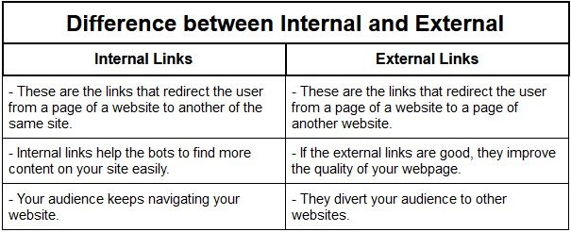

Internal and external links
But leveraging both types of links is important for your own SEO.
Using external links helps:
Show Google how your content relates to other pages
Provide value to your readers by offering more information and resources
Build relationships with other sites, which can lead to exposure, traffic, and backlinks
Using internal links helps:
Improve the user experience and navigation on your site
Spread link equity (ranking power) among your pages
Boost the relevance and authority of your pages for specific keywords
Are External Links Good for SEO?
Using external links (or outbound links) on your site can help your SEO in two big ways:
First, they provide value to users—which improves the user experience. And a better UX can contribute to better rankings in various ways.
Second, they may help search engines understand your topic and niche.
When you link to sites that are related to your content, you’re giving more context about what your site is about. And how it fits into your industry’s big picture.

Slide 26
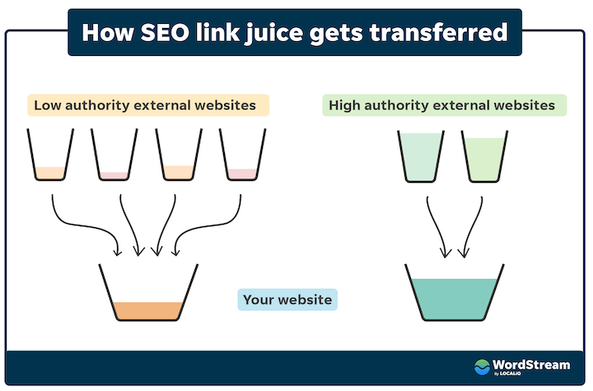
How to do SEO: Off-page optimization
Off-page SEO, is what you do on other pages of your website, other websites, and even other platforms to help your page to rank. Here are some off-page SEO tactics
Backlinks
Earn and reach out for backlinks
Backlinks, or links to your site from other websites, are the third most important Google ranking factor. Backlinks from higher credibility sites are, of course, more valuable than those from lower credibility sites. The more high-quality backlinks you have, the higher you’ll rank.
A backlink is a link to your page that comes from another website. A page with a lot of links pointing back to it indicates to Google that the particular page is providing exceptional value, and is coming from a credible website. But one link from one quality domain is much better than multiple links from several low-authority websites.
Backlink Hyperlink that links to a particular web page (or website). Also known as an inbound link. Google PageRank and Yahoo! Web Rank are methods of enumerating this.

Slide 27
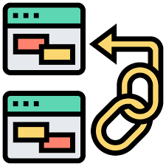
So how do you get backlinks? Here are four link-building strategies.
Original, quality content: If your content is high-quality, unique, and provides value to your audience, it will generate backlinks on its own. Go for the irreplaceable content like thought leadership content and original data-driven pieces.
Cold outreach: It takes years to build this kind of authority, so you’ll also want to build backlinks by finding related content and pitching your pieces to the author for a link.
Guest posts: Another method for building backlinks is by guest blogging. Rather than just asking for a link, offer to write a post for that site. You can include a backlink to your site in the post or in your author bio. How does off page optimization benefits in SEO?
Off page optimization is defined as the technique which helps the website to improve its ranking on the search engine results page. These factors functions outside the boundaries of the web pages. These ranking factors are not directly controlled by the publisher. Off-page optimization basically deals in link building for SEO.
Off page SEO is a long term and time consuming process. It includes acquiring backlinks to your webpage from the authority sites, Social media and Social bookmarking. Off page factors work in the background to improve the search rankings.

Slide 28

Share your content on social media
In addition to linking to your homepage in social media profiles, you should also be regularly sharing your blog posts with your feed. This earns you referral traffic, and the more eyes on a post, the higher the chances of generating backlinks. Social media itself isn’t a direct google ranking factor, but your activity on the platforms and users’ engagement with your content there send social signals to Google that influence your ranking.
Build your brand reputation
When determining how high to rank a particular page on your site, Google doesn’t just look at that one page. It takes into account your brand as a whole, which it does so by looking at other information about it across the web—including reviews, ratings, listings, awards, and even unlinked brand mentions. As such, building your brand reputation by optimizing your listings, gaining positive press, and asking for reviews is essential for SEO. Much of this falls under the realm of local SEO but there are plenty of brand- building strategies that apply to non-brick-and-mortar businesses too.

Slide 29


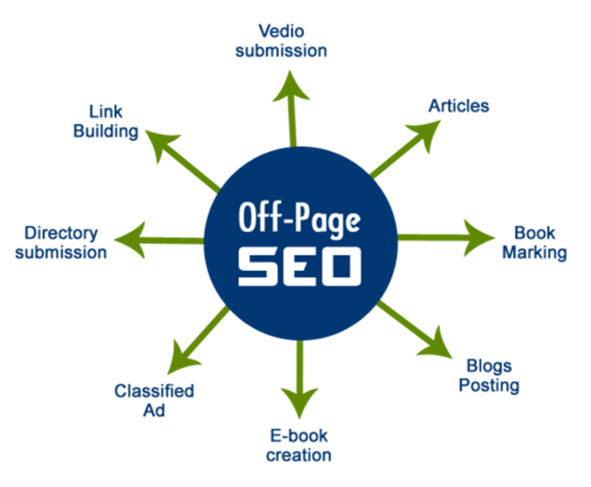
The benefits of off page optimization are:
More rankings - By using the techniques of “off page” optimization, a successful strategy will help increase your website rankings in the SERPs. This will help you attract more traffic.
More exposure - The best part about SEO is when you start ranking higher on SERPs, you get more exposure, i.e. more clicks, more visits, more links and more mentions on social media. This is a chain of events which takes place one after another.
Better PageRank - PageRank is a concept introduced by Larry page which talks about importance of a website in the eyes of Google. The concept is about ranking the web pages between 1 to 10. The higher the rank, the better is the website in the eye of Google.

Slide 30
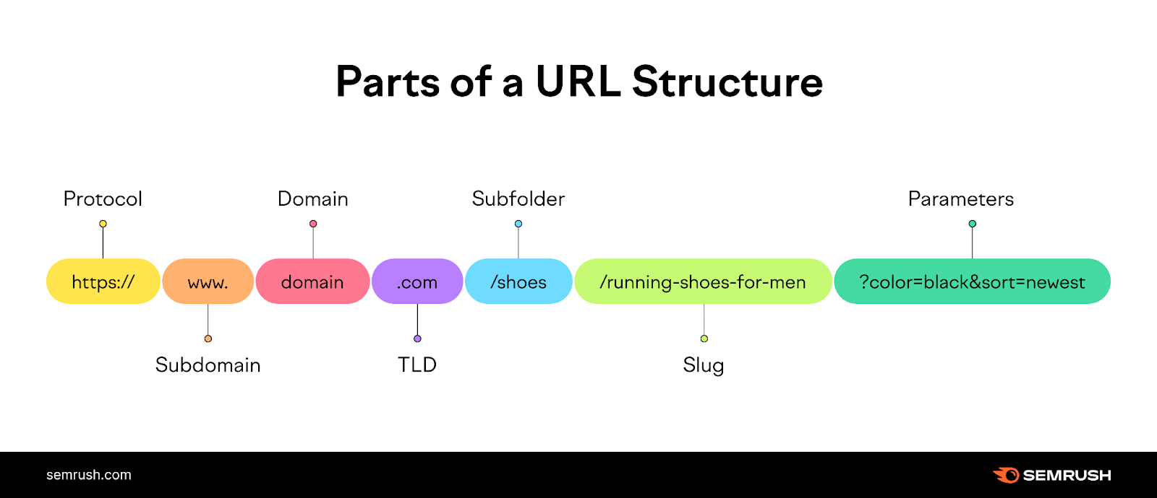
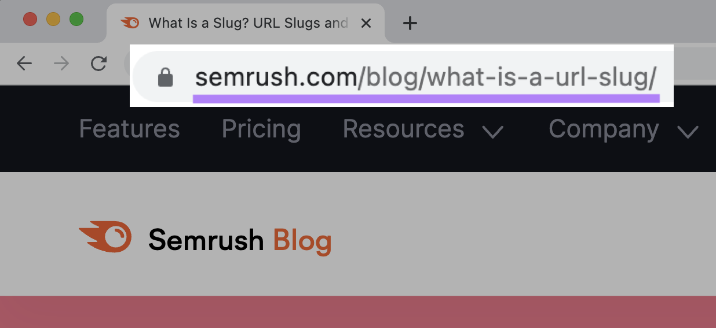
How to do SEO: Technical optimizations
Technical SEO optimizations are done on the back end of your website to make sure it meets Google’s site security and user experience requirements, as well as to make it as easy as possible for Google to do its job on your site.
Since it involves knowledge of website structure and content management systems, technical SEO is commonly a joint effort between marketing and development teams. But although this may seem complicated, once your website is in good working order, there’s not a lot of ongoing maintenance required in terms of SEO.
Here are some of the main technical optimizations to take care of:
URL structure: An organized site structure, such as by using /blog, /landing page, /product buckets, makes it easier for Google to crawl your site, for users to navigate it, and for you to segment data in reports. URLs are important. Because they help users access the webpage they want to view.
Plus, if you’re doing SEO, they can help you set up your website for SEO success by providing information to search engines about the content and purpose of a webpage.
So they can rank it appropriately.
A URL (Uniform Resource Locator) is the web address of an internet resource, like a webpage.
You can see the URL of the webpage you’re on in the address bar at the top of your browser’s window.

Slide 31
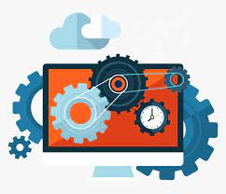
Website architecture
search engines work by crawling and indexing different pieces of content on your website. Internal links refer to any hyperlink that points to another page on your same website. The more organized and tightly-knit your internal linking structure is, the more points of access you create to any given page, and the easier it is for search engines (and users) to find what they’re looking for.
Ideally, any given page on your site should be accessible in three clicks or less. To do this, you must be mindful of what pages you’re linking to each time you create a new page or a new piece of content.
It makes it so that search engines can easily understand and index the content. Topic clusters are also beneficial from a user experience perspective. It makes your content easier to navigate and readers will realize that they don’t have to go to multiple sites to find what they’re looking for.
It’s likely that your website already undergoes regular maintenance to check for things like bugs or server errors. For SEO purposes, it’s a good idea to do a technical SEO audit of your site every couple of months to check for things such as 404 errors, redirect loops, and broken links.
Site architecture: Ideally, a user should be able to access any page on your site in three clicks or less. Internal linking is key here.

Slide 32
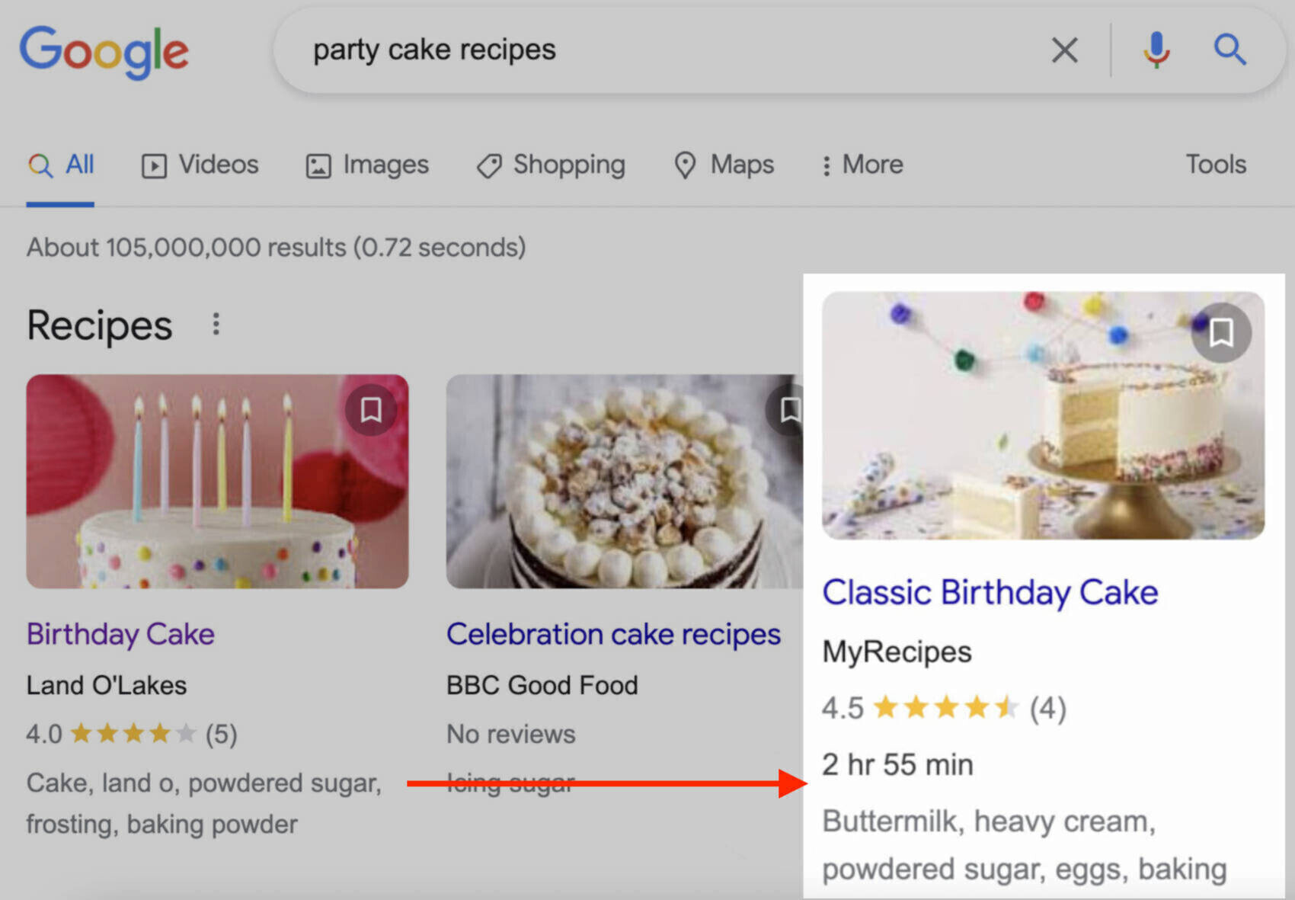
Canonical URLs: A canonical URL is the URL that you want to represent a set of duplicate pages. Google will do its best to identify the canonical URL for any given set of duplicates, but you can also indicate this to Google through canonical tags or redirects. For example,
http://wordstream.com
http://wordstream.com/
https://wordstream.com
https://wordstream.com/
https://www.wordstream.com/
All redirecting to this one canonical URL:
https://www.wordstream.com
Crawlability/ index ability: Your sitemap and robots.txt together tell Google what you do and don’t want Google to crawl and index.
Without first being crawled and indexed, the page will not be ranked by Google. No rankings = no search traffic.
Schema markup: Schema markup helps Google (and other search engines) understand the types of content you have, allowing it to display rich results when applicable.
Schema markup (also commonly referred to as structured data) is a vocabulary that helps search engines better understand the information on your page. When search engines recognize the schema markup on your page, they serve rich results, or rich snippets.
a canonical URL is the URL of a page that Google chose as the most representative from a set of duplicate pages. Often called deduplication, this process helps Google show only one version of the otherwise duplicate content in its search results.

Slide 33
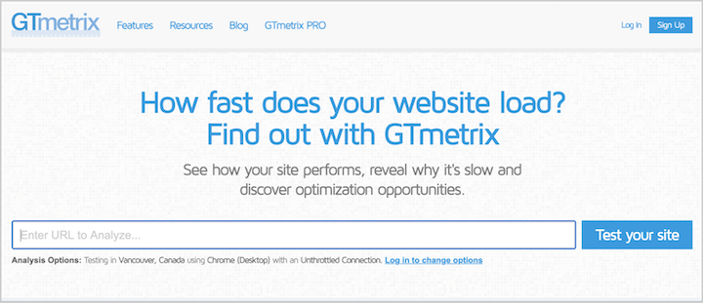
Page speed
In addition to image sizes, the code behind your website content and the order in which it loads can impact page speed. This where lazy loading and page speed optimizations come into play.
Users expect a pain-free browsing experience, which is why page speed is an important ranking factor. If your pages take too long to load, your bounce rate will increase and your ranking will decrease. You can check yours with Metrix or Google Page Speed Insights.
Site security
Security: Make sure your site is using HTTPS rather than HTTP.
Ever wonder what the s stands for in https (as opposed to just plain old http)? Well it stands for secure. And the way you get your site to be an https site rather than an http site is to get an SSL (secure sockets layer) certificate. There are a few different routes to getting an SSL, and the cost depends on the level of security you need as well as your hosting setup. Hub Spot, for example offers free SSL through its CMS.
Page speed (also called “load speed”) measures how fast the content of a page loads.
Lazy loading is the practice of delaying load or initialization of resources or objects until they're actually needed to improve performance and save system resources.

Slide 34
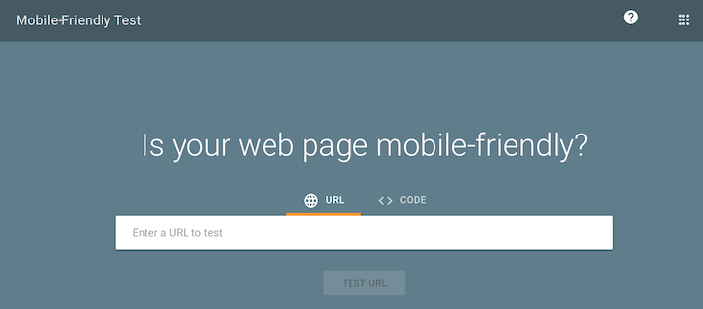
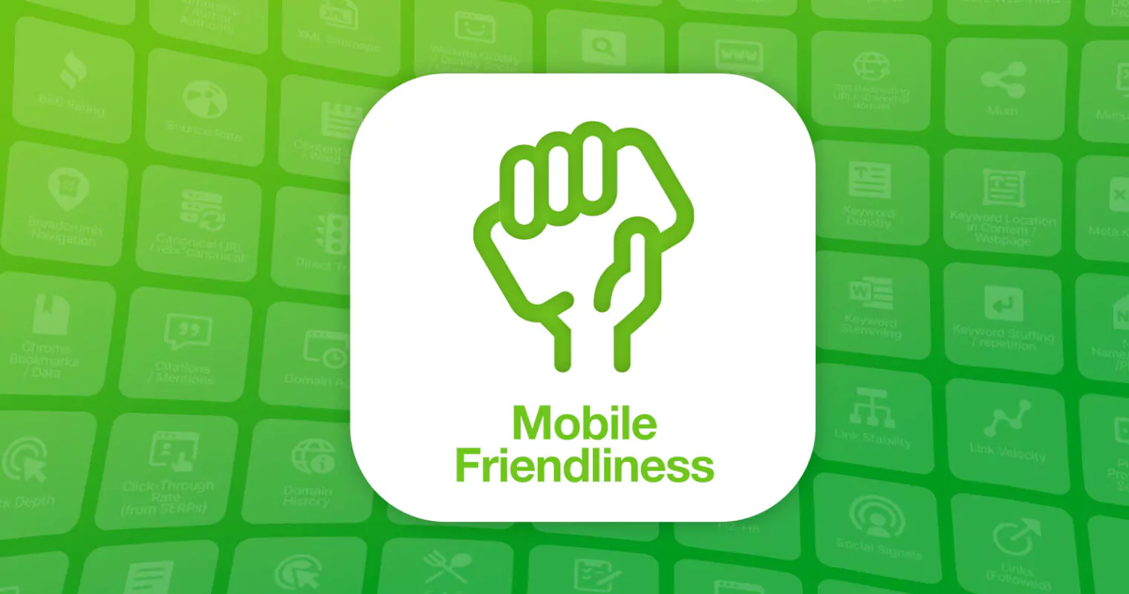
Mobile-friendliness
Google makes its ranking assessment based on the mobile version of a site rather than the desktop. all sites are now subject to mobile-first indexing.
In other words, even if the desktop version of your site is flawless, your search engine ranking could take a major hit if it isn’t optimized for mobile. Most content management systems allow you to make preview and adjustments for mobile/smaller screens. You can also use Google’s Mobile-Friendly Test. In addition to these tests, you should still always preview and test your web pages on an actual mobile device because there are some things that code just can’t pick up. Google started using “mobile-friendliness” as a ranking factor for mobile search. that means that if your website is mobile friendly, mobile ready or responsive (these terms are interchangeable), when someone does a Google search on their mobile phone, your website will rank higher than a website that is not mobile friendly or responsive. This is a wake-up call for those websites that are not mobile-ready.
Mobile-first: Being mobile-friendly doesn’t cut it anymore. Google’s indexing is now mobile-first, so your site needs to be fully responsive.
mobile friendly means that a website works the same and provides a seamless user experience (UX) regardless of the device it's accessed on. Users can see all the same images, copy, and text on a desktop, tablet, or phone.

Slide 35
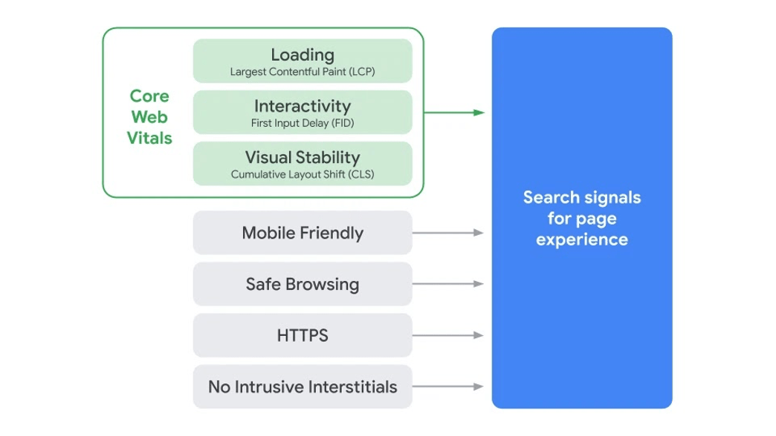
7. Core Web Vitals
Google did introduce a new ranking factor—Core Web Vitals—as a part of the page experience update. Core Web Vitals quantify a person’s experience on your page, which dictates whether and how they engage with it. They include:
LCP (Largest Content full Paint): how long it takes for the visible elements on a page to load.
FID (First Input Delay): How long it takes for your page to register the first click or tap on the page.
CLS (Cumulative Layout Shift): whether there are unexpected movements or disruptive popups
You can improve your Core Web Vitals with lazy loading, code modification, image compression, and more.
Core Web Vitals is a set of metrics that measure real-world user experience for loading performance, interactivity, and visual stability of the page

Slide 36
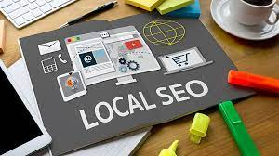
Local SEO
Local SEO is a type of SEO suited for local businesses only.
In other words, if you have a website and your goal is to get clients visiting your local store, then you should optimize your website for local SEO.
Everything that is mentioned above is valid for Local SEO, with the addition of the following guidelines:
Make sure that you have your business name, address, contact details on all pages of your website.
Add the Local Business schema on your homepage
Create a Google My Business Account
Register your business with trusted directories such as Yelp, Yahoo small business, Foursquare and other.
Promote your website on local directories and websites (for example online local newspapers).
Local business schema is a type of structured data markup code you can add to your business's website to make it easier for search engines to identify what type of organization you are and what you do. This is a helpful way to help optimize your website for local SEO, as it's a major ranking factor

Slide 37
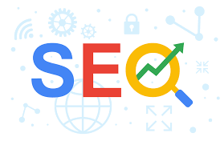
SEO strategies and best practices
always search the keyword: What you think users are looking for when they perform a particular search in Google may not be what they’re actually looking for. Keyword intent matters, so always search the keywords you’re trying to target to make sure you have an intent match.
Be patient: SEO takes time. Like, a lot of time. It can take a few months before you really start to see the fruit of your efforts, but once you start seeing the impact, the benefits compound over time—so don’t give up prematurely!
Focus on quality: Google is always updating its algorithm and coming out with new SERP features, but at the end of the day, it’s all designed to surface the best content out there. So your focus should always remain on creating useful, trustworthy content consistently. That is the best SEO strategy above all else.
Maintain your content: While the consistent publication of quality content is the top Google ranking factor, this should not be at the expense of letting old content go stale. Regularly refresh your evergreen pages to preserve their SEO value and get consistent traffic growth over time.
Track and measure: Report on your traffic and site data regularly so you can see what topics resonate most with your audience, detect issues, and set goals for traffic growth.

Slide 38
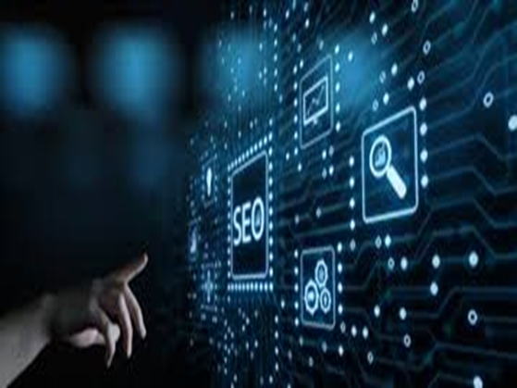
Advantages and disadvantages of SEO
Advantages of SEO The main benefits of SEO are:
• Significant traffic driver. search marketing can attract a significant proportion of visitors to the site if companies are successful in implementing it.
• Highly targeted. Visitors are searching for particular products or services so will often have a high intent to purchase - they are qualified visitors.
• Potentially low-cost visitors. There are no media costs for ad display or click-through Costs arise solely from the optimization process where agencies are paid to improve positions in the search results.
• Dynamic. The search engine robots will crawl the home page of popular sites daily; so new content is included relatively quickly for the most popular pages of a site (less so for deep links.

Slide 39
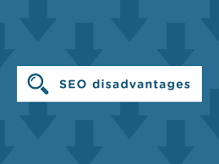
Disadvantages of SEO
Despite the targeted reach and low cost of SEO, it is not straightforward as these rages indicate:
• Lack of predictability: Compared with other media, SEO is very unreliable. the return on investment - it is difficult to predict results for a given invest highly competitive.
• Time for results to be implemented. The results from SEO may take moos achieved, especially for new sites.
• Complexity and dynamic nature. The search engines take hundreds of account, yet the relative weightings are not published, so there is not a direct between marketing action and results - it is more of an art than a science. Further the ranking factors change through time.
• Ongoing investment. Investment is needed to continue to develop new come generate new links.
• Poor for developing awareness in comparison with other media channel. Searches already have to be familiar with a brand or service to find it. However, it offers the opportunity for less well-known brands to 'punch above their weight' and to develop following dick-through . For these reasons, investment in paid search may also be worthwhile.

Slide 40

Chapter at a glance
WHAT IS SEO?
Types of SEO
How does SEO work?
How to do SEO: On-page optimization
How to do SEO: Off-page optimization
Technical optimizations
SEO strategies and best practices
Advantages of SEO
Disadvantages of SEO

Slide 41



Thank You

