Slide 1


Managing People and Organizations
Prepared by Dr. Usama Al-Fendi
MGM603
Managing People and Organizations
Lecture 10

Slide 2

Lecture
10
Managing Multigenerational Work force
www.midocean.ae

Slide 3
Lecture
Lecture Outline
10
What is a multigenerational workforce.
challenges in managing multigenerational workforce.
Key Leadership Strategies for a Multigenerational Workforce.
The Role of the Inclusive Leader.
www.midocean.ae

Slide 4
Lecture
What is a multigenerational workforce
10
Today's workplace is increasingly a convergence of multiple generations, with potential age gaps of up to five decades between the oldest and youngest employees. This multigenerational makeup, driven by rising retirement ages, brings together distinct cohorts—from Baby Boomers to Generation Z—each shaped by vastly different economic and social landscapes. Consequently, organizations now navigate a rich tapestry of diverse work attitudes, communication styles, and professional priorities.
www.midocean.ae

Slide 5
Lecture
What is a multigenerational workforce
10
These differences, particularly in areas like technology adoption, work-life balance, and career expectations, present both a unique challenge and a significant opportunity for businesses to foster inclusive and dynamic environments.
www.midocean.ae

Slide 6
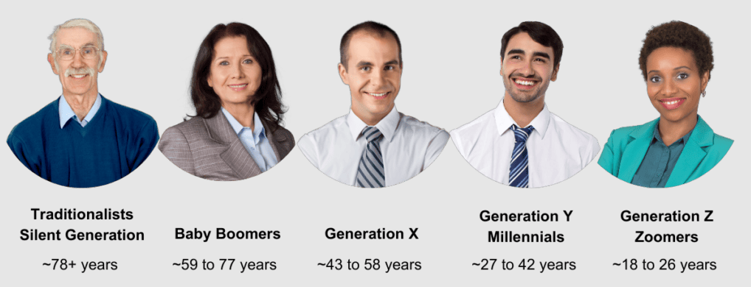
Lecture
What is a multigenerational workforce
10
www.midocean.ae

Slide 7
Lecture
What is a multigenerational workforce
10
Baby Boomers
Born between 1946 and 1964, Baby Boomers are the generation you’re least likely to have amongst even a multigenerational workforce. However, not all Boomers will retire at the expected age of 65; rather, some will keep working out of joy and others may not be able to retire at a ‘traditional’ age. This means that while they make up a small slice in your pie, they’re still likely to hang around longer than other generations.
www.midocean.ae

Slide 8
Lecture
What is a multigenerational workforce
10
Baby Boomers
This generation values loyalty, job security, and teamwork, and they tend to prefer structured environments and in-person interactions.
Recognize achievements and offer leadership development.
www.midocean.ae

Slide 9
Lecture
What is a multigenerational workforce
10
Baby Boomers as employees
Average time spent in job: 15 years
Driven by: Financial stability
Strength: Depth of experience
www.midocean.ae

Slide 10
Lecture
What is a multigenerational workforce
10
Generation X
Generation X hark from the period between 1965–1979. They’re like the middle child of the family; often overlooked while older (Boomers) and younger (Millennials) siblings share the limelight (for good or bad).
They’re highly adaptable and experienced, yet some of the most overlooked for promotions. And whilst they were once called the slacker generation, Gen X are most likely to have dependents both younger and older than them.
www.midocean.ae

Slide 11
Lecture
What is a multigenerational workforce
10
Generation X
Independent, adaptable, and keen on prioritizing work-life balance, Gen X favor email communication and flexible work arrangements.
Provide autonomy, consistent feedback, and growth opportunities.
www.midocean.ae

Slide 12
Lecture
What is a multigenerational workforce
10
Generation X as employees
Average time spent in job: 5 years
Driven by: Work-life balance
Strength: Adaptable leadership
www.midocean.ae

Slide 13
Lecture
What is a multigenerational workforce
10
Millennials Generation Y (born 1981–1996)
This generation is tech-savvy, purpose-driven, and motivated by flexibility and meaningful work.
Support with remote work options and values-based leadership.
As of 2017, they’re the largest generation in the labor force and the group that’s experienced the starkest shift in career priorities.
www.midocean.ae

Slide 14
Lecture
What is a multigenerational workforce
10
Millennials Generation Y (born 1981–1996)
For Millennials, fun perks and quick promotions are a nice-to-have but job satisfaction, stability and opportunities to learn are non-negotiable. They marry and have children later, staying in tertiary education longer. The oldest Millennials are in their early 40s while the youngest are still 20-somethings, so they possess diverse priorities even within their own age group.
www.midocean.ae

Slide 15
Lecture
What is a multigenerational workforce
10
Millennials as employees
Average time spent in job: 2 years
Driven by: Career growth, purpose
Strength: Most collaborative
www.midocean.ae

Slide 16
Lecture
What is a multigenerational workforce
10
Generation Z (born 1997–2012)
The newest entrants to the workforce, the eldest of Generation Z were born in 1997.
Much like Millennials, Gen Z are interested in career and leadership development and want to see their work contribute to a larger objective.
They’re multicultural, tech native and all about employers exhibiting the same diversity and inclusivity they champion themselves—which explains why Gen Z are more attracted to jobs that interest them than those that pay well.
www.midocean.ae

Slide 17
Lecture
What is a multigenerational workforce
10
Generation Z (born 1997–2012)
This generation are proud digital natives who value inclusivity, mental health, and instant communication.
Foster a diverse, well-being-focused culture with informal communication channels.
www.midocean.ae

Slide 18
Lecture
What is a multigenerational workforce
10
Generation Z as employees
Average time spent in job: TBD
Driven by: Entrepreneurism, global citizenship
Strength: Tech savvy.
www.midocean.ae

Slide 19
Lecture
challenges in managing multigenerational workforce
10
Communication and Feedback Styles
Different generations often have distinct preferences for how, when, and how often they communicate and receive feedback.
Older Generations (Baby Boomers, Gen X): May prefer formal communication (e.g., emails, scheduled meetings) and annual or semi-annual performance reviews.
Younger Generations (Millennials, Gen Z): Often favor instant messaging and collaborative platforms (e.g., Slack, Teams) and expect frequent, real-time, and informal feedback.
www.midocean.ae

Slide 20
Lecture
challenges in managing multigenerational workforce
10
Communication and Feedback Styles
The impact will appear mainly in miscommunication, frustration, and feelings of being ignored or micromanaged.
Important information can get lost if it's only shared through one channel..
www.midocean.ae

Slide 21
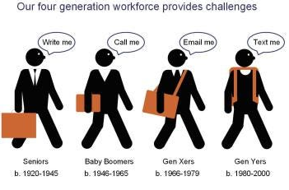
Lecture
What is a multigenerational workforce
10
www.midocean.ae

Slide 22
Lecture
challenges in managing multigenerational workforce
10
Clashing Views on Work Ethic and "Face Time"
Deeply held beliefs about what constitutes "hard work" and commitment can vary significantly.
Traditional View: Often equates long hours and physical presence in the office with dedication and loyalty.
Modern View: Tends to prioritize flexibility, efficiency, and outcomes (what you achieve) over "face time" (simply being seen at your desk).
www.midocean.ae

Slide 23
Lecture
challenges in managing multigenerational workforce
10
Clashing Views on Work Ethic and "Face Time"
The impact will appear mainly in that resentment can build, with some viewing remote or flexible workers as "slackers," while others see rigid 9-to-5 schedules as outdated and inflexible
www.midocean.ae

Slide 24
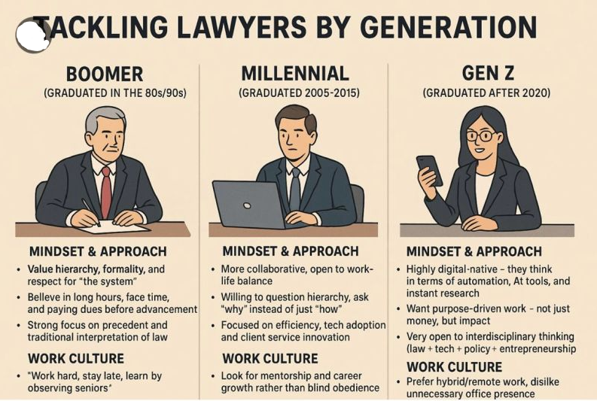
Lecture
challenges in managing multigenerational workforce
10
www.midocean.ae

Slide 25
Lecture
challenges in managing multigenerational workforce
10
Technology Adoption and Digital Fluency
The gap in comfort and proficiency with new technologies can create friction and inefficiency.
Digital Natives (Millennials, Gen Z): Grew up with technology, adapt to new software quickly, and may prefer digital solutions for most tasks.
Digital Immigrants (Baby Boomers, some Gen X): May have learned technology later in life and prefer more traditional, analog methods or require more training and support.
www.midocean.ae

Slide 26
Lecture
challenges in managing multigenerational workforce
10
Technology Adoption and Digital Fluency
A "digital divide" can slow down processes, create dependency on certain employees for tech-related tasks, and lead to frustration on both sides
www.midocean.ae

Slide 27
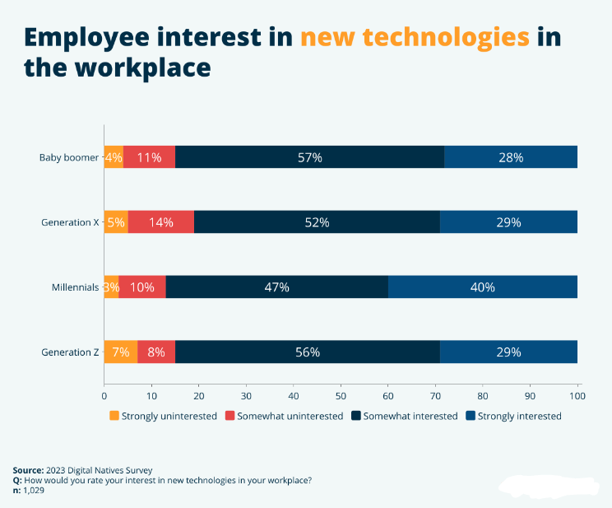
Lecture
challenges in managing multigenerational workforce
10
www.midocean.ae

Slide 28
Lecture
challenges in managing multigenerational workforce
10
Differing Motivators and Career Aspirations
What motivates an employee can be generationally influenced, affecting engagement and retention strategies.
Older Generations: May be motivated by job security, hierarchical advancement, titles, and financial rewards.
Younger Generations: Often prioritize purpose, work-life balance, learning and development opportunities, rapid career growth, and meaningful recognition.
www.midocean.ae

Slide 29
Lecture
challenges in managing multigenerational workforce
10
Differing Motivators and Career Aspirations
A one-size-fits-all approach to rewards, recognition, and career pathing will fail to engage large segments of the workforce.
www.midocean.ae

Slide 30
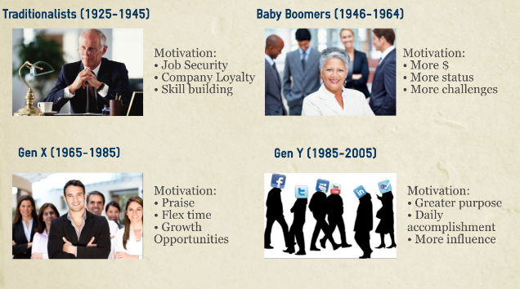
Lecture
challenges in managing multigenerational workforce
10
www.midocean.ae

Slide 31
Lecture
challenges in managing multigenerational workforce
10
Approaches to Hierarchy and Authority
Attitudes toward organizational structure and leadership vary widely.
Traditional Approach: Often respects a clear chain of command, formal titles, and top-down decision-making.
Modern Approach: Tends to prefer flat(ter) structures, collaborative decision-making, and values a leader who is a coach or mentor rather than a distant authority figure.
www.midocean.ae

Slide 32
Lecture
challenges in managing multigenerational workforce
10
Approaches to Hierarchy and Authority
Younger employees may be perceived as disrespectful for challenging ideas, while older managers may be seen as inflexible or "out of touch."
www.midocean.ae

Slide 33
Lecture
challenges in managing multigenerational workforce
10
Varying Expectations for Work-Life Integration
The line between work and personal life is viewed differently across generations.
Traditional View: Often maintained a clearer separation between work and home life.
Contemporary View: Grew up with connectivity, leading to a more blended approach. They may expect flexibility to handle personal matters during the day but are also more likely to check work emails after hours.
www.midocean.ae

Slide 34
Lecture
challenges in managing multigenerational workforce
10
Varying Expectations for Work-Life Integration
Conflicts can arise over availability, response times after hours, and the appropriateness of using personal time for work (and vice versa).
www.midocean.ae

Slide 35
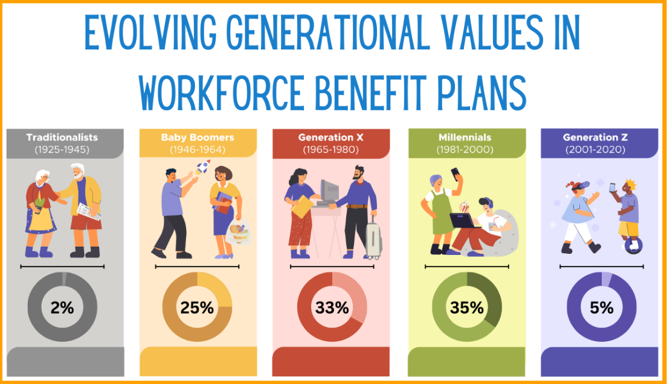
Lecture
challenges in managing multigenerational workforce
10
www.midocean.ae

Slide 36
Lecture
challenges in managing multigenerational workforce
10
Resistance and Stereotyping
The most pervasive challenge is the tendency to rely on generational stereotypes.
Labels like "entitled" (for younger workers) or "resistant to change" (for older workers) are often inaccurate and harmful.
These biases can poison team culture, hinder collaboration, lead to unfair management practices, and prevent leaders from seeing the unique individual behind the generational label.
www.midocean.ae

Slide 37
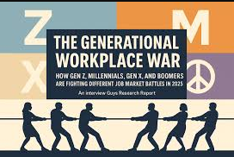
Lecture
challenges in managing multigenerational workforce
10
www.midocean.ae

Slide 38
Key Leadership Strategies for a Multigenerational Workforce
Lecture
10
Foster Fluid Communication
Diversify Your Channels: Don't rely on a single method. Use a mix of formal emails (for official announcements), instant messaging (for quick collaboration), and video calls (for building connection). Ensure critical information is shared across all relevant platforms.
Normalize Feedback Loops: Implement a culture of continuous feedback. Train managers to give constructive criticism that is respectful and actionable. Simultaneously, encourage upward feedback through regular check-ins, anonymous surveys, and an open-door policy (both physical and virtual).
www.midocean.ae

Slide 39
Key Leadership Strategies for a Multigenerational Workforce
Lecture
10
Champion Flexibility and Customization
Flexible Work Arrangements: Offer a spectrum of options—remote work, hybrid models, flexible hours, compressed workweeks. Judge performance on output and results, not on physical presence or hours logged.
Personalized Recognition and Rewards: Move beyond a one-size-fits-all rewards program. Some employees may value public recognition, others may prefer a bonus, extra time off, or opportunities for professional development. Ask your employees what motivates them.
www.midocean.ae

Slide 40
Key Leadership Strategies for a Multigenerational Workforce
Lecture
10
Bridge the Technology Gap
Provide Purposeful Training: When introducing new technology, frame it as a tool for efficiency, not just "the new way." Offer tiered training—basic for beginners, advanced for power users—and create a system of "digital mentors" where tech-savvy employees can assist those who are less comfortable.
Solicit Input from All Sides: When adopting new tools, involve a cross-generational team in the selection process. Gen Z can highlight the latest innovations, while more experienced workers can provide insights on integration and practical usability.
www.midocean.ae

Slide 41
Key Leadership Strategies for a Multigenerational Workforce
Lecture
10
Create Growth Pathways for All
Multi-Directional Mentoring: Formalize programs that are not just top-down. Pair a senior employee (sharing industry wisdom and institutional knowledge) with a junior employee (sharing insights on digital trends and new tools). This fosters mutual respect and learning.
Skills-Based Advancement: Clearly define the skills needed for advancement and provide accessible ways to acquire them. This shifts the focus from "tenure" or "age" to demonstrable competencies, which is fair and motivating for all.
www.midocean.ae

Slide 42
Key Leadership Strategies for a Multigenerational Workforce
Lecture
10
Build a Cohesive, Inclusive Culture
Focus on Shared Goals and Values: Unite the team around a common purpose, the company's mission, and shared values like respect, integrity, and customer focus. This creates a common language that transcends generational differences.
Actively Combat Stereotypes: Call out and correct generational generalizations in meetings and conversations. Reframe statements from "Millennials are so entitled" to "Can you help me understand your career expectations?" Focus on individual behaviors, not generational attributes.
www.midocean.ae

Slide 43
Key Leadership Strategies for a Multigenerational Workforce
Lecture
10
Build a Cohesive, Inclusive Culture
Celebrate Diverse Perspectives: In meetings, deliberately solicit opinions from people of different ages and backgrounds. Explicitly state that diverse viewpoints lead to better decisions and innovation.
www.midocean.ae

Slide 44
The Role of the Inclusive Leader
Lecture
10
In a multigenerational workforce, the traditional, one-size-fits-all command-and-control leadership style is obsolete. The modern solution is Inclusive Leadership—a proactive and intentional approach that doesn't just manage diversity but actively leverages it as a strategic asset. The inclusive leader acts as a facilitator, a coach, and a bridge-builder, creating an environment where five generations can collaborate, innovate, and thrive together.
www.midocean.ae

Slide 45
The Role of the Inclusive Leader
Lecture
10
The Empathetic Architect: Designing an Equitable Environment
An inclusive leader does not assume that all employees are motivated by the same things. Instead, they architect a workplace that offers flexibility and choice.
They design systems that cater to diverse needs. This includes:
Flexible Work Models: Offering a menu of options (remote, hybrid, flex-time) and evaluating performance based on outcomes, not physical presence.
www.midocean.ae

Slide 46
The Role of the Inclusive Leader
Lecture
10
The Empathetic Architect: Designing an Equitable Environment
Personalized Recognition: Understanding that a Baby Boomer may value public acknowledgment, while a Gen Z employee might prefer a learning stipend or mental health days.
Varied Communication Channels: Ensuring important information is shared via email, instant messaging, and short video updates to meet different preferences.
www.midocean.ae

Slide 47
The Role of the Inclusive Leader
Lecture
10
The Bridge Builder: Fostering Connection and Mentorship
Inclusive leaders actively break down silos and build bridges of understanding between generations. They are the catalyst for mutual respect and knowledge exchange.
They implement structured programs that facilitate connection:
Reverse Mentoring: Pairing junior employees with senior leaders to share knowledge on technology, social media trends, and emerging consumer tastes, while the senior leader shares strategic wisdom and institutional knowledge.
www.midocean.ae

Slide 48
The Role of the Inclusive Leader
Lecture
10
The Bridge Builder: Fostering Connection and Mentorship
Cross-Generational Project Teams: Deliberately creating teams with age diversity to solve problems, ensuring that a variety of perspectives are heard from the outset.
Facilitating "Why" Conversations: Encouraging teams to explain the reasoning behind their preferences (e.g., "I prefer a formal report because..."), which builds empathy and replaces assumptions with understanding.
www.midocean.ae

Slide 49
The Role of the Inclusive Leader
Lecture
10
The Bias Interrupter: Championing Fairness and Individuality
The inclusive leader is careful in identifying and dismantling generational stereotypes, which are a form of unconscious bias. They focus on the individual, not the generational label.
They consistently:
Challenge Stereotypes: They call out generalizations like "Gen Z is job-hoppers" or "Boomers are resistant to change" in meetings and conversations.
www.midocean.ae

Slide 50
The Role of the Inclusive Leader
Lecture
10
The Bias Interrupter: Championing Fairness and Individuality
Focus on Behaviors: They give feedback based on observable actions and results, not on perceived generational traits (e.g., "I noticed the report was submitted after the deadline" vs. "Your generation has no work ethic").
Ensure Equitable Opportunities: They audit processes like promotions, high-visibility projects, and learning opportunities to ensure they are distributed fairly, not based on proximity bias or personal affinity.
www.midocean.ae

Slide 51
The Role of the Inclusive Leader
Lecture
10
The Facilitator of Psychological Safety: Creating a "Speak-Up" Culture
The most critical role of an inclusive leader is to create an environment of psychological safety, the shared belief that one can speak up without risk of punishment or humiliation. This is essential for harnessing the full potential of a diverse team.
They model and enforce behaviors that build trust:
Admit Their Own Limitations: They openly state, "I'm not an expert on this new platform, so I'm counting on you all to share your insights."
www.midocean.ae

Slide 52
The Role of the Inclusive Leader
Lecture
10
The Facilitator of Psychological Safety: Creating a "Speak-Up" Culture
request opposit Opinions: In meetings, they explicitly ask, "What are we missing?" or "Who has a completely different perspective?"
Validate All Contributions: They acknowledge every idea brought forward, ensuring that quieter or more junior employees feel heard and valued.
www.midocean.ae

Slide 53
The Role of the Inclusive Leader
Lecture
10
The Developer of Agile Talent: Personalizing Growth
An inclusive leader recognizes that career aspirations and learning styles are not uniform across a multigenerational team. They act as a career coach, not just a manager.
They personalize development:
Skills-Based Pathways: They focus on helping every employee build relevant skills, whether for a next promotion, a lateral move, or mastery in their current role.
www.midocean.ae

Slide 54
The Role of the Inclusive Leader
Lecture
10
The Developer of Agile Talent: Personalizing Growth
Offer Diverse Learning Modalities: They provide access to learning in various formats—from formal workshops and online micro-courses to peer-to-peer coaching and job shadowing.
Have "Career Conversations": They regularly discuss individual goals, understanding that for one employee, "advancement" might mean a leadership title, and for another, it might mean more autonomy or a specialized expert track.
www.midocean.ae

Slide 55



Thank You

