Slide 1


Business Mathematics
Prepared by Dr. Alfaisal Hasan
MTH 112
Business Mathematics
Lecture NO 1

Slide 2


Business Mathematics
Lecture NO 1
MTH 112
Business Mathematics
Prepared by
Dr. Alfaisal Hasan
www.midocean.ae

Slide 3

Chapter
Topics
Chapter 1: Mathematical preliminaries
Chapter 2: The straight line and applications
Chapter 3: Functions and Graphs
Chapter 4: Limits and Continuity
Chapter 5: Financial Mathematics
Chapter 6: Differentiation
Chapter 7: Methods of Differentiation
Chapter 8: Function of several variables
Chapter 9: Integration and applications
Chapter 10: Linear algebra and applications
www.midocean.ae

Slide 4
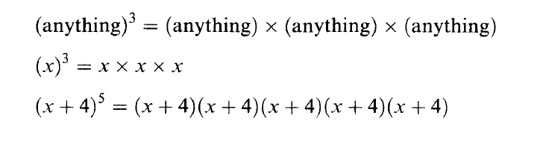
Chapter
Some Mathematical Preliminaries
Powers: positive whole numbers such as 2⁴ which means
2 x 2 x 2 x 2= 16
www.midocean.ae

Slide 5
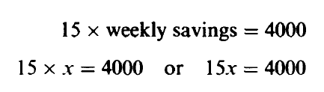

Chapter
Some Mathematical Preliminaries
Variables and letters: when we don’t know the value of quantity, we give that quantity a symbol, such as x
This statements may be expressed as a mathematical equation:
www.midocean.ae

Slide 6
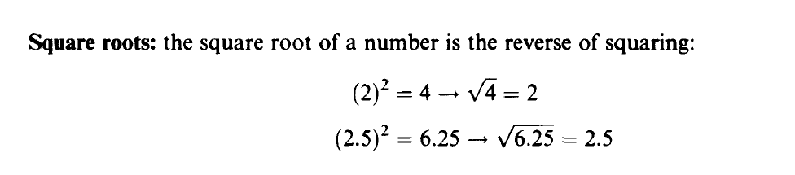
Chapter
Some Mathematical Preliminaries
www.midocean.ae

Slide 7
Chapter
Arithmetic Operations
Adding: If all the signs are the same, simply add all the terms and give the answer with the common overall sign.
Subtracting: When subtract any two numbers or any two similar terms, give the answer with the sign of the largest number or terms.
www.midocean.ae

Slide 8
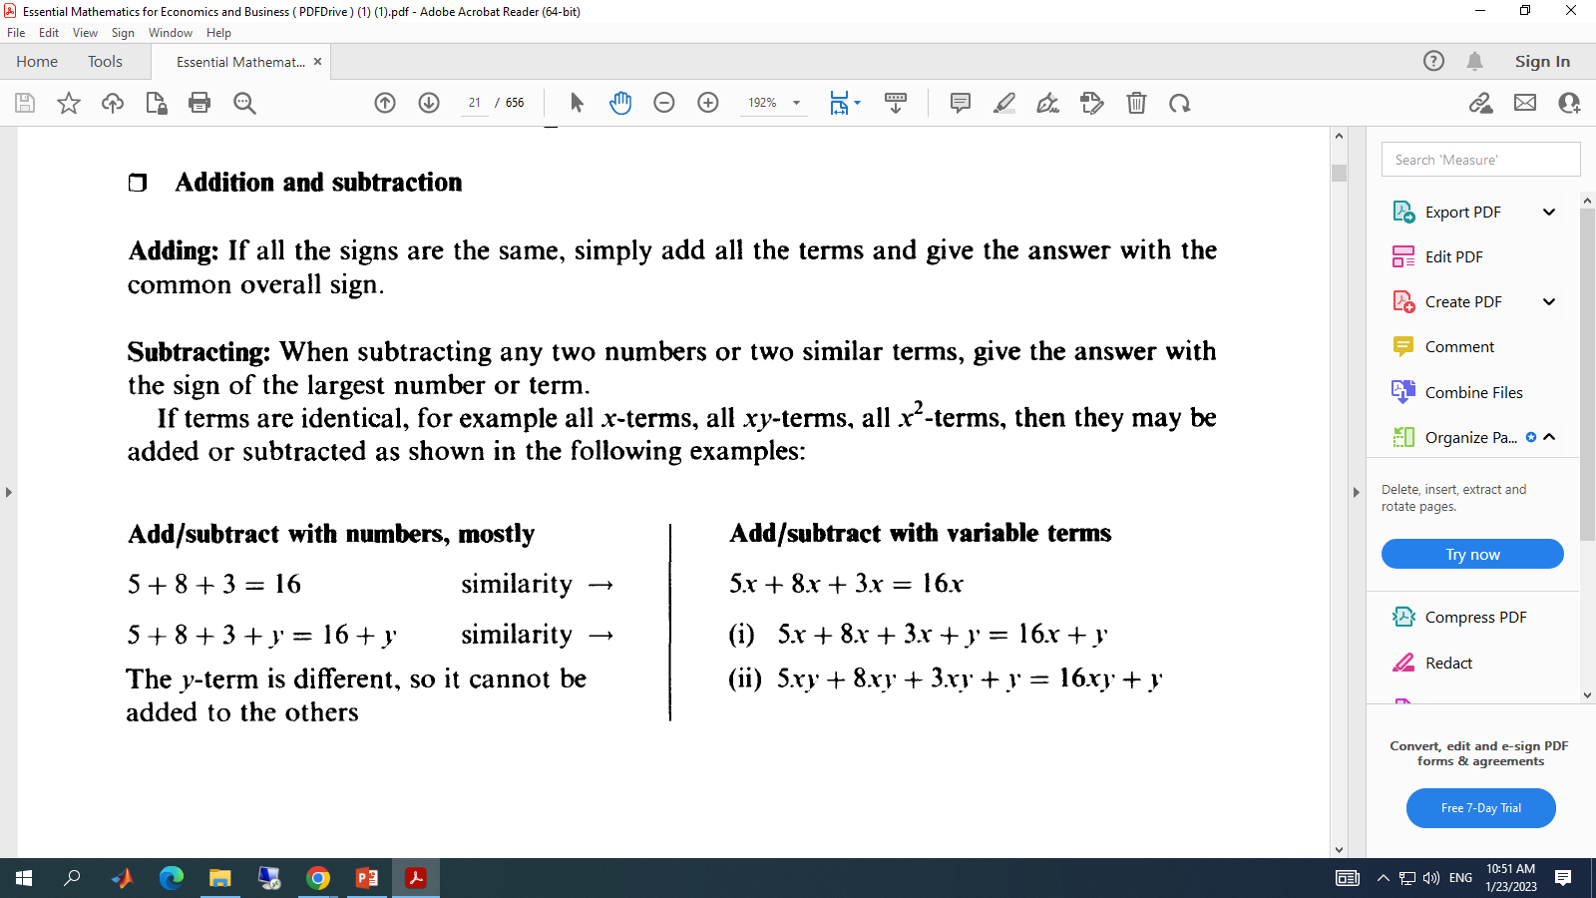
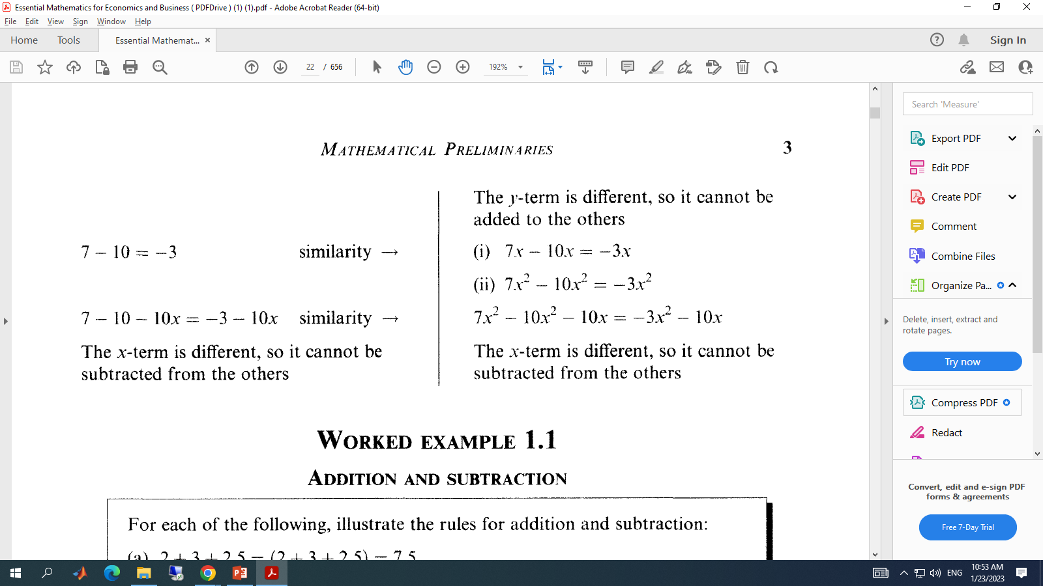
Chapter
Arithmetic Operations
www.midocean.ae

Slide 9
Chapter
Arithmetic Operations
www.midocean.ae

Slide 10
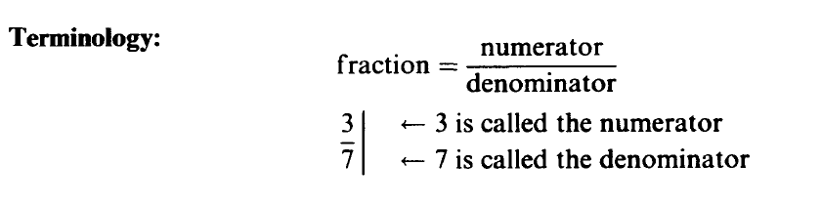
Chapter
Fractions
www.midocean.ae

Slide 11
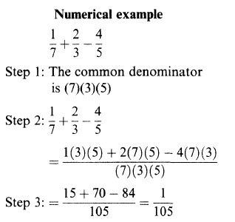
Chapter
Fractions
www.midocean.ae

Slide 12
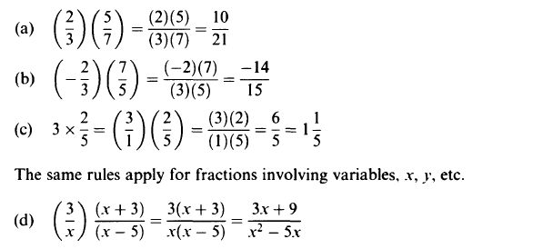
Chapter
Fractions
www.midocean.ae

Slide 13

Solving Equations
What do you notice about each of the following?
6 + 3 = 9
5 - 3 = 2
5 + 3 = 1 + 7
x = 4.
2x = x + x
3x = 2x + x = x + x + x
What does this picture represent?
What is this apparatus called?
www.midocean.ae

Slide 14
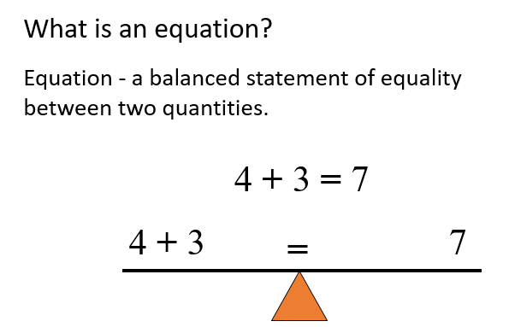
Chapter
Solving Equations
www.midocean.ae

Slide 15
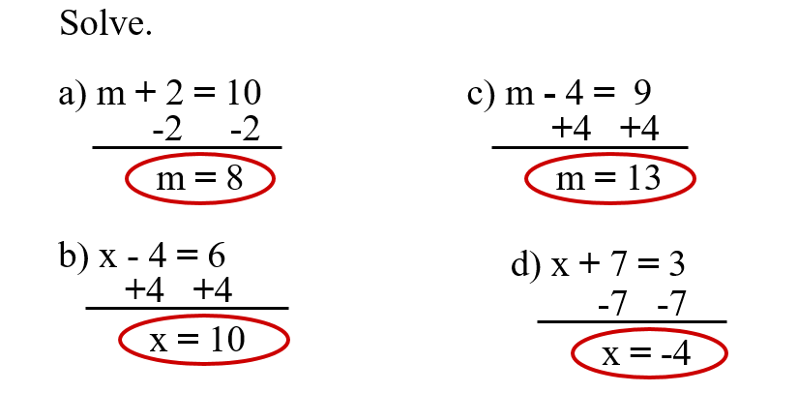
Chapter
Solving Equations
www.midocean.ae

Slide 16
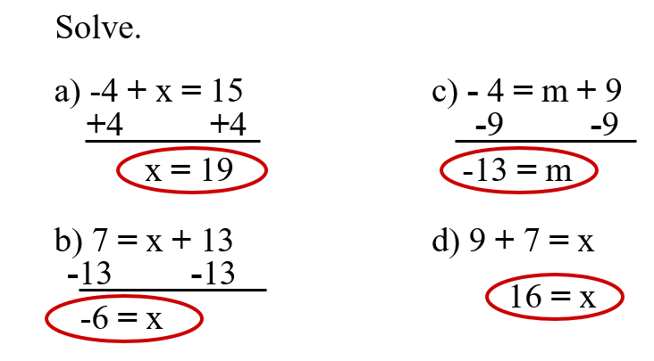
Chapter
Solving Equations
www.midocean.ae

Slide 17
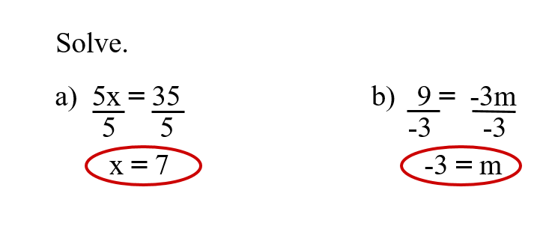
Chapter
Solving Equations
www.midocean.ae

Slide 18
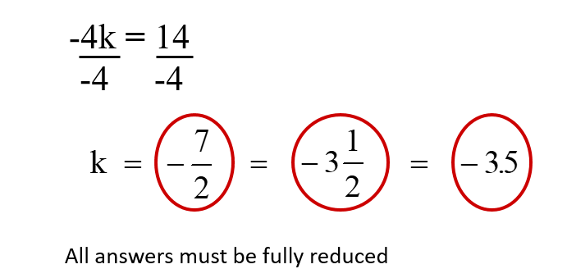
Chapter
Solving Equations
www.midocean.ae

Slide 19
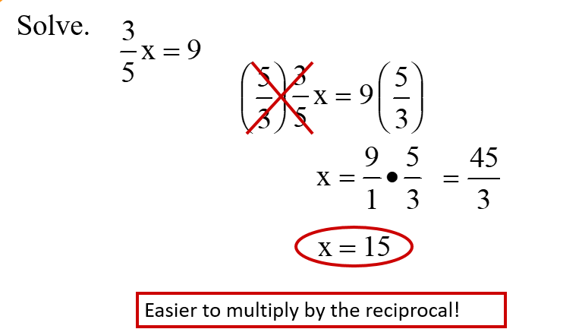
Chapter
Solving Equations involving fractions
www.midocean.ae

Slide 20
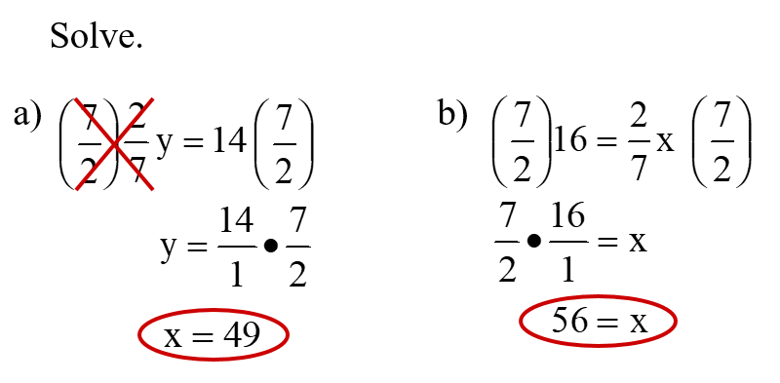
Chapter
Solving Equations involving fractions
www.midocean.ae

Slide 21
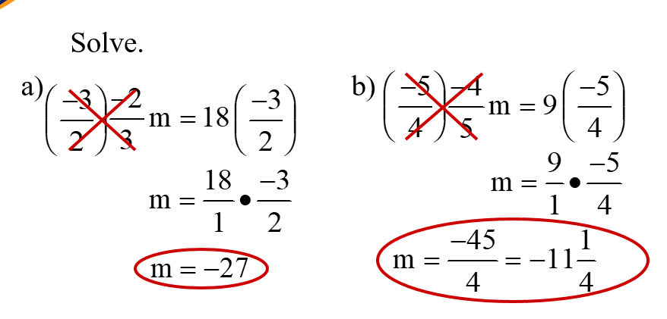
Chapter
Solving Equations involving fractions
www.midocean.ae

Slide 22
Chapter
Simple Inequalities
An inequality is like an equation, but instead of an equal sign (=) it has one of these signs:
< : less than
≤ : less than or equal to
> : greater than
≥ : greater than or equal to
www.midocean.ae

Slide 23
Chapter
Simple Inequalities
x < 5
means that whatever value x has,
it must be less than 5.
What could x be?
www.midocean.ae

Slide 24
Chapter
Simple Inequalities
x ≥ -2
means that whatever value x has,
it must be greater than or equal to -2.
What could x be?
www.midocean.ae

Slide 25
Chapter
Simple Inequalities
Graphing Rules
Symbol | Circle | Direction of Arrow
< | Open | Left
> | Open | Right
≤ | Closed | Left
≥ | Closed | Right
www.midocean.ae

Slide 26

Chapter
Simple Inequalities
Examples:
x < 5
x > -2
www.midocean.ae

Slide 27
Chapter
Simple Inequalities
Examples:
x ≤ -8
x ≥ 4
www.midocean.ae

Slide 28
Chapter
Solving one-step Inequalities
Divide both sides by the coefficient of x
www.midocean.ae

Slide 29
Chapter
Solving one-step Inequalities
Multiply both sides by the reciprocal of the coefficient
www.midocean.ae

Slide 30
Chapter
Solving Inequalities
Solving inequalities is the same as solving equations.
There are only 2 things you need to know…
  1.) If you multiply or divide by a negative number you must switch the sign.
  -7x < 21
  -7 -7
  x > -3
  2.) You will graph your solutions.
Dividing by a negative means switch the sign!!
www.midocean.ae

Slide 31
Chapter
Solving Inequalities
When solving inequalities, if you multiply or divide by a negative you must switch the signs.
Switching the signs:
  Less than becomes Greater than < switches to >
  Greater than becomes Less than > switches to <
  Less than or equal to becomes Greater than or equal to
  ≤ switches to ≥
  Greater than or equal to becomes Less than or equal to
  ≥ switches to ≤
www.midocean.ae

Slide 32
Chapter
Solving Inequalities
Caution! Dividing by a negative number
Same if multiplying?
Notice: Sign CHANGED
www.midocean.ae

Slide 33
Chapter
Solving Inequalities
Caution! When you multiply by a negative number…
YES!
…the sign CHANGES
-x > 2
5
(-5 )-x > 2(-5)
1 5
x < -10
www.midocean.ae

Slide 34
Chapter
Solving Inequalities
Follow same steps used to solve equations:
3x + 4 < 13
- 4 -4
3x < 9
3 3
x < 3
www.midocean.ae

Slide 35
Chapter
Un Solved Examples
Find the value of
www.midocean.ae

Slide 36
Chapter
Un Solved Examples
Find the value of
www.midocean.ae

Slide 37
Chapter
Un Solved Examples
Find the value of
www.midocean.ae

Slide 38
Chapter
Un Solved Examples
Find the value of
www.midocean.ae

Slide 39
Chapter
Un Solved Examples
Find the value of
www.midocean.ae

Slide 40
Chapter
Un Solved Examples
Find the value of
www.midocean.ae

Slide 41
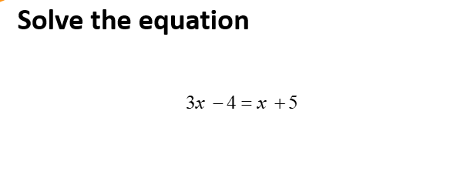
Chapter
Un Solved Examples
www.midocean.ae

Slide 42
Chapter
www.midocean.ae

Slide 43
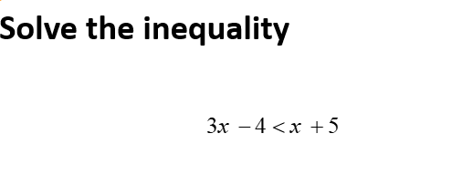
Chapter
Un Solved Examples
www.midocean.ae

Slide 44
Chapter
www.midocean.ae

Slide 45

Chapter
Un Solved Examples
www.midocean.ae

Slide 46
Chapter
Caution! When you multiply by a negative number…
…the sign CHANGES
www.midocean.ae

Slide 47
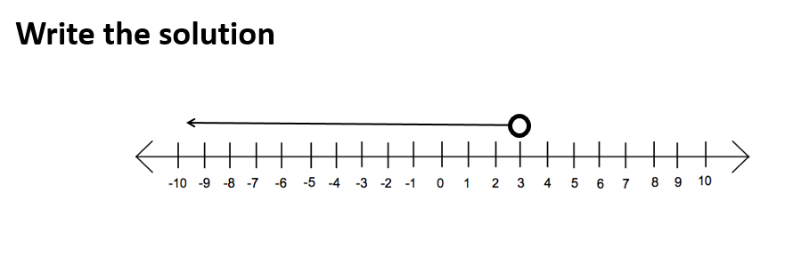
Chapter
Un Solved Examples
www.midocean.ae

Slide 48
Chapter
Un Solved Examples
www.midocean.ae

Slide 49

Chapter
Un Solved Examples
www.midocean.ae

Slide 50
Chapter
Un Solved Examples
www.midocean.ae

Slide 51


Thank You

