Slide 1

PMG 611
Enterprise Risk Management
Prepared by Dr. Abdullah Jameel Halawany
Lecture 7
Integration of KPIs and KRIs and ERM Dashboard Reporting

Slide 2

Session Outline
What Is an Indicator?
Using Key Performance Indicators
Building Key Risk Indicators
KPI and KRI Program Implementation
ERM Dashboards
Session Outline

Slide 3
Introduction

Slide 4
Introduction
A successful ERM program not only highlights risks that an organization faces and helps avert them, but also highlights opportunities the company can take advantage of to boost growth and value.
This is only possible if one is able to peer into the future to see those risks and opportunities coming down the pike.
But how?

Slide 5
Introduction
Key Performance Indicators (KPIs) help managers determine how well they are progressing toward their goals.
Key Risk Indicators (KRIs) that one can tease out trends that may indicate future risk.
The adage “what gets measured gets managed” is true not just of KPIs but of KRIs as well.
If risk managers can measure risk, then and only then can they optimize business decisions around it.

Slide 6
What Is Indicator?

Slide 7
What Is Indicator?
An indicator is a specific type of metric that answers the question, “How are we doing?” in an actionable way.
Often, indicators accompany benchmarks to measure success or failure in meeting certain goals.
Indicators enable management and other decision-makers to assess the needs of the company and the progress toward intended outputs, outcomes, tactical goals, and strategic objectives.

Slide 8
Way Of Classifying Indicators
Indicators are as varied as the activities they measure.
One way of classifying indicators is by the stage of a process they are measuring.
An input indicator, for example, might measure the human and financial resources assigned to a particular project.
An output indicator could measure the quantity of goods and services produced.
An outcome indicator measures broader results achieved through goods and services.

Slide 9
Way Of Classifying Indicators
Another way to categorize indicators is according to the breadth of their relevance.
A macro indicator might be relevant to understanding risk exposure based on macroeconomic trends, for example.
A common indicator is relevant to everyone in the organization
A specific indicator would apply to a single business unit, function, or activity

Slide 10
KPIs
KPIs are simply indicators specifically used to determine how well the company is performing against its business goals.
They are key because they directly and significantly impact business performance.
A KPI must be sufficiently specific to suggest actions that will lead to improvement.

Slide 11
KPIs
For example, total sales volume may be an important metric, but if it falls short of expectations, it doesn’t provide any hint as to a cause or potential solution to the problem.
By contrast, consider a company that has chosen to grow sales by focusing on a target market of midsize manufacturers in a certain geographic region.
A KPI that measures the value of sales opportunities with that profile can reveal just how efficiently the sales team is working.
It also hints at possible solutions, such as increasing the size of the sales team or drilling down to find potential sticking points in the sales process.

Slide 12
KRIs
KRIs show how much risk is associated with a specific activity or investment.
Companies may use them to monitor controls, risk drivers, and exposures in order to provide insight into possible risk events.
The best KRIs can be tracked against risk tolerance levels and monitored alongside related KPIs and business objectives.
While KPIs measure the result of past actions and events, KRIs are more forward looking.
That allows time for rapid action should a company’s risk profile threaten to surpass appetite.
If KPIs help answer the question, “How are we doing?” KRIs answer the question, “Where are we going?”

Slide 13
Using Key Performance Indicators

Slide 14
Using Key Performance Indicators
KPIs fall into two broad categories: Internal and External.
Internal KPIs typically affect a company’s performance only in a limited way, without material effect on the bottom line.
Companies may use internal KPIs to improve internal processes, without the need to report to clients, shareholders, or even senior management.

Slide 15
Using Key Performance Indicators
KPIs fall into two broad categories: Internal and External.
External KPIs are those that impact the company’s bottom line, and which deserve the attention of senior management.
Example,
  the number of people following a consumer-goods company on Facebook is unlikely to be a useful external KPI, whereas the volume of product support requests, which could reflect serious quality issues impacting sales, would be an effective external indicator.

Slide 16
Using Key Performance Indicators
Good KPIs can be challenging to identify, but the following attributes can help guide the development:
Quantifiable: KPIs must be objectively measurable.
Relevant: When KPIs are tied directly to business objectives, they will typically provide information that is immediately actionable.
Critical: External KPIs should have a linear relationship with revenue, cost, or business objectives and directly impact the company’s bottom line.
Timely: The best KPIs are not only quantifiable, but they can also be measured quickly (preferably in real time) so that management can act on the data as soon as possible.

Slide 17
Few examples of common KPIs
Financial: Net Profit, Return on Investment, Price/Earnings Ratio
Marketing: Market Share, Brand Equity, Search Engine Rankings
Operations: Project Cost Variance, Time to Market, Process Waste Level
Internal: Human Capital Value Added, Revenue per Employee
Sustainability: Carbon Footprint, Energy Consumption, Waste Reduction Rate
Customers: Net Promoter Score, Customer Retention Rate, Customer Profitability Score

Slide 18
Using Key Performance Indicators
Companies have a wide variety of KPIs to choose from, so it is best to focus on a few critical ones while monitoring the others less intently.
Every organization is different, so each must begin by using its own scorecard and strategy as a guide in choosing the most effective KPIs to track.

Slide 19
Building Key Risk Indicators

Slide 20
Building Key Risk Indicators
While KPIs work like thermostats or electric meters, providing current and historical data to act upon, Key Risk Indicators (KRIs) function more like smoke detectors.
Good KRIs are based on warning signs that a company is headed in the wrong direction and could potentially lose value.
KRIs also identify variables (e.g., interest rates, economic trends, business drivers) that can have a significant impact on future performance.

Slide 21
Building Key Risk Indicators
These warnings will alert key executives early enough so that the company can adapt to the changes or avoid trouble altogether before it’s irreversible.
And since not all risks are bad risks, a company should also have KRIs that indicate potential opportunities as well as challenges.

Slide 22
Sources and Characteristics of Effective KRIs
Like key performance indicators, KRIs should be quantifiable, critical, relevant, and timely so as to provide objective feedback to managers on business direction and help focus action.
They should be predictive enough to act as early warning signs for possible changes in an organization’s risk profile.

Slide 23
Sources and Characteristics of Effective KRIs
As part of a comprehensive ERM program, companies should develop a set of KRIs for each risk category they face.
Easy for companies that collect data as part of doing business but can present a challenge in other areas.
For example,
  Financial institutions usually have an abundance of data describing credit and market risk indicators, but little to support operational KRIs.
  Nonfinancial corporations may have significant insight into operational risk but find it difficult to develop KRIs for financial or technology risk.
All companies face the challenge of developing leading indicators that can effectively provide early warnings of potential future losses.

Slide 24
Business and Functional Units
The leaders of the Company’s Business and Functional Units are important source of KPIs and KRIs deserves special note.
Interview them will not only add color to risks identified in assessments, but they may also uncover additional, often more significant, risks that need to be measured and monitored.

Slide 25
Business and Functional Units
Questions 1 and 2 help to develop KPIs while questions 3 and 4 relate to KRIs.
The last three questions should lead to a better understanding the business or functional unit’s perspective on the overall ERM program, and identify opportunities for improvement
What are the key business or financial objectives based on the business strategy?
What key performance indicators (KPIs) best quantify the achievement of these objectives? What are the performance targets or triggers for these KPIs?

Slide 26
Business and Functional Units
What are the risks that can drive variability in actual vs. expected performance?3
What are the key risk indictors (KRIs) that quantify the levels and/or potential loss of these risks? What are the risk limits or tolerances for these KRIs?
What are the worst-case scenarios for the business? (i.e., defined as “extremely unlikely, but possible” scenarios that may include the occurrence of one or more key risks, and possibly one or more control failures)?
How can the company improve its risk mitigation and management processes?
How can the company improve its risk reporting and monitoring programs for the board and management?

Slide 27
Business and Functional Units
The meetings with business leaders should produce a good set of KPIs and KRIs, but the focus should be on quality rather than quantity.
In addition to executive meetings, the risk team should consider other sources and characteristics of effective KRIs.

Slide 28
Sources and Characteristics of Effective KRIs
The sources may produce a large number of KRIs.
The risk team can narrow that number down by evaluating their effectiveness against the following 10 characteristics:

Slide 29
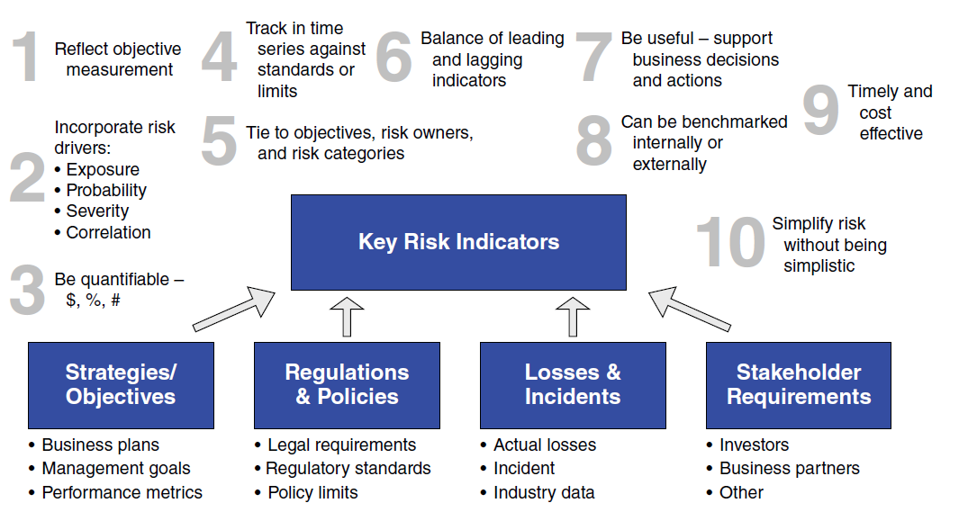
Sources and Characteristics of Effective KRIs

Slide 30
KPI And KRI Program Implementation

Slide 31
KPI and KRI Program Implementation
The first step in implementing an effective key indicators program is to define
  Business Strategy / Business Objectives / Specific Performance Targets / Risk Tolerances
The company’s overall risk framework should provide some guidance in this respect, but if that framework is in development, one can still proceed with identifying key indicators.
That could inform the framework, so they are both part of an iterative process.
Regulatory requirements should also be included in this effort.

Slide 32
KPI and KRI Program Implementation
The next step in implementing an effective key indicators program is that the risk management function should map the decision-making process that leads to each goal or requirement.
  Who makes what decisions, whether an individual, function, or committee?
  How do we support those decision-makers with the right KPIs, KRIs, expert analyses, and reporting?
  How do we support the analyses and reporting with the right technology and data resources?

Slide 33
KPI and KRI Program Implementation
With this in mind, let’s discuss the steps to identify, select, and report on the appropriate KPIs and KRIs.
  Identification
  Selection
  Tracking and Reporting

Slide 34
Identification
The task at this stage is to identify an indicator for each exposure.
For example, if the company’s bottom line relies heavily on a certain commodity price, knowing the current price doesn’t offer insights into its future movement.
For that one must track a driver behind that commodity’s future price.
These could be as disparate as political stability, weather patterns, or supply-and-demand trends in key markets.
Such indicators might identify current exposure levels, emerging risk trends, or past events that could present significant risk.

Slide 35
Selection
Now the risk function must consider the “key” part of KRI by whittling this list down to those indicators that are truly significant and worthy of close monitoring.
Begin by evaluating each risk in terms of probability and severity.
Then look at how each affects strategic objectives.
Mapping key risks to strategic initiatives lets management identify the most critical metrics that can serve as key risk indicators to help oversee the core strategic initiatives and business operations.

Slide 36
Selection
Next, evaluate the effectiveness of controls associated with the key risks.
Determine the risk management strategies (including accountabilities and action plans) for each key risk the process identified.
Finally, the risk team should prioritize the top risks identified for further analyses, quantification, and risk mitigation.

Slide 37
Tracking and Reporting
In order to track KPIs and KRIs, it is necessary to determine trigger thresholds, or warning indicators that activate feedback loops.
The organization may have already set tolerances for such triggers based on its risk appetite statement.
If not, one can turn to industry best practice and internal surveys to set these thresholds.
These warning levels should be submitted to the board for final approval, along with mitigation plans that address how to handle breaches.

Slide 38
Tracking and Reporting
The next step is to monitor each key indicator and make sure that it is available to the relevant decision-makers when they need it.
Practically speaking, this means determining how to aggregate and report the data.
The final step is to determine how frequently to track indicators.
This depends on both the accessibility of the data and its time sensitivity, and can range from continuous monitoring to weekly, monthly, or other periodic reports.

Slide 39
Steps to Identify, Select, and Report – Summary
Identification
  identify an indicator for each exposure
Selection
  Evaluating each risk in terms of probability and severity.
  How each affects strategic objectives (Mapping)
  Determine the risk management strategies
  Prioritize
Tracking and Reporting
  Determine trigger thresholds, or warning indicators that activate feedback loops (Risk Appetite)
  Monitor each key indicator
  Determine how frequently to track indicators

Slide 40
KPI and KRI Program Implementation
Once the company’s KPI and KRI programs are up and running, the risk function should revisit them on a regular basis to reassess their usefulness and accuracy.

Slide 41
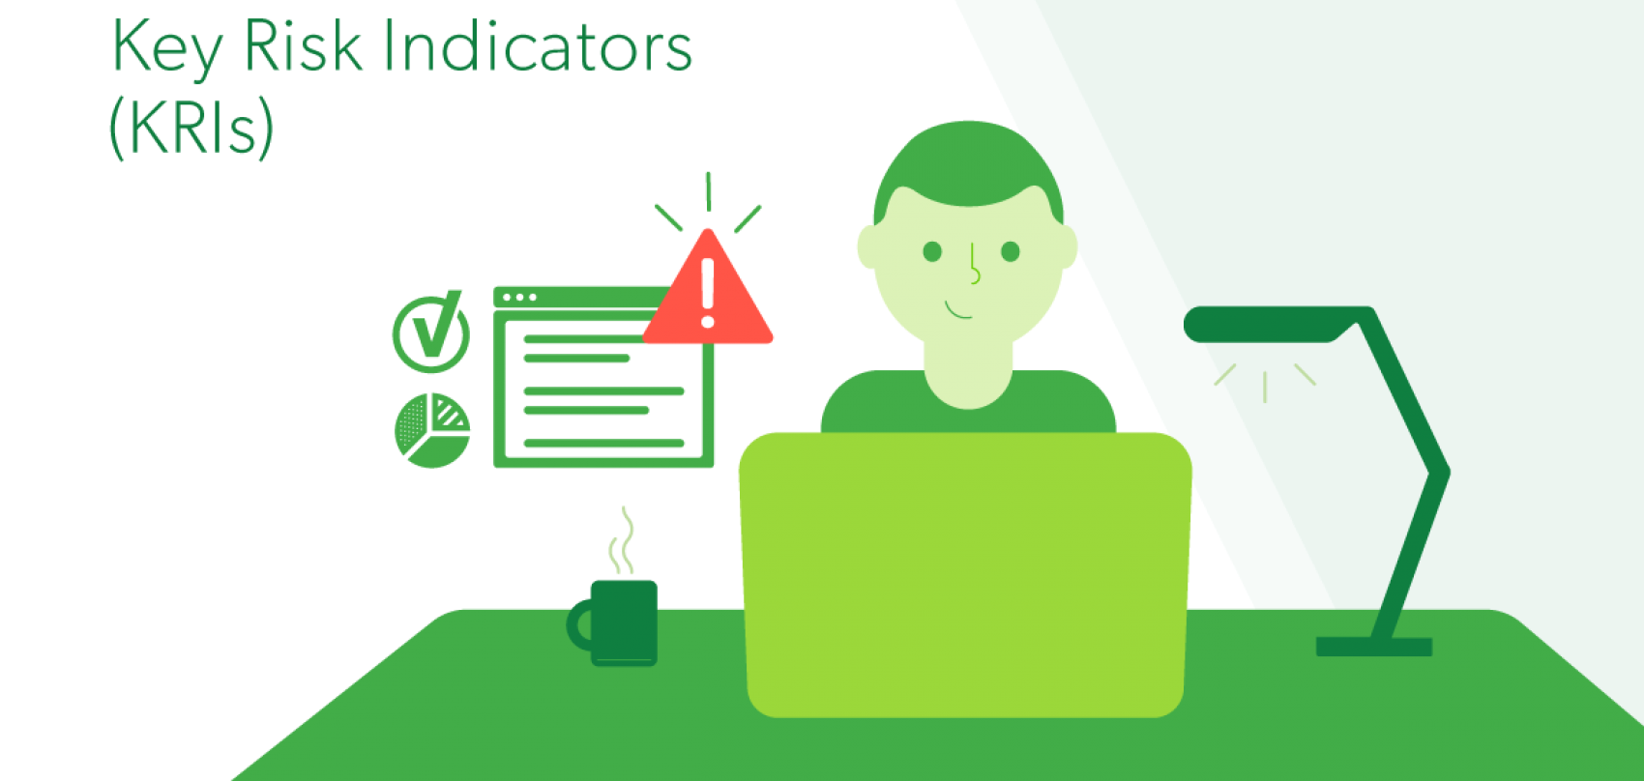
Best Practices KRIs
Keep Stakeholders and Objectives in Mind
Leverage Existing Metrics
Limit Indicators to the Most Relevant
Establish Monitoring and Reporting Frequencies Early On

Slide 42
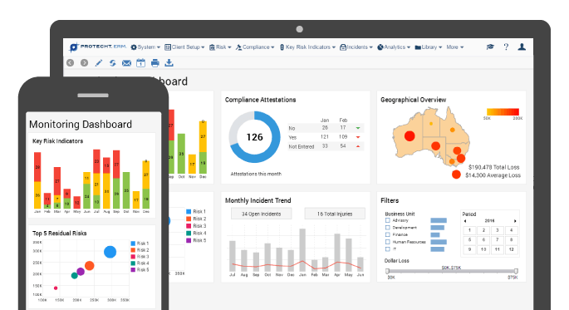
Integrated Dashboards

Slide 43
Dashboard Reporting
One of the key objectives of ERM is to promote risk transparency, both in terms of internal risk reporting and public disclosure.
Dashboard Reporting allows a company to aggregate data in one place and automatically build reports designed for individual decision-makers.

Slide 44
Basic Questions in Dashboard Design
Which If Any of Our Business Objectives Are at Risk?
Are We in Compliance with Laws, Regulations, and Policies?
What Risk Incidents Have Been Escalated?
What Key Indicators Require Attention?
What Risk Assessments Need Review?

Slide 45
Basic Questions in Dashboard Design
With an effective dashboard reporting system, the board and management should be able to answer all five of these questions in a few minutes.
The dashboard would provide executive reporting of enterprise-wide risks, with drill-down capabilities to allow central monitoring of all key risks.

Slide 46
ERM Dashboard Reporting
An integrated approach to analysis
Forward-looking indicators
Greater flexibility
Decision-oriented approach
Interactive data
Single-Source Publishing
Collaborative Real-Time Editing
Data Visualization
Interactive Data Displays

Slide 47
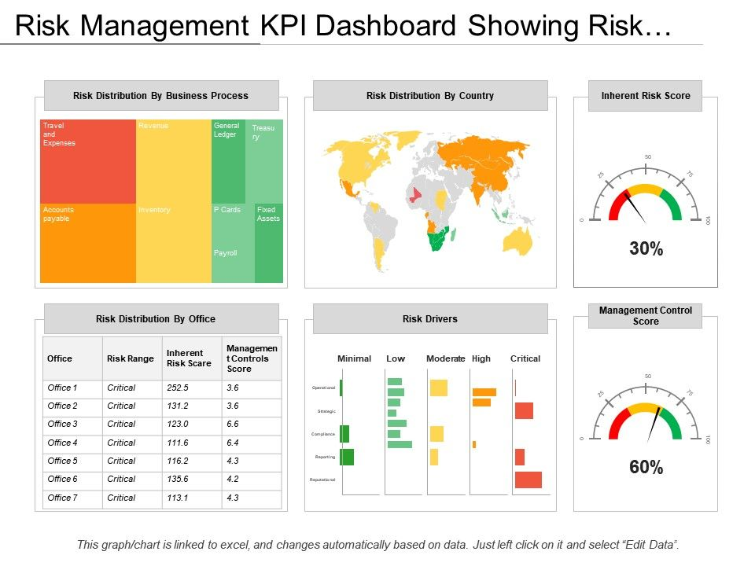
Best Practices
Choose Metrics That Matter
Make It Visual
Make It Interactive
Make It User-Friendly
Real-Time Is the Right Time
Never Stop Improving

Slide 48
Summary

Slide 49
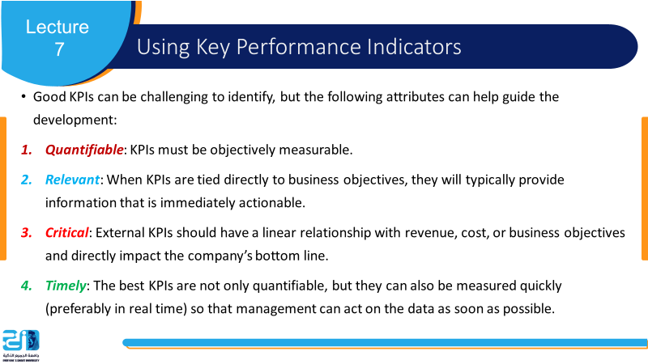
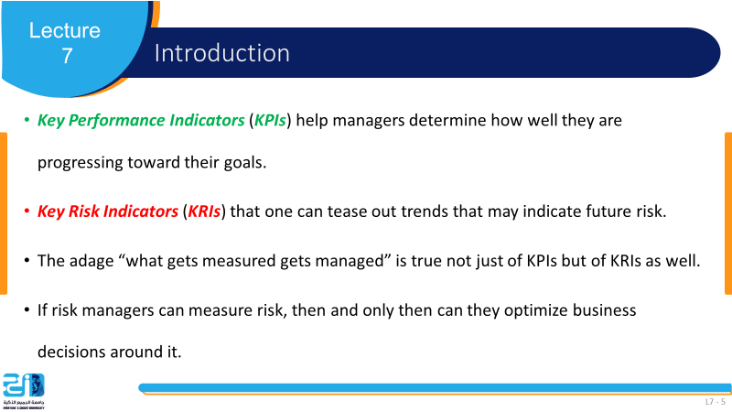
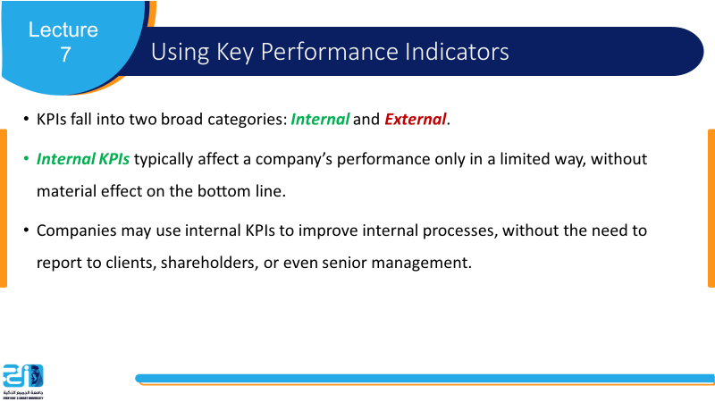
Summary
L7 - 49

Slide 50
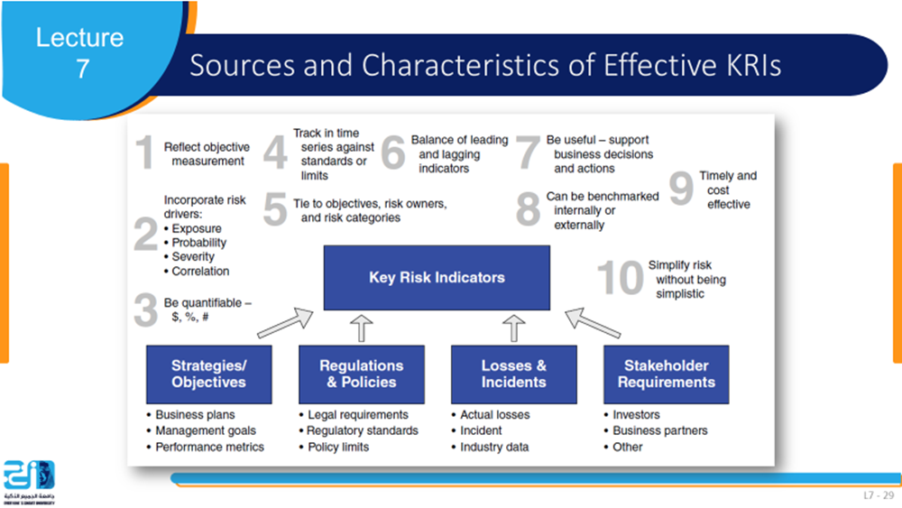
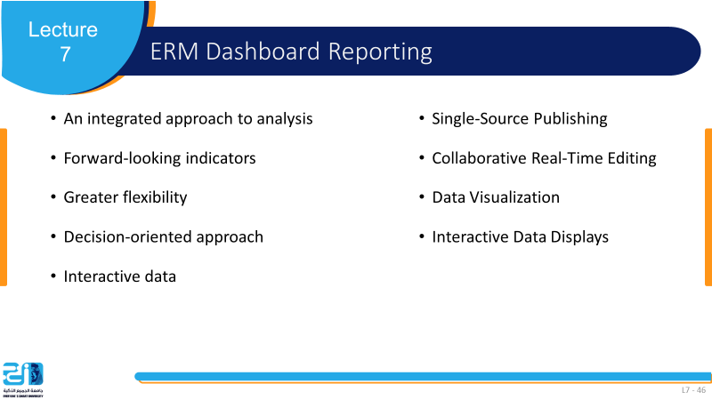
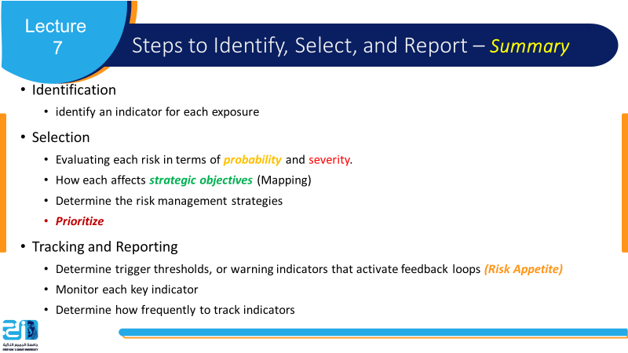
Summary
L7 - 50

Slide 51
References
Implementing Enterprise Risk Management: From Methods To Applications. James Lam.

