Slide 1



Internet and Information Technology
ITC202
Lecture 0
Overview
Prepared by
Dr. Eng. Youssef Ntefeh
www.midocean.ae

Slide 2
Course Overview
This course contains an introduction to information technology and computing systems.
The history and theory of information systems.
Practical application of technologies.
The student will be introduced to computer software, hardware, and networking technologies.
An introduction to the latest version of Microsoft Office.

Slide 3
Learning Outcomes
Using Technology Effectively.
Understanding the Computers Parts.
Application Software: Programs That Let You Work.
Introduction to Word, Excel, and PowerPoint.

Slide 4
|Course content
Lecture 1: History of computing.
Lecture 2: Introduction to information technology.
Lecture 3: The System Unit - Processing and Memory
Lecture 4: The System Unit – Storage
Lecture 5: The System Unit - Input and Output
Lecture 6: Operating Systems and Utility Programs
Lecture 7: Application Software
Lecture 8: Microsoft Word
Lecture 9: Microsoft PowerPoint
Lecture 10: Microsoft Excel

Slide 5


Slide 6

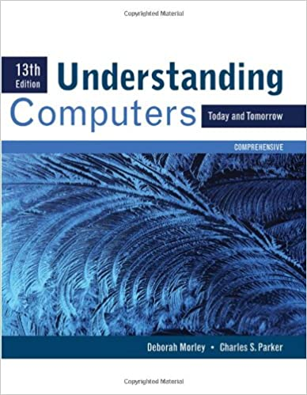
Reference

