Slide 1



Project communication
Prepared by Dr. Merna Emad
Lecture 2
www.midocean.ae

Slide 2

What will we learn?
Explore various recommendations for identifying the audience in your project, including their role, their level of power and influence over the project, and their level of support for the project.
See the value of understanding what is important to the members of your audience—the WIIFM (what’s in it for me)
Become familiar with stakeholder personas as a communication approach
Put it into practice: Know your audience in traditional and virtual project teams.

Slide 3
Section 2
Prioritizing Stakeholders
Stakeholder engagement
Lecture
Section 1
Defining our audience

Slide 4
Section One
Defining our audience

Slide 5
Defining our audience
Audience = Stakeholders
In a project, the audience is the stakeholders.
Which we can define as “an individual, group, or organization that may affect, be affected by, or perceive itself to be affected by a decision, activity, or outcome of a project, program, or portfolio.
In fifth stage, we witness a change in the concept which we spot the light on Stakeholder Management.
This change was in response to feedback around the need to expand stakeholder management concepts and recognize communications management and stakeholder management as two distinct areas.

Slide 6
Defining our audience
The importance of looking at your project’s stakeholders?
The project cannot be completed without those who initiate it, execute it, and live with the results once the project is complete.
Stakeholders can also be the barometer by which project success is measured stakeholder satisfaction is one of the criteria outlined.
They are assessing project success. If stakeholders are not satisfied with the project outcomes, it may not matter whether you have fully achieved the project’s objectives.

Slide 7
Identifying Stakeholders
Many of a project’s stakeholders can be discerned by reviewing project documents, including the charter, business case, and agreements.
Another tool for identifying stakeholders in a project is expert judgment, which includes seeking input from:
Those who have a thorough understanding of the organization’s functions, culture, and power structures. These people can help identify stakeholders who may have interest in or influence over the project.

Slide 8
Identifying Stakeholders
Many of a project’s stakeholders can be discerned by reviewing project documents, including the charter, business case, and agreements.
Another tool for identifying stakeholders in a project is expert judgment, which includes seeking input from:
Those with thorough knowledge of the industry, customers, or wider environment. They can help identify stakeholders and stakeholder concerns that derive from the external environment in which the project will exist.

Slide 9
Identifying Stakeholders
Are all the stakeholders easy to identify?
No.
Some stakeholders will be easy to identify, such as the sponsor and the team. It may be more difficult, however, to identify everyone who will be impacted by the project.

Slide 10
Identifying Stakeholders
Are all the stakeholders easy to identify?

Slide 11
Identifying Stakeholders
Are all the stakeholders easy to identify?
Some stakeholders will be easy to identify, such as the sponsor and the team. It may be more difficult, however, to identify everyone who will be impacted by the project.
Some of the information you will want to track includes the role(s) the stakeholder plays in the project and the organization; the stakeholder’s power and influence; and the stakeholder’s level of support for the project.

Slide 12
Identifying Stakeholders
Examples of Stakeholders in projects
•Investors
•Sponsors
•Financiers (the people)
•Suppliers
•Vendors
•Consultants
•Customers
•End users
•Project manager
•Team members
•Managers
•Resource managers
•Executives
•Senior management
•Company owners

Slide 13
Section Two
Prioritizing Stakeholders

Slide 14
Prioritizing Stakeholders
The importance of Prioritizing stakeholders
Ensures that the project plans are a reflection of the real needs and priorities
Develops an environment of trusts by allowing the voices of the stakeholders be heard and their issues be known
Makes the project accountable to the stakeholders
Enables the voices of the stakeholders to be heard and by doing that the level of trust in the relationships increases.

Slide 15
Prioritizing Stakeholders
The importance of Prioritizing stakeholders
Promotes transparency in the actions of the project and ensures that the project is held accountable for its actions.
Increases ownership by stakeholders who feel the project is taking in account their views and motivates them to sponsor the project, which ultimately leads to sustainability.
Is a key strategy to win support to the project, to gain commitment to the project, and ultimately to increase the chances for sustainability after the project has been completed.

Slide 16
Prioritizing Stakeholders
Now that we’ve gained a solid understanding of the prioritization of tasks and risks, we can now address stakeholders: how to find them, what effects they can have on the project, and how they’re affected by the project.
When it comes to finding stakeholders, the following guidelines are important to remember:
• Finding stakeholders is a team effort: Like risk identification, a more complete list requires everyone’s participation. Brainstorming can be an effective tool here.
• Start early and revisit often: The team should use early project activities such as feasibility studies and requirements gathering to search for stakeholders. As the project progresses, stakeholder identification should be revisited often.

Slide 17
Prioritizing Stakeholders
Now that we’ve gained a solid understanding of the prioritization of tasks and risks, we can now address stakeholders: how to find them, what effects they can have on the project, and how they’re affected by the project.
When it comes to finding stakeholders, the following guidelines are important to remember:
• Stakeholders can be groups: One common mistake is to try and identify every individual stakeholder by name. If groups of people have a similar relationship to the project, identify and manage them as a group until circumstances require a change.
• Keep a record of stakeholders: A typical format for this is the stakeholder register.

Slide 18
Section Two
Stakeholder engagement

Slide 19
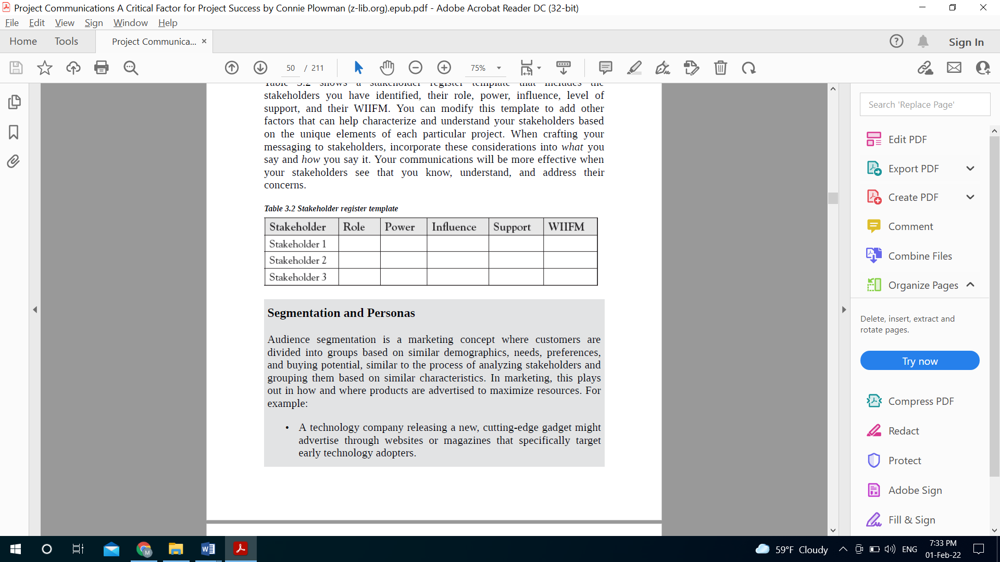
Tips to register Stakeholders
Term definition
The stakeholder register is simply a table containing information about a project’s stakeholders. The following is an example of what a basic wedding stakeholder register may look like:

Slide 20
Tips to register Stakeholders
Roles
Roles include the person or group’s position within the organization as well as their relationship to the project. Roles include titles or descriptors like project manager, business partner, sponsor, subject matter expert, business analyst, etc.
For example, in a software implementation project, the head of IT in the organization will certainly be a stakeholder, as will any employees expected to use the new software. Roles are an excellent starting point for building your stakeholder register, and for understanding how you can best communicate with each individual or group.

Slide 21
Tips to register Stakeholders
POWER
Power is a representation of the stakeholder’s level of authority as it relates to the project.
For example, a project sponsor has the ability to stop or completely shut down the project, so they have a very high level of power with regard to the project. An end user who will be using the new product or software generated by the project, for example, may have a relatively low level of power.

Slide 22
Tips to register Stakeholders
Influence
Influence, which is often related to power, is an indicator of how much the stakeholder can affect others involved with the project. Who can they influence, and how strongly?
The software’s end users may not have a high level of power, but they still have the ability to spread negative views about the project, which can influence others’ support for the project, as well as the long-term adoption and integration of the project outcomes into the organization.

Slide 23
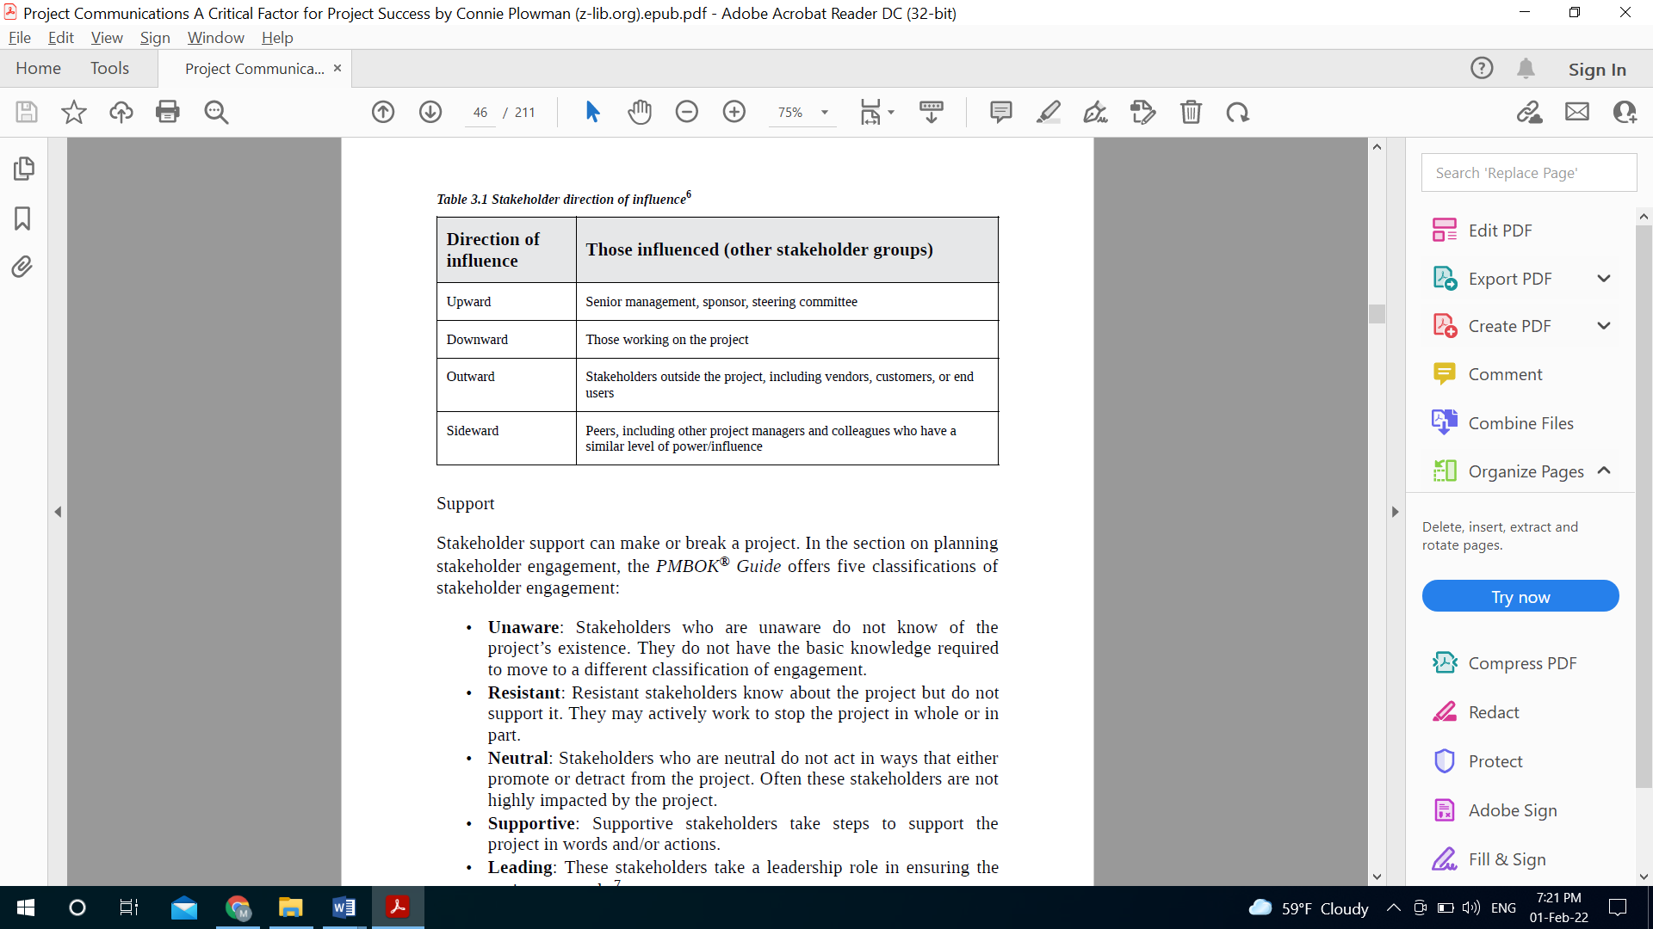
Tips to register Stakeholders
Direction of influence

Slide 24
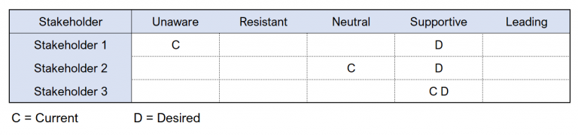
Tips to register Stakeholders
Support
Stakeholder support can make or break a project. In the section on planning stakeholder engagement. We offer five classifications of stakeholder engagement:

Slide 25
Tips to register Stakeholders
Support
Stakeholder support can make or break a project. In the section on planning stakeholder engagement. We offer five classifications of stakeholder engagement:
Unaware: Stakeholders who are unaware do not know of the project’s existence. They do not have the basic knowledge required to move to a different classification of engagement.
Resistant: Resistant stakeholders know about the project but do not support it. They may actively work to stop the project in whole or in part.

Slide 26
Tips to register Stakeholders
Support
Stakeholder support can make or break a project. In the section on planning stakeholder engagement. We offer five classifications of stakeholder engagement:
Neutral: Stakeholders who are neutral do not act in ways that either promote or detract from the project. Often these stakeholders are not highly impacted by the project.
Supportive: Supportive stakeholders take steps to support the project in words and/or actions.
Leading: These stakeholders take a leadership role in ensuring the project succeeds.

Slide 27
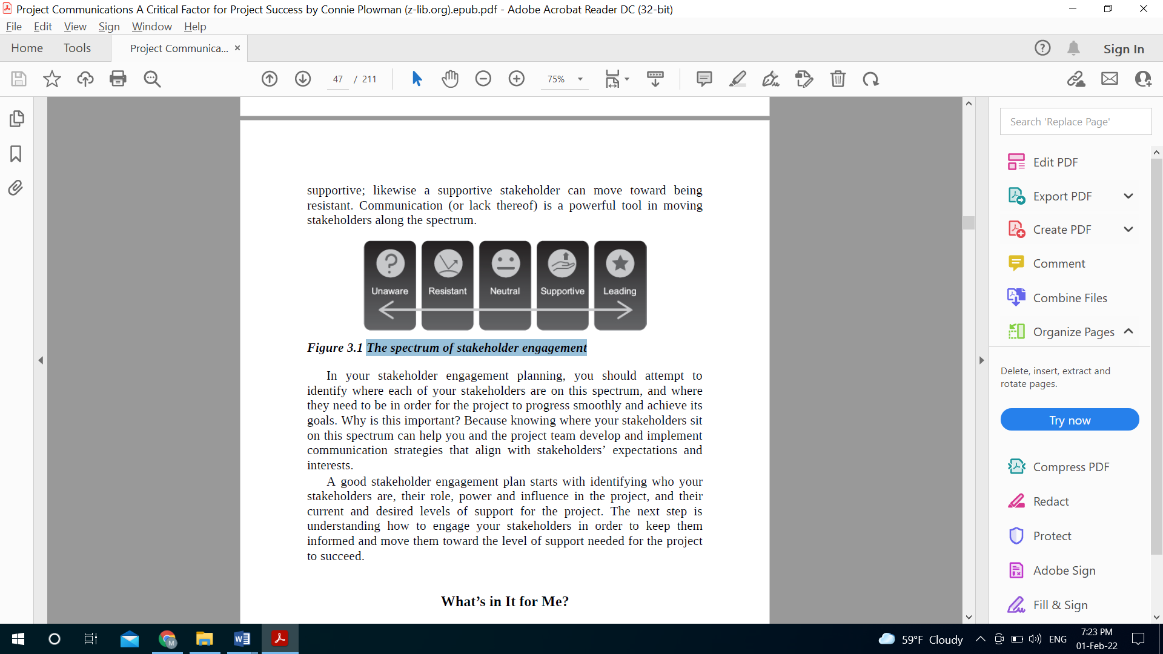
Tips to register Stakeholders
Support

Slide 28
Tips to register Stakeholders
The spectrum of stakeholder engagement
In your stakeholder engagement planning, you should attempt to identify where each of your stakeholders are on this spectrum, and where they need to be in order for the project to progress smoothly and achieve its goals.
Why is this important? Because knowing where your stakeholders sit on this spectrum can help you and the project team develop and implement communication strategies that align with stakeholders’ expectations and interests.

Slide 29
Tips to register Stakeholders
WIFM
Frequently referred to as “what’s in it for me” or WIIFM, this concept is basic but powerful. Simply put, people respond better and engage more when you talk about what matters to them.
Why is this important? Because knowing where your stakeholders sit on this spectrum can help you and the project team develop and implement communication strategies that align with stakeholders’ expectations and interests.

Slide 30
Tips to register Stakeholders
WIFM
“Just as the stakeholders may affect the project, the project affects stakeholders”
Stakeholders want to know how the project will impact them, when it will happen, and what kind of support they will receive in adjusting to the changes the project brings.
A project team member might care most about what will be expected of them and who they will be working with. The project sponsor might want to know about factors that impact whether the project will deliver its intended results, and the project’s priority within the organization.

Slide 31
Tips to register Stakeholders
WIFM
Finding the WIFM
A good place to start is to simply put yourself in their shoes.
Take your list of stakeholders and imagine how you would feel as a team member, a sponsor, a subject matter expert, a functional manager, end user, etc.
Try to write down What would be most important to you? Would you be concerned that the project could affect your status in the organization, either positively or negatively, or the way you do your work?

Slide 32
Tips to register Stakeholders
WIFM
Finding the WIFM
Another way is to collect additional data about stakeholders and their interests, such as surveys and brainstorming meetings with the project team. If you’re using expert judgment, as previously noted, this can also be a valuable tool for identifying not only who your stakeholders are, but what their concerns are about the project.

Slide 33
Tips to register Stakeholders
WIFM
Finding the WIFM
Meetings are another technique that can be useful with a wide range of stakeholder types and groups, especially when done early on in the project.
In fact, face-to-face or virtual meetings can be invaluable in understanding stakeholder concerns because you will be able to learn from nonverbal communication as well

Slide 34
Tips to register Stakeholders
WIFM
Finding the WIFM
When talking with stakeholders to understand their interests in the project, ask basic questions like:
On a scale of 1 to 10 (where 1 is extremely low and 10 is extremely high), how impactful is this project on your day-to-day work?
What do you see as the biggest benefit of this project?
Is there anything about this project that worries you?
Are there aspects of this project that conflict with your other priorities?

Slide 35
Tips to register Stakeholders
WIFM
Finding the WIFM
Add all of the data you collect to your stakeholder register. It should have a robust and nuanced “WIIFM” field for every stakeholder group that covers everything you have learned in your identification of stakeholders.

Slide 36
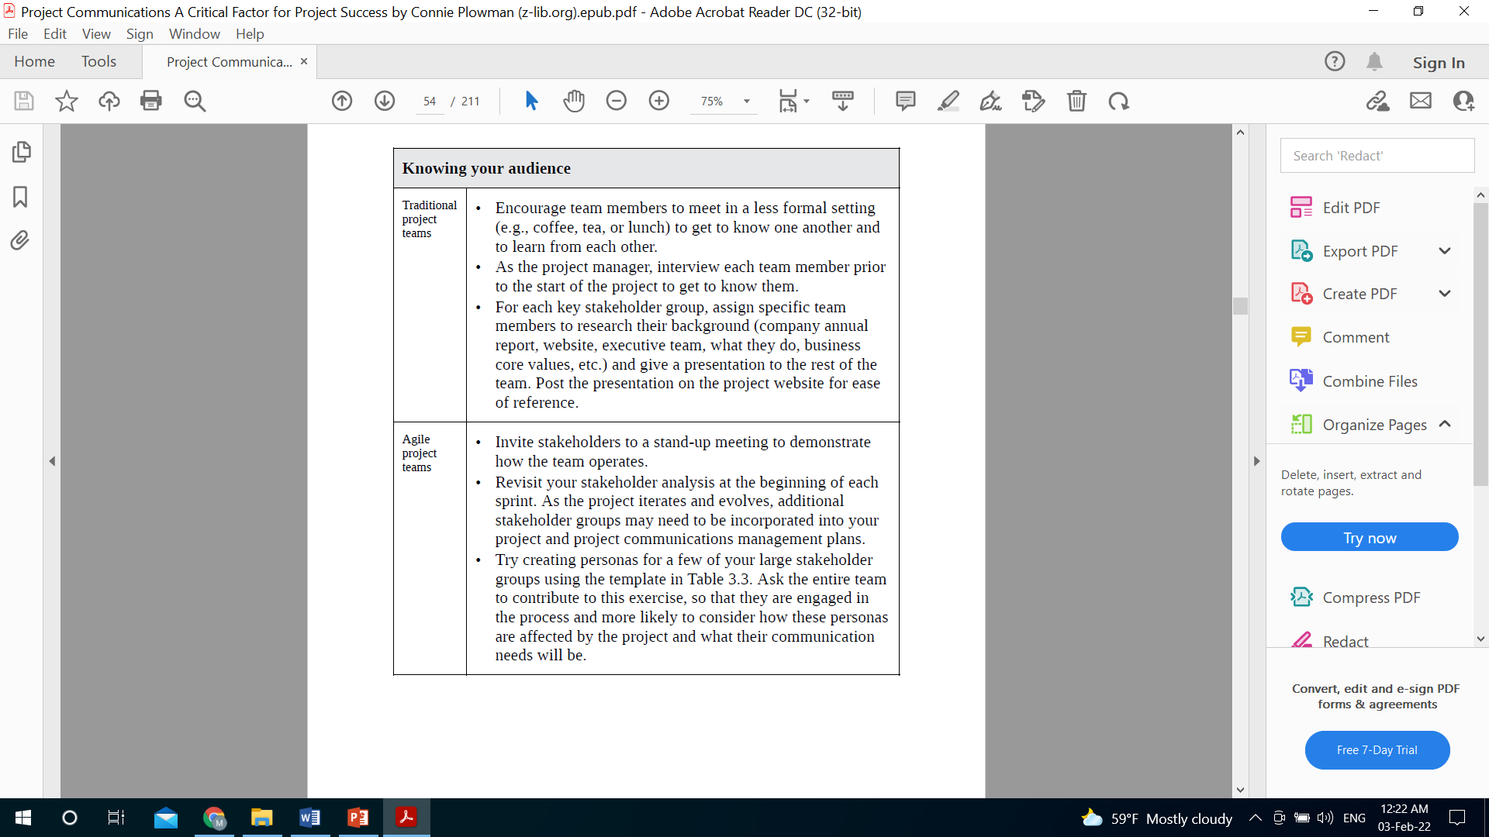
Traditional Teams

Slide 37
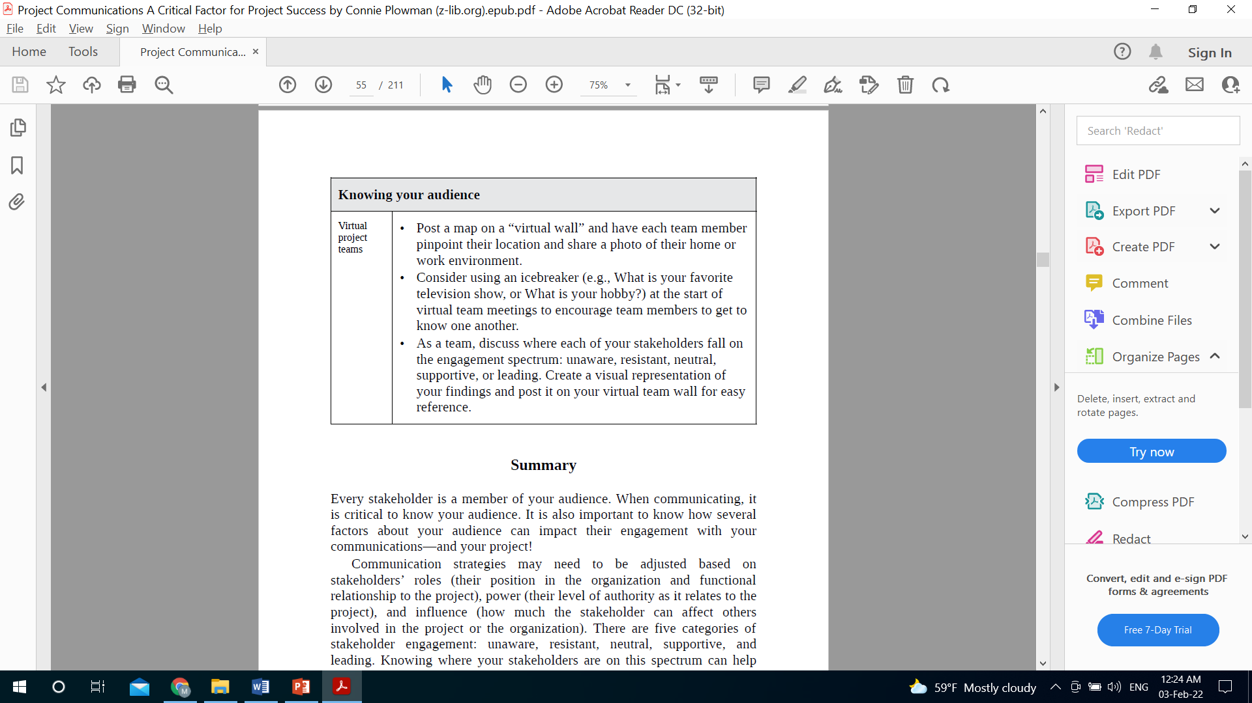
Virtual Teams

Slide 38




Thank You

