Slide 1

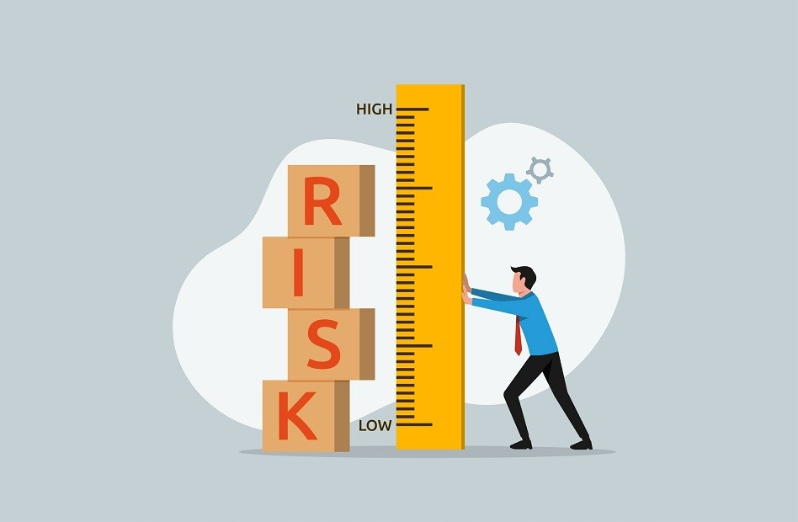
Project Management Technologies
PMG 312
Prepared by Dr. Majid Saad
PMG 312- L9
S4 - Tools and techniques for developing the project plan
Ch. 11 - Introduction to risk
Ch. 22 - Risk mechanics

Slide 2



Project Management Technologies
PMG 312
PMG 312- L9
S4 - Tools and techniques for developing the project plan
Ch. 11 - Introduction to risk
Ch. 22 - Risk mechanics
Prepared by
Dr. Prepared by Dr. Majid Saad
www.midocean.ae

Slide 3
Chapter 11- Introduction to risk
Risk management
Project risk management
Risk identification
Identification tools
Risk register

Slide 4
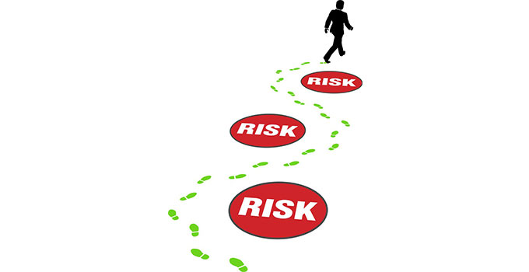
Introduction to risk

Slide 5
Risk management
There are many uncertainties with everything in life but planning for uncertainties can prevent or reduce negative outcomes, thus bringing about the term risk management.
Risk can be thought of as unplanned events in the future that could occur.
Project risk management is both the art and science of studying identification, analysis, and response to risk events throughout the life of a project.
The objective is to increase the probability and impact of positive events and to decrease the probability and impact of events considered to be adverse to the project. Some risks that are inherent in the project goal can never be avoided. Also, all risks cannot be fully mitigated because of financial and practical limitations.

Slide 6
Risk management
Risk management is formally defined as the systematic process of planning for, identifying, analyzing, responding to, and monitoring project risks involving processes, tools, and techniques to help the Project Manager maximize the probability of a predictable outcome.

Slide 7
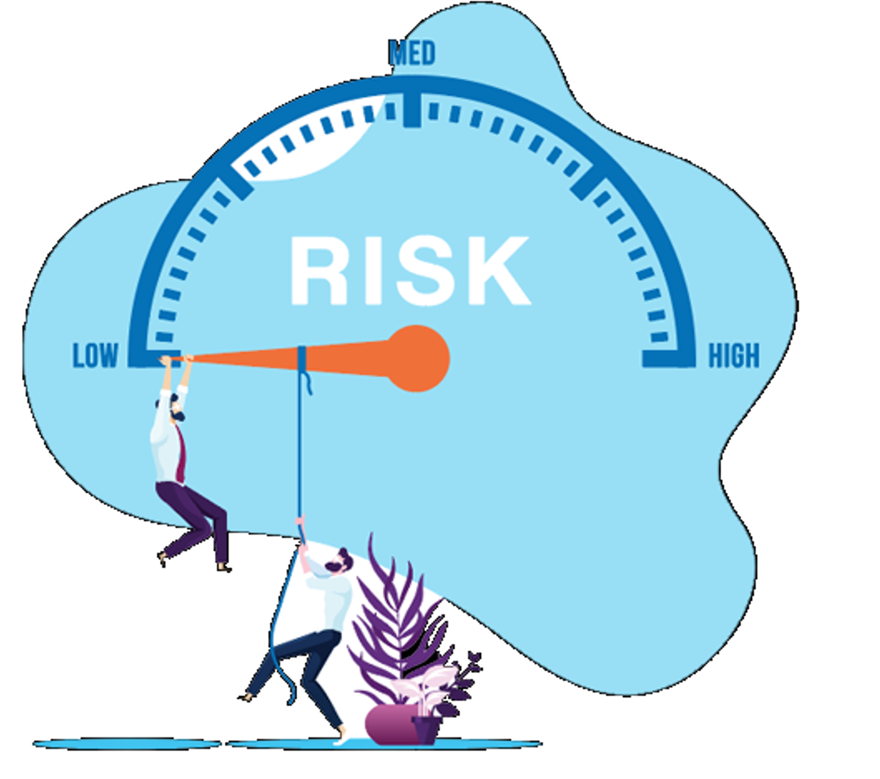
Risk management

Slide 8
Risk management
To be effective, the risk management process must be proactive throughout the project life cycle.
Therefore, not only does a Project Manager anticipate and plan for the event, but the Project Manager must also monitor activities during the execution phase to minimize risk impact when the event does occur.
The ultimate management vision of risk management is in understanding the realm of potential risks that can occur in the project as well as how each risk can affect project success.
Risks are potential events with a probability of less than 100% occurring and the impact of the risk is measured in terms of how the risk event will impact the project objectives if it occurs.

Slide 9
Risk management
It is important to note that a risk occurring can pose an opportunity or a threat.
Most risks are viewed as negative but sometimes the event can be linked to a positive factor such as new technology being introduced.
If successfully delivered, this can create a competitive advantage for the organization.
Therefore, in some cases, a risk event can relate to a better approach, resulting in a better outcome that may not have been available when the project first began.

Slide 10
Risk management
Realize that a risk event relates to something that has not happened yet.
The vocabulary term trigger is used to define an early warning sign that a risk event has occurred or is about to occur.
Delivering a project successfully within cost, time, and quality does not typically occur without effective risk management and this is the reason the project planning process must incorporate risk considerations.

Slide 11
Risk management
Risks are divided into two broad categories, known risks, and unknown risks, as described below:
  Known risks are risks that are logically expected to occur and for which some general probabilities and impacts can be estimated. These risks can be handled through risk management techniques and can be minimized by following those techniques.
  Unknown risks are not predictable events and are not generally anticipated in terms of the formal risk evaluation process.
The wise Project Manager will realize that this management aspect of the project dynamic is a critical success factor and will treat it accordingly. For that reason, the risk is becoming a topic of increasing interest.

Slide 12
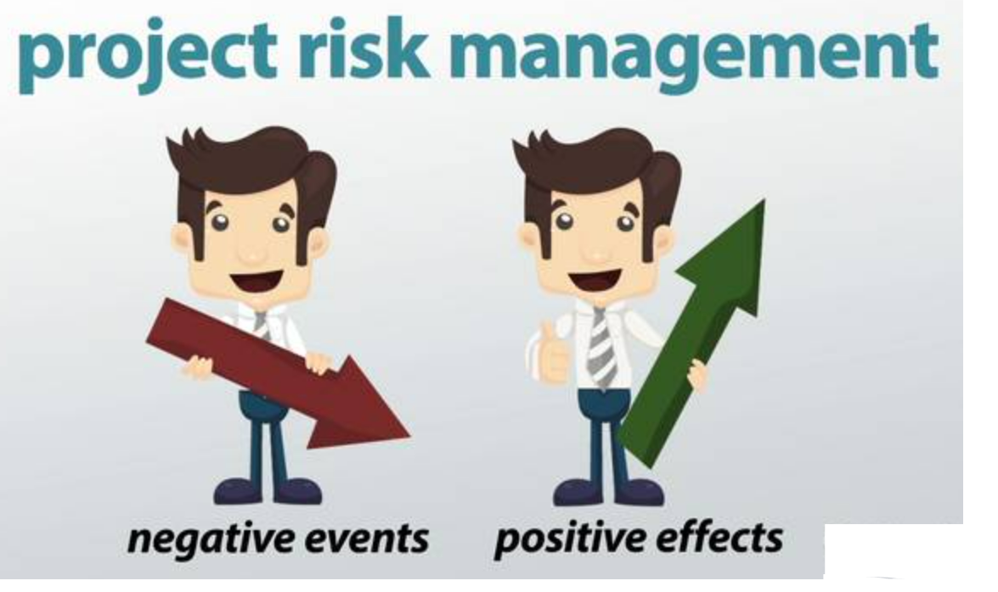
Project risk management

Slide 13
Project risk management
A risk management process identifies tools and techniques to aid in minimizing uncertainty through understanding, assessing, and managing the uncertainty inherent in projects. It is now recognized that formal processes related to this aspect of the project can have an effective impact on subsequent project events.
As a result, a description of these actions becomes part of the content for the risk management section in the project plan and the basis to show how risk in a project environment is handled. These processes can include but cannot be limited to project planning areas such as cost estimation, earned value analysis, task allocation, and detailing how monitoring and control of the project is to be accomplished.

Slide 14
Project risk management
Within the framework of a project and as referenced in the PMBOK® Guide, risk management consists of six major subordinate processes.
The six model processes are listed below and are also displayed in Figure 11.1:

Slide 15
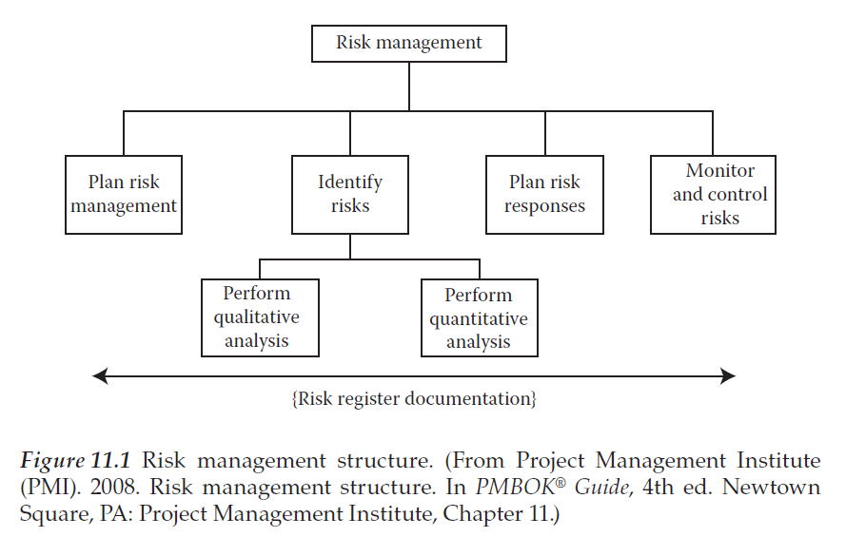
Project risk management

Slide 16
Project risk management
The six model processes are listed below and are also displayed in Figure 11.1:
  Plan risk management. Consists of details outlining how to approach, plan, and execute the risk management activities for a project with the main output of this process being the risk management plan.
  Identify risk. This process defines the risk events that are likely to affect a project.
  Perform qualitative risk analysis. Prioritizes the identified events for subsequent further analysis or action by assessing their probability of occurrence and impact with the main output being to update the risk register.

Slide 17
Project risk management
  Perform quantitative risk analysis. Provides a quantification of the selected events to establish a measure of impact.
  Plan risk responses. Develops options and actions to enhance opportunities and to reduce threats for the selected events. From the details resulting from the planned responses, various mitigation plans are established and a contingency reserve is established to handle the remaining potential events. All these details are recorded in the risk register.
  Monitoring and control risks. This management process is designed to track both identified and unidentified new events. As these events are handled, the process monitors the effectiveness of the mitigation processes.

Slide 18

Risk identification

Slide 19
Risk identification
Risk identification involves the definition of potential risks affiliated with a project.
These risks can be known risks for a potential project such as those identified by looking at company historical records to see which risk factors have occurred before on a related project.
However, a brainstorming session is an often-used support process to further identify other risks that may have never occurred before but still pose a threat to the project.
Suggests categorizing risks using headings such as environment, technical, resources, integration, management, marketing, and strategy.
The environment category is further broken down into government policy, exchange rates, weather, culture, and so on.
Technical grouping could be new technologies or methods.

Slide 20
Risk identification
Resource risks include people resources, monetary resources, and equipment or material resources.
Examples of the integration category are risks affiliated with merging new with old systems.
Management category items include corporate policies, project management techniques, and organizational structure.
Marketing risks include customers and competitors.
Competitors can also be further broken down into direct, indirect, and substitute.

Slide 21
Risk identification
Direct examples are companies with similar products or services that sell to similar customers.
Indirect examples are competitors with related businesses or capabilities.
Substitute competitors are competitors who sell products or services that can replace (be substituted as) your company’s products or services.
Adds in the category of “commercial risks,” which includes financing, warranty, and vendor performance.
These categories are listed in Figure 11.2, which displays a sample risk breakdown structure.

Slide 22
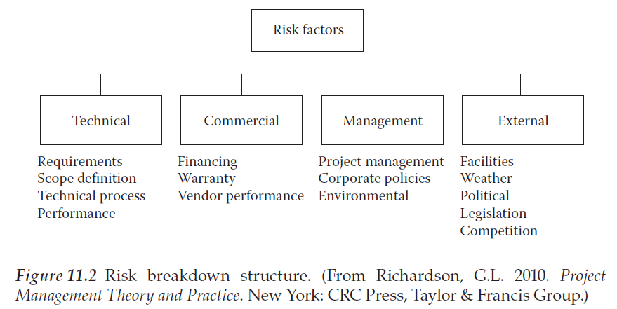
Section four
Ch. 11
Risk identification

Slide 23
Identification tools
A fishbone diagram (also known as an Ishakawa or cause-and-effect diagram) is a schematic map that is used to provide a logical method to list factors that may affect a problem or a preferred corrective outcome.
Figure 11.3 displays a sample layout of this diagram and Figure 11.4 displays an example of a filled-out diagram relating to the car case study.
This method allows a team to graphically identify and detail the possible causes of a problem.
The box to the far right of the diagram is the “effect” or problem and everything to the left of the box is a possible cause of that effect.

Slide 24
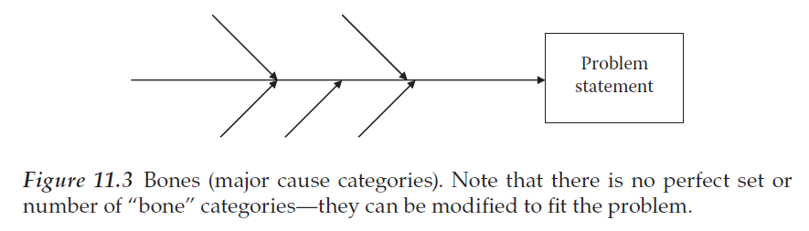
Identification tools

Slide 25
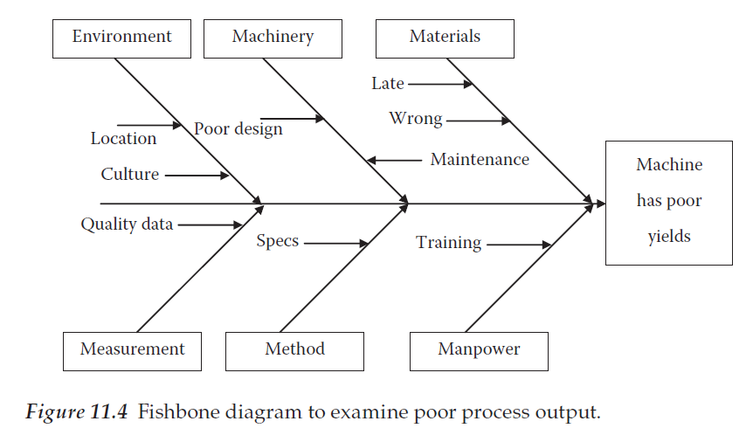
Identification tools

Slide 26
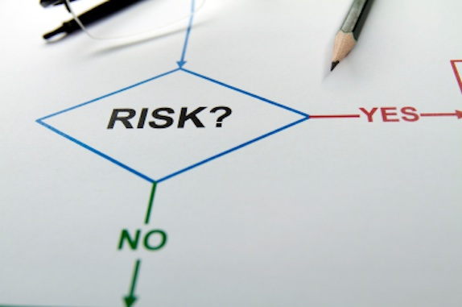
Risk register

Slide 27
Risk register
The primary documentation output of the risk identification phase is the risk register.
This document is a formal repository source for capturing the project knowledge regarding risks and their status.
Table 11.3 displays a sample risk register as a tool for documenting potential risk events and related information.
The name of the risk is listed under the risk column along with a description.
A risk may fall under a particular category (Categ.) such as technology, facilities, and so on, and can have the category defined.

Slide 28
Risk register
Other information pertaining to the specific risk can be identified well such as the root cause of the risk or any triggers that can signal activation of the event. The term trigger is used and can be defined as an early warning sign that a risk has occurred or is about to occur.
An identified item in the risk register is a risk event and its corresponding trigger.
A planned response to the risk can also be tracked in the risk register along with the risk owner, the responsible person for handling the risk, and the probability and impact assessment.
Last, the status column is used to signal the status of the event through the life cycle.

Slide 29
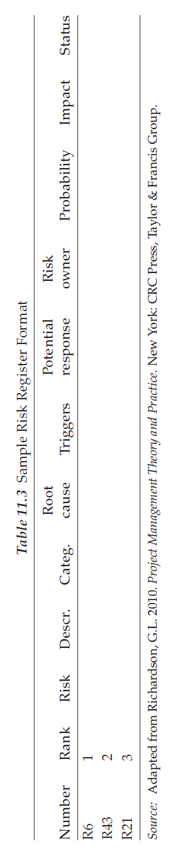
Risk register

Slide 30
Chapter 22- Risk mechanics
Risk management
Risk analysis
Qualitative risk analysis
Quantitative risk assessment
Risk response planning
Accept risk
Avoid risk
Risk monitoring and control
Summary

Slide 31
Risk management
The first two processes were discussed in Chapter 11 and the remaining four processes are discussed in this chapter. Below are the six processes:
  Plan risk management: Consists of how to approach, plan, and execute the risk management activities for a project with the main output of this process being the risk management plan.
  Identify risk: Determines the risks that are likely to affect a project and documents the characteristics of each with the main output of this process being the risk register.
  Perform qualitative risk analysis: Prioritizes risks for subsequent further analysis or action by assessing and combining their probability of occurrence and impact with the main output being to update the risk register.
  Perform quantitative risk analysis: Estimates numerically the effects of risks on project objectives with the main output also involving updates to the risk register.

Slide 32
Risk management
  Plan risk responses: Develops options and actions to enhance opportunities and to reduce threats to project objectives. Using the outputs of the above processes, various risk response strategies are made, resulting in the main output of this process being also to update the risk register as well as the project management plan and risk-related contractual agreements.
  Monitoring and controlling risks: Tracks identified risks, monitoring residual risks, identifying new risks, executing risk response plans, and evaluating their effectiveness throughout the project cycle. The main outputs of this process are recommended corrective and preventive actions, requested changes, updates to the risk register, and revised project management plan.

Slide 33
Risk analysis
Qualitative and Quantitative risk assessment and analysis:
These analyses are simply a way to prioritize risks based on the consequences that could occur should the risk occur.
Prioritization is generally based on criteria set by the team and often listed from most to least of concern.
The purpose of these types of analyses is to analyze the likelihood of occurrence and impact to the project should the risk occur.

Slide 34
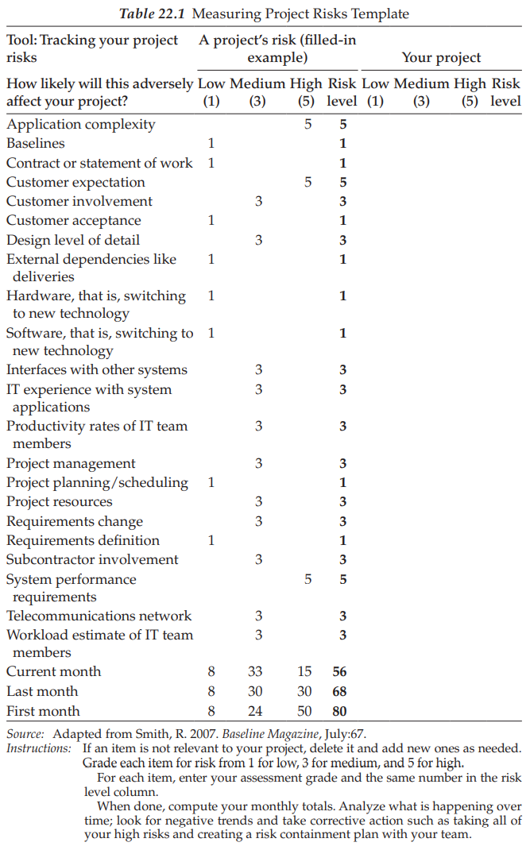
Qualitative risk analysis

Slide 35
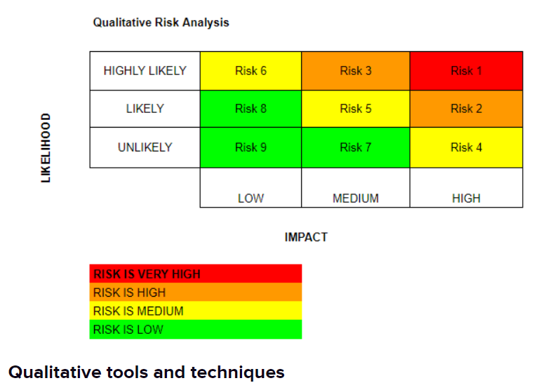
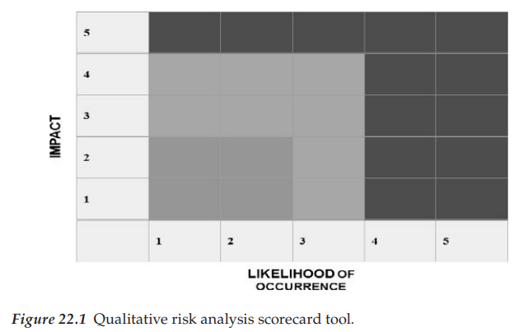
Qualitative risk analysis

Slide 36
Qualitative risk analysis
Different templates can be used to assist with this analysis.
Table 22.1 is a template to assess project risks.
Also, Figure 22.1 is an example of a qualitative risk analysis scorecard tool.
The qualitative risk analysis tool such as the risk scorecard provides a way to assess how likely it is for a risk to occur (probability of occurrence) and the impact the risk, if it occurs, will have on a project (consequence).
In this example there are different categories for probability such as very small, small, moderate, great, and very great.
For instance, a “5” is given for a probability assigned to a risk of “very great.”
Although it appears as if these categories are subjective, there is a very detailed document that accompanies different risk scorecards so that each risk will be analyzed exactly the same.

Slide 37
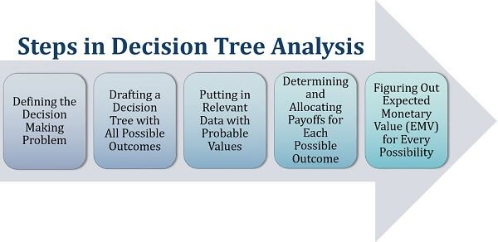
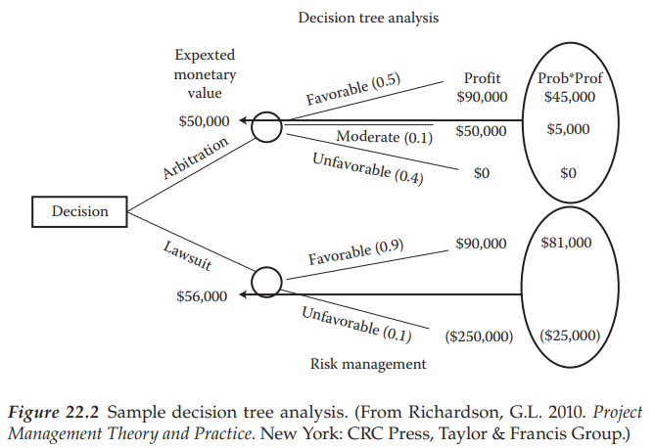
Quantitative risk assessment

Slide 38
Quantitative risk assessment
Common quantitative risk assessments often use decision tree analysis, sensitivity analysis, and simulation modeling.
Decision tree analysis is a probabilistic evaluation of an event, which can be modeled using the decision tree
diagramming technique.
For example, it encompasses the cost of each available choice, the probabilities of each possible scenario, and the rewards of each alternative logical path.
Solving the decision tree provides the expected monetary value for each alternative when all the rewards and subsequent decisions are quantified, such as the example decision tree in Figure 22.2.

Slide 39
Quantitative risk assessment
This decision tree example compares a strategy of pursuing a lawsuit or using arbitration to settle a dispute.
Each of the branches outlines options that are considered and the corresponding probability of that individual outcome.
At the end of each branch, the monetary result is displayed.
By multiplying the probability of the event times the outcome and summing the branch, it is evident that the decision to pursue a lawsuit receives the greatest expected value.
However, it also has the highest potential for loss at $250,000.
Sometimes, the avoidance of a major loss is more desirable than achieving maximum return.
Sensitivity analysis is used in determining which risks have the most potential impact on the project.
It takes each task and sees what the effect on project completion would be if it took its optimistic or pessimistic duration, while all other tasks took the deterministic value.

Slide 40
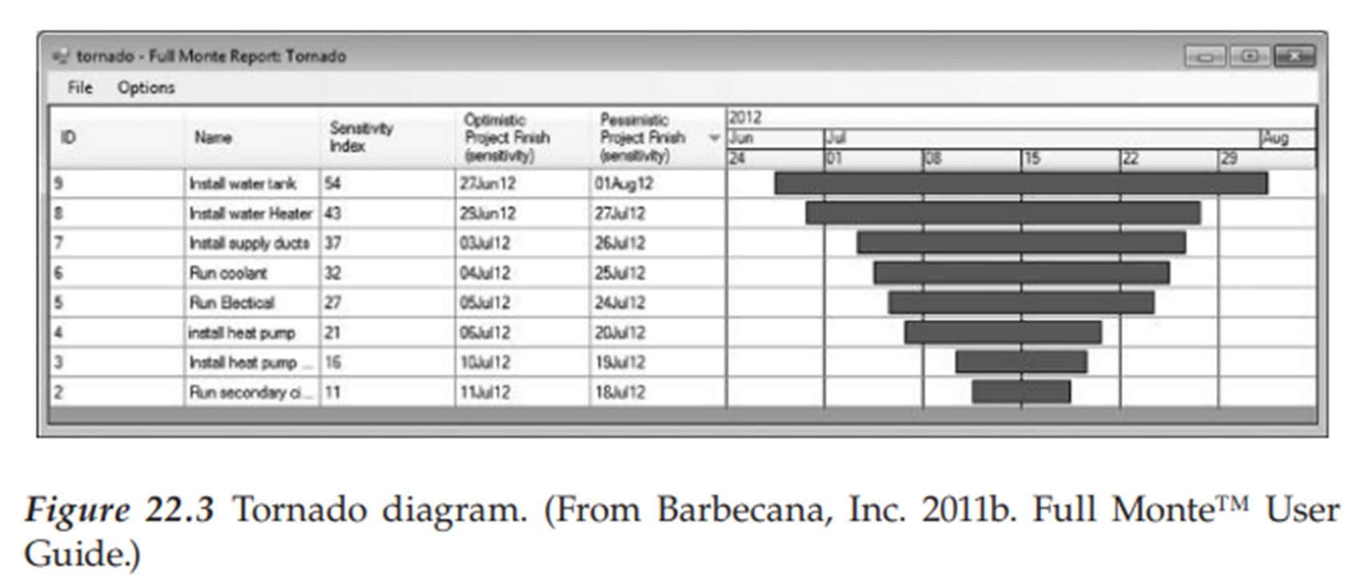
Quantitative risk assessment
Sensitivity analysis can be in the form of a tornado diagram that ranks the project activities in order of significance for, say, critical path.
The tornado diagram helps decide where to focus attention.
An example of a tornado diagram is shown in Figure 22.3.

Slide 41
Risk response planning
Defining risk responses is necessary so there is a plan in place to respond to a risk should it occur.
This plan is helpful as it is a plan written in advance of the risk occurring so that the team can easily refer to the plan should the risk occur.
Being proactive with risks is important as once a risk occurs, the team could be in a state of distress trying to identify a solution if there isn’t a plan to fall back on regarding the best risk response.
Following a plan that was written in advance helps the team be proactive with the goal of enhancing opportunities and reducing threats to the project’s objectives.
The four different risk strategies are accept risk, avoid risk, mitigate risk, and transfer risk.

Slide 42
Risk response planning
Identifying the root cause of a risk or risks helps to understand the reason why the risk could occur, which brings insights into whether a risk will be accepted, avoided, mitigated, or transferred.
A risk be accepted if the likelihood of the risk occurring and the financial impact to the project are both low.
If the likelihood of the risk occurring and the financial impact to the project are both high, the risk be avoided.
Furthermore, if the likelihood of the risk occurring is high and the financial impact to the project is low, the risk mitigation strategy may be the best decision.
Finally, if the likelihood of the risk occurring is low and the financial impact to the project is high, a risk-avoidance strategy may be best.

Slide 43
Risk response planning
However, each industry, company, and even project is unique, so what works for one project in one company within one industry may not also work in a different project within a different company or industry.
Even one project within the same industry and company may have very strong views and differing views on how to handle risks.
Each of these strategies will now be addressed.
Risks can also be positive such as using a new software tool to speed up a task.
Using the tool could complete the task much earlier than estimated, which is a positive risk.
However, there may also be potential negative risks affiliated with the tool due to the amount of time it may take for the team to learn how to use the tool, which could potentially impact the project negatively if the learning time takes away from other project tasks.

Slide 44
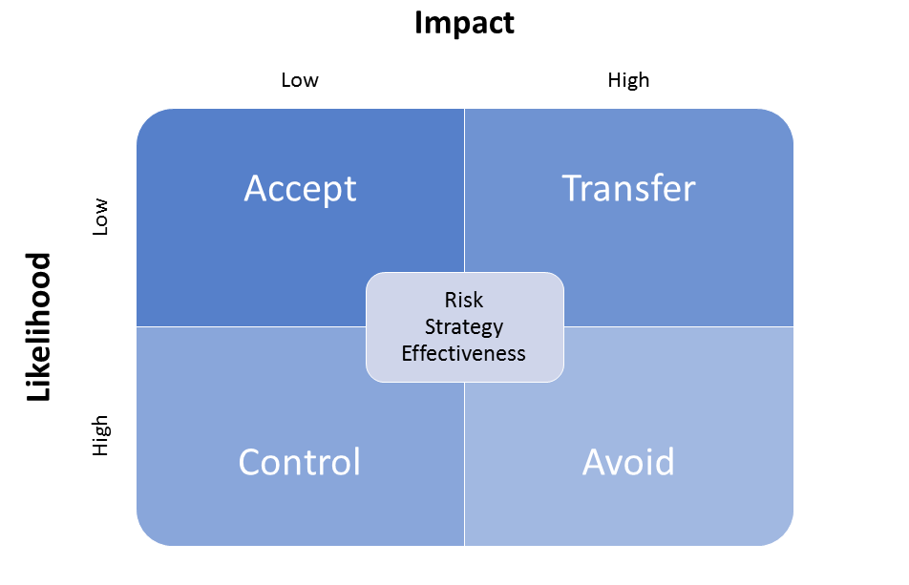
Risk response planning

Slide 45

Accept risk

Slide 46
Accept risk
Accepting a risk takes place when a project team is aware of a risk that could occur and decides not to reduce the likelihood of the risk occurring or the impact it would have if it does occur.
An example of accepting project risk is using a new technology.
For instance, new software may have potential bugs in it that could negatively impact the project in some way.
Ultimately, the Project Manager has decided that no course of action is going to be identified for dealing with this potential risk should it be realized.
Another example could be an outside community fair that carries the risk of weather impacting the success of the fair.

Slide 47
Accept risk
Since dates for the fair must be set, the project team will just accept the risk that the fair may not be successful due to weather.
In some cases, a project risk has to be accepted due to circumstances such as this example where there may not be a building large enough in a community to house an indoor fair or the cost of such a building is beyond the funds available to host the fair.
Accepting project risks is no different than the risk a person takes every day by assuming risks in traveling by car, for instance.
Sometimes, it is impossible to do anything but to accept risks to move forward within a project.

Slide 48

Avoid risk

Slide 49
Avoid risk
Avoiding a risk occurs when a project team is aware of a risk that could occur and decides to identify a plan of action to reduce the likelihood of the risk occurring.
This way the risk can be avoided and thereby it is unable to impact the project.
To avoid the risk, a plan of action could be identified.
Furthermore, sometimes a risk is decided by the Project Manager to be ignored for many reasons such as viewing new technology as an opportunity versus a risk or for many political reasons as well.
Now, an example of avoiding risk for a wedding planner is planning a wedding with a concern of an outdoor wedding being rained out to instead hold the wedding in an indoor location.
This is a way to completely avoid the risk from impacting the project, in this case, a wedding.
Another example is of a company adapting different technology and considering new technology.
The risk is that there may be problems finding skilled new hires experienced with the new technology.
A way to avoid the risk is for the company to instead adapt proven technology where there is an abundance of skilled workers to hire.

Slide 50
Risk monitoring and control
Finally, risk monitoring and control needs to occur.
This consists of merely tracking all the risks previously identified and implementing response strategies as necessary, so the project is not impacted by the potential risks.
The monitoring and controlling of risks is an ongoing effort throughout the life of the project.
Those risks that have been previously identified along with an identified risk strategy need to be monitored to gauge how likely it is that the risk could occur.
As a good rule of thumb, a Project Manager should not leave the risk monitoring and controlling effort open-ended and instead set certain time intervals officially established for monitoring and controlling risks.
Therefore, one should not monitor and control risks once in the life of the project as that is not enough.
Perhaps, the project plan should state that risks must be monitored and controlled when each major milestone work begins and ends.

Slide 51
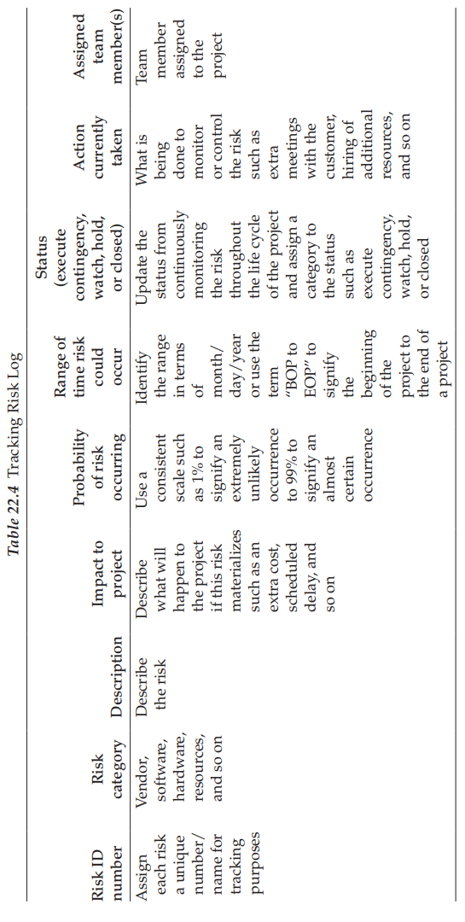
Risk monitoring and control

Slide 52
Risk monitoring and control
The team cannot decide to suddenly begin monitoring and controlling risks in the middle of a project.
For project success, a process at the onset of the project must be established for the team to follow in monitoring and controlling risks.
Therefore, it is important to develop the process for your team to carry out the task of monitoring and controlling risk so that risks can be reported, which is not limited to but should include the following tasks:
  Look at current risks in exploring how these risks could be reduced or eliminated and no longer need coverage.
  Track systematically the identified risks in a risk log displayed in Table 22.4.
  Identify new risks continuously throughout the life cycle of the project.
  Produce lessons learned for future risk assessment and allocation efforts.

Slide 53
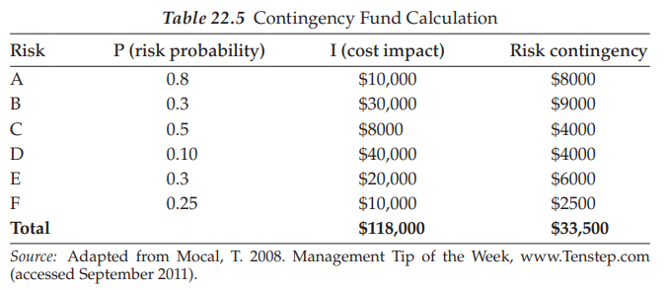
Risk monitoring and control

Slide 54
Risk monitoring and control
After all risks have been identified and analyzed, the Project Manager needs to set aside sufficient reserves to support these future events.
The simple example shown in Table 22.5 illustrates the mechanics of this process.
Mathematically, these calculations would indicate that a contingency fund of $33,500 would be sufficient to cover this probabilistic set of items.
However, note that risk D by itself would wipe out the fund, so what is wrong with this process?
First, we have to recognize that the expected value calculation requires a sufficient number of observations to function properly.
Second, this process is not a pure science and there will likely be events occurring that are not in the list, as well as probability and impact quantification errors.
Under normal situations, the number of items identified will suffice for the mathematical size requirement, leaving behind the quantification and undefined event issues.
Experience will help with the specification of a valid contingency reserve and on that basis will be somewhat stable to management.
However, it will always be an issue to show reserves in a project for items that have not yet been physically defined or happened.
Regardless of the amount set aside for this class of unknowns, it is important to recognize this time and cost aspect of the planning process.
The Project Manager has the challenge of justifying to management why these additional funds are needed.

Slide 55
Summary
Risk planning begins with a series of steps designed to help approach, plan, and execute the risk management activities, which constitutes the first major step in risk management.
The second process step involves the identification of risks by looking at a company’s historical records to identify all previous risks encountered on past related projects, which was the second objective of this chapter.
Risks are analyzed with a quantitative or a qualitative assessment.
Once the risk has been thoroughly assessed, a plan as to how to respond to the risk is identified.
Therefore, a plan is put in place to respond to each risk event with the goal being to enhance opportunities and reduce threats to the project’s objectives.
The last step is the monitoring and controlling of risks throughout the life of the project.
This section has discussed many tools and techniques in risk management, which will require many resources for the Project Manager and project team to be successful.
Most importantly, although risks are identified at the beginning of the project, new risks may become identified throughout the life cycle of the project, so it is important to continuously assess potential risks throughout the project.

Slide 56



Thank You

