Slide 1





Writing in Organizations
Prepared by Dr. Adam Yagoub
Lecture 3
MGM202
Writing Routine Business
Correspondence

Slide 2

Lecture 1
Lecture 3
Key Learning Points
Course Outline
Lecture 1: Getting Started: Writing and Your Career.
Lecture 2: The Writing Process and Collaboration at Work.
Lecture 3: Writing Routine Business Correspondence.
Lecture 4: Writing Letters: Some Basics for Communicating with Audiences Worldwide.
Lecture 5: How to Get a Job: Searches, Dossiers, Portfolios, Résumés, Letters, and Interviews.
Lecture 6: Designing Successful Documents, Visuals, and Websites.
Lecture 7: Writing Instructions and Procedures.
Lecture 8: Writing Effective Short Reports.
Lecture 9: Writing Proposals.
Lecture 10: Writing Careful Long Reports.

Slide 3
Lecture 3
Lecture Outline
1- What Memos, Faxes, E-Mails, IMs, and Blog Posts Have in Common
2- Memos
3- Sending Memos: E-mail or Hard Copy?
4- Sending Faxes: Some Guidelines
5- E-Mail: Its Importance in the Workplace
6- Instant Messages (IMs) for Business Use
7- Blogs
8- Routine Correspondence: A Final Word

Slide 4
Lecture 3
Writing Routine Business Correspondence
1- What Memos, Faxes, E-Mails, IMs, and Blog Posts Have in Common:
Although memos, faxes, e-mails, IMs, and blog posts are very different types of correspondence, they share the following characteristics:
1. Each of these types of correspondence is streamlined for the busy world of work. Unlike letters, proposals, or reports, which can be long and detailed and contain formal parts and sections, these routine types of correspondence give writers and readers a particularly fast way to communicate.

Slide 5
Lecture 3
Writing Routine Business Correspondence
2. They give busy readers information quickly. While the messages they contain can be about any topic in the world of work, most often they focus on day-to-day activities and operations at your company—sales and product information, policy and schedule changes, progress reports, orders, troubleshooting problems.
3. They are informal. Compared to letters, proposals, and reports, these kinds of routine correspondence are not as formal. They emphasize a conversational, yet professional, style of writing.

Slide 6
Lecture 3
Writing Routine Business Correspondence
4. Even though they are routine, they still demand a great deal of thought and time. Although memos, e-mails, blogs, and IMs are less formal than, for instance, a letter to a client, they all must be written clearly and with correct grammar and punctuation, even when the correspondence is between two employees in the same department of a company. Always plan and review what you are going to write.

Slide 7
Lecture 3
Writing Routine Business Correspondence
2- Memos:
Memorandum, usually shortened to memo, is a Latin word for “something to be remembered.” The Latin meaning points to the memo’s chief function: to record information of immediate importance and interest in the busy world of work, as in Figure 3.1. Memos are brief and informal but can contain official announcements that serve a variety of functions, including:

Slide 8
Lecture 3
Writing Routine Business Correspondence
■ making an announcement
■ providing instructions
■ clarifying a policy, procedure, or issue
■ changing a policy or procedure
■ alerting employees to a problem or issue
■ delegating responsibilities
■ making a request
■ offering suggestions or recommendations
■ providing a record of an important matter
■ confirming an outcome

Slide 9
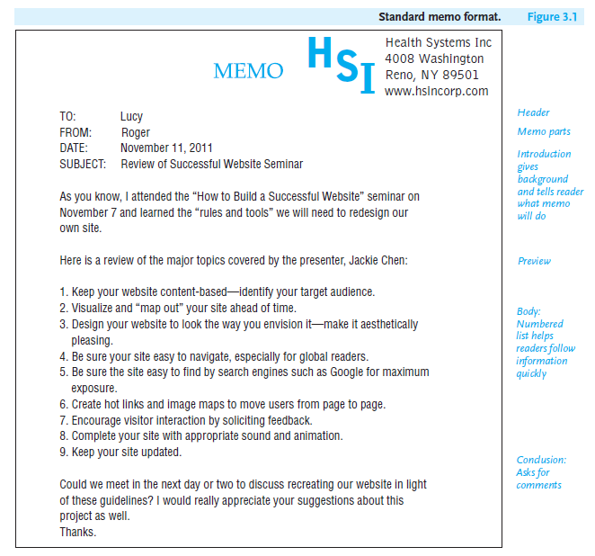
Lecture 3
Writing Routine Business Correspondence

Slide 10
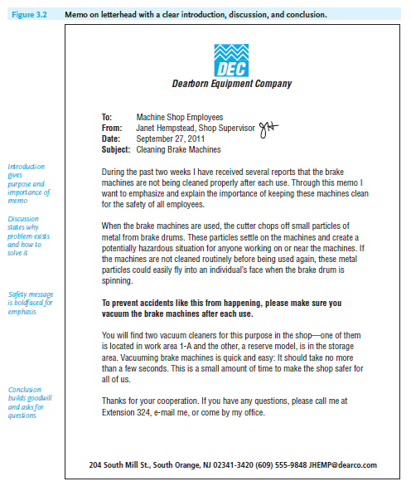
Lecture 3
Writing Routine Business Correspondence
- Memo Format
Memos vary in format and the way they are sent. Some companies use standard, printed forms (Figure 3.1), while others have their names (letterhead) printed on their memos (as in Figures 3.2 and 3.3). You can also create a memo by including the necessary parts in an e-mail.

Slide 11
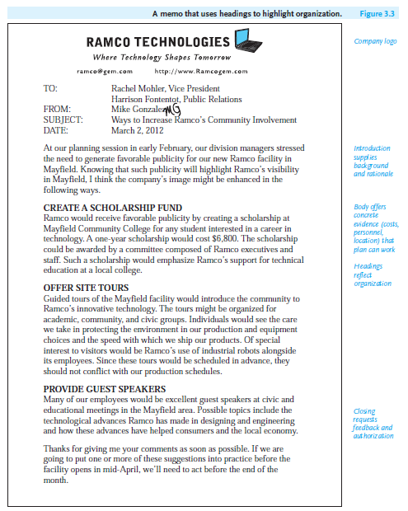
Lecture 3
Writing Routine Business Correspondence

Slide 12
Lecture 3
Writing Routine Business Correspondence
- Strategies for Organizing a Memo
Organize your memos so that readers can find information quickly and act on it promptly. For longer, more complex communications, such as the memos in Figures 3.2 and 3.3, your message might be divided into three parts: (1) introduction, (2) body or discussion, and (3) conclusion. Regardless of how short or long your memo is, recall the three P’s for success—plan what you are going to say; polish what you wrote before you send it; and proofread everything.

Slide 13
Lecture 3
Writing Routine Business Correspondence
Introduction
The introduction of your memo should do the following:
■ Tell readers clearly about the issue, policy, or problem that prompted you to write.
■ Explain briefly any background information the reader needs to know.
■ Be specific about what you are going to solve a problem.

Slide 14
Lecture 3
Writing Routine Business Correspondence
Body (Discussion)
In the body, or discussion section, of your memo, help readers in these ways:
■ State why a problem, procedure, or decision is important; who will be affected by it; and what the consequences are.
■ Indicate why and what changes are necessary.
■ Give precise dates, times, locations, and costs.

Slide 15
Lecture 3
Writing Routine Business Correspondence
Conclusion
In your conclusion, state specifically how you want the reader to respond to your memo. To get readers to act appropriately, you can do one or more of the following:
■ Ask readers to call you if they have any questions, as in Figure 3.2.
■ Request a reply—in writing, over the telephone, via e-mail, or in person—by a specific date, as in Figures 3.1 and 3.3.
■ Provide a list of recommendations that readers are to accept, revise, or reject, as in Figure 3.3.

Slide 16
Lecture 3
Writing Routine Business Correspondence
3- Sending Memos: E-mail or Hard Copy?
A memo can be sent as a printed hard copy, as an e-mail, or in an e-mail attachment. Find out your company’s policy. Increasingly, e-mail is replacing printed memos, but there are times when a hard-copy memo is preferred as essential.
Consider the level of official importance and confidentiality of your memo. If your memo is an official document, such as the policy outlined in Figure 3.2, you may not want to send it via e-mail, because it could easily be deleted or altered. Moreover, if your memo is confidential (e.g., an evaluation of a co-worker or vendor, a message containing sensitive financial or medical information), you may not want to send it via e-mail, because it could easily be forwarded or fall victim to hackers.

Slide 17
Lecture 3
Writing Routine Business Correspondence
4- Sending Faxes: Some Guidelines:
Even though you will use e-mail attachments and scan and send documents via e-mail, faxes are still used in the world of work. A fax is an original document copied and transmitted over telephone or computer lines. Faxes are particularly helpful either when you have only hard copy to send or when you want to send an original signed letter, contract, blueprint, artwork, or other document that you could not send via an e-mail transmission. Faxes demonstrate exactly what original documents look like and allow recipients to obtain a hard copy quickly.

Slide 18
Lecture 3
Writing Routine Business Correspondence
- Cover Page
When you send a fax, make sure your cover page includes the following information:
1. The name of the sender and his or her fax and phone numbers. The phone number is important because it enables the recipient to report an incomplete transmittal.
2. The name of the recipient and his or her fax and phone number. The recipient’s correct fax and phone numbers should be included to ensure delivery of the message.

Slide 19
Lecture 3
Writing Routine Business Correspondence
3. The total number of pages being faxed. Note that the total number of pages includes the cover page itself.
4. A brief explanatory note that lets the recipient know what the fax is, what its purpose is, and how and when to respond to it.

Slide 20
Lecture 3
Writing Routine Business Correspondence
- Sending a Document
Follow these four guidelines to fax a clear and complete document:
1. Make sure the original documents you send are clear. An unclear faxed document will be difficult for the recipient to read. For example, penciled comments may be too faint to fax clearly.
2. Avoid writing on the top, bottom, or edges of the documents to be faxed. Any comments written on the outer edges may be cut off or blurred during transmittal.

Slide 21
Lecture 3
Writing Routine Business Correspondence
3. Do not send overly long faxes. Be careful about sending anything longer than three or four pages because you will tie up both your own and the recipient’s fax machines.
4. Respect the recipient’s confidentiality. Because faxes may be picked up by other employees in your office, don’t assume your message will be confidential, unless, of course, the recipient has a private fax machine.

Slide 22
Lecture 3
Writing Routine Business Correspondence
5- E-Mail: Its Importance in the Workplace:
E-mail continues to be one of the most common forms of communication in the workplace. It is the lifeblood of every business or organization because it expedites communications within your firm as well as outside of it. Professionals in the world of work may receive hundreds of e-mails a day from supervisors, colleagues, clients, and vendors. Moreover, these e-mails may contain visuals, soundbites, and tables, lists, and statistical files. As we saw, memos, too, can be sent via e-mail.

Slide 23
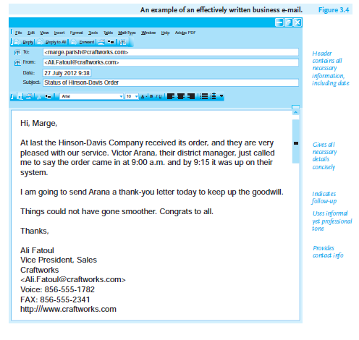
Lecture 3
Writing Routine Business Correspondence
- Business E-Mail Versus Personal E-Mail
E-mail is an informal, relaxed type of business correspondence, far more so than a printed memo, letter, short report, or proposal. (However, e-mail should never be sent in place of a formal letter. Think of business e-mail as a polite, informative, and professional conversation—friendly, to the point, and always accessible, as in Figure 3.4.

Slide 24
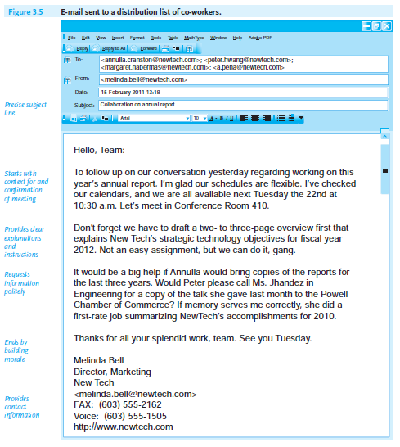
Lecture 3
Writing Routine Business Correspondence
Yet even though business e-mail is basically informal and casual, sending it does not mean you can forget about your responsibilities as an informed, cautious, and courteous employee and co-worker. Figure 3.5 exemplifies an e-mail used as a diplomatic yet informal way of communicating with a collaborative team.

Slide 25
Lecture 3
Writing Routine Business Correspondence
- Guidelines for Using E-Mail on the Job
When you prepare and organize your e-mail message, always consider your reader’s specific needs as well as those of your company. Following the guidelines below will help you to write effective business e-mails.
1. Make sure your e-mail is confidential and ethical.
2. Make your e-mails easy to read.
3. Observe the rules of netiquette (Internet + etiquette).
4. Adopt a professional style.
5. Ensure that your e-mail is safe and secure.

Slide 26
Lecture 3
Writing Routine Business Correspondence
6- Instant Messages (IMs) for Business Use:
IMs are streamlined textual conversations online and sent close to real time. Think of a professional IM as somewhere between a phone call and an e-mail, or a chat with a colleague in the hallway. IM conversations are almost as instantaneous as phone conversations, but at the same time they provide written records of communications, just as e-mails do. Keep in mind, though, that IMs are not just for communications with your friends; they play a vital role in workplace correspondence.

Slide 27
Lecture 3
Writing Routine Business Correspondence
In fact, researchers estimate that 90 percent of all businesses have or will use IMs for routine workplace correspondence. IMs allow you to communicate with co-workers and managers in the same office, at remote sites, or around the globe. Crossing time zones, IMs give you access to anyone around the world who is online and connected to the same service. Figure 3.8 is an example of a workplace IM conversation.

Slide 28
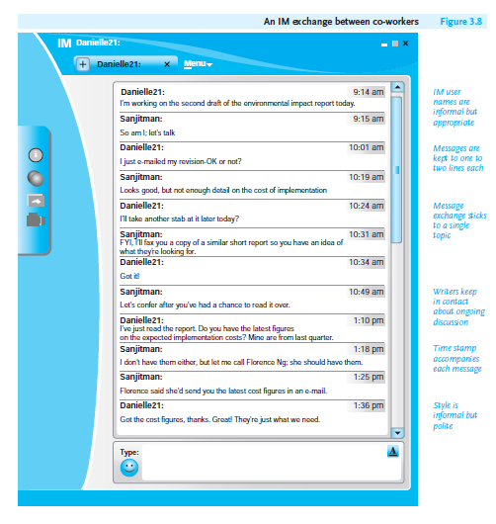
Lecture 3
Writing Routine Business Correspondence

Slide 29
Lecture 3
Writing Routine Business Correspondence
- When to Use IMs Versus E-Mails
Like e-mails, IMs promote collaboration, provide a written record, and further global communication. But they are used for very different kinds of messages. E-mails are more detailed than IMs. By answering the following questions, you will be better able to determine when to send an IM or an e-mail.
1. How quickly does my message need to be sent/received? If you need information right away, use IM rather than an e-mail because recipients will most likely reply at once if they are online.

Slide 30
Lecture 3
Writing Routine Business Correspondence
2. How long or complex is my message? If you need to transmit a message that, say, is more than a line or two (e.g., even extending to a paragraph or more) or contains multiple points, send an e-mail.
3. If your message requires more time than a few brief back-and-forth communications, start an e-mail exchange that can extend over several hours or days.

Slide 31
Lecture 3
Writing Routine Business Correspondence
- Guidelines on Using IMs in the Workplace
observe these safe rules for your IMs.
1. Stay connected. Indicate your messenger status—“Away,” “Busy,” “Offline.
2. Keep your messages short. Get to the point right away. A line or two at most is enough for your IMs.
3. Write about one topic at a time. Don’t include information about two or three different topics in one IM exchange.

Slide 32
Lecture 3
Writing Routine Business Correspondence
4. Avoid unfamiliar abbreviations. As in an e-mail, commonly understood abbreviations such as “FYI” or “ASAP” are fine—even encouraged—in IMs.
5. Make sure your message is professional. Even though IMs are the most informal business messages you can send, don’t disregard professional courtesy and ethics.
6. Organize your contact (buddy) lists into separate groups, such as business, co-workers, friends/family, etc.

Slide 33
Lecture 3
Writing Routine Business Correspondence
7. Don’t use IMs to send sensitive/confidential information about personnel, financial, hiring, or medical/legal issues.
8. Watch for viruses. Be careful about sharing files or opening attachments via IMs.
9. Safeguard the privacy of your contact lists as well as the contents of any IM attachments.

Slide 34
Lecture 3
Writing Routine Business Correspondence
7- Blogs:
Like e-mails and IMs, blogs (an abbreviation of “Web logs”) are important tools for e-correspondence for employees, managers, and customers. A blog is more than just a casual journal or diary in the world of work. Think of a business blog as an evolving website or daily business newspaper for which employees and management write regular columns, or posts.

Slide 35
Lecture 3
Writing Routine Business Correspondence
- Internal/External Blogs
Blogs can be either internal or external, depending on the intended audience. Internal blogs are designed exclusively for employee readers. Employees can interact by posting their comments and asking questions, express their views on new policies, announce events and introduce new staff, and communicate up and down the corporate ladder.

Slide 36
Lecture 3
Writing Routine Business Correspondence
External blogs allow companies to express their side of the story—their interpretation of events and their clarification of the issues—quickly and publicly. But besides being a forum for the company’s viewpoints, external blogs are a fast way to get the information out about new or updated product and services, expanded locations, changes in technology, product recalls, efforts at greening an environment, community service, or just about anything related to a company’s mission and activities.

Slide 37
Lecture 3
Writing Routine Business Correspondence
- Guidelines for Writing a Business Blog:
Following the guidelines below will help you write an effective (external) business blog.
1. Respect your company’s protocols. Don’t post anything discriminatory or confidential about an employer, co-workers, product, or service.
2. Positively project your company’s image. Keep your company’s history, mission, and reputation in mind when you prepare your blog.
3. Avoid making your company liable for false or misleading information.
4. Target your audience. Try to reach current and potential customers by anticipating their questions and needs.

Slide 38
Lecture 3
Writing Routine Business Correspondence
5. Date every blog posting so readers can follow a conversation. Update your blog to make sure your information is current.
6. Write an attention-grabbing headline.
7. Share your story. Draw from your experiences. Offer your own perspectives.
8. Adopt a casual, conversational style. Be upbeat and succinct. Emphasize how and why your comments will help readers.
9. Structure your blog. so that your first paragraph comes to the point at once and tells readers what you are blogging about and why.

Slide 39
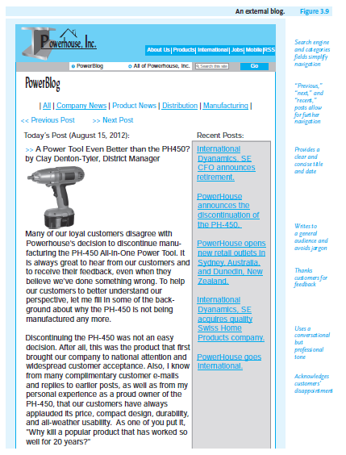
Lecture 3
Writing Routine Business Correspondence
10. Make it easy for readers to respond to your posting. Tell them where and how to reply.
11. Document your sources. If you use someone else’s statistic, surveys, illustrations, or ideas, first get permission from the individual or the company that owns the copyright.
12. Include relevant visuals. The blog in Figure 3.9 clearly shows what the new model looke like.

Slide 40
Lecture 3
Writing Routine Business Correspondence
8- Routine Correspondence: A Final Word:
In today’s global marketplace, you can expect to write the types of correspondence discussed in this chapter as a regular and vital part of your job. They are quick, brief, to-the-point, and informal, the workhorses of the business world. Always remember, though, that they are professional business communications that represent your company and should portray you as a proficient and ethical employee. As this chapter has stressed, to write successful memos, faxes, e-mails, IMs, and company blogs, follow these essential guidelines:

Slide 41
Lecture 3
Writing Routine Business Correspondence
(1) Plan your correspondence—don’t just write and click.
(2) Politely address your reader’s questions and problems.
(3) Make sure your information is accurate and up-to-date.
(4) Adhere to your company security/privacy rules.
(5) Proofread for spelling, grammar, punctuation, style, and tone.

Slide 42
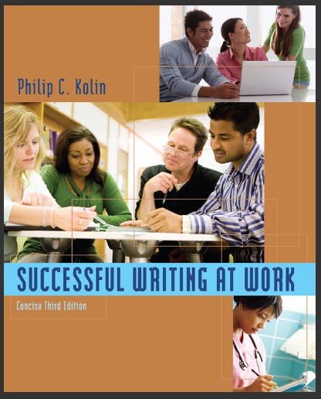
Lecture 3
Writing Routine Business Correspondence
Resources:
Successful Writing at Work, Concise Third Edition,
By: Philip C. Kolin
University of Southern Mississippi
Chapter 3

