Slide 1

Social Media Management (DGM 721)
Prepared by
Dr. Mahitab ELrafii
Lecture No.4
Social Media Management (DGM721)

Slide 2
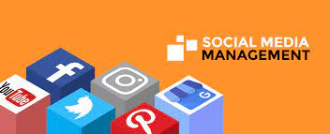
Sources of Knowledge
Social media management
Dr. Mahitab ELrafii
customer relationship management

Slide 3
Content of lecture
The Content of lecture 4 Includes the following:
What is meant by social CRM?
Why is social CRM important?
How to set up a social CRM process
4 tips for using social media CRM as a business strategy.
What are the three types of customer relationship management?
key benefits a CRM could provide.
Artificial intelligence and CRM.
Emerging trends in 2025 CRM.

Slide 4

What is meant by social CRM?
Social CRM or social customer relationship management is the integration of social media channels into Customer Relationship Management (CRM) platforms. Increasingly, CRM platforms support social media alongside traditional channels so customers can interact with businesses via their preferred channels. This means better customer service and greater marketing insight gathered from customer social media data.

Slide 5
Social CRM is a business strategy that entails the extension of marketing, sales and customer service processes to include the active participation of customers or visitors to an Internet channel (Web or mobile) with the goal of fostering participation in the business process.

Slide 6

Social CRM stands for social customer relationship management.
It involves connecting social media channels with your CRM system, giving all team members within the company a complete record of interactions with the customer or prospect. Including, of course, interactions that happen on social channels.
That means social connections can become real leads. Your first contact with someone on social media is generally not the best time to go in with a hard sell. But without a way to track this potential lead, it’s impossible to nurture the relationship and work towards a sale over the longer term.

Slide 7

Integrating social media into your CRM also allows you to create a fuller picture of the success of your social marketing strategy. Customer interactions on social networks can be clearly tied to business outcomes like a purchase or subscription.
Finally, social CRM data enables you to create highly targeted custom audiences for social ads. The characteristics of existing customers are the best basis for effective lookalike audiences.

Slide 8
Why is social CRM important?
Social CRM benefits all departments that work with customers or leads. It gives everyone a fuller picture of the people they're talking to. That includes sales, customer service, tech support, marketing, and even product development

Slide 9
How to set up a social CRM process
Social CRM benefits all departments that work with customers or leads. It gives everyone a fuller picture of the people they’re talking to. That includes sales, customer service, tech support, marketing, and even product development

Slide 10

Set up a social listening program
Social listening involves tracking brand mentions, including conversations about:
your company
your products and services
key people within your company
and targeted keywords across social channels
… even when you’re not tagged.

Slide 11

Finding existing social conversations about your brand or your niche is an important part of building relationships online.
That might mean uncovering a customer complaint that needs to be addressed on Twitter. Or identifying a potential business lead on LinkedIn. All of this information can benefit teams across the company and provides a good starting point for adding social data to your CRM.

Slide 12
2. Consolidate social interactions
Your social and customer support teams may be interacting with existing and potential customers on multiple channels. Consolidating that information in one inbox ensures your CRM data is tied to people, not just profiles.

Slide 13
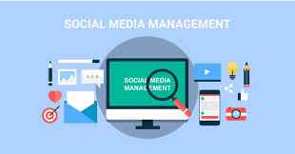
3. Incorporate social data into your existing CRM
Ideally, you’ll be able to integrate social data into your CRM using platform integrations. We’ll get into the details in the Tools section below but know for now that this doesn’t have to be complicated.
Social CRM is a growing point of focus for companies of all sizes. So, many existing CRM systems already allow for easy integration with social tools.

Slide 14
Social CRM challenges you should be aware of
There can be some bumps along the road when setting up social CRM. That may be why only 10% of marketers surveyed for the Hootsuite Social Transformation Report said they had effectively connected social data with an enterprise CRM.

Slide 15
Change can be uncomfortable
Changing the nature of your company’s approach to CRM may be challenging for the sales and customer service teams. They may have to learn how to use new tools, or simply reevaluate how they’ve always done things.
Make sure to help them understand the ways in which they’ll benefit from social media CRM, so they’re motivated to embrace the change. For customer service, the prime benefit is a fuller customer history, while for sales it’s more and better leads.

Slide 16
Depending on the size of your social following, you might not get a ton of social data right off the bat. In that case, it can feel a little like you’re spinning your wheels.
Stick with it. As you grow your following, the social data being fed into your CRM will improve. In turn, that better data will help you further grow your social media following. It’s a virtuous circle that may just need a little time to get going.

Slide 17
On the other hand, maybe you have a large social following, or there are already many conversations about your brand on social. In this case, you might find yourself overwhelmed by the sheer volume of new potential data to include in your CRM.
You’ll need to make some decisions about what kinds of interactions and data to add to the CRM. For example, maybe you’ll include interactions that involve a direct question or comment but not those that mention your brand in passing.

Slide 18

4 tips for using social media CRM as a business strategy
1. Use social CRM to understand the true value of a lead and a customer
Having a complete picture of how social interactions convert to sales allows you to truly understand the value of a social lead over the long term. This will help you plan your social media budget, especially the amount you plan to spend on social ads.

Slide 19
2. Use social data for effective customer service
More than three-quarters (76%) of customers say they expect consistent interactions from all departments. But more than half (54%) say teams don’t seem to share information: They get different responses from sales, service, and marketing.

Slide 20
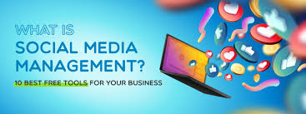
3. Better qualify leads with social data
Social leads can help fill your sales funnel. Even better, incorporating social interactions into lead and customer profiles can help qualify leads faster and more accurately.
Make sure you have appropriate offers and campaigns in place to nurture leads discovered through social media platforms. Consider an opt-in newsletter or a drip campaign and dedicated deals available exclusively to social leads. This will help establish your credibility while building the relationship as you work up to the sale.

Slide 21

4. Use CRM data to create custom audiences for social ads
CRM helps you understand who your customers are. Social CRM lets you translate that data into highly targeted new lookalike audiences for social ads based on characteristics like age, location, social behaviors, and so on.
A lookalike audience based on people who have actually bought from you is more likely to create conversions than a lookalike audience based on fans or followers.
Save time building an efficient social CRM with Spark central by Hoot suite. Quickly respond to questions and complaints across a variety of channels, create tickets, and work with chatbots all from one dashboard. Try it free today.

Slide 22
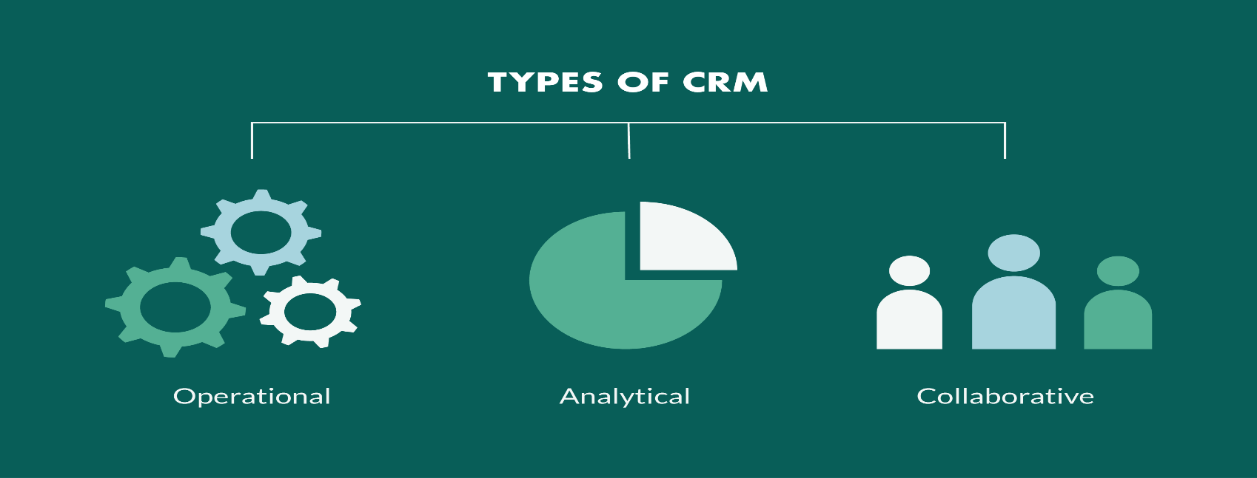
What are the three types of customer relationship management?
The 3 types of CRM are analytical, operational and collaborative:
Analytical uses data as the foundation of the platform.
Operational is based around automating workload.
Collaborative breaks down silos.
Let’s take a closer look at each type of CRM.

Slide 23
1. Analytical CRM
An analytical CRM will help you gather data, insights and information for you to take action and fuel business growth.
Typically, an analytical CRM will include features such as:
OLAP (Online analytical processing): Organize large sets of data, simultaneously. It can also help you “predict the future” with your CRM, highlighting potential trends and opportunities.
Data warehouse: A hub that collects and archives data from multiple systems. Best used for organizing data that can be used in company-wide reports.
Data mining: Analyze data to solve business problems by identifying patterns and relationships.

Slide 24
How does an analytical CRM benefit sales, marketing and customer service teams?
Sales: Use the analytical CRM to compare the number of B2B sales closed over a certain period of time and understand what type of customer your business closes the most deals with.
Marketing: Use the analytical CRM to measure the effectiveness of your B2B marketing campaigns.
Customer service: Use the analytical CRM to gain insights into how frequent your customer communication is at certain points in time, which can give you a better understanding of when to

Slide 25
An analytical CRM is best suited for businesses that are focused on data-driven decision making. The common users of an analytical CRM are data analysts, accountants and business intelligence managers, when the CRM database consists of thousands (or millions) of contacts.

Slide 26
2. Operational CRM::
An operational CRM system will help you do more with less.
Operational CRM systems are designed to automate and streamline business processes to acquire new customers and improve customer retention.
An operational CRM is best used for businesses that are short on resources and are looking for ways to minimize repetitive tasks through sales automation and marketing automation. The most common users for operational CRMs are customer-facing team, such as sales and marketing.

Slide 27
How do an operational CRM benefit sales, marketing, and customer service teams?
Sales: Use the operational CRM to automate steps in your sales process, such as meetings and follow-up emails.
Marketing: Use the operational CRM to nurture leads in different buyer and customer journey stages.
Customer service: Use the operational CRM to send automated acknowledgment emails to customers or to escalate urgent cases automatically.

Slide 28
3. Collaborative CRM
A collaborative CRM will improve internal communication.
Not only will it remove silos between sales, marketing, and customer service teams, but it will also help you communicate externally, too, by creating a more seamless connection with your distributors, partners, and suppliers.
A collaborative CRM is best used for companies that are customer-centric and want to improve the customer experience. As a company-wide platform, a collaborative CRM is used by everyone in the company, not just customer-facing teams.

Slide 29
How do a collaborative CRM benefit sales, marketing, and customer service teams?
Sales: Use the collaborative CRM to assign new prospects to a specific marketing campaign based on input from sales meetings.
Marketing: Use the collaborative CRM to assign hot leads to specific sales reps based on email campaigns they have engaged with.
Customer service: Use the collaborative CRM to tag sales managers if a customer has contacted customer support to ask for more user licenses.

Slide 30
What type of CRM is Super Office CRM?
Super Office CRM is an analytical, operational, and collaborative CRM. That’s what makes it unique.
Super Office is a cloud-based CRM platform designed to help you build strong business relationships with your customers at scale
Unlike other platforms, Super Office CRM was built for customer-facing teams from the beginning and is the only platform to use the same technology and UI for sales, marketing, and service features (which makes user-onboarding quick!).

Slide 31
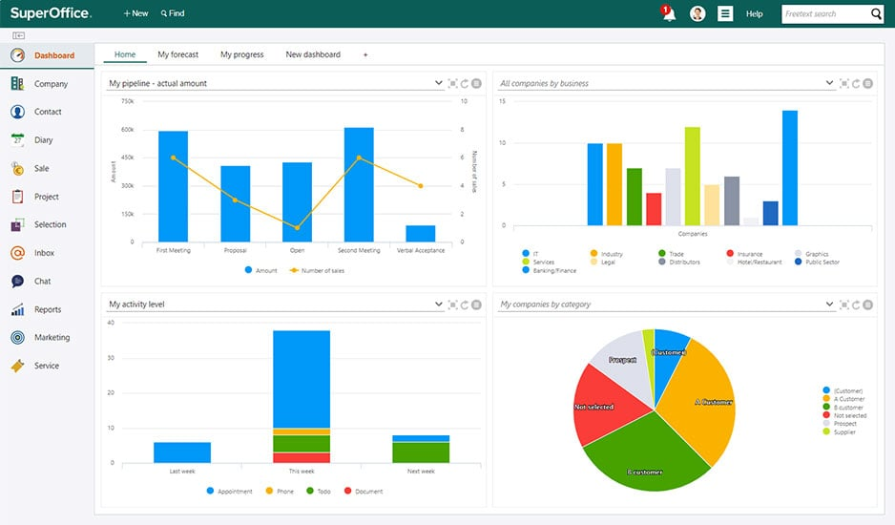
Super Office CRM is designed for companies that see CRM as critical to the success of their business. Most users that work with Super Office CRM are in sales, marketing and customer service. However, all Super Office employees, including people from IT, accounting, admin, and the C-suite – all use Super Office CRM on a daily basis.

Slide 32
How do Super Office CRM benefit sales, marketing, and customer service teams?
Analytical CRM: Manage your sales pipeline better with our out-of-the-box reports. Get insight into which deals are stalling and which prospects are closer to buying. Sales managers can get an overview of all sales reps' performance with our CRM dashboards.
Operational CRM: Automate the lead sign-up process in marketing from web forms, landing pages, and email nurture sequences. No more manual and time-consuming email campaigns. Automate your communication while keeping it personal.
Collaborative CRM: Put the customer at the heart of your business and give everyone the same access to view engagement and communication history – giving everyone the context they need to deliver a better experience.

Slide 33
CRM software can provide a wealth of benefits for your small business, from customer retention to increased productivity.
CRM software is used to gather customer interactions in one central place to improve customer experience and satisfaction.
CRM is one of the world’s fastest-growing industries, expected to grow at a rate of 14% between 2021 and 2027.
The benefits of CRM include better customer retention, increased sales and detailed analytics.

Slide 34
Customer relationship management (CRM) software has become a near-vital tool for businesses of all sizes. CRM software can provide several benefits to any business, from organizing contacts to automating key tasks. It can also be a centralized, organized hub that enables consistent communication both with customers and within the organization. This is especially important as more organizations shift to remote work.

Slide 35
key benefits a CRM could provide.
Better customer service.
Increased sales .
Improved customer retention .
Detailed analytics .
Higher productivity and efficiency .

Slide 36
6. Centralized database of information .
7. Managed communications with prospective leads .
8. Improved customer segmentation .
9. Automated sales reports .
10. More accurate sales forecasting .
11. Streamlined internal communications .

Slide 37
Artificial intelligence and CRMs
Automation in manual tasks can save workers tons of time in manual labor. In fact, there is even a separate type of software for automating manual sales tasks called AI sales assistant software. AI sales assistants often work alongside other programs or integrate with an existing CRM software, or sometimes even built within a CRM. AI sales assistants can automate manual tasks such as lead qualification and follow-up, pipeline manage

Slide 38
How does AI affect CRM?
With CRM – AI integration, AI technologies can serve to automate the organization's sales, marketing, and customer service processes. The AI automation of an organization's processes will enhance immensely the organizational management of crucial sales, marketing, and customer service operations.

Slide 39
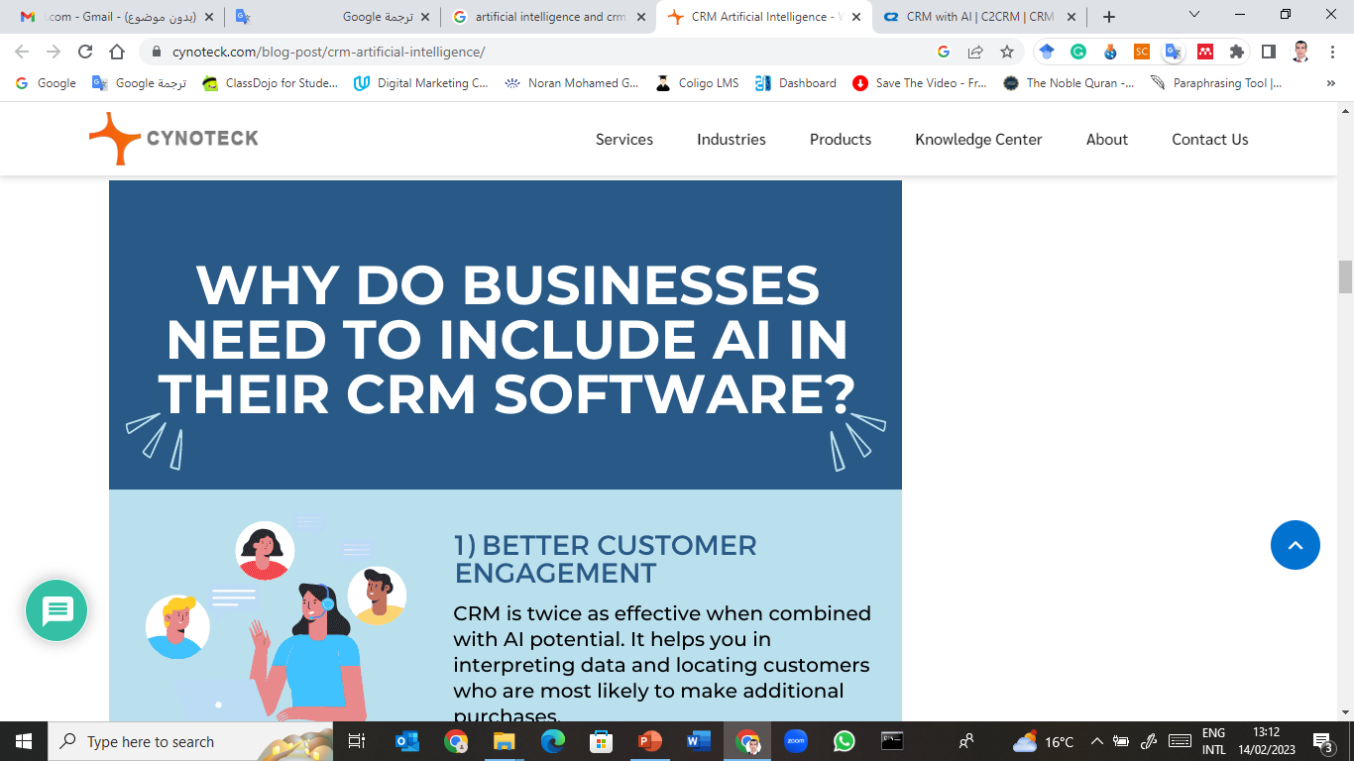
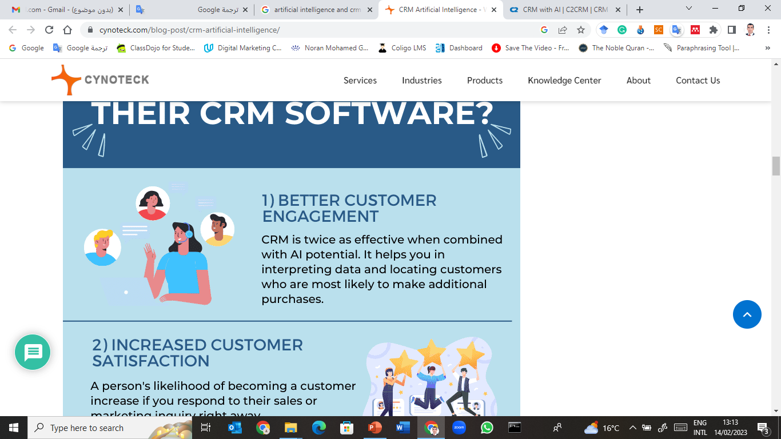
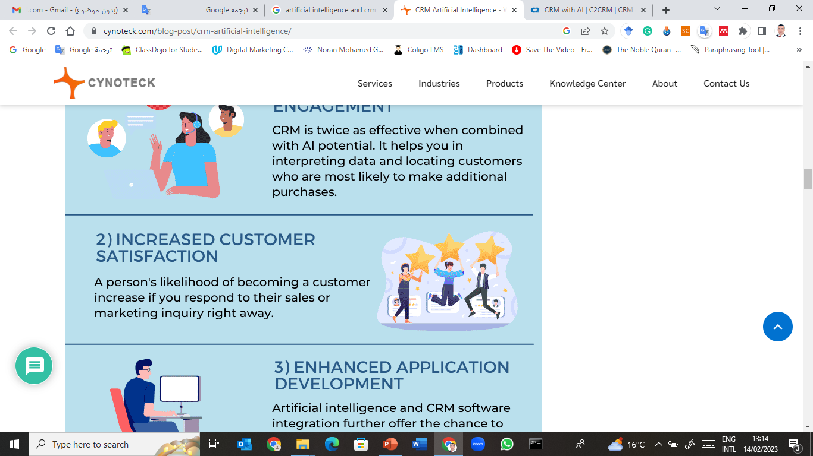
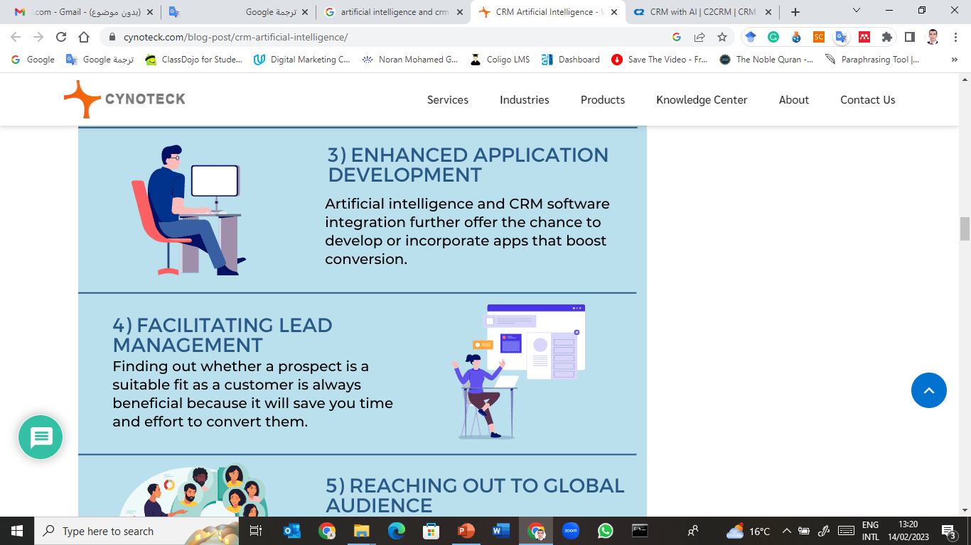

Slide 40

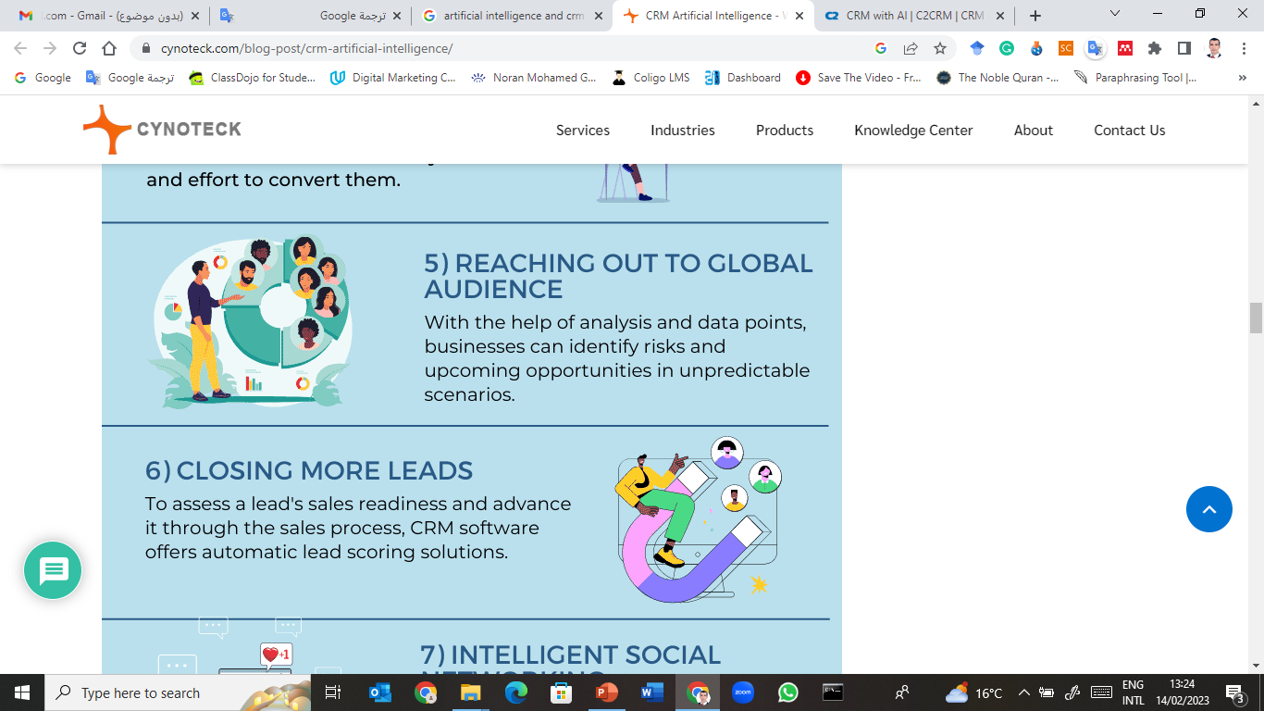

Slide 41
Emerging trends in 2025 CRM
1. Mobile CRM Solutions
Importance: With the increasing reliance on mobile technology, CRM systems are becoming more mobile-centric.
Benefits: Sales and service teams can access critical customer information on the go, ensuring they are always well-informed.
adaglobal.com
2. Omnichannel CRM
Definition: Omnichannel CRM integrates various customer channels, including physical stores, websites, mobile apps, social media, and call centers, to create a unified view of the customer journey.
Objective: Deliver personalized experiences that meet customer expectations across all touchpoints.

Slide 42
3.Agentic AI in CRM:
Definition: Agentic AI refers to autonomous systems capable of independent action and decision-making.
Application: CRM platforms are integrating agentic AI to automate customer interactions, providing proactive support and personalized recommendations.
Example: Salesforce's "Agentforce" platform utilizes agentic AI to handle customer queries and automate tasks, enhancing efficiency and customer satisfaction.
4. Predictive Analytics:
Purpose: Utilize AI-driven predictive analytics to forecast customer behavior and trends.
Advantage: Enables businesses to make data-driven decisions, optimize marketing strategies, and improve customer retention

Slide 43
Thank you

