Slide 1


Machine Learning
for Finance
Prepared by Dr. Diaa Salama
FNT633
Decision Tree
Lecture 5

Slide 2



Machine Learning
for Finance
Lecture
FNT633
Decesion Tree
Prepared by
Dr. Diaa Salama
www.midocean.ae

Slide 3
Week
06
Today
Classification
Decision Tree
Classification: Basic Concepts
Decision Tree Induction
Prediction using classification model
Model Evaluation and Selection
Summary
www.midocean.ae

Slide 4
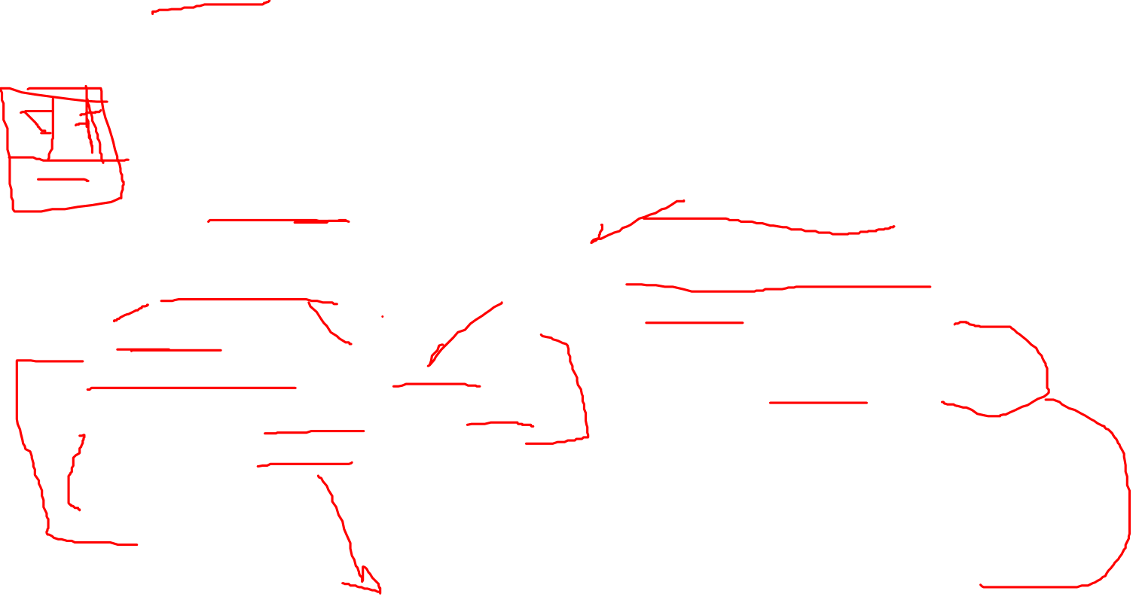
Week
06
Supervised vs. Unsupervised Learning
Learning
Supervised Learning
Unsupervised Learning
Unsupervised learning (clustering)
The class labels of training data is unknown.
Given a set of measurements,
observations, etc.… with the aim of establishing the existence of
classes or clusters in the data.
Supervised learning (classification)
The class labels and the number of classes of training data is known.
New data is classified based on the training set.
www.midocean.ae

Slide 5
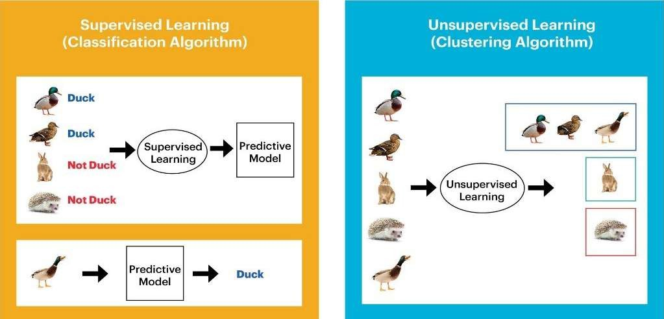
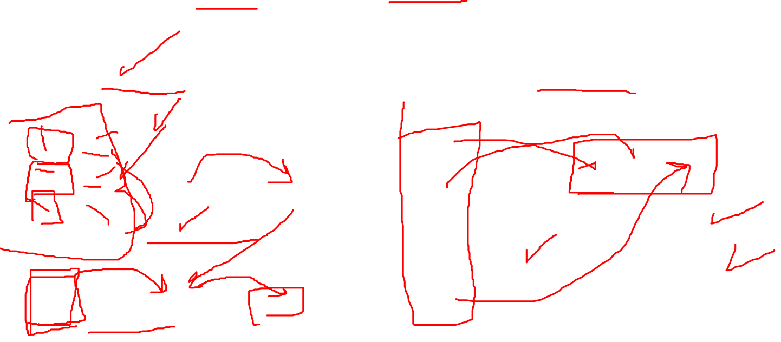
Week
06
Example: Supervised vs. Unsupervised
Class labels √
Class labels x
Number of classes √ or x
Number of classes √
X : Unknown in advance
√ : Known in advance
www.midocean.ae

Slide 6

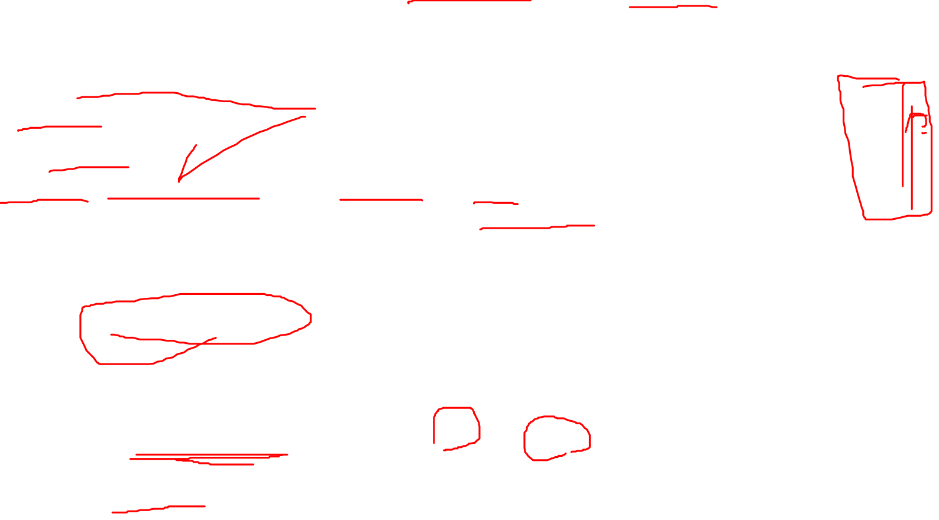
Week
06
Prediction Problems: Classification vs. Regression
Classification and Regression are two major types of prediction problems.
Classification:
Predicts categorical class labels (discrete or nominal).
Classifies data (constructs a model) based on the training set and the values (class labels) in a classifying attribute and uses it in classifying new data.
Regression:
Models continuous-valued functions, i.e., predicts unknown or missing values.
Activity: (classification or regression?)
For some loan application data → predict “safe” or “risky”.
For a marketing manager → predict how much a given customer will spend during a sale.
www.midocean.ae

Slide 7
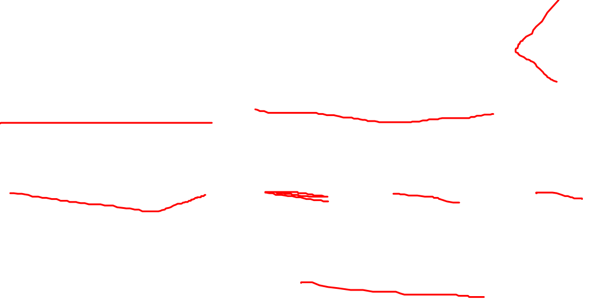
Week
06
Typical applications of classification
Credit/loan approval: if a customer should be approved or not.
Medical diagnosis: if a tumor is malignant or benign.
Fraud detection: if a transaction is fraudulent.
www.midocean.ae

Slide 8
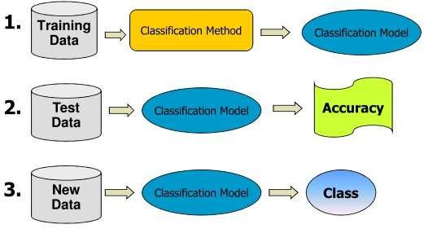
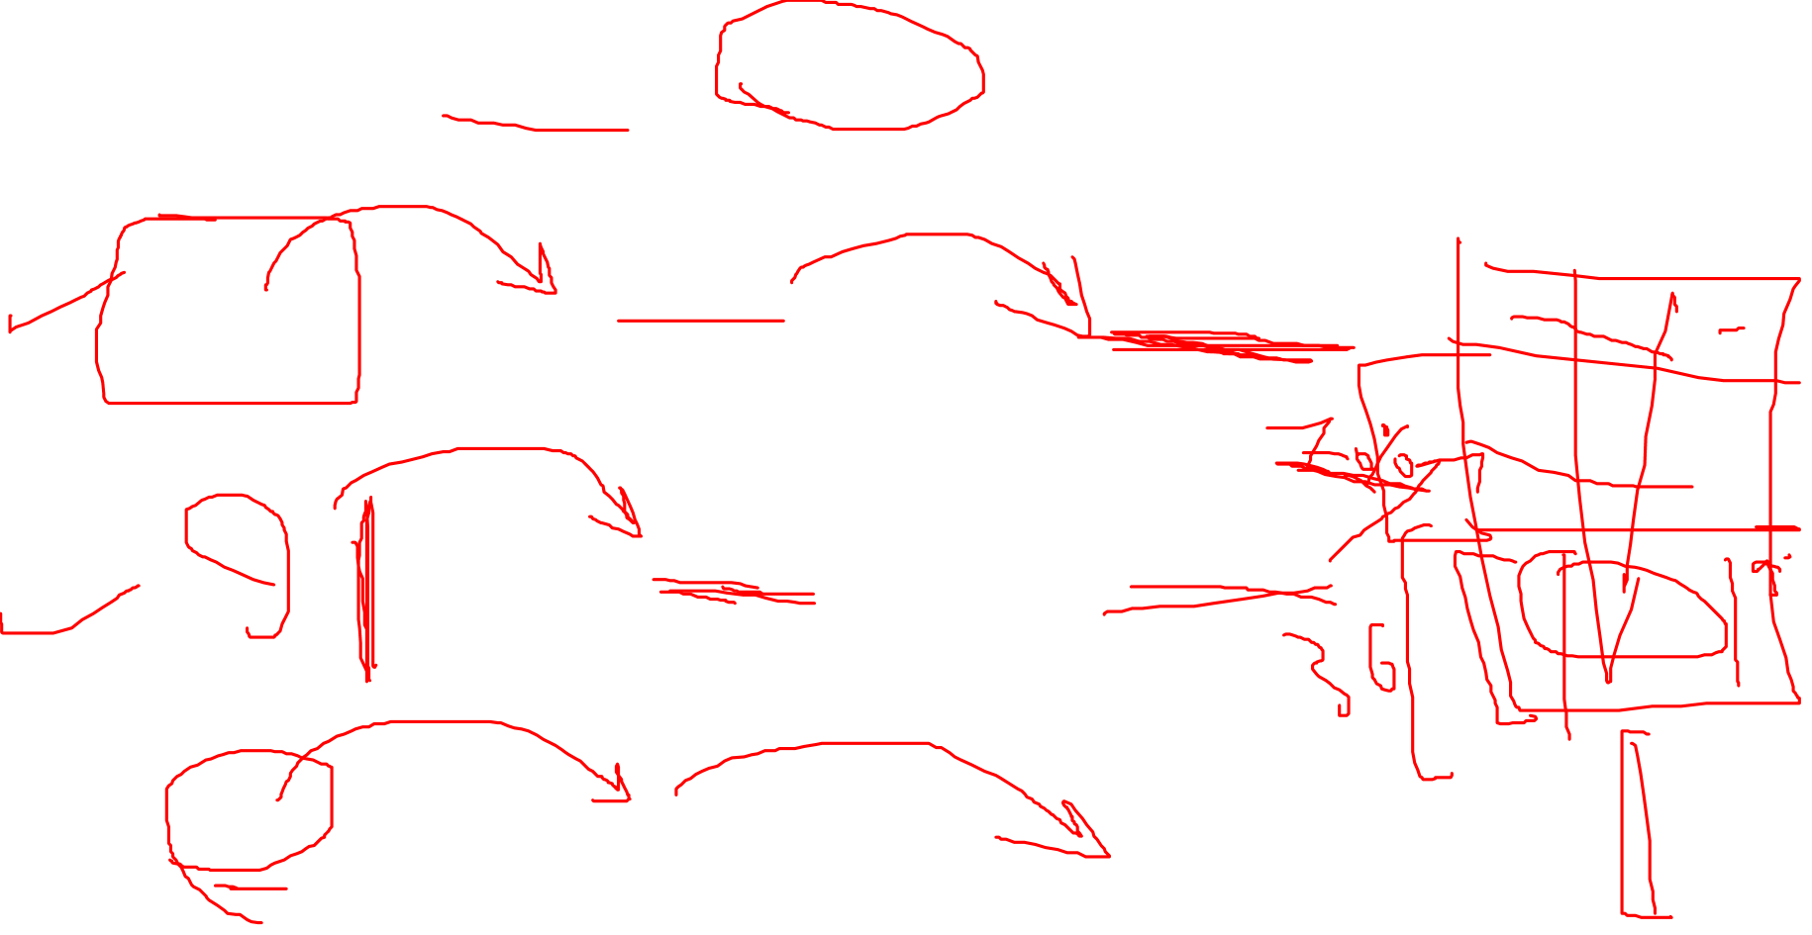
Week
06
Classification Process: the 3 steps
www.midocean.ae

Slide 9
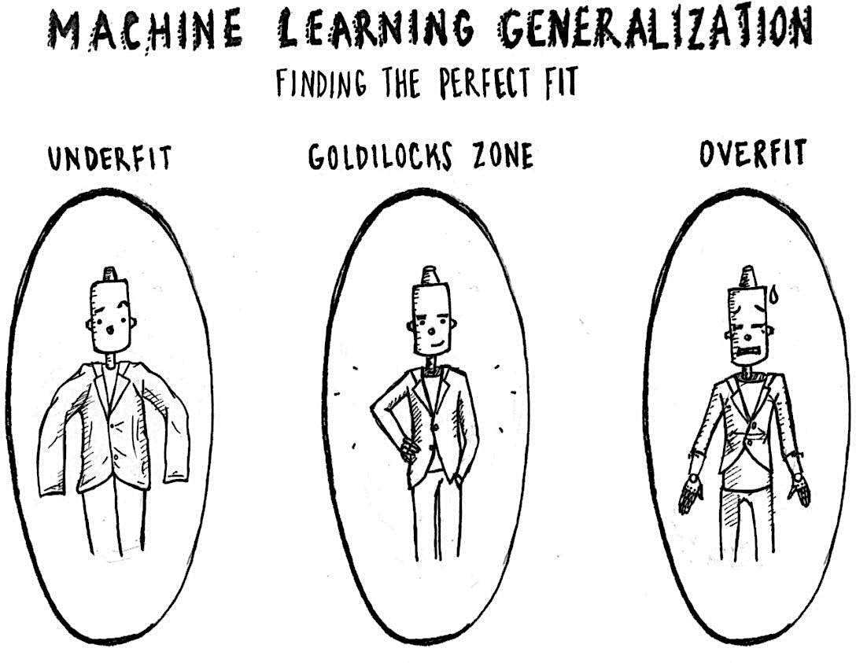
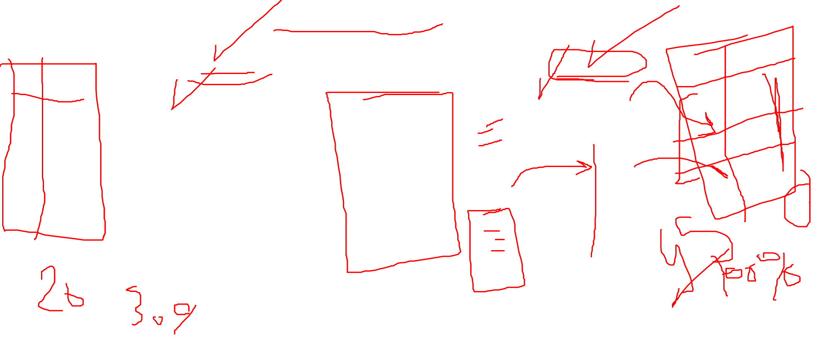
Week
06
www.midocean.ae

Slide 10

Week
06
Step 1: Model construction (Learning)
Each tuple is assumed to belong to a predefined class, as determined by one of the attributes, called the class label.
The set of all tuples used for construction of the model is called training set.
The model is represented in the following forms:
  Classification rules, (IF-THEN statements).
  Decision tree.
  Mathematical formula.
www.midocean.ae

Slide 11
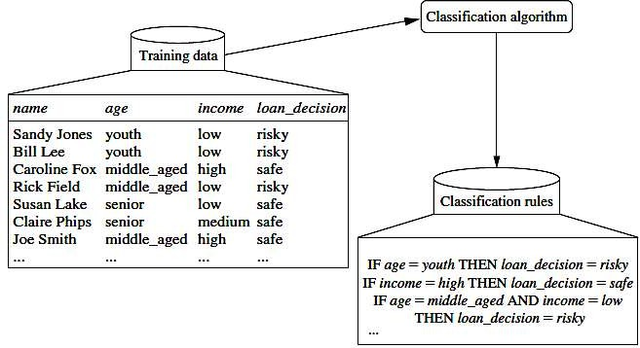
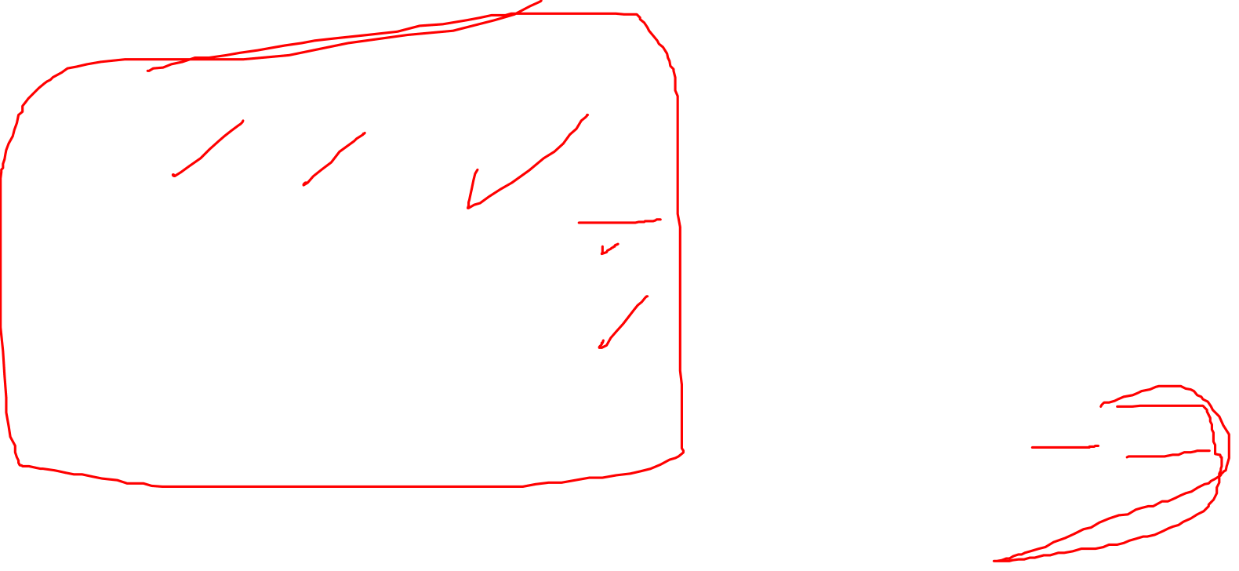
Week
06
Step 1: Model construction (Learning)
www.midocean.ae

Slide 12
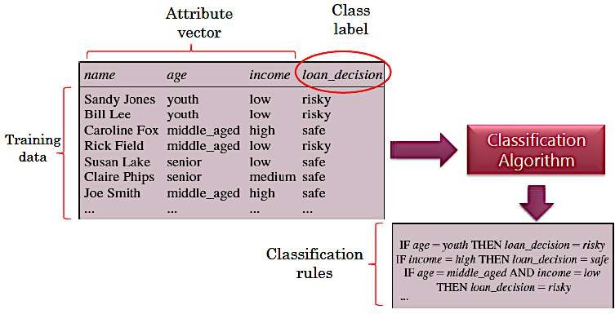
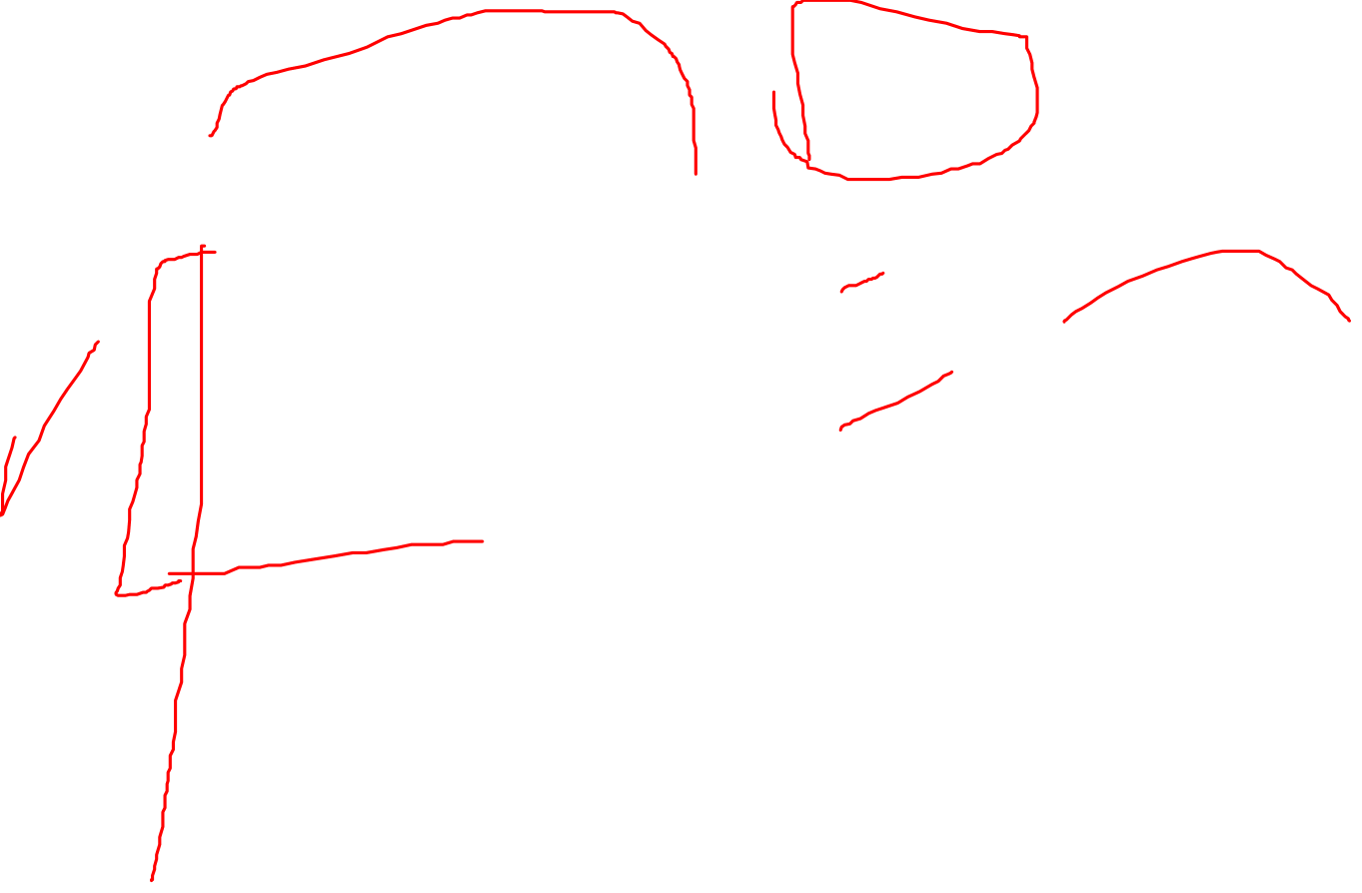
Week
06
THE BASICS GENERAL APPROACH
www.midocean.ae

Slide 13

Week
06
Step 2: Model Evaluation
Estimate the accuracy rate of the model based on a test set.
The known label of test sample is compared with the classified result from the model.
Accuracy rate is the percentage of test set samples that are correctly classified by the model.
Test set is independent of training set, otherwise over-fitting will occur.
If the accuracy is acceptable, use the model to classify data tuples whose class labels are not known.
www.midocean.ae

Slide 14
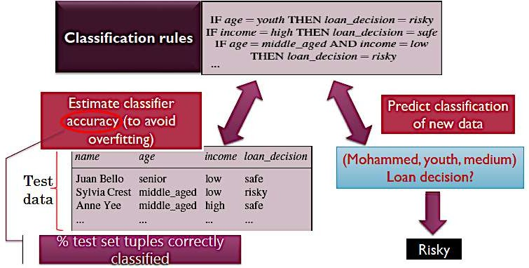

Week
06
Model Evaluation
www.midocean.ae

Slide 15
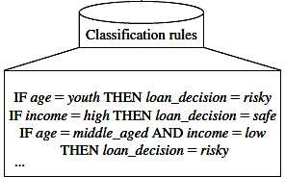
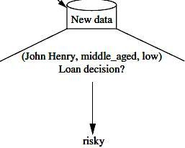

Week
06
Step 3: Using the Model in Prediction
The model is used to classify unseen objects (new data).
Give a class label to a new tuple.
Predict the value of an actual attribute (class label).
Predict if the new data is (safe) or risky)) ?
www.midocean.ae

Slide 16
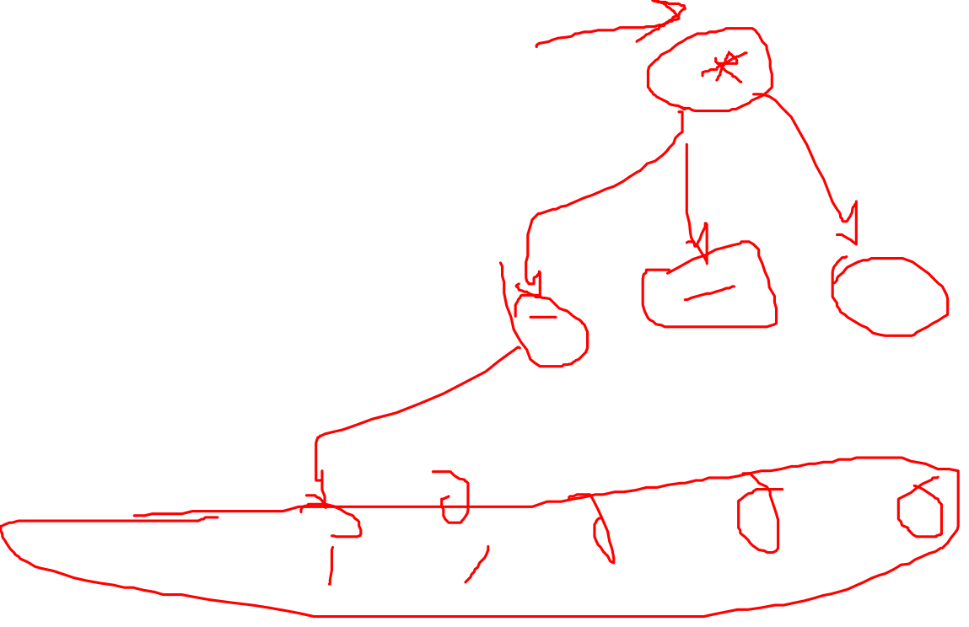
Week
06
Decision Tree Basics
Decision Tree Introduction
www.midocean.ae

Slide 17
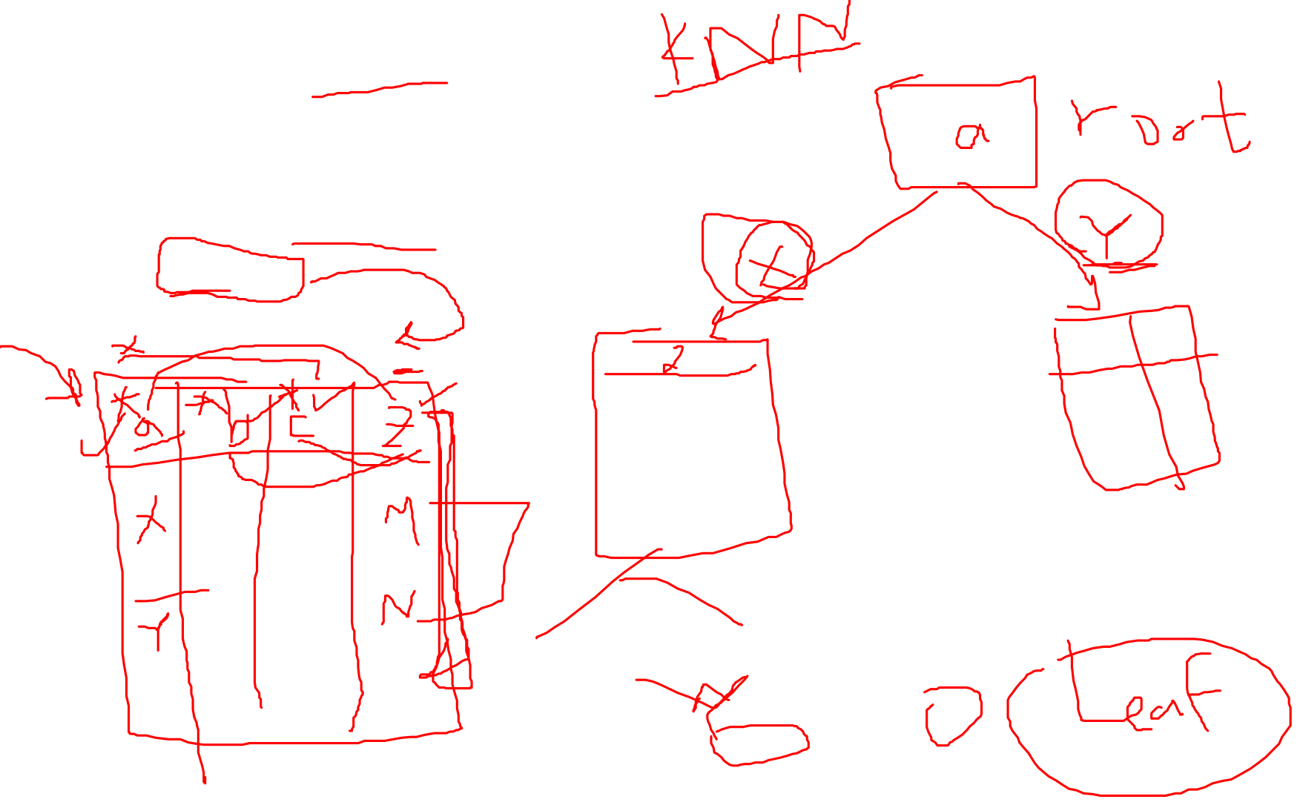
Week
06
Decision Tree:
    What is decision tree?
    Entropy.
    Information gain.
www.midocean.ae

Slide 18

Week
06
Decision Tree:
    What is decision tree?
        A decision tree is a tree like predictive model used for classification and regression.
        It is supervised learning method
    Learning algorithms used:
        ID3 Algorithm: used for classification problem.
www.midocean.ae

Slide 19
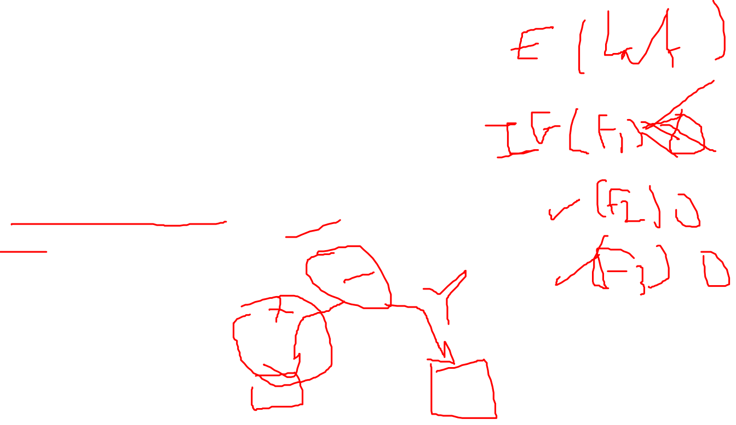
Week
06
Machine Learning Decision Tree
www.midocean.ae

Slide 20
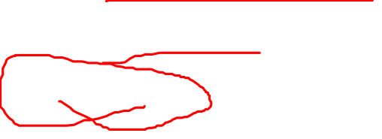
Week
06
    Examples on Decision Tree
    Problems Definition
    ID3 algorithm
www.midocean.ae

Slide 21

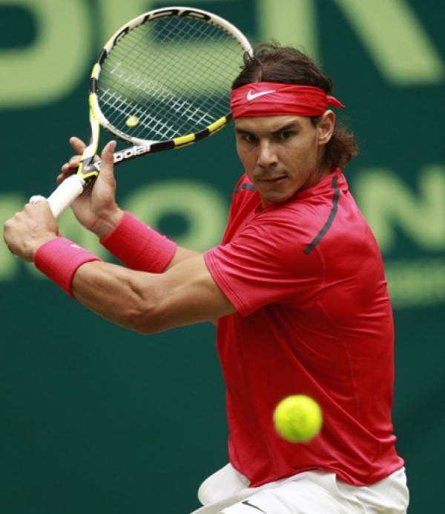
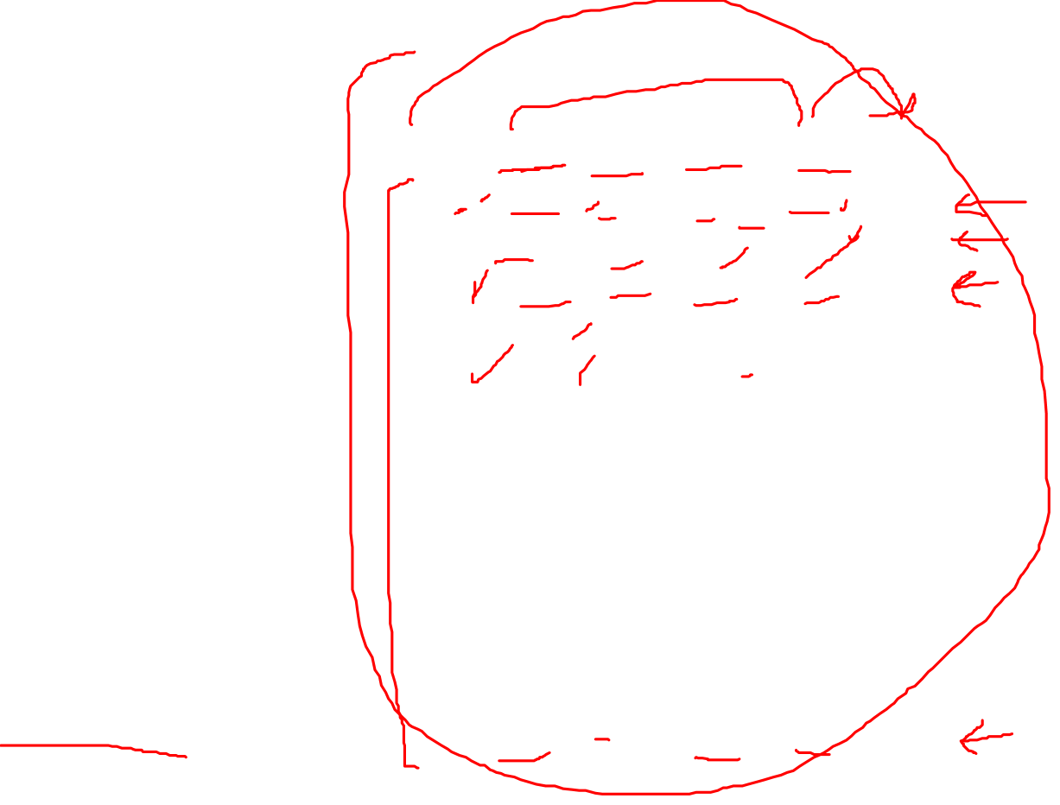
Will Nadal play Tennis?
Day Outlook Temp Humidity Wind
Play Tennis
1 | Sunny | Hot | High | Weak | No
2 | Sunny | Hot | High | Strong | No
3 | Overcast | Hot | High | Weak | Yes
4 | Rain | Mild | High | Weak | Yes
5 | Rain | Cool | Normal | Weak | Yes
6 | Rain | Cool | Normal | Strong | No
7 | Overcast | Cool | Normal | Weak | Yes
8 | Sunny | Mild | High | Weak | No
9 | Sunny | Cool | Normal | Weak | Yes
10 | Rain | Mild | Normal | Strong | Yes
11 | Sunny | Mild | Normal | Strong | Yes
12 | Overcast | Mild | High | Strong | Yes
13 | Overcast | Hot | Normal | Weak | Yes
14 | Rain | Mild | High | Strong | No
Rafael Nadal

Slide 22
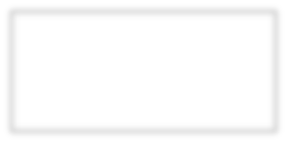





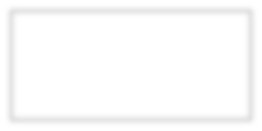

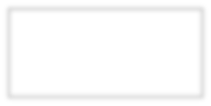













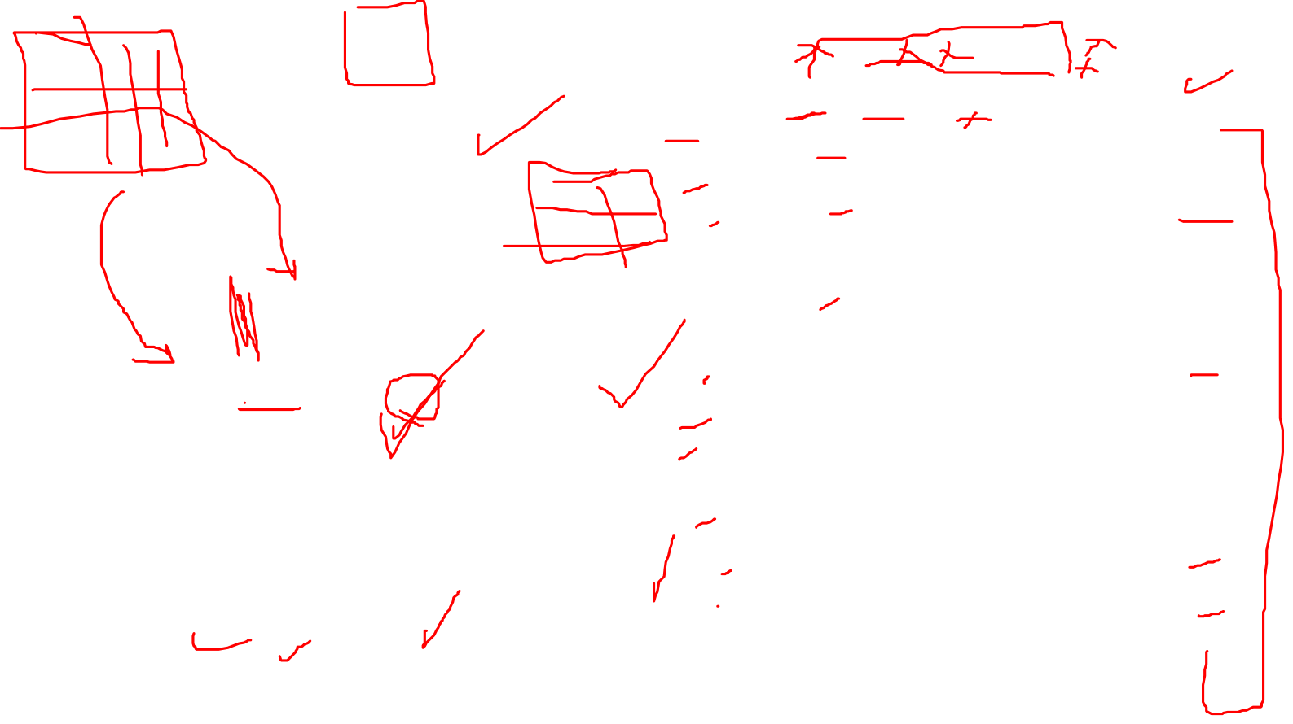
Will Nadal play Tennis?
Day Outlook Temp Humidity Wind
Play Tennis
Outlook
1 | Sunny | Hot | High | Weak | No
2 | Sunny | Hot | High | Strong | No
3 | Overcast | Hot | High | Weak | Yes
4 | Rain | Mild | High | Weak | Yes
5 | Rain | Cool | Normal | Weak | Yes
6 | Rain | Cool | Normal | Strong | No
7 | Overcast | Cool | Normal | Weak | Yes
8 | Sunny | Mild | High | Weak | No
9 | Sunny | Cool | Normal | Weak | Yes
10 | Rain | Mild | Normal | Strong | Yes
11 | Sunny | Mild | Normal | Strong | Yes
12 | Overcast | Mild | High | Strong | Yes
13 | Overcast | Hot | Normal | Weak | Yes
14 | Rain | Mild | High | Strong | No
Overcast
Humidity
Yes
Wind
No
Yes
No
Yes

Slide 23
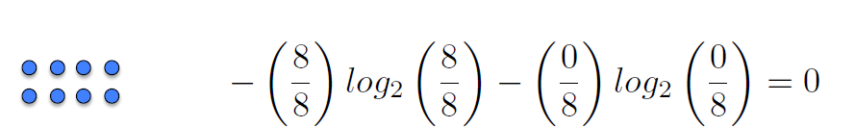

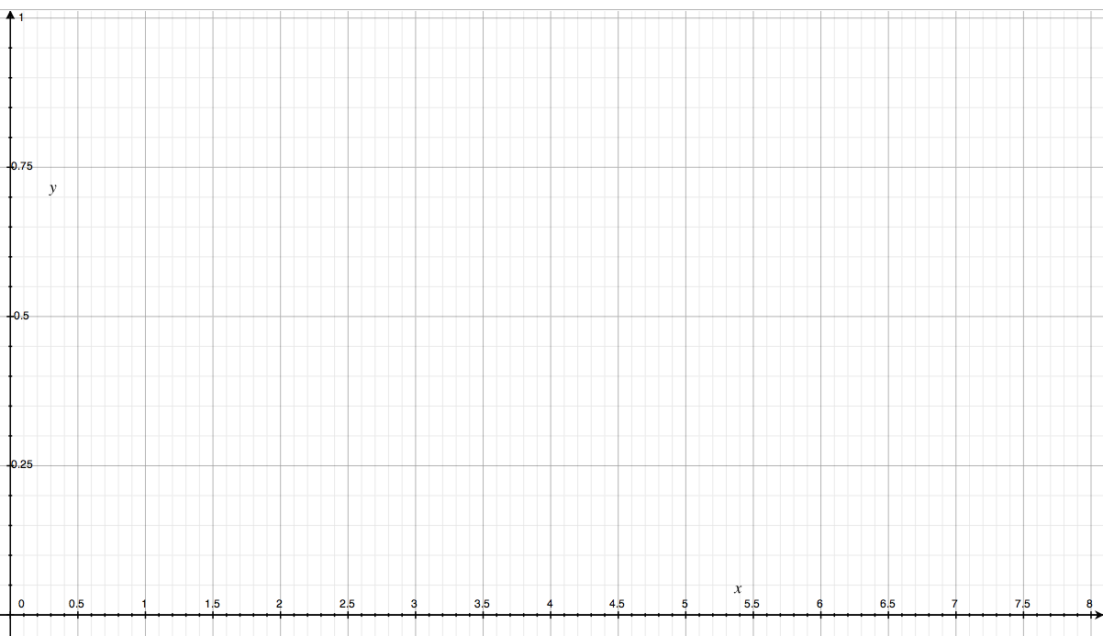

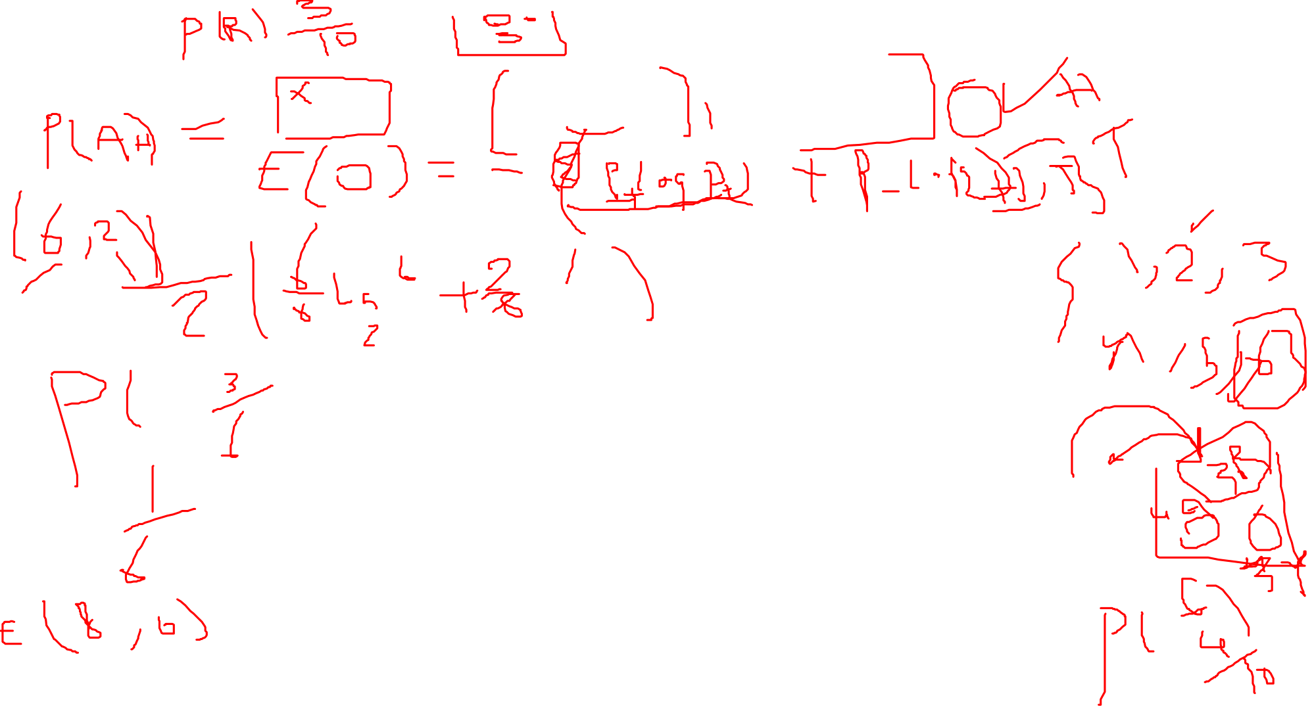

Slide 24
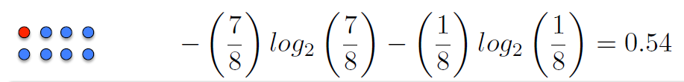

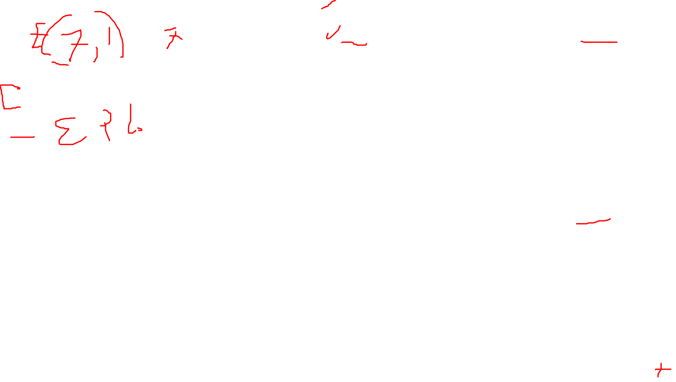

Slide 25
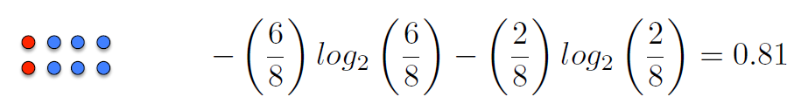

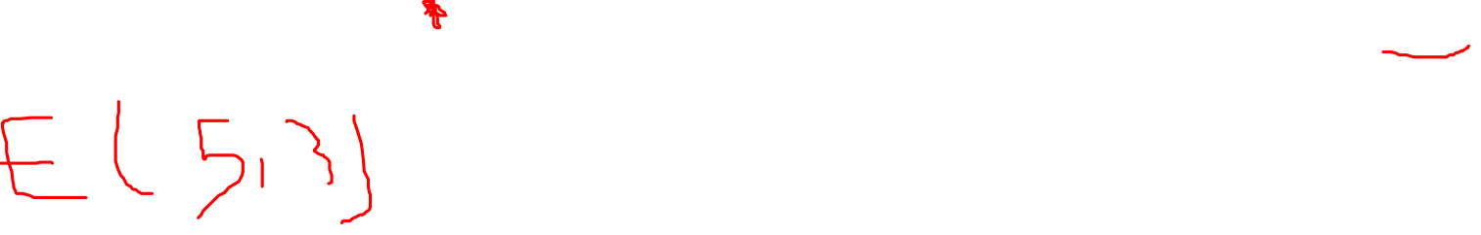

Slide 26
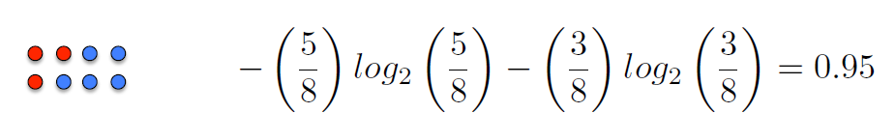


Slide 27



Slide 28



Slide 29
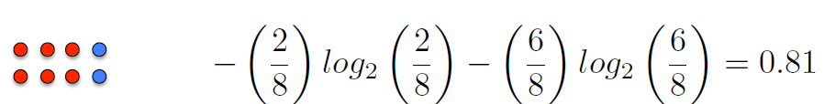


Slide 30



Slide 31
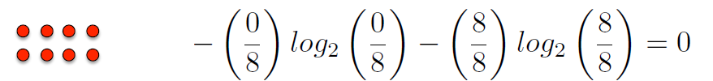


Slide 32
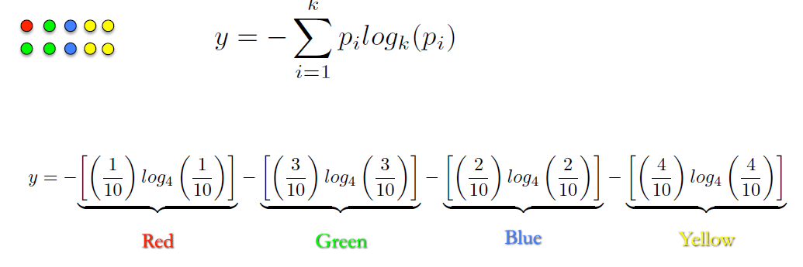
Week
06
www.midocean.ae

Slide 33
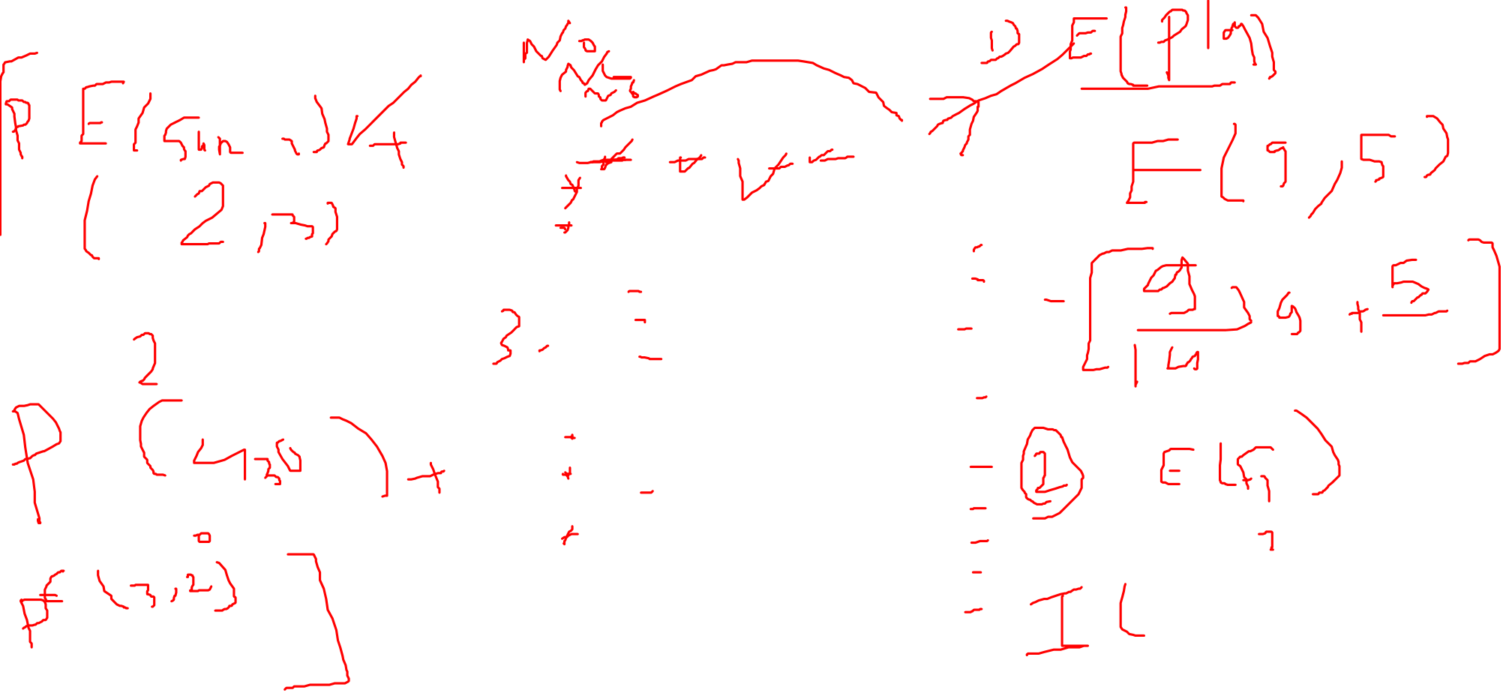
Day Outlook Temp Humidity Wind
Play Tennis
1 | Sunny | Hot | High | Weak | No
2 | Sunny | Hot | High | Strong | No
3 | Overcast | Hot | High | Weak | Yes
4 | Rain | Mild | High | Weak | Yes
5 | Rain | Cool | Normal | Weak | Yes
6 | Rain | Cool | Normal | Strong | No
7 | Overcast | Cool | Normal | Weak | Yes
8 | Sunny | Mild | High | Weak | No
9 | Sunny | Cool | Normal | Weak | Yes
10 | Rain | Mild | Normal | Strong | Yes
11 | Sunny | Mild | Normal | Strong | Yes
12 | Overcast | Mild | High | Strong | Yes
13 | Overcast | Hot | Normal | Weak | Yes
14 | Rain | Mild | High | Strong | No

Slide 34



























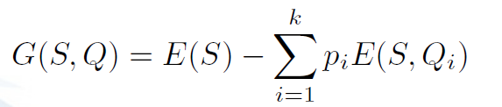
Question 1
Question 2
E=1
E=1
Yes
No
Yes
No
E=0.97
E=0.92
E=0.72
E=0
Information Gain

Slide 35



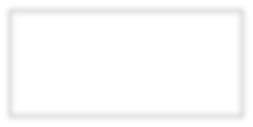








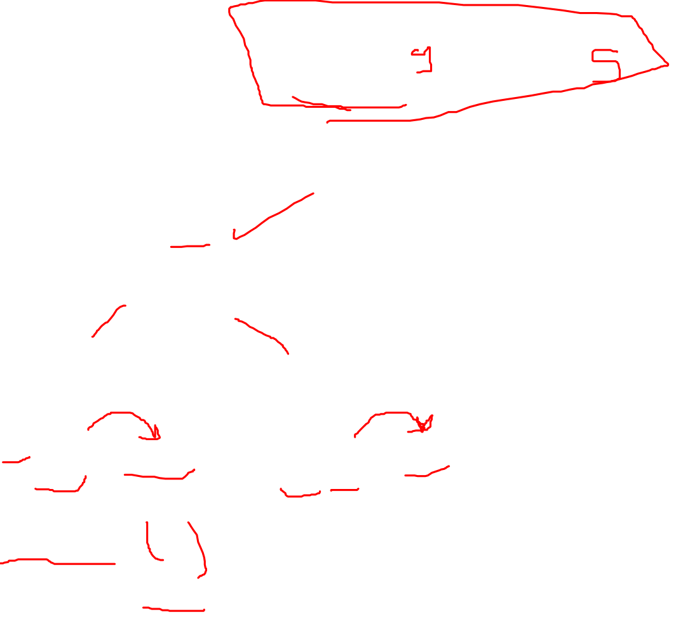
E=0.954
Wind
E=0.811
E=1
G(S, Wind) = 0.954 —
8 6
0.811 — 1
14
14
G(S, Wind) = 0.048

Slide 36

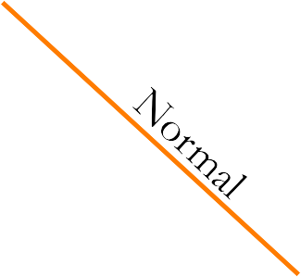






G(S, Wind) = 0.048
E=0.954
Humidity
E=0.985
E=0.592
G(S, Humidity) = 0.954 —
7 7
0.985 — 0.592
14
14
G(S, Humidity) = 0.151

Slide 37
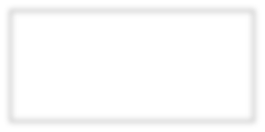

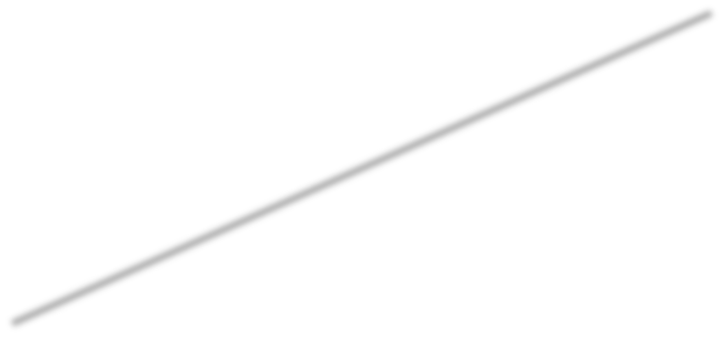










G(S, Wind) = 0.048
G(S, Humidity) = 0.151
E=0.954
Temp
Mild
E=1
E=0.92
E=0.81
G(S, Temp) = 0.954 — ⁴ 1 — ⁶ 0.92 — ⁴ 0.81
14 14
14
G(S, Temp) = 0.042

Slide 38





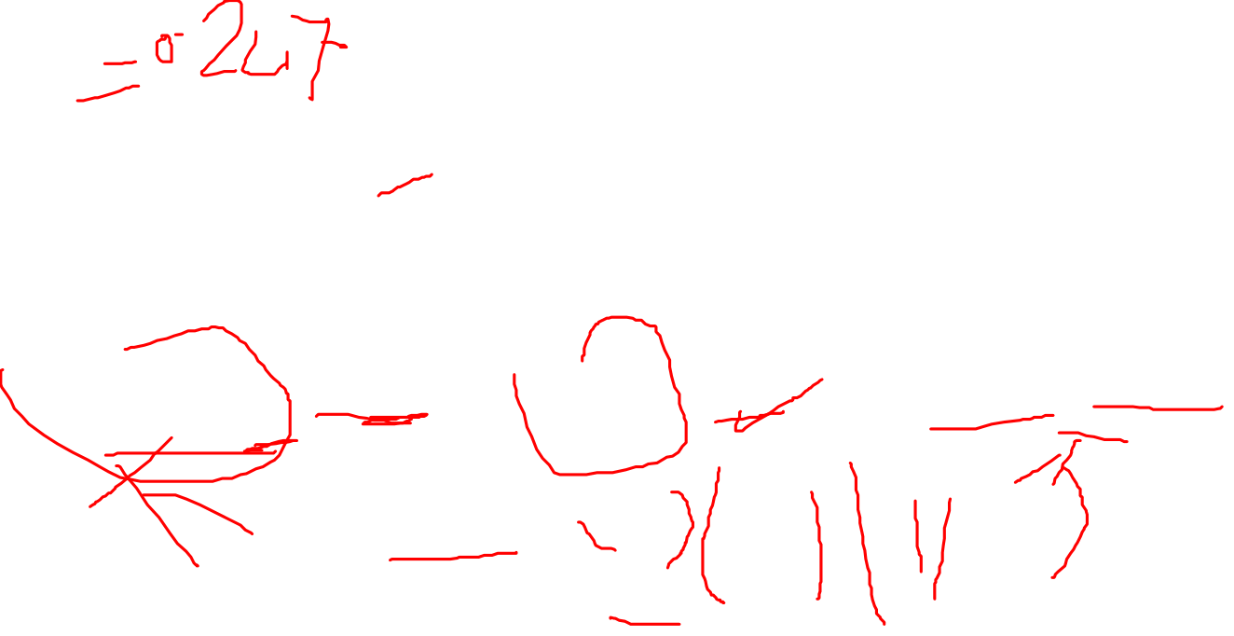
G(S, Wind) = 0.048
G(S, Humidity) = 0.151
E=0.954
G(S, Temp) = 0.042
Outlook
Overcast
E=0.971
E=0
E=0.971
G(S, Outlook) = 0.954 — ⁵ 0.971 —
4 5
0 — 0.971
14
14
14
G(S, Outlook) = 0.247

Slide 39
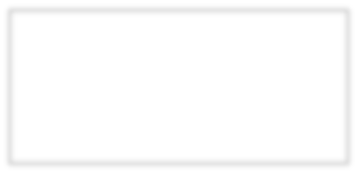





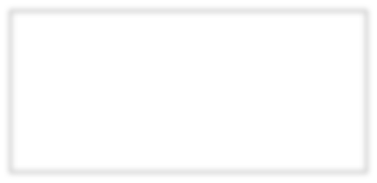

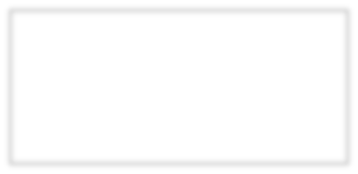














Outlook
Overcast
Humidity
Yes
Wind
No
Yes
No
Yes

Slide 40
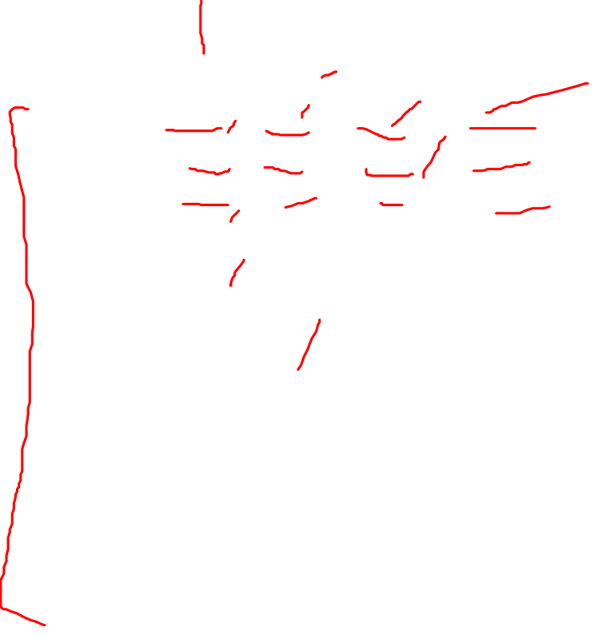
Week
06
Example on Decision Tree
Num |  | Salary | Student | Credit | Buy Computer or not
64 |  | High | No | Ok | No
64 |  | High | No | Good | No
128 |  | High | No | Ok | Yes
60 |  | Middle | No | Ok | Yes
64 |  | Low | Yes | Ok | Yes
64 |  | Low | Yes | Good | No
64 |  | Low | Yes | Good | Yes
128 |  | Middle | No | Ok | No
64 |  | Low | Yes | Ok | Yes
132 |  | Middle | Yes | Ok | Yes
64 |  | Middle | Yes | Good | Yes
32 |  | Middle | No | Good | Yes
32 |  | High | Yes | Ok | Yes
63 |  | Middle | No | Good | No
1 |  | Middle | Yes | Good | Yes
    If you have such a statistical table on the left, given a new customer with some information can you predict whether he or she would like to buy a computer or not.
    Decision tree methods can help you to solve this problem
www.midocean.ae

Slide 41
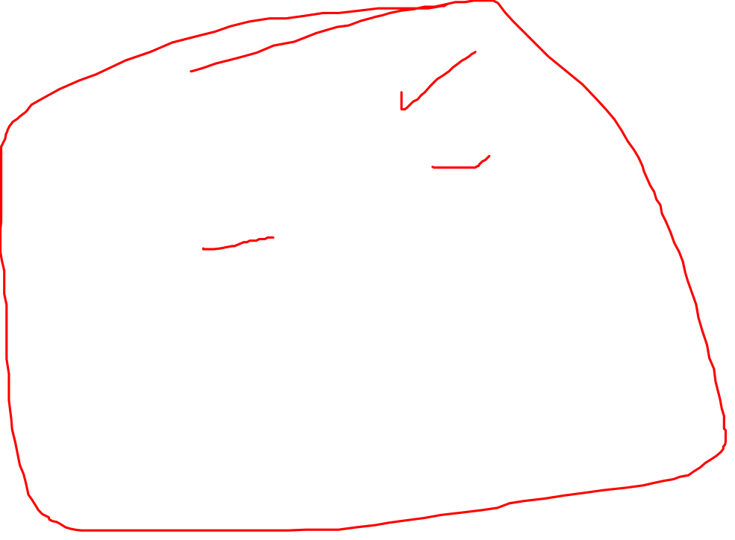
Week
06
Example on Decision Tree
    Use the decision tree below:
    Each node is an attribute, can classify the data based on the value of the attribute.
    Each node’s branch corresponding to a value of this attribute.
    Each leaf node is the final decision.
Age？
Young
Old
Middle
If (Age＝M)or (Age＝Old and
Student？
Buy
Credit？
Credit＝Ok) or(Age＝Y and
Student:＝Y) then Buy Computer
no
yes
Good
Ok
If (Age＝O and Credit＝G) or (Age
Not buy
Buy
Buy
＝Y and Student:＝No) then Not buy Computer
Not
buy
www.midocean.ae

Slide 42

Week
06
Definition on Decision Tree
    Tree.
    Decision Tree is a decision support tool that uses a tree-like graph or model of decision and their possible consequences, including chance event outcome, resource costs, and utility.
    Decision tree are commonly used in decision analysis, to help identify a strategy most likely to reach a goal.
Age？
Young
Old
Middle
Student？
Buy
Credit？
no
yes
Good
Ok
Not buy
Buy
Not buy
Buy
www.midocean.ae

Slide 43

Week
06
Decision Tree
    Node: attribute.
    Branch: value of the attribute.
    Leaf: final decision.
    Good or Bad: select different attributes for
    different nodes
salary？
high
middle
low
student？
Age？
yes
buy
no
Young
credit？
Middle
Old
ok
good
Not
buy
Student？
Buy
Credit？
age？
no
yes
Good
Ok
y
Not buy
middle
Buy
Not buy
Buy
Not buy
Buy
www.midocean.ae

Slide 44

Week
06
Construct the Decision Tree
    To classify the bear dangerous or not dangerous.
    Select the attribute:
    first select the attribute which has the classify ability.
Num | Color | Size | Hair | Class
1 | Black | Big | Curls | Dangerous
2 | Brown | Big | Straight | Dangerous
3 | Brown | Middle | Curls | No
4 | Black | Small | Curls | No
5 | Brown | Middle | Straight | Dangerous
6 | Black | Big | Straights | Dangerous
7 | Brown | Small | Curls | Dangerous
8 | Brown | Small | Straights | No
9 | Brown | Big | Curls | Dangerous
10 | Black | Middle | Curls | No
11 | Black | Middle | Straights | No
12 | Black | Small | Straights | No
Size
www.midocean.ae

Slide 45

Week
06
Construct the Decision Tree
Num | Color | Size | Hair | Class
1 | Black | Big | Curls | D
2 | Brown | Big | Straight | D
6 | Black | Big | Straight | D
9 | Brown | Big | Curl | D
    Divide the training sets based on the attribute value.
Num | Color | Size | Hair | Class
3 | Brown | M | Curl | No
5 | Brown | M | Straigh | D
10 | Black | M | Curl | No
11 | Black | M | Straith | No
Big
Middle
Size
Num | Color | Size | Hair | Class
4 | Black | Small | Curl | No
7 | Brown | Small | Curl | D
8 | Brown | Small | Straight | No
12 | Black | Small | Straight | No
Small
www.midocean.ae

Slide 46
Week
06
Construct the Decision Tree
    continue to classify the sub-training sets until all the sub-sets belongs to the same class.
Num | Colo r | Size | Hair | Class
3 | Br | M | C | Not
5 | Br | M | S | Da
Size
Big _{le} Small
Br
Midd
Da
？
？
Color
Num | Col or | Size | Hair | Class
10 | Bl | M | C | Not
11 | Bl | M | S | Not
Num | Colo r | Size | Hair | Class
3 | Br | M | C | Not
5 | Br | M | S | Da
10 | Bl | M | C | Not
11 | Bl | M | S | Not
Bl
www.midocean.ae

Slide 47

Week
06
Construct the Decision Tree
Num | Colo r | Size | Hair | Class
4 | Bl | S | C | Not
7 | Br | S | C | Dangerous
8 | Br | S | S | Not
12 | Bl | S | S | Not
Size
Big
Middle ^{Small}
Da
Color
？
Num | Colo r | Size | Hair | Class
4 | Bl | S | C | Not
12 | Bl | S | S | Not
Bl
Br
Bl
Not
？
Color
Br
Num | Color | Size | Hair | Class
7 | Br | S | C | Da
8 | Br | S | S | Not
www.midocean.ae

Slide 48

Week
06
Construct the Decision Tree
Num | Colo r | Size | Hair | Class
3 | Br | M | C | Not
5 | Br | M | S | Dange rous
Size
Big
S
Num | Colo | Size | Hair | Class
3 | Br | M | C | Not
Middle
C
Dangerous
Bl
Color
Color
Hair
Br
Num | Colo r | Size | Hair | Class
5 | Br | M | S | Da
Bl
Br
S
Not
？
Not
？
C
Num | Colr | Size | Hair | Class
3 | Br | S | C | Da
Num | Colo r | Size | Hair | Class
7 | Br | S | C | Dange rous
8 | Br | S | S | Not
Hair
S
Num | Colo r | Size | Hair | Class
5 | Br | S | S | Not
www.midocean.ae

Slide 49
Week
06
Measuring of Dispersion data
    Finally the Decesion Tree
Size
Big
S
Middle
Da
Color
Color
Bl
Bl
Br
Not
Hair
Not
Hair
C
Not Dangerous
C
Dangerous
S
S
Not
www.midocean.ae

Slide 50

Week
06
Construct the Decision Tree – ID3 Algorithm
Select the node (attribute).
ID3(Iterative Dichotomiser 3) algotithm is an algorithm used to generate a decision tree invented by Ross Quinlan
Summarize of the ID3 algorithm
  Take all unused attributes and count their entropy concerning test samples
  Choose attribute for which entropy is minimum (information gain is
maximum)
  Make node containing that attribute
www.midocean.ae

Slide 51

Week
06
Algorithm3 Construct the Decision Tree – ID
    Entropy : S is a set which contain n training set, S is divided into c classes, each class contain ni , then the entropy of S divided by c classes is.
E(S)= − ∑^{𝑐}
𝑛
𝑖
𝑛
𝑖
𝑐
𝑖=1
𝑙𝑜𝑔 ( )= − ∑
𝑃_{𝑖} 𝑙𝑜𝑔₂(𝑃_{𝑖})
𝑖=1 _{𝑛}
2
𝑛
www.midocean.ae

Slide 52

Examples – ID3 Algorithm
? Play Tennis
Day | Outlook | Temperature | Humidity | Wind | Play
D1 | Sunny | Hot | High | Weak | No
D2 | Sunny | Hot | High | Strong | No
D3 | Overcast | Hot | High | Weak | Yes
D4 | Rain | Mild | High | Weak | Yes
D5 | Rain | Cool | Normal | Weak | Yes
D6 | Rain | Cool | Normal | Strong | No
D7 | Overcast | Cool | Normal | Strong | Yes
D8 | Sunny | Mild | High | Weak | No
D9 | Sunny | Cool | Normal | Weak | Yes
D10 | Rain | Mild | Normal | Weak | Yes
D11 | Sunny | Mild | Normal | Strong | Yes
D12 | Overcast | Mild | High | Strong | Yes
D13 | Overcast | Hot | Normal | Weak | Yes
D14 | Rain | Mild | High | Strong | No

Slide 53

Examples – ID3 Algorithm
The information gain of the S Sample is:
Outlook
Sunny
Sunny
Overcast
Rain
Rain
Rain
Overcast
Sunny
Sunny
Rain
Sunny
Overcast
Overcast
Rain
Play
No
No
Yes
Yes
Yes
No
Yes
No
Yes
Yes
Yes
Yes
Yes
No
5
E(S) = - ⁹ log ( ⁹ ) − ⁵ log ( ) =0.94
14 14 14 2 14
Attribute “Outlook”, compute its information gain: three properties “Sunny” “Overcast” “Rain”

Slide 54


Examples – ID3 Algorithm
Outlook | Play
Sunny | No
Sunny | No
Sunny | No
Sunny | Yes
Sunny | Yes
2 ₋ 3
3
Outlook | Play
Overcast | Yes
Overcast | Yes
Overcast | Yes
Overcast | Yes
E(S )= − ² og ( )
l
2
log ( ) = 0.971
2
sunny
5
5 5
5
E(S
)= −⁴ log (⁴) − ⁰
log (⁰) =0
4 4 4 ² 4
Overcast
2
E(S )= − ³ log ( ³) − ² log ( ²) = 0.971
Outlook | Play
Rain | Yes
Rain | Yes
Rain | No
Rain | Yes
Rain | No
Rain 2 2
5
5 5 5
E(S,Outlook) = ⁵ E(S
)+ ⁴ E(S
14
)+ ⁵ E(S
14
)=0.694
14
Sunny
Overcast
Rain

Slide 55

Examples – ID3 Algorithm
The information gain of the attribute “Outlook” is:
Gain(S,Outlook) =E(S) -E(S,Outlook) =0.94-0.694 =0.246
Use the same method we can compute the information gain of attributes “Humidity” “Temperature” and “Wind”
Gain( S , Humidity)= 0.151 Gain( S ,Temperature) = 0.029 Gain( S ,Wind ) =0.048
Base on the computation above, we choose the attribute “Outlook” as the root node.

Slide 56
Examples – ID3 Algorithm
The first stage decision tree
Outlook
Over | cast
Sunny
Rain
?
?
yes

Slide 57
Examples – ID3 Algorithm
The first stage decision tree
Day | Outlook | Temperature | Humidit y | Wind | Play
D1 | Sunny | Hot | High | Weak | No
D2 | Sunny | Hot | High | Strong | No
D8 | Sunny | Mild | High | Weak | No
D9 | Sunny | Cool | Normal | Weak | Yes
D11 | Sunny | Mild | Normal | Strong | Yes
Sunny
Outlook
Overcast
yes
Day | Outlook | Temperature | Humidit y | Wind | Play
D4 | Rain | Mild | High | Weak | Yes
D5 | Rain | Cool | Normal | Weak | Yes
D6 | Rain | Cool | Normal | Strong | No
D10 | Rain | Mild | Normal | Weak | Yes
D14 | Rain | Mild | High | Strong | No
Rain

Slide 58
Examples – ID3 Algorithm
Continue to construct the decision at the branch “outlook”=“sunny.”
Compute the entropy
Temperatur e | Humidity | Wind | Play
Hot | High | Weak | No
Hot | High | Strong | No
Mild | High | Weak | No
Cool | Normal | Weak | Yes
Mild | Normal | Strong | Yes
3 ₋ 2 2
E(S) = −³
log ( ₂) log₂ ( ) =0.971
5 5 5 5
Compute the information gain of “Temperature” “Humidity” and “Wind”
Gain(S,Temperature) = E(S) − E(S,Temperature) = 0.971−0.4 = 0.571
Gain ( S , Humidity ) = 0.971
Gain ( S , Wind ) = 0.02
Select “Humidity” as current node

Slide 59
Examples – ID3 Algorithm
The current stage decision tree
Outlook
Ove | rcast
Sunny
Humidity | Play
High | No
High | No
High | No
Normal | Yes
Normal | Yes
Rain
Humidity
?
yes
Normal
High
yes
No

Slide 60
Examples – ID3 Algorithm
Continue to construct the decision at the branch “outlook”=“rain.”
Compute the entropy
Temperature | Humidity | Wind | Play
Mild | High | Weak | Yes
Cool | Normal | Weak | Yes
Cool | Normal | Strong | No
Mild | Normal | Weak | Yes
Mild | High | Strong | No
3 ₋ 2 2
E(S) = −³
log2) ( log ( ) =0.971
2
5 5 5 5
Compute the Entropy of “mild” “cool”
Temperature | Play
Mild | Yes
Mild | Yes
Mild | No
E ( S ) = −
2 ₍ 2 1
3 3 3 3
M i l d
l o g ) − l o g ( ¹ ) = 0 . 9 1 8
2 2
E ( S ) = − ¹ l o g ( ¹ ) −
¹ l o g ( ¹ ) = 1
C o o l
2
2
2 2
2 2
E ( S , T e m p e r a t ur e ) = ³ E ( S
5
) + ² E ( S
5
)
Temperature | Play
Cool | Yes
Cool | No
M i l d
C o o l
3
5
2
5
=
× 0 . 9 1 8 +
× 1 = 0 . 9 5 1

Slide 61
Examples – ID3 Algorithm
The information gain of “temperature” is
Gain(S,Temperature)= E(S) − E(S,Temperature) = 0.971−0.951= 0.02
The information gain of “Humidity” and “Wind” is
Gain(S,Humidity) = 0.02
Gain(S,Wind ) = 0.971
So select “Wind” as current node

Slide 62
Examples – ID3 Algorithm
The final decision tree
Outlook
Ove | rcast
Sunny
Rain
Humidity
Wind
yes
Normal
High
weak
strong
yes
No
yes
No

Slide 63
Week
06
Construct the Decision Tree – ID3 Algorithm
Class
Da
Da
Not
Not
Da
Da
Da
Not
Da
Not
Not
Not
    Example: the entropy of two classes (Dangerous, Not Dangerous)
    is:
E ( S ) = − ⁶ log ) ⁶ (− ⁶ log
12 ² 12 12
) ⁶ ( = ¹ + ¹ = 1
12 2 2
2
www.midocean.ae

Slide 64

Week
06
Construct the Decision Tree – ID3 Algorithm
    Information gain: In general terms, the information gain is the change in information entropy from a prior state to a state (new classification) that takes some information as given:
    The information gain of attribute A in according to training set S is:
www.midocean.ae

Slide 65
Construct the Decision Tree – ID3 Algorithm
Num | Color | Size | Hair | Class
1 | Black | Big | Curls | D
2 | Brown | Big | Straight | D
6 | Black | Big | Straight | D
9 | Brown | Big | Curl | D
Based on attribute “Shape” there are three branches, each has two classes (Dangerous or Not Dangerous).
Num | Color | Size | Hair | Class
3 | Brown | M | Curl | No
5 | Brown | M | Straigh | D
10 | Black | M | Curl | No
11 | Black | M | Straith | No
E(S ) = − ⁰ log (⁰) − ⁴ log (⁴) = 0 + 0 = 0
1 2
2
4 4 4 4
E(S ) =−¹
1 ₋ 3 3
log (₂ ) log ₂( ) =0.5+0.0637=0.5637
2
4 4 4 4
3
E(S ) = − ¹ log ( ¹) − ³ log ( ) = 0.5 + 0.0637 = 0.5637
3
2₄
4 4 4
2
Num | Color | Size | Hair | Class
4 | Black | Small | Curl | No
7 | Brown | Small | Curl | D
8 | Brown | Small | Straight | No
12 | Black | Small | Straight | No
E( X , S) = ⁴ E(S ) + ⁴ E(S ) + ⁴ E(S )
1 2 3
12 12 12
4
12
4
12
4
12
=
× 0 +
× 0 . 5637 +
× 0 . 5637 = 0 . 3758

Slide 66
Construct the Decision Tree – ID3 Algorithm
Based on attribute “Size” the information gain is:
Gain(X , S) = E(S) − E(X , S) =1− 0.3758 = 0.6242
There are also some other attributes such as: “Color” “Hair”, select the biggest information gain to be the root node... to construct the decision tree… classify.

Slide 67
Construct the Decision Tree – ID3 Algorithm
A decision tree can be constructed top-down using the information gain inthe
following way:
begin at the root node
determine the attribute with the highest information gain which is not already used as an ancestor node
add a child node for each possible value of that attribute
attach all examples to the child node where the attribute values of the examples are identical to the attribute value attached to the node
if all examples attached to the child node can be classified uniquely add that
classification to that node and mark it as leaf node
go back to step two if there is at least one more unused attribute left, otherwise add the classification of most of the examples attached to the child node

Slide 68
Week
06
Problems with ID3
ID3 is not optimal
  Uses expected entropy reduction, not actual reduction
Must use discrete (or discretized) attributes
  What if the wind is just fine(neither strong nor weak ?)
  We could break down the attributes into smaller values…
www.midocean.ae

Slide 69
Week
06
Problems with Decision Trees
While decision trees classify quickly, the time for building a tree may be higher than another type of classifier
Decision trees suffer from a problem of errors propagating throughout a tree
–A very serious problem as the number of classes increases
www.midocean.ae

Slide 70
Week
06
Error Propagation
Since decision trees work by a series of local decisions, what happens when one of these local decisions is wrong?
  Every decision from that point on may be wrong
  We may never return to the correct path of the tree
www.midocean.ae

Slide 71
Week
06
Summary
Decision trees can be used to help predict the future
The trees are easy to understand
Decision trees work more efficiently with discrete attributes
The trees may suffer from error propagation
www.midocean.ae

Slide 72



Thank You

