Slide 1

Elective 1: Programming Foundations
In Python
Prepared by Dr. Hamada I. AbdulWakel
Lecture 1

Slide 2
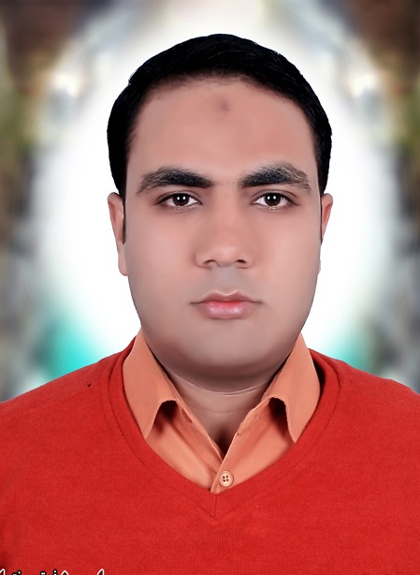

Lecture 1
COURSE STAFF: Instructor (Short Bio)
Dr. Hamada I. AbdulWakel
He received his B.Sc. degree in Computer Science from Minia University (Faculty of
Computers and Information),Minia, Egypt. He received his M.Sc. and PhD degrees from
Cairo University (Faculty of Computers and Artificial Intelligence).
His M.Sc. work was on employing Semantic Web & Social Networks techniques for sending
SMS for groups of Individuals. His Ph.D. work was on using Internet of Things and System Versification for IoT services verification and validation.

Slide 3
Lecture 1
LEARNING OBJECTIVES OF THIS COURSE
Teach an example of scripting and interpretative language and compare it with classical compiled programming languages.
Introduce the student to Python programming fundamentals.
Learn to apply fundamental problem solving techniques.
Expose students to application development and prototyping using Python.
Gain best practice in software development.

Slide 4
Lecture 1
TOPICS COVERED
The main content of the course are:
  Introduction to Python and Computer Programming.
  Data Types and Basic I/O Operations.
  Conditional Execution, Loops and Lists.
  Functions, Tuples, Dictionaries and Data Processing.

Slide 5
Lecture 1
TOPICS COVERED
Cont'd
The main content of the course are:
  Modules, Packages, String and List Methods and Exceptions.
  The Object-Oriented Programming, Exception Handling and Working with Files.
  Writing GUIs in Python.

Slide 6
Lecture 1
COURSE MATERIALS
All recorded lectures.
Required resources:
  The prescribed textbook for the course: "Fundamentals of Python From First Programs Through Data Structures", by Kenneth A. Lambert

Slide 7
Module 1: Introduction to Python and
Computer Programming

Slide 8
Lecture 1
MODULE OBJECTIVES
Describe the basic features of an algorithm.
Explain how hardware and software collaborate in a computer’s architecture.
Give a brief about Python programming.
Compose and run a simple Python program.

Slide 9
Lecture 1
COMPUTER SCIENCE?
Computer science is the study of computation and information.
Computer science is fundamentally problem-solving.
We can think of problem-solving as the process of taking some input (details about the problem) and generate some output (the solution to the problem). The "black box" in the middle is computer science.
Computer Science
Input
Output

Slide 10
Lecture 1
COMPUTER SCIENCE?
Cont'd
Data; Raw, unorganized facts (can be in the form of text, graphics, audio, or video).
Information; Data that has been processed into a meaningful form.
Information Processing; converting data into information.
Information Processing
Data
Info.

Slide 11
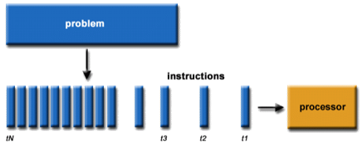
Lecture 1
ALGORITHM & INFORMATION PROCESSING
Sequence of steps that describes each of these computational processes is called an algorithm.

Slide 12
Lecture 1
ALGORITHM & INFORMATION PROCESSING
Cont'd
Features of an algorithm:
    Consists of a finite number of instructions.
    Each individual instruction is well defined.
    Describes a process that eventually halts after arriving at a solution to a problem.

Slide 13
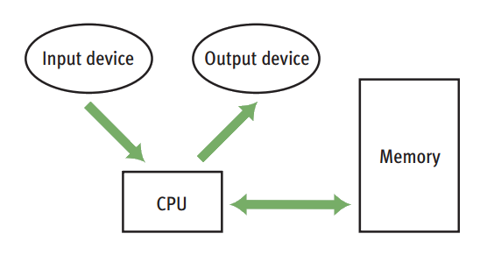
Lecture 1
HW & SW COLLABORATION

Slide 14
Lecture 1
HW & SW COLLABORATION
Cont'd
A program (i.e., an algorithm) stored in computer memory must be represented in binary digits, or machine code.
A loader takes a set of machine language instructions as input and loads them into the appropriate memory locations.

Slide 15
Lecture 1
WHY PYTHON??!!
Famous and fastest growing language.
Open-source language.
Scripting, Interpreted, and Expressive language.
Simple and easy to learn language.
C#: str.Substring(0, 6); JavaScript: str.substr(0, 6); Python: str[0:6]

Slide 16
Lecture 1
WHY PYTHON??!!
Cont'd
Multipurpose language.
High level language.
Cross platform language.
+20 years old language.

Slide 17
Lecture 1
WHAT'S PYTHON USED FOR?
Web Development (Django - Flask).
Games (PyGame).
Desktop Apps (PyGUI - Tkinter).
Hacking.
Machine Learning & Data Science.

Slide 18
Lecture 1
WHAT'S PYTHON USED FOR?
Cont'd
AI & Robots in Mars.
Automation.
Web Scraping.
Android Games.

Slide 19
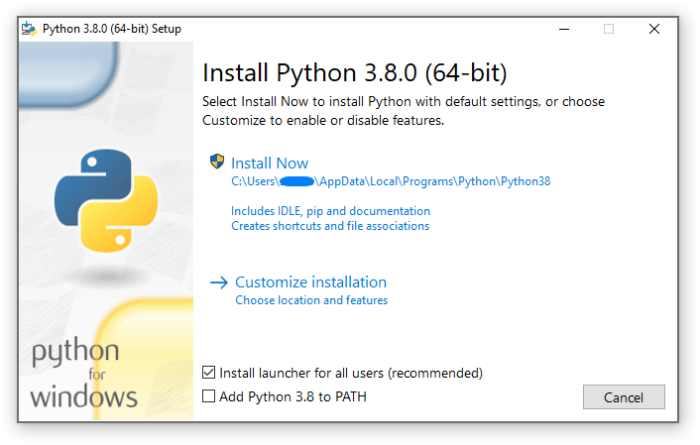
Lecture 1
INSTALLING PYTHON LANGUAGE
On Windows
  Straightforward steps.

Slide 20
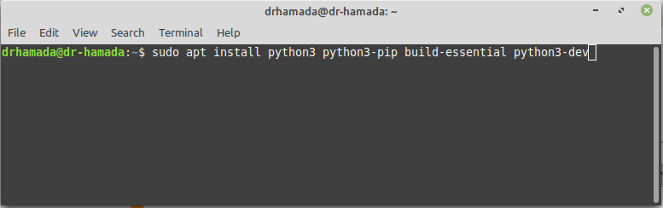
Lecture 1
INSTALLING PYTHON LANGUAGE
Cont'd
On Linux
  sudo apt install python3 python3-pip build-essential python3-dev

Slide 21
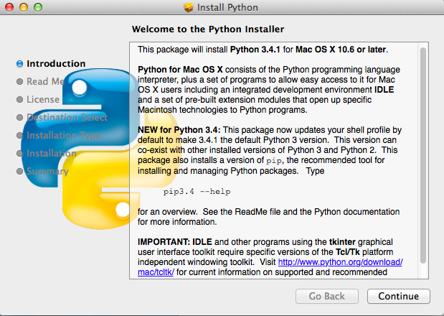
Lecture 1
INSTALLING PYTHON LANGUAGE
Cont'd
On Mac
  Straightforward steps.

Slide 22
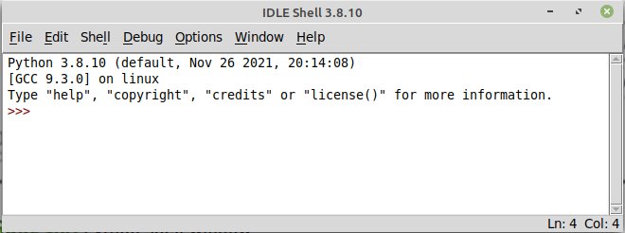
Lecture 1
PYTHON IDEs
Python IDLE.
Notes:
Python's Integrated Development and Learning Environment

Slide 23

Lecture 1
PYTHON IDEs
Cont'd
Visual Studio Code (VScode)
  Download.

Slide 24
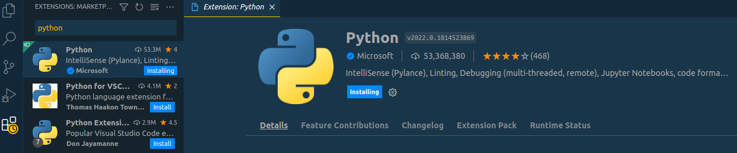
Lecture 1
PYTHON IDEs
Cont'd
Visual Studio Code (VScode)
  Python extension.

Slide 25

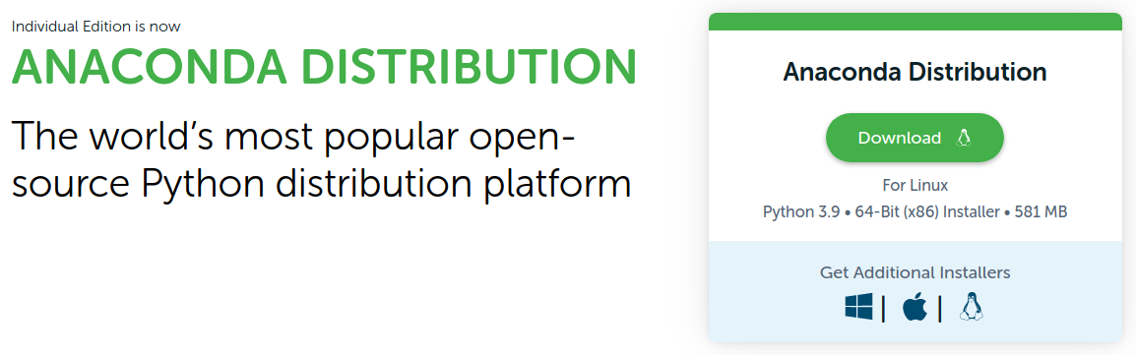
Lecture 1
PYTHON IDEs
Cont'd
Jupyter Notebook.
  Download.

Slide 26
Lecture 1
PYTHON IDEs
Cont'd
Online Editors:
  Online Python.
  Pynative.
  Programiz.

Slide 27
Lecture 1
FIRST PROGRAM IN PYTHON
Using cmd (in Windows) or Terminal (in Linux) to do the following:
  Create code folder.
  Create code file.
  Python program files use .py extension.
  Open code file in the text editor (or IDE).
  Write your code.
  print("I Love Python")

Slide 28
Lecture 1
FIRST PROGRAM IN PYTHON
Cont'd
Using cmd (in Windows) or Terminal (in Linux) to do the following:
  Run your code in cmd.
  python3 first.py
  "/path/to/python3" "/path/to/code file/first.py"
  In VScode IDE open new terminal to and press run button on top right.

Slide 29
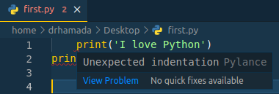
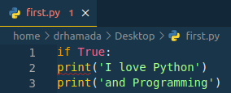
Lecture 1
SYNTAX IN PYTHON
Based on INDENTATION even if one space!!!

Slide 30
Lecture 1
FIRST PROGRAM IN PYTHON
Write a python code to sum two numbers num1 and num2.
  Steps:
    Ask the user to enter the first number.
    Ask the user to enter the second number.
    Compute the summation of the input numbers.
    Display the result.

Slide 31
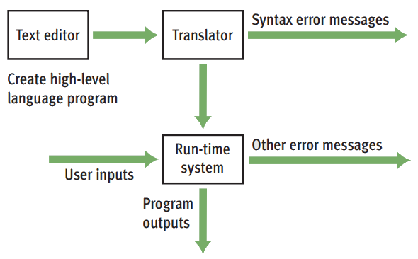
Lecture 1
FIRST PROGRAM IN PYTHON
Cont'd

