Slide 1


Writing in
Organizations
Prepared by Dr. Magdy Alhaj
MGM 202
Lecture 3

Slide 2



Writing Routine Business Correspondence & Meeting
Lecture 3
MGM 202
Prepared by
Dr. Magdy Alhaj

Slide 3

Lecture
3
Course Outline
Lecture 1: Getting Started: Writing and Your Career.
Lecture 2: The Writing Process and Collaboration at Work.
Lecture 3: Writing Routine Business Correspondence & Meeting
Lecture 4: Writing Letters: Some Basics for Communicating with Audiences Worldwide.
Lecture 5: E-Communications at Work Email, Blogs, Messaging, and Social Media
Lecture 6: Making Successful Presentations at Work
Lecture 7: Writing Instructions and Procedures.
Lecture 8: Writing Effective Short Reports.
Lecture 9: Writing Careful Long Reports
Lecture 10: Designing Clear Visuals

Slide 4
Lecture
LECTURE OUTLINE
3
1- What Memos, Faxes, E-Mails, IMs, and Blog Posts Have in Common
2- Memos.
3- Sending Memos: E-mail or Hard Copy?
4- Sending Faxes: Some Guidelines.
5- Meeting
6- Planning a Meeting
7- Creating an Agenda
8-Writing the Minutes
9-Virtual Meetings
www.midocean.ae

Slide 5
Lecture
3
Writing Routine Business Correspondence
1- What Memos, Faxes, E-Mails, IMs, and Blog Posts Have in Common:
Although memos, faxes, e-mails, IMs, and blog posts are very different types of correspondence, they share the following characteristics:
1. Each of these types of correspondence is streamlined for the busy world of work. Unlike letters, proposals, or reports, which can be long and detailed and contain formal parts and sections, these routine types of correspondence give writers and readers a particularly fast way to communicate.

Slide 6
Lecture
3
Writing Routine Business Correspondence
2. They give busy readers information quickly. While the messages they contain can be about any topic in the world of work, most often they focus on day-to-day activities and operations at your company—sales and product information, policy and schedule changes, progress reports, orders, troubleshooting problems.
3. They are informal. Compared to letters, proposals, and reports, these kinds of routine correspondence are not as formal. They emphasize a conversational, yet professional, style of writing.

Slide 7
Lecture
3
Writing Routine Business Correspondence
4. Even though they are routine, they still demand a great deal of thought and time. Although memos, e-mails, blogs, and IMs are less formal than, for instance, a letter to a client, they all must be written clearly and with correct grammar and punctuation, even when the correspondence is between two employees in the same department of a company. Always plan and review what you are going to write.

Slide 8
Lecture
3
Writing Routine Business Correspondence
2- Memos:
Memorandum, usually shortened to memo, is a Latin word for “something to be remembered.” The Latin meaning points to the memo’s chief function: to record information of immediate importance and interest in the busy world of work, as in Figure 3.1. Memos are brief and informal but can contain official announcements that serve a variety of functions, including:

Slide 9
Lecture
3
Writing Routine Business Correspondence
■ making an announcement
■ providing instructions
■ clarifying a policy, procedure, or issue
■ changing a policy or procedure
■ alerting employees to a problem or issue
■ delegating responsibilities
■ making a request
■ offering suggestions or recommendations
■ providing a record of an important matter
■ confirming an outcome

Slide 10
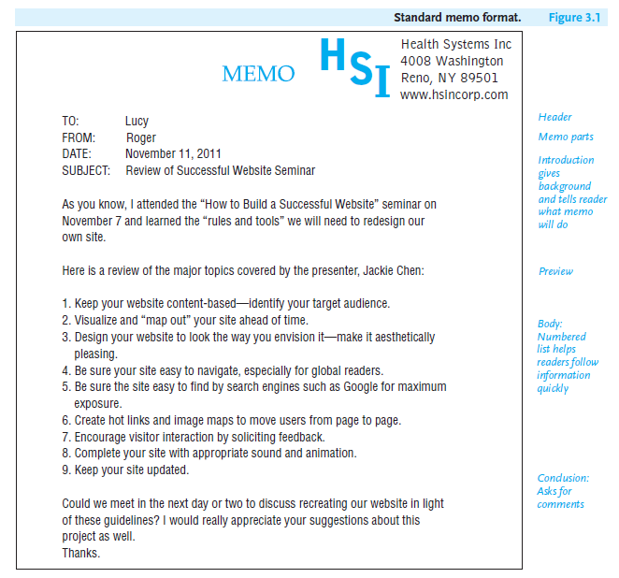
Lecture
3
Writing Routine Business Correspondence

Slide 11
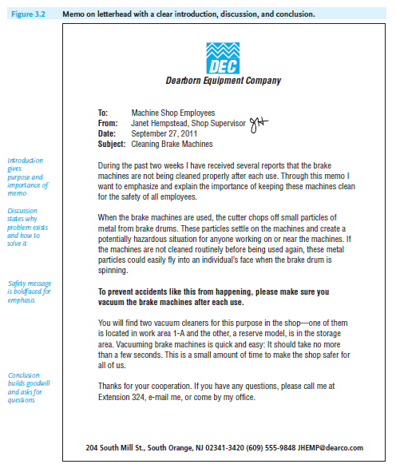
Lecture
3
Writing Routine Business Correspondence
- Memo Format
Memos vary in format and the way they are sent. Some companies use standard, printed forms (Figure 3.1), while others have their names (letterhead) printed on their memos (as in Figures 3.2 and 3.3). You can also create a memo by including the necessary parts in an e-mail.

Slide 12
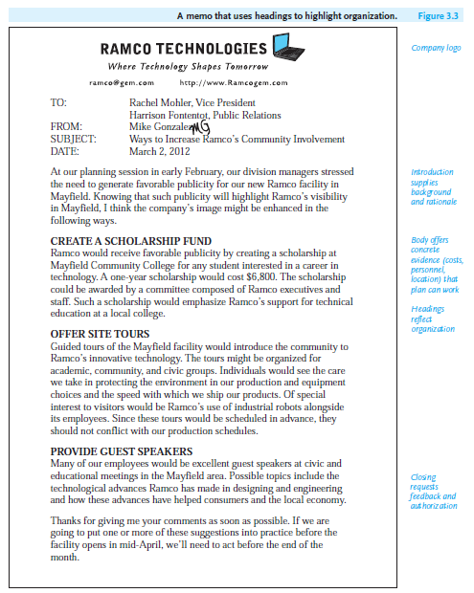
Lecture
3
Writing Routine Business Correspondence

Slide 13
Lecture
3
Writing Routine Business Correspondence
- Strategies for Organizing a Memo
Organize your memos so that readers can find information quickly and act on it promptly. For longer, more complex communications, such as the memos in Figures 3.2 and 3.3, your message might be divided into three parts: (1) introduction, (2) body or discussion, and (3) conclusion. Regardless of how short or long your memo is, recall the three P’s for success—plan what you are going to say; polish what you wrote before you send it; and proofread everything.

Slide 14
Lecture
3
Writing Routine Business Correspondence
Introduction
The introduction of your memo should do the following:
■ Tell readers clearly about the issue, policy, or problem that prompted you to write.
■ Explain briefly any background information the reader needs to know.
■ Be specific about what you are going to solve a problem.

Slide 15
Lecture
3
Writing Routine Business Correspondence
Body (Discussion)
In the body, or discussion section, of your memo, help readers in these ways:
■ State why a problem, procedure, or decision is important; who will be affected by it; and what the consequences are.
■ Indicate why and what changes are necessary.
■ Give precise dates, times, locations, and costs.

Slide 16
Lecture
3
Writing Routine Business Correspondence
Conclusion
In your conclusion, state specifically how you want the reader to respond to your memo. To get readers to act appropriately, you can do one or more of the following:
■ Ask readers to call you if they have any questions, as in Figure 3.2.
■ Request a reply—in writing, over the telephone, via e-mail, or in person—by a specific date, as in Figures 3.1 and 3.3.
■ Provide a list of recommendations that readers are to accept, revise, or reject, as in Figure 3.3.

Slide 17
Lecture
3
Writing Routine Business Correspondence
3- Sending Memos: E-mail or Hard Copy?:
A memo can be sent as a printed hard copy, as an e-mail, or in an e-mail attachment. Find out your company’s policy. Increasingly, e-mail is replacing printed memos, but there are times when a hard-copy memo is preferred as essential.
Consider the level of official importance and confidentiality of your memo. If your memo is an official document, such as the policy outlined in Figure 3.2, you may not want to send it via e-mail, because it could easily be deleted or altered. Moreover, if your memo is confidential (e.g., an evaluation of a co-worker or vendor, a message containing sensitive financial or medical information), you may not want to send it via e-mail, because it could easily be forwarded or fall victim to hackers.

Slide 18
Lecture
3
Writing Routine Business Correspondence
4- Sending Faxes: Some Guidelines:
Even though you will use e-mail attachments and scan and send documents via e-mail, faxes are still used in the world of work. A fax is an original document copied and transmitted over telephone or computer lines. Faxes are particularly helpful either when you have only hard copy to send or when you want to send an original signed letter, contract, blueprint, artwork, or other document that you could not send via an e-mail transmission. Faxes demonstrate exactly what original documents look like and allow recipients to obtain a hard copy quickly.

Slide 19
Lecture
3
Writing Routine Business Correspondence
- Cover Page
When you send a fax, make sure your cover page includes the following information:
1. The name of the sender and his or her fax and phone numbers. The phone number is important because it enables the recipient to report an incomplete transmittal.
2. The name of the recipient and his or her fax and phone number. The recipient’s correct fax and phone numbers should be included to ensure delivery of the message.

Slide 20
Lecture
3
Writing Routine Business Correspondence
3. The total number of pages being faxed. Note that the total number of pages includes the cover page itself.
4. A brief explanatory note that lets the recipient know what the fax is, what its purpose is, and how and when to respond to it.

Slide 21
Lecture
3
Writing Routine Business Correspondence
- Sending a Document
Follow these four guidelines to fax a clear and complete document:
1. Make sure the original documents you send are clear. An unclear faxed document will be difficult for the recipient to read. For example, penciled comments may be too faint to fax clearly.
2. Avoid writing on the top, bottom, or edges of the documents to be faxed. Any comments written on the outer edges may be cut off or blurred during transmittal.

Slide 22
Lecture
3
Writing Routine Business Correspondence
3. Do not send overly long faxes. Be careful about sending anything longer than three or four pages because you will tie up both your own and the recipient’s fax machines.
4. Respect the recipient’s confidentiality. Because faxes may be picked up by other employees in your office, don’t assume your message will be confidential, unless, of course, the recipient has a private fax machine.

Slide 23
Lecture
3
Meetings
Meetings
One of the most frequent ways to collaborate is through meetings, which can be small group discussions or large, formal conferences. Whether regularly scheduled (a weekly staff meeting) or a special, unscheduled one, a meeting requires teamwork. Collective energy and goodwill will bear much fruit. To succeed in the workplace, you need to know how to plan a meeting, create an agenda, and write minutes for your group

Slide 24
Lecture
3
Meetings
Planning a Meeting
As with a collaboratively written document, meetings have to be carefully planned. They need to be organized, specifying when and how the meeting will take place (in-person, face-to-face via Skype, a virtual meeting, etc.), a focus provided for the meeting, and guidelines set for how it will be conducted. If you have the responsibility of planning a meeting, be sure you can answer the following questions:

Slide 25
Lecture
3
Meetings
What is the purpose of the meeting? Determine why the meeting is necessary, what essential topics need to be discussed, and what results or outcomes the meeting hopes to accomplish.
Who should attend the meeting? Identify key people who need to be involved, e.g., managers, co-workers, colleagues from other departments, clients, vendors, etc.
What specific responsibilities do individuals in your group have? Determine who will take minutes (see “Writing the Minutes,” pages 105–109), introduce the meeting, or deliver a PowerPoint or Prezi presentation, for example

Slide 26
Lecture
3
Meetings
4. When should the meeting take place? There are good times and bad times to hold a business meeting, as the following schedule shows:
Good times
1. Mid-morning or mid-afternoon
2. Any time during the week except
Monday morning or Friday afternoon, or immediately before or after a major holiday
3. After a major company celebration when morale is high

Slide 27
Lecture
3
Meetings
Bad times
1. Early in the morning or late in the afternoon
2. Monday morning or Friday afternoon
3. Immediately before or after a major holiday
4. Same day as a long training session or long meeting
5. Where should the meeting take place? Select an appropriate space, one equipped with all the technology your group plans to use (e.g., speakerphones, SMART Boards, web-based conferencing systems)

Slide 28
Lecture
3
Meetings
Creating an Agenda
Out of your planning will come your agenda, a list of the topics to be covered at the meeting. An agenda is a one- or sometimes two-page outline of the main points to be covered at the meeting. The agenda should list only those items that your group, based on its work and interaction, regards as most crucial. Prioritize your action items so that the most important ones come first.

Slide 29
Lecture
3
Meetings
Observing Courtesy at a Group Meeting
To show your team members the courtesy they deserve during a meeting (whether face-to-face or virtually), observe the following guidelines:
1. Be on time. Coming in late can disrupt a meeting and cause further delays if you have to be brought up-to-date.
2. Silence your cell phone. Set your phone on vibrate if you are expecting an important business call.
3. Do not send text messages. Sending text messages during a meeting is as rude as playing a video game on a smartphone.
4. Avoid side conversations. Talking to others around you while the meeting is in progress shows poor manners and can distract from the business and progress of the meeting.

Slide 30
Lecture
3
Meetings
5. Avoid interrupting. If you need to interject a comment, raise your hand or
wait for the meeting planner to ask for comments from the group.
6. Be an active listener. Pay attention to what is being said at the meeting and also try to discern the message behind those words.
7. Participate; don’t dominate. Give everyone a chance to speak. Contribute to the discussion, but don’t monopolize it.
8. Be a focused speaker. If you are called on or choose to speak to the group, get to the point quickly, be clear, and avoid straying from your topic.
9. Do not record the meeting or take photographs. Unless you have permission, do not bring an audio recorder or video camera to a meeting, and do not take photographs

Slide 31
Lecture
3
Meetings
Writing the Minutes
The minutes are a summary of what happened at the meeting . Copies of minutes are kept on file—they are the official, permanent record of the group’s deliberations and are regarded as legal documents. Minutes need to be clear, accurate, and impartial. If you are asked to take minutes, don’t inject your own opinions of how well or poorly the meeting went; for example, “Once more Hicks got off the topic” is not appropriate. Plan on transmitting minutes 24 to 48 hours after the meeting has adjourned.

Slide 32
Lecture
3
Meetings
What to Include in Your Minutes
Minutes of a meeting should include the following information:
date, time, and place of the meeting, name of the group holding the meeting, and why
name of the person chairing the meeting
names of those present and those absent
the approval or amendment of the minutes of the previous meeting

Slide 33
Lecture
3
Meetings
for each major point—the action items—indicate what was done:
what was discussed, suggested, or proposed
what was decided and the vote, including abstentions
what was continued (tabled) for a subsequent study, report, or meeting
the time the meeting officially concluded

Slide 34
Lecture
3
Meetings
Guidelines on Writing Minutes
To be effective, minutes must be concise and to the point. Here are a few guidelines to help you:
● Make sure of your facts; spell all names, products, and tests correctly.
● Concentrate on the major facts surrounding action items. Condense lengthy discussions, debates, and reports given at the meeting.
● Do not report verbatim what everyone said; readers will be more interested in outcomes—what the group did.
● List each motion (or item voted on) exactly as it is worded and in its final
form.
● Avoid words that interpret (negatively or positively) what the group or anyone in the group did or did not do.

Slide 35
Lecture
3
Meetings
Virtual Meetings
While face-to-face meetings are still very frequent in the workplace, technology has made virtual meetings a useful alternative. They allow a group to meet online, no matter where team members are located. Virtual meetings in the world of work facilitate communication and save money on travel costs
Here are three ways technology can help you conduct a virtual meeting:

Slide 36
Lecture
3
Meetings
Teleconferencing
allows for conference calls in which multiple participants at one’s office, across the country, or around the globe can communicate with one another. But note that participants have to be notified of the call and given a password to participate in the conversation.

Slide 37
Lecture
3
Meetings
2. Web conferencing
(such as Cisco’s WebEx) combines the audio component of teleconferencing with the face-to-face interaction of a traditional meeting. The greatest advantage of web conferencing over teleconferencing is that individuals attending a web conference can view presentations and share documents electronically during a meeting

Slide 38
Lecture
3
Meetings
3. Dedicated videoconferencing
Systems are primarily used for group-to-group conferences or one-way seminars in large rooms and auditoriums, bringing large groups of people together to share information without the expense and time of traveling

Slide 39
Lecture
3
Meetings
Videoconferencing with Skype
Skype allows individuals in the world of work to conduct videoconferences over the Internet without purchasing expensive videoconferencing systems. Skype can be used for one-on-one meetings or for video conferences with a small group (up to ten participants). Skype functions like a telephone call, but it uses a webcam to send video to your partner(s). You can download the free software from www.skype.com

Slide 40
Lecture
3
Meetings
Like other business meetings, you have to prepare for a Skype conference. You need to do your homework—planning, sharing information, and taking notes. Here are five guidelines to help make your Skype videoconference productive:
● Collaboration works best in Skype videoconferences when everyone has a compatible, fast Internet connection.
● Always test your webcam to make sure it is working (and is in focus) before making a Skype call, and ask the other participants to check theirs, too. In your Skype contact list, click on “Echo/Sound Test Service” to test your audio settings

Slide 41
Lecture
3
Meetings
● Look directly into your computer’s webcam (and not at the keyboard) so that the participants can see you clearly.
●Be sure that any files you share during the meeting through Skype are relevant.
● Do not try to carry on another conversation on your cell phone, tweet, or text during your Skype conversation

Slide 42



References:
Successful Writing at Work,,
By: Philip C. Kolin
University of Southern Mississippi
Chapter 3
Thank You
www.midocean.ae

Slide 43


Thank You

