Slide 1






Sequences and Financial mathematics
Prepared by Dr. Sahar ALBOSAILY
Lecture 07
MTH 112
Business Mathematics

Slide 2
At the end of this section you should be familiar with:
    Arithmetic and Geometric Sequences and Serieses
    Simple Interest
    Compound Interest
    Present Value
    Future Value

Slide 3
Arithmetic & Geometric Sequences and Series
Revision on Arithmetic and Geometric sequences definitions
Arithmetic sequence
If the rule is that each term, after the first, is obtained by adding a constant, $d$, to the previous term, then the sequence is called an arithmetic sequence, such as 2, 6, 10, 14, 18, 22,... , where $d$ = 4.
$d$ is known as the common difference.

Slide 4
Arithmetic & Geometric Sequences and Series
Revision on Arithmetic and Geometric sequences definitions
Geometic sequence
If the rule is that each term, after the first, is obtained by multiplying the previous term by a
constant, $r$, then the sequence is called a geometric sequence, such as, 4, 16, 64, 256, 1024, …
where $r$ = 4.
$r$ is known as the common ratio.

Slide 5
Financial Mathematics
Definitions
A series is the sum of the terms of a sequence.
A series is finite if it is the sum of a finite number of terms of a sequence.
A series is infinite if it is the sum of an infinite number of terms of a sequence.

Slide 6
Financial Mathematics
Revision on Arithmetic and Geometric serieses definitions
Arithmetic series
An arithmetic series is the sum of the terms of an arithmetic sequence, such as 2, 6, 10, 14, 18, 22, . . . , with d= 4. Denoting the first term of an arithmetic sequence with the value a and progressing by adding the value d to each previous term, the arithmetic sequence can be outlined as in Table 5.1.
Each element of a sequence can be identified by reference to its term number;

Slide 7
Example
Find the sum of the first 15 terms of the series: 20+ 18 + 16 + 14 +

Slide 8
Arithmetic sequence

Slide 9
Arithmetic sequence

Slide 10
Arithmetic series

Slide 11
Financial Mathematics
Arithmetic sequence
$S_{n}$= $\frac{n}{2}$ $\left[2a+\left(n−1\right)d\right]$
Table 5.1 Arithmetic sequence
Sequence | a | a + d | a + 2d | ….. | a +(n – 1) d
Term number |  | T₂ | T₃ | ….. | T_{n}
$$T_{1}$$

Slide 12
Example
Find the sum of the first 15 terms of the series: 20+ 18 + 16 + 14 +
Solution:
This is an arithmetic series since the difference d = -2.
Therefore,
a = 20, d = –2, n = 15, and hence,
using formula (5.2),
$$S_{15}=\frac{15}{2}[2(20)+(15-1)(-2)]=90$$

Slide 13
Example
Geometric series
Find the sum of the first 12 terms of the series: 4 + 2 + 1 + $\frac{1}{2}$ + $\frac{1}{4}$….

Slide 14
Geometric Series(or geometric progression denoted by GP)

Slide 15
Geometric Series(or geometric progression denoted by GP)

Slide 16
Geometric Series(or geometric progression denoted by GP)

Slide 17
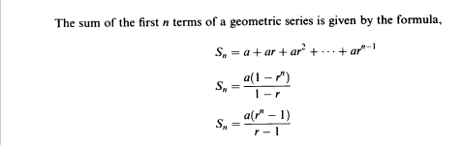
Geometric Series(or geometric progression denoted by GP)

Slide 18
Solution

Slide 19
Example
A manufacturer produces 1200 computers each week. After week 1, he increases production by:
Scheme I: 80 computers each week
Scheme II: 5% each week
(a) (i) Find the output in week 20 under each scheme.
(ii) Find the total output over the first 20 weeks under each scheme.
(b) Calculate for schemes I and II the week in which production first exceeds 8000.

Slide 20
Solution

Slide 21
Solution

Slide 22
Solution

Slide 23
Solution

Slide 24
Solution

Slide 25
Solution

Slide 26
Solution

Slide 27
Solution

Slide 28

Simple Interest
Simple interest is a fixed percentage of the principal, P0, that is paid to an investor each year, irrespective of the number of years the principal has been left on deposit; that is, money invested at simple interest will increase in value by the same amount each year. So, if the investor is paid a fixed annual amount, i% of P0, then the amount of simple interest, I, received over t years is given by the formula
I=P0 X/X

Slide 29

Simple Interest
Therefore, the total value after t years, Pt is the principal plus interest and is given by

Slide 30

Simple Interest
When the total value (future value), the interest rate and time are known, the principal (present value) may be calculated by rewriting formula (5.8) as

Slide 31
Simple Interest
Note: The interest rate is always quoted as a percentage, i%. In calculations, you write i% as the fraction i/l00

Slide 32
Compound Interest
In the modern business environment, the interest on money borrowed (lent or invested) is usually compounded. Compound interest pays interest on the principal plus on any interest accumulated in previous years. The total value, Pt of a principal, P0, when interest is compounded at;'% per annum is

Slide 33
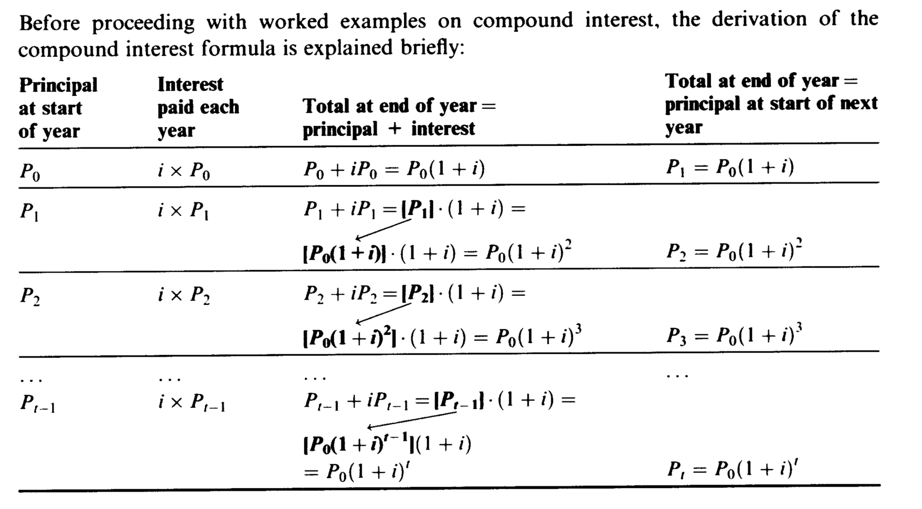
Compound Interest

Slide 34
Compound Interest
Each year, the interest earned is added to the total amount on deposit (principal,p0, plus anyaccumulated interest ), at the beginning of that year.
Notice that the amounts due at the end of each year form a geometric progression where a=p0, and r, the common ration is (1+i), giving the sequence

Slide 35
Compound Interest

Slide 36
Compound Interest

Slide 37
Compound Interest
The present value of a future sum, Pt, is the amount which, when put on deposit at t — 0, at /% rate of interest, will grow to the value of P, after t years. The present value, P0, is calculated by rearranging the compound interest formula (5.10):

Slide 38
Compound Interest
£5000 is invested at 8% compound interest per annum for three years.
(a) Calculate the value of the investment at the end of three years.
(b) Compute the present value of receiving (i) £6298.50, (ii) £15000 in three years' time when the discount rate is 8%.

Slide 39
Compound Interest

Slide 40
Compound Interest

Slide 41
Compound Interest

Slide 42
Compound Interest

Slide 43
Compound Interest

Slide 44
Compound Interest

