Slide 1




DIGITAL MARKETING
APPLICATIONS

Slide 2

DIGITAL MEDIA AND THE MARKETING MIX
Chapter at a glance
Main topics
PRODUCT
PRICE
PLACE
PROMOTION
PEOPLE
PROCESS
PHYSICAL EVIDENCE
COURSE CODE - MKT720

Slide 3

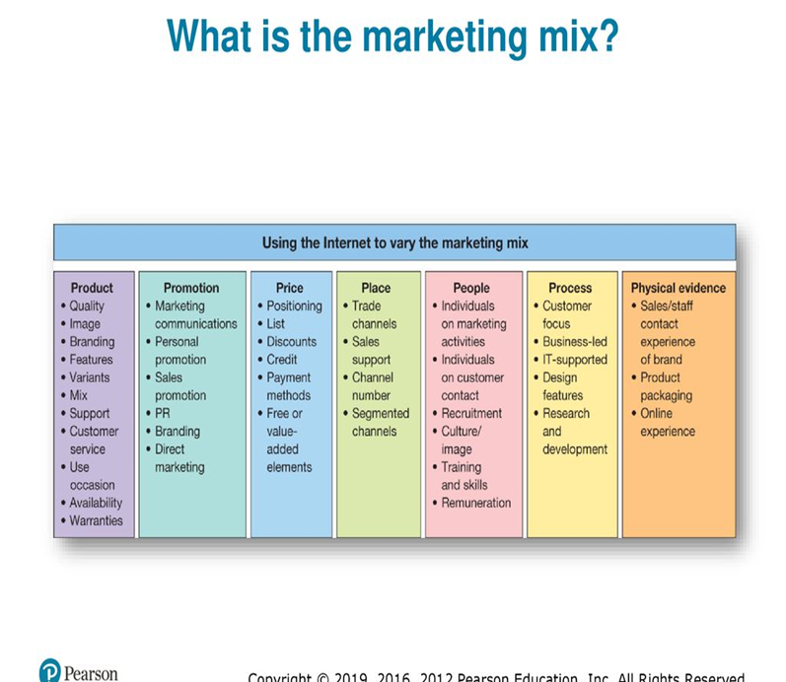
Digital media and the marketing mix
What is the marketing mix ?
The marketing mix - wide referred to as the 4Ps of Product, Price, Place and Promotion - was originally proposed Jerome McCarthy (1960) and is still used as an essential part of formulating and implementing marketing strategy by many practitioners. The popularity of the mix as a guide ford application of marketing techniques is driven by the apparent simplicity of the framework However, in the 1980s the 4Ps was challenged for not referencing the importance of customer service. The result was that the mix was extended to 7Ps, which includes three further elements (the service mix) that better reflect service delivery: People, Process and Physical evidence. Some writers argue that the service mix should be subsumed within the 4Ps.
The Figure summarizes the different sub-elements of the 7Ps.
Marketing mix:- the series of seven key variables – product , price, promotion , people , process and physical evidence – that are varied by marketers as part of the customer offering.

Slide 4
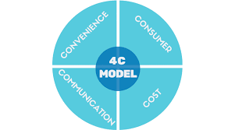
Since the 1990s there have been more changes in marketing thinking the outcome has been a shift in emphasis in the application of the marketing mix towards the development of relationship building. Some writers even argue that this is a paradigm shift, altering the underlying marketing philosophy guiding the application of marketing tools and concepts). Whereas others suggest the move to more relationship-orientated marketing is in response to growing customer demands and increasingly complex technology-driven trading environments
Note that the marketing mix concept has been criticized for not being customer-centric.
Lautenborn (1990) suggested the 4Cs framework, which considers the 4Ps from a customer perspective. In brief, the 4Cs are:
• customer needs and wants (from the product)
• cost to the customer (price)
• convenience (relative to place)
• communication (promotion).
Online branding:- how online channels are used to support brands that in essence are the sum of the characteristics of a product or service as perceived by a user.

Slide 5

It is important to acknowledge the rise in importance of relationship building as this is key to the application of digital marketing strategies and the application of the marketing mix ,Digital media and technology provide many new opportunities for the marketer:
• to vary the application of the marketing mix;
• to develop new routes to delivering competitive advantage;
• to create new market positions;
• to build and service relationships in increasingly innovative ways
• to cut through the barriers of time and space and offer continuous and instantaneous access to products and services.
Core product :- the fundamentals features of the product that meet the users needs.
Extended product:- additional features and benefits beyond the core product.

Slide 6

Product variable
the product variable of the marketing mix refers to characteristics of a product, and has implications for service or branding. Product decisions should be informed by market research where customers' needs are assessed and the feedback is used to modify existing products or develop new products. There are many alternatives for varying the product in the online context when a company is developing its digital strategy; product decisions can usefully be divided into decisions affecting the core product and the extended product.
The core product refers to the main product purchased by the consumer to fulfil their needs, while the extended or augmented product refers to additional services and benefits that are built around the core of the product.
The main implications of digital technology for the product element of the mix are:
1 options for varying the core product
2 options for offering digital products
3 options for changing the extended product
4 conducting research online
5 speed of new product development
6 speed of new product diffusion.
Product variable:- the element of the marketing mix that involves researching customers needs, developing appropriate products and communicating their features and benefits.

Slide 7

1-OPTIONS FOR VARYING THE CORE PRODUCT
For some companies, there may be options for new digital products that will typically be information products that can be delivered over the web. developing new products or adding 'digital value' to customers. The questions posed still prove useful today:
• Can l offer additional information or transaction services to my existing customer base? For example, a fashion retailer can provide customer reviews, fashion previews and personal digital shopping assistants
• Can I address the needs of new customer segments by repackaging my current information assets or by creating new business propositions using the Internet? For example, many products can have accompanying eBook's, videos and tutorials to inform customers.
• Can I use my ability to attract customers to generate new sources of revenue such as advertising or sales of complementary products?
Some of the markets transformed most by the Internet are those where products can be transformed into digital services, such as music (downloading or streaming of digital tracks, books (ebooks), newspaper and magazine publishing (online access to articles)

Slide 8
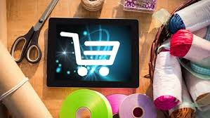
2-OPTIONS FOR OFFERING DIGITAL PRODUCTS.
Publishers, TV companies, media owners and other companies that can offer digital pro Publishers, as published content, music or videos now have great Flexibility to offer a range of product purchase options at different price points, including:
Subscription. This is a traditional publisher revenue model, but subscription can potentially be offered for different periods (for example, three months, twelve months or two years) and at different price points.
Pay-per-view. A fee for a single download or viewing session at a higher relative price than the subscription service - for example, music products from iTunes.
Bundling. Different channels or content can be offered as individual products or grouped at a reduced price compared to pay-per-view.
Ad-supported content. There is no direct price set here. Instead, the publisher's main revenue source is through adverts on the site (CPM display advertising on-site using banner ads and skyscrapers), a fixed sponsorship arrangement or CPC, which stands for 'cost-per-click' - more typical when using search ad network publishing, such as Google Adsense, which makes a significant contribution to Google's revenue. Other options include affiliate revenue from sales on third-party sites or offering access to subscriber lists.
The digitization of products presents opportunities to some industries and threats to others.

Slide 9

3- OPTIONS FOR CHANGING THE EXTENDED PRODUCT
When a customer buys a new computer or mobile phone it consists not only of the tangible product, and peripheral devices, but also the information provided by the salesperson the instruction manual, the packaging, the warranty and the follow -up technical somehow the Internet can be used to vary the extended product:
These are elements of the extended product. example
endorsements;
awards;
testimonies
customer lists
customer feedback
warranties
guarantees
money-back offers
customer service (see people, process and physical evidence)
incorporating tools to help users during their selection and use of the product.
Once customers are attracted to a site and have begun to learn about the brand then companies can offer freemium content or sample content or trial products. Through providing freemium content, more customers will encouraged to enter into a paid-for relationship with the organization.

Slide 10

4- SPEED OF NEW PRODUCT DEVELOPMENT
Digital channels give instant access to target markets and provide platforms, which enable new products to be developed more rapidly as it is possible to test new ideas and concepts and explore different product options through online market research. Companies can use their own panels of consumers to test opinion more rapidly and often at lower costs than for traditional market research. Another aspect of the velocity of new product development is that the network effect of the Internet enables companies to form partnerships more readily in order to launch new products. In the early days of the Internet, to remain competitive, organizations would have to roll out new products more rapidly to international markets. Additionally, the importance of word-of-mouth communication on the impact of the rate of adoption of new products, especially through the Internet.

Slide 11
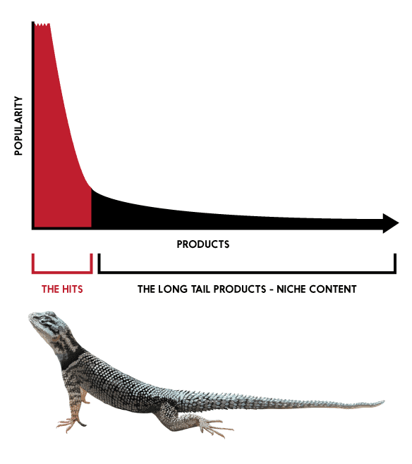
The long tail concept
Long tail in marketing refers to those offerings which are in less demand compared to the actual popular product of a specific category.
Some examples of long tail markets are (different types of) laptop chargers in the laptop niche, (different types of) mobile covers in the smartphone accessories market, and (different types of) customized gifts in the gifting niche.
The usual retail scenario runs like the above graph where there is one dominant head in the front (the popular product which referred to as ‘hit’) followed by a long tail of not that popular products.
Long tail concept:- a frequency distribution suggestions the relative variation in popularity of items selected by consumers

Slide 12
What Is Long Tail Marketing?
In the usual retail environment, a small group of popular products dominate sales. These popular items could be a newly released gadget, movie, book, game or any recently acclaimed product. The stores focus on stocking up and promoting these popular products to earn most of the profits while other products in the inventory continue to sell in a usual pattern with no single item making a big impact.
Long tail marketing is a business strategy of equaling or exceeding the market demand of a hit product by stocking, offering, and marketing many less demand volume niche products. Unlike the usual strategy of product promotion, the long tail strategy focuses more on inventory management and selling multiple less popular products to generate as much profit from the long tail as the hit head.
The concept of long tails explain the market that is being created and catered to with the advent of the internet and availability of endless information. It revolves around how consumers in the modern economy are shifting towards individualized niche products than being attracted to a small number of ‘hit’ products. globalization and the internet revolution has made it really easy and economical to produce and stock a large amount of less-demand products. This eventually creates more choices for the consumers to choose from and helps the seller stand out by catering to a niche or micro-niche.

Slide 13
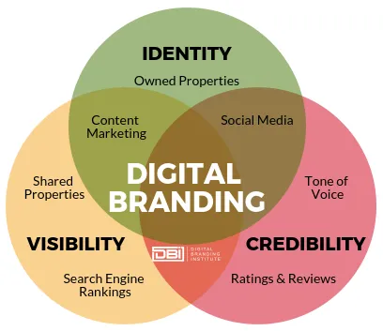
BRANDING IN A DIGITAL ENVIRONMENT
Branding is important online and offline as it helps customers differentiate between products and services from different manufacturers and producers. Furthermore, branding is how companies set themselves apart from their competitors.
Perhaps most importantly, branding affects perceptions since it is well-known that in blind product resting consumers fail to distinguish between brands' Consequently, how a brand is developed and presented online is particularly important because a website visitor has limited physical cues to help form an opinion about a company and its services, such as talking so a sales representative or the ambiance of the physical store.
Branding can add value across the supply chain, act as a barrier to competition, increase consumer trust and generate high levels of profitability. Before examining online brands, let's consider the fundamentals of branding.
manufacturers and producers develop their products and services into brands in order to create unique market positions in the minds of their customers. From a manufacturer's perspective, at a basic level, there are product categories such as washing power and computers. To identify a unique position - within such basic categories - a manufacturer builds a brand around the basic core product in order to distinguish their offering from the competition.
Each brand can then be divided into variants, which extend customer choice within the brand.

Slide 14

BRANDING IN A DIGITAL ENVIRONMENT
In addition to manufacturer brands, there are also own-label brands which are brands developed by distributors
Own-label brands often provide lower-cost alternatives to the customer than the category leader brands, which are often highly priced. For physical products, brand producers take the core product, create a brand name and image and then augment the product through service, guarantees, design quality, packaging and delivery. The result is customers can then choose between brands by selecting those that best suit their needs and wants. However, it is not only manufacturers and products that should be concerned with online branding. All businesses are perceived as brands and the online presence is increasingly important in governing brand perception. The company's website, mobile apps and social media presence all affect the perception of the brand and are part of the experience of a brand Social media provide a new platform to interact with brands.
Digital branding is how you design and build your brand online through websites, apps, social media, video and more. Digital branding consists of a combination of digital marketing and internet branding to develop a brand online.

Slide 15

A key concept at the heart of creating a brand is positioning and, creating a unique position in the marketplace involves a careful choice of target market and establishing a clear differential in the minds of the people.
Brands Organizations are able to get into the minds of the customers, to position their brands, using a range of brand elements contributing to brand equity:
brand domain - key target markets, where the brand competes
brand heritage - the background and culture of the brand
brand values - the core characteristics, e.g., price, quality, performance
brand assets - distinctive names, symbols, images
brand personality - the character of the brand
brand reflection - how the customer perceives themselves as a result of buying the brand.
Brand equity:-The assets(or liabilities)linked to a brands name and symbol that add to (or subtract from)a service

Slide 16


SUCCESS FACTORS FOR BRAND SITES
the manager of the site needs to think carefully of the best way the brand can engage with consumers given the lack of content naturally associated with low-involvement products. For the site itself, it is not the quantity of visitors that is important; rather it is about the quality of visitors, since brand sites are most likely to attract brand advocates, who can be important in influencing others to make them aware of the brand or trial the brand. it is important that brand sites provide a home for the brand loyalists and advocates. It follows that brand owners should determine the type of content on a brand site that will encourage brand loyalists (and also the brand-neutral consumer) to visit and then return to the brand site.
Brand advocate a customer who has favorable perception of a brand who will talk favorably about a brand to their acquaintances to help generate awareness of the brand or influence purchase intent

Slide 17


encouraging visitors to.: return is key, a quality site experience to achieve this to encourage visitors to return include:
• Creating a compelling, interactive experience including rich media that reflects the brand. The research by Flores (2004) showed that a site that delivers an unsatisfactory experience will negatively affect brand perception.
• Considering how the site will influence the sales cycle by encouraging trial. Trial will often be fulfilled offline, so approaches such as samples, coupons or prize draws can be used. These response activators should be integrated throughout the site. For example, car brands will all have prominent options for taking a test drive, receiving a brochure or the option to win a car or a visit to a race circuit.
• Developing an exchange (permission marketing) program on your website to begin a 'conversation' with the most valuable customer segments. Permission-based email or text messages can be used to update consumers about new products or promotions.
Additionally we would stress the importance of achieving customer engagement with brand sites to encourage participation or co-creation of content. For example, brands can encourage users to share and submit their comments, stories, photos or videos. Once engaged in this way, visitors are more likely to return to a site to see others' comments. The success factors a brand uses should closely interlink with the brand's identity.

Slide 18

Brand identity
the importance of developing a plan to communicate the key features of the brand identity and increase brand awareness.
Brand identity is again more than the name. a set of brand associations that imply a promise to customers from an organization.:
there are two rules for naming online brands:
1- The Law of the Common Name. They say the kiss of death for an Internet brand is a common name'. The idea is that common names such as Art.com or Advertising.com are poor since they are not sufficiently distinctive.
2- The Law of the Proper Name. They say 'your name stands alone on the Internet, so you'd better have a good one'. This suggests that proper names are to be preferred to generic names, the characteristics of the word chosen to represent a brand can influence consumer behavior and be linked to the propensity with which a buyer will engage with a brand. in order to increase the likelihood that a consumer will engage with a new brand, it should be easy to pronounce, have interesting arrangements of syllables and consonants so as to make the name easy to recall but should not be too similar to other words (thereby causing confusion with other brand names).In essence, good brand names those that are easy to remember and pronounce but also have potential to catch the attention of customers
Brand identity:- the totality of brand association's, including name and symbols that must be communicated

Slide 19

PRICE
The price variable of the marketing mix refers to an organization's pricing policies, which are used to define pricing models and to set prices for products and services, which ultimately differentiate a brand.
The Internet has implications for pricing in many sectors. Original research suggested two approaches commonly adopted for pricing online:
1) startup companies have tended to use low prices to gain a customer base
2) existing companies just transferred their existing prices to the web
However, as organizations are increasingly developing multichannel strategies in order to give their customers more opportunities to interact with brands, it becomes more difficult to justify online and offline pricing policies, especially in consumer markets.
for companies selling goods and services, it is becoming harder to legitimize differential online pricing as this can reduce buyer confidence and trust. The Pricing element of the mix invariably relates to the Product element (even when the offer is a service), since online pricing depends on the range of products offered and the point at which a product is in its lifecycle. Extending the product range may allow these products to be discounted online. Some organizations have launched new products online that have a lower price element.

Slide 20

PRICE
The main implications of the Internet for the price aspect of the mix, are:
increased price transparency and its implications on differential pricing.
downward pressure on price (including commoditization).
alternative pricing structure or policies.
Price transparency:- customer knowledge about pricing increase due to increase availability of pricing information.
Price elastic of demand:- measure of consumer behavior that indicates the change in demand for a product or service in response to changes in price .price elasticity of demand is used to assess the extant to which a change in price will influence demand for a product.

Slide 21

PRICE
increased price transparency and its implications on differential pricing.
There are two contradictory effects of the Internet on price that are related to price transparency. First, a supplier can use the technology for differential pricing - for example, for customers in different countries However, if precautions are not taken about price, the customers may be able to quickly find out about the price discrimination through price comparison and they will object to it.
Pricing online has to take into account the concept of price elasticity of demand. This is a measure of consumer behavior based on economic theory that indicates the change in demand for a product or service in response to changes in price. Price elasticity of demand is determined by the price of the product, availability of alternative goods from alternative suppliers (which tends to increase online) and consumer income
Differential pricing :- identical products are priced differently for different types of customers, markets or buying situations

Slide 22

PRICE
A product is said to be 'elastic' (or responsive to price changes) if a small change in price increases or reduces the demand substantially. A product is 'inelastic' if a large change in price is accompanied by a small amount of change in demand. Although, intuitively, price transparency enabled through the digital price comparison services which leads to searching by product rather than by store level, would lead to common comparisons of price and the selection of the cheapest product, the reality seems different.
Pricing online is relatively inelastic. There are two main reasons for this:
1) pricing is only one variable - consumers also decide on suppliers according to other aspects about the brand, such as familiarity, trust and perceived service levels.
2) consumers often display satisficing behavior. The term 'satisfice' means that people are only 'rational enough' and that they suspend or relax their rationality if they feel it is no longer required. This is called 'bounded rationality' by cognitive psychologists. In other words, although consumers may seek to minimize some variable (such as price) when making a product or supplier selection.

Slide 23

PRICE
The number of sites and digital information sources can also vary depending on the product or service being sought. Retailers or other transactional e-commerce companies operating in markets where their products are readily reviewed online need to review their strategy towards the impact of aggregators, which facilitate price comparison. One strategy for companies in the face of increased price transparency is to highlight the other features of the brand - such as the quality of the retail experience, fulfilment choice or customer service - to reduce the emphasis on cost as a differentiator. Another strategy is to educate the market about the limitations in aggregators, such as incomplete coverage or limited information about delivery or service levels. Arguably, this conflict shows the importance of companies that are featured within aggregators possessing a strong brand that can offer additional value in terms of customer service or trust. It also shows the continuing importance of offline advertising in shaping consumer perceptions of brands and driving visitors directly to a destination site
Aggregators :- an alternative term to price comparison site or comparison search engines . aggregators include product ,price, and service information comparing competitors within a sector such as financial service.

Slide 24
2- DOWNWARD PRESSURE ON PRICE
An efficient market where there are an infinite number of suppliers and buyers and complete price transparency.
Price transparency is one reason for downward pressure on price. The Internet also tends to drive down prices since Internet-only retailers which do not have a physical presence do not have the overhead of operating stores and a retailer distribution network. This means that online companies can offer lower prices than offline rivals. This phenomenon is marked in the banking sector where many banks have set up online companies offering better rates of interest on savings products.
A further reason for downward pressure on price is that companies looking to compete online may discount online prices. For example, easyJet discounted online prices in an effort to meet its growth objectives of online revenue contribution. Such discounts are possible since there is a lower overhead of processing a customer transaction online than for phone transactions. Note that there may be a danger in channel conflicts resulting from this approach.
Price variable :- the element of the marketing mix that involves defining product prices and pricing models.
Price models:- describe the form of payment, such as outright purchase, auction, rental, volume purchases and credit terms.

Slide 25
PRICE
there are two aspects of competition that affect an organization's pricing.
The first is the structure of the market - the greater the number of competitors and the visibility of their prices the nearer the market is to being a perfect market. The implication of a perfect market is that an organization will be less able to control prices, but must respond to competitors' pricing strategies. It is clear that since the Internet is a global phenomenon and, as we have seen, it facilitates price transparency, it does lead to a move towards a perfect market.
The second is the perceived value of the product. If a brand is differentiated in some way, it may be less subject to downward pressure on price. As well as making pricing more transparent, the Internet does lead to opportunities to differentiate in information describing products or through added-value services. Whatever the relative importance of these factors in influencing purchase decisions, it seems clear that the Internet will lead to more competition-based pricing.
Differential pricing:- identical products are priced differently for different types of customers , markets or buying situations

Slide 26

PRICE
There three factors to assist in pricing.
1 Precision. Each product has a price-indifference band, where varying price has little or no impact on sales..
2 Adaptability. This refers simply to the fact that it is possible to respond more quickly to the demands of the marketplace with online pricing. For some product areas such as ticketing it may be possible to dynamically alter prices in line with demand.
3 Segmentation This refers to pricing differently for different groups of customers. This has not traditionally been practical for B2C markets since at the point of sale, information is not known about the customer, although it is widely practiced for B2B markets.
Pricing level:- the price set for a specific product or range of products

Slide 27

3 ALTERNATIVE PRICING STRUCTURE OR POLICIES
Different types of pricing may be possible on the Internet, particularly for digital, downloadable products. Software and music have traditionally been sold for a continuous right to use. As explained in more detail in the section on Product, the Internet offers new options such as payment per use, rental at a fixed cost per month, a lease arrangement and bundling with other products. The use of application service providers (ASPs) to deliver services such as website traffic monitoring also gives new methods of volume pricing. Further pricing options that could be varied online include
basic price
discounts
add-ons and extra products and services
guarantees and warranties
refund policies
order cancellation terms.

Slide 28

Place
The place variable of the marketing mix refers to how the product is distributed to customers. Typically, for offline channels, the aim of Place is to maximize the reach of distribution to achieve widespread availability of products while minimizing the costs of inventory, transport and storage. In an online context, thanks to ease of navigating from one site to another, the scope of Place is less clear since Place also relates to Promotion and Partnerships. Take the example of a retailer of mobile phones: for this retailer to reach its potential audience to sell and distribute its product, it has to think beyond its own website to third-party web. sites where it can promote its services. Successful retailers are those that maximize their representation or visibility on third-party sites that are used by their target audiences. These third-party sites will include search engines, online portals reviewing mobile phones and product comparison sites. When thinking about representation on third-party sites, it is useful to think of the long tail concept (. Across the Internet, there are a small number of sites, including portals such as Google and Yahoo!, that are very popular (known as the head, which may theoretically account for 80 per cent of the volume of visitors) and a much larger number of sites that are less popular individually, but still collectively important. Similarly, within a category of sites, such as automotive,

Slide 29

Place
there will be a few very popular sites and then many niche sites, which are collectively important in volume and may be more effective at reaching a niche target audience (the tail).When considering Place and Promotion, it is important to target both the head and the tail to maximize reach and to attract quality visitors to the destination site. The main implications of digital for the Place aspect of the mix reviewed in this section are
1 place of purchase
2 new channel structures
3 channel conflicts
4 virtual organizations.

Slide 30


Place of purchase
Suggesting the concept of place in relation to the Internet may seem peculiar, but as it is a global virtual environment that crosses geographical boundaries, the issues associated with distribution, logistics and the point at which sales and other transactions take place are important for digital marketers. For example, when selling physical goods there are cost and time issues associated with fulfilment (local, regional and international) together with issues of trust, culture and local support networks. However, in the case of sellers of digital products there is no physical limitation on fulfilment ,there are three aspects of 'navigational advantage* that are key to achieving competitive advantage online.
Place variable:- the element of the marketing mix that involves distribution products to customers in line with demand and minimizing cost of inventory ,transport and storage.

Slide 31
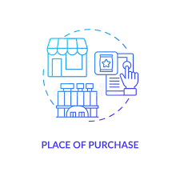
Place of purchase
These three, which all relate to the Place element of the mix, are:
• Reach. 'It [reach] means, simply, how many customers a business can connect with and how many products it can offer to those customers'. Reach can be increased by moving from a single site to representation with a large number of different intermediaries niche suppliers can readily reach a much wider market due to search-engine marketing . also reach refers to the range of products and services that can be offered, since this will increase the number of people the company can appeal to.
• Richness. This is the depth or detail of information that is both collected about the customer and provided to the customer, The latter is related to the richness of product information and how well it can be personalized to be relevant to individual needs.
• Affiliation. This refers to whose interest the selling organization represents - consumers or suppliers' - and stresses the importance of forming the right partnerships. This particularly applies to retailers. successful online retailers will reward customers who provide them with the richest information on comparing competitive products.

Slide 32

SYNDICATION
In an online context, This practice related to Place and Partnerships needs to be reviewed for online content owners, since there may be opportunities to generate additional revenue by republishing content on third-party sites through feeds, widgets or data exchange, or it may be possible to increase exposure on partner sites and so generate awareness or visits to the company site. But syndication also has implications for other companies, and in particular retailers, since syndication of information from their product catalogues to third-party aggregators is important to extend their reach. Since integrating product data with a range of aggregators that will require formats can be time-consuming, some companies such as Channeladvisor now offer a service to upload data and track results across a range of aggregators
SYNDICATION:- CONTENT OR PRODUCT INFORMATION IS DISTRIBUTED TO THIRD PARTIES.ONLINE THIS IS COMMONLY ACHIEVED THROUGH STANDARD XML FORMAT SUCH AS RSS.

Slide 33

Payment mechanisms - purchase place
Traditionally, online purchase will occur at the retailer through a partnership with an online secure payment provider Effectively, the purchase transaction occurs on a different domain, but it is important that customers are reassured that the payment process is secure and seamless. Retailers often offer payment mechanisms where the purchaser has already set up payment with another payment provider, This approach can assist with reassurance about privacy and security and increase purchase convenience and choice for the user, so these options also have to be reviewed.
LOCALIZATION
Providing a local site, with or without a language-specific version and additional cultural adaptations, is referred to as localization. A site may need to support customers from a range of countries with
• different product needs
• language differences
• cultural adaptation.
LOCALIZATION:-tailoring of website information for individual countries or regions. Localization include simple translation but also cultural adaption

Slide 34
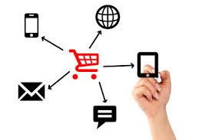
New channel
New channel structures enabled by the Internet The main types of phenomena that companies need to develop strategies for are:
• Disintermediation. Digital marketers should ask themselves the question: is there an option for selling direct? But they should also remember that selling direct can lead to channel conflicts
• Reintermediation. The new intermediaries created through reintermediation should be evaluated for suitability for partnering in affiliate arrangements
• Counter mediation. Counter mediation refers to the strategic options to make better use of online intermediaries, such as through partnering with independent intermediaries, purchasing or creating an independent intermediary.
When considering channel structures it is important to remember that there may be implications for the physical distribution channel

Slide 35

4 Virtual organizations
'it is becoming increasingly difficult to delineates accurately the borders of today's organizations, and a further implication of the introduction of electronic networks such as the Internet is that it becomes easier to outsource aspects.: of the production and distribution of goods to third parties. This can lead to the boundaries within an organization becoming blurred. Employees may work in any time zone, and customers are able to purchase tailored products from any location. The absence of any rigid boundary or hierarchy within the organization should lead to a company becoming more responsive and flexible, and having a greater market orientation.
features of a virtual organization, which remain relevant:
• Processes transcend the boundaries of a single form and are not controlled by a single organizational hierarchy
.• Production processes are flexible, with different parties involved at different times.
• Parties involved in the production of a single product are often geographically dispersed.
• Given this dispersion, coordination is heavily dependent on telecommunications and data networks.
All companies tend to have some elements of the virtual organization. The process whereby these characteristics increase is known as virtualization. the presence of electronic networks tends to lead to virtualization since they enable the governance and coordination of business transactions to be conducted effectively at lower cost. What are the implications for a marketing strategist of this trend towards virtualization? Initially it may appear that outsourcing does not have direct relevance to market orientation.
A virtual organization uses information and communication technology to allow it to operate without clearly defined physical boundaries between different functions.it provides customized service by outsourcing production and other functions to third parties
Virtualization the process whereby a company develops more of the characteristics of a virtual organization

Slide 36
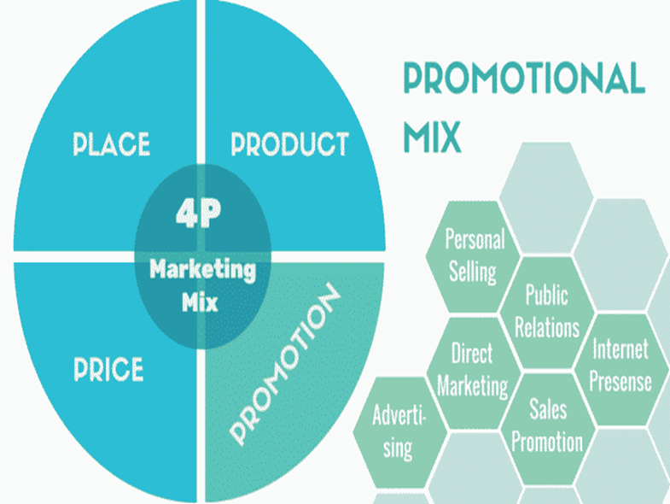
PROMOTION
The Promotion variable of the marketing mix refers to how marketing communications are used to inform customers and other stakeholders about an organization and its products.
The Internet and digital marketing techniques are highly important and have significant implications for marketing communication planning
In this chapter the aim is to briefly outline the core components of Promotions
'Good communications are the lifeblood of successful market-orientated companies and their brands.
But creating good communications presents many challenges'. Digital technology is changing the way individuals and business communicate, the channels through which they communicate and the number of touchpoints encountered Modern businesses are developing more integrated approaches towards the use of communications tools in order to maximize the opportunities to deliver messages to their target audiences The main elements of the promotional mix a business might use to communicate, and their online equivalents
Promotion in the marketing mix :- Marketers use various promotional techniques within the marketing mix to achieve their goals, giving rise to the promotion mix. The promotion mix is a combination of various promotional tools marketers can use to reach their target audience.

Slide 37
PROMOTION
Specification of the Promotion element of the mix is usually part of a communications strategy. This will include selection of target markets, positioning and integration of different communications tools. The Internet offers a new, additional marketing communications channel to inform customers of the benefits of a product and assist in the buying decision.
some different approaches for looking at how the Internet can be used to vary the Promotion element of the mix:
1- reviewing new ways of applying each of the elements of the communications mix-such as advertising, sales promotions, PR and direct marketing;
2 - assessing how the Internet can be used at different stages of the buying process;
3- using promotional tools to assist in different stages of customer relationship management, from customer acquisition to retention

Slide 38

PROMOTION
In a web context this includes gaining initial visitors to the site and gaining repeat visits using a number of communications techniques:
reminders in traditional media campaigns of why a site is worth visiting - such as online services and unique online offers and competitions;
direct email reminders of site proposition – new offers.
frequently updated content - including promotional offers or your customer do their job or reminds them to visit.
Promotion variable :- The element of the marketing mix that involves communication with customers and other stakeholders to inform them about the product and the organization.

Slide 39
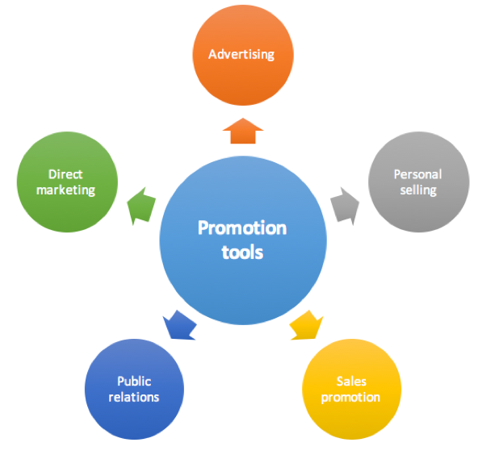
KEY COMPONENTS OF THE PROMOTIONAL MIX
Personal Selling
Advertising
Direct Marketing
Sales Promotion
Public Relations
Corporate Image
Sponsorship
Internet Presence

Slide 40
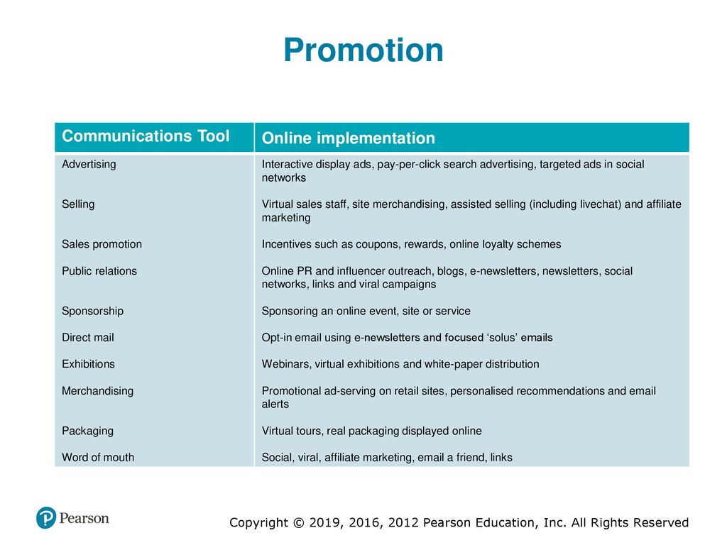
THE MAIN ELEMENT OF THE PROMOTIONAL MIX

Slide 41

PEOPLE,PROCESS AND PHYSICAL EVIDENCE
The People, Process and Physical evidence elements of the mix are closely related and often grouped as 'the service elements‘ They are significant since the level of perceived service will impact on a customer's loyalty and the probability of their recommending the service. Some of the key issues in improving the delivery of service online identify these questions that senior executives and managers should ask to assess the combination of technology and human assistance that is used to deliver service.
typical examples of applications for each type:
1 Substitution. Deploying technology instead of people (or the opposite situation), for example:
⚫ frequently asked questions section on a website;
⚫ in-site search engine;
⚫ avatar offering answers to questions,
• automated email response or a series of 'Welcome' emails educating customers about how to use a service;
⚫ using video to demonstrate products online.

Slide 42

PEOPLE,PROCESS AND PHYSICAL EVIDENCE
2 Complementarity. Deploying technology in combination with people,
for example:
call-back facility where the website is used to set up a subsequent call from a contact Centre;
online chat facility - the user chats through exchanging text messages on the website;
an employee using a Wi-Fi-enabled hand-held device to facilitate easy rental-car returns.
3 Displacement. Outsourcing or 'offshoring technology or labour
for example:
a fast-food chain centralizing drive-through order taking in a remote call center;
the online chat or call-back systems referred to above can be deployed at a lower cost through outsourcing.

Slide 43

PEOPLE
The People variable of the marketing mix relates to how an organization's staff interact with customers and other stakeholders during sales and pre and post-sales communications with them.
, online, the main consideration for the People element of the mix is the review of how staff involvement in the buying is changed, either through new roles such as replying to emails or online chat enquiries, or through their being replaced through automated online services.
While the options for this form of customer service outlined above are straightforward, what is challenging is to implement the applications effectively. For example, if an FAQ doesn't have sufficient relevant answers or a call-back does not occur at the right time, then the result will be a dissatisfied customer who is unlikely to use a service again or will tell others about their experience either through ratings in shopping comparison engines.
People variable:- the element of the marketing mix that involves the delivery or services to customers during interactions with those customers.

Slide 44

Process
The Process variable of the marketing mix refers to the methods and procedures companies use to achieve all marketing functions-such as new product development, promotion, sales and customer service , The restructuring of the organization and channel structures to accommodate online marketing, are part of process.
Customer contact strategies are a compromise between delivering quality customer service with the emphasis on customer choice and minimizing the cost of customer contacts.
Process variables
The element of the marketing mix that involves the methods and procedures companies use to achieve all marketing functions

Slide 45

Process
Typical operational objectives that should drive the strategies and measure effectiveness are:
to minimize average response time per email and the range of response time from slowest to fastest-this should form the basis of an advertised service quality level.
to minimize clear-up (resolution) time - for example, number of contacts and elapsed time to resolution.
to maximize customer satisfaction ratings with response.
to minimize average staff time and cost per email response.

Slide 46

Physical evidence
The Physical evidence variable of the marketing mix refers to the tangible expression of a product and how it is purchased and used In an online context, 'physical evidence refers to the customer's experience of the company through the website It includes issues such as site ease of use or navigation, availability and performance
Physical evidence variable The element of the marketing mix that involves the tangible expression of a product and how it is purchased and used

Slide 47


Thank You

