Slide 1



Project Feasibility Study
PMG201
Introduction
Prepared by: Mrs. Deena Ibraheem
www.midocean.ae

Slide 2


www.midocean.ae

Slide 3

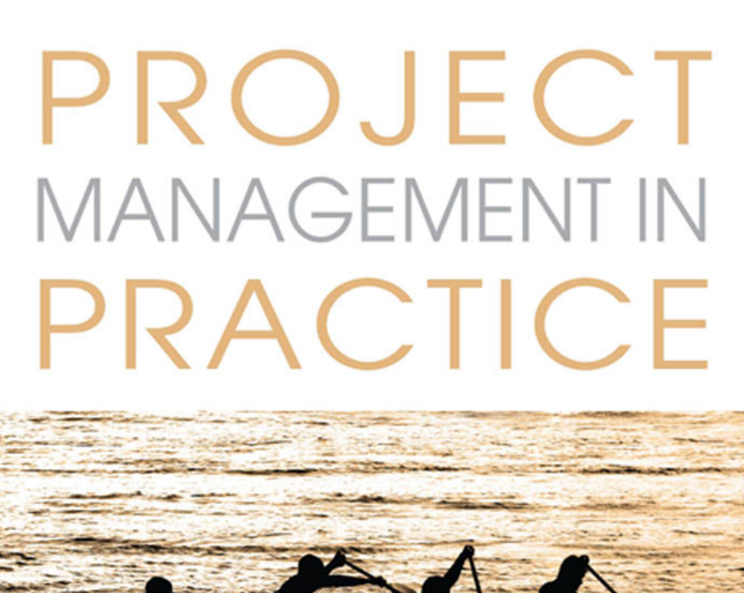

www.midocean.ae

Slide 4
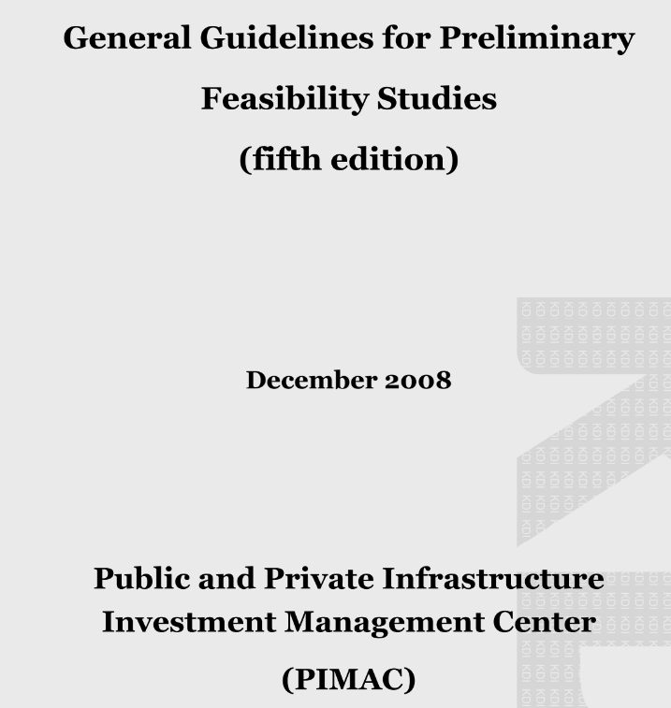
www.midocean.ae

Slide 5


PMG101
Foundations of Project Management
www.midocean.ae

Slide 6

Lecture 2: Economic analysis. | Lecture 1: Project overview and basic data analysis.
Lecture 4: The world of project management. | Lecture 3: Policy analysis.
Lecture 6: Planning the project. | Lecture 5: The manager, the organization, and the team.
Lecture 8: Scheduling the project. | Lecture 7: Budgeting the Project.
Lecture 10: Monitoring and controlling the project. | Lecture 9: Allocating resources to the project.
www.midocean.ae

Slide 7

www.midocean.ae

Slide 8
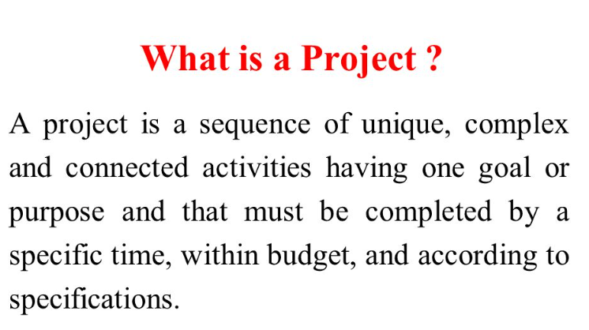

www.midocean.ae

Slide 9

What is Project Management
Project management is the use of specific knowledge, skills, tools and techniques to deliver something of value to people. The development of software for an improved business process, the construction of a building, the expansion of sales into a new geographic market—these are all examples of projects.
www.midocean.ae

Slide 10
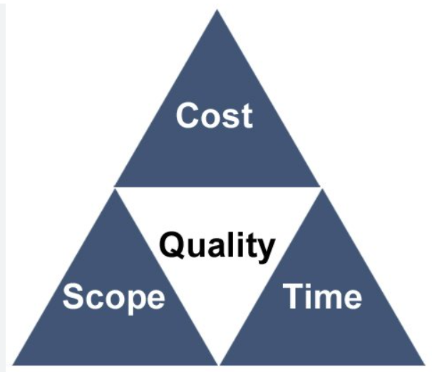
The Triple Constraint in Project Management: Time, Scope & Cost
1- Cost: The financial constraints of a project, also known as the project budget.
2- Scope: The tasks required to fulfill the project’s goals.
3- Time: The schedule for the project to reach completion.
www.midocean.ae

Slide 11
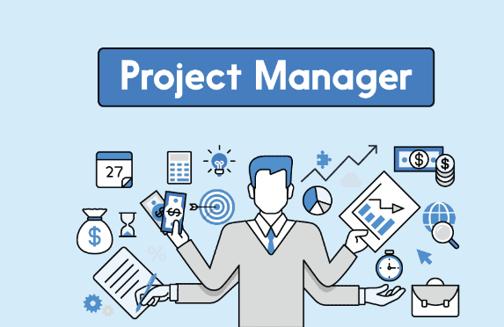
Who is the Project Manager?
Determine and define the scope of a project scope and its objectives with team members to make sure that all parties are on track with project requirements, deadlines, and schedules.
Lead project planning sessions.
Prepare budgets based on the scope of work and resource requirements.
Manage project progress by adapting work as required.
Manage relationships with clients and shareholders
www.midocean.ae

Slide 12

www.midocean.ae

Slide 13

What is the feasibility study
The feasibility study is an integrated set of specialized studies that are carried out to determine the validity of the investment in all its aspects, so some search for how to prepare a feasibility study, to predict knowledge of the possibilities and failure of the project.
www.midocean.ae

Slide 14

Contents of a Feasibility Study:
The most-common feasibility study should include the following sections:
An Executive Summary.
Description of Product or Service.
Technology Considerations.
Product or Service Marketplace.
Identification of Specific Market.
Marketing Strategy.
Organization Structure.
Schedule.
Financial Projections.
www.midocean.ae

Slide 15
Feasibility Study vs. Business Plan
The separate roles of the feasibility study and the business plan are frequently misunderstood.
Business Plan | Feasibility Study
The business plan provides a planning function. The business plan outlines the actions needed to take the proposal from "idea" to "reality." | The feasibility study provides an investigating function. It addresses the question of "Is this a viable business venture?"
The business plan deals with only one alternative or scenario. | The feasibility study outlines and analyzes several alternatives or methods of achieving business success.
A business plan is prepared only after the business venture has been deemed to be feasible. | The feasibility study is conducted before the business plan.
www.midocean.ae

Slide 16
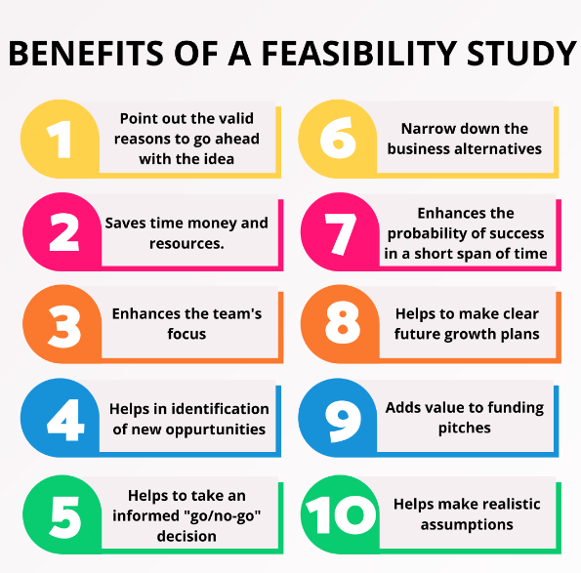
www.midocean.ae

Slide 17

www.midocean.ae

