Slide 1


Work Design
and Measurement
Prepared by Dr. Injy Nashaat
Lecture 7

Slide 2
Job Design
  The act of specifying the contents and methods of jobs
    What will be done in a job
    Who will do the job
    How the job will be done
    Where the job will be done
  Importance
    Organizations are dependent on human efforts to accomplish their goals
    Many job design topics are relevant to continuous and productivity improvement
  Objectives
    Productivity
    Safety
    Quality of work life
7-2

Slide 3
Efficiency vs. Behavioral Job Design
Efficiency School
  Emphasizes a systematic, logical approach to job design
  A refinement of Frederick Winslow Taylor’s scientific management concepts
Behavioral School
  Emphasizes satisfaction of needs and wants of employees
  Specialization is a primary issue of disagreement between the efficiency and behavioral approaches
7-3

Slide 4
Specialization
  Specialization is the primary area of disagreement between these two schools.
Advantages
For management: Simplifies training High productivity Low wage costs | For employees: Low education and skill requirements Minimum responsibility Little mental effort needed
Disadvantages
For management: Difficult to motivate quality Worker dissatisfaction, possibly resulting in absenteeism, high turnover, disruptive tactics, poor attention to quality | For employees: Monotonous work Limited opportunities for advancement Little control over work Little opportunity for self-fulfillment
7-4

Slide 5

Behavioral Approaches to Job Design
Job Enlargement
  Giving a worker a larger portion of the total task by horizontal loading
Job Rotation
  Workers periodically exchange jobs
Job Enrichment
  Increasing responsibility for planning and coordination tasks, by vertical loading
7-5

Slide 6

Motivation
Motivation is a key factor in many aspects of work life
  Influences quality and productivity
  Contributes to the work environment
Trust is an important factor that affects motivation
More motivated employees are more likely to suggest improvements in the work environment.
7-6

Slide 7

Teams
Teams take a variety of forms:
  Short-term team
    Formed to collaborate on a topic or solve a problem
  Long-term teams
    Self-directed teams
      Groups empowered to make certain changes in their work processes
      Self-directed teams tend to be given responsibility only for their processes
7-7

Slide 8

Teams (cont.)
Benefits of teams
  Higher quality
  Higher productivity
  Greater worker satisfaction
Team problems
  Some managers feel threatened
  Conflicts between team members
7-8

Slide 9
Requirement for successful team building
Expert Robert Bacal has a list of requirements for successful team building:
1. Clearly stated and commonly held vision and goals.
2. Talent and skills required to meet goals.
3. Clear understanding of team members’ roles and functions.
4. Efficient and shared understanding of procedures & norms.
5. Effective and skilled interpersonal relations.
6. A system of reinforcement and celebration.
7. Clear understanding of the team’s relationship to the greater organization.

Slide 10
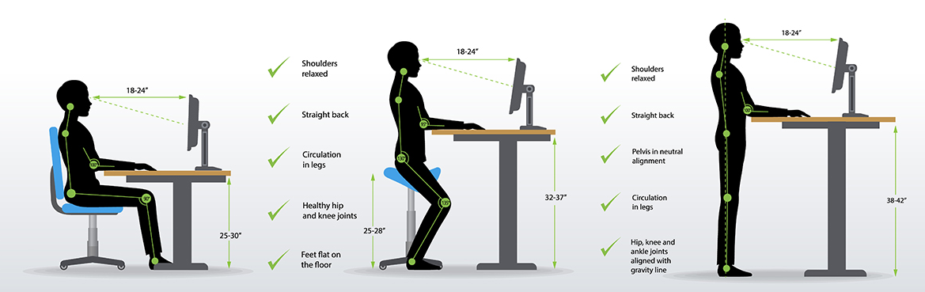
Ergonomics
Scientific discipline concerned with the understanding of human interaction with the elements of a system. An ergonomically designed system or part
Increases productivity
Reduces worker’s discomfort and fatigue
Reduces to injuries to the back, neck, arms, etc
Automation reduces human interaction with the system; therefore, ergonomics becomes a lesser concern..

Slide 11

Quality of Work Life
Quality of work life affects not only workers’ overall sense of well-being and contentment, but also their productivity
Important aspects of quality of work life:
  How a worker has a good relationship with co-workers
  Quality of management
  Working conditions
  Compensation
7-11

Slide 12

Compensation
It is important for organizations to develop suitable compensation plans for their employees
Compensation approaches
  Time-based systems
  Output-based systems
  incentives to increase output
  Knowledge-based systems
  Management compensation
7-12

Slide 13
Compensation Systems
Time-based system
  Compensation based on time an employee has worked during the pay period
Output-based (incentive) system
  Compensation based on amount of output an employee produced during the pay period
7-13

Slide 14
Comparing Compensation Approaches
 | Management | Worker
TIME-BASED Advantages | Stable labor costs Easy to administer Simple to compute pay Stable output | Stable pay Less pressure to produce than under output system
Disadvantages | No incentive for workers to increase output | Extra efforts not rewarded
OUTPUT-BASED Advantages | Lower cost per unit Greater output | Pay related to efforts Opportunity to earn more
Disadvantages | Wage computation more difficult Need to measure output Quality may suffer Difficult to incorporate wage increases Increased problems with scheduling | Pay fluctuates Workers may be penalized because of factors beyond their control (e.g., machine breakdown)
7-14

Slide 15
Individual and Group Incentive Plans
Individual incentive plans
  Straight piecework
    Worker’s pay is a direct linear function of his or her output
    Minimum wage legislation has reduced their popularity
  Base rate + bonus
    Worker is guaranteed a base rate, tied to an output standard, that serves as a minimum
    A bonus is paid for output above the standard
Group incentive plans
  Tend to stress sharing of productivity gains with employees
7-15

Slide 16
Knowledge-Based Pay Systems
  A pay system used by organizations to reward workers who undergo training that increases their skills
  Three dimensions:
    Horizontal skills
      Reflect the variety of tasks the worker can perform
    Vertical skills
      Reflect the managerial skills the worker is capable of
    Depth skills
      Reflect quality and productivity results
7-16

Slide 17
Management Compensation
Many organizations used to reward managers based on output
New emphasis is being placed on other factors of performance
  Customer service
  Quality
Executive pay is increasingly being tied to the success of the company or division for which the executive is responsible
7-17

Slide 18

Methods Analysis
Methods Analysis
  Analyzing how a job gets done
    It begins with an analysis of the overall operation
    It then moves from general to specific details of the job concentrating on
    Workplace arrangement
      Movement of workers and/or materials
7-18

Slide 19
The Need for Methods Analysis
The need for methods analysis can arise from a variety of sources
  Changes in tools and equipment
  Changes in product design or introduction of new products
  Changes in materials and procedures
  Government regulations or contractual agreements
  Accidents or quality problems
  Establishes the method for new jobs.
7-19

Slide 20
Methods Analysis Procedure
Identify the operation to be studied, and gather relevant data
Discuss the job with the operator and supervisor to get their input
Study and document the present methods
Analyze the job
Propose new methods
Install the new methods
Follow up implementation to assure improvements have been achieved
7-20

Slide 21

Guidelines for Selecting a Job to Study
Consider jobs that:
  Have a high labor content
  Are done frequently
  Are unsafe, tiring, unpleasant, and/or noisy
  Are designated as problems
    Quality problems
    Processing bottlenecks
    etc.
7-21

Slide 22
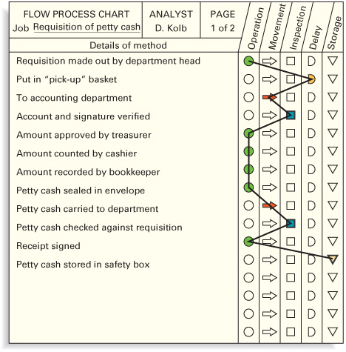
Analyzing the Job: Flow Process Charts
  Chart used to examine the overall sequence of an operation by focusing on movements of the operator or flow of materials
7-22

Slide 23
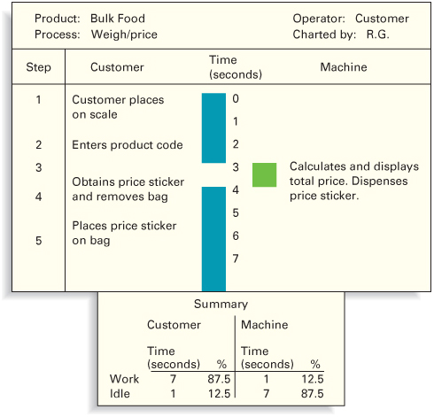
Analyzing the Job: Worker-Machine Chart
  Chart used to determine portions of a work cycle during which an operator and equipment are busy or idle
7-23

Slide 24

Developing Work Methods
In developing work methods that are motion efficient, the analyst attempts to
  Eliminate unnecessary motions
  Combine activities
  Reduce fatigue
  Improve the arrangement of the workplace
  Improve the design of tools and equipment
7-24

Slide 25

Work Measurement
Work measurement is concerned with how long it should take to complete a job.
It is not concerned with either job content or how the job is to be completed since these are considered a given when considering work measurement.
Jobs at the lowest levels often involve heavy standardization.
7-25

Slide 26
Work Measurement (cont.)
Standard time
  The amount of time it should take a qualified worker to complete a specified task, working at a sustainable rate, using given methods, tools and equipment, raw material inputs, and workplace arrangement.
Commonly used work measurement techniques
  Stopwatch time study
  Historical times
  Predetermined data
  Work sampling
7-26

Slide 27
Work Measurement Techniques
Stopwatch Time Study
  Used to develop a time standard based on observations of one worker taken over several cycles.
Standard Elemental Times
  Derived from a firm’s own historical time study data.
Predetermined time standards
  Involve the use of published data on standard elemental times.
Work sampling
  A technique for estimating the proportion of time that a worker or machine spends on various activities and idle time.
7-27

Slide 28
Stopwatch Time Study
Used to develop a time standard based on observations of one worker taken over a few cycles.
Basic steps in a time study:
  Define the task to be studied and inform the worker who will be studied
  Determine the number of cycles to observe
  Time the job, and rate the worker’s performance
  Compute the standard time
7-28

Slide 29
Number of Cycles to Observe
The number of observations to collect is a function of
  Variability of the observed times
  The desired level of accuracy
  Desired level of confidence for the estimated job time
7-29

Slide 30
Observed Time
The time measured to complete the task. Performance rating factor: The number pace the person is working at. 90% is working slower than normal, 110% is working faster than normal, 100% is normal. This factor is calculated by an experienced worker who is trained to observe and determine the rating.
7-30

Slide 31
Standard Time
The length of time it should take a qualified worker using appropriate process and tools to complete a specific job, allowing time for personal fatigue and unavoidable delays. The third component in work system design, work measurement, is a way of determining how long it should take to do a job.
7-31

Slide 32
Historical Times
Standard Elemental Times are derived from a firm’s own historical time study data.
  Over time, a file of accumulated elemental times that are common to many jobs will be collected.
  In time, these standard elemental times can be retrieved from the file, eliminating the need to go through a new time study to acquire them.
7-32

Slide 33
Predetermined Time Standards
Involve the use of published data on standard elemental times.
    The MTM (methods-time-measurement) tables are based on extensive research of basic elemental motions and times.
    To use this approach, the analyst must divide the job into its basic elements (reach, move, turn, etc.) measure the distances involved, and rate the difficulty of the element, and then refer to the appropriate table of data to obtain the time for that element
7-33

Slide 34
Work Sampling
Work sampling is a technique for estimating the proportion of time that a worker or machine spends on various activities and the idle time.
  Work sampling does not require timing an activity or involve continuous observation of the activity
  Uses:
    Ratio-delay studies which concern the percentage of a worker’s time that involves unavoidable delays or the proportion of time a machine is idle.
    Analysis of non-repetitive jobs.
7-34

Slide 35
Work Sampling vs. Stopwatch Time Studies
Advantages of Work Sampling
Observations are spread out over a period, making results less susceptible to short-term fluctuations There is little or no disruption of work Workers are less resentful Studies are less costly and less time-consuming, and the skill requirements of the analyst are much less Studies can be interrupted without affecting the results No timing device is required It is well suited for nonrepetitive tasks
Disadvantages of Work Sampling
There is much less detail on the elements of a job Workers may alter their work patterns when they spot the observer, thereby invalidating the results In many cases, there is no record of the method used by the worker Observers may fail to adhere to a random schedule of observations It is not well suited for short, repetitive tasks Much time may be required to move from one workplace to another and back to satisfy the randomness requirement
7-35

Slide 36
Job Design Success
Success factors:
  Carried out by personnel with appropriate training and background
  Consistent with the goals of the organization
  In written form
  Understood and agreed to by both management and employees
  Job design must take technology into consideration.
7-36

Slide 37
Operations Strategy
It is important to make design of work systems a key element of strategy:
  People are still at the heart of the business
  Workers can be valuable sources of insight and creativity
  It can be beneficial to focus on quality of work life and instilling pride and respect among workers
  Companies are reaping gains through worker empowerment
7-37

Slide 38



Thank You

