Slide 1


Probability and
Statistics
Prepared by Dr. Alfaisal Hasan
STA 201
Probability and Statistics
Lecture NO 8

Slide 2



Probability and
Statistics
Lecture NO 8
STA 201
Probability and Statistics
Prepared by
Dr. Alfaisal Hasan
www.midocean.ae

Slide 3

Chapter
Topics
Chapter 1: Introduction To Statistics
Chapter 2: Descriptive Statistics
Chapter 3: Probability
Chapter 4: Discrete Probability Distributions
Chapter 5: Normal Probability Distributions
Chapter 6: Confidence Intervals
Chapter 7: Hypothesis Testing with One Sample
Chapter 8: Hypothesis Testing with Two Samples
Chapter 9: Correlation And Regression
Chapter 10: Chi-Square Tests and The F-Distribution
www.midocean.ae

Slide 4
Chapter
Hypothesis Testing with Two Sample
8.1 Testing the Difference Between Means (Large Independent Samples)
8.2 Testing the Difference Between Means (Small Independent Samples)
8.3 Testing the Difference Between Means (Dependent Samples)
8.4 Testing the Difference Between Proportions
www.midocean.ae

Slide 5
8.1 Testing the Difference Between Means (Large Independent Samples)
Chapter
Determine whether two samples are independent or dependent
Perform a two-sample z-test for the difference between two means μ₁ and μ₂ using large independent samples
www.midocean.ae

Slide 6
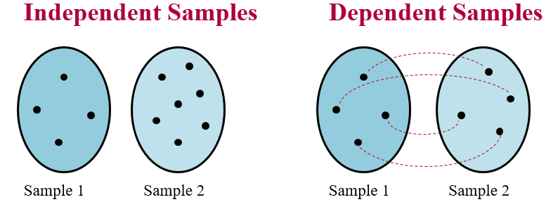
Independent and Dependent Samples
Chapter
  Independent Samples
    The sample selected from one population is not related to the sample selected from the second population.
  Dependent Samples (paired or matched samples)
    Each member of one sample corresponds to a member of the other sample.
www.midocean.ae

Slide 7
Example: Independent and Dependent Samples
Classify the pair of samples as independent or dependent.
Sample 1: Resting heart rates of 35 individuals before drinking coffee.
Sample 2: Resting heart rates of the same individuals after drinking two cups of coffee.
Solution:
Dependent Samples (The samples can be paired with respect to each individual)
www.midocean.ae

Slide 8
Example: Independent and Dependent Samples
Classify the pair of samples as independent or dependent.
Sample 1: Test scores for 35 statistics students.
Sample 2: Test scores for 42 biology students who do not study statistics.
Solution:
Independent Samples (Not possible to form a pairing between the members of the samples; the sample sizes are different, and the data represent scores for different individuals.)
www.midocean.ae

Slide 9
Two Sample Hypothesis Test with Independent Samples
Null hypothesis H₀
  A statistical hypothesis that usually states there is no difference between the parameters of two populations.
  Always contains the symbol ≤, =, or ≥.
Alternative hypothesis H_{a}
  A statistical hypothesis that is true when H₀ is false.
  Always contains the symbol >, ≠, or <.
www.midocean.ae

Slide 10
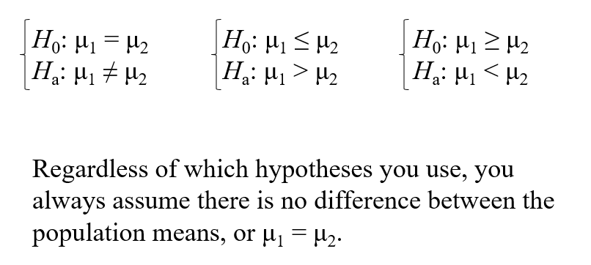
Two Sample Hypothesis Test with Independent Samples
www.midocean.ae

Slide 11
Two Sample z-Test for the Difference Between Means Large Samples
Three conditions are necessary to perform a z-test for the difference between two population means μ₁ and μ₂.
The samples must be randomly selected.
The samples must be independent.
Each sample size must be at least 30, or, if not, each population must have a normal distribution with a known standard deviation.
www.midocean.ae

Slide 12
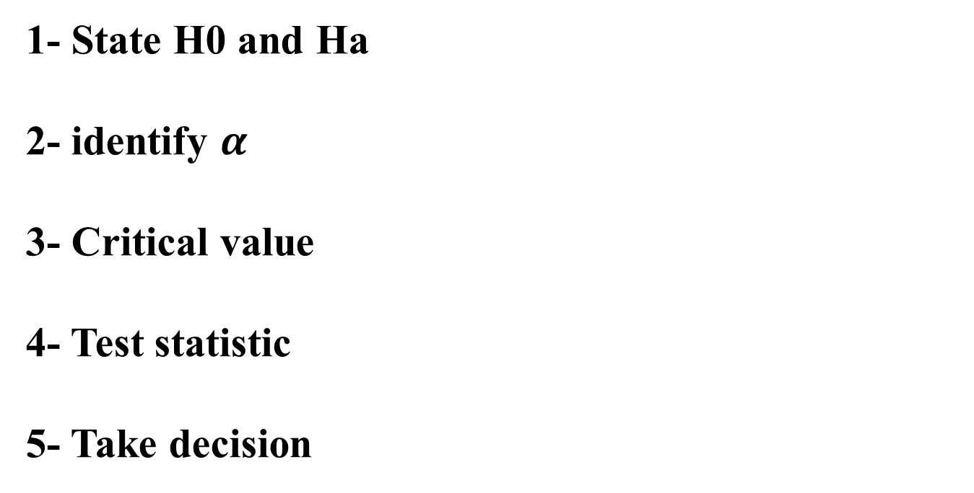
Steps for conducting Testing the Difference Between Means (Large Independent Samples)
1- State H0 and Ha
2- identify $α$
3- Critical value
4- Test statistic
5- Take decision
www.midocean.ae

Slide 13
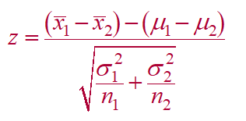
Two Sample z-Test for the Difference Between Means
The test statistic is
When the samples are large, you can use s₁ and s₂ in place of σ₁ and σ₂. If the samples are not large, you can still use a two-sample z-test, provided the populations are normally distributed and the population standard deviations are known.
www.midocean.ae

Slide 14
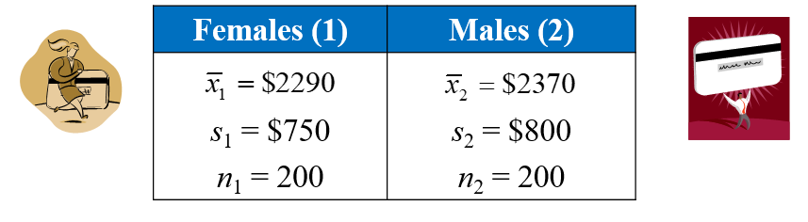
Example: Two-Sample z-Test for the Difference Between Means
A consumer education organization claims that there is a difference in the mean credit card debt of males and females in the United States. The results of a random survey of 200 individuals from each group are shown below. The two samples are independent. Do the results support the organization’s claim? Use α = 0.05.
www.midocean.ae

Slide 15
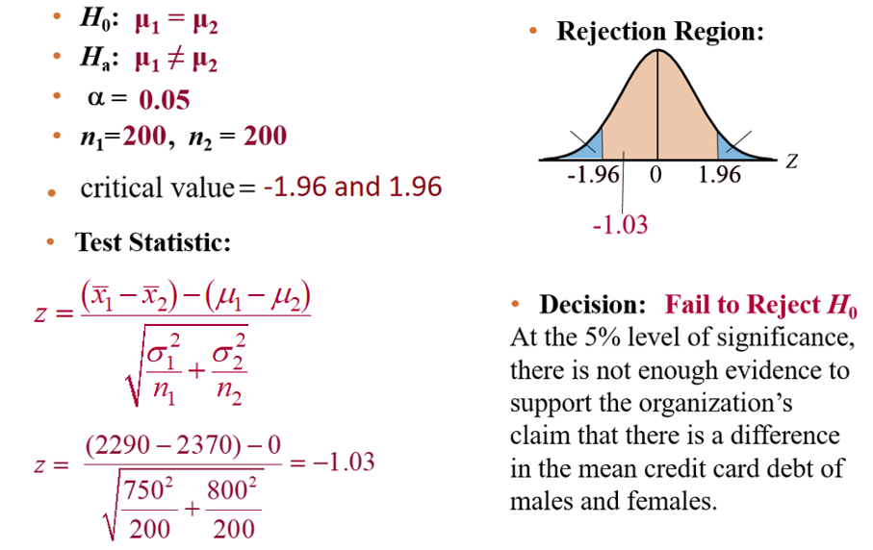
Solution: Two-Sample z-Test for the Difference Between Means
www.midocean.ae

Slide 16
8.2 Testing the Difference Between Means
(Small Independent Samples)
If samples of size less than 30 are taken from normally-distributed populations, a t-test may be used to test the difference between the population means μ₁ and μ₂.
Three conditions are necessary to use a t-test for small independent samples:
  The samples must be randomly selected.
  The samples must be independent.
  Each population must have a normal distribution.
www.midocean.ae

Slide 17
Testing the Difference Between Means
(Small Independent Samples)
The standardized test statistic is
The standard error and the degrees of freedom of the sampling distribution depend on whether the population variances are equal.
www.midocean.ae

Slide 18
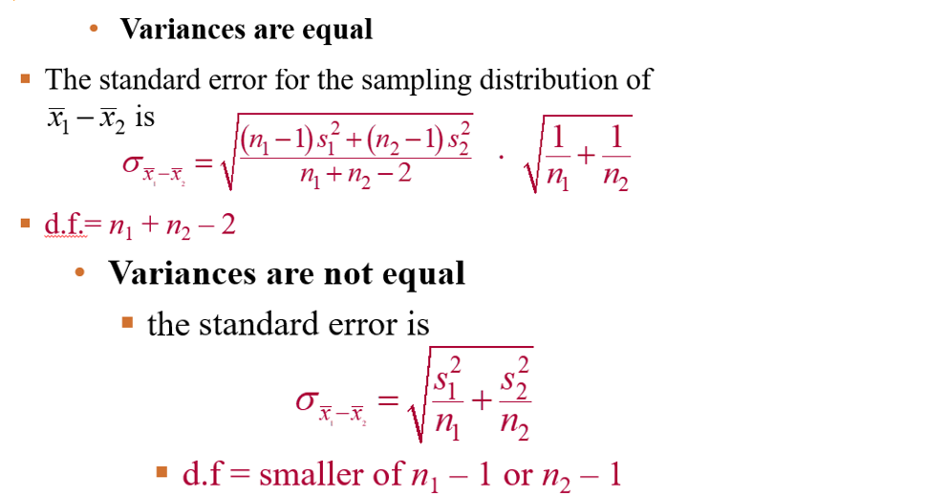
Testing the Difference Between Means
(Small Independent Samples)
www.midocean.ae

Slide 19
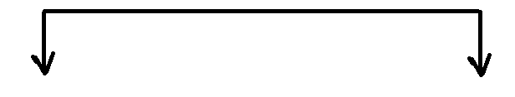
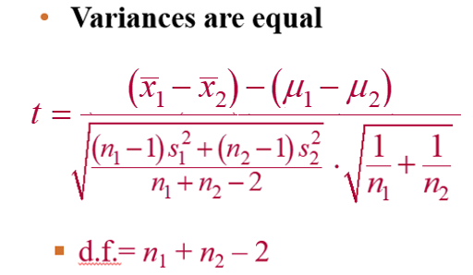
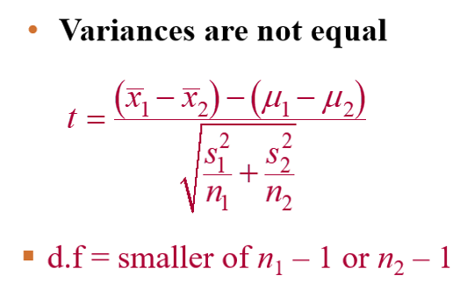
Test Statistic
www.midocean.ae

Slide 20
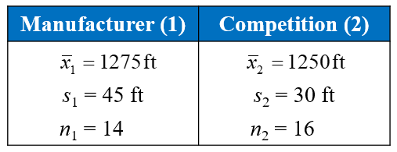
Example: Two-Sample t-Test for
the Difference Between Means
A manufacturer claims that the calling range (in feet) of its 2.4-GHz cordless telephone is greater than that of its leading competitor. You perform a study using 14 randomly selected phones from the manufacturer and 16 randomly selected similar phones from its competitor. The results are shown below. At α = 0.05, can you support the manufacturer’s claim? Assume the populations are normally distributed and the population variances are equal.
www.midocean.ae

Slide 21
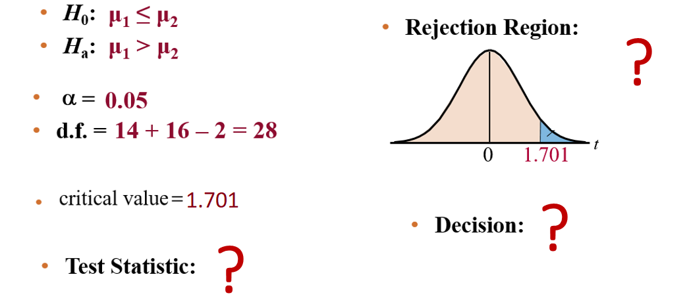
Solution: Two-Sample t-Test for
the Difference Between Means
www.midocean.ae

Slide 22

T- distribution table
Chapter
www.midocean.ae

Slide 23
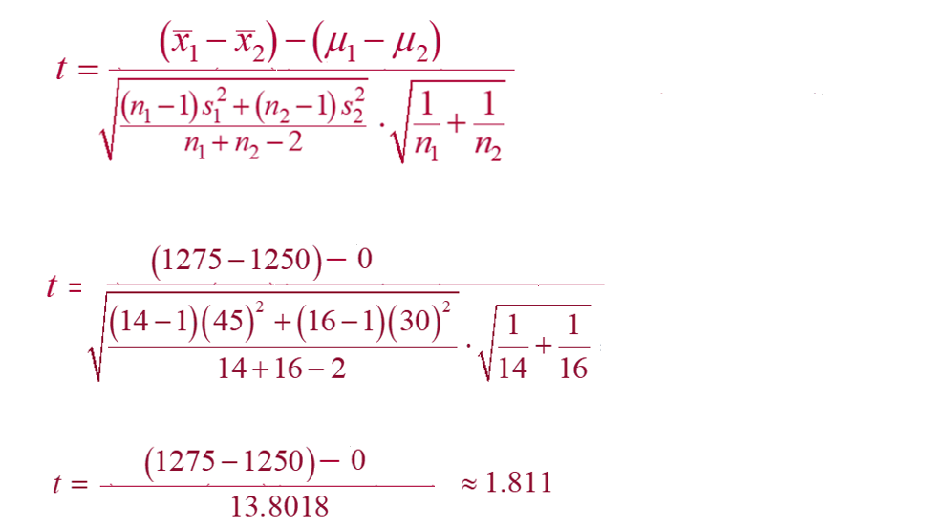
Solution: Obtaining Test statistic
www.midocean.ae

Slide 24
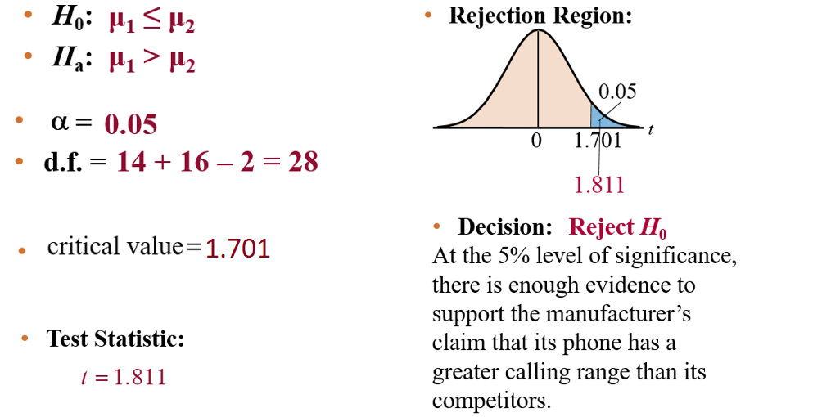
Solution: Two-Sample t-Test for
the Difference Between Means
www.midocean.ae

Slide 25
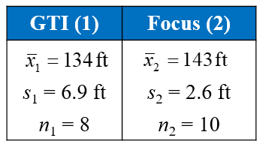
Example: Two-Sample t-Test for the Difference Between Means
The braking distances of 8 Volkswagen GTIs and 10 Ford Focuses were tested when traveling at 60 miles per hour on dry pavement. The results are shown below. Can you conclude that there is a difference in the mean braking distances of the two types of cars? Use α = 0.01. Assume the populations are normally distributed and the population variances are not equal. (Adapted from Consumer Reports)
www.midocean.ae

Slide 26
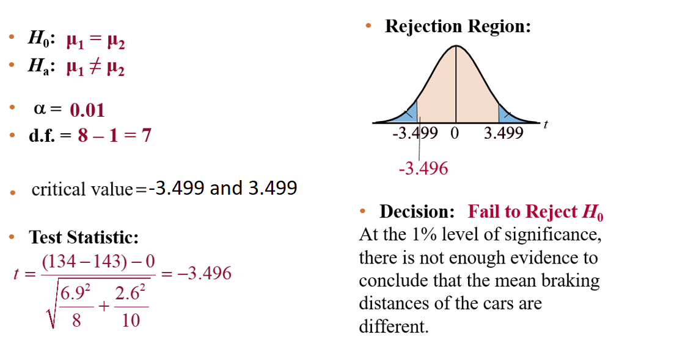
Solution: Two-Sample t-Test for
www.midocean.ae

Slide 27
T- distribution table
Chapter
www.midocean.ae

Slide 28
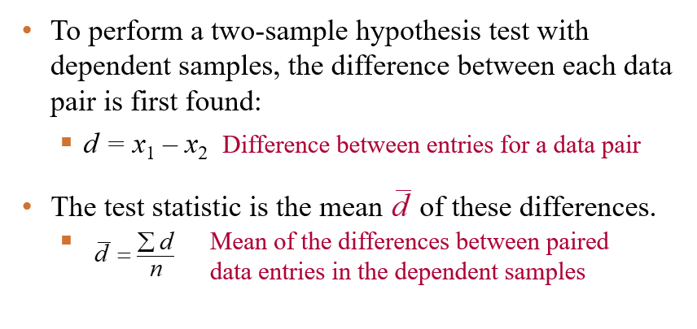
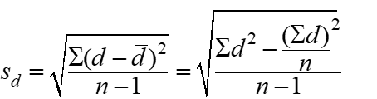
Section 8.3: Testing the Difference Between Means (Dependent Samples)
The standard deviation of the differences between the paired data entries in the dependent samples
www.midocean.ae

Slide 29
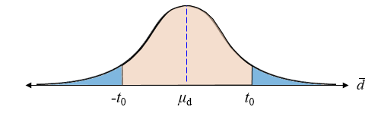
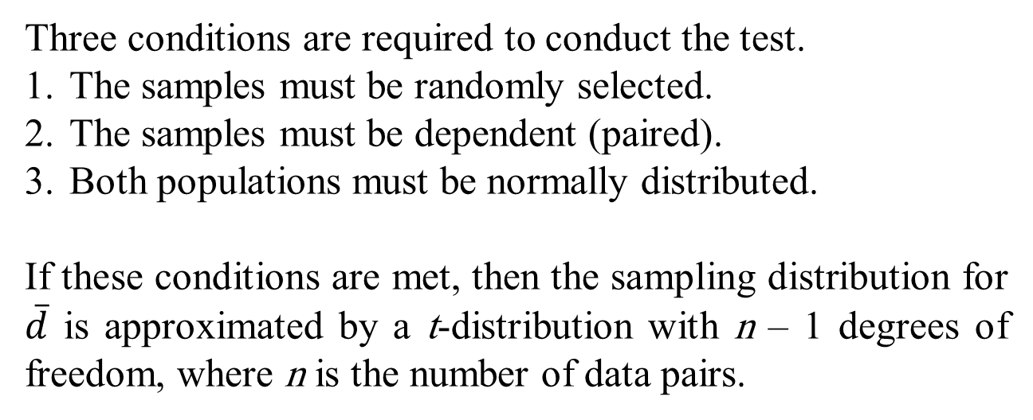
Testing the Difference Between Means (Dependent Samples)
Three conditions are required to conduct the test.
The samples must be randomly selected.
The samples must be dependent (paired).
Both populations must be normally distributed.
If these conditions are met, then the sampling distribution for $\overline{d}$ is approximated by a t-distribution with n – 1 degrees of freedom, where n is the number of data pairs.
www.midocean.ae

Slide 30
Testing the Difference Between Means (Dependent Samples)
The test statistic is
The standardized test statistic is
The degrees of freedom are
d.f. = n – 1
www.midocean.ae

Slide 31
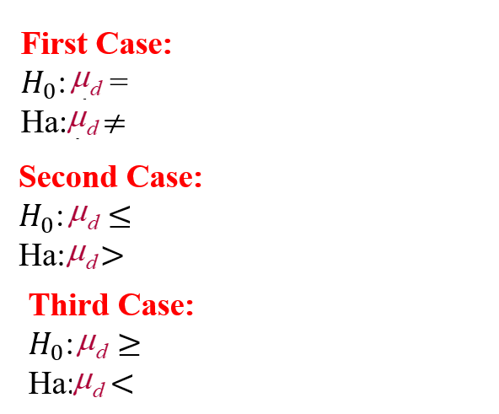
Null Hypothesis and Alternative Hypothesis
www.midocean.ae

Slide 32
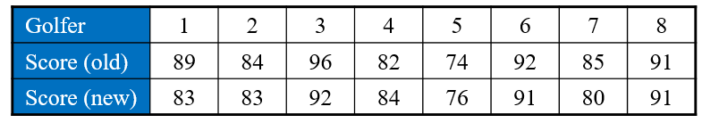
Example: Testing the Difference Between Means (Dependent Samples)
A golf club manufacturer claims that old scores are greater than new scores even if using the manufacturer’s newly designed golf clubs. Eight golfers are randomly selected, and each is asked to give his or her most recent score. After using the new clubs for one month, the golfers are again asked to give their most recent score. The scores for each golfer are shown in the table. Assuming the golf scores are normally distributed, is there enough evidence to support the manufacturer’s claim at α = 0.10?
www.midocean.ae

Slide 33
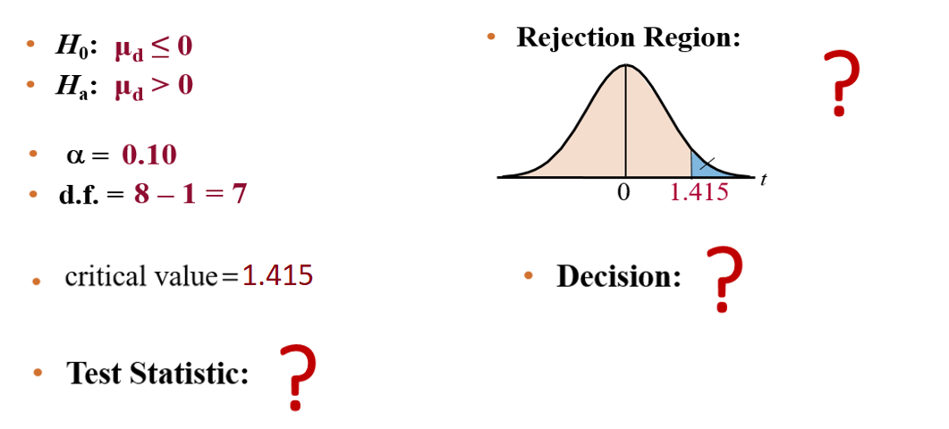
Solution: Testing the Difference Between Means (Dependent Samples)
www.midocean.ae

Slide 34
T- distribution table
Chapter
www.midocean.ae

Slide 35
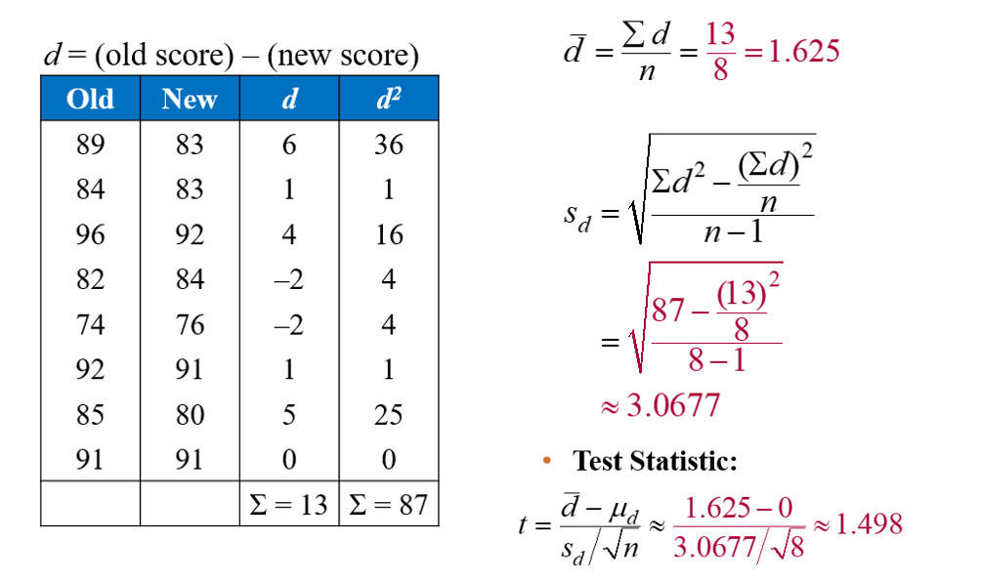
Solution: Obtaining test statistic
www.midocean.ae

Slide 36
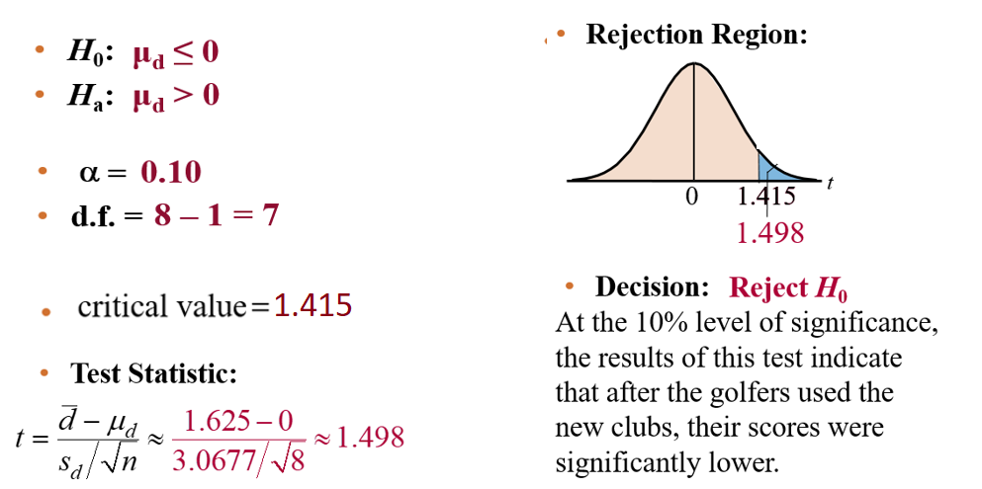
Solution: Testing the Difference Between Means (Dependent Samples)
www.midocean.ae

Slide 37
Section 8.4: Testing the Difference Between Proportions
Used to test the difference between two population proportions, p₁ and p₂.
Three conditions are required to conduct the test:
  The samples must be randomly selected.
  The samples must be independent.
  The samples must be large enough to use a normal sampling distribution. That is,
  n₁p₁ ≥ 5, n₁q₁ ≥ 5, n₂p₂ ≥ 5, and n₂q₂ ≥ 5.
www.midocean.ae

Slide 38
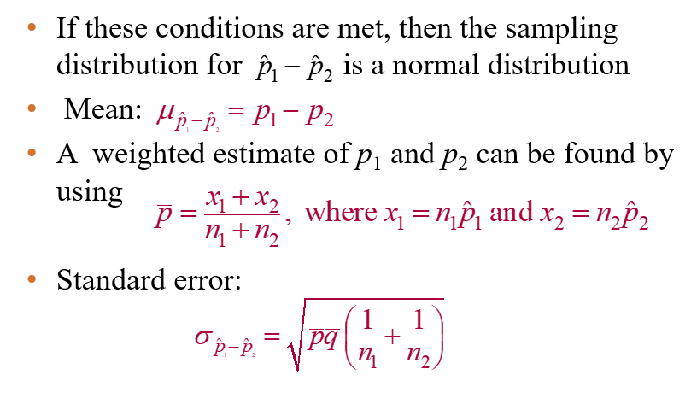
Testing the Difference Between Proportions
www.midocean.ae

Slide 39
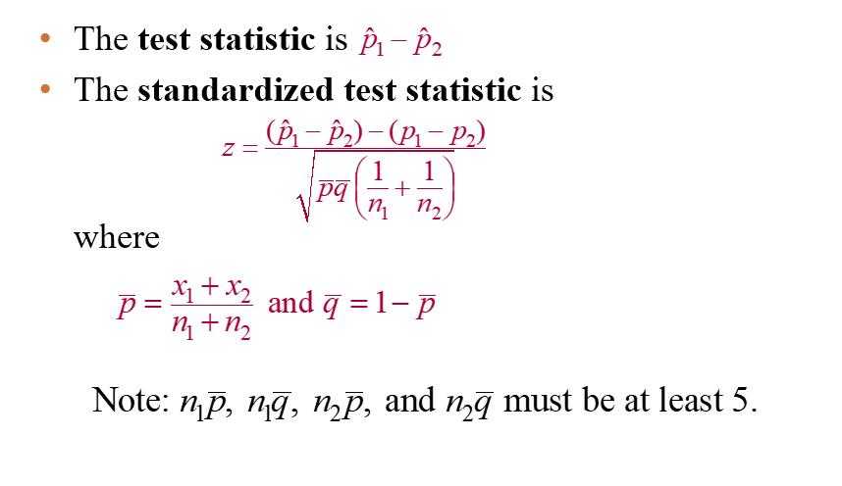
Testing the Difference Between Proportions
www.midocean.ae

Slide 40
Example: Testing the Difference Between Proportions
In a study of 200 randomly selected adult female and 250 randomly selected adult male Internet users, 30% of the females and 38% of the males said that they plan to shop online at least once during the next month. At
α = 0.10 test the claim that there is a difference between the proportion of female and the proportion of male Internet users who plan to shop online.
Solution:
1 = Females 2 = Males
www.midocean.ae

Slide 41
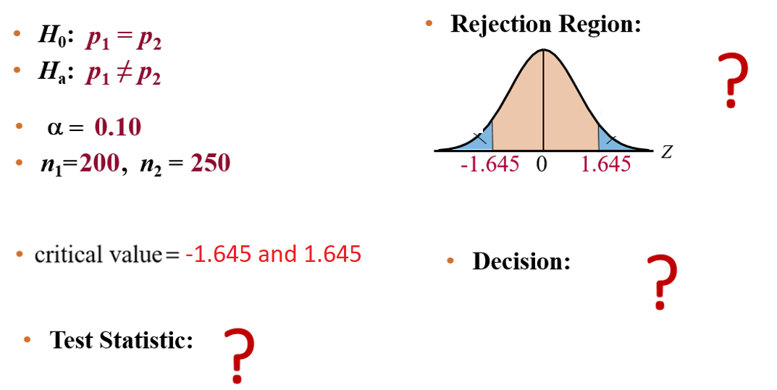
Solution: Testing the Difference Between Proportions
www.midocean.ae

Slide 42
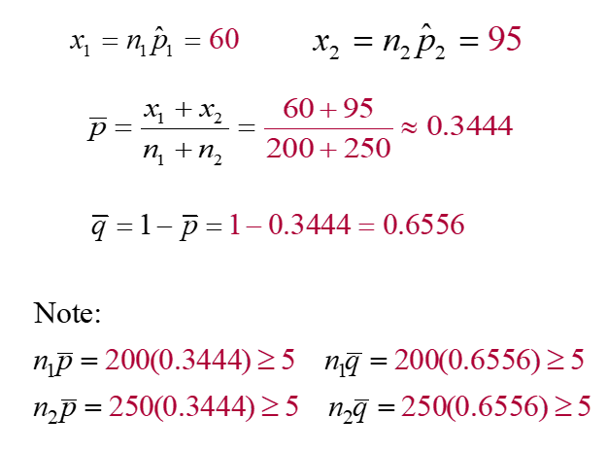
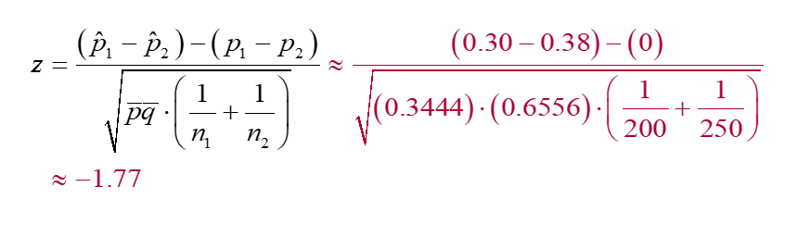
Solution: Obtaining test statistic
www.midocean.ae

Slide 43
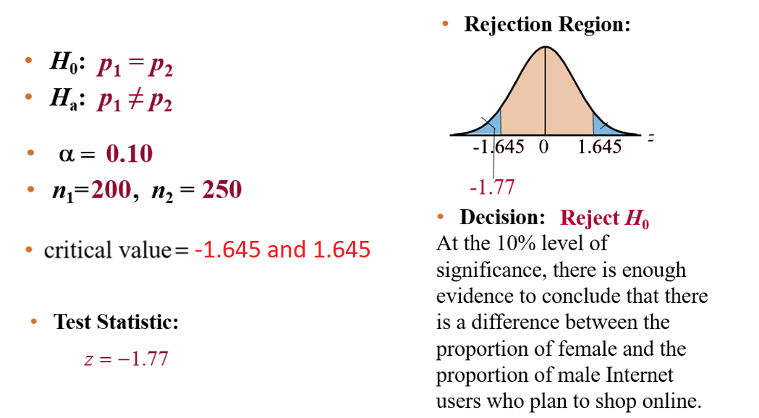
Solution: Testing the Difference Between Proportions
www.midocean.ae

Slide 44
Example: Testing the Difference Between Proportions
A medical research team conducted a study to test the effect of a cholesterol reducing medication. At the end of the study, the researchers found that of the 4700 randomly selected subjects who took the medication, 301 died of heart disease. Of the 4300 randomly selected subjects who took a placebo, 357 died of heart disease. At α = 0.01 can you conclude that the death rate due to heart disease is lower for those who took the medication than for those who took the placebo? (Adapted from New England Journal of Medicine)
Solution:
1 = Medication 2 = Placebo
www.midocean.ae

Slide 45
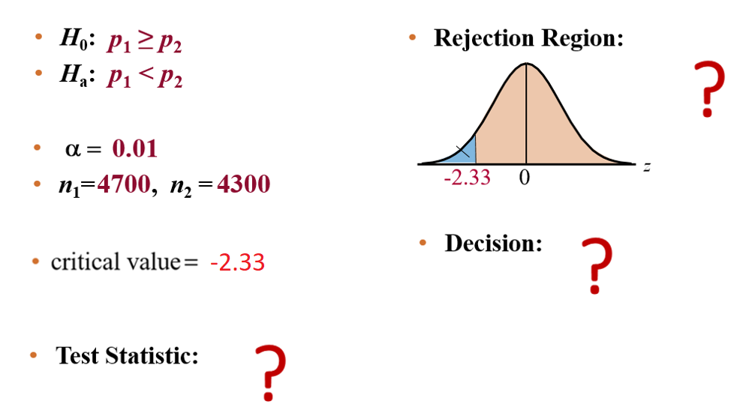
Solution: Testing the Difference Between Proportions
www.midocean.ae

Slide 46
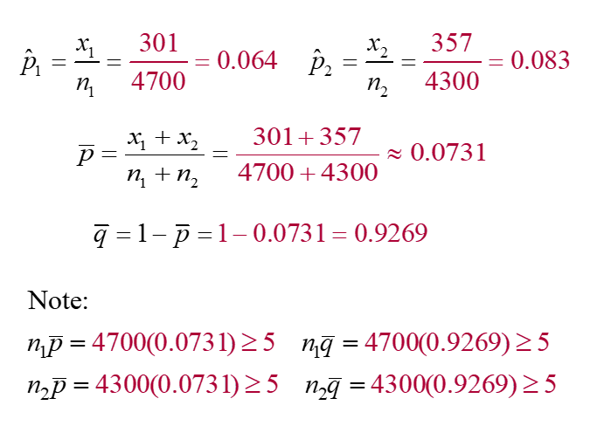
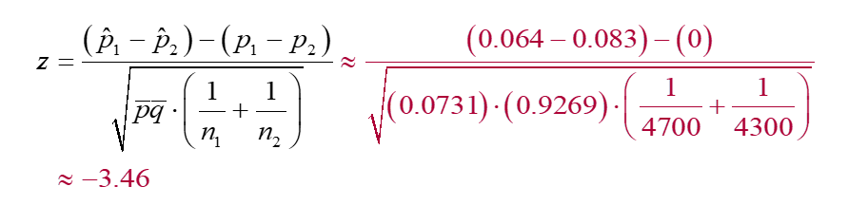
Solution: Obtaining test statistic
www.midocean.ae

Slide 47
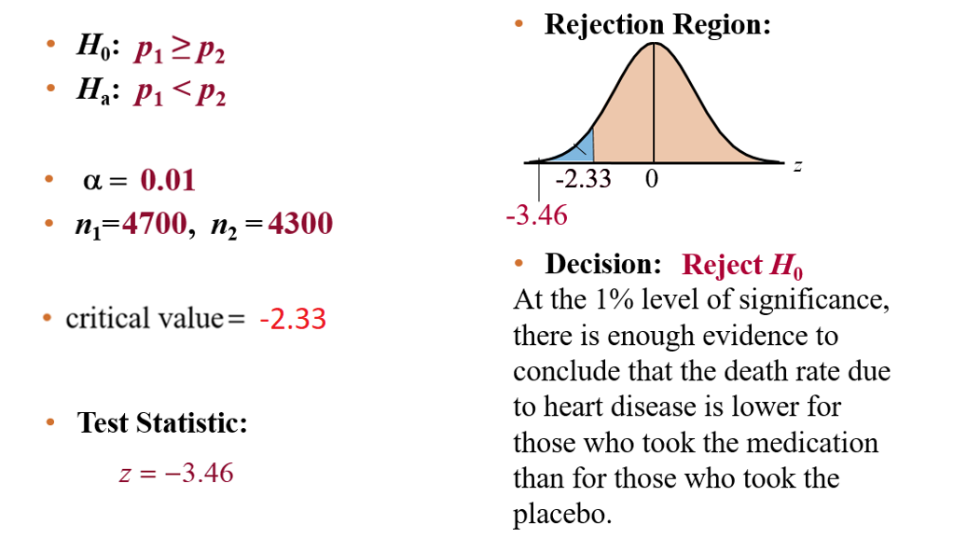
Solution: Testing the Difference Between Proportions
www.midocean.ae

Slide 48
Chapter Summary
Chapter
8.1 Testing the Difference Between Means (Large Independent Samples)
8.2 Testing the Difference Between Means (Small Independent Samples)
8.3 Testing the Difference Between Means (Dependent Samples)
8.4 Testing the Difference Between Proportions
www.midocean.ae

Slide 49
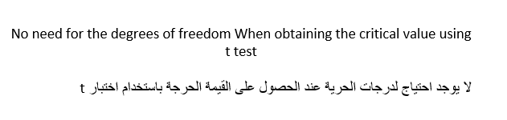
Un Solved Examples
Chapter
www.midocean.ae

Slide 50
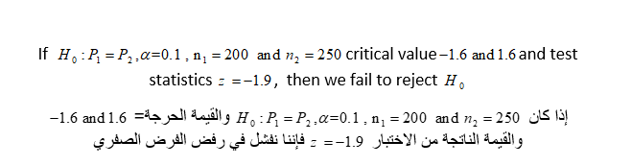
Un Solved Examples
Chapter
www.midocean.ae

Slide 51


Thank You

