Slide 1

RHSA (Admin 1) Red Hat Enterprise Linux 8 Essentials
Prepared by Eng. Taghreed Elsayed
Lecture 7
MANAGING RED HAT ENTERPRISE LINUX NETWORKING

Slide 2

Chapter
011
MANAGING RED HAT ENTERPRISE LINUX NETWORKING
IPV4 NETWORKING TCP/IP standards follow a 5-layers network model
• Application Each application has specifications for communication so that clients and servers may communicate across platforms. Common protocols include SSH (remote login), HTTPS (secure web), NFS or CIFS (file sharing), and SMTP (electronic mail delivery).
• Transport Transport protocols are TCP and UDP.
TCP is a reliable connection-oriented communication, while UDP is a connectionless datagram protocol. Application protocols use TCP or UDP ports.
A list of well-known and registered ports can be found in the /etc/services file.
When a packet is sent on the network, the combination of the service port and IP address forms a socket. Each packet has a source socket and a destination socket. This information can be used when monitoring and filtering.

Slide 3
Chapter
011
MANAGING RED HAT ENTERPRISE LINUX NETWORKING
• Internet The Internet, or network layer, carries data from the source host to the destination host. Each host has an IP address and a prefix used to determine network addresses. Routers are used to connect networks.
ICMP is a control protocol at this layer. Instead of ports, it has types. The ping utility is an example of using ICMP packets to test connectivity.
ping sends an ICMP ECHO_REQUEST packet. A successful ping receives an ICMP ECHO_REPLY acknowledgment.
An unsuccessful ping may receive ICMP error messages such as "destination unreachable" or may not receive any response.
Link The link, or media access, layer provides the connection to physical media. The most common types of networks are wired Ethernet (802.3) and wireless WLAN (802.11). Each physical device has a hardware address (MAC) which is used to identify the destination of packets on the local network segment.

Slide 4
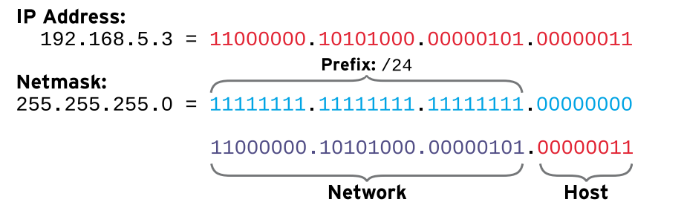
Chapter
011
MANAGING RED HAT ENTERPRISE LINUX NETWORKING

Slide 5
Chapter
011
MANAGING RED HAT ENTERPRISE LINUX NETWORKING
IPv4 addresses
An IPv4 address is a 32-bit number, normally expressed in decimal as four octets ranging in value from 0 to 255, separated by dots.
The address is divided into two parts: the network part and the host part.
All hosts on the same subnet, which can talk to each other directly without a router, have the same network part; the network part identifies the subnet.
No two hosts on the same subnet can have the same host part; the host part identifies a particular host on a subnet.
The lowest possible address on a subnet (host part is all zeros in binary) is sometimes called the network address.

Slide 6
Chapter
011
MANAGING RED HAT ENTERPRISE LINUX NETWORKING
The highest possible address on a subnet (host part is all ones in binary) is used for broadcast messages in IPv4, and is called the broadcast address.
Network masks are expressed in two forms. The older syntax for a netmask which uses 24 bits for the network part would read 255.255.255.0. A newer syntax, called CIDR notation, would specify a network prefix of /24. Both forms convey the same information; namely, how many leading bits in the IP address contribute to its network address.

Slide 7
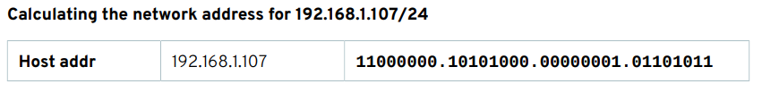
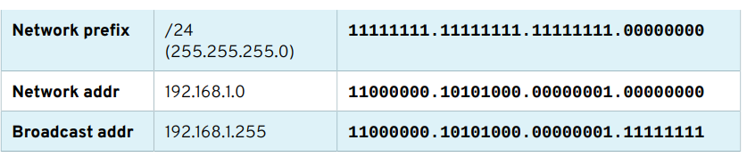
Chapter
011
MANAGING RED HAT ENTERPRISE LINUX NETWORKING

Slide 8
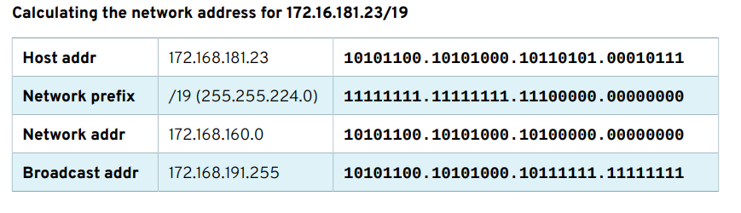
Chapter
011
MANAGING RED HAT ENTERPRISE LINUX NETWORKING

Slide 9
Chapter
011
MANAGING RED HAT ENTERPRISE LINUX NETWORKING
Names and IP addresses
The IP protocol uses addresses to communicate, but human beings would rather work with names than long and hard-to-remember strings of numbers.
DNS, the Domain Name System, is a distributed network of servers that maps host names to IP addresses.
In order for name service to work, the host needs to be pointed at a nameserver. This nameserver does not need to be on the same subnet; it just needs to be reachable by the host.
DHCP or static network configuration Many systems are configured to obtain network settings automatically at boot time.
The local configuration files indicate that DHCP should be used and a separate client service queries the network for a server and obtains a lease for network settings

Slide 10
Chapter
011
MANAGING RED HAT ENTERPRISE LINUX NETWORKING
If a DHCP server is not available, the system must use a static configuration where the network settings are read from a local configuration file.
The correct network settings are obtained from the network administrator or architecture team to ensure there are no conflicts with other systems. Since DHCP uses the hardware address to track assignments, only one address may be assigned per interface with DHCP.
Multiple static addresses may be assigned to a single interface. This practice is common in systems hosting services for multiple clients, such as HTTP IP-based hosting. Red Hat Enterprise Linux interfaces typically have an IPv4 address and an IPv6 local-link address, but may have more addresses assigned.

Slide 11
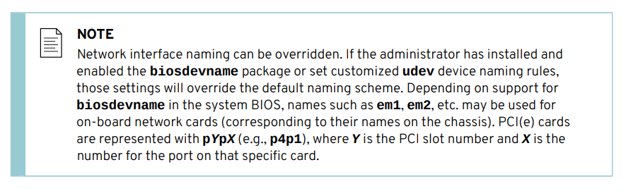
Chapter
011
MANAGING RED HAT ENTERPRISE LINUX NETWORKING

Slide 12
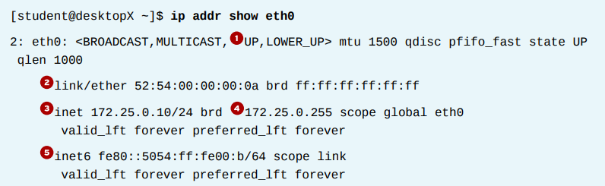
Chapter
011
MANAGING RED HAT ENTERPRISE LINUX NETWORKING
VALIDATING NETWORK CONFIGURATION
DISPLAYING IP ADDRESSES
The /sbin/ip command is used to show device and address information.

Slide 13
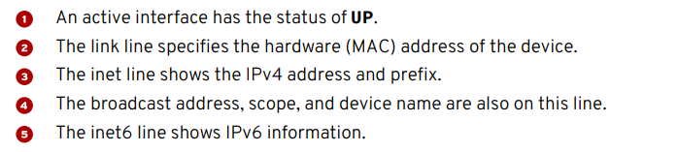
Chapter
011
MANAGING RED HAT ENTERPRISE LINUX NETWORKING
TROUBLESHOOTING ROUTING The /sbin/ip command is also used to show routing information.

Slide 14
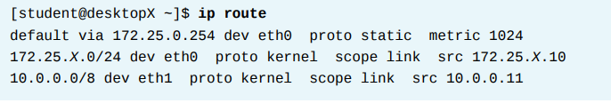

Chapter
011
MANAGING RED HAT ENTERPRISE LINUX NETWORKING
The ping command is used to test connectivity. The command will continue to run until Ctrl+C is pressed unless options are given to limit the number of packets sent.

Slide 15
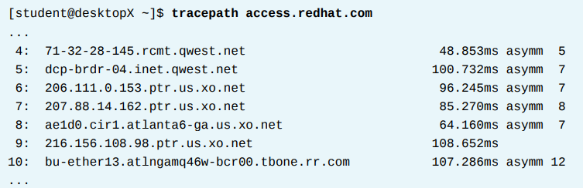
Chapter
011
MANAGING RED HAT ENTERPRISE LINUX NETWORKING
To trace the path to a remote host, use either traceroute or tracepath.
Both commands can be used to trace a path with UDP packets; however, many networks block UDP and ICMP traffic.
The traceroute command has options to trace the path with UDP (default), ICMP (-I), or TCP (-T) packets, but may not be installed by default.

Slide 16
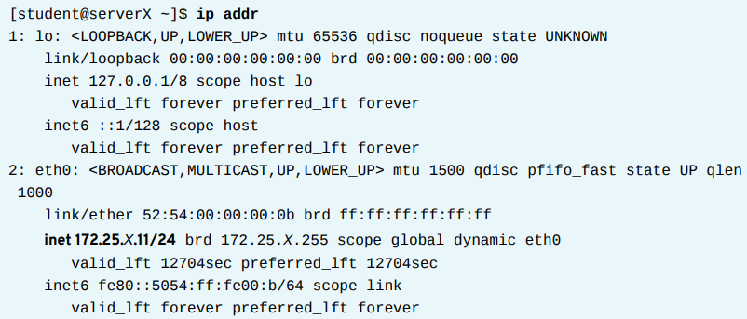
Chapter
011
MANAGING RED HAT ENTERPRISE LINUX NETWORKING
EXAMINING NETWORK CONFIGURATION
1. Display the current IP address and netmask for all interfaces.

Slide 17
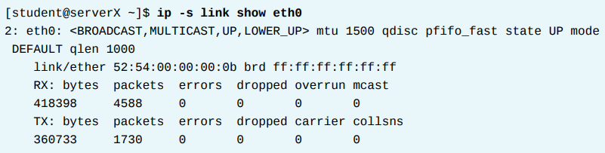

Chapter
011
MANAGING RED HAT ENTERPRISE LINUX NETWORKING
2. Display the statistics for the eth0 interface.
3. Display the routing information.

Slide 18
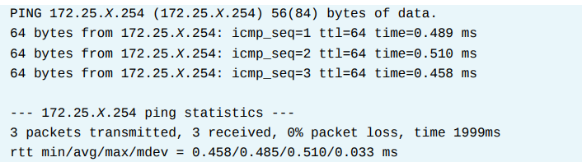
Chapter
011
MANAGING RED HAT ENTERPRISE LINUX NETWORKING
4. Verify that the router is accessible.

Slide 19

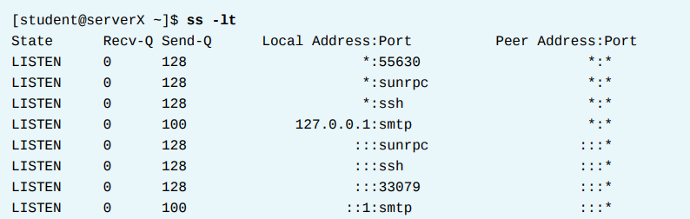
Chapter
011
MANAGING RED HAT ENTERPRISE LINUX NETWORKING
5. Show all the hops between the local system and classroom.example.com.
6. Display the listening TCP sockets on the local system.

Slide 20
Chapter
011
MANAGING RED HAT ENTERPRISE LINUX NETWORKING
CONFIGURING NETWORKING WITH nmcli
TO manage network settings and devices with nmcli and NetworkManager.
NetworkManager is a daemon that monitors and manages network settings. In addition to the daemon, there is a GNOME Notification Area applet that provides network status information. Command-line and graphical tools talk to NetworkManager and save configuration files in the / etc/sysconfig/network-scripts directory.

Slide 21
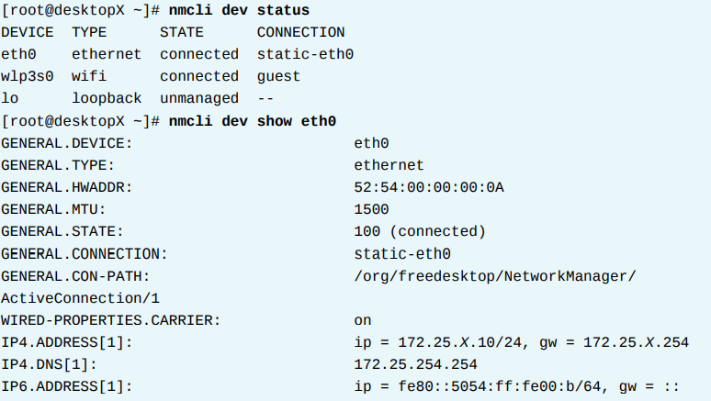
Chapter
011
MANAGING RED HAT ENTERPRISE LINUX NETWORKING
The nmcli command can be used to show device status and details.

Slide 22
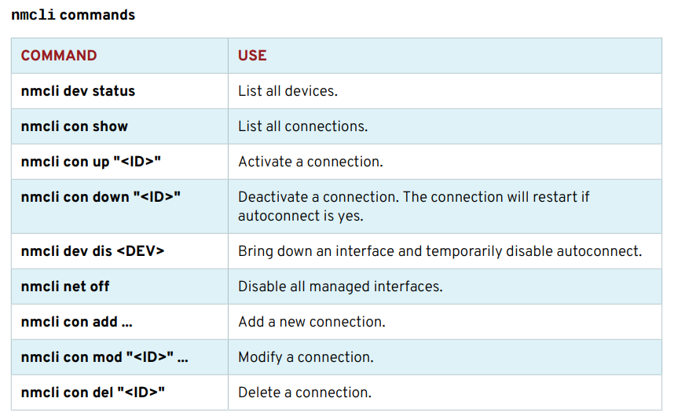
Chapter
011
MANAGING RED HAT ENTERPRISE LINUX NETWORKING

Slide 23

Chapter
011
MANAGING RED HAT ENTERPRISE LINUX NETWORKING
CONFIGURING HOST NAMES AND NAME RESOLUTION
CHANGING THE SYSTEM HOST NAME The hostname command displays or temporarily modifies the system's fully qualified host name.
CONFIGURING NAME RESOLUTION
The stub resolver is used to convert host names to IP addresses or the reverse. The contents of the file /etc/hosts are checked first.

Slide 24
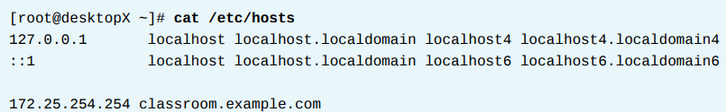
Chapter
011
MANAGING RED HAT ENTERPRISE LINUX NETWORKING
The getent hosts hostname command can be used to test host name resolution with the / etc/hosts file.

Slide 25
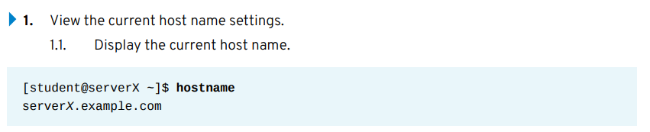
Chapter
011
MANAGING RED HAT ENTERPRISE LINUX NETWORKING
you will configure the system host name and name resolution.

Slide 26
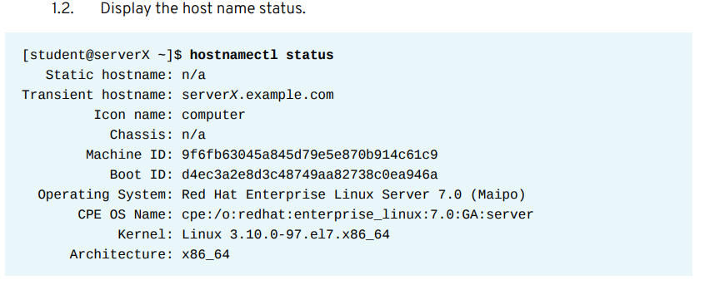
Chapter
011
MANAGING RED HAT ENTERPRISE LINUX NETWORKING

Slide 27
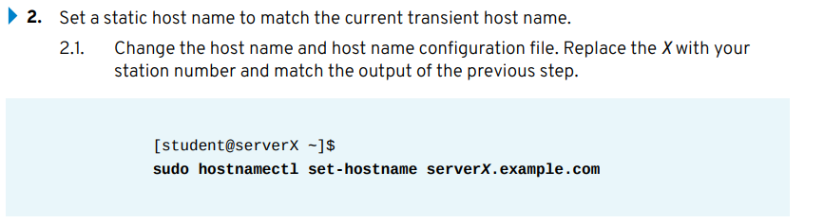
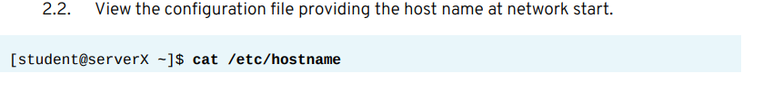
Chapter
011
MANAGING RED HAT ENTERPRISE LINUX NETWORKING

Slide 28
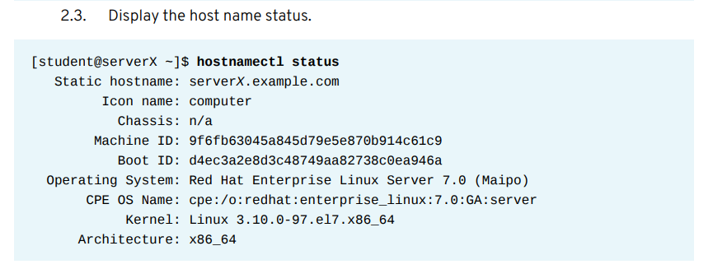
Chapter
011
MANAGING RED HAT ENTERPRISE LINUX NETWORKING

Slide 29
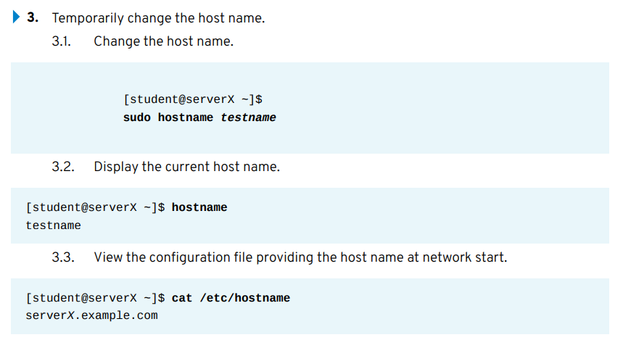
Chapter
011
MANAGING RED HAT ENTERPRISE LINUX NETWORKING

Slide 30
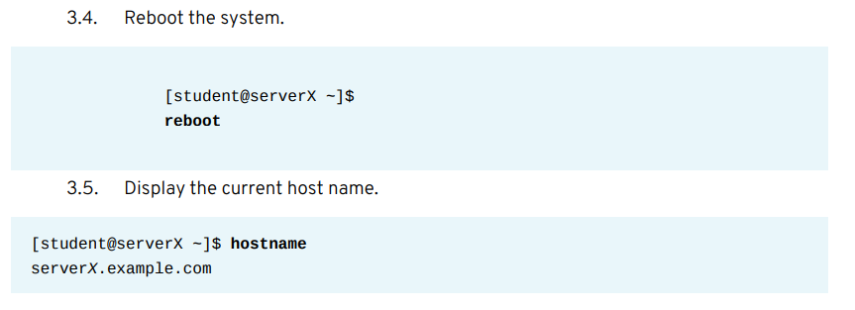
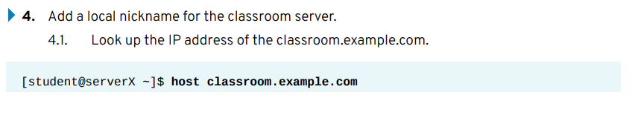
Chapter
011
MANAGING RED HAT ENTERPRISE LINUX NETWORKING

Slide 31
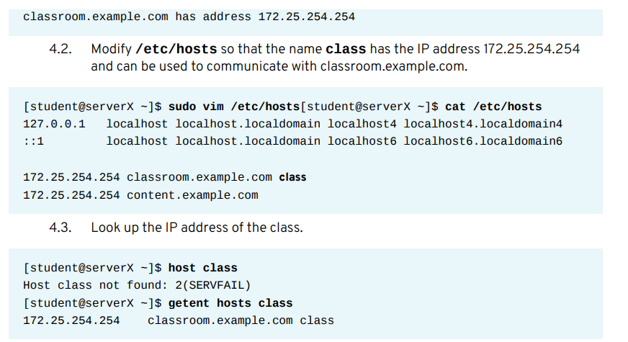
Chapter
011
MANAGING RED HAT ENTERPRISE LINUX NETWORKING

Slide 32
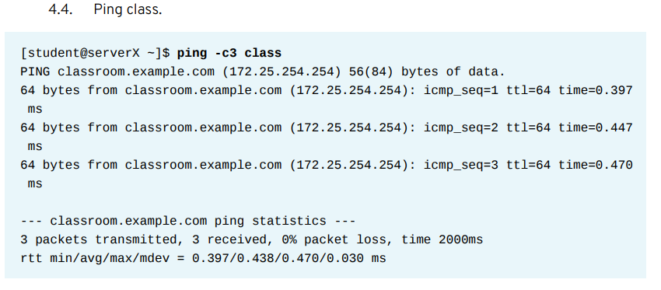
Chapter
011
MANAGING RED HAT ENTERPRISE LINUX NETWORKING

Slide 33
Chapter
011
MANAGING RED HAT ENTERPRISE LINUX NETWORKING

