Slide 1


Probability Concepts and Distributions
Prepared by Dr. Mohamed Sleem
Subject code : FNT 631
Data Analysis
Lecture 4

Slide 2



Probability Concepts and Distributions
Lecture 4
Subject code : FNT 631
Data Analysis
Prepared by
Dr. Mohamed Sleem

Slide 3
Chapter 3 Review Questions
Question 1: Explain the concepts of mean, median, and mode, and provide an example of how each is used in financial data analysis.
Answer:
- Mean: The mean, or average, is the sum of all values divided by the number of values.
- Example: Calculating the average return on an investment portfolio to evaluate performance.
- Median: The median is the middle value of a dataset when arranged in ascending order.
- Example: Analyzing median household income to understand income distribution without being skewed by extremely high incomes.
- Mode: The mode is the value that appears most frequently in a dataset.
- Example: Identifying the most common transaction type in a bank to enhance related services.

Slide 4
Chapter 3 Review Questions
Question 2: What are the measures of dispersion, and why are they important in statistical analysis? Provide an example in finance.
Answer:
- Measures of Dispersion: Include range, variance, and standard deviation.
- Range: Difference between the maximum and minimum values.
- Variance: Average of the squared differences from the mean.
- Standard Deviation: Square root of the variance, showing how much data deviates from the mean.
- Importance: They help understand the spread and variability within a dataset.
- Example in Finance: Calculating the standard deviation of stock returns to assess investment risk.

Slide 5
Chapter 3 Review Questions
Question 3: Describe skewness and kurtosis and their significance in data analysis. Provide an example of how each is applied in financial analysis.
Answer:
- Skewness: Measures the asymmetry of the data distribution.
- Positive Skewness: Tail on the right side; indicates more high-value outliers.
- Negative Skewness: Tail on the left side; indicates more low-value outliers.
- Example: Assessing the skewness of return distributions to understand potential risk in investment portfolios.
- Kurtosis: Measures the "tailedness" of the data distribution.
- High Kurtosis: Indicates heavy tails, meaning more outliers.
- Low Kurtosis: Indicates light tails, meaning fewer outliers.
- Example: Evaluating the kurtosis of insurance claims to predict the likelihood of extreme events and set appropriate premiums.

Slide 6

Chapter
Subject’s Objectives
05
Understand the Basics of Probability
Identify Experiments and Outcomes
Explore Random Variables and Probability Distributions
Apply Conditional Probability and Probability Laws
Analyze Continuous Probability Distributions

Slide 7
Chapter
Probability
05
Probability – the likelihood that an outcome occurs
  Probabilities are values between 0 and 1. The closer the probability is to 1, the more likely it is that the outcome will occur.
Some convert probabilities to percentages
  The statement “there is a 10% chance that oil prices will rise next quarter” is another way of stating that “the probability of a rise in oil prices is 0.1.”

Slide 8
Experiments and Outcomes
Experiment – a process that results in some outcome
  Roll dice
  Observe and record weather conditions
  Conduct market survey
  Watch the stock market
Outcome – an observed result of an experiment
  Sum of the dice
  Description of the weather
  Proportion of respondents who favor a product
  Change in the Dow Jones Industrial Average

Slide 9
Experiments and Outcomes
Sample space - all possible outcomes of an experiment
  Dice rolls: 2, 3, …, 12
  Weather outcomes: clear, partly cloudy, cloudy
  Customer reaction: proportion who favor a product (a number between 0 and 1)
  Change in DJIA: positive or negative real number

Slide 10
Three Views of Probability
Classical definition: based on theory
Relative frequency: based on empirical data
Subjective: based on judgment

Slide 11
Classical Definition
Probability = number of favorable outcomes divided by the total number of possible outcomes
Example: There are six ways of rolling a 7 with a pair of dice, and 36 possible rolls. Therefore, the probability of rolling a 7 is 6/36 = 0.167.

Slide 12
Relative Frequency Definition
Probability = number of times an event has occurred in the past divided by the total number of observations
Example: Of the last 10 days when certain weather conditions have been observed, it has rained the next day 8 times. The probability of rain the next day is 0.80

Slide 13
Subjective Definition
What is the probability that the New York Yankees will win the World Series this year?
What is the probability your school will win its conference championship this year?
What is the probability the NASDAQ will go up 2% next week?

Slide 14
Basic Probability Rules and Formulas
Probability associated with any outcome must be between 0 and 1
  0 ≤ P(O_{i}) ≤ 1 for each outcome O_{i}
Sum of probabilities over all possible outcomes must be 1.0
  P(O₁) + P(O₂) + … + P(O_{n}) = 1
Example: Flip a coin three times
Outcomes: HHH, HHT, HTH, THH, HTT, THT, TTH, TTT
Each has probability of (1/2)³ = 1/8

Slide 15
Events
An event is a collection of one or more outcomes from
  Obtaining a 7 or 11 on a roll of dice
  Having a clear or partly cloudy day
  The proportion of respondents that favor a product is at least 0.60
  Having a positive weekly change in the Dow
If A is any event, the complement of A, denoted A^{c}, consists of all outcomes in the sample space not in A.

Slide 16
Mutually Exclusive Events
Two events are mutually exclusive if they have no outcomes in common.
A
C
B & C
B
B
A and B are mutually exclusive B and C are not

Slide 17
Rules
The probability of any event is the sum of the probabilities of the outcomes that compose that event.
The probability of the complement of any event A is P(A^{c}) = 1 - P(A).

Slide 18
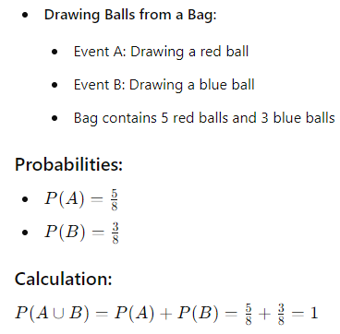
Rule 3
If events A and B are mutually exclusive, then
P(A or B) = P(A) + P(B).

Slide 19


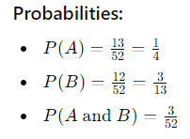
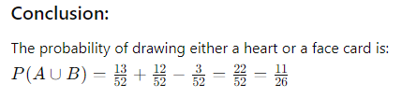
Rule 4
If two events A and B are not mutually exclusive, then
P(A or B) = P(A) + P(B) - P(A and B).

Slide 20
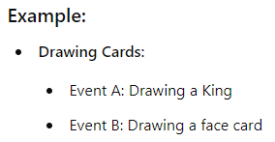
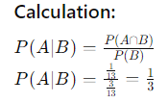
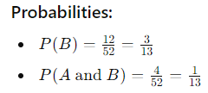
Conditional probability
the probability of the occurrence of one event, A, given that another event B is known to be true or have already occurred. P(A|B) = P(A and B)/P(B)

Slide 21
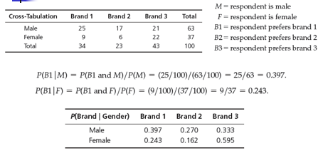
Example

Slide 22


Multiplication Law of Probability
Used to calculate the probability of two events happening together (intersection of two events).
For Independent Events: If events 𝐴 and 𝐵 are independent:
For Dependent Events:
If events A and B are dependent:

Slide 23
Random Variables
Random variable – a numerical description of the outcome of an experiment. Random variables are denoted by capital letters, X, Y, …; specific values by lower case letters, x, y, …
  Discrete random variable – the number of possible outcomes can be counted
  Continuous random variable – outcomes over one or more continuous intervals of real numbers

Slide 24
Examples of Random Variables
Experiment: flip a coin 3 times.
  Outcomes: TTT, TTH, THT, THH, HTT, HTH, HHT, HHH
  Random variable: X = number of heads.
  X can be either 0, 1, 2, or 3.
Experiment: observe end-of-week closing stock price.
  Random variable: Y = closing stock price.
  X can be any nonnegative real number.

Slide 25
Probability Distributions
Probability distribution – a characterization of the possible values a random variable may assume along with the probability of assuming these values.
  Probability distributions may be defined for both discrete and continuous random variables.

Slide 26
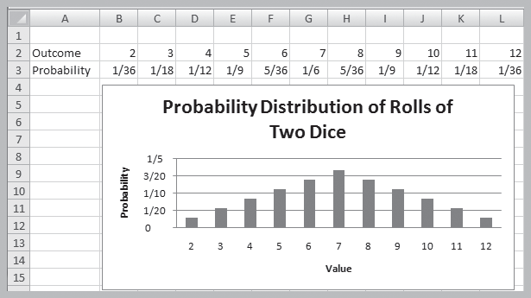
Example: Theoretical Probability Distribution

Slide 27
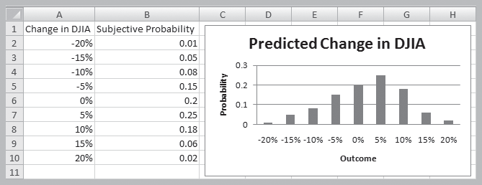
Example: Subjective Probability Distribution

Slide 28
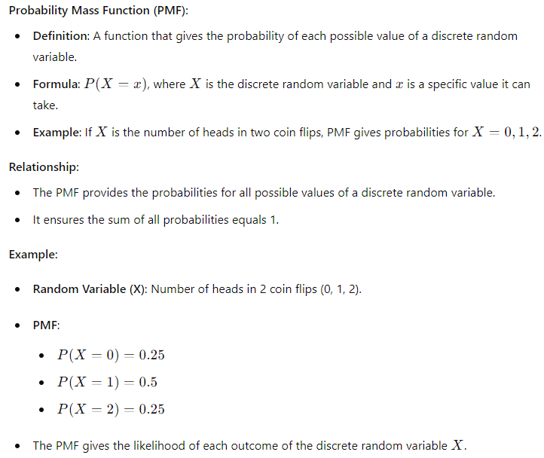
Discrete Random Variables

Slide 29
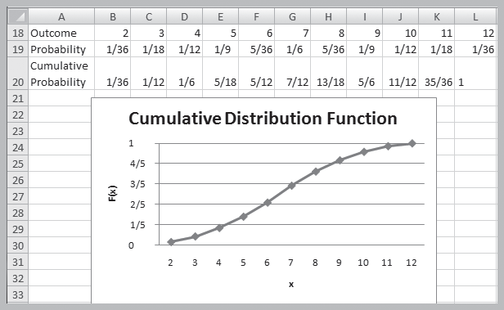
Cumulative Distribution Function, F(x)
Specifies the probability that the random variable X will be less than or equal to x, denoted as P(X ≤ x).

Slide 30
Expected Value and Variance of Discrete Random Variables
Expected Value (Mean):
Meaning: The average outcome you expect to see if you were to repeat an experiment many times.
Example in Finance: If you invest in a stock that can gain $10, $20, or $30 with different probabilities, the expected value helps you understand the average return you might get.
Variance:
Meaning: It measures how much the outcomes deviate from the expected value, showing the spread or risk associated with the investment.
Example in Finance: In the same stock investment, the variance tells you how much the returns fluctuate from the average return, helping you understand the risk.
Standard Deviation:
Meaning: It is the square root of the variance and provides a measure of risk in the same units as the returns, showing how much the returns typically deviate from the average.
Example in Finance: For the stock investment, the standard deviation gives you a sense of the typical range of returns around the expected value, helping you compare the riskiness of different investments.

Slide 31
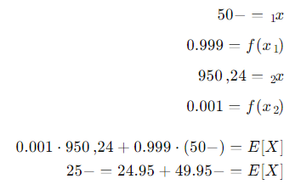
Example
You play a lottery in which you buy a ticket for $50 and are told you have a 1 in 1000 chance of winning $25,000. The random variable X is your net winnings, and its probability distribution is
x f(x)
-$50 0.999
$24,950 0.001

Slide 32
Calculations
E[X] = -$50(0.999) + $24,950(0.001) = -$25.00
Var[X] = (-50 - [-25.00])²(0.999) + (24,950 - [-25.00])²(0.001) = 624,375

Slide 33
Discrete Probability Distributions
1. Bernoulli Distribution:
The Bernoulli distribution describes a single trial experiment that has only two possible outcomes: success or failure.
2. Binomial Distribution:
The Binomial distribution describes the number of successes in a fixed number of independent and identical trials, where each trial has only two possible outcomes (success or failure).
3. Poisson Distribution:
The Poisson distribution describes the number of events occurring within a fixed interval of time or space, provided that these events occur with a known constant mean rate and independently of the time since the last event.

Slide 34
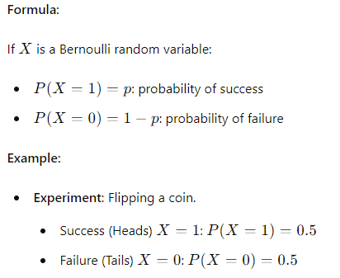
Bernoulli Distribution
A random variable with two possible outcomes: “success” (x = 0) and “failure” (x = 1)
p = probability of “success”
Expected value = p; variance = p(1 – p)

Slide 35
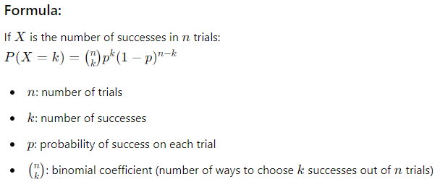
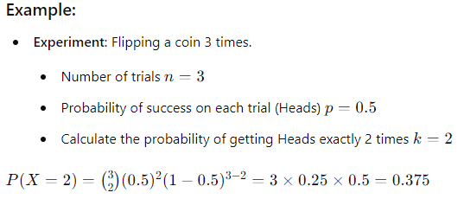
Binomial Distribution
The Binomial distribution describes the number of successes in a fixed number of independent and identical trials, where each trial has only two possible outcomes (success or failure).

Slide 36
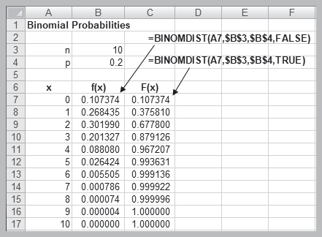
Excel Function
BINOM.DIST(number_s, trials, probability_s, cumulative)
BINOM.DIST(number_s, trials, probability_s, cumulative)

Slide 37
Poisson Distribution
Models the number of occurrences in some unit of measure, e.g., events per unit time, number of items per order
X = number of events that occur; x = 0, 1, 2,
Expected value = λ; variance = λ
Poisson approximates binomial when n is large and p small

Slide 38
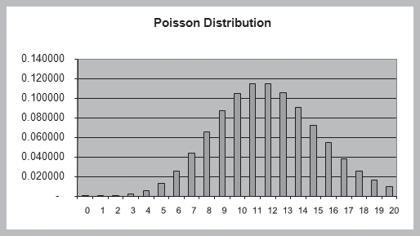
Example of the Poisson Distribution (l = 12)

Slide 39
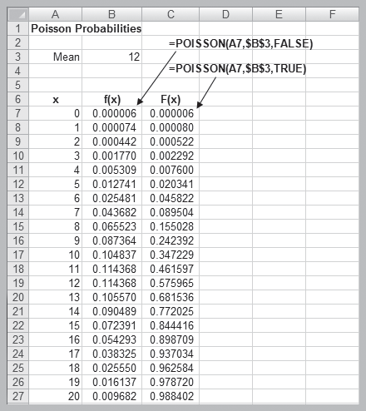
Excel Function
POISSON.DIST(x, mean, cumulative)

Slide 40
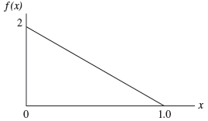
Continuous Probability Distributions
Probability density function, f(x), a continuous function that describes the probability of outcomes for a continuous random variable X. A histogram of sample data approximates the shape of the underlying density function.

Slide 41
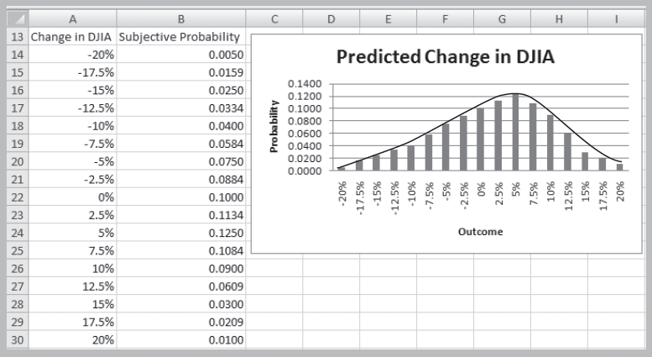
Refining Subjective Probabilities Toward a Continuous Distribution

Slide 42
Conclusion:
Probability Basics: Understanding the likelihood of events occurring, ranging from 0 to 1.
Probability Distributions: Describes the possible values of a random variable and their probabilities.
Discrete vs Continuous: Discrete variables have countable outcomes, while continuous variables have outcomes over intervals.
Normal Distribution: A key distribution in finance, characterized by the bell curve.
  Applications in Finance:
  - Risk Analysis: Estimating investment risks.
  - Market Predictions: Forecasting stock market movements.
Expected Value and Variance: Measures of the central tendency and spread of a probability distribution.
Conditional Probability: The probability of an event given that another event has occurred.

Slide 43
Review Questions:
Q1: What is the difference between discrete and continuous random variables?**
Q2: How is the expected value of a random variable calculated?**
Q3: What is the significance of the normal distribution in finance?**

Slide 44



Thank You

