Slide 1

RHSA (Admin 1) Red Hat Enterprise Linux 8 Essentials
Prepared by Eng. Taghreed Elsayed
Lecture 3
Getting help in Red Hat Enterprise Linux

Slide 2

Chapter
03
Getting help in Red Hat Enterprise Linux
man command in Linux is used to display the user manual of any command that we can run on the terminal. It provides a detailed view of the command which includes NAME, SYNOPSIS, DESCRIPTION, OPTIONS, EXIT STATUS, RETURN VALUES, ERRORS, FILES, VERSIONS, EXAMPLES, AUTHORS and SEE ALSO.
Every manual is divided into the following sections:
Executable programs or shell commands
System calls (functions provided by the kernel)
Library calls (functions within program libraries
Games
Special files (usually found in /dev)
File formats and conventions eg /etc/passwd
Miscellaneous (including macro packages and conventions), e.g. groff(7)
System administration commands (usually only for root)
Kernel routines [Non standard]

Slide 3
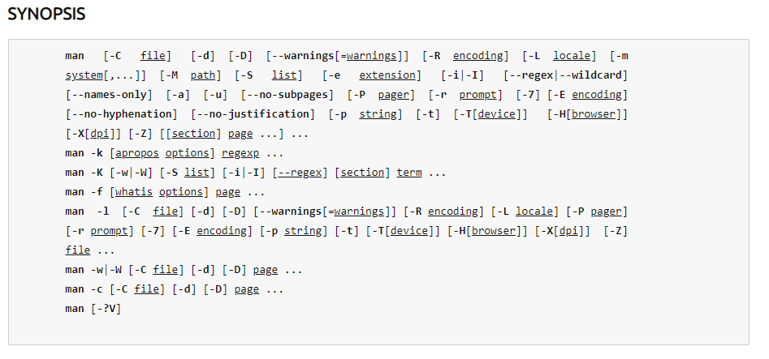
Chapter
03
Getting help in Red Hat Enterprise Linux

Slide 4
Chapter
03
Getting help in Red Hat Enterprise Linux
man ls Display the manual page for the item (program) ls.
man -a intro Display, in succession, all of the available intro manual pages contained within the manual. It is possible to quit between successive displays or skip any of them.
man -t alias | lpr -Pps Format the manual page referenced by `alias', usually a shell manual page, into the default troff or groff format and pipe it to the printer named ps. The default output for groff is usually PostScript. man --help should advise as to which processor is bound to the -t option.

Slide 5
Chapter
03
Getting help in Red Hat Enterprise Linux
man -k printf Search the short descriptions and manual page names for the keyword printf as regular expression. Print out any matches. Equivalent to apropos -r printf.
man -f smail Lookup the manual pages referenced by smail and print out the short descriptions of any found. Equivalent to whatis -r smail.

Slide 6
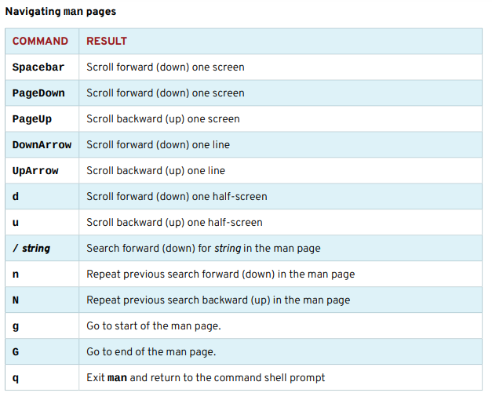
Chapter
03
Getting help in Red Hat Enterprise Linux
NAVIGATE AND SEARCH man PAGES The ability to efficiently search for topics and navigate man pages is a critical administration skill. The following table lists basic man navigation commands:

Slide 7
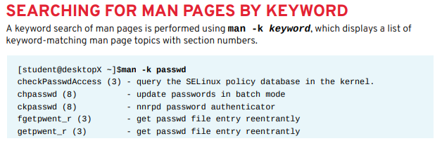
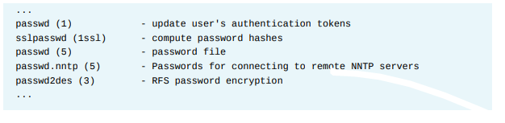
Chapter
03
Getting help in Red Hat Enterprise Linux

Slide 8
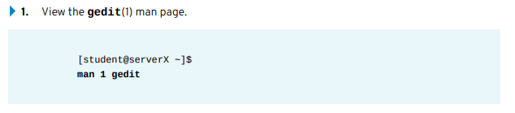
Chapter
03
Getting help in Red Hat Enterprise Linux
IMPORTANT The man command -K option performs a full-text page search, not just titles and descriptions like the -k. A full-text search can use greater systems resources and take more time.
Finding relevant information by using man options and arguments . Perform the following steps on server X unless directed otherwise:

Slide 9
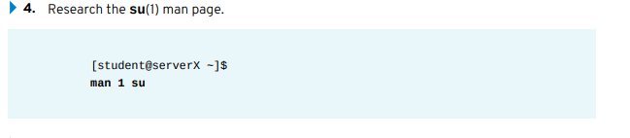
Chapter
03
Getting help in Red Hat Enterprise Linux
2. Research how to edit a specific file using gedit from the command line.
gedit filename
3. Research the gedit option used to begin an editing session with the cursor at the end of the file.
gedit + filename

Slide 10


Chapter
03
Getting help in Red Hat Enterprise Linux
5. Research what su does when the username argument is omitted.
su assumes a username of root.
6. Research how su behaves when a single dash option is used.
su starts a child login shell (creating login environment by sourcing login scripts). Without the single dash, a non-login child shell is created, matching the user's current environment.
7. Consult the passwd(1) man page. Determine the options that will lock and unlock a user account when this command is used by root.

Slide 11
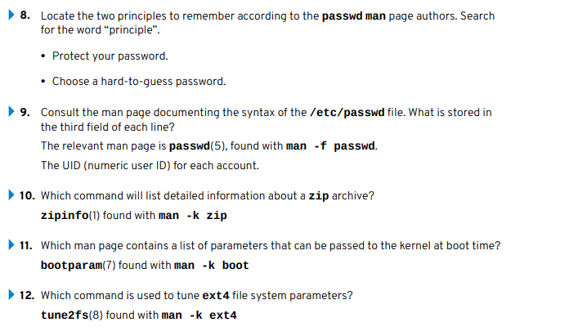
Chapter
03
Getting help in Red Hat Enterprise Linux

Slide 12
Chapter
03
READING DOCUMENTATION USING PINFO
Some commands and utilities have both man pages and info documentation; usually, the info documentation will be more in-depth. Compare the differences in tar documentation using man and pinfo:
The pinfo info reader is more advanced than the original info command. Designed to match the lynx text web browser keystrokes, it also adds color. Info nodes for a particular topic are browsed with pinfo topic. Enter only pinfo for the info topics directory. New documentation nodes become available in pinfo when their corresponding software packages are installed.

Slide 13
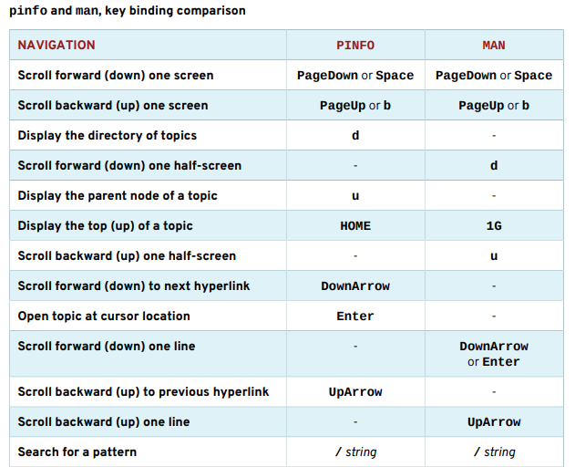
Chapter
03
READING DOCUMENTATION USING PINFO

Slide 14
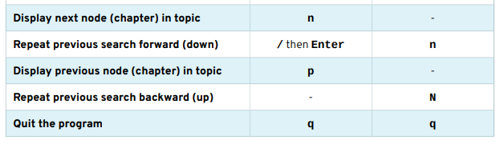
Chapter
03
READING DOCUMENTATION USING PINFO

Slide 15
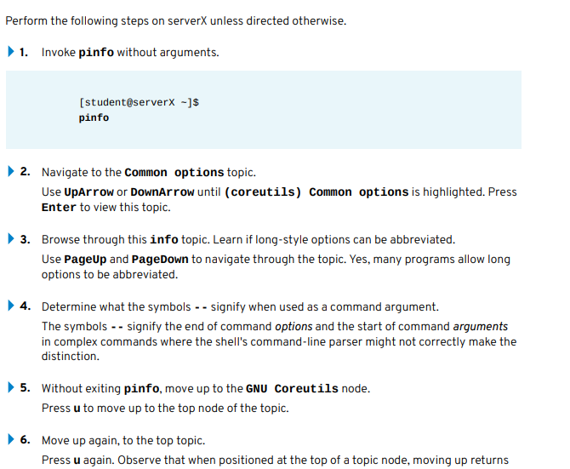
Chapter
03
USING THE PINFO COMMAND

Slide 16
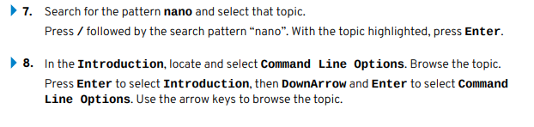
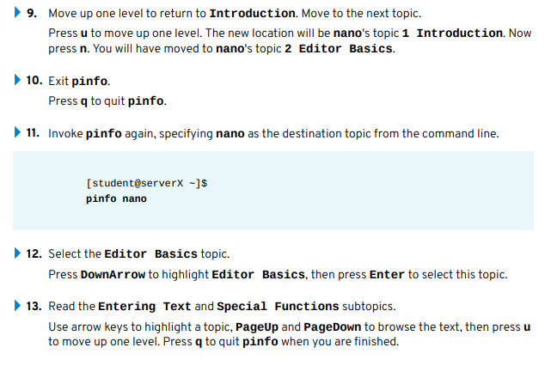
Chapter
03
Getting help in Red Hat Enterprise Linux

Slide 17
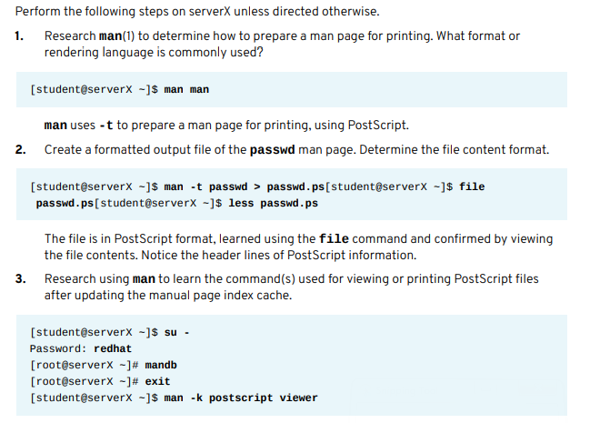
Chapter
03
VIEWING AND PRINTING HELP DOCUMENTATION

Slide 18
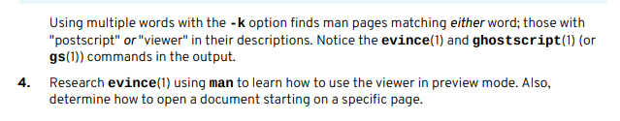
Chapter
03
VIEWING AND PRINTING HELP DOCUMENTATION

Slide 19
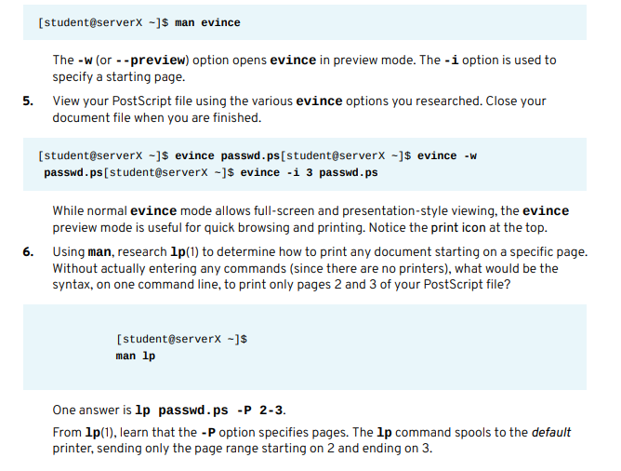
Chapter
03
VIEWING AND PRINTING HELP DOCUMENTATION

Slide 20
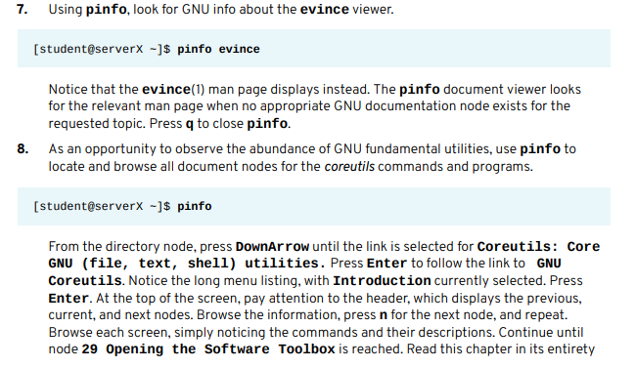
Chapter
03
VIEWING AND PRINTING HELP DOCUMENTATION

Slide 21
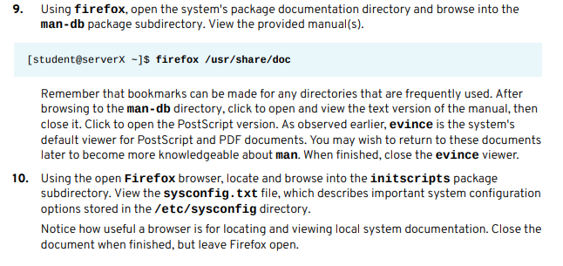
Chapter
03
Getting help in Red Hat Enterprise Linux

Slide 22
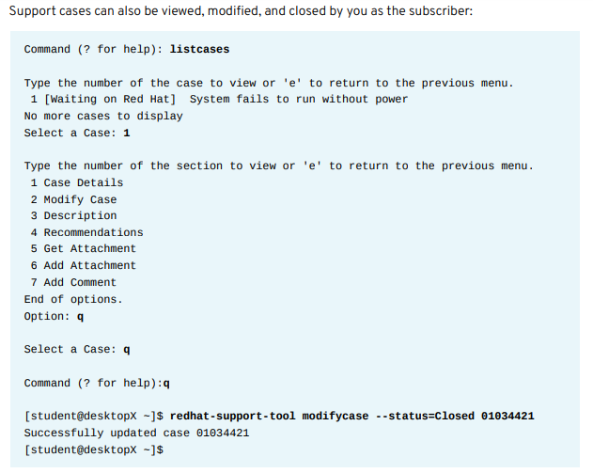
Chapter
03
Getting help in Red Hat Enterprise Linux

Slide 23
Chapter
03
Getting help in Red Hat Enterprise Linux
The Red Hat Support Tool has advanced application diagnostic and analytic capabilities. Using kernel crash dump core files, redhat-support-tool can create and extract a backtrace, a report of the active stack frames at the point of a crash dump, to provide onsite diagnostics and open a support case.
The tool also provides log file analysis. Using the tool's analyze command, log files of many types, including operating system, JBoss, Python, Tomcat, oVirt, and others, can be parsed to recognize problem symptoms, which can then be viewed and diagnosed individually. Providing preprocessed analysis, as opposed to raw data such as crash dump or log files, allows support cases to be opened and made available to engineers more quickly.

