Slide 1



The Negotiation and Influencing Skills
Creative thinking, problem solving and time management in negotiation situations
Lec.6
ENT623
College of Entrepreneurship and Innovation
Prepared by
Dr. Bothaina Mahmoud Fouad

Slide 2

Understanding the concepts of creative thinking, problem solving and time management.
Understanding its importance in negotiation situation
Case studies
Our Learning Outcomes

Slide 3

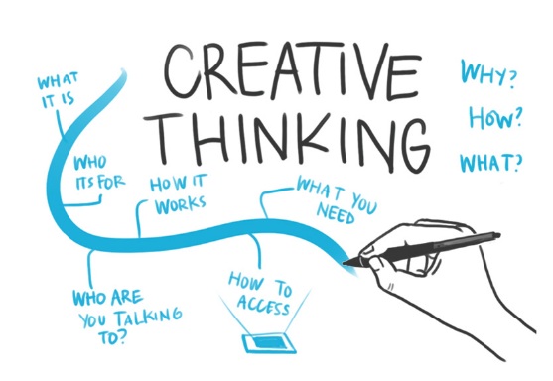
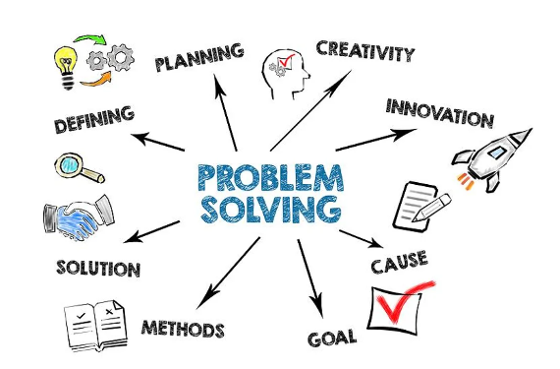
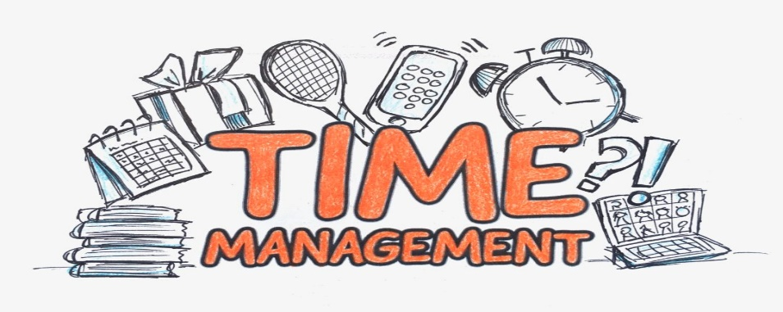
Creative thinking
Problem solving
Time management

Slide 4
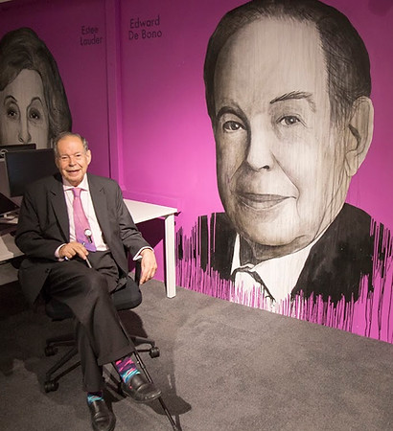
Creative thinking is not a talent, it is a skill that can be learnt.
It empowers people by adding Strength to their natural abilities which improves teamwork, productivity and where appropriate profits.
      Edward De. Bono
      writer and thinker
Creative Thinking

Slide 5
Creative thinking refers to using abilities and soft skills to come up with new solutions to problems.
Creative thinking skills are techniques used to look at the issue from different and creative angles, using the right tools to assess it and develop a plan.

Slide 6
Some definitions
Creativity is the act of turning new and imaginative ideas into reality.
"Building universes out of nothing.“
Other: The ability to imagine or invent something new
Other : The ability to generate new ideas by combining, changing, or reapplying existing ideas
Other : The attitude to accept change and new ideas, a willingness to play with ideas and possibilities, a flexibility of outlook (Harris, 1998)

Slide 7
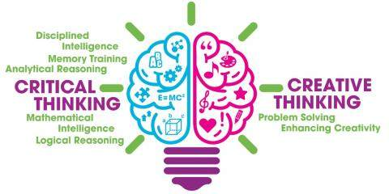
There are two ways of thinking:

Slide 8
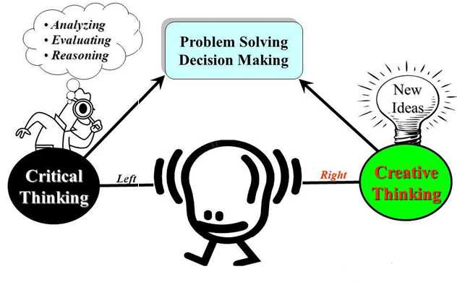
Types of Thinking

Slide 9
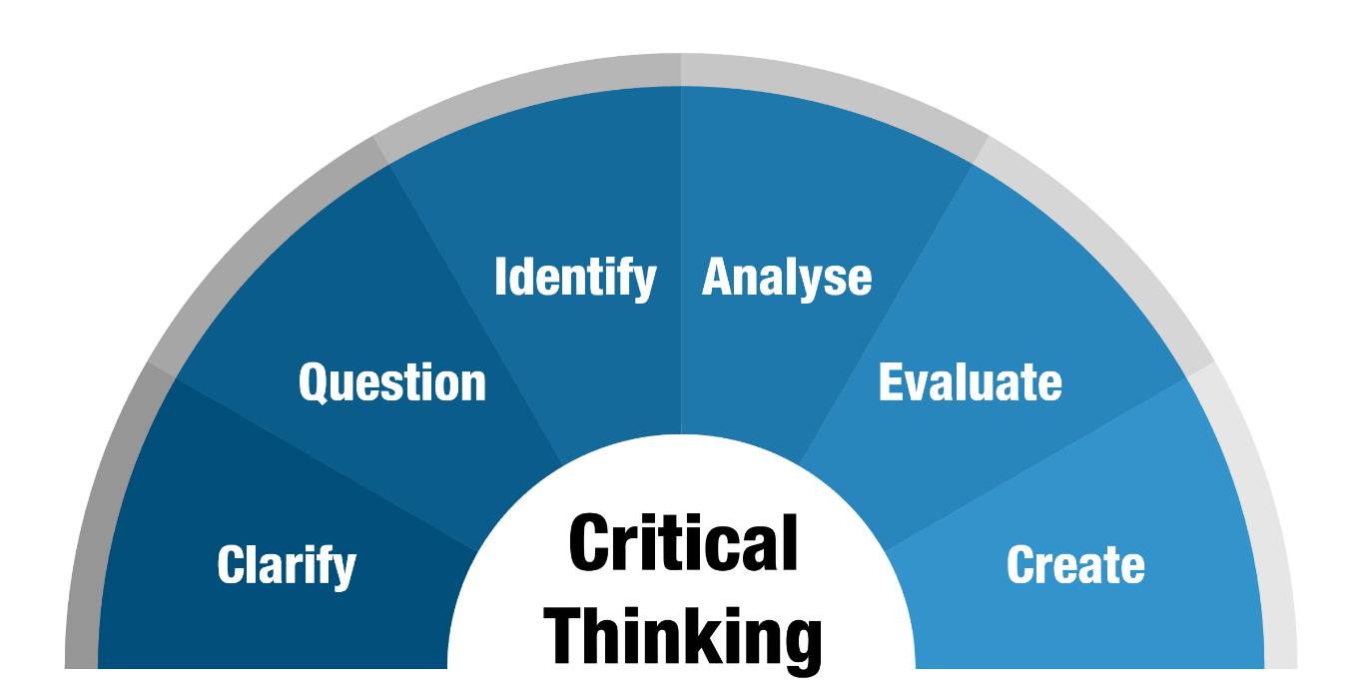
Critical thinking is the ability to clearly and logically consider information that is presented to us.
Critical Thinking

Slide 10
Creative thinking is the ability to generate new ideas by combining, changing, or reapplying existing ideas
Advantages of Creative Thinking
Multiple solving approaches to a problem.
Sharpens the concentration and observation power.
Develops left and right side of brain (intuition and Innovation)
Develops team building, confidence and leadership.
Creative Thinking

Slide 11
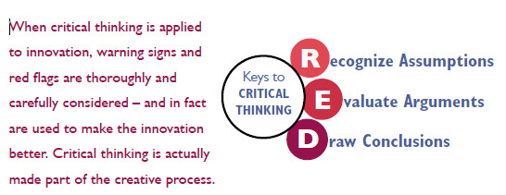
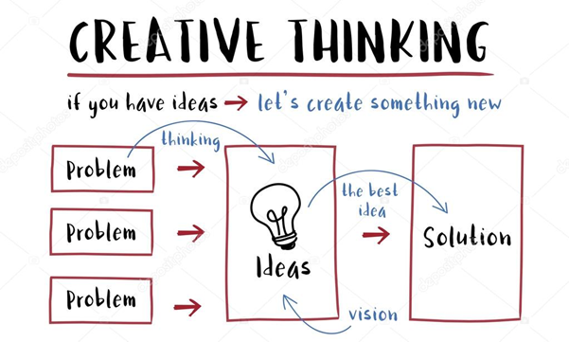
Using Imagination and ideas
Using Logic
and Facts

Slide 12
Creativity involves two processes:
thinking,
then
producing.
Three reasons why people are motivated to be creative:
1.Need for novel, varied, and complex stimulation.
2. Need to communicate ideas and values.
3. Need to solve problems.

Slide 13
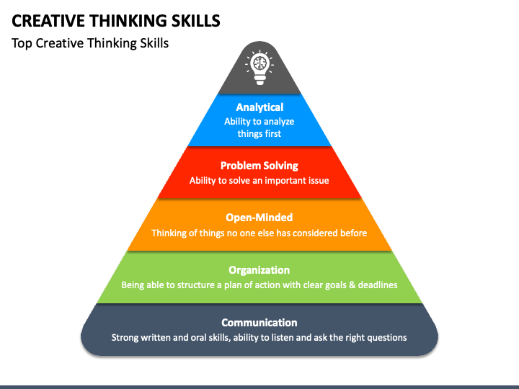

Slide 14
Examples of creativity skills
1
Making connections: you find connections between different ideas and use those connections to solve problems.
2
Asking questions: look for better ways to do that task or revise the procedures to make them more relevant.
3
Making observations: You can discover fresh ways of doing things by paying close attention to how people use products or services can help you see how well they function, and then you can devise ways to improve them.

Slide 15
Examples of creativity skills
4
Networking: Being around people from different backgrounds can expose you to new ideas and inspire creative thinking.
5
Experimenting: a creative person is willing to test it and see if it works. They see failure as an opportunity to learn and improve. To develop this skill, keep working on a problem.

Slide 16
CHARACTERISTICS OF THE CREATIVE PERSONALITY
a. Creative individuals have a great deal of energy, but they are also often quiet and at rest.
b. Creative individuals tend to be smart, yet also naive at the same time.
c. Creative individuals have a combination of playfulness and discipline, or responsibility and irresponsibility.
d. Creative individuals alternate between imagination and fantasy at one end, and rooted sense of reality at the other.
e. Creative individuals are also remarkable humble and proud at the same time.
f. The openness and sensitivity of creative individuals often exposes them to suffering pain yet also a great deal of enjoyment. etc

Slide 17
Importance of creative thinking in the Workplace
Increased employee attraction and retention
Improved teamwork and collaboration
Enhanced productivity and problem-solving

Slide 18
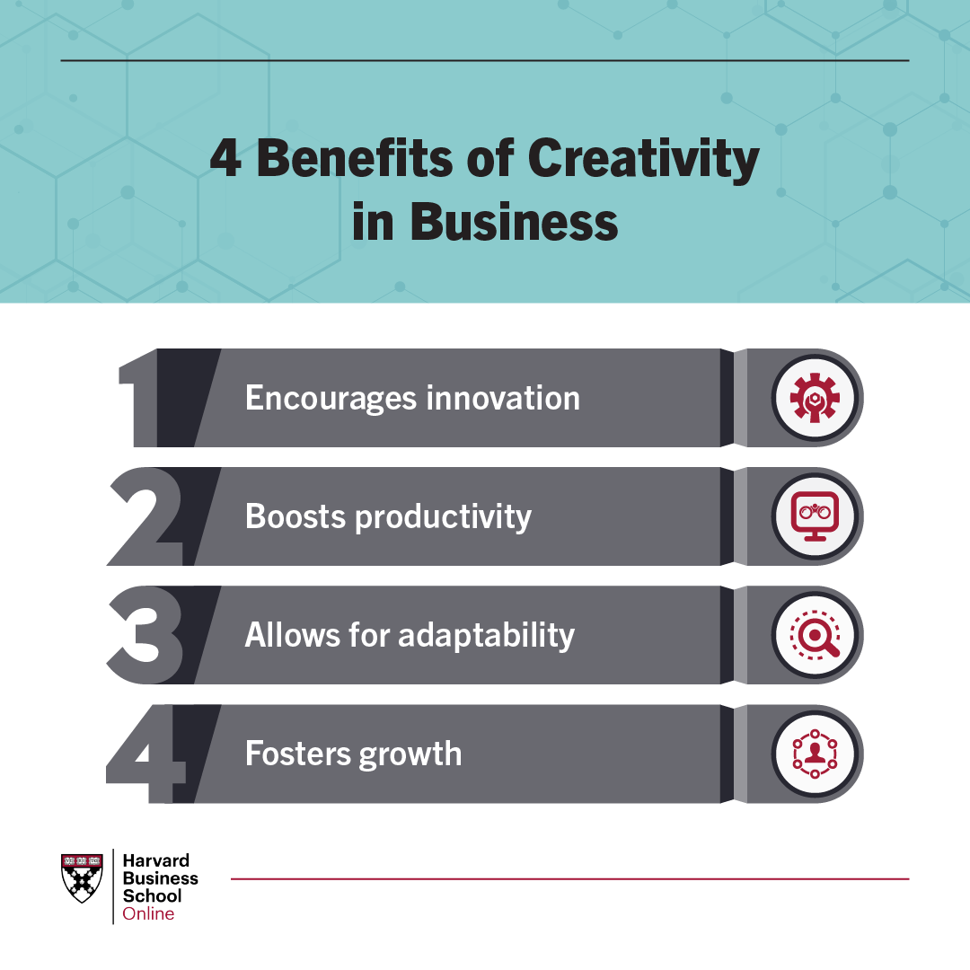

Slide 19
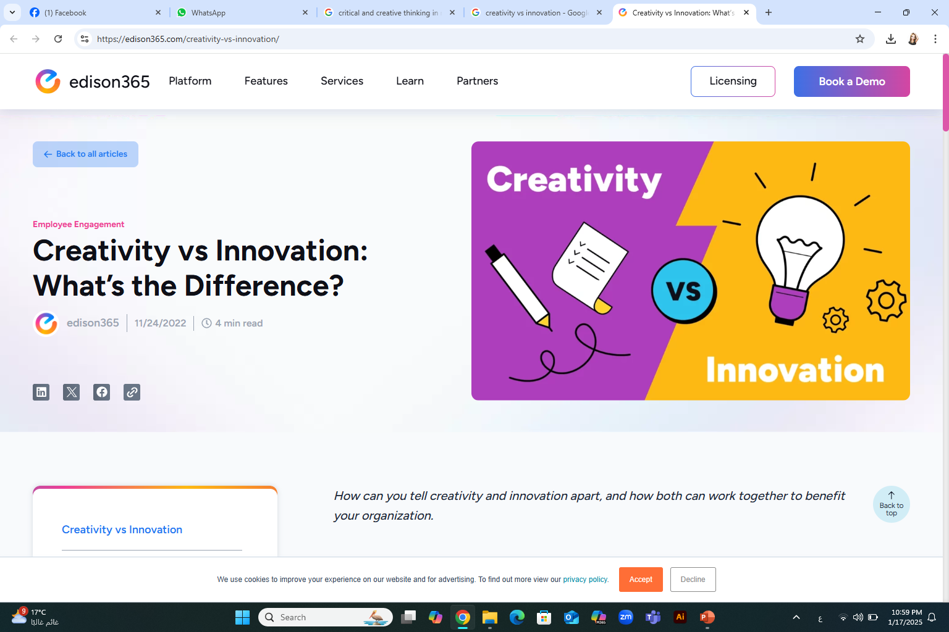
CREATIVITY VS INNOVATION
creativity | innovation.
The quality of thinking new ideas and putting them into reality. | The act of executing the creative ideas into practice
imaginative process | Implementation process
conceive a fresh idea or plan | implies initiating something new to the market, which is not introduced earlier

Slide 20
Creative thinking techniques
Brainstorming
The main goal is to form a group of people and throw around ideas without interference
Lateral thinking
involves looking in less obvious areas and lines of reasoning. It can work well if you and your partners try to put yourselves under different perspectives or reverse the problem to look at it differently.
Mind mapping
helps you connect ideas you never imagined could be combined. Because of that, it might help you reach appropriate solutions while using creative thinking skills.

Slide 21
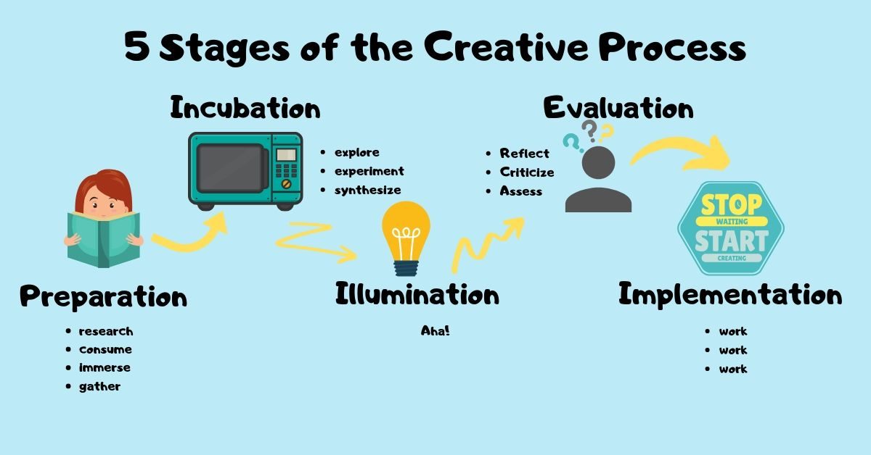
Creativity Process
Stage No.1
Preparation stage: As you begin the creative journey, the first stage involves prep work and idea generation. This is when you gather materials and conduct research that could spark an interesting idea. Brainstorm and let your mind wander, or write in a journal to foster divergent thinking; this will help you consider all possible approaches to building out your idea. In this first part of the process, your brain is using its memory bank to draw on knowledge and past experiences to generate original ideas

Slide 22
Creativity Process
Stage No.2
Incubation stage: When you have finished actively thinking about your idea, the second stage is where you let it go. Part of creative thinking is taking a step away from your idea before you sit down to flesh it out. You might work on another project or take a break from the creative process altogether—regardless, you are not consciously trying to work on your idea. Walking away from your idea might seem counterproductive, but it’s an important stage of the process. During this time, your story or song or problem is incubating in the back of your mind.

Slide 23
Creativity Process
Stage No.3
Illumination stage: Sometimes called the insight stage, illumination is when the “aha” moment happens. The light bulb clicks on as spontaneous new connections are formed and all of that material you’ve gathered comes together to present the solution to your problem. In this third stage, the answer to your creative quest strikes you. For example, you overcome writer’s block by figuring out the ending to your story. It can take you by surprise but after the incubation stage, an idea has emerged.

Slide 24
Creativity Process
Stage No.4
Evaluation stage: During this stage, you consider the validity of your idea and weigh it against alternatives. This is also a time of reflection when you look back at your initial concept or problem to see if your solution aligns with your initial vision. Business professionals might do market research to test the viability of the idea. During this phase, you might go back to the drawing board or you might forge on, confident in what you’ve come up with.

Slide 25
Creativity Process
Stage No.5
Implementation (Verification) stage: This is the final stage of the creative process. It’s when the hard work happens. Your creative product might be a physical object, an advertising campaign, a song, a novel, an architectural design—any item or object that you set out to create, propelled by that initial idea that popped into your head. Now, you finalize your design, bring your idea to life, and share it with the world

Slide 26

Is an analytical skill that many employers look for when reviewing candidate application forms and to solve problems
Problem Solving

Slide 27
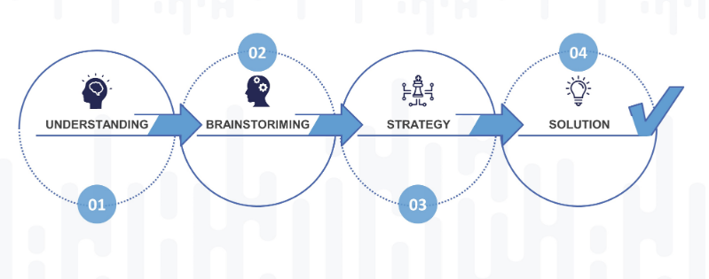
The stages of Problem-Solving
( Processing ) in negotiation situation
Stage No.1
Understanding The Challenge
Define the problem
When you define the problem, you simply get your hands on what’s actually wrong! You can begin by:
take assumptions, data as well as hypothesis into consideration.
Ask the right questions
Gathering of data
Diligent study of the collected data
Scrutiny to filter relevant data
Historical analysis

Slide 28
The stages of Problem-Solving
( Processing ) in negotiation situation
Stage No.2
Generate alternative solutions
it is one of the most effective ways used by leaders around the world. It can be an individual or group activity which is purposed to generate number of solutions and then identifying the best solution as per the challenge, using:
Creative thinking
Brainstorming
Planning a project
Forecasting future trends
Prediction of possible outcomes

Slide 29
The stages of Problem-Solving
( Processing ) in negotiation situation
Stage No.3
Picking The Best Strategy
Evaluate and select an alternative
it Once you’re done scrutinizing the problem and end up with some considerable options to solve it, it’s time for decision making. It is important to consider all the options and then pick the one which can offer a win-win.
Skilled problem solvers use a series of considerations when selecting the best alternative.
  ( Analysis, Discussion, Teamwork, Identifying change in trends, Prioritization)

Slide 30
The stages of Problem-Solving
( Processing ) in negotiation situation
Stage No.4
Deploying The Solution
Implement and follow up on the solution
You must understand that implementing the right solution is the key to increase the productivity of any individual as well as an organization.
Skills you need for implementation:
Project management
Implementation of project strategy
Collaboration & Time management
Developing appropriate quality benchmark
Skills you need for follow up: Data analysis/ Surveys, Feedback/ Close follow-up, Communication

Slide 31
Problem-Solving Tools & techniques
Analysis skills further assist you in identifying the discrepancies and the possible actions which can resolve the issue.
Decision-making The ability to make decisions in hours of need defines your mettle. The onus is on you to be proactive and choose the right course of action.
Dependability Having dependable members boosts the morale of the team. If you are a problem-solver, taking responsibility and taking it on the chin to solve the issues needs to be your forte.
Communication skills can help you garner much-required assistance for the project. Communication of the issues and how you want the project done are critical for the problem-solving process's smooth flow.
Research Problem-solving is not complete without extensive research. It is otherwise impossible to identify the problem without gathering enough data on the errors and their analysis. Consulting with your team gives you an edge to find the solution quicker

Slide 32
The main factors What Affects Problem Solving
Understanding the problem : the bigger picture it sits within, the factors and stakeholders involved, the causes of the problem and any potential solutions. Effective solutions are unlikely to be discovered if the exact problem is not fully understood.
Personality types: it is important to select team members for a project whose personalities skills align with the problem at hand. such as patience, communication, team skills and cognitive skills can all affect an individual’s likelihood of solving a problem. Different individuals will take different approaches to solving problems and experience varying degrees of success. .
Skills/Competencies: Individual’s skills will also affect the problem solving process. For example, a straight-forward technical issue may appear very complicated to an individual from a non-technical background. Skill levels are most commonly determined by experience and training and for this reason it is important to expose newer team members to a wide variety of problems, as well as providing training.
Resources available Although many individuals believe they have the capabilities to solve a certain problem, These resources may be in the form of technology, human capital or finance. For example, a team may come up with a solution for an inefficient transport system by suggesting new vehicles are purchased. Despite the solution solving the problem entirely, it may not fit within the budget. This is why only realistic solutions should be pursued and resources should not be wasted on other projects.
External factors: should also always be taken into account when solving a problem,. Examples include competitor actions, fluctuations in the economy, government restrictions and environmental issues.

Slide 33
Main challenges facing problem solving
1. Misleading Information
When you start solving a problem you should scrutinize on the fact that whether the information you’re receiving is trustworthy and accountable or not. . When you trust on irrelevant data, faulty solutions are produced.
2. Mindset
This is another obstacle which involved people making use of solutions which have worked in the past. When you’re confined to an already proven set of a solution, you make your brain inflexible. Always remember that no two problems have the same solution.
3. CULTURAL DIFFERENCES ACROSS THE ORGANIZATION
4. MULTIPLE GEOGRAPHICAL LOCATIONS OF INDIVIDUALS AND TEAMS
5. HAVING THE TIME TO SOLVE PROBLEMS
6. DIFFERENT PROBLEM-SOLVING METHODS USED ACROSS THE ORGANIZATION

Slide 34
Examples of Problem Solving
Case Study No.1
client was upset about our software pricing.
I apologized for the confusion and then spoke to our billing team to see what type of solution we could come up with. We decided that
The best course of action was to offer a long-term pricing package that would provide a discount. This not only solved the problem but got the customer to agree to a longer-term contract, which means we’ll keep their business for at least one year now, and they’re happy with the pricing.
I feel I got the best possible outcome and the way I chose to solve the problem was effective.
Define
Generate
Idea
Recognize
Make
Decision
Evaluate
Implement

Slide 35
Examples of Problem Solving
Case Study No.2
Define
In my last job, I had to do quite a bit of problem solving related to our shift scheduling. We had four people quit within a week and the department was severely understaffed. I coordinated a ramp-up of our hiring efforts, I got approval from the department head to offer bonuses for overtime work, and then I found eight employees who were willing to do overtime this month. I think the key problem solving skills here were taking initiative, communicating clearly, and reacting quickly to solve this problem before it became an even bigger issue
Generate
Idea
Recognize
Make
Decision
Evaluate
Implement
https://careersidekick.com/problem-solving-examples/

Slide 36
Examples of Problem Solving
Case Study No.3
Amy is a software engineer at a tech startup. She has been with the company for two years and has consistently exceeded her performance targets. She believes that she is due for a salary increase, but her manager, Bob, is hesitant to offer her one.
Amy schedules a meeting with Bob to discuss her salary. During the meeting, Amy presents her case for a salary increase, citing her track record of success and increased responsibilities. Bob acknowledges Amy's contributions, but explains that the company is under financial constraints and cannot offer a salary increase at this time.
Amy and Bob engage in problem-solving negotiation to find a mutually acceptable solution. They explore different possibilities, such as a one-time bonus, stock options, or additional benefits. They also discuss the potential impact of a salary increase on the company's budget and how it could affect other employees.
Define
Generate
Idea
Recognize
Make
Decision
Evaluate
Implement
https://careersidekick.com/problem-solving-examples/

Slide 37
Examples of Problem Solving
Case Study No.3
After discussing various options, they reach a compromise: Amy will receive a one-time bonus that will be equivalent to a 5% increase in her salary. She will also receive additional stock options that will vest over the next two years. In exchange, Amy agrees to delay her next salary review by six months.
Amy and Bob both leave the negotiation feeling satisfied with the outcome. Amy receives recognition for her contributions, and the company is able to manage its budget while retaining a valuable employee.
In this case study, Amy and Bob engaged in problem-solving negotiation by exploring different options and finding a compromise that met both of their needs. They focused on the underlying interests and concerns of each party, rather than taking a positional approach, which helped them to reach a mutually acceptable solution.
Define
Generate
Idea
Recognize
Make
Decision
Evaluate
Implement
https://careersidekick.com/problem-solving-examples/

Slide 38
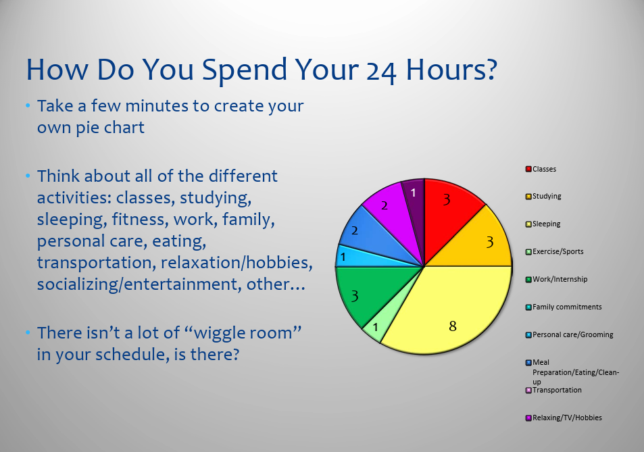
Time Management

Slide 40
TIME IS MONEY
You can make money; you can’t make time.
An inch of gold cannot buy an inch of time (Chinese proverb).
20% of your time will produce 80% of your productive output. Can you afford not to manage at-least that 20% ?
Pareto Principle

Slide 41
the ability to use one's time effectively or productively, especially at work.
is a technique for using your time more effectively. Organize your professional and personal tasks based on how urgent and important they are, and take care of the most urgent and important first, followed by activities that are not urgent but still important
"time management is the key to efficient working"
Time Management

Slide 42

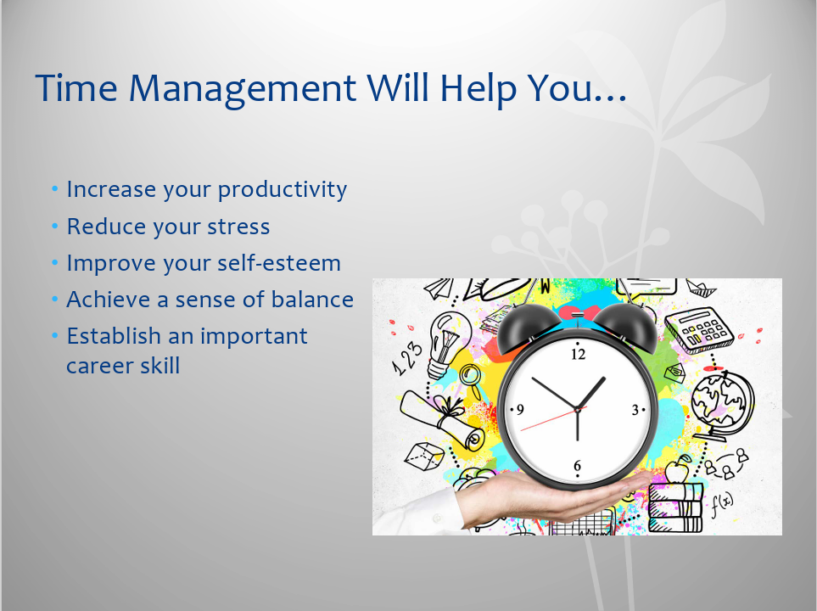
why it is important?
The benefits of good time management include greater productivity, less stress, and more opportunities to do the things that matter.

Slide 43
In order to know what you should be doing with your time, it is important to know what you are working towards
Choose Goals Priorities
Short-term goals
Long-term goals
Long term goals = Life-long goals (usually take a year or more to accomplish)
Short-term goals = Stepping stones (less than a year to accomplish)

Slide 44
The 4 Ds of Time Management
the 4 Ds of productivity
A popular strategy for discerning whether or not a task or project is worth your time. It involves making a quick decision about what to act on now either by doing it yourself or delegating to someone else, what to act on in the future, or what to drop from your to-do list

Slide 45
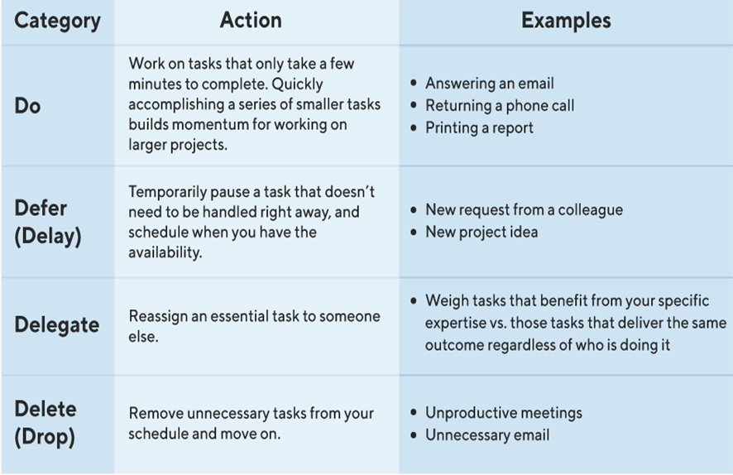
the 4 Ds of productivity

Slide 46
Time-management challenges
How to fix it | Challenge
You might also identify ways your task will help you reach a different, yet related, goal that is important to you | The effort may seem to exceed your energy level on a given day, perhaps, or it might have to do with your enthusiasm level for a specific task. | Low motivation
try concentrating on one objective at a time. You may find that this makes your work more effective and efficient, as well as higher quality | Multitasking involves switching between tasks rapidly, which can overwhelm a person's decision-making processes. And affect work quality | Attempted multitasking
Consider reorganizing your physical space to streamline your workflow and Try keeping a to-do list | Many people also find that messiness can impede their time management and productivity | Lack of organization

Slide 47
Time-management challenges
You might also try to collaborate with a colleague or even refer to a trusted mentor to help decide which tasks are most important for a given period of time. | Different stakeholders may have expectations that differ from your own understanding of how to prioritize tasks at work | Trouble prioritizing
try integrating success measures into your to-do list. | Attention to detail can be a valuable asset in the workplace. When prioritized out of the bounds of moderation | Perfectionism

Slide 48
Case Study
Negotiating a Contract Renewal
John is the CEO of a consulting firm that provides services to a large corporate client. The contract with the client is set to expire in three months, and John wants to negotiate a renewal before the expiration date. He schedules a meeting with the client's procurement manager, Lisa, to discuss the renewal.
During the meeting, John and Lisa discuss the terms of the contract and exchange proposals. However, they quickly realize that they have different priorities and are not making progress in their negotiation. Lisa suggests that they schedule a follow-up meeting to continue the discussion.

Slide 49
Case Study
John recognizes the importance of time management in negotiation and suggests a more efficient approach. He proposes that they schedule a longer meeting the following week, during which they will work intensively to reach an agreement. He suggests that they both prepare thoroughly for the meeting by reviewing their priorities and identifying areas of flexibility.
Lisa agrees to the proposal, and they schedule a four-hour meeting for the following week. Prior to the meeting, John and his team conduct a thorough review of the client's needs and priorities, and they identify areas where they can be flexible in their proposals. They also prepare a clear set of objectives and a timeline for the negotiation.

Slide 50
Case Study
During the meeting, they use their time efficiently by focusing on the key priorities and finding areas of agreement. They also use creative problem-solving techniques to find solutions to areas of disagreement. By the end of the meeting, they have reached a mutually beneficial agreement that satisfies both parties.
John's effective time management skills allowed him to negotiate a successful contract renewal with his client. By recognizing the importance of efficient use of time in negotiation, he was able to propose a more effective approach that enabled them to reach an agreement quickly and efficiently. His team's thorough preparation and clear objectives also helped to ensure that the negotiation was productive and successful.

Slide 51
“Make sure you know where your time goes.”
Peter Drucker

Slide 52



Thank You

