Slide 1




Fundamentals of
Risk Management
Lecture 5
PMG510
Prepared by
Dr. Usama Al-Fendi

Slide 2

Lecture 5
Lecture Outlines
Application of a risk matrix
Inherent and current level of risk
Control confidence
4T’s of risk response
Risk capacity
Risk likelihood
Risk Magnitude
Loss prevention, Limit damage, and cost containment

Slide 3
Lecture 5
Risk analysis and evaluation
Application of a risk matrix:
Large organizations frequently make use of a risk matrix as a means of summarizing their risk profile.
The risk matrix is very useful and can be used for a range of applications
It can also be used to identify the type of risk response that is most likely to be employed.

Slide 4
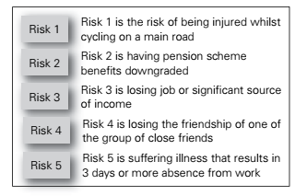
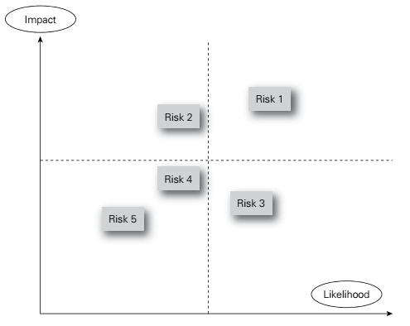
Lecture 5
Risk analysis and evaluation
Application of a risk matrix:

Slide 5
Lecture 5
Risk analysis and evaluation
Application of a risk matrix:
Impact is not the same as magnitude, because a risk may have a high magnitude in terms of the size of the event, but the impact and consequences may be smaller.
Example, a road transport company may suffer the complete loss of one of its vehicles but, depending on the exact circumstances, this may have a very small overall impact on the business. This will be especially true if the company did not have sufficient work to fully utilize the type of vehicle involved in the loss.

Slide 6
Lecture 5
Risk analysis and evaluation
Inherent and current level of risk:
Many risk management practitioners assess risk at its current (also referred to as residual) level. However, internal auditors prefer to undertake an assessment of the risk at its inherent level.
Considering the inherent level will enable the effect of individual control measures to be identified.
NEXT Figure illustrates the effect of controls on the level of risk.

Slide 7
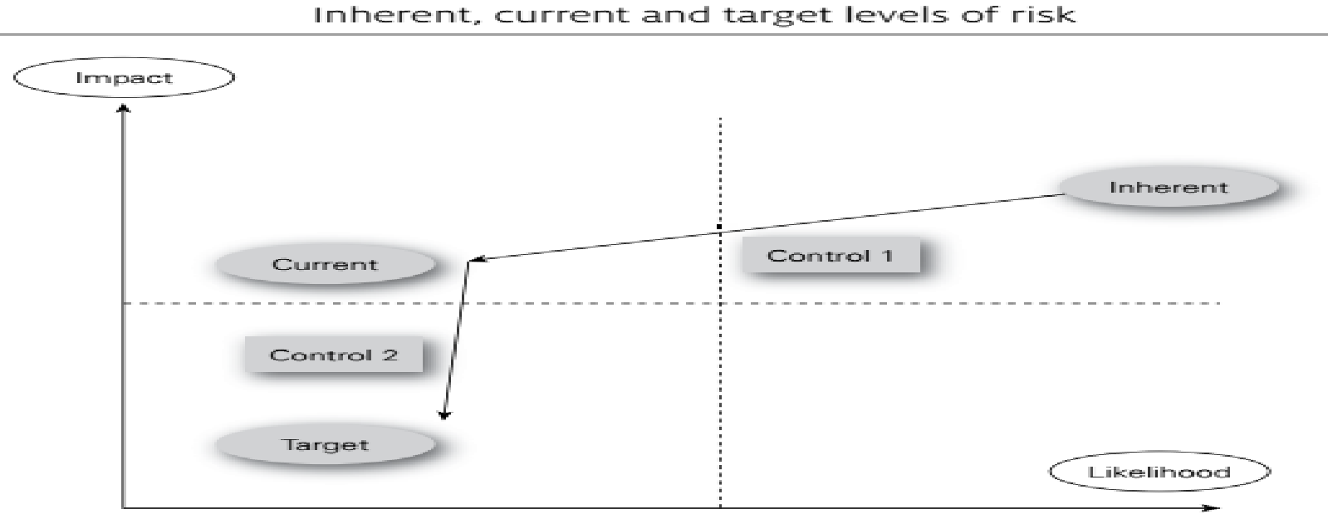
Lecture 5
Risk analysis and evaluation
Inherent and current level of risk:

Slide 8
Lecture 5
Risk analysis and evaluation
Inherent and current level of risk:
Control 1 is an existing control and it reduces the risk from the inherent level to the current (or residual) level and it can be seen that this control has its main effect on the likelihood of the risk materializing.
Control 2 is an additional control that will be introduced to affect the impact oftherisk and to reduce the risk from the current level to the target level.

Slide 9
Lecture 5
Risk analysis and evaluation
Inherent and current level of risk:
When seeking to establish the target level of risk, a concept that is often used by health and safety practitioners is seeking to reduce the risk to the level that is ‘as low as reasonably practicable’ (ALARP).
ALARP is one of the fundamental principles of risk management for health and safety risks.
It is not necessary to manage risk to the point where it is eliminated, but to the point where the cost of additional controls would exceed the benefits.

Slide 10
Lecture 5
Risk analysis and evaluation
Inherent and current level of risk:
As Low As Reasonably Practicable (ALARP)
The requirement for risks to be ALARP is fundamental and in simple terms it is a requirement to take all measures to reduce risk where doing so is reasonable.
In most cases this is not done through an explicit comparison of costs and benefits, but rather by applying established relevant good practice and standards.
The development of relevant good practice and standards includes ALARP considerations, so in many cases meeting those standards is sufficient.
In other cases, either where standards and relevant good practice are less evident, or not fully applicable, measures must be implemented to the point where the costs of any additional measures (in terms of money, time or trouble) would be grossly disproportionate to the further risk reduction (or safety benefit) that would be achieved

Slide 11
Lecture 5
Risk analysis and evaluation
Control confidence:
It is not possible for an organization to be absolutely confident that controls will always be fully implemented and will be as effective as expected or required.
Controls will need to be audited in order to allow confidence that the control selected has been properly designed and implemented and is producing the desired effect.

Slide 12
Lecture 5
Risk analysis and evaluation
Control confidence:
If the effectiveness of a control is uncertain, a greater variability of the outcome may be expected.
It is the responsibility of internal auditors to check that the correct controls have been selected and that they are working correctly in practice.

Slide 13
Lecture 5
Risk analysis and evaluation
4T’s of hazard risk response:
Tolerate will be the dominant response for the low-likelihood/low-impact risks.
Treat will be the dominant response for high-likelihood/low-impact risks.
Transfer will be the dominant response for high-impact/low-likelihood risks.
Terminate will be the dominant response for high-impact/high-likelihood risks.

Slide 14
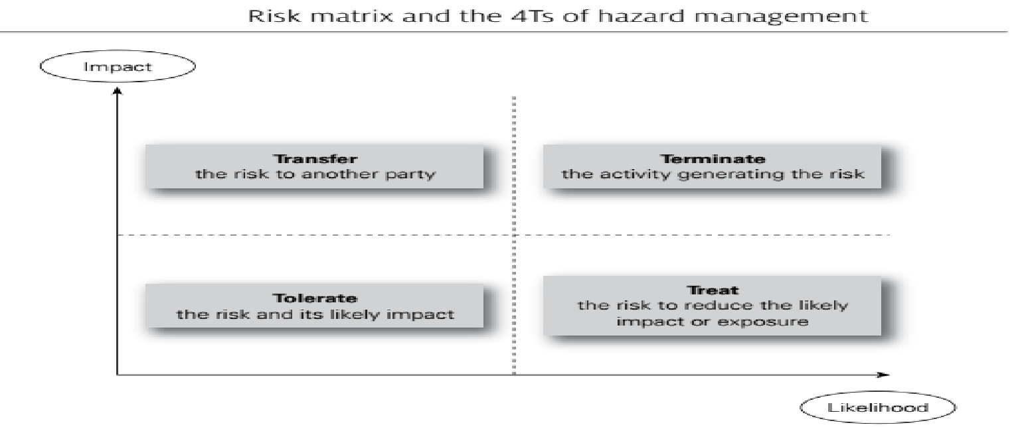
Lecture 5
Risk analysis and evaluation
4T’s of hazard risk response:

Slide 15
Lecture 5
Risk analysis and evaluation
4T’s of hazard risk response:
Assessment of each of the risks will enable the organization to place the risk on a risk matrix.
The position of the risk on the risk matrix will then indicate the most likely response to that risk.
If the risk assessment is undertaken at the current level of risk, the effect of the existing controls will already have been evaluated as part of the risk assessment exercise.

Slide 16
Lecture 5
Risk analysis and evaluation
4T’s of hazard risk response:
Example:
Consider the case of a theatre that needs to respond to the increasing use of agents who require payment at the time of the booking, rather than after the performance.
Also, a recent failure of an actor to arrive on the night of the performance caused the theatre considerable financial loss.
This has resulted in the theatre reviewing the booking and appearance arrangements for actors and deciding responses that are appropriate in relation to all 4Ts.

Slide 17
Lecture 5
Risk analysis and evaluation
4T’s of hazard risk response:
Example :
The theatre might decide that it has to tolerate the new booking fee arrangements.
It has also decided that in order to treat/reduce the risk, it will only deal with established agents in future and terminate existing arrangements with an agency that has proved unreliable in the past.
The theatre might also investigate the possibility of buying insurance, so that the theatre can transfer the cost of a performance cancelled because the actor fails to arrive on the night.

Slide 18
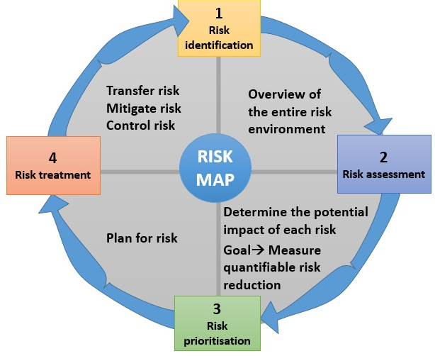
Lecture 5
Risk analysis and evaluation

Slide 19
Lecture 5
Risk analysis and evaluation
Likelihood Rating Scale
Rating System | Criteria
6: Almost Certain/ Frequent | Happens on a regular basis – at least once a week
5: Likely | Likely to happen once or twice in the next month
4: Possible/ Probable | Likely to happen once or twice in the next three months
3: Occasional | Likely to happen once or twice in the next year
2: Remote | Likely to happen once or twice in the next 3 years
1: Rare/ Incredible | Unlikely to happen in the next 5 Years

Slide 20
Lecture 5
Risk analysis and evaluation
Impact Rating Scale
Rating System | Definition | Criteria
6: Catastrophic | Potential or actual loss in excess of USD 2 MM Requires immediate action to resolve (usually completed within 3 months) Monthly status report to CORC until resolved | Serious impact on the business or country Serious operations risk or corporate governance breach Critical control weaknesses Serious regulatory implications (e.g. revocation of banking license, imprisonment) High possibility of reputational risk Country manager will have been immediately informed of the issues Potential or actual implications of share price
5: Major | Potential or actual loss greater than USD1 Million but less than USD 2 Million Requires immediate action to resolve (usually completed within 3 months) Monthly status report to CORC until resolved | Major impact on the business or country Major operations risk or corporate governance breach Major control weaknesses Serious regulatory implications (e.g. revocation of banking license, imprisonment) High possibility of reputational risk Country manager will have been immediately informed of the issues Potential or actual implications of share price
4: Substantial | Potential or actual loss greater than USD500,000 but less than USD 1 Million Requires action to resolve (usually completed within 6 months) | Substantial impact on the business or country Substantial operations risk or corporate governance breach Unacceptable exposure to control weaknesses medium reputational risk Recurring issues that were previously rated 1 or 2 Likelihood of serious regulatory sanctions.

Slide 21
Lecture 5
Risk analysis and evaluation
Impact Rating Scale
Rating System | Definition | Criteria
3: Significant | Potential or actual loss greater than USD100,000 but less than USD500,000 Requires action to resolve (usually completed within 6 months) | Significant impact on the business or country Significant operations risk or corporate governance breach Unacceptable exposure to control weaknesses medium reputational risk Recurring issues that were previously rated 1 or 2 Possibility of fines/penalties by regulators Medium financial losses with some potential for recovery Customer service issues requiring management's intervention
2: Moderate | Potential or actual loss greater than USD25,000 but less than USD100,000 Actions not time critical | Moderate impact on the business or country Watch list issues Control weaknesses identified which could escalate if not brought under control Moderate reputational risk Resolution of issues usually at a business level Exposure to regulatory sanctions low Exposures low and hence acceptable as part of doing business Customer service issues are within expected levels Limited vulnerability to financial loss or reputation
1: Minor | Potential or actual loss less than USD25,000 Actions not time critical | Minor impact on the business or country Watch list issues Control weaknesses identified, which could escalate if not brought under control Low reputational risk Resolution of issues usually at a business level

Slide 22
Lecture 5
Risk analysis and evaluation
Rating System | Criteria For the Level of Risk
Extreme Risk | The risk cannot be justified under any circumstances. Where the impact of a risk is considered to be catastrophic then the objective should be to achieve a probability of rare. All catastrophic risks will be submitted to the Bank Executives for review and acceptance
High Risk | Further risk reduction may be impractical, but the opportunities and the benefits of the proposed activity outweigh the risks. A residual high risk score will require additional controls to be implemented unless the level of residual risk is approved and accepted at executive level;
Medium Risk | This risk level may be managed through innovative approaches that go beyond the common measures. A medium residual risk score requires additional controls to be implemented unless subject to Executive agreement and acceptance
Low Risk | The risk is acceptable giving that current risk treatments continue, and no other risk controls can be added to reduce risk to acceptable level. A low residual risk score is considered acceptable to the Bank and will require no further action or treatment other than to ensure the relevant controls are operating effectively. Management should review the controls for low risk areas carefully to ensure there is not over control

Slide 23
Lecture 5
Risk analysis and evaluation
LIKELIHOOD | LEVEL OF RISK - RISK SCORE
6 | H | E | E | E | E | E
5 | M | H | E | E | E | E
4 | M | M | H | H | E | E
3 | L | M | M | H | H | E
2 | L | L | M | M | H | H
1 | L | L | L | M | M | H
 | 1 | 2 | 3 | 4 | 5 | 6
 | IMPACT

Slide 24
Lecture 5
Risk analysis and evaluation
Risk capacity:
Overall, the organization will have a total risk exposure. This is the sum of the total risk that the organization has taken in these three categories.
There will also be compliance risks, but most organizations seek to minimize compliance risks and have the necessary compliance controls embedded into core processes.

Slide 25
Lecture 5
Risk analysis and evaluation
Risk capacity:
Risk exposure is the actual risk that the organization is taking and this may not be the same as the risk appetite that the board believes is appropriate for the organization.
There is also another important measure of risk, and that is the risk capacity of the organization. This is a measure of how much risk the organization should take or can afford to take.
All of these ways of analyzing risk should be compatible with the attitude of the organization to risk.

Slide 26
Lecture 5
Risk analysis and evaluation
Risk capacity:
The risk appetite of the board should be within the risk capacity of the organization and greater than or equal to the actual risk exposure that the organization faces.
Example: A contributing factor to the global financial crisis was that certain financial institutions were exposed to a level of risk beyond the risk-bearing capacity of those organizations.

Slide 27
Lecture 5
Risk analysis and evaluation
Risk capacity:
It would be inappropriate for an organization to embark on a project that could exhaust all of its resources.
The capacity of the organization to accept risk will depend on its financial strength, the robustness of its infrastructure, the strength of its reputation and brands and the competitive nature of the marketplace in which it operates.
The more rapidly the marketplace is changing, the greater capacity for risk the organization is required to have available.

Slide 28
Lecture 5
Risk analysis and evaluation
Risk capacity:
Example,
If an organization is facing a significant change in technology, the strategic options may be limited. Consider an organization that is involved in the manufacture of DVD players when it becomes obvious that streaming technology is taking over.
The organization will be faced with a significant risk related to the change in technology and will need to develop a new business model.
It will have to acquire new production equipment, new skills and new distribution patterns. It may be that the transfer to the new technology and the risks that it involves are outside the resources and risk capacity of the organization.

Slide 29
Lecture 5
Risk analysis and evaluation
Risk capacity:
Risk Capacity of a bank
Risk capacity is the level of risk the bank considers itself capable of absorbing, based on its earnings power, without damage to its dividend paying ability, its strategic plans and, ultimately, its reputation and ongoing business viability. It is based on a combination of budgeted, forecast and historical revenues and costs, adjusted for variable compensation, dividends and related taxes.
Risk exposure is an estimate of potential loss based on current and prospective risk positions across major risk categories – primary risks, operational risk and business risk.
It builds as far as possible on the statistical loss measures used in the day-to-day operating controls. Correlations are taken into account when aggregating potential losses from risk positions in various risk categories to obtain an overall estimate of the risk exposure.

Slide 30
Lecture 5
Risk analysis and evaluation
Risk capacity:
Risk Capacity of a bank
The bank recorded a large net loss, showing that the risk exposures remained greater than its risk capacity.
Risk exposure remained high as a result of a lack of liquidity in the markets for securitized assets and due to significantly increased volatility levels in global markets.
The reduction in risk exposure that was achieved through sales in addition to the significant write-downs incurred on risk positions was offset by a simultaneous decrease of risk capacity due to downward revisions of earnings expectations as a consequence of the deteriorating economic outlook

Slide 31
Lecture 5
Loss control
Risk likelihood:
For risk in general, previous history may be a good indication of how likely the risk is to occur.
For a fleet of motor vehicles, there is certain to be a history of vehicle accidents and breakdowns.
Controls will be in place to reduce the likelihood of these events.

Slide 32
Lecture 5
Loss control
Risk likelihood:
A road haulage company should assess the likelihood of vehicle breakdowns on an inherent basis and also on the basis of current controls.
There are, however, difficulties in assessing the inherent likelihood of vehicle accidents, because certain assumptions would have to be taken about what effect the removal of controls would have on the likelihood of accidents.
For risks, previous history may be a good indication of how likely the risk is to occur.

Slide 33
Lecture 5
Loss control
Risk likelihood:
Example of a control measure that has an effect on the magnitude of the risk but may have no effect on its likelihood is the use of seat belts in cars.
In simple terms, the driver wears a seat belt to reduce the impact of an accident, because the seat belt has no effect on the likelihood of an accident occurring.
The driver wears the seat belt as a control measure for when the accident happens.

Slide 34
Lecture 5
Loss control
Risk Magnitude:
Reducing the magnitude of a risk is very important. For risks, magnitude is often referred to as the inherent severity of the risk should it materialize.
Reduction in overall risk severity will be achieved by reducing both the impact and consequences when the adverse event occurs.
The seat belt in a car can reduce the impact of an accident, but has no effect on the likelihood of having an accident.

Slide 35
Lecture 5
Loss control
Risk Magnitude:
In many cases, it is likely that inadequate attention was paid to pre-incident planning, so that the damage of the organization was not effectively minimized at the time the incident occurred.
Organizations will also need to be concerned with cost containment.

Slide 36
Lecture 5
Loss control
Risk Magnitude:
Cost containment following an event is usually based on the business continuity plan (BCP) or disaster recovery plan (DRP) that the organization put in place before the incident occurred.
The development of effective BCP and DRP will put the organization in the best position to ensure that the overall cost of the incident is kept as low as possible.

Slide 37
Lecture 5
Loss control
Risk Magnitude:
Control of fires in hotels
Given the long emphasis on fire peril, perhaps it’s not surprising that improvements in sprinkler systems have been a hallmark of the past 40 years. The single most impressive innovation as it relates to fire has been the advent of the suppression mode sprinkler.
Standard sprinklers were control mode sprinklers, which controlled the fire until someone arrived to put it out. The fire could grow and produce a lot of smoke.
As hotel fittings became more susceptible to smoke and water damage, the desire was to suppress the fire, not just control it. The new sprinklers resulted in smaller areas being affected by fire with less smoke and less damage.

Slide 38
Lecture 5
Loss control
Risk Magnitude:
Control of fires in hotels
Sprinkler technology has evolved significantly. Where we had a single standard spray sprinkler head, we now have extra-large orifice heads and early-suppression, fast-response sprinkler heads.
The use of sprinkler systems has also spread from more traditional manufacturing facilities into light-hazard exposures such as offices and nursing homes.
Corporations became more deeply involved in loss control efforts. For example, hotels carried out two initiatives in the early 1980s using controlled fires to prove the efficacy of plastic piping in hotel room sprinkler systems.
Before the successful tests, sprinklers relied on iron piping, which was more difficult to install than plastic and which took rooms out of service for days during a re-fit.

Slide 39
Lecture 5
Loss control
Hazard risks:
The range of hazard risks where reducing the magnitude of the adverse event is important will include fraud, health and safety, property protection and efficient operation of IT systems, as well as incidents with the potential to cause damage to reputation.
Although the main focus of managing hazard risks will be on loss prevention, successful management of hazard risks must also include consideration of damage limitation and cost containment.

Slide 40
Lecture 5
Loss control
Loss prevention, Limit damage, and cost containment:
There is a developing trend in the insurance market towards settling claims in a more efficient and cost-effective manner.
This trend is partly based on encouraging organizations to get back to normal operation as soon as possible. Indeed, some insurance companies refer to initiatives of this type as ‘cost containment’.
The next Figure shows how a bow-tie can be used to illustrate the three components of loss control.

Slide 41
Lecture 5
Loss control
Loss prevention, Limit damage, and cost containment:
Before the event occurs, the organization will have controls in place to seek to achieve loss prevention.
As the event is developing, steps should be in place to limit the damage that the event is causing.
After the event, cost containment controls by way of business continuity and arrangements to reduce the cost of repair should be activated.
Disaster recovery plans will be relevant during both the damage limitation and the cost containment stages.

Slide 42
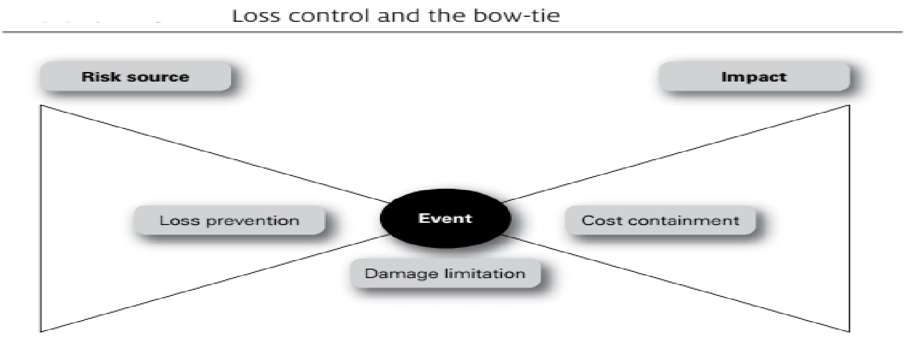
Lecture 5
Loss control
Loss prevention, Limit damage, and cost containment:

Slide 43
Lecture 5
Loss control
Loss prevention, Limit damage, and cost containment:
1- Another way of looking at loss control activities is that loss prevention is about reducing the likelihood of an adverse event occurring, although it will also be concerned with reducing the magnitude of an event that does occur.
2- Damage limitation is concerned with reducing the magnitude of the event when it does materialize. The contribution of damage limitation will be greatest if actions are planned that can be implemented as the event is actually taking place.

Slide 44
Lecture 5
Loss control
Loss prevention, Limit damage, and cost containment:
3- Cost containment is concerned with reducing the impact and consequences of the event.
Cost containment will be concerned with ensuring the lowest cost of repairs, as well as business continuity plans to ensure that the organization can continue operations following damage to the asset that has been affected.

Slide 45
Lecture 5
Loss control
Loss prevention, Limit damage, and cost containment:
Product recall risk management:
Any company or organization that manufactures, assembles, processes, wholesales or retails products could be financially impacted by the direct or indirect costs of a product recall.
Direct costs can include wages for staff who have to implement the recall plan. Other direct costs include communications and this could entail purchasing air time on radio and television and notices in newspapers or industry publications.

Slide 46
Lecture 5
Loss control
Loss prevention, Limit damage, and cost containment:
Product recall risk management:
Indirect costs can include lost production time for staff who must focus on the recall process, as well as the hiring of temporary employees to ensure continued production.
However, the greatest indirect cost is the impact that adverse publicity could have on market share. A product recall should be designed to:
protect the customer from bodily injury or property damage;
remove the product from the market and from production;
comply with specific regulatory requirements;
protect the assets of the company

Slide 47
Lecture 5
Conclusion

Slide 48


Thank You

