Slide 1


Storage Technologies
IT403
Prepared by
Dr. Ahmed El-Douh
Lecture 10

Slide 2



Storage Technologies
Lecture 10
IT403
Modern Data Center
Prepared by
Dr. Ahmed El-Douh

Slide 3
Foreword
This module mainly introduces the development history of Data Centers, and the basic modules and components of Data Centers. This module also introduces the evolution and trends of Cloud Data Centers.
www.midocean.ae

Slide 4
Objectives
Upon completion of this module, you will be able to:
  Understand the history of Data Centers.
  Familiar with the basic components and modules of the Data Center.
  Understand the evolution and current trends of cloud Data Centers.
www.midocean.ae

Slide 5
Chapter
Outlines
10
History of Data Centers.
Basic Components and Modules of Data Centers.
Data Center Architecture
Challenges of Cloud Data Centers and its Development Trends.
Innovation Data Center
Cloud Data Center Development Trend
www.midocean.ae

Slide 6


Chapter
10
History of Data Centers
www.midocean.ae

Slide 7
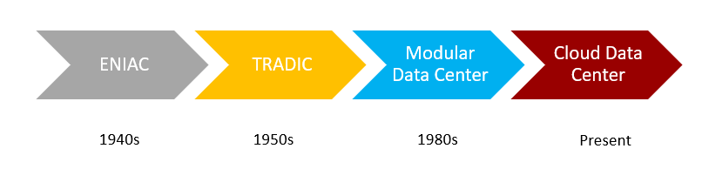
Evolution of Data Centers
www.midocean.ae

Slide 8
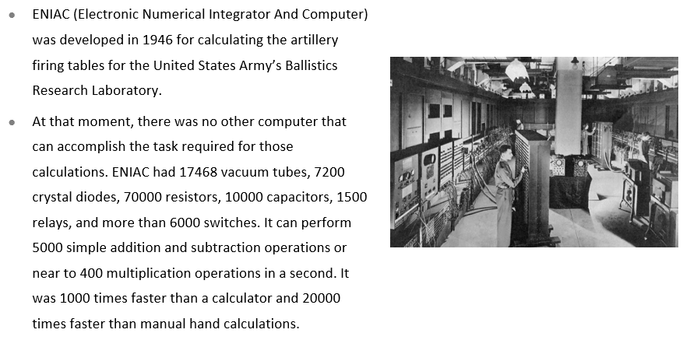
Earliest Development of Data Centers - ENIAC
www.midocean.ae

Slide 9
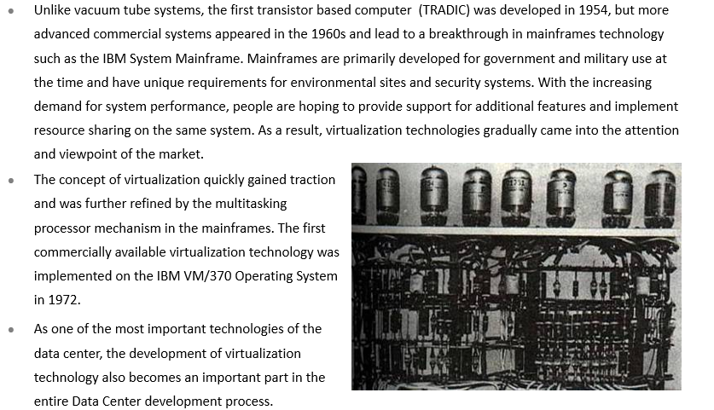
Commercialization of Virtualization Technologies in
Data Centers - TRADIC
www.midocean.ae

Slide 10
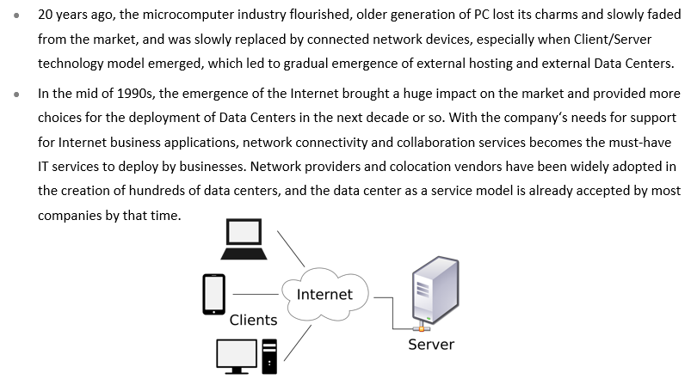
C/S Architecture Computing Model and the Internet
www.midocean.ae

Slide 11
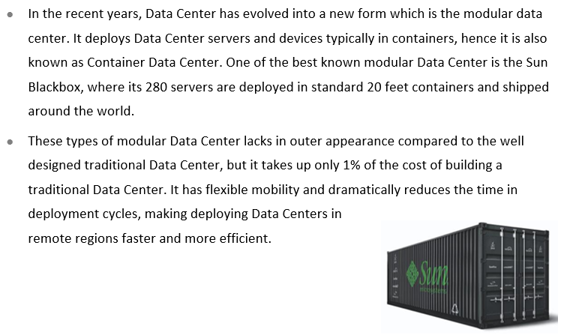
Emergence of Modular Data Centers
www.midocean.ae

Slide 12
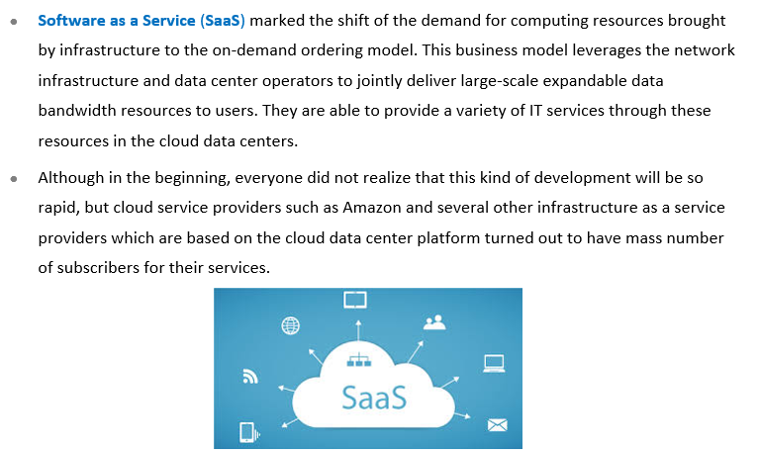
Cloud Data Centers
www.midocean.ae

Slide 13
Chapter
Basic Components and Modules
of Data Centers
10
www.midocean.ae

Slide 14
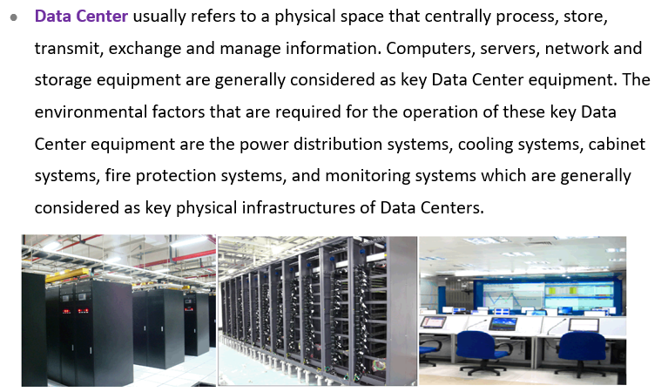
What is a Data Center ?
www.midocean.ae

Slide 15
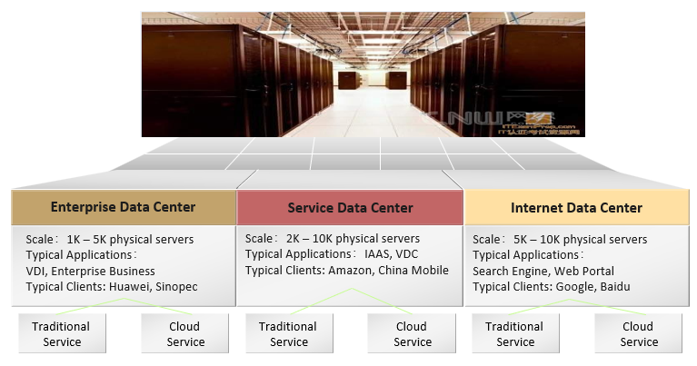
Types of Data Center
www.midocean.ae

Slide 16
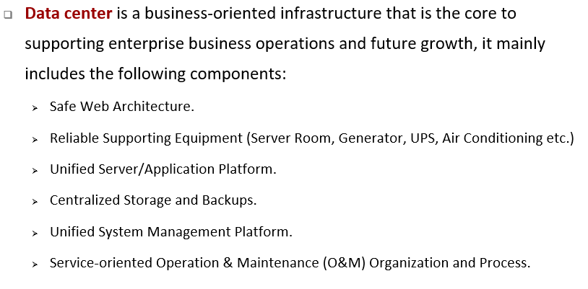
Components of Data Center
www.midocean.ae

Slide 17
Chapter
10
Data Center Architecture
www.midocean.ae

Slide 18
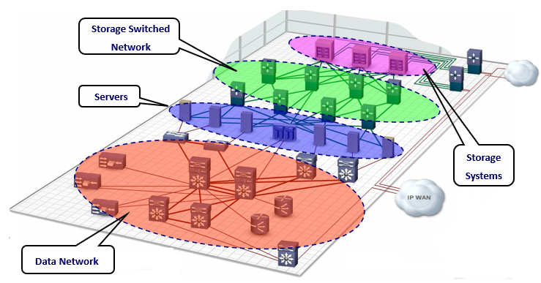
Standard Data Center Architecture
www.midocean.ae

Slide 19
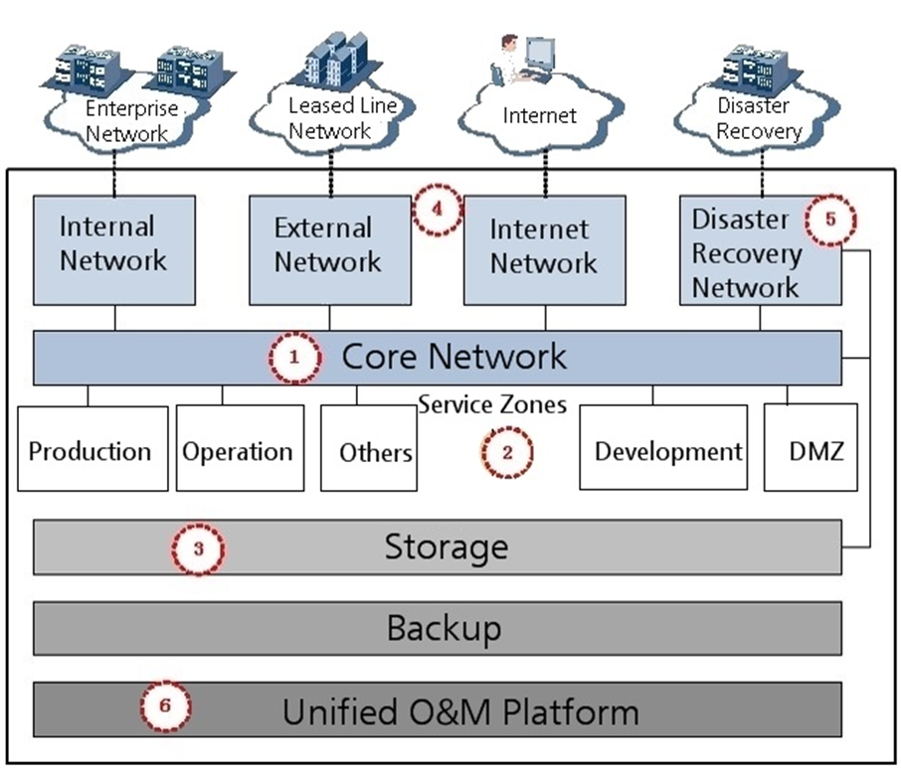
Logical Architecture of Data Centers
www.midocean.ae

Slide 20
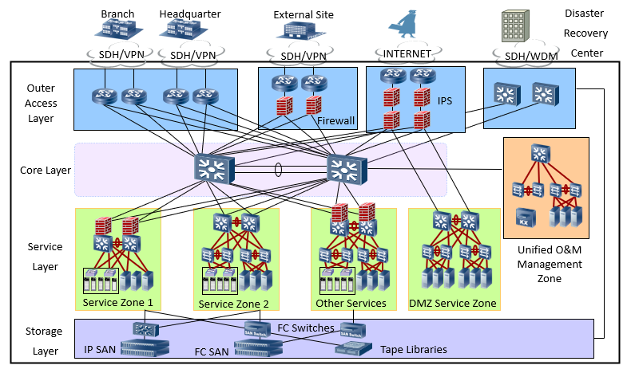
Physical Architecture of the Data Center
www.midocean.ae

Slide 21
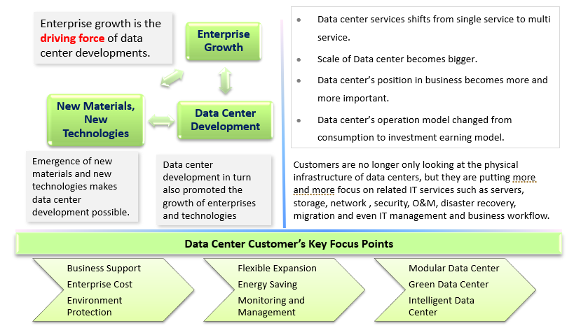
Data Center Infrastructure Development Trends
www.midocean.ae

Slide 22
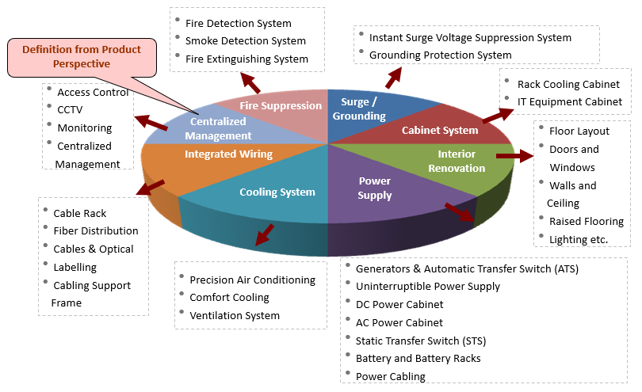
Components of Data Center Infrastructure
www.midocean.ae

Slide 23
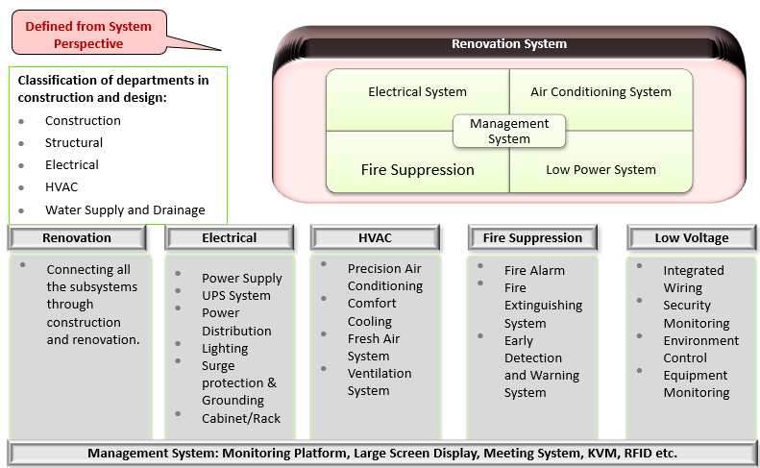
Classification of Data Center Infrastructure
www.midocean.ae

Slide 24
Chapter
Challenges of Cloud Data Centers and
its Development Trends
10
www.midocean.ae

Slide 25
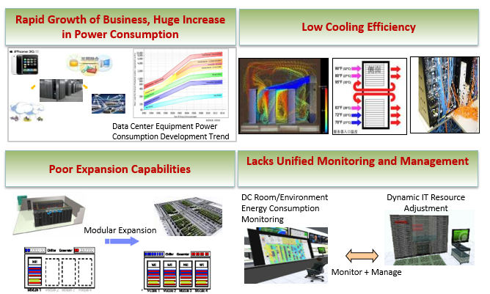
Challenges of Traditional Data Center
www.midocean.ae

Slide 26
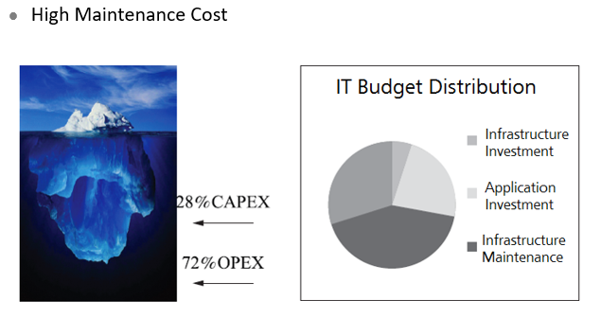
Challenges of Traditional Data Center - Maintenance Cost
www.midocean.ae

Slide 27
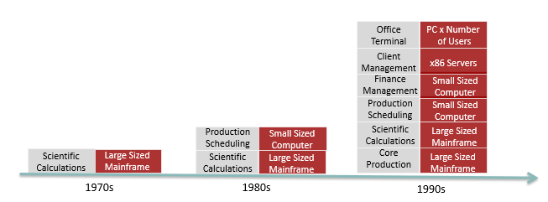
Challenges of Traditional Data Center - Increase in Services and Equipment (1)
www.midocean.ae

Slide 28
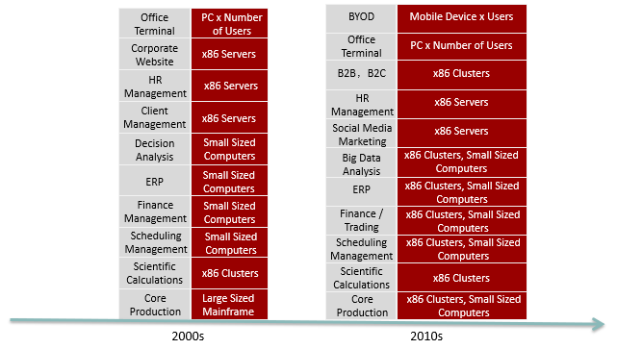
Challenges of Traditional Data Center - Increase
in Services and Equipment (2)
www.midocean.ae

Slide 29
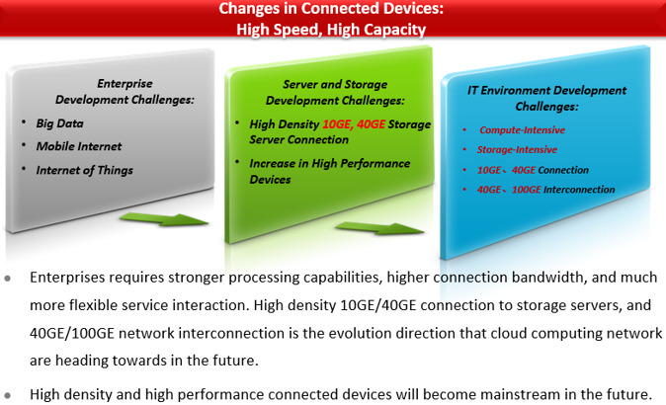
Challenges of Traditional Data Center – Increase
in Data Traffic (1)
www.midocean.ae

Slide 30
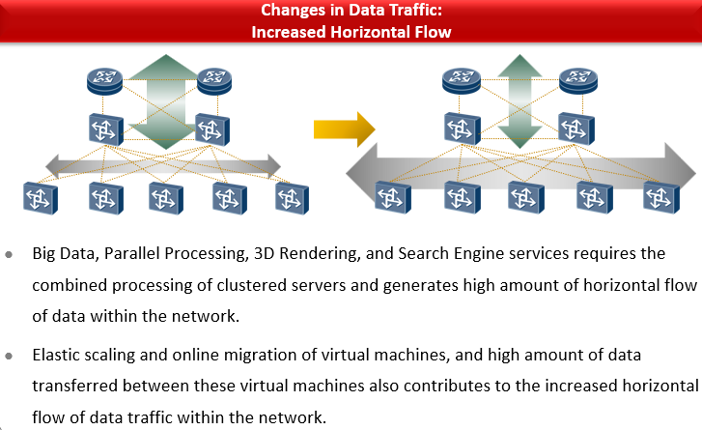
Challenges of Traditional Data Center – Increase
in Data Traffic (2)
www.midocean.ae

Slide 31
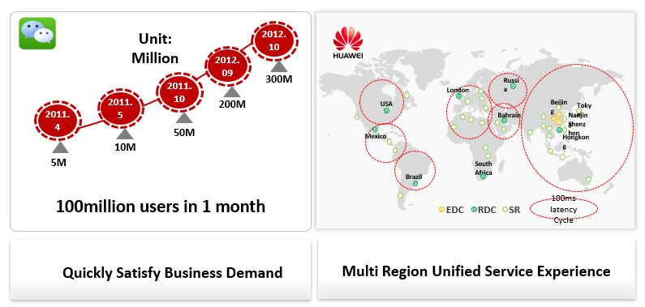
Challenges of Traditional Data Center - Business
Driven Growth
www.midocean.ae

Slide 32
Chapter
10
Innovation Data Center
www.midocean.ae

Slide 33
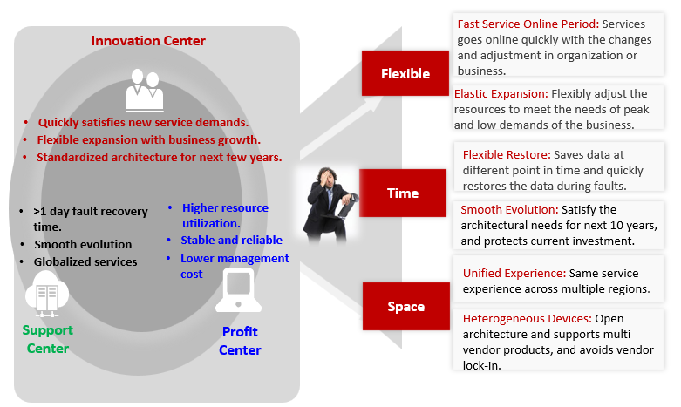
What Kind of Data Center is Needed by Enterprises ?
www.midocean.ae

Slide 34
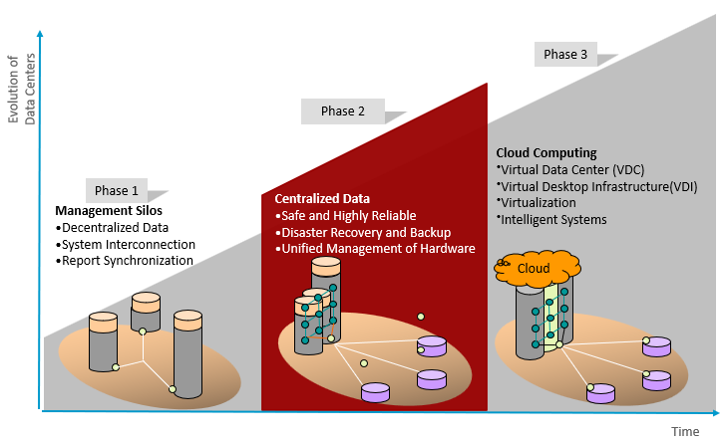
Data Center Development Stages
www.midocean.ae

Slide 35
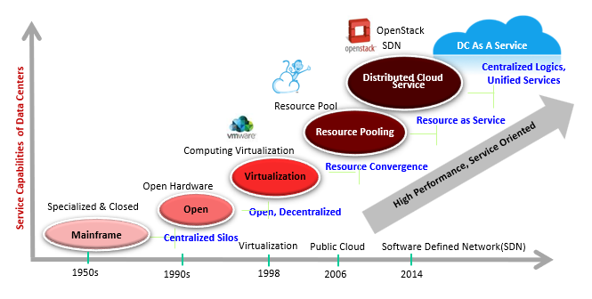
Service Oriented Cloud Data Center
www.midocean.ae

Slide 36
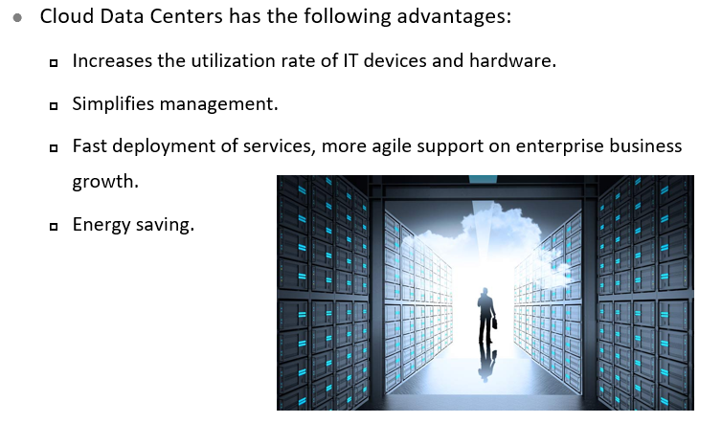
Unique Features of Cloud Data Centers
www.midocean.ae

Slide 37
Chapter
10
Cloud Data Center Development Trend
www.midocean.ae

Slide 38
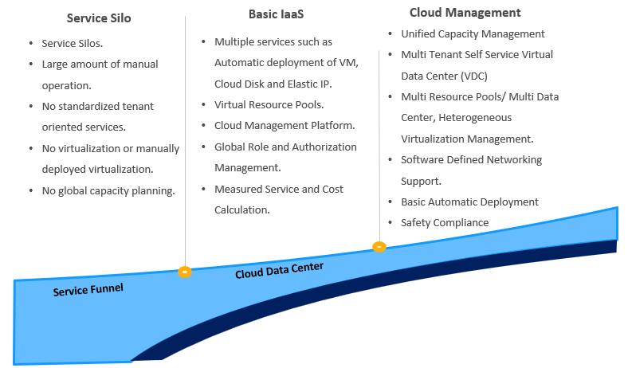
Cloud Data Center Development Trend (1)
www.midocean.ae

Slide 39
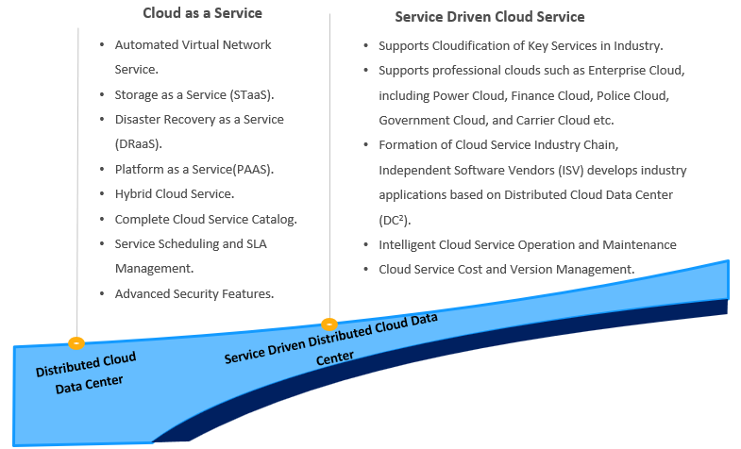
Cloud Data Center Development Trend (2)
www.midocean.ae

Slide 40



Thank You

