Slide 1


Slide 2
Outlines
Introduction, or what is knowledge?
Rules as a knowledge representation technique
The main players in the development team
Structure of a rule-based expert system

Slide 3
Characteristics of an expert system
Forward chaining and backward chaining
Summary

Slide 4
Introduction, or what is knowledge?
Knowledge is a theoretical or practical understanding of a subject or a domain.
Knowledge is also the sum of what is currently known, and apparently knowledge is power.
Those who possess knowledge are called experts.
Anyone can be considered a domain expert if he or she has deep knowledge (of both facts and rules) and strong practical experience in a particular domain.
The area of the domain may be limited.
In general, an expert is a skilful person who can do things other people cannot.

Slide 5
The human mental process is internal, and it is too complex to be represented as an algorithm. However, most experts are capable of expressing their knowledge in the form of rules for problem solving.
IF the ‘traffic light’ is green THEN the action is go
IF the ‘traffic light’ is red THEN the action is stop

Slide 6
Rules as a knowledge representation technique
The term rule in AI, which is the most commonly used type of knowledge representation, can be defined as an IF-THEN structure that relates given information or facts in the IF part to some action in the THEN part. A rule provides some description of how to solve a problem. Rules are relatively easy to create and understand.
Any rule consists of two parts: the IF part, called the antecedent (premise or condition) and the THEN part called the consequent (conclusion or action).

Slide 7
IF <antecedent>
THEN <consequent>
A rule can have multiple antecedents joined by the keywords AND (conjunction), OR (disjunction) or
a combination of both.
IF <antecedent 1> AND <ante.cedent 2>
IF <antecedent 1> OR
<ante.cedent 2>
.
.
AND <antecedent n>
OR <antecedent n>
THEN <consequent>
THEN <consequent>

Slide 8
The antecedent of a rule incorporates two parts: an object (linguistic object) and its value. The object and its value are linked by an operator.
The operator identifies the object and assigns the value. Operators such as is, are, is not, are not are used to assign a symbolic value to a linguistic object.
Expert systems can also use mathematical operators to define an object as numerical and assign it to the numerical value.
IF ‘age of the customer’ < 18 AND ‘cash withdrawal’ > 1000
THEN ‘signature of the parent’ is required

Slide 9
Rules can represent relations, recommendations, directives, strategies and heuristics:
Relation
IF the ‘fuel tank’ is empty THEN the car is dead
Recommendation
IF the season is autumn AND the sky is cloudy AND the forecast is drizzle
THEN the advice is ‘take an umbrella’
Directive
IF AND THEN
the car is dead
the ‘fuel tank’ is empty
the action is ‘refuel the car’

Slide 10
Strategy IF THEN
the car is dead
the action is ‘check the fuel tank’; step1 is complete
IF step1 is complete AND the ‘fuel tank’ is full
THEN the action is ‘check the battery’; step2 is complete
Heuristic
IF AND AND THEN
the spill is liquid the ‘spill pH’ < 6
the ‘spill smell’ is vinegar
the ‘spill material’ is ‘acetic acid’

Slide 11
The main players in the development team
There are five members of the expert system development team: the domain expert, the knowledge engineer, the programmer, the project manager and the end-user.
The success of their expert system entirely depends on how well the members work together.

Slide 12
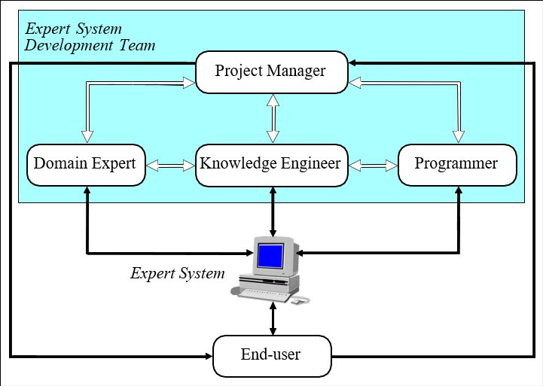
The main players in the development team
Programmer

Slide 13
The domain expert is a knowledgeable and skilled person capable of solving problems in a specific area or domain. This person has the greatest expertise in a given domain. This expertise is to be captured in the expert system. Therefore, the expert must be able to communicate his or her knowledge, be willing to participate in the expert system development and commit a substantial amount of time to the project. The domain expert is the most important player in the expert system development team.

Slide 14
The knowledge engineer is someone who is capable of designing, building and testing an expert system. He or she interviews the domain expert to find out how a particular problem is solved. The knowledge engineer establishes what reasoning methods the expert uses to handle facts and rules and decides how to represent them in the expert system.
The knowledge engineer then chooses some development software or an expert system shell, or looks at programming languages for encoding the knowledge.
And finally, the knowledge engineer is responsible for testing, revising and integrating the expert system into the workplace.

Slide 15
The programmer is the person responsible for the actual programming, describing the domain knowledge in terms that a computer can understand. The programmer needs to have skills in symbolic programming in such AI languages as LISP, Prolog and OPS5 and also some experience in the application of different types of expert system shells. In addition, the programmer should know conventional programming languages like C, Pascal, FORTRAN and Basic.

Slide 16
The project manager is the leader of the expert system development team, responsible for keeping the project on track.
He or she makes sure that all deliverables and milestones are met, interacts with the expert, knowledge engineer, programmer and end-user.
The end-user, often called just the user, is a person who uses the expert system when it is developed. The user must not only be confident in the expert system performance but also feel comfortable using it. Therefore, the design of the user interface of the expert system is also vital for the project’s success; the end-user’s contribution here can be crucial.

Slide 17
Structure of a rule-based expert system
In the early seventies, Newell and Simon from Carnegie-Mellon University proposed a production system model, the foundation of the modern rule- based expert systems.
The production model is based on the idea that humans solve problems by applying their knowledge (expressed as production rules) to a given problem represented by problem-specific information.
The production rules are stored in the long-term memory and the problem-specific information or facts in the short-term memory.

Slide 18
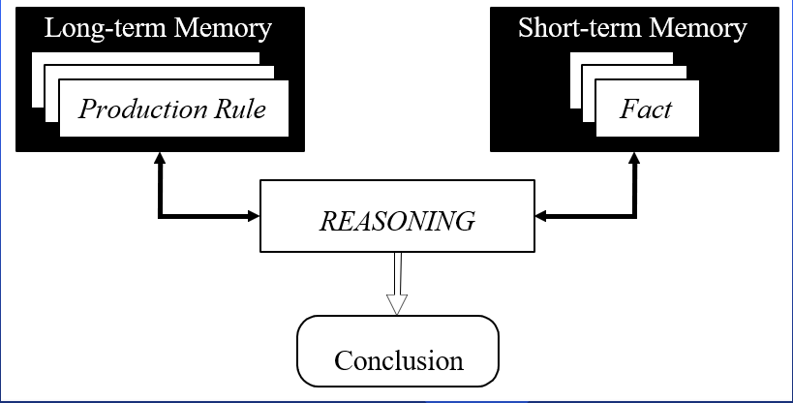
Production system model

Slide 19
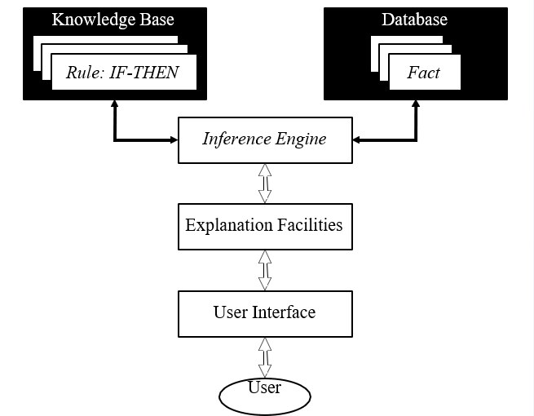
Basic structure of a rule-based expert system
Rule: IF-THEN

Slide 20
The knowledge base contains the domain knowledge useful for problem solving. In a rule- based expert system, the knowledge is represented as a set of rules. Each rule specifies a relation, recommendation, directive, strategy or heuristic and has the IF (condition) THEN (action) structure. When the condition part of a rule is satisfied, the rule is said to fire and the action part is executed.
The database includes a set of facts used to match against the IF (condition) parts of rules stored in the knowledge base.

Slide 21
Expert system has a knowledge base from Expert domain but Knowledge-based system has a knowledge from expert domain and book…….
Rule based system also known as knowledge-based system.

Slide 22
The inference engine carries out the reasoning whereby the expert system reaches a solution. It links the rules given in the knowledge base with the facts provided in the database.
The explanation facilities enable the user to ask the expert system how a particular conclusion is reached and why a specific fact is needed. An expert system must be able to explain its reasoning and justify its advice, analysis or conclusion.
The user interface is the means of communication between a user seeking a solution to the problem and an expert system.

Slide 23
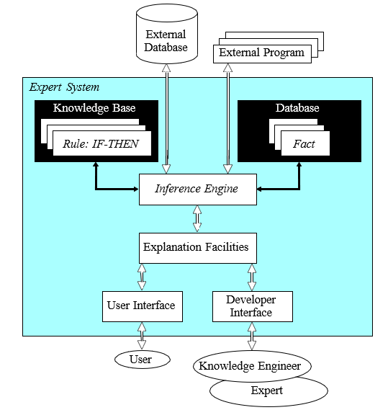
Complete structure of a rule-based expert system
Ft

Slide 24
Characteristics of an expert system
An expert system is built to perform at a human expert level in a narrow, specialised domain. Thus, the most important characteristic of an expert system is its high-quality performance. No matter how fast the system can solve a problem, the user will not be satisfied if the result is wrong.
On the other hand, the speed of reaching a solution is very important. Even the most accurate decision or diagnosis may not be useful if it is too late to apply, for instance, in an emergency, when a patient dies or a nuclear power plant explodes.

Slide 25
Expert systems apply heuristics to guide the reasoning and thus reduce the search area for a solution.
A unique feature of an expert system is its explanation capability. It enables the expert system to review its own reasoning and explain its decisions.
Expert systems employ symbolic reasoning when solving a problem. Symbols are used to represent different types of knowledge such as facts, concepts and rules.

Slide 26
Can expert systems make mistakes?
Even a brilliant expert is only a human and thus can make mistakes. This suggests that an expert system built to perform at a human expert level also should be allowed to make mistakes. But we still trust experts, even we recognise that their judgements are sometimes wrong. Likewise, at least in most cases, we can rely on solutions provided by expert systems, but mistakes are possible and we should be aware of this.

Slide 27
In expert systems, knowledge is separated from its processing (the knowledge base and the inference engine are split up). A conventional program is a mixture of knowledge and the control structure to process this knowledge. This mixing leads to difficulties in understanding and reviewing the program code, as any change to the code affects both the knowledge and its processing.
When an expert system shell is used, a knowledge engineer or an expert simply enters rules in the knowledge base. Each new rule adds some new knowledge and makes the expert system smarter.

Slide 28
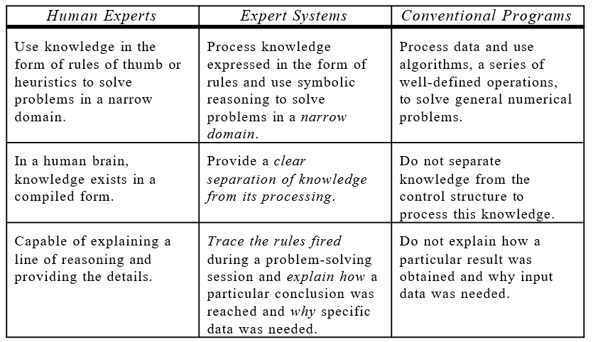
Comparison of expert systems with conventional systems and human experts

Slide 29
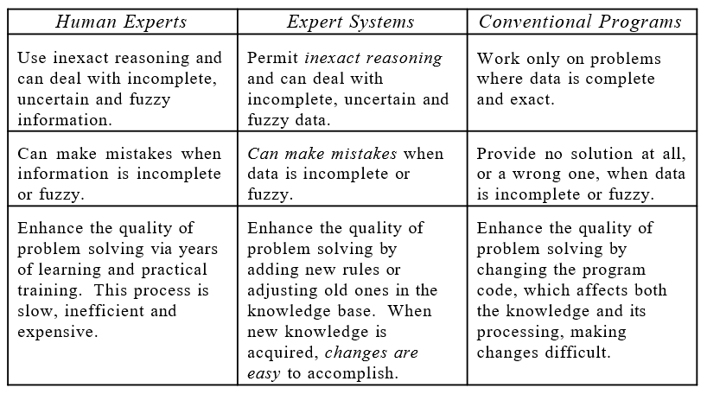
Comparison of expert systems with conventional systems and human experts (Continued)

Slide 30
Forward chaining and backward chaining
In a rule-based expert system, the domain knowledge is represented by a set of IF-THEN production rules and data is represented by a set of facts about the current situation.
The inference engine compares each rule stored in the knowledge base with facts contained in the database. When the IF (condition) part of the rule matches a fact, the rule is fired and its THEN (action) part is executed.
The matching of the rule IF parts to the facts produces inference chains. The inference chain indicates how an expert system applies the rules to reach a conclusion.

Slide 31
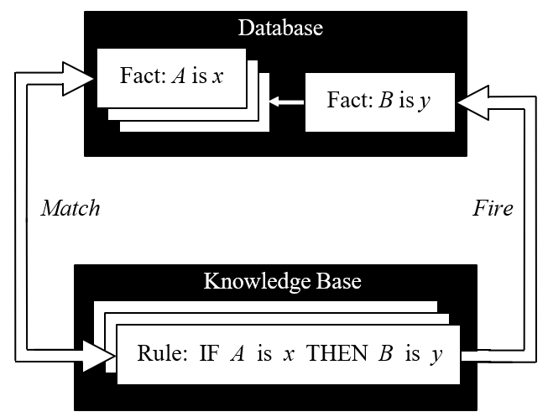
Inference engine cycles via a match-fire procedure

Slide 32
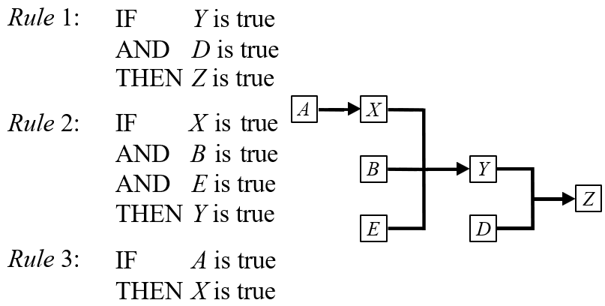
An example of an inference chain

Slide 33
Forward chaining
Forward chaining is the data-driven reasoning. The reasoning starts from the known data and proceeds forward with that data. Each time only the topmost rule is executed. When fired, the rule adds a new fact in the database. Any rule can be executed only once. The match-fire cycle stops when no further rules can be fired.

Slide 34
Many problem domains seem to lend themselves more naturally to forward search. In an interpretation problem, for example, most of the data for the problem are initially given and it is often difficult to formulate an hypotheses or goal. This suggests a forward reasoning process in which the facts are placed in working memory and the system searches for an interpretation.

Slide 35
Backward chaining
Backward chaining is the goal-driven reasoning. In backward chaining, an expert system has the goal (a hypothetical solution) and the inference engine attempts to find the evidence to prove it. First, the knowledge base is searched to find rules that might have the desired solution. Such rules must have the goal in their THEN (action) parts. If such a rule is found and its IF (condition) part matches data in the database, then the rule is fired and the goal is proved. However, this is rarely the case.

Slide 36
Many problem domains seem to lend themselves more naturally to Backward search.

Slide 37
SUMMARY
In this lecture
We presented an overview of rule-based expert systems.
We briefly discussed what knowledge is, and how experts express their knowledge in the form of production rules.

Slide 38
We identified the main players in the expert system development team and showed the structure of a rule-based system.
We discussed fundamental characteristics of expert systems and noted that expert systems can make mistakes.

Slide 39
We reviewed the forward and backward chaining inference techniques.
Finally, the advantages and disadvantages of rule-based expert systems were examined.

Slide 40


