Slide 1



Internet and Information Technology
Lecture 10
ITC202
Microsoft Office: Excel
Prepared by
Dr. Eng. Youssef Ntefeh

Slide 2
Learning Objectives
Explain
  Basic spreadsheet concepts
  Relative/Absolute addresses
  Functions
  Advanced formatting options
Show how to:
  Create, edit, print, and save spreadsheets using Excel

Slide 3
Concepts
Spreadsheet is made up of rows and columns (cols), essentially a table
  Excel calls this a worksheet
Col(s) identified with a letter(s): A
Row(s) identified with a number(s): 1
  Intersection of row & col is a cell
  Cells identified by col letter followed by the row number: A1

Slide 4
Concepts
Cells hold the contents of the spreadsheet/worksheet
Input is entered one cell at a time via the active cell
To enter data, move the cursor to a cell (to make it the active cell) and start typing
In Excel, multiple worksheets are stored in a single PC file with a file extension of .xlsx called a workbook

Slide 5
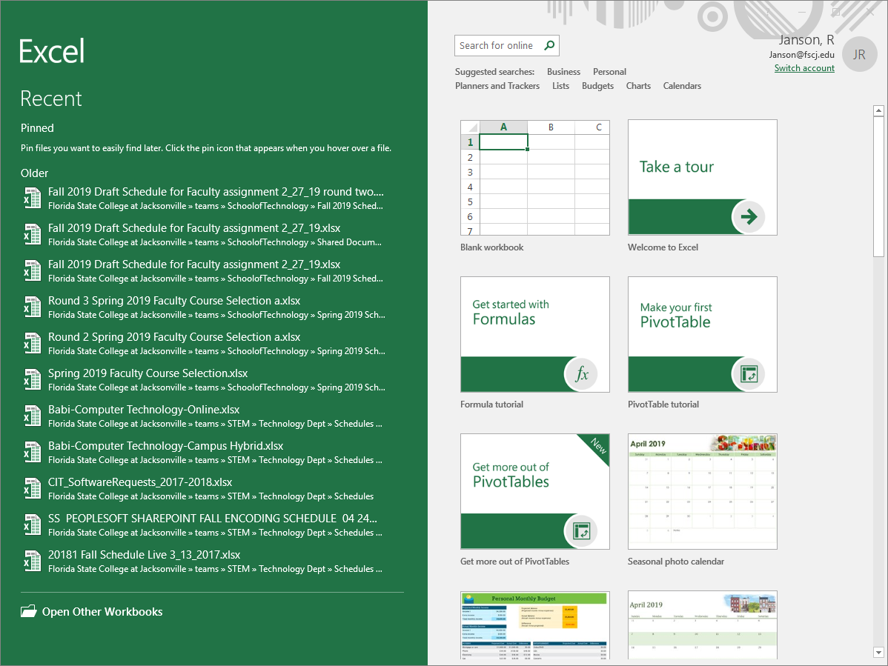
Like Word, when Excel first started you can create from a template or create blank workbook

Slide 6
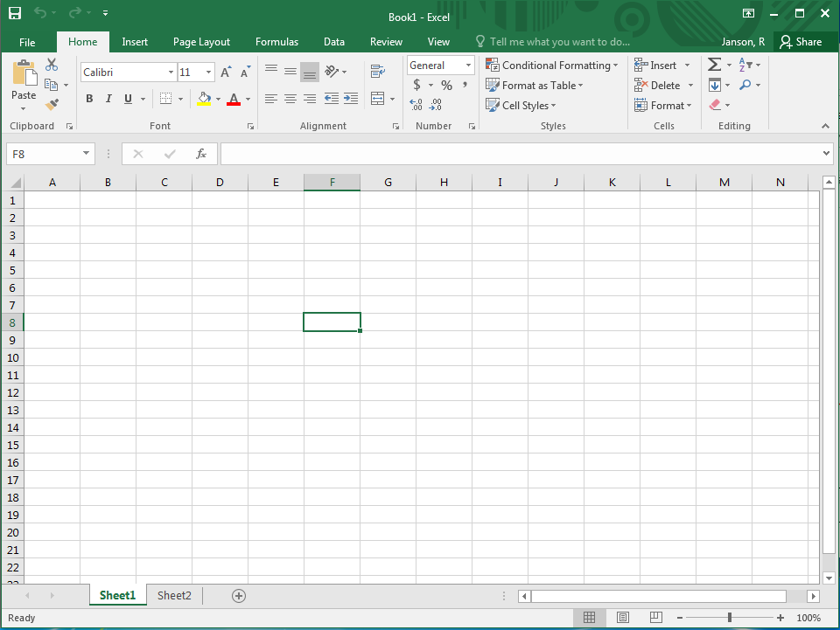
Standard tabs and ribbons
Active cell (where cursor is) has border (called the cell pointer) and cell address displayed in Name box
Border shows row numbers, column letters, and active row/col is highlighted
SS can have many sheets

Slide 7
Moving In the Spreadsheet
Up, down, right, and left arrows move one cell at a time
When at the edge of the displayed portion of the spreadsheet, the arrows scroll one row/column at a time
To AutoFit column width or AutoFit row height, double click on the border between the column / row name and the next one

Slide 8
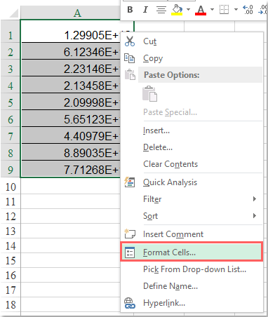
Convert Scientific Notation To Text
If you have a lot of numbers which are displayed as the scientific notation, you can convert them with the Format Cells function in Excel.
1. Select the data range that you want to convert.
2. Right click, and choose Format Cells from the context menu

Slide 9
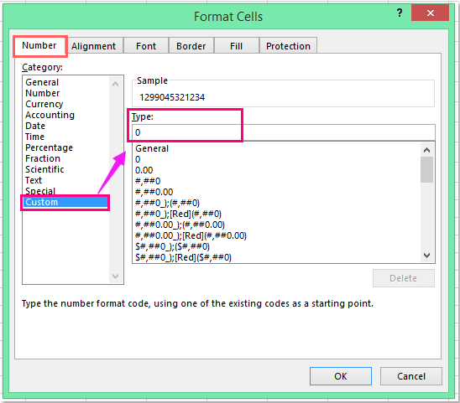
Convert Scientific Notation To Text
3. In the Format Cells dialog, under the Number tab, click Custom from the Category list box, input the number 0 into the Type box
4. Then click OK button, and the cell numbers which displayed as scientific notation have been converted to normal numbers.

Slide 10
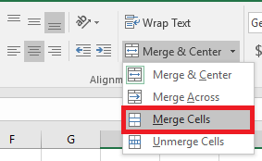
How to Merge Cells
Highlight or select a range of cells.
Right-click on the highlighted cells and select Format Cells....
Click the Alignment tab and place a checkmark in the checkbox labeled Merge cells.
you can also use the Merge and Center button on the Excel tool bar.

Slide 11
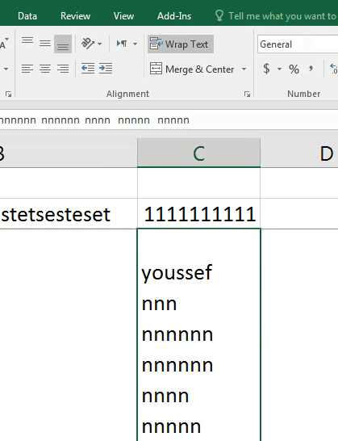
wrap the text in a cell
Highlight or select a range of cells.
use the warp button on the Excel tool bar.

Slide 12
Move or copy cells and cell contents
Move cells by drag and dropping
Select the cells or range of cells that you want to move or copy.
Point to the border of the selection.
When the pointer becomes a move pointer move pointer, drag the cell or range of cells to another location.

Slide 13
Insert or delete rows and columns
Insert or delete a column:
Select any cell within the column, then go to Home > Insert > Insert Sheet Columns or Delete Sheet Columns.
Alternatively, right-click the top of the column, and then select Insert or Delete.
Insert or delete a row
Select any cell within the row, then go to Home > Insert > Insert Sheet Rows or Delete Sheet Rows.
Alternatively, right-click the row number, and then select Insert or Delete.

Slide 14
How to Increment a Number in Excel
Excel offers a numbering system to automatically create a series of incremented numbers.
Enter any starting value in cell A1. Enter the next value in cell A2 to establish a pattern. Select those two cells and drag the bottom fill handle down the column to create a series of incremental numbers.
As an example, entering 12 and 24 in cells A1 and A2 would create the series 12, 24, 36, 48, 60 when copied down to cell A5.

Slide 15
Sum , avearge functions
SUM function adds values. You can add individual values, cell references or ranges or a mix of all three.
For example: =SUM(A2:A10) Adds the values in cells A2:10.
AVERAGE function returns the average (arithmetic mean) of the arguments. For example, if the range A1:A20 contains numbers, the formula =AVERAGE(A1:A20) returns the average of those numbers.

Slide 16
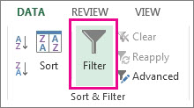
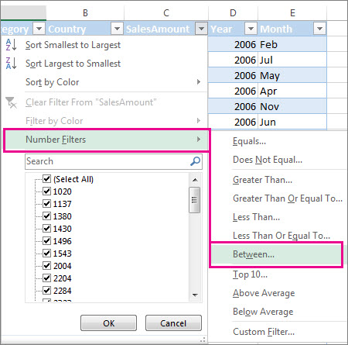
Filter a range of data
select any cell within the range.
Select Data > Filter.
Select the column header arrow Filter arrow.
Select Text Filters or Number Filters, and then select a comparison, like Between.

Slide 17
The Order of Operator Precedence in Excel Formulas
It’s important to understand that when you create a formula with several operators, Excel evaluates and performs the calculation in a specific order. For instance, Excel always performs multiplication before addition. This order is called the order of operator precedence. You can force Excel to override the built-in operator precedence by using parentheses to specify which operation to evaluate first.

Slide 18
The Order of Operator Precedence in Excel Formulas
The order of operations for Excel is as follows:
Evaluate items in parentheses.
Perform negation (-).
Perform exponentiation (^).
Perform multiplication (*) and division (/), which are of equal precedence.
Perform addition (+) and subtraction (-), which are of equal precedence.

Slide 19
Reference cell in another sheet in Excel
To reference a cell or range of cells in another worksheet in the same workbook, put the worksheet name followed by an exclamation mark (!) before the cell address.
In other words, in an Excel reference to another worksheet, you use the following format:
Sheet_name!Cell_address

Slide 20
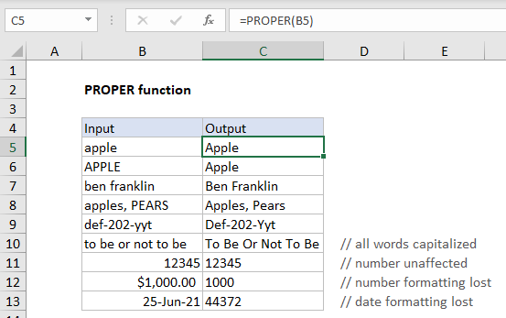
PROPER Function
The Excel PROPER function capitalizes each word in a given text string. Numbers, punctuation, and spaces are not affected.

Slide 21
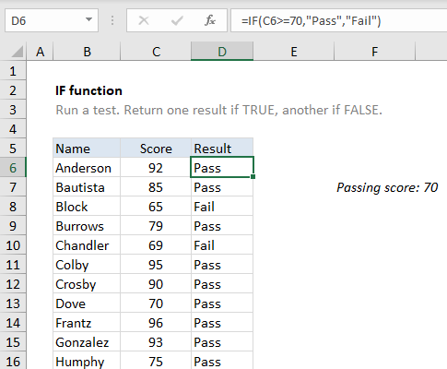
IF function
The IF function runs a logical test and returns one value for a TRUE result, and another for a FALSE result. For example, to "pass" scores above 70: =IF(A1>70,"Pass","Fail").

Slide 22
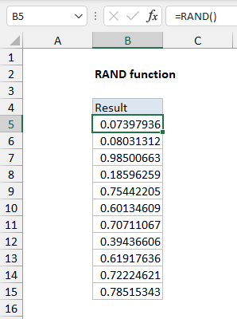
RAND function
The Excel RAND function returns a random number between 0 and 1. For example, =RAND() will generate a number like 0.422245717.
RAND recalculates when a worksheet is opened or changed.

Slide 23
EXACT Function
The Microsoft Excel EXACT function compares two strings and returns TRUE if both values are the same. Otherwise, it will return FALSE.
EXACT( text1, text2 )
Returns
The EXACT function returns TRUE if the two strings are the same.
The EXACT function returns FALSE if the two strings are different.

Slide 24
&
&: Connects, or concatenates, two values to produce one continuous text value.
="North"&"wind"

Slide 25
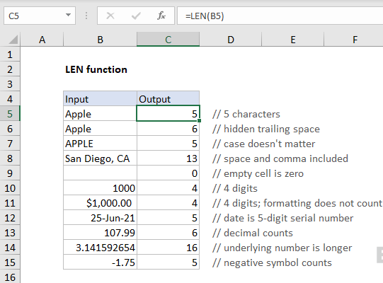
LEN function
The Excel LEN function returns the length of a given text string as the number of characters. LEN will also count characters in numbers, but number formatting is not included.

Slide 26
REPT Function
The Excel REPT function repeats characters a given number of times. For example, =REPT("x",5) returns "xxxxx".

Slide 27
TRIM function
The TRIM function is used to “normalize” all spacing. TRIM automatically strips space at the start and end of a given string and leaves just one space between all words inside the string. It takes care of extra spaces caused by empty cells.
=TRIM(" A stitch in time. ") returns "A stitch in time."

Slide 28
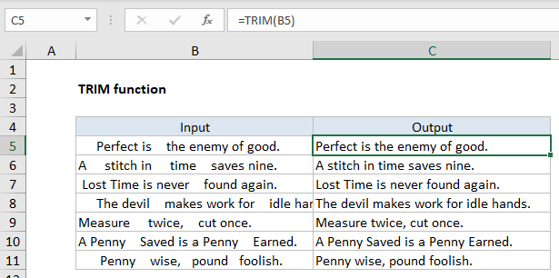
LEFT function
The Excel LEFT function extracts a given number of characters from the left side of a supplied text string. For example:
LEFT("apple",3) returns "app".

Slide 29
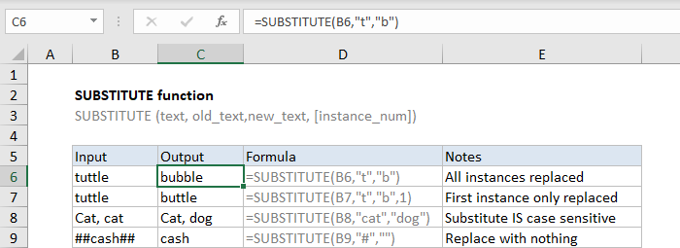
SUBSTITUTE function
The Excel SUBSTITUTE function replaces text in a given string by matching. For example =SUBSTITUTE("952-455-7865","-","") returns "9524557865"; the dash is stripped. SUBSTITUTE is case-sensitive.

Slide 30
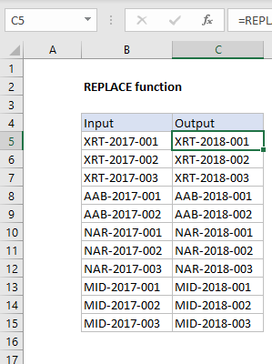
REPLACE function
The Excel REPLACE function replaces characters specified by location in a given text string with another text string. For example:
=REPLACE("XYZ123",4,3,"456") returns "XYZ456".

Slide 31
TODAY Function
The Excel TODAY function returns the current date, updated continuously when a worksheet is changed or opened. The TODAY function takes no arguments.

Slide 32
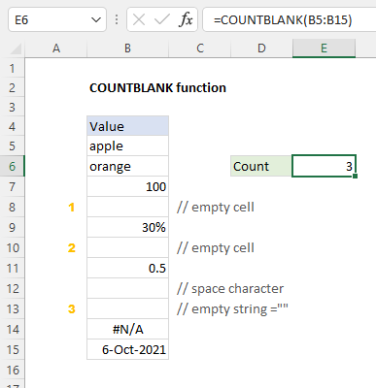
COUNTBLANK function
The Excel COUNTBLANK function returns a count of empty cells in a range. Cells that contain text, numbers, errors, spaces, etc. are not counted. Formulas that return empty text are counted.
=COUNTBLANK(B5:B15) // returns 3

Slide 33
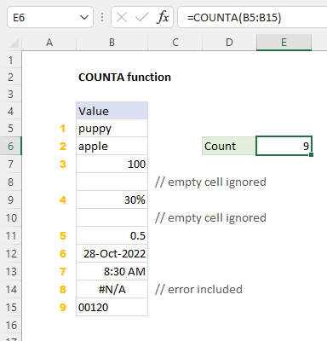
COUNTA Function
The Excel COUNTA function returns the count of cells that contain numbers, text, logical values, error values, and empty text (""). COUNTA does not count empty cells.
Examples
=COUNTA(B5:B15) // returns 9

Slide 34
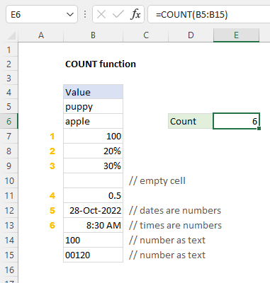
COUNT Function
The Excel COUNT function returns a count of values that are numbers. Numbers include negative numbers, percentages, dates, times, fractions, and formulas that return numbers. Empty cells and text values are ignored.
Examples
=COUNT(B5:B15) // returns 6

Slide 35
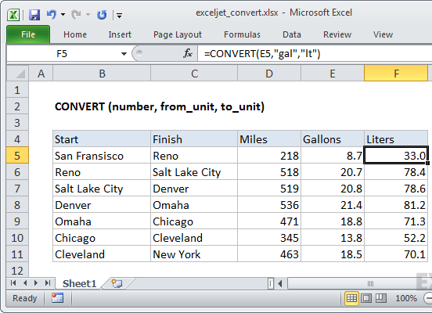
CONVERT function
The Excel CONVERT function converts a number in one measurement system to another. For example, you can use CONVERT to convert feet into meters, pounds into kilograms, Fahrenheit to Celsius, gallons into liters, and for many other unit conversions.

Slide 36
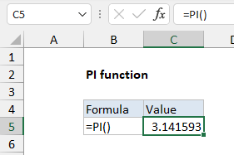
PI Function
The Excel PI function returns the value of the geometric constant π (pi).

Slide 37
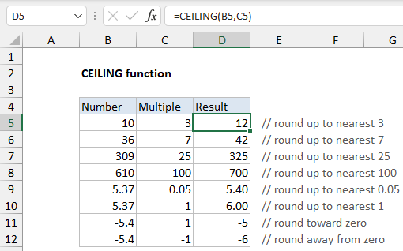
CEILING function
The Excel CEILING function rounds a number up to a given multiple. The multiple to use for rounding is provided as the significance argument. If the number is already an exact multiple, no rounding occurs and the original number is returned.
The CEILING function takes two arguments, number, and significance.
Number is the numeric value to round up.
The significance argument is the multiple to which number should be rounded.

Slide 38
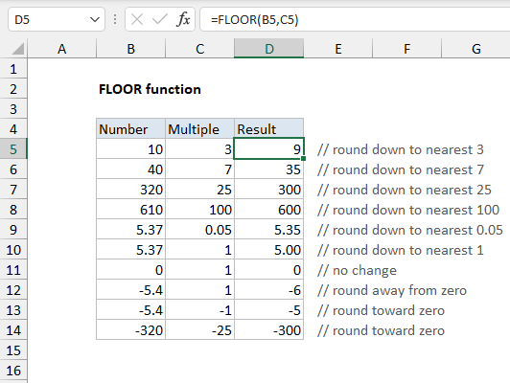
FLOOR function
The Excel FLOOR function rounds a given number down to the nearest specified multiple. FLOOR works like the MROUND function, but FLOOR always rounds down.

Slide 39
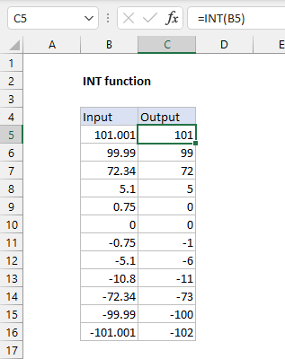
INT Function
The Excel INT function returns the integer part of a decimal number

Slide 40
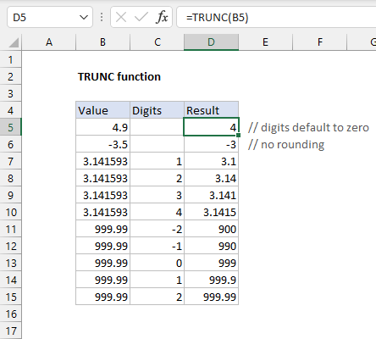
TRUNC function
The Excel TRUNC function returns a truncated number based on an (optional) number of digits. For example, TRUNC(4.9) will return 4, and TRUNC(-3.5) will return -3. The TRUNC function does no rounding, it simply truncates as specified.

Slide 41
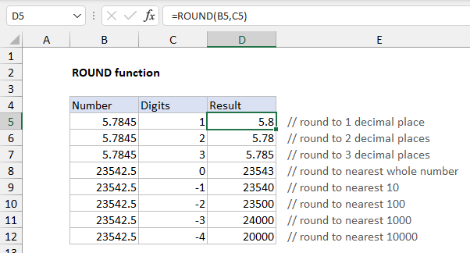
ROUND function
The Excel ROUND function returns a number rounded to a given number of digits. The ROUND function can round to the right or left of the decimal point.

Slide 42
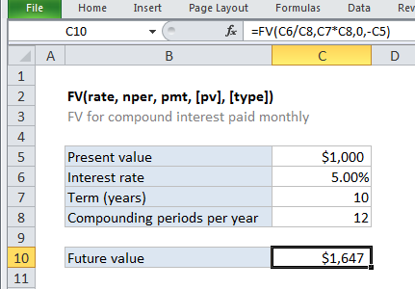
FV function
The Excel FV function is a financial function that returns the future value of an investment. You can use the FV function to get the future value of an investment assuming periodic, constant payments with a constant interest rate.

Slide 43
PV function
The Excel PV function is a financial function that returns the present value of an investment. You can use the PV function to get the value in today's dollars of a series of future payments, assuming periodic, constant payments and a constant interest rate.
=PV (rate, nper, pmt, [fv], [type])
rate - The interest rate per period.
nper - The total number of payment periods.
pmt - The payment made each period.
fv - [optional] A cash balance you want to attain after the last payment is made. If omitted, assumed to be zero.
type - [optional] When payments are due. 0 = end of period, 1 = beginning of period. Default is 0.

Slide 44
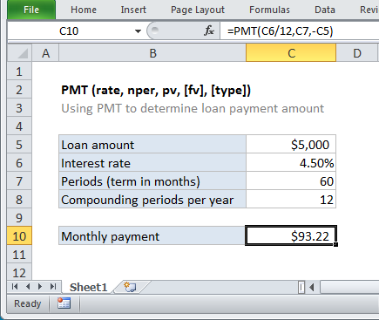
PMT function
The Excel PMT function is a financial function that returns the periodic payment for a loan. You can use the PMT function to figure out payments for a loan, given the loan amount, number of periods, and interest rate.

Slide 45
Charts
How to create a basic chart
The charting system in Excel is flexible and deep. You can create charts with very little effort, and you have the power to customize almost every aspect of a chart.
if we have annual sales for a small company. We'll use this data to build a basic column chart. The first step in creating a chart in Excel is to prepare the data. Charting works best if the data is structured in a simple grid that doesn't include blank rows or columns.

Slide 46
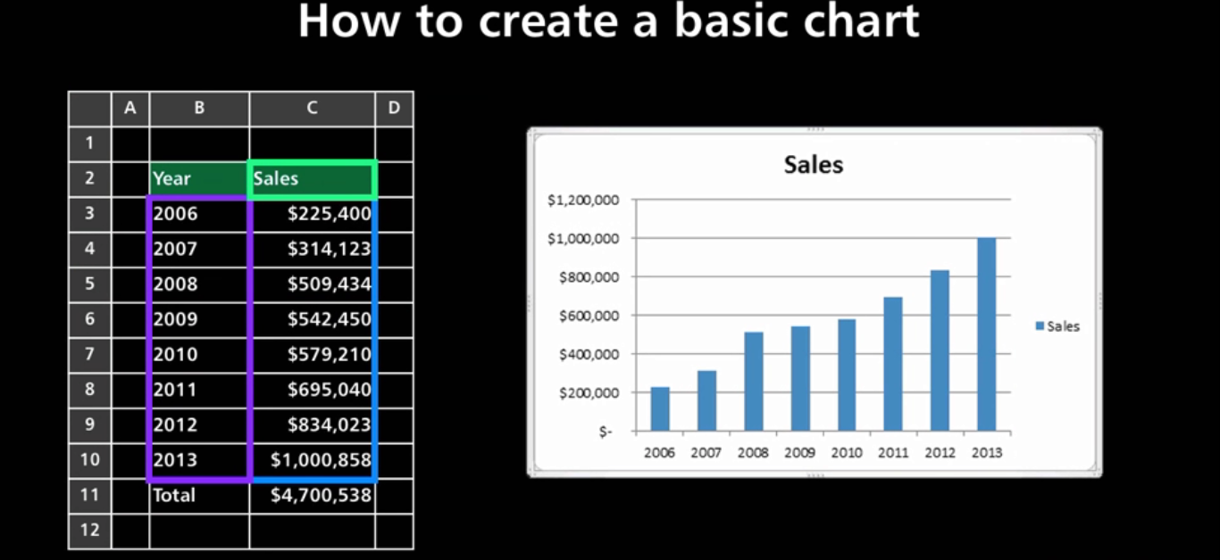
Charts

Slide 47
Charts
First, select the data you'd like to chart. If your data includes totals, don't include these in your selection. However, you should include data labels, if they exist, so that Excel can use them in the chart.
Next, click the Insert tab on the ribbon; then click Column, to see a list of column chart styles. All Excel charts have several variations. For Column charts, you'll see options for 2-D columns, 3-D columns, cylinders, cones, and pyramids.
For this example, we're going to stick with a basic 2-D column. When you select a chart option, Excel will immediately create a chart in that style. With the chart selected, Excel highlights the cells used to create the chart on the worksheet. You'll see this highlighting only when the chart is selected.

Slide 48
Case Study: How Starbucks Uses Excel for Store Performance and Managerial Decision-Making
Introduction
In 2024, Starbucks continued expanding globally while facing rising operational costs and changing customer behavior.
Store managers needed fast, simple, and flexible tools to evaluate performance and support day-to-day decisions.
Despite advanced BI systems, Excel remained a core decision-support tool at the managerial level.

Slide 49
Case Study: How Starbucks Uses Excel for Store Performance and Managerial Decision-Making
The Management Problem
Uneven performance across branches
Difficulty identifying low-performing stores early
Rising operational costs affecting profitability
Need for quick comparison between branches and regions

Slide 50
Case Study: How Starbucks Uses Excel for Store Performance and Managerial Decision-Making
Objectives
Compare monthly sales across branches
Identify stores with declining performance
Analyze profit contribution per branch
Support decisions related to staffing, promotions, and cost control

Slide 51
Case Study: How Starbucks Uses Excel for Store Performance and Managerial Decision-Making
Solution Using Excel
Store managers used Excel to consolidate branch data including:
Store ID
Monthly Sales
Operating Costs
Number of Transactions
Employees per Store
Excel was used locally by area managers without requiring IT support.

Slide 52
Case Study: How Starbucks Uses Excel for Store Performance and Managerial Decision-Making
Key Excel Analysis
Key Calculations:
Profit per Store =Sales – Operating Costs
Sales per Employee =Sales / Number of Employees
Average Transaction Value =Sales / Number of Transactions
Conditional Formatting:
Highlight low-profit stores in red
Highlight high sales-per-employee stores in green

Slide 53
Case Study: How Starbucks Uses Excel for Store Performance and Managerial Decision-Making
Scenario & What-If Analysis
Managers used Excel What-If Analysis to test:
Impact of reducing staff by 1 employee
Effect of a 5% price increase on profitability
Impact of promotional discounts on transaction volume
This supported data-driven managerial decisions at branch level

Slide 54
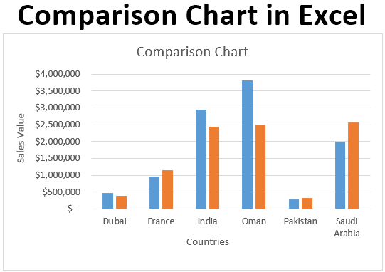
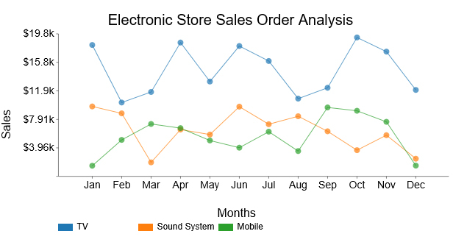
Case Study: How Starbucks Uses Excel for Store Performance and Managerial Decision-Making
Visualization for Management
Using Excel Charts:
Column charts to compare branch performance
Line charts to monitor monthly trends
Simple dashboards for area managers
These visuals helped managers communicate insights to top management.

Slide 55
Case Study: How Starbucks Uses Excel for Store Performance and Managerial Decision-Making
Managerial Impact
✔ Faster decision-making
✔ Better branch-level control
✔ Reduced operational inefficiencies
✔ Excel proved as a strategic managerial tool, not just a spreadsheet

Slide 56


Reference

