Slide 1


Marketing Management
MGM612
Dr. Ayman Hassan
  Lecture - 7-
New-Product Development Strategy

Slide 2


Chapter
6
New-Product Development Strategy
Lecture : 7
Dr. Ayman Hassan

Slide 3
In the previous lecture,
We have discussed
In the previous lecture, we presented the topic of the Branding, We explained a set of topics, which are as follows:
Brand Definition
The Importance Of Branding
Forms Of Brands
Elements Of A Brand
Types Of Brands
Branding Mechanisms

Slide 4
Learning Outcomes
Chapter
6
After studying this chapter you will be able to know all of the following:
Explain how companies find and develop new-product ideas
List and define the steps in the new-product development process and the major considerations in managing this process
Describe the stages of the product life cycle
Describe how marketing strategies change during the product’s life cycle
Discuss two additional product and services issues: socially responsible product decisions and international product and services marketing

Slide 5

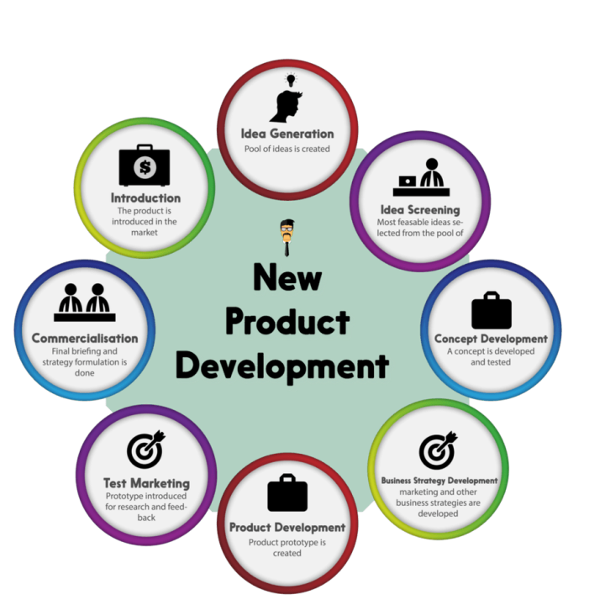
Chapter
6
New-Product Development Strategy
A firm can obtain new products through:
Acquisition
New product development

Slide 6
Chapter
6
New-Product Development Strategy
Acquisition
Refers to the buying of a whole company, a patent, or a license to produce someone else’s product.
New product development
Refers to original products, product improvements, product modifications, and new brands developed from the firm’s own research and development.

Slide 7

Chapter
6
Why New-Product Development?
Reasons for new product failure
Overestimation of market size
Poor design
Incorrect positioning
Wrong timing
Priced too high
Ineffective promotion
Management influence
High development costs
Competition

Slide 8
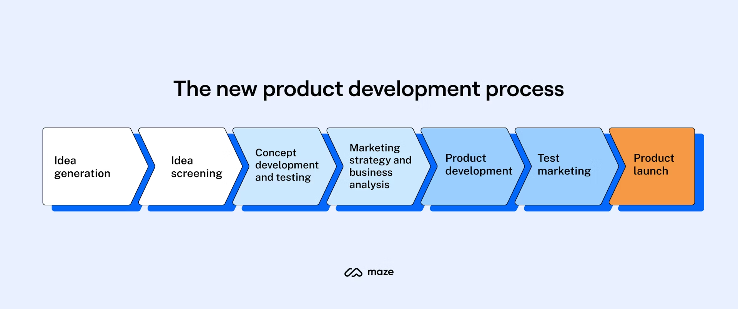
Chapter
6
Steps of New-Product Development Strategy
Idea generation
Idea screening
Concept development and testing
Marketing strategy development
Business analysis
Product development
Test marketing
Commercialization

Slide 9
Chapter
6
1- Idea Generation
New idea generation : is the systematic search for new product ideas.
To create a large number of ideas
Sources of new-product ideas
  Internal sources :
  refer to the company’s own formal research and development, management and staff, and entrepreneurial programs.
  External sources :
  refer to sources outside the company such as customers, competitors, distributors, suppliers, and outside design firms.

Slide 10
Chapter
6
2- Idea Screening
Idea screening :
Refers to reviewing new-product ideas in order to drop poor ones as soon as possible.
idea screening :
Is the stage in the new product development process which follows idea (or concept) generation.
It often involves use of scoring models, checklists, or personal judgments and is based on information from experience and market research

Slide 11
Chapter
6
3- Concept Development and Testing
Product idea :
Is an idea for a possible product that the company can see itself offering to the market.
Product concept :
Is a detailed version of the idea stated in meaningful consumer terms.
Product image :
Is the way consumers perceive an actual or potential product.
Concept testing :
Refers to testing new-product concepts with groups of target consumers. To find out how attractive each concept is to customers, and choose the best one.

Slide 12
Chapter
6
4- Marketing strategy development
Marketing strategy development : refers to the initial marketing strategy for introducing the product to the market.
Marketing strategy statement
Part 1:
  Description of the target market
  The planning product positioning; sales, market share, and profit goals
Part 2:
  Price distribution and budget
Part 3:
  Long-term sales, profit goals, and marketing mix strategy

Slide 13
Chapter
6
5- Business Analysis
Business analysis
In today’s dynamic and competitive business environment, organizations are constantly seeking ways to optimize processes, improve efficiency, and achieve strategic goals.
Business analysis plays a critical role in this pursuit.
It helps businesses understand their current state, identify needs, and define solutions that maximize value.
Business analysis bridges the gap between business goals and practical solutions.
Involves a review of the sales, costs, and profit projections to find out whether they satisfy the company’s objectives.

Slide 14
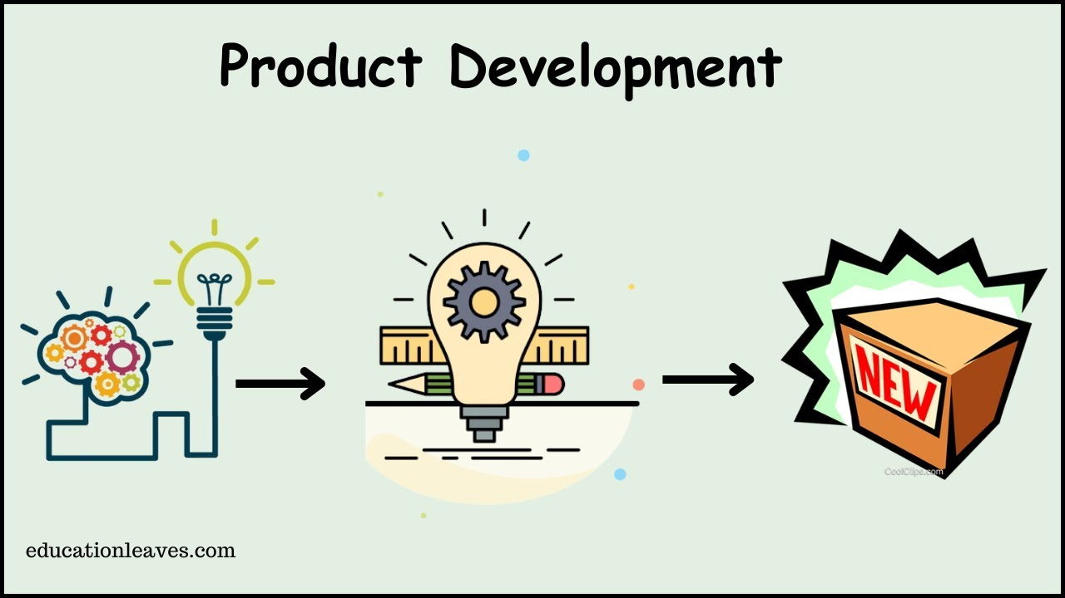
Chapter
6
6- Product Development
Product development
Involves the creation and testing of one or more physical versions by the R&D or engineering departments.
Requires an increase in investment
R&D Engineering is a leading provider of manufacturing equipment, testing equipment and tools

Slide 15
Chapter
6
7- Test marketing
Test marketing : Is the stage at which the product and marketing program are introduced into more realistic marketing settings.
Test marketing provides the marketer with experience in testing the product and entire marketing program before full introduction.
Test Marketing, Example
We see test marketing everywhere. It’s in the retail stores where companies are offering free samples of their products mainly food items, cosmetics, and perfumes.
Their goal is to collect customer feedback and use the data to analyze how the product will be received in the market.

Slide 16

Chapter
6
7- Test marketing
When firms test market: New product with large investment; Uncertainty about product or marketing program
When firms may not test market: Simple line extension; Copy of competitor product; Low costs; Management confidence

Slide 17
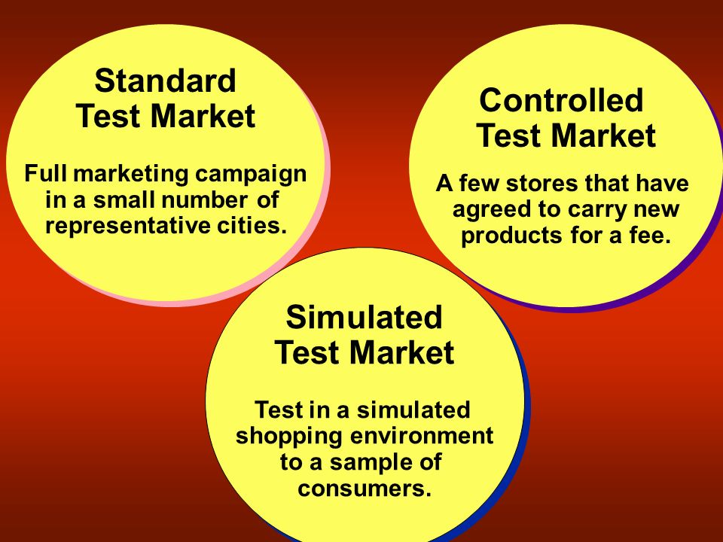
Chapter
6
7-1 Approaches to test marketing
  Approaches to test marketing
  Standard test markets
  Controlled test markets
  Simulated test markets

Slide 18
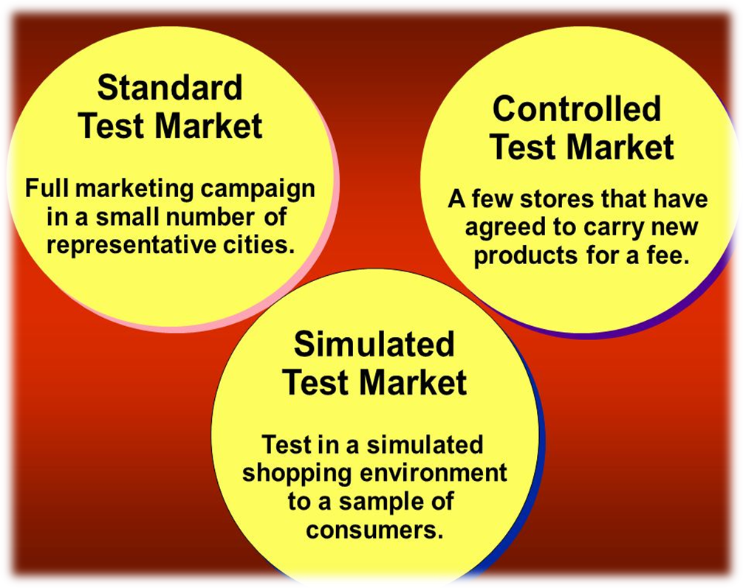
Chapter
6
7-1-1 Approaches to test marketing
Standard test markets
  Small representative markets where the firm conducts a full marketing campaign
  Uses store audits, consumer and distributor surveys, and other measures to gauge product performance
  Results are used to
    Forecast national sales and profits
    Discover product problems
    Fine-tune the marketing program

Slide 19
Chapter
6
7-1-1 Approaches to test marketing
Standard test markets
Challenges of standard test markets
  Cost
  Time
  Competitors can monitor the test as well
  Competitor interference
  Competitors gain access to the new product before introduction

Slide 20
Chapter
6
7-1-2 Approaches to test marketing
A controlled market test is generally conducted in chain stores with the product’s initial launch. In this test, the new products offered by the brand are introduced with a sales pitch, advertising banner, or test presentation to attract consumers.
  Panels of stores that have agreed to carry new products for a fee
  Less expensive than standard test markets
  Faster than standard test markets
  Competitors gain access to the new product
Controlled Market Test

Slide 21
Chapter
6
7-1-3 Approaches to test marketing
Simulated test markets
Simulated Test Market is a research technique that evaluates the success of a new product/ service before its launch.
It involves exposing a representative sample of the target market to the product/service in a controlled environment that mimics real-world market conditions.
In an STM, researchers select participants who represent the demographic and psychographic characteristics of the target market.
These participants can interact with the product/service in a simulated shopping environment, which includes virtual stores or physical mock-ups.
They are encouraged to make purchasing decisions and provide feedback on their experiences.
  Provides measure of trial and the effectiveness of promotion
  Researchers can interview consumers

Slide 22
Chapter
6
7-1-3 Approaches to test marketing
Simulated test markets
Advantages of simulated test markets
  Less expensive than other test methods
  Faster
  Restricts access by competitors
Disadvantages of simulated test markets
  Not considered as reliable and accurate due to the controlled setting

Slide 23
Chapter
6
Examples of testing marketing
Here are three hypothetical examples of market testing to help you better understand this concept:
Example 1: Small product launch
Harvey's Hikers, a national hiking supply retailer, is designing a new hiking sock. The marketing team wants to test the product with a group of loyal customers to assess how hikers view the new design. They offer a customer rewards program for repeat customers. Through this program, they offer an exclusive link to purchase the new socks. They use this data to evaluate how the socks perform with their target audience. They can use this data to set a fair price for the item.
Example 2: Usability test
Appliance World wants to test a new microwave design. During the early stages of their design process, they create a prototype. They gather a group of random participants to complete the usability test. During the test, customers use the sample product and moderators compile notes. They assess how customers used the machine, how quickly they figured out the buttons and how many were successful in using the new microwave. They discovered the microwave buttons were challenging to press. They redesign the buttons to make them more user-accessible.

Slide 24
Chapter
6
8- Commercialization
Commercialization : is the introduction of the new product into the market
  When to launch
  Where to launch
  Planned market rollout (the widespread public introduction of a new product )

Slide 25
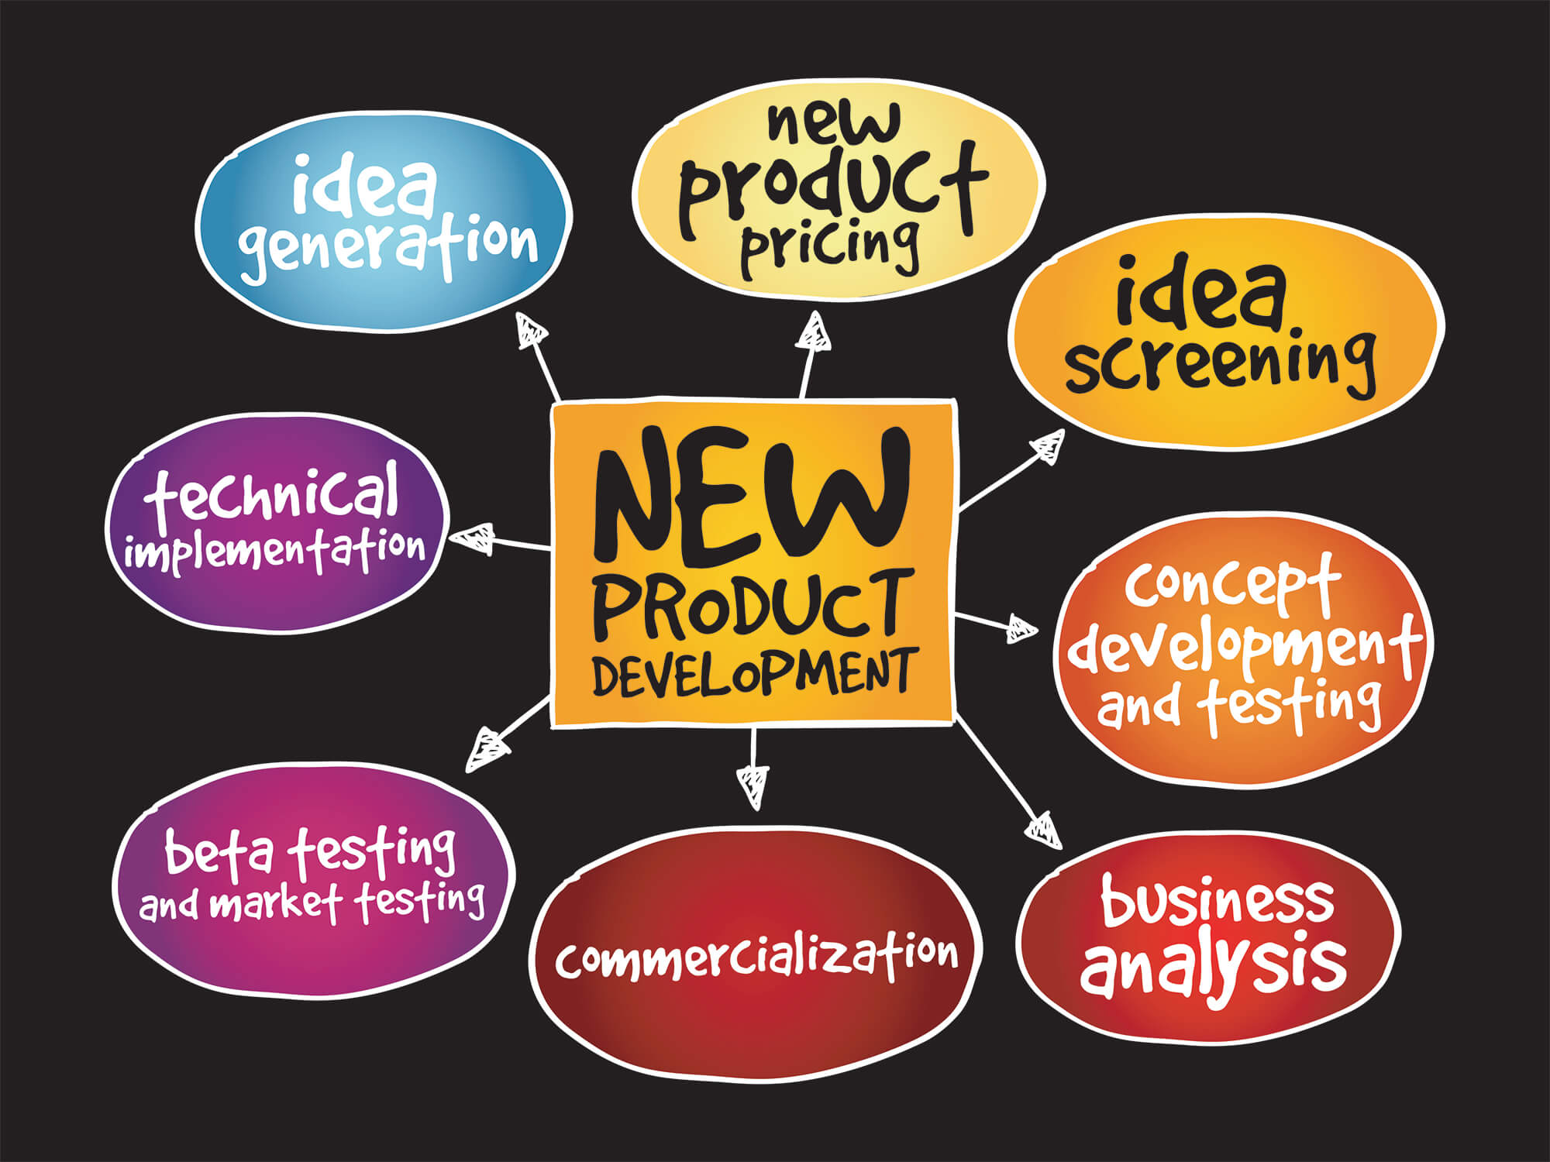
Chapter
6
Managing New-Product Development

Slide 26
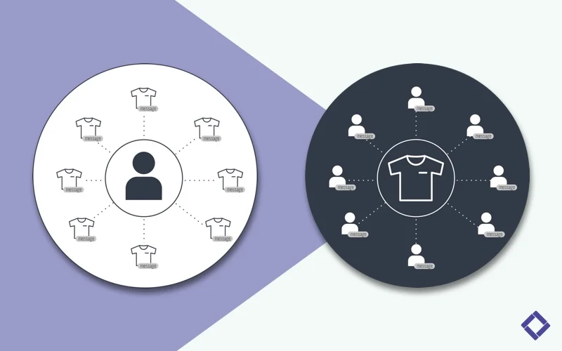
Chapter
6
New-Product Development Strategies
Customer-centered new product development
Team-based new product development
Systematic new product development

Slide 27
Chapter
6
Customer-centered new-product development
focuses on finding new ways to solve customer problems and create more customer satisfying experiences
  Begins and ends with solving customer problems
  The most successful new products are ones that are differentiated

Slide 28

Chapter
6
Team-based new-product development
Team-based new-product development is a development approach where company departments work closely together in cross-functional teams, overlapping in the product-development process to save time and increase effectiveness.
  increase tension and confusion
  is faster and more flexible

Slide 29

Chapter
6
Systematic new product development
Systematic new product development : is an innovative development approach that collects, reviews, evaluates, and manages new product ideas.
  Creates an innovation-oriented culture
  Yields a large number of new-product ideas

Slide 30
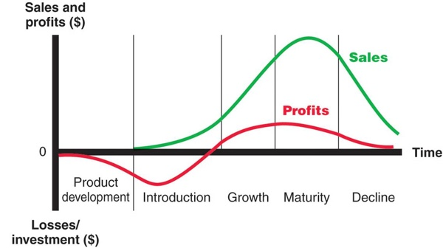
Chapter
6
Product Life-Cycle Strategies
Product life-cycle (PLC) : is the course that a product’s sales and profits take over its lifetime:
  Product development
  Introduction
  Growth
  Maturity
  Decline

Slide 31
Chapter
6
Product Life-Cycle Strategies
Note : Sales and profits over the product’s life from inception to decline

Slide 32
Chapter
6
Product Life-Cycle Strategies
Product life-cycle (PLC) can describe a product class, a product form, or a brand
Product classes : have the longest life cycles, with sales of many product classes in the mature stage for a long time.
Product forms : have the standard PLC shape: introduction, rapid growth, maturity, and decline.
Brands : have changing PLCs due to competitive threats.

Slide 33
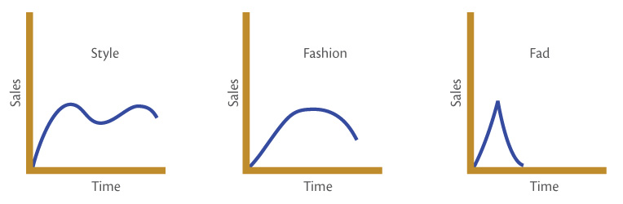
Chapter
6
Product Life-Cycle Strategies
Product life-cycle (PLC) can also be applied to styles, fashions and fads
Style is a basic and distinctive mode of expression.
Fashion is a currently accepted popular style in a given field.
Fads are temporary periods of unusually high sales driven by consumer enthusiasm and immediate product or brand popularity.

Slide 34
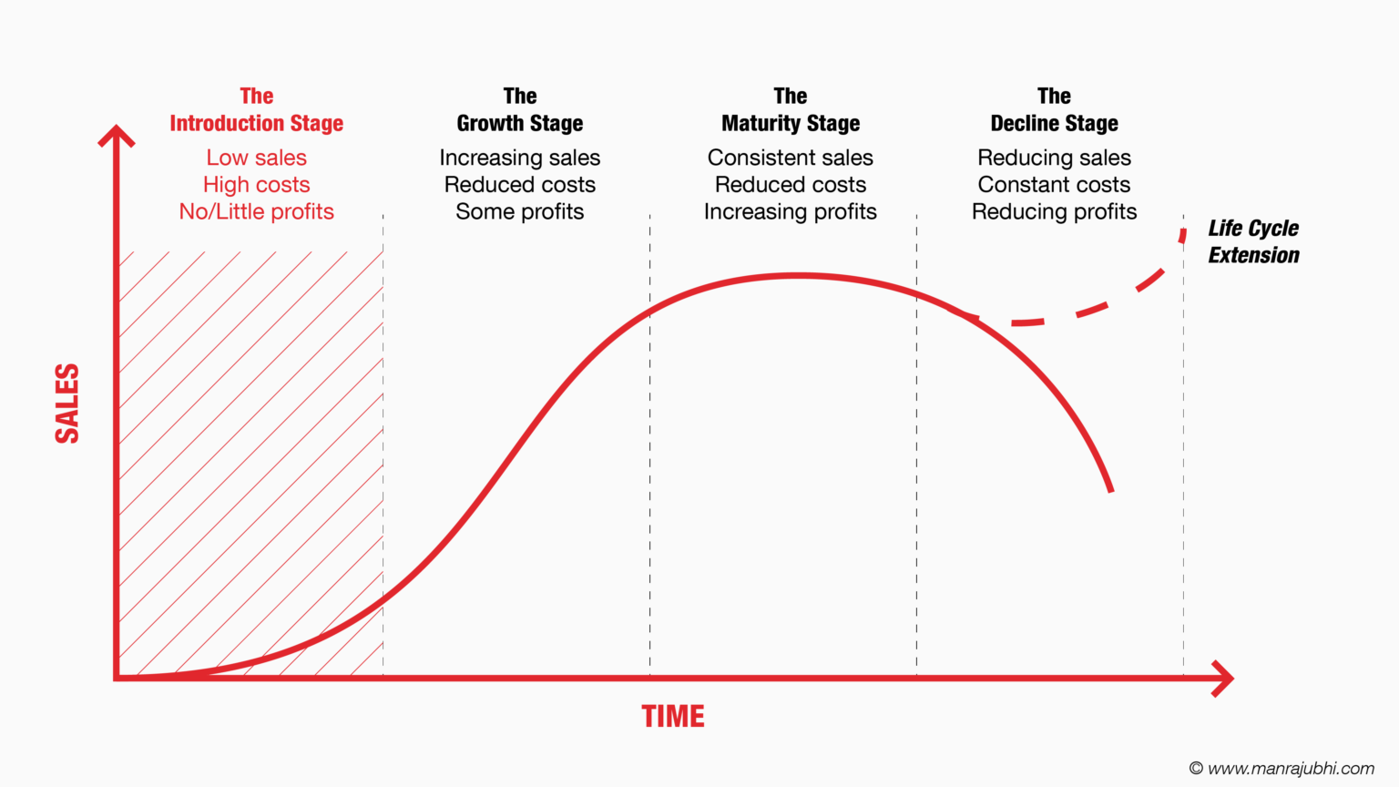
Chapter
6
PLC -1- Introduction stage
Introduction stage: is when the new product is first launched.
  Takes time
  Slow sales growth
  Little or no profit
  High distribution and promotion expense

Slide 35
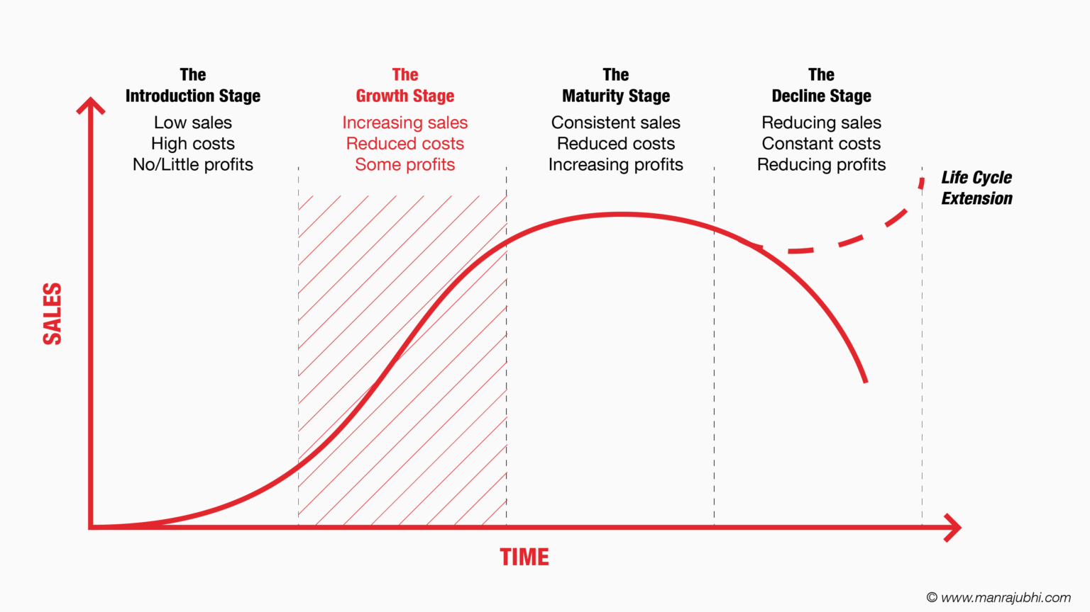
Chapter
6
PLC -2- Growth stage
Growth stage is when the new product satisfies the market.
  Sales increase
  New competitors enter the market
  Price stability or decline to increase volume
  Consumer education
  Profits increase
  Promotion and manufacturing costs gain economies of scale
  Product quality increases
  New features
  New market segments and distribution channels are entered

Slide 36
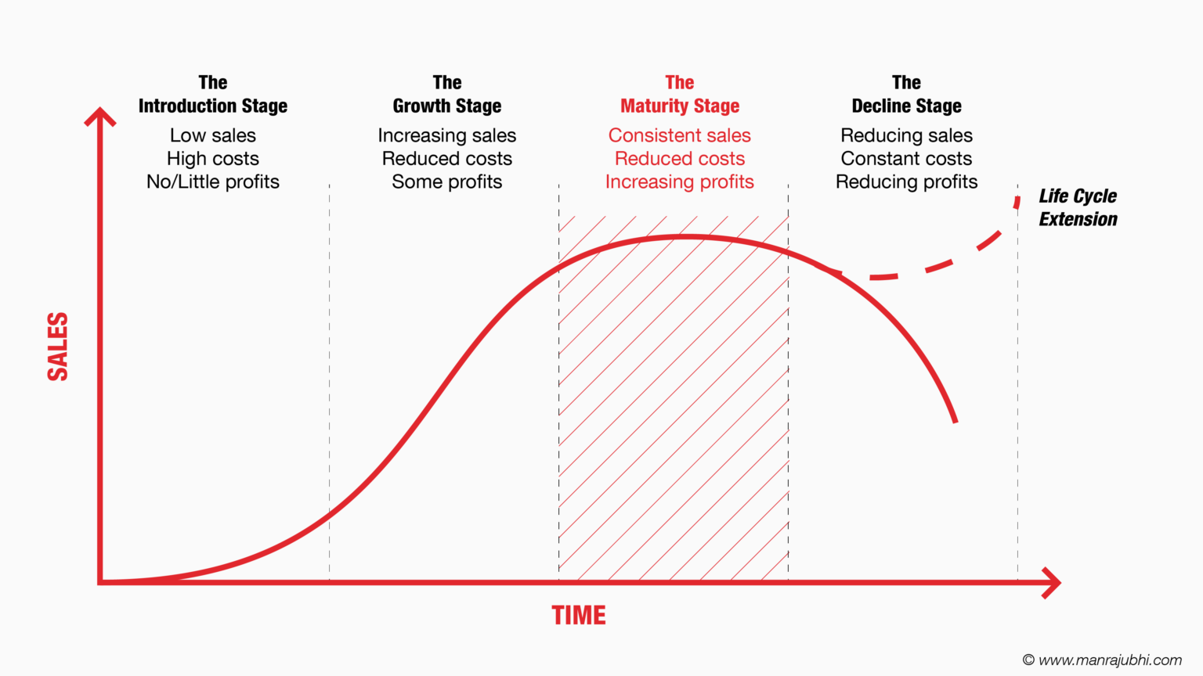
Chapter
6
PLC -3- Maturity stage
Maturity stage is a long-lasting stage of a product that has gained consumer acceptance.
  Slowdown in sales
  Many suppliers
  Substitute products
  Overcapacity leads to competition
  Increased promotion and R&D to support sales and profits.
  Marketers consider modifying strategies at the maturity stage

Slide 37
Chapter
6
PLC -3- Maturity stage
Marketers consider modifying strategies at the maturity stage
Market modifying
Product modifying
Marketing mix modifying

Slide 38
Chapter
6
PLC -3- Maturity stage
Market modifying : is when a company tries to increase consumption of the current product (New users; Increase usage of existing users; New market segments)
Product modifying : is changing characteristics (quality, features, or style) to attract new users and to inspire more usage.
Marketing mix modifying : is when a company changes one or more of the marketing mix elements.
  Price
  Promotion
  Distribution channels

Slide 39
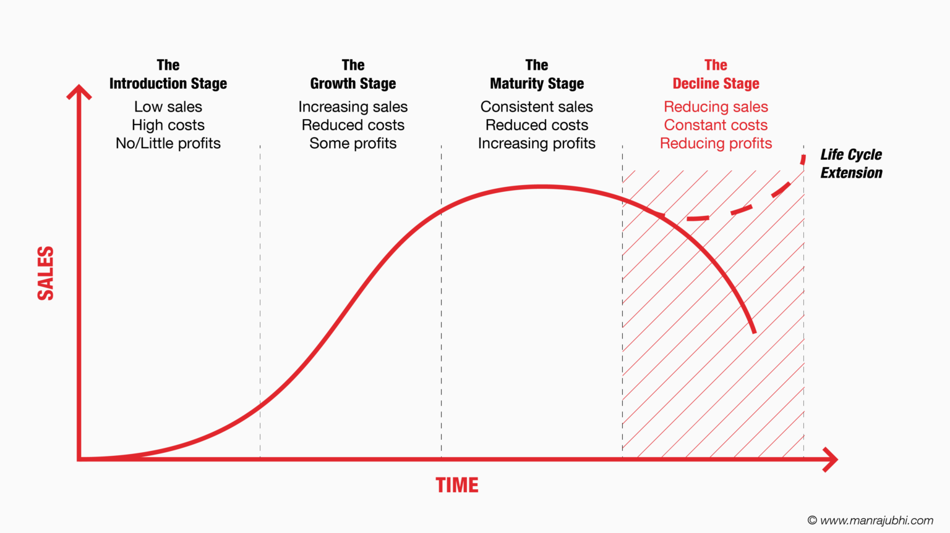
Chapter
6
PLC -4- Decline stage
Decline stage : is when sales decline or level off for an extended time, creating a weak product.
  Maintain the product without change in the hope that competitors leave the industry
  Reposition or reformulate the product in hopes of moving back into the growth stage
  Harvest the product that means reducing various costs and hoping that sales hold up
  Drop the product by selling it to another firm or simply liquidate it at salvage value

Slide 40
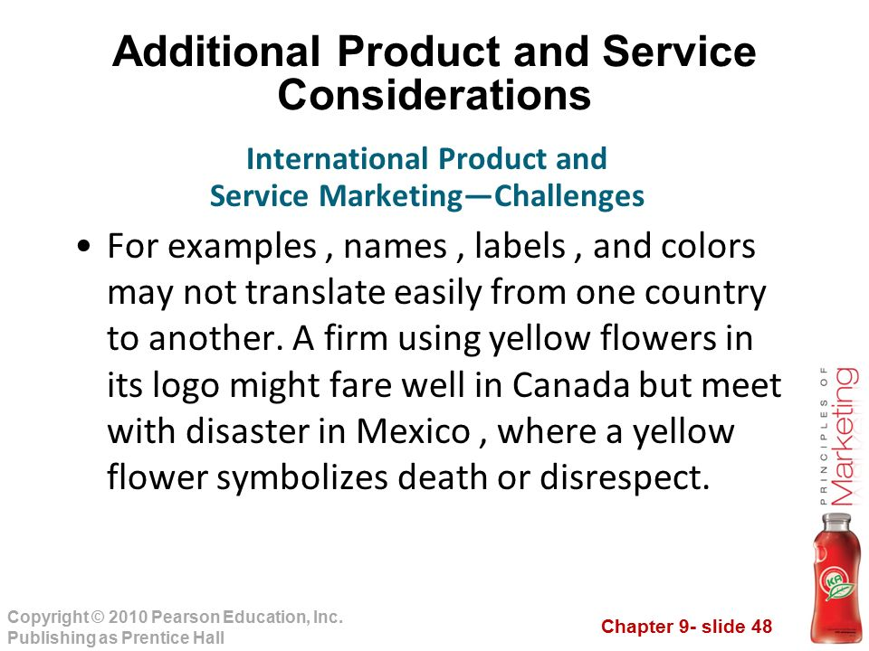

Chapter
6
Additional Product and Service Considerations
Product Decisions and Social Responsibility
Public policy and regulations regarding developing and dropping products, patent protection, product quality and safety, and product warranties.
International Product and Service Marketing
  Determining what products and services to introduce in which countries
  Standardization versus customization
  Packaging and labeling
  Customs, values, laws

Slide 41
Chapter
6
Additional Product and Service Considerations

Slide 42
Chapter
6
See you in the next lecture

Slide 43
Chapter
6
Resources and References
What is Product development? | New Product development
Test Marketing | How to Test Market a New Product | starlight analytics blog
Types of Product Development Strategies - BigOhTech
Systematic New Product Development: Amazon.co.uk: Gordon S. Douglas, Philip Kemp, Jeremy Cook: 9780566024122: Books
New-Product Development and Product Life-Cycle Strategies - ppt download

Slide 44

Chapter
6
Thanks for listening.
01
Best wishes
Dr. Ayman Hassan

