Slide 1





Lecture: #08
Biometrics & Databases Security
Dr. Hesham Abou Elfetouh
Cybersecurity Department
Faculty of Informatics
Midocean University
Secure Operating Systems (CYB610)
www.midocean.ae

Slide 2
Chapter
Outline
08
    This chapter covers the following topics and concepts: Biometrics & Databases Security
Biometrics
- Why Biometrics?
- Problems with Biometrics
- Biometrics Usage
- Phases of Biometric System
- Authentication in distributed systems
Databases Security
- Basic database terminology and concepts
- Security requirements for databases
- Implementing access controls in databases
- Protecting sensitive data
- Data mining and big data
2
www.midocean.ae
Secure Operating Systems

Slide 3
Chapter
Introduction
08
In Previous Lecture you learned:
In the use of authentication
Password Selection Criteria
One-Time Passwords
Challenge-response Authentication
Attacks on Passwords
3
www.midocean.ae
Secure Operating Systems

Slide 4
Chapter
CHAPTER 8 GOALS
08
When you complete this chapter, you will be able to:
Describe Why we use biometrics
Explain the phases of biometric system
Describe the Authentication in distributed systems
Explain the token-based authentication
4
www.midocean.ae
Secure Operating Systems

Slide 5
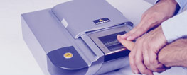

Chapter
Biometrics
08
Use a person’s physical characteristics
  fingerprint, voice, face, keyboard timing, …
Advantages
  Cannot be disclosed, lost, forgotten
Disadvantages
  Cost, installation, maintenance
  Reliability of comparison algorithms
    False positive: Allow access to unauthorized person
    False negative: Disallow access to authorized person
  Privacy?
  If forged, how do you revoke?
5
www.midocean.ae
Secure Operating Systems

Slide 6
Chapter
Biometrics
08
  A biometric should be
  Universal: The ideal biometric should apply to virtually everyone.
  Distinguishing: The ideal biometric should distinguish with virtual certainty.
  Permanent: The physical characteristic being measured should never change.
  Collectible: The physical characteristic should be easy to collect without any potential to cause harm to the subject.
  Reliable, robust, and user-friendly
6
www.midocean.ae
Secure Operating Systems

Slide 7
Chapter
Identification versus Authentication
08
  Biometrics are very reliable for Identification but much less effective for authentication
  The difference is between a system that looks at a hand geometry and says "this is Captain Hook" (identification) versus a man who says "I am, Captain Hook, presenting my hand to prove who I am" and the system confirms "this hand matches Captain Hook's template" (authentication).
7
www.midocean.ae
Secure Operating Systems

Slide 8
Chapter
Identification versus Authentication
08
  Identification:
  Identify the subject from a list of many possible subjects.
  E.g., a suspicious fingerprint from a crime scene is sent to the FBI fingerprint database for comparison with all records on file. In this case, the comparison is one to many.
  Authentication:
  The comparison is one to one
  E.g., if someone claiming to be Alice uses a thumbprint mouse biometric, the captured thumbprint image is only compared with the stored thumbprint of Alice.
8
www.midocean.ae
Secure Operating Systems

Slide 9
Chapter
Why Biometrics?
08
  More secure replacement for passwords
  Cheap and reliable biometrics needed
  An active area of research
  Biometrics used in security are :
  Thumbprint mouse
  Palm print for secure entry
  Fingerprint to unlock car door, etc.
  But biometrics not too popular
  Has not lived up to its promise (yet?)
9
www.midocean.ae
Secure Operating Systems

Slide 10
Chapter
Problems with Biometrics
08
  Biometric recognition devices are costly
  All biometric readers use sampling and establish a threshold for when a match is close enough to accept.
  Biometrics can become a single point of failure.
  although equipment is improving, there are still false readings
  The speed at which a recognition must be done limits accuracy.
  Although we like to think of biometrics as unique parts of an individual, forgeries are possible.
10
www.midocean.ae
Secure Operating Systems

Slide 11

Chapter
Biometrics
08
    Common uses
    Specialized situations, physical security Combine :
    Multiple biometrics
    Biometric and PIN
    Biometric and token
11
www.midocean.ae
Secure Operating Systems

Slide 12
Chapter
Phases of Biometric System
08
The Enrollment Phase:
subjects have their biometric information entered into a database.
The Recognition Phase:
subjects have their biometric information compared with that stored in the database.
12
www.midocean.ae
Secure Operating Systems

Slide 13
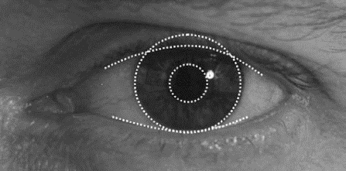
Chapter
Biometric Examples
08
Fingerprints
Hand Geometry
Iris Scan
13
www.midocean.ae
Secure Operating Systems

Slide 14
Chapter
Biometric Error Rates
08
  For fingerprint biometric systems, the error rate is about 5%
  hand geometry has an equal error rate of about 10⁻³
14
www.midocean.ae
Secure Operating Systems

Slide 15
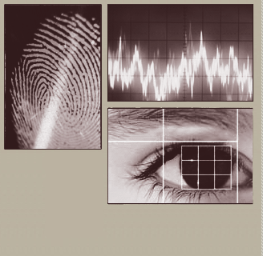
Chapter
Biometrics: Authentication Not Using Passwords
08
Biometrics are biological authenticators, based on some physical characteristics of the human body.
Now there are devices to recognize the following biometrics:
fingerprints
hand geometry (shape and size of fingers)
retina and iris (parts of the eye)
voice
handwriting
blood vessels in the finger
face.
15
www.midocean.ae
Secure Operating Systems

Slide 16
Chapter
Biometrics: Authentication Not Using Passwords
08
Authentication with biometrics has advantages over passwords because:
a biometric cannot be:
lost,
stolen,
forgotten,
lent,
or forged and is
always available,
always at hand.
16
www.midocean.ae
Secure Operating Systems

Slide 17
Chapter
Authentication in distributed systems
08
  Single sign-on, Microsoft Passport
  Trusted Intermediaries
17
www.midocean.ae
Secure Operating Systems

Slide 18
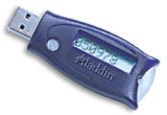
Chapter
Token-based Authentication
08
Smart Card
With embedded CPU and memory
  Carries conversation with a small card reader
Various forms
  PIN protected memory card
    Enter PIN to get the password
  Cryptographic challenge/response cards
    A cryptographic key in memory
    Computer create a random challenge
    Enter PIN to encrypt/decrypt the challenge with the card
  Cryptographic Calculator (readerless smart card)
    Simulating a smartcard: user enter the encrypted result
18
www.midocean.ae
Secure Operating Systems

Slide 19
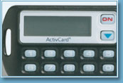
Chapter
Smart Card Example
08
Time
Challenge
Time
Some complications
  Initial data shared with server
    Need to set this up securely
    Shared database for many sites
  Clock skew
Initial data
function
19
www.midocean.ae
Secure Operating Systems

Slide 20
Chapter
Microsoft Passport
08
Launched 1999
  Claim > 200 million accounts in 2002
  Over 3.5 billion authentications each month
  Microsoft Passport is a two-factor authentication (2FA) system that combines a PIN or biometrics (via Windows Hello) with encrypted keys from a user's device to provide two-factor authentication.
  If you sign into Windows with fingerprint or face recognition, then you are already using Windows Hello.
  What does Microsoft Passport service do?
  It allows you to log in to Windows using your Active Directory and replace passwords, smartcards, and virtual smart cards.
20
www.midocean.ae
Secure Operating Systems
Notes:
Ordinary عادي

Slide 21
Chapter
Microsoft Passport
08
How do I get a Microsoft Passport?
Creating Passport: Upon first login to their device the user is prompted to create a gesture. After they create the gesture, Windows creates a private-public key pair and registers the user's public key while the private key is protected by encrypted with a locally derived secret.
21
www.midocean.ae
Secure Operating Systems
Notes:
Ordinary عادي

Slide 22
Chapter
Microsoft Passport
08
Log in to many websites using one account
Used by MS services Hotmail, MSN Messenger or MSN subscriptions; also Radio Shack, etc.
Hotmail or MSN users automatically have Microsoft Passport accounts set up
The Passport may continue to evolve; bugs have been uncovered
22
www.midocean.ae
Secure Operating Systems
Notes:
Ordinary عادي

Slide 23
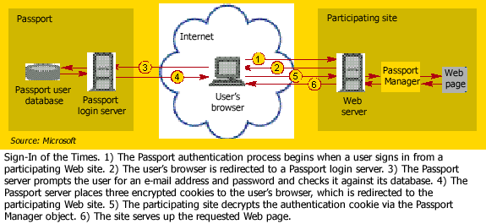
Chapter
Passport log-in
08
23
www.midocean.ae
Secure Operating Systems
Notes:
Ordinary عادي

Slide 24
Chapter
Trusted Intermediaries
08
Symmetric key problem:
How do two entities establish a shared
secret key over the network?
Solution:
trusted key distribution center (KDC)
acting as intermediary between entities
Public key problem:
When Alice obtains Bob’s public key (from web site, e-mail, flash memory), how does she know it is Bob’s public key, not a spy?
Solution:
trusted certification authority (CA)
24
www.midocean.ae
Secure Operating Systems
Notes:
Ordinary عادي

Slide 25



Chapter
Key Distribution Center (KDC)
08
Alice, Bob need shared symmetric key.
KDC: server shares a different secret key with each registered user (many users)
Alice, Bob know own symmetric keys, K_{A-KDC} K_{B-KDC} , for communicating with KDC.
KDC
K_{B-KDC}
K_{A-KDC}
K_{P-KDC}
K_{X-KDC}
K_{P-KDC}
K_{Y-KDC}
K_{A-KDC}
K_{Z-KDC}
K_{B-KDC}
25
www.midocean.ae
Secure Operating Systems
Notes:
Ordinary عادي

Slide 26
Chapter
Key Distribution Center (KDC)
08
Q: How does KDC allow Bob, Alice to determine shared symmetric secret key to communicate with each other?
KDC generates R1
K_{A-KDC}(A,B)
Alice
knows R1
Bob knows to use R1 to communicate with Alice
K_{A-KDC}(R1, K_{B-KDC}(A,R1) )
K_{B-KDC}(A,R1)
Alice and Bob communicate: using R1 as
session key for shared symmetric encryption
26
www.midocean.ae
Secure Operating Systems
Notes:
Ordinary عادي

Slide 27
Chapter
Ticket
08
In K_{A-KDC}(R1, K_{B-KDC}(A,R1) ), the K_{B-KDC}(A,R1) is also known as a ticket
Comes with expiration time
27
www.midocean.ae
Secure Operating Systems

Slide 28
Chapter
Certification Authorities
08
Certification authority (CA): binds a public key to a particular entity, E.
E (person, router) registers its public key with CA.
  E provides “proof of identity” to CA.
  CA creates certificate binding E to its public key.
  Certificate containing E’s public key digitally
  signed by CA – CA says “this is E’s public key”
Bob’s
public
key
+
K
+
Digital signature
(encrypt)
B
K
B
Bob’s
identifying information
certificate for Bob’s public key, signed by CA
CA
private
key
-
K
CA
28
www.midocean.ae
Secure Operating Systems

Slide 29
Chapter
Certification Authorities
08
When Alice wants Bob’s public key:
  gets Bob’s certificate (Bob or elsewhere).
  apply CA’s public key to Bob’s certificate, get Bob’s public key
+
digital
signature
(decrypt)
Bob’s
public
key
K
B
+
K
B
CA
public
key
+
K
CA
29
www.midocean.ae
Secure Operating Systems

Slide 30
Chapter
Single KDC/CA
08
Problems
Single administration trusted by all principals
Single point of failure
Scalability
Solutions: break into multiple domains
Each domain has a trusted administration
30
www.midocean.ae
Secure Operating Systems

Slide 31
Chapter
Multiple KDC/CA Domains
08
Secret keys:
KDCs share pairwise key
topology of KDC: tree with shortcuts
Public keys:
cross-certification of CAs
example: Alice with CA_{A}, Boris with CA_{B}
  Alice gets CA_{B}’s certificate (public key p₁), signed by CA_{A}
  Alice gets Boris’ certificate (its public key p₂), signed by CA_{B} (p₁)
31
www.midocean.ae
Secure Operating Systems

Slide 32
Chapter
Summary
08
This part explained :
Biometrics Usage
Phases of Biometric System
Authentication in distributed systems
  Smart Card
  Microsoft Passport
  Key Distribution Center (KDC)
  Certification Authorities) (CA)
32
www.midocean.ae
Secure Operating Systems

Slide 33
Chapter
Database Security
08
Databases Security
33
www.midocean.ae
Secure Operating Systems

Slide 34
Chapter
Database Terms
08
Database administrator
Database management system (DBMS)
Record
Field/element
Schema
Subschema
Attribute
Relation
34
www.midocean.ae
Secure Operating Systems

Slide 35
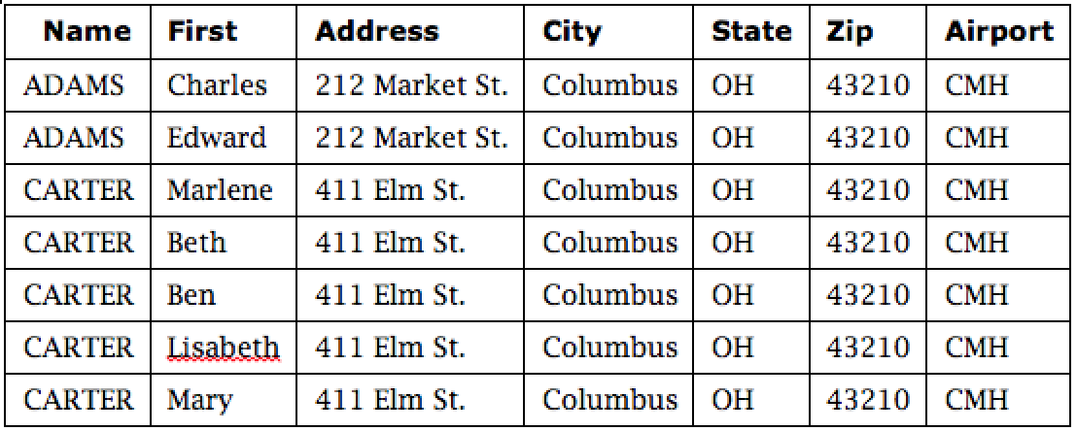
Chapter
Example SQL Query
08
SELECT ZIP=‘43210’
35
www.midocean.ae
Secure Operating Systems

Slide 36
Chapter
Reliability and Integrity
08
Reliability: in the context of databases, reliability is the ability to run for long periods without failing
Database integrity: concern that the database as a whole is protected against damage
Element integrity: concern that the value of a specific data element is written or changed only by authorized users
Element accuracy: concern that only correct values are written into the elements of a database
36
www.midocean.ae
Secure Operating Systems

Slide 37
Chapter
Two-Phase Update
08
Phase 1: Intent
  DBMS does everything it can, other than making changes to the database, to prepare for the update
    Collects records, opens files, locks out users, makes calculations
  DBMS commits by writing a commit flag to the database
Phase 2: Write
  DBMS completes all write operations
  DBMS removes the commit flag
If the DBMS fails during either phase 1 or phase 2, it can be restarted and repeat that phase without causing harm
37
www.midocean.ae
Secure Operating Systems

Slide 38
Chapter
Other Database Security Concerns
08
Error detection and correction codes to protect data integrity
For recovery purposes, a database can maintain a change log, allowing it to repeat changes as necessary when recovering from failure
Databases use locks and atomic operations to maintain consistency
  Writes are treated as atomic operations
  Records are locked during write so they cannot be read in a partially updated state
38
www.midocean.ae
Secure Operating Systems

Slide 39
Chapter
Types of Disclosures
08
  Keeping records from being dumped out of the database is not sufficient to actually prevent disclosure.
  There are many ways to deduce the content of a database.
  Apply the appropriate protection mechanisms to protect sensitive database information.
39
www.midocean.ae
Secure Operating Systems

Slide 40
Chapter
Preventing Disclosure
08
  Suppress obviously sensitive information
  Keep track of what each user knows based on past queries
  Disguise the data
40
www.midocean.ae
Secure Operating Systems

Slide 41
Chapter
Security vs. Precision
08
41
www.midocean.ae
Secure Operating Systems

Slide 42
Chapter
Data Mining
08
Data mining uses statistics, machine learning, mathematical models, pattern recognition, and other techniques to discover patterns and relations on large datasets
The size and value of the datasets present an important security and privacy challenge, as the consequences of disclosure are naturally high
42
www.midocean.ae
Secure Operating Systems

Slide 43
Chapter
Data Mining Challenges
08
Correcting mistakes in data
Preserving privacy
Secure data storage
Transaction logs
Real-time security monitoring
43
www.midocean.ae
Secure Operating Systems

Slide 44
Chapter
Summary
08
This part explained :
Database security requirements include.
Reliability and Integrity
Two-Phase Update
There are many subtle ways for sensitive data to be inadvertently disclosed, and there is no single answer for prevention
Data mining and big data have numerous open security and privacy challenges
44
www.midocean.ae
Secure Operating Systems

Slide 45



Thank You

