Slide 1




EXCEL
IT111 - Introduction to Information Technology
Bachelor of Science in Information Technology
Eng. Eman Hamdy
Excel

Slide 2
Introduction to Spreadsheets
A spreadsheet is an electronic file used to organize related data and perform calculations.
A worksheet is a single spreadsheet that contains formulas, values, text, and graphical representations of data. Each worksheet is identified by a sheet tab
A workbook is a file containing related worksheets. By default, new workbooks have one worksheet
A cell address or cell reference names a cell and it is made up from the column letter and row number

Slide 3
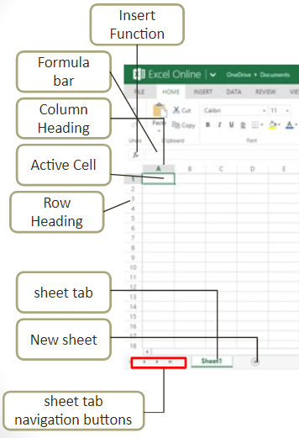
Excel Window

Slide 4
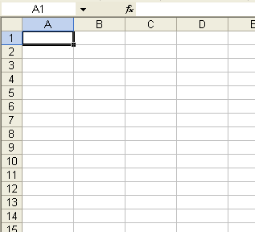
Worksheets
4
Excel’s main screen is called a “worksheet”.
Each worksheet is comprised of many boxes, called “cells”.
Notes:
4

Slide 5
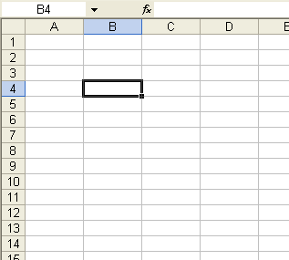
Selecting a Cell
“Select” a cell by clicking on it once (don’t double click).
You can move from cell to cell with the arrow keys.

Slide 6
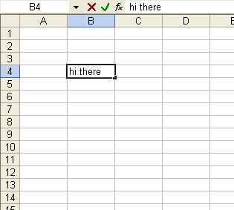
Entering Information / The Formula Bar
To enter information in a cell, just start typing.
When you are done either
  Press the Enter Key
  Press an arrow key
The information in the selected cell is also displayed in the “formula bar” above the worksheet.

Slide 7
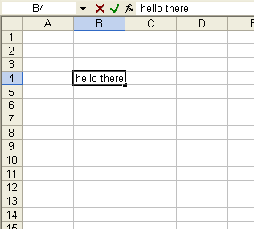
Double Click to Modify a Cell
Double click to change “hi there” to “hello there”

Slide 8
Column Names (letters) & Row Names (numbers)
The columns of the worksheet are named with letters
The rows are named with numbers
Selected Cell

Slide 9
Cell Names (ex. B4)
Name Box
Selected Cell
The name of a cell is a combination of the Letter Of The Column that the cell is in followed by the Number Of The Row that the cell is in.
Example: the selected cell in the picture is named B4 (NOT 4B)
Excel automatically shows the the name of the currently selected cell in the “name box” (located above the worksheet).

Slide 10
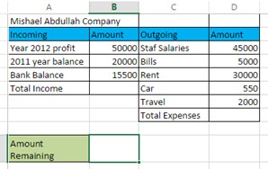
Excel Window
Text is any combination of letters, numbers, symbols, and spaces not used in calculations.

Slide 11
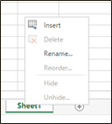
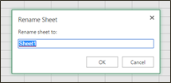
Rename A Worksheet
Double-click a sheet tab, type the new name, and then press OK.
OR
Right-click the sheet tab, select Rename from the shortcut menu, type the new sheet name, and then press OK.

Slide 12

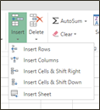
Excel Window
To insert a new worksheet, do one of the following:
Click New sheet to the right of the last worksheet tab.
Click the Insert arrow—either to the right or below Insert—in the Cells group on the HOME tab and select Insert Sheet.
Right-click any sheet tab, select Insert from the shortcut menu, click Worksheet in the Insert dialog box,

Slide 13
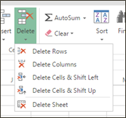
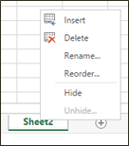
Delete a Worksheet
To delete a worksheet in a workbook, do one of the following:
Click the Delete arrow—either to the right or below Delete—in the Cells group on the HOME tab and select Delete Sheet.
Right-click any sheet tab and select Delete from the shortcut menu 13

Slide 14
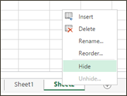
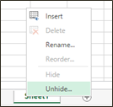
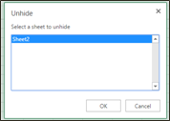
Hide and Unhide a Worksheet
To hide a worksheet in a workbook, do the following:
  Right-Click the sheet tab and select hide from the shortcut menu.
To unhide a worksheet in a workbook, do the following:
1.Right-click any sheet tab and select unhide from the shortcut menu
2.Then select the sheet you need to unhide

Slide 15
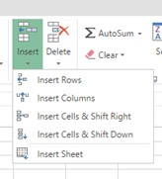
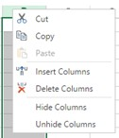
Inserting Rows and Columns
To insert a new column or row, do one of the following:
Click in the column or row for which you want to insert a new column to the left or a new row above, respectively. Click the Insert arrow in the Cells group on the HOME tab and select Insert Sheet Columns or Insert Sheet Rows.
Right-click the column (letter) or row (number) heading for which you want to insert a new column to the left or a new row above, respectively, and select Insert from the shortcut menu.

Slide 16
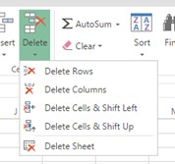
Deleting Rows and Columns
To delete a column or row, do one of the following:
Click the column or row heading for the column or row you want to delete, then click Delete in the Cells group on the HOME tab.
Right-click the column letter or row number for the column or row you want to delete and select Delete from the shortcut menu.

Slide 17
Insert or delete rows and columns
insert or delete a column:
Select any cell within the column, then go to Home > Insert > Insert Sheet Columns or Delete Sheet Columns.
Alternatively, right-click the top of the column, and then select Insert or Delete.
Insert or delete a row
Select any cell within the row, then go to Home > Insert > Insert Sheet Rows or Delete Sheet Rows.
Alternatively, right-click the row number, and then select Insert or Delete.

Slide 18
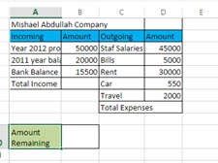
Adjusting Column Width
To widen a column to accommodate the longest label or value in a column, do one of the following:
Position the pointer on the vertical border between the current column heading and the next column heading. When the pointer displays as a two-headed arrow, double click the border.
Drag the vertical border to the left to decrease the column width or to the right to increase the column width.

Slide 19
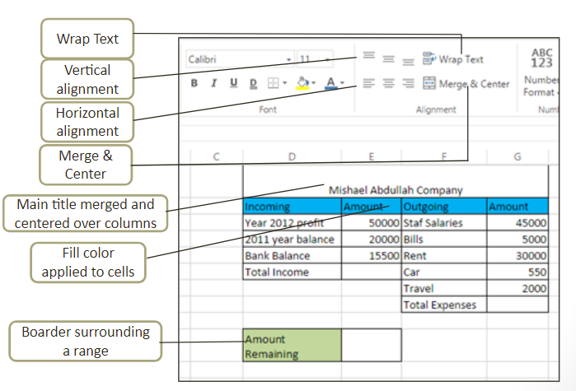
Formatting
The following figure shows different formatting options such as wrap text, merge, applying alignment options, borders and fill color.

Slide 20
Function Basics
An Excel function is a predefined formula that performs a calculation.
A function begins with the equal sign (=) followed by the function name and arguments in parentheses.
Example:=SUM(A1:A3)

Slide 21
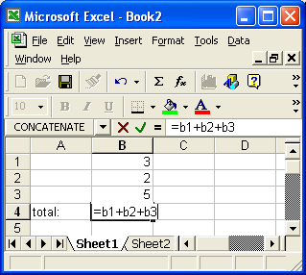
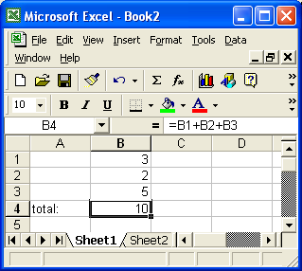
Formulas - correct
formula with = sign
After pressing ENTER

Slide 22
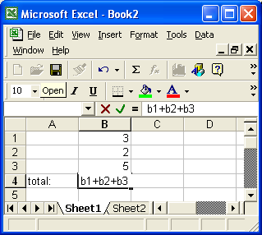
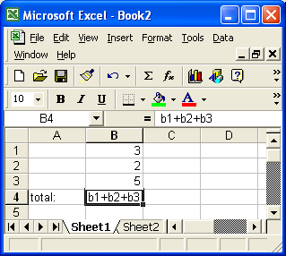
Missing = sign
Missing = sign!
Before pressing enter
After pressing ENTER
(no change - not a formula)

Slide 23
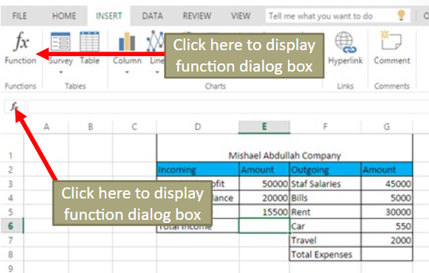
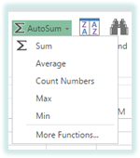
Basic Functions
Common functions include:
1)AVERAGE arithmetic mean
2)MIN minimum value
3)MAX maximum value
4)COUNT number of values in range
5)SUM calculates a total
6)IF logical function

Slide 24
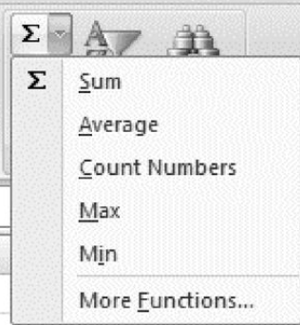
Common Functions
SUM
  Calculates the sum of a range of cells
MAX
  Displays the largest value in a range of cells
MIN
  Displays the smallest value in a range of cells
COUNT
  Calculates the number of values in a range of cells
AVERAGE
  Calculates the average of values in a range of cells

Slide 25
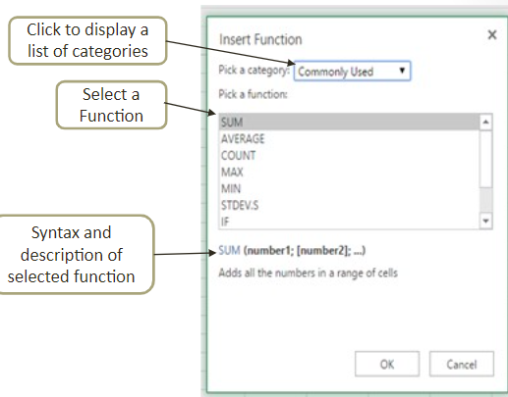
Insert Function
From within the dialog box, select a function category, such as Most Recently Used, and select a function to display the syntax and a brief description of that function.

Slide 26
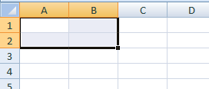
Ranges
A rectangular box of cells is called a “range”.
The name of a range is
  the name of the upper left cell of the range
  Followed by a colon :
  Followed by the lower right cell of the range
Example: A1:B2 is shorthand for A1,A2,B1,B2
  See next slide for more examples
A1:B2

Slide 27
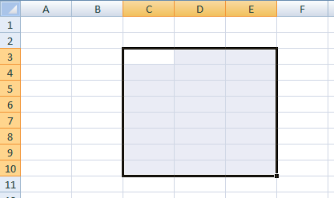
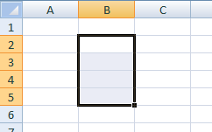
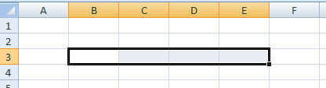
Examples of Range Names
  C3:E10
  B2:B5
  B3:E3

Slide 28
Types of operations
You can use any of the following operations in a formula:
operation symbol example
  addition: + =a1+3
  subtraction: - =100-b3
  multiplication: * =a1*b1
  division: / =d1/100
  exponentiation ^ =a2^2

Slide 29
The Order of Operator Precedence in Excel Formulas
The order of operations for Excel is as follows:
Evaluate items in parentheses.
Perform negation (-).
Perform exponentiation (^).
Perform multiplication (*) and division (/), which are of equal precedence.
Perform addition (+) and subtraction (-), which are of equal precedence.

Slide 30

Summing a range(Addition)
Both of the following function calls produce the same result as =a1+b1+c1+a2+b2+c2+a3+b3+c3+a4+b4+c4
however, the 2nd version uses a range and is much shorter.
without a range
=SUM(a1,b1,c1,a2,b2,c2,a3,b3,c3,a4,b4,c4)
with a range
=SUM(a1:c4)

Slide 31
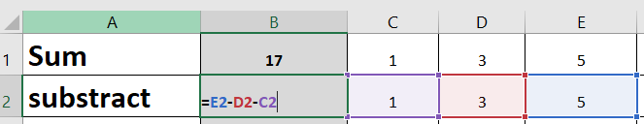
Subtract Formula
To do simple subtraction, use the - (minus sign) arithmetic operator.
For example, if you enter the formula =10-5 into a cell, the cell will display 5 as the result.

Slide 32


Multiply numbers in a cell
Multiplying and dividing in Excel is easy, but you need to create a simple formula to do it. Just remember that all formulas in Excel begin with an equal sign (=), and you can use the formula bar to create them.
To do this task, use the * (asterisk) arithmetic operator.
For example, if you type =5*10 in a cell, the cell displays the result, 50.

Slide 33
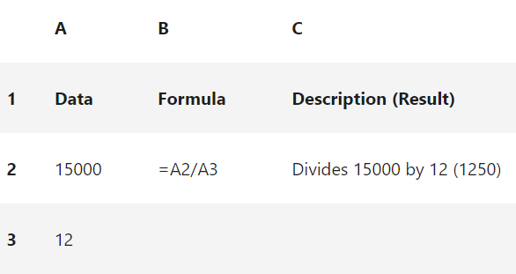
Divide numbers in a cell
To do this task, use the / (forward slash) arithmetic operator.
For example, if you type =10/5 in a cell, the cell displays 2.
Note: There is no DIVIDE function in Excel.

Slide 34
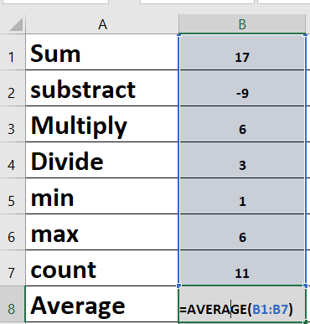
AVERAGE function
Returns the average (arithmetic mean) of the arguments. For example, if the range B1:B7 contains numbers, the formula =AVERAGE(B1:B7) returns the average of those numbers.

Slide 35
Sum , avearge functions
SUM function adds values. You can add individual values, cell references or ranges or a mix of all three.
For example: =SUM(A2:A10) Adds the values in cells A2:10.
AVERAGE function returns the average (arithmetic mean) of the arguments. For example, if the range A1:A20 contains numbers, the formula =AVERAGE(A1:A20) returns the average of those numbers.

Slide 36
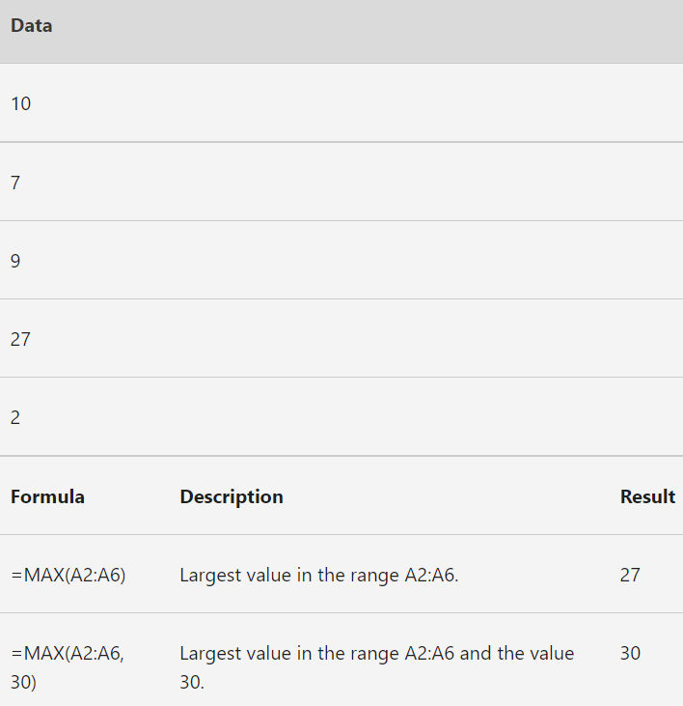
MAX function
Returns the largest value in a set of values.
Syntax
MAX(number1, [number2], ...)

Slide 37
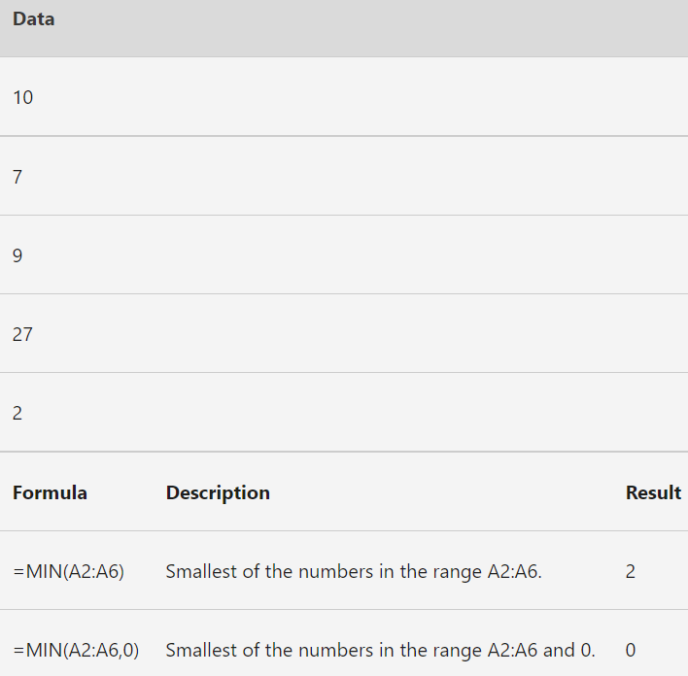
MIN function
Returns the smallest number in a set of values.
Syntax
MIN(number1, [number2], ...)

Slide 38
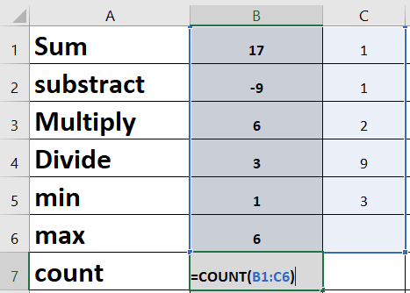

COUNT function
Returns the smallest number in a set of values.
Syntax:
The COUNT function counts the number of cells that contain numbers and counts numbers within the list of arguments.
For example, you can enter the following formula to count the numbers in the range B1:C6: =COUNT(B1:C6). In this example, if 11 of the cells in the range contain numbers, the result is 11.

Slide 39
Combine data using the CONCAT function
Select the cell where you want to put the combined data.
Type =CONCAT(.
Select the cell you want to combine first.
Use commas to separate the cells you are combining and use quotation marks to add spaces, commas, or other text.
Close the formula with a parenthesis and press Enter. An example formula might be =CONCAT(A2, " Family").

Slide 40

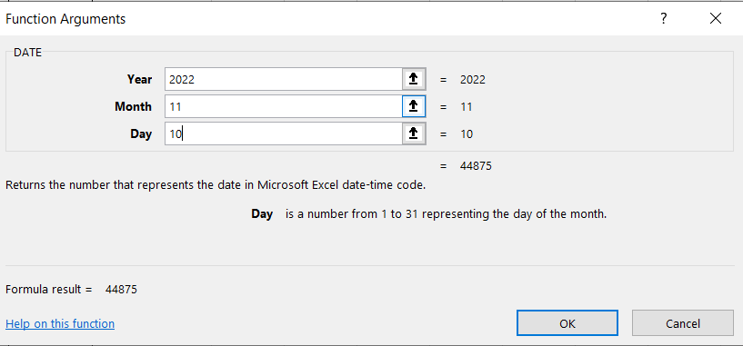
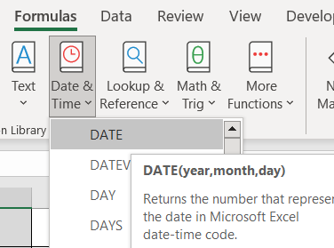
Today, Function
The Excel TODAY function returns the current date, updated continuously when a worksheet is changed or opened. The TODAY function takes no arguments.

Slide 41
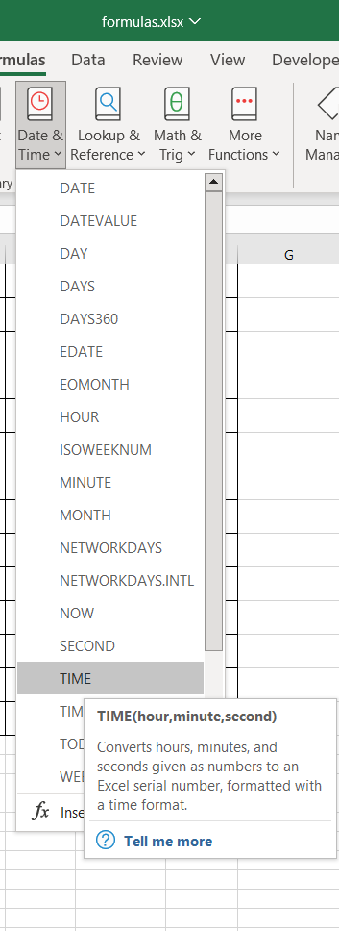
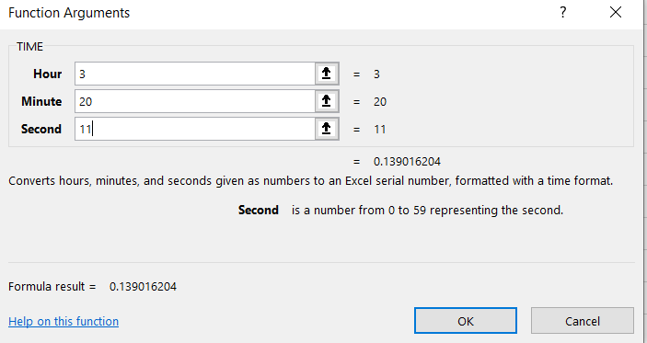
Time Function
From Formula
Select Date & Time choose Time

Slide 42
IF function
The IF function runs a logical test and returns one value for a TRUE result, and another for a FALSE result. For example, =IF(D11="smile","yes","no")
If D11(sad)= “Smile” is true return Yes if this condition false return No

Slide 43
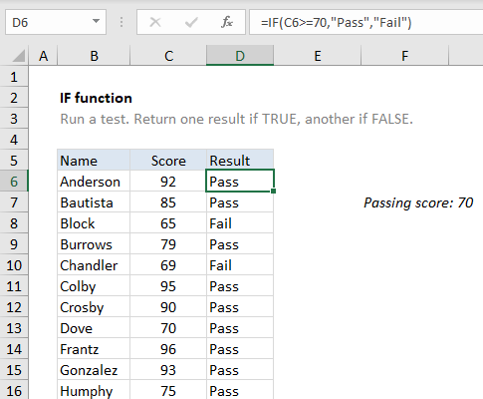
IF function
The IF function runs a logical test and returns one value for a TRUE result, and another for a FALSE result. For example, to "pass" scores above 70: =IF(A1>70,"Pass","Fail").

Slide 44
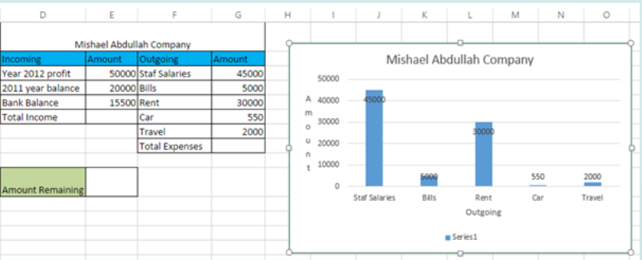
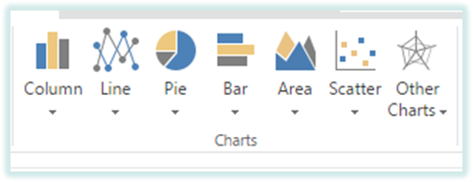
Chart Basics
A chart is a visual representation of numeric data
Choosing a Chart type

Slide 45
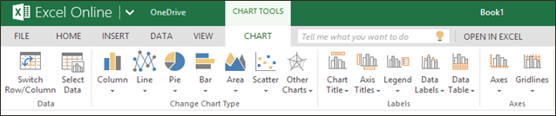
Changing the Chart Type
Using the Chart Tools contextual tab: In Change Chart Type group Select the desired chart type

Slide 46
Chart Titles and Legend
A chart title is the label that describes the entire chart.
An axis title is a label that describes either the category or value axis.
A legend is used to distinguish data points in a pie chart or data series in a multiple series chart.

Slide 47
THANK YOU ☺

