Slide 1


Project Governance
Prepared by Dr. Fayez Jrad
PMG 424
Lecture 05

Slide 2



Project Governance
Lecture 05
PMG 424
Project Ownership vs. Asset Ownership
Prepared by
Dr. Fayez Jrad

Slide 3
Chapter
Learning Outcomes
05
What is asset ownership.
What is project ownership.
What is the difference between project ownership and asset ownership.
Why we need to differentiate between project ownership and asset ownership.

Slide 4
What is an Asset?
An asset is anything that has value (people, qualities, objects, skills).
An asset is a store of value representing a benefit or a series of benefits accruing to the economic owner; it can be:
Tangible, such as hardware, software, data, or documents.
Intangible, such as reputation, knowledge, or intellectual property.
A process, a service, or a function that supports the organization's objectives.

Slide 5
Asset Ownership
Asset ownership has economic benefits, which are any possible income or holding gains/losses by owning the asset.
Each asset needs an owner who has the authority and accountability for its viability and security.

Slide 6
Asset Owners
An asset owner is usually a senior manager or a business unit leader who has the best understanding of the asset's value, purpose, and function.
The asset owner is responsible for classifying the asset, approving its access rights, ensuring its compliance with policies, and reporting any security issues.
The asset owner can delegate some of these tasks to other roles, while remains ultimately accountable for the asset’s usage and security.

Slide 7
Asset Owner Responsibilities
Asset owner responsibilities include:
Deciding on asset custodians, users, and auditors:
  - asset custodians: the technical staff who maintain and support the asset;
  - asset users: the authorized individuals who access and use the asset;
  - asset auditors: the independent parties verifying and evaluating the asset.
Protecting the asset.
Complying with related policies and standards.

Slide 8
Project Ownership
Project governance raised the awareness of the importance of project owners, and of the concept of project ownership.
Project ownership concerns both the control and responsibility for cost and income related to a project.

Slide 9
What is Project Ownership?
There is no universal definition of project ownership.
The definition of project ownership varies from a very narrow to a very wide perspective.
There is considerable overlap in the use of the project owner and the project sponsor terms.

Slide 10
Working Towards a Definition
A project owner usually sits above the project manager.
A project owner is a strategic leader, with overall responsibility for a project.
A project owner is Not necessarily involved in the day-to-day management, but takes care of the vision and goals of the project.
A project owner is responsible for the cost and future value of the project.

Slide 11
Project Ownership Definition
Project Ownership Typically Focuses on One Owner (Person or Group) Responsible for the Cost and Value of Initiating, Securing the Funding, and Overseeing a Project

Slide 12
Project Owner Synonyms
The role of project owner could come with a different job title, but their roles will ultimately remain the same.
Some of the job titles that you might see used instead of project owner include:
Head of project (or project head).
Project chief.
Project director.
Project lead (or project leader).

Slide 13
Project Owner Job Description
The project owner sets the goals for a project, identify how it will benefit the business, and establish processes.
A project owner must be able to communicate effectively and build relationships with main stakeholders.
A project owner must hold both practical and commercial views of the project to be able to understand both technical and business languages.

Slide 14
Project Owner Incentives
A project owner is incentivized to maximize the value creation related to the resources of the project.
Projects owners have incentives for weighing costs against benefits of a project.
Project owners have incentives to cancel a project if the business case no longer justifies the project.

Slide 15
Project Ownership Role
The project owner is typically the person that proposed the project and will be the recipient of the project output.
A project owner can have a defined role within a business, but not all projects are going to have a designated project owner.
A project owner is typically a senior person on the project team.

Slide 16
Project Owner Duties
A project owner works with the project manager throughout the project life cycle.
A project owner:
Defines the project's scope, objectives, and requirements.
Ensures project success through working with the project manager and team members.
Finalizes the risks related to the cost and future value of the project.

Slide 17
Project Owner Responsibilities
Project ownership gives control on the benefits and responsibility of the project.
In a project context, project owners should be responsible for a project’s business case.
Project ownership includes the identification and definition of the project.
The project owner takes the risk related to the cost and future value of a project; these can be transferred to other project actors.

Slide 18
Project Owner Responsibilities
The combination of control and responsibility for both cost and income from the owned resource put owners in a special position.
A project owner is responsible for both the operation of the project delivery as well as the efficient execution of the project.
This requires the project owner to be located at a high level in organizations, where responsibilities for project investments and operations meet.

Slide 19
Summary of Project Owner Responsibilities
Responsible for the “big picture” and owning the project vision.
Enabling and motivating team members.
Taking ownership of the project’s success or failure.
Communicating the project vision and goals with main stakeholders.
Providing strategic leadership in project activities.

Slide 20
Summary of Project Owner Responsibilities
Assisting the project manager.
Encouraging buy-in from other project stakeholders.
Acting as the project advocate and identifying project sponsors.
In some cases, they might also be responsible for parts of the project plan.

Slide 21
Project Owner in Practice
Project ownership may be different practiced when compared to the descriptions of best practice.
Different stakeholders can be responsible for project cost and project benefits.
The term project owner may be used for senior officials responsible for the project delivery.
The project manager reports typically to the project owner.

Slide 22
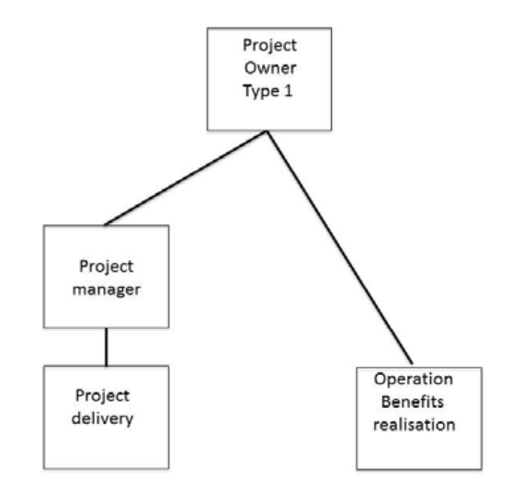
Project Owner Position 1

Slide 23
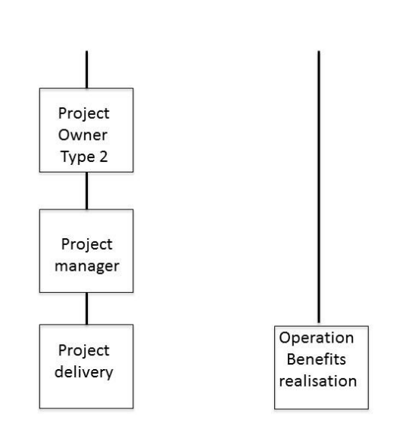
Project Owner Position 2

Slide 24
Project Owner and Other Related Titles
It might be hard to tell the clear difference between project owners and other related titles such as project managers, project sponsors, product owners, product managers, and project leaders.
The distinction between them all can be achieved based on their responsibilities.

Slide 25
Project Owner vs. Project Manager
Owning project execution and day-to-day operations.
Asking, ‘who does what, how, and when?’.
Managing project planning and scheduling.
Creating a project timeline and deadlines.
Assigning specific resources, optimizing resource allocation, and scheduling.

Slide 26
Project Owner vs. Project Manager
Tracking the budget.
Coordinating between teams and delegating tasks.
Optimizing cost, speed, and quality of project deliverables.
Staying on top of performance metrics.
Streamlining processes to ensure the project is completed successfully.

Slide 27
Project Owner vs. Project Sponsor
The role of a project owner and a project sponsor may overlap, but still some distinction can be made.
A project sponsor can:
  Be a single individual or a group who has invested resources or funds in a project.
  Often acts as the champion of a project alongside the project owner.
  Have several projects on the go at once, unlike the project owner.

Slide 28
Project Owner vs. Product Owner
Product owner is a role that initially came out of the Scrum Agile framework.
That said, the role itself is only a few decades old.
The product owner:
  May be able to bridge the gap between execution and strategy.
  Is responsible for organizing sprints and managing the product backlog.
  Often expected to answer any questions from engineers and developers.

Slide 29
Project Owner vs. Product Manager
A product manager is responsible for:
The entire product life cycle.
Identifying customer pain points and needs.
Translating customer needs into a plan.
Prioritizing what needs to be done, and when.

Slide 30
Project Owner vs. Project Leader
Project owners and project leaders are often used interchangeably within organizations.
Both roles are responsible for:
  The vision and success of a project.
  Supporting the wider project team.
  Providing leadership and ensuring teams stay on track.

Slide 31
How To Take Ownership of a Project
There are five best practices to take ownership of a project:
Understand why the project needs to happen.
Define the vision.
Be clear on the project goals.
Enable collaboration.
Stay the course.

Slide 32
Asset Ownership vs. Project Ownership
Asset Ownership
Asset ownership refers to the legal right and control over tangible or intangible items that hold value and can be owned or controlled by an individual or an organization.
The owner of an asset has the right to use, sell, transfer, or dispose of the asset as they see fit, within the boundaries of relevant laws and regulations.
Project Ownership
Project ownership involves overseeing the planning, execution, and delivery of a project, which is a one-time endeavor or a part of an ongoing program or portfolio.
The project owner is accountable for the project's success, including meeting deadlines, staying within budget constraints, and achieving the desired outcomes.
vs.

Slide 33
Asset Ownership and Project Ownership Are Distinct Concepts That Relate To Different Aspects of Ownership and Control Within a Business Context

Slide 34
Why To Distinguish Between Asset Ownership and Project Ownership?
Distinguishing between asset ownership and project ownership helps in effective management, decision-making, and overall organizational success.

Slide 35
Why To Distinguish Between Asset Ownership and Project Ownership?
Some key reasons for making this distinction include:
  Accountability and responsibility.
  Resource allocation.
  Risk management.
  Legal and financial considerations.
  Strategic planning.

Slide 36
Conclusions
Project ownership typically focuses on one owner (person or group) responsible for risk related and the cost and value of a project.
Asset ownership includes having a senior management personnel responsible and accountable for the economic benefits of an organizational asset
Distinguishing between asset ownership and project ownership helps in effective management, decision-making, and overall organizational success.

Slide 37
Task 1
How would you explain the fundamental dissimilarity between asset ownership and project ownership to someone unfamiliar with business terminology?

Slide 38
Task 2
Can you provide examples of scenarios where a clear understanding of asset ownership and project ownership is crucial for effective decision-making within an organization?

Slide 39

Reference

Slide 40



Thank You

