Slide 1




Artificial Intelligence
Eng.Eman Elgallad
Lecture 1- AI overview

Slide 2


Lecture
Overview
01
Introduction
Intelligence Types
What is Artificial Intelligence
Relationship Between AI, Machine Learning, and Deep Learning
Major Schools of AI
Types of AI
AI Eco-system
AI Subfields
Data Science vs. Machine Learning and Data Mining
Data Science Analysis Types
www. esu.ac.ae

Slide 3
Lecture
Introduction
01
"I propose to consider the question, 'Can machines think?'"
— Alan Turing, 1950
"...making a machine behave in ways that would be called intelligent if a human were so behaving."
— John McCarthy et al., 1956
"Artificial intelligence is the science of making machines do things that would require intelligence if done by men."
— Marvin Minsky
www. esu.ac.ae

Slide 4
Lecture
What Is Intelligence?
01
According to the theory of multiple intelligences proposed by Professor Howard Gardner, multiple
intelligences are manifested by eight capabilities:
  Linguistic-verbal intelligence
  Logical-mathematical intelligence
  Visual-spatial intelligence
  Bodily-kinesthetic intelligence
  Musical-rhythmic and harmonic intelligence
  Interpersonal intelligence
  Intrapersonal intelligence
  Naturalistic intelligence
HCIA-AI Huawei
www. esu.ac.ae

Slide 5
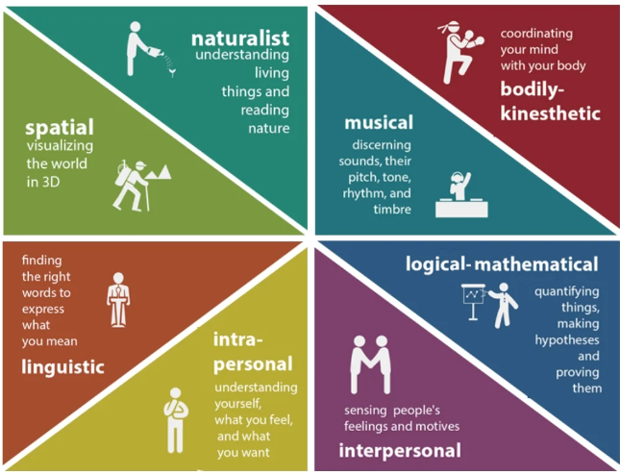
Lecture
01
www. esu.ac.ae

Slide 6
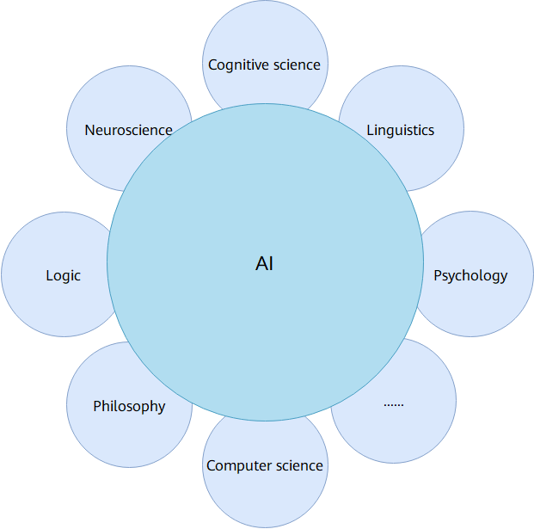
Lecture
Artificial Intelligence
01
"Artificial" in artificial intelligence (AI) means that it is designed by and is created for humans.
AI is a scientific discipline that studies and develops theories, techniques, and application systems used to simulate and extend human intelligence. The term was first coined by John McCarthy in 1956, who defined it as the "science and engineering of making intelligent machines, especially intelligent computer programs".
The very premise of AI technology is to enable machines to learn from collected data, and make human-like decisions.
Today, AI has involved various fields.
www. esu.ac.ae

Slide 7
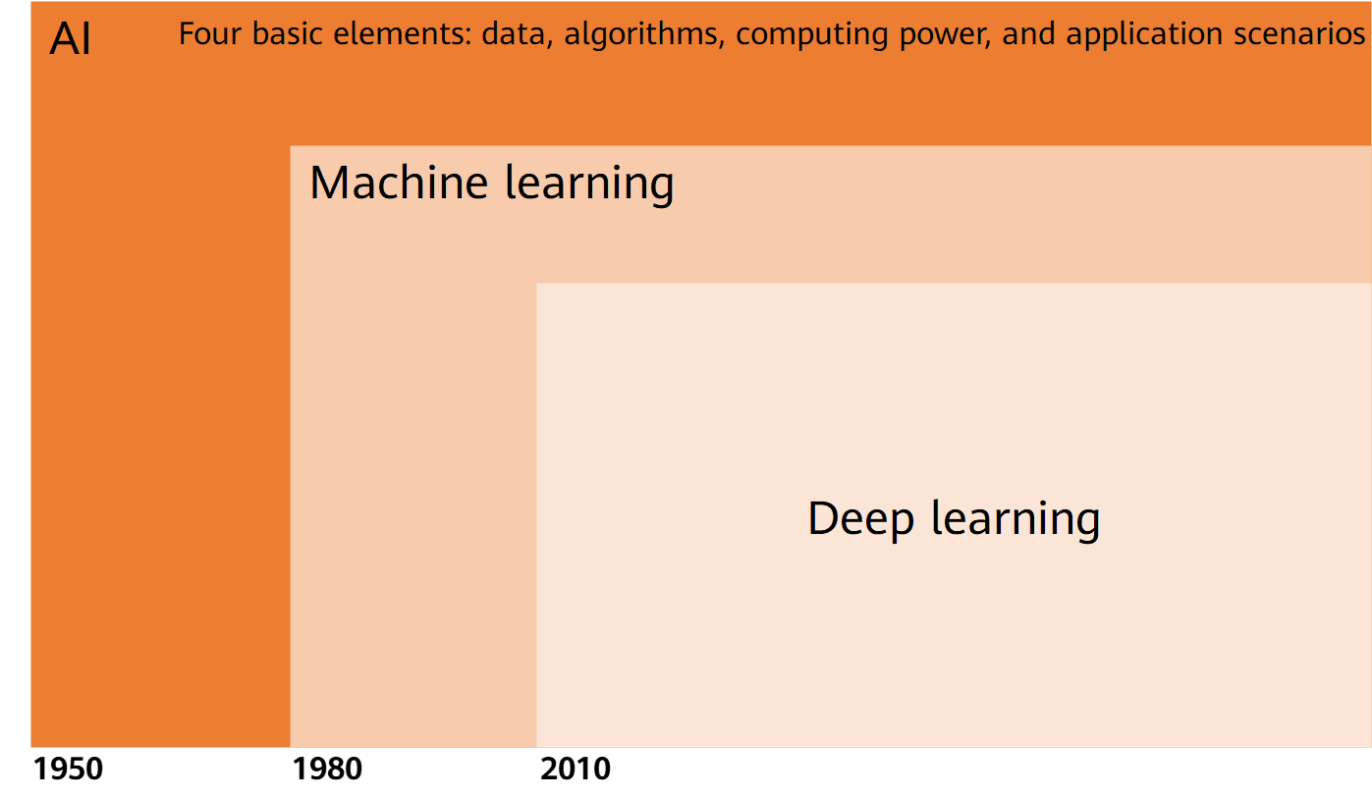
Relationship Between AI,
Machine Learning, and Deep Learning
Lecture
01
www. esu.ac.ae

Slide 8
Lecture
01
AI "artificial intelligence": was previously used to describe machines that imitate and demonstrate "human" cognitive skills related to human thinking.
Machine learning (ML) : refers to the ability of computers to learn, simulate, or implement human behavior to acquire new knowledge or skills, and continuously update existing knowledge structures to improve performance.
Deep learning (DL): is a research field in ML and originates from artificial neural network (NN) studies. Deep learning uses higher level features derived from the lower level features to form a hierarchical representation. Deep learning aims to establish neural networks that simulate the human brain to analyze and interpret data, such as images, voice, and text.
www. esu.ac.ae

Slide 9
Major Schools of AI - Symbolism
Lecture
01
Symbolicism, also called psychologism, or computerism, refers to the symbolic AI that is derived from mathematical logic.
It suggests the basic cognition units of humans are symbols, and human cognition is a reasoning process based on various symbols.
As humans and computers are both physical symbol systems, computers can be used to simulate intelligent human behaviors.
This theory, proposed by McCarthy et al in 1956
symbolicism developed heuristic algorithms -> expert systems -> knowledge engineering theory and technology and made great progress in the 1980s.
www. esu.ac.ae

Slide 10
Major Schools of AI -Connectionism
Lecture
01
Connectionism, argues AI originates from bionics, that is, it is the study of human brain.
Researchers believe the neuron is the basic thinking unit. Connectionism starts with neurons and studies NNs and brain models, to create a new development path for AI.
The McCulloch-Pitts (MP) neuron model was proposed in 1943. However, the study of brain models was limited due to biological prototypes and technical conditions in the 1970s and 80s. It was not until the proposal of hardware-simulated neural networks that the trend of connectionism reemerged again.
Nowadays, the artificial neural network (ANN) is a common technique but its complexity and scale has brought many interpretability problems.
www. esu.ac.ae

Slide 11
Major Schools of AI - Actionism
Lecture
01
Actionism is also known as evolutionism or cyberneticsism and states that AI originates from cybernetics.
It suggests intelligence depends on perception and actions, and that intelligence does not require knowledge, representation, or reasoning. AI can evolve like human intelligence, and intelligent behavior can only be manifested in the real world by interacting with the surrounding environment.
Early research on actionism focused on simulating intelligent behavior of people in the control process. It led to the birth of intelligent control and robotics in the 1980s.
www. esu.ac.ae

Slide 12
Types of AI
Lecture
01
Strong AI:
  This hypothesis aims to create intelligent machines that replicate human functions, such as reasoning and problem-solving, and are perceptive and self-conscious. Strong AI will be able to think independently and teach itself to solve new problems, and have its own values and worldviews, and will even have the same instincts as creatures, such as survival and safety needs. In a sense, strong AI can be seen as a new species.
Weak AI:
  Weak AI aims to build intelligent machines that can perform specific tasks but rely heavily on human interference. These machines may seem intelligent but are not self-conscious.
www. esu.ac.ae

Slide 13
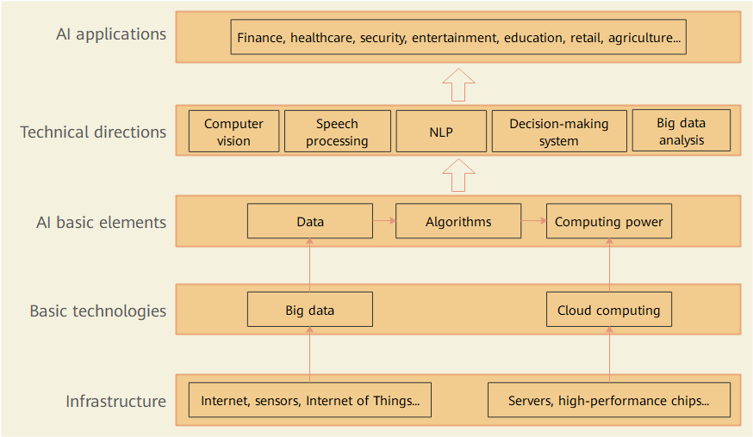
AI - Ecosystem
Lecture
01
Data, algorithms, computing power, and application scenarios are the basic elements of AI applications. We must combine AI with premium cloud computing, big data, and IoT to facilitate our intelligent society.
www. esu.ac.ae

Slide 14
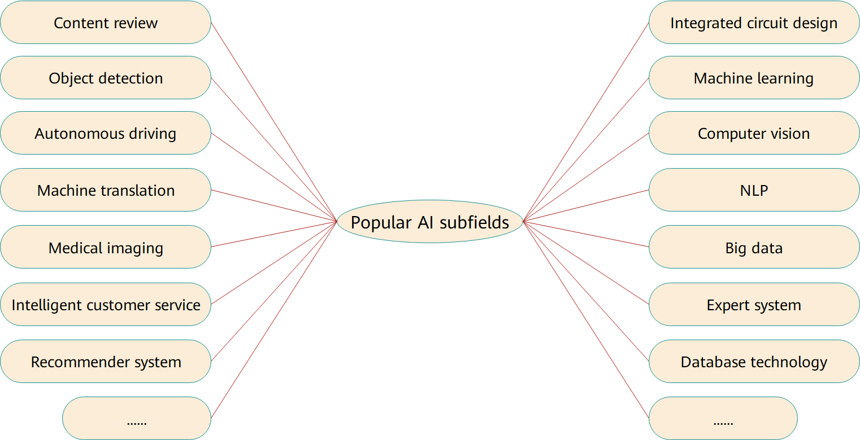
AI - Subfields
Lecture
01
www. esu.ac.ae

Slide 15
DS vs. ML & DM
Lecture
01
▪ Data Mining (DM):
▪ Process of finding the existing patterns in data. Deals with analysis of structured data & places emphasis on commercial applications
▪ Machine Learning (ML):
▪ Design & evaluation of algorithms for extracting patterns or learn from data
▪ Data Science:
▪ Unifies DM & ML, can use big data technologies & incorporates tasks related to ethics & regulation
www. esu.ac.ae

Slide 16
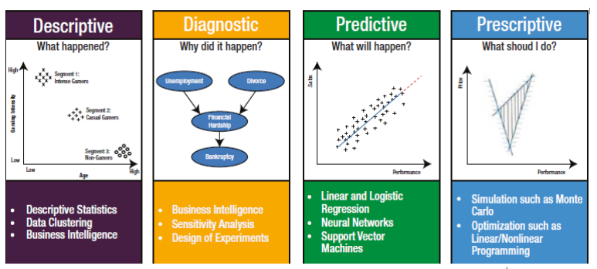
DS Analysis Types:
Lecture
01
Low Level
High Level
www. esu.ac.ae

Slide 17
DS Analysis Types:
Lecture
01
▪ Descriptive Analytics:
Used to explain what is happening in a given situation
E.g., Who are my customers? How many types of users do we have?
▪ Diagnostic Analytics:
Helps you understand why certain things happened & the key drivers
E.g., Why are dropped calls increasing? Why a drop in sales over 3rd qrt.?
▪ Predictive Analytics:
Helps to predict what will happen in the future. Use current & historical data
E.g., Predict if a credit card transaction is fraudulent or not
▪ Prescriptive Analytics:
Necessary actions that to be taken in case of certain predicted event
E.g., What measures should be taken to increase the sales in off season?
www. esu.ac.ae

Slide 18
Will AI take over our jobs?
Lecture
01
Throughout the course of history, humans have sought ways to improve efficiency, that is, to obtain more from fewer resources. Just as sharp stones improve hunting, and steam engines reduce the demand for horses, every step towards automation has changed our society. In the AI era, what tasks will be taken over by AI?
AI may take over:
  Repeatable tasks
  Non-creative tasks
  Tasks that require weak social skills
  Dangerous tasks
  ......
www. esu.ac.ae

Slide 19


