Slide 1




Digital Analytics
MKT631
Lecture 10
Prepared by
Dr. Karim Ahmed
www.midocean.ae

Slide 2

The Art of
Analytics
Part 3
www.midocean.ae

Slide 3

Chapter
Content
10
Ensuring Data Quality
Analyzing for Insights
Countering Bias in Analysis
Storytelling with Data
www.midocean.ae

Slide 4
Chapter
10
Ensuring Data Quality
www.midocean.ae

Slide 5
Chapter
10
Ensuring data quality
Analysts must collect data in a way that ensures its quality. An analysis is only as good as the data that analysts collect. Errors are possible at several points in the data collection process. Understanding these points of “data danger” can help analysts avoid common errors and preserve data quality.
www.midocean.ae

Slide 6
Chapter
10
Ensuring data quality
1- Questionnaire Bias
Questionnaire bias can creep in through the questions consumers answer, typically in surveys. Questionnaire bias leads respondents to a conclusion or influences their responses.
For example, a survey that asks, “What words would you use to describe your love of (brand X)?” implies consumers’ experiences with the brand have been positive. Analysts can eliminate questionnaire bias by designing surveys that feature only neutral, unbiased questions.
www.midocean.ae

Slide 7
Chapter
10
Ensuring data quality
2- Sampling Bias
Sampling bias, also known as “selection bias,” is another way that data can be tainted. When collecting data from a sample of a population, insights from that data are applicable to the larger population only if the sample represents the whole. For example, soliciting opinions on a public official’s performance from only high net worth citizens wouldn’t provide insight into the views of the entire population. When samples don’t represent the whole, sampling bias prevents pattern extrapolation for the entire population.
www.midocean.ae

Slide 8
Chapter
10
Ensuring data quality
2- Sampling Bias
Analysts can reduce the effects of sampling bias by ensuring that surveyed consumers are drawn from all elements of the population, including obvious attributes, such as gender, age, and income, and those more difficult to discern, such as interests, attitudes, and preferences.
www.midocean.ae

Slide 9
Chapter
10
Ensuring data quality
3- Data-Handling Errors
When analysts handle data, they can introduce errors that contaminate the collected information. Understanding these critical points can help analysts avoid data contamination:
Data integration errors – Joining tables can introduce errors. Data accidentally copied, deleted, or incorrectly matched are examples of integration errors that contaminate datasets and have limited value. Handling data carefully is the best way for analysts to minimize errors.
www.midocean.ae

Slide 10
Chapter
10
Ensuring data quality
3- Data-Handling Errors
Data input errors – Errors typically occur when analysts collect data manually. They can transpose numerals, misread them, and enter them incorrectly. Enacting data quality control methods, such as normalizing data (i.e., allowing data inputters to select from a predefined set of inputs), peer reviews, and other techniques can help reduce input errors.
www.midocean.ae

Slide 11
Chapter
10
Ensuring data quality
3- Data-Handling Errors
Calculation errors – When calculations are used to transform data, errors can be common. When analysts use calculations to transform data, they can make errors. Peer reviews and testing calculations on small portions of the data before rolling out to the entire dataset can help reduce such errors.
www.midocean.ae

Slide 12
Chapter
10
Analyzing for Insights
www.midocean.ae

Slide 13
Chapter
10
We’ve reached the point where we can begin analyzing data. The proper approach to analysis is more like making diamonds – compressing all the things we learn into tight, consumable pieces of insight – than hunting for gold. Developing “diamond insights” forces analysts to delete extraneous facts that don’t contribute to the story that emerges from the data. Such insights will be on display as we attempt to synthesize findings into a concise 60-second story that expresses the true heart of the matter and becomes the yardstick by which we’ll measure the value of our analysis.
www.midocean.ae

Slide 14
Chapter
10
The Five Categories of Marketing Data Analysis
1- Descriptive Analysis
The first category of marketing data analysis is descriptive analysis. This is typically the initial kind of analysis an analyst performs. The objective of descriptive analysis is to create a summary of the data to yield useful information and prepare the data for further analysis. For example, summing visitors by month from a dataset of daily visits is a way to gain a descriptive understanding of total monthly website visits. Calculating a mean, median, mode, count, and any other standard statistical values also fits this category of analysis. Descriptive analysis will yield clear answers to simple questions the analyst has asked but won’t provide much more detail. Monthly website visitors can provide insight into traffic trends but answering more nuanced questions requires more sophisticated analysis techniques.
www.midocean.ae

Slide 15
Chapter
10
The Five Categories of Marketing Data Analysis
2- Inferential Analysis
Inferential analysis is a second category of data investigation. This approach features the use of a small set of data to infer something about a larger set. Inferential analysis is commonly the goal of analysis conducted on survey data that has been modeled to account for sampling bias.
We can give an example of Inferential Analysis from customer satisfaction surveys. Suppose a company conducts a customer satisfaction survey among a randomly selected sample of 500 customers out of their total customer base of 100,000. The survey includes questions about overall satisfaction, product quality, customer service, and other relevant factors.
www.midocean.ae

Slide 16
Chapter
10
The Five Categories of Marketing Data Analysis
3- Exploratory Analysis
The third category of analysis is exploratory analysis. Typically, visual based, exploratory analysis seeks to discover connections and patterns in data. This category might not always answer questions, but it reveals interesting connections that lead to deeper investigation and understanding. In this way, exploratory analysis can be a good early step on a broad dataset that points analysts to other techniques.
Example: Social Media Engagement Analysis
Imagine a marketing team wants to understand the effectiveness of their social media campaigns across various platforms. They collect a dataset containing information about post engagement, including likes, shares, comments, and the time of day the posts were made.
www.midocean.ae

Slide 17
Chapter
10
The Five Categories of Marketing Data Analysis
4- Causal Analysis
Causal analysis seeks to determine how the movement of one variable registers on other variables. Typically regarded as the gold standard for data analysis, causal analysis uses correlation and regression techniques to explore the relationship between attributes in a dataset.
Example: Advertising Campaign Impact on Sales
Suppose a company runs an advertising campaign with the goal of increasing product sales. The marketing team collects data on various variables, including the amount spent on advertising (in dollars), the reach of the campaign, and the subsequent sales figures for the promoted product.
www.midocean.ae

Slide 18
Chapter
10
The Five Categories of Marketing Data Analysis
5- Predictive Analysis
Predictive analysis is the final category of marketing data analysis. Closely linked to causal analysis, predictive analysis uses models to predict the future value of data attributes when market forces move some related data. Successful predictive analysis depends on the analyst having the right data and the right data quality. If the model includes data errors, the predictive value will be diminished. Predictive analysis is the most sophisticated method of modeling and analysis.
Media optimization modeling (e.g., MMMs), attribution modeling (e.g., MTAs) and other kinds of response modeling, such as consumer response modeling, are examples of this analysis category.
www.midocean.ae

Slide 19
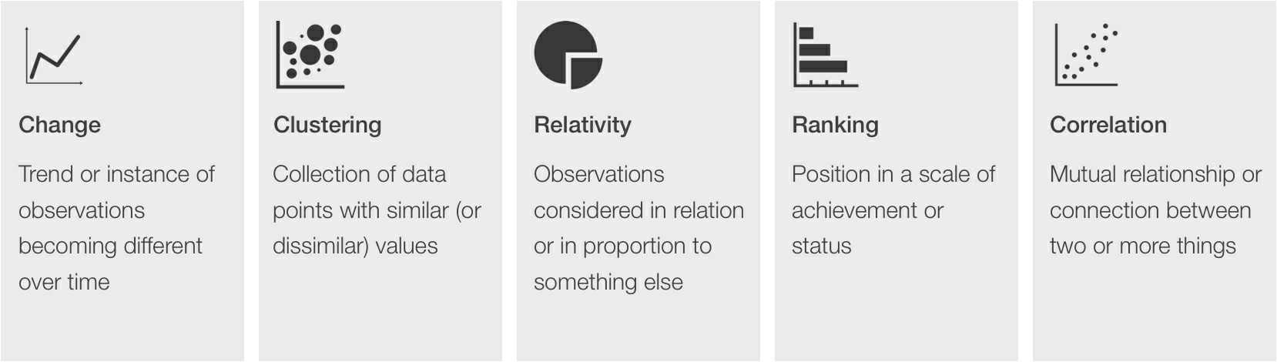
Chapter
10
Finding Patterns in Data
Often, the best way to find patterns in data is to visualize that data. Visualizing data expresses stories that are unrecognizable when the data is in tabular form. We look for five data patterns.
Categories of patterns found in data
www.midocean.ae

Slide 20
Chapter
10
Finding Patterns in Data
Change will present as either gradual change or sudden shifts. Clustering represents a collection of data points that are similar to one and yet different from others. Visual techniques that demonstrate relativity allow analysts to identify how two different data points relate to each other. Ranking determines what’s at the top of the scale, what’s at the scale’s lowest point, and everything in between. Finally, how one set of data influences or affects another is revealed through correlation. Each of these patterns indicate the presence of powerful insights that can aid the analyst’s story.
www.midocean.ae

Slide 21
Chapter
10
Finding Patterns in Data
Certain visual techniques will reveal each pattern and others will obscure them. For example, a line graph will show change over time, but not ranking. A pie chart might be great at depicting relativity but won’t reveal change. In other words, it’s important to identify the appropriate visual to answer each specific question and ensure they’re in alignment.
It’s important to identify the techniques analysts use to answer questions and ensure they’re in alignment.
www.midocean.ae

Slide 22
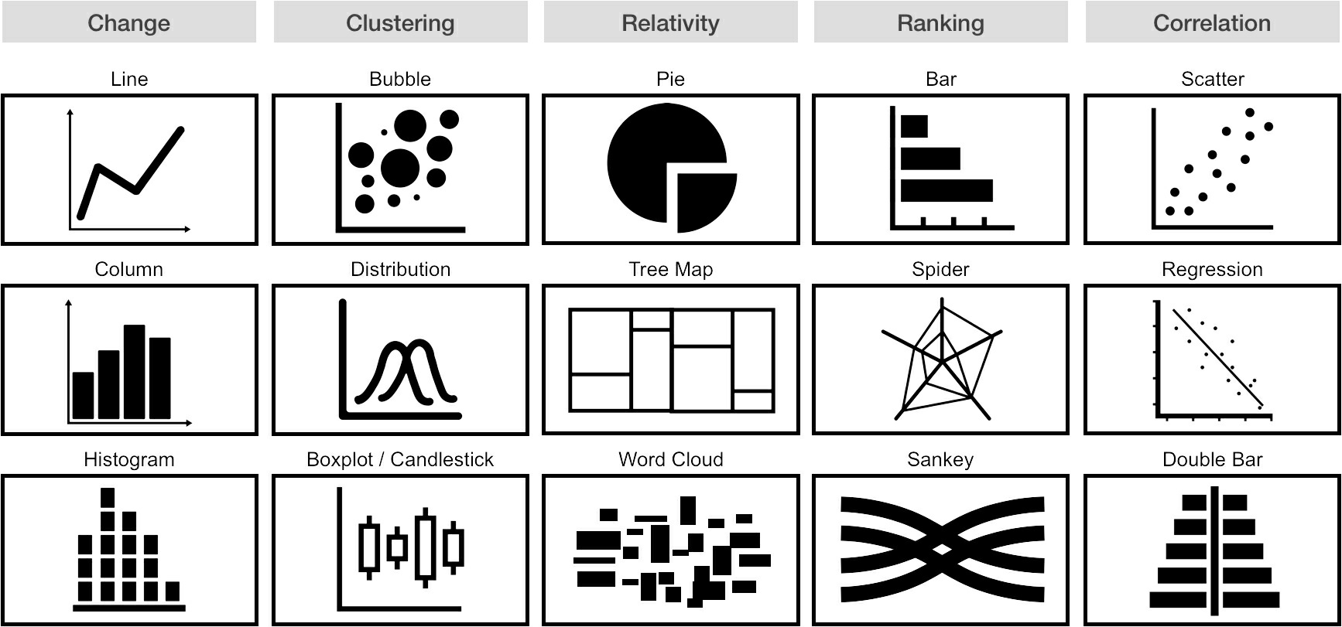
Chapter
10
Finding Patterns in Data
Matching pursuit of patterns to visual forms
www.midocean.ae

Slide 23
Chapter
10
Finding Patterns in Data
Analysts can use a variety of tools to apply each category of visual patterns to the data they’re analyzing:
Change – Analysts can produce common visual forms, such as line charts and bar charts, using nearly any data analysis or visualization tool they choose – from Excel spreadsheets to more advanced data visualization tools like Tableau.
www.midocean.ae

Slide 24
Chapter
10
Finding Patterns in Data
Clustering – While Excel, Google Sheets and other tools have cluster analysis capabilities, the process is unwieldy. Statistical software, including SPSS, features more elegant approaches to clustering data. In addition, analysts can execute clustering analysis with R.
Relativity – Any data analysis or visualization tool will create pie charts and other common visual forms. Analysts can use a tool like Wordle to conduct text relevance analyses to visually quantify relativity in text.
www.midocean.ae

Slide 25
Chapter
10
Finding Patterns in Data
Ranking – Analysts can use any tool to create bar charts and other simple ranking techniques. More sophisticated visual forms, such as spider charts (also known as radar charts) or Sankey diagrams, require the use of more sophisticated tools such as Tableau, or R.
Correlation – While analysts can produce simple correlation techniques using spreadsheet tools, they can perform deeper correlation analyses using SPSS and other statistical software or more robust analysis tools like R.
www.midocean.ae

Slide 26
Chapter
10
Countering Bias in Analysis
www.midocean.ae

Slide 27
Chapter
10
Countering Bias in Analysis
While biases like questionnaire bias and sampling bias can lead to errors that degrade the quality of collected data, biases during analysis can be equally crippling. We can generally classify biases that creep into analysis under the heading of “interpretation bias,” but analysts should know about two common varieties:
accessibility bias
confirmation bias.
www.midocean.ae

Slide 28
Chapter
10
Countering Bias in Analysis
Accessibility bias
People tend to make assumptions based on limited information and fail to seek information not already known. Analysts can protect against this bias by ensuring they analyze the data they need – not simply the data they have. The simplest way for analysts to do that is to look objectively at the question the analysis is answering and compare the data included in the analysis with the data they would collect in a perfect world. If the current dataset matches the ideal data (or if dependable proxies have been found for the desired data) analysts can move content forward, knowing they’ve minimized accessibility bias.
www.midocean.ae

Slide 29
Chapter
10
Countering Bias in Analysis
Accessibility bias
Imagine a digital marketing agency analyzing the performance of a recent online advertising campaign for a client. The agency has access to data such as click-through rates, conversion rates, and engagement metrics from the campaign's digital platforms. In a rush to provide quick insights to the client, the analysts focus solely on the available data without considering external factors.
www.midocean.ae

Slide 30
Chapter
10
Countering Bias in Analysis
Accessibility bias
In this scenario, accessibility bias may occur if the analysts don't look beyond the metrics readily available to them. For instance, they might not consider external factors such as changes in market trends, competitor activities, or shifts in consumer behavior that could impact the campaign's effectiveness. By limiting their analysis to the data they have on hand, they risk missing out on a comprehensive understanding of what contributed to the campaign's success or challenges.
www.midocean.ae

Slide 31
Chapter
10
Countering Bias in Analysis
Accessibility bias
To mitigate accessibility bias in digital marketing analytics, analysts should take a holistic approach. They should critically assess whether the data they have covers all relevant aspects of the campaign's performance. This may involve seeking additional data sources, considering external factors, and ensuring a more thorough analysis to provide the client with a well-rounded and accurate assessment of the digital marketing campaign.
www.midocean.ae

Slide 32
Chapter
10
Countering Bias in Analysis
Confirmation bias
Approaching an analysis with a preconceived idea of what the data will say introduces the risk of confirmation bias. Such prejudice can lead an analyst to draw a conclusion after finding supporting evidence for that conclusion, without reviewing the entire dataset. The analyst will arrive at the answer they seek, but not necessarily the right answer. Analysts can counter confirmation bias by challenging their assumptions and allowing stories to rise from the data organically.
www.midocean.ae

Slide 33
Chapter
10
Countering Bias in Analysis
Confirmation bias
A discussion between an analyst and the chief marketing officer (CMO) of a multinational quick-serve restaurant company illustrates the challenge of confirmation bias. During a three-hour meeting, the analyst presented an analysis that demonstrated the importance of digital media to this brand and substantiated the need to divert money from television advertising to online video. Hard-hitting facts related to demographic shifts, consumer behavior trends, and the ability to achieve more measurable levels of brand engagement build a strong, data-based case for how the brand could achieve greater results with a media plan that increased its online video presence.
www.midocean.ae

Slide 34
Chapter
10
Countering Bias in Analysis
Confirmation bias
The executive dismissed the analysis with a simple wave of his hand, saying, “We do our own analysis on our media spend. Each month, I look at the curve of our television ad spend over time and the curve of our sales over time and the two are almost perfectly correlated. TV drives our sales.”
What followed was a conversation about correlation and the difference between it and causality. But we also talked about confirmation bias and how the analysis the brand conducted sought to confirm the CMO’s narrative rather than reveal the best results for the brand.
www.midocean.ae

Slide 35
Chapter
10
Storytelling with Data
www.midocean.ae

Slide 36
Chapter
10
Storytelling with Data
Studies show that people forget 80 percent of what they learn within 24 hours. As analysts who’ve worked so hard to construct stories by working through tons of data to craft perfect diamond insights, we want our audiences to remember what we say. Often, audiences forget information presented because it slips through gaps in attention or the information isn’t introduced in a memorable way. So, how does an analyst – as a Data Designer eager to present their story in an effective visual form – do that?
www.midocean.ae

Slide 37
Chapter
10
Storytelling with Data
1- Know Your Audience:
Understand the background, expertise, and interests of your audience.
Consider whether they are familiar with the specific terminology and concepts you'll be presenting.
Tailor your storytelling approach to resonate with the audience's perspective and priorities.
2- Simplify Complexity:
Identify the core message you want to convey and break down complex data into digestible components.
Avoid jargon or technical terms that might confuse your audience.
Use analogies or real-world examples to simplify intricate concepts.
www.midocean.ae

Slide 38
Chapter
10
Storytelling with Data
3- Create a Clear Narrative:
Structure your presentation with a clear storyline that has a beginning, middle, and end.
Ensure a logical flow of information, guiding your audience through the journey of your data insights.
Use a narrative arc to build suspense or emphasize key points.
4- Use Visualizations Wisely:
Choose visualizations that align with the data and enhance understanding.
Avoid unnecessary complexity in visuals; simplicity often aids comprehension.
Provide clear labels and context for each visualization to aid interpretation.
www.midocean.ae

Slide 39
Chapter
10
Storytelling with Data
5- Focus on Key Insights:
  Prioritize the most critical findings that align with the overarching narrative.
  Use visual cues, such as color or emphasis, to highlight key data points.
  Avoid overwhelming your audience with unnecessary details.
6- Make it Relatable:
  Connect data points to real-world situations or scenarios that your audience can easily grasp.
  Use relatable examples to bridge the gap between data and everyday experiences.
  Humanize the data by considering its impact on individuals or communities.
www.midocean.ae

Slide 40
Chapter
10
Storytelling with Data
7- Engage the Senses:
  Craft visually appealing and well-designed slides or materials.
  Consider incorporating storytelling elements that engage both the visual and auditory senses.
  Use multimedia, such as videos or audio clips, when they enhance the narrative.
8- Encourage Interaction:
  Foster engagement by allowing your audience to explore the data interactively.
  Use tools that enable hands-on exploration or include Q&A sessions.
  Solicit feedback or questions to ensure active participation.
www.midocean.ae

Slide 41
Chapter
10
Storytelling with Data
9- Repeat and Reinforce:
  Strategically repeat key messages to reinforce important insights.
  Use visual repetition or verbal summaries to emphasize critical points.
  Reinforcement aids memory retention and comprehension.
10- Provide Context:
  Offer background information to contextualize the data and its relevance.
  Clearly articulate the implications of your findings and any actionable steps.
  Help your audience understand the broader significance of the data within a larger context.
www.midocean.ae

Slide 42
In this lecture, we discussed:
Ensuring Data Quality
Analyzing for Insights
The Five Categories of Marketing Data Analysis
Finding Patterns in Data
Countering Bias in Analysis
Storytelling with Data
www.midocean.ae

Slide 43


Thank You

