Slide 1




Social Media and Crises
Lecture 3
DGM 730
Analysis of Social Media Crisis
Prepared by
Dr. Doaa Rady

Slide 2

Lecture
03
Lecture outline
Analysis of Social Media Crisis
What is crisis management in social media?
  How does social media affect a crisis?
The categories of Social Media Crisis
The levels of Social Media Crisis
The life cycle of Social Media Crisis
How to analyze a crisis?
Principles of Crisis Response

Slide 3
Lecture
03
What is crisis management in social media?
Crisis management in social media is the process through which a brand uses social media to address a crisis.
Although some crises can originate from social media, often the mess happens offline and then overflows onto social media as the public takes the story and runs with it.

Slide 4
Lecture
03
What is crisis management in social media?
An example:
Back in 2019, a Duke University freshman basketball player got a serious injury when his Nike shoes literally fell apart. This took place during a basketball game, and it didn’t take long before the whole story was on social media, riding a wave of attention from high-profile people like Barack Obama and LeBron James.

Slide 5
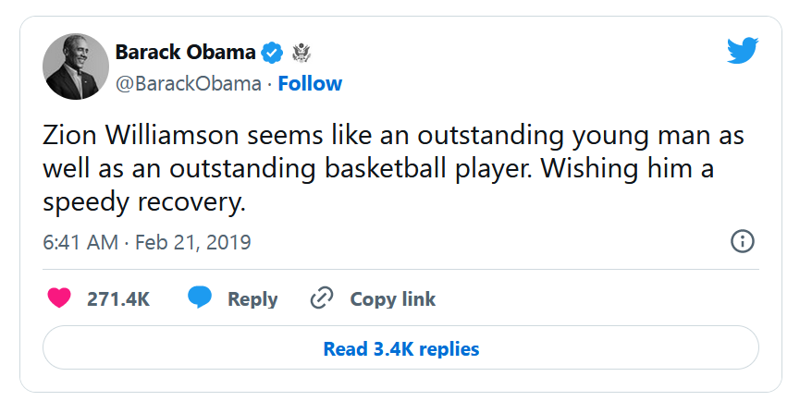
Lecture
03
What is crisis management in social media?

Slide 6
Lecture
03
What is crisis management in social media?
An example:
Needless to say, the crisis outpaced any damage control the brand's PR tried to do, and in fact went so far as to affect Nike’s stocks. That shows just how crucial crisis management is and social media's role during a crisis.
That brings us to the next question:
How does social media affect a crisis?

Slide 7
Lecture
03
How does social media affect a crisis?
Social media is a double-edged sword when it comes to handling a crisis, capable of resolving the situation or making things much, much worse, depending on how you use it. The vast number of people on social media means that a single wrong move can harm your brand's reputation in front of literally millions of vocal users.

Slide 8


The categories of Social Media Crisis

Slide 9
Lecture
03
The categories of Social Media Crisis
Types of social media crises
Social media crises can even be classified into types:
Multi-channel crisis – extremely dangerous because it has the potential to go viral and generate a great deal of negative publicity very quickly.
Emerging crisis – If you don’t anticipate and deal with it as soon as possible, it can quickly escalate into a bigger scandal.
Industry crisis – occurs when a vendor or competitor is experiencing a social media crisis. For example, when many fashion brands are suddenly all attacked for non-transparent actions.
Fake news – in the age of social media, a post can go viral in just one click. The ability to detect rumors about your brand quickly is essential.

Slide 10

The levels of Social Media Crisis

Slide 11
Lecture
03
The levels of Social Media Crisis
The three phases of a crisis
Pre-crisis phase: entails prevention and preparation for a potential crisis and the reduction of the risk of one occurring. This includes creating a crisis management plan, training and preparing a crisis response team and performing tests and drills.
Research showed that organizations generally handle crises better when they have a crisis management plan that is updated at least once a year, and a specific crisis management team that exercises it annually.

Slide 12
Lecture
03
The levels of Social Media Crisis
The three phases of a crisis
Crisis response phase: looks at the initial crisis response and then reputation repair. After encountering a crisis, it is important to be rapid and accurate.
Researchers suggest that a response should be in place within the first hour after it occurs. The reason is that they have a chance to articulate their side of the story and to stay on top of where the conversation is going.
When addressing the media regarding a crisis, an organization should very carefully select their spokesperson. Ideally, the spokesperson should present information clearly and avoid using technical terms. Further, the spokesperson should appear pleasant, maintain strong eye contact, and no exhibit no visual nervous habits.

Slide 13
Lecture
03
The levels of Social Media Crisis
The three phases of a crisis
The post-crisis phase where the company is going back to business as usual. Here a company should release any further updates in the aftermath of the event. Additionally, the company should analyze how the crisis transpired and attempt to learn from the experience—what did and did not work, and what could have been done differently and so on.

Slide 14
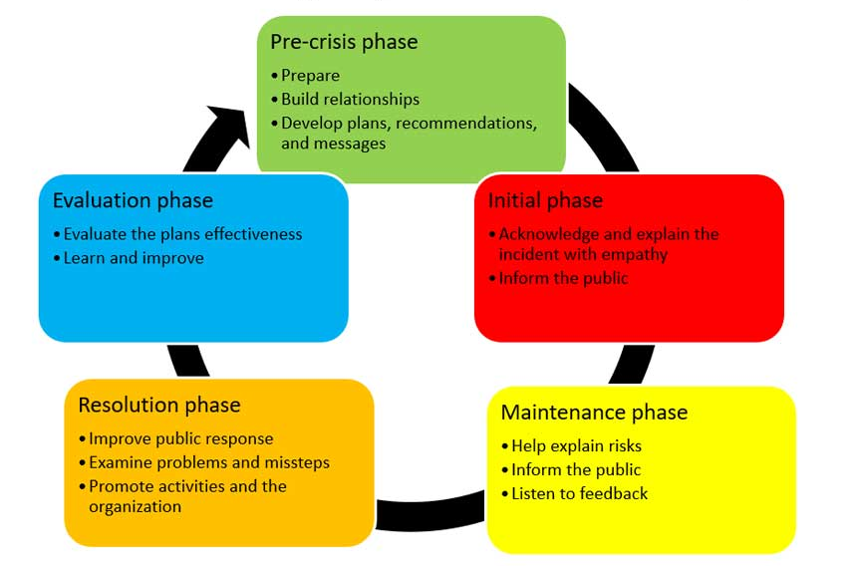
The life cycle of Social Media Crisis

Slide 15
Lecture
03
The life cycle of
Social Media Crisis
The Stage of Detection of Warning Signals
It refers to the stage before the onset of the crisis, and it is represented by the ability of the organization to respond to the warning signals that may cause the crisis which includes taking preventive measures that would prevent the occurrence of the crisis, or at least mitigate its severity and effects if it occurred despite the organization’s efforts to prevent its occurrence and discovering early warnings of the occurrence of a crisis means discovering the crisis before it occurs, which will be a pleasure in preparing for it.

Slide 16
Lecture
03
The life cycle of
Social Media Crisis
The Preparedness and Prevention Stage
The organizations must at this stage create an emergency plan to confront the crisis, and form a crisis management team, who has previous experience in crisis management as possible.
This stage also includes discovering the weak points in the organization and developing a plan to confront them, and identifying the necessary methods and tools necessary to help confronting the crisis, training employees on how to face crises, benefit from the lessons of others, develop information about crises and expected problems, and evaluate their degree of severity.

Slide 17
Lecture
03
The life cycle of
Social Media Crisis
The Crisis Containment Phase (harm containment)
In this stage, a set of measures to be taken are defined, the communication processes are organized within the crisis field itself, the situation is stopped deteriorating, the losses are reduced, the psychological and social effects resulting from the crisis are addressed, and the practical performance is improved in a better way than before. Accordingly, the plans are carried out by implementing the decree to confront the crisis, and by using the organization's resources to reduce the crisis.

Slide 18
Lecture
03
The life cycle of
Social Media Crisis
The Activity Recovery Stage
where the activity and operations of the organization are resumed, and the organization evaluates its loss and assesses what is required in order to fully benefit from the activity and balance, human resources play an important role in this process, provided that human resources situation must be evaluated and what are the remaining capabilities of the organization, and what are the assets used and exploited after knowing the resources available so as to use them efficiently and effectively.

Slide 19
Lecture
03
The life cycle of
Social Media Crisis
The Learning Stage
It is the stage of drawing morals and lessons, and benefiting from the experience of dealing with the previous crisis to form experiences capable of avoiding crises, avoiding their recurrence, and standing at weaknesses, improving and avoiding them through the process of development and improvement.

Slide 20

How to analyze a crisis?

Slide 21
Lecture
03
How to analyze a crisis?
A social media crisis can damage your brand reputation, customer loyalty, and revenue. But it can also be an opportunity to learn from your mistakes, improve your communication, and strengthen your community.
Now every crisis finds its way onto social media, either by accident or purpose, but always with consequences.
Social media had transformed the way every crisis emerges, how it’s driven, and how it’s handled.

Slide 22
Lecture
03
How to analyze a crisis?
What are the main points to analyze a crisis recently in the news?
• The nature of the crisis.
• When it was discovered.
• The timeliness of the organization’s response to the crisis.
• The nature of the response.
• Any unintended consequences of the response.
• The effectiveness of the response.
• How individual constituencies were affected by the crisis and
response.
• How the crisis was resolved, if it has been.
• Your assessment of what worked, what didn’t and how the
organization might have been more effective in its response.

Slide 23
Lecture
03
How to analyze a crisis?
Identify the root cause
The first step is to find out what triggered the crisis, how it spread, and who was affected. You can use tools like social listening, sentiment analysis, and web analytics to monitor the online conversations, feedback, and traffic related to the crisis. You can also interview your team members, customers, and stakeholders to get their perspectives and insights. By identifying the root cause, you can understand what went wrong and how to prevent it from happening again.

Slide 24
Lecture
03
How to analyze a crisis?
Assess the impact
The second step is to measure the impact of the crisis on your brand, your audience, and your goals. You can use metrics like reach, engagement, sentiment, conversions, and retention to evaluate how the crisis affected your social media performance, your online reputation, and your business outcomes. You can also compare your results with your previous benchmarks, your competitors, and your industry standards to see how you fared in the crisis. By assessing the impact, you can quantify the damage and the opportunities for improvement.

Slide 25
Lecture
03
How to analyze a crisis?
Apologize and respond
The third step is to apologize and respond to the crisis in a timely, transparent, and sincere manner. You can use your social media channels, your website, your blog, or your email to communicate with your audience and stakeholders. You can acknowledge the issue, express your regret, explain your actions, and offer a solution or a compensation. You can also answer the questions, address the concerns, and thank the feedback of your followers, customers, and partners. By apologizing and responding, you can show your accountability, empathy, and commitment.

Slide 26
Lecture
03
How to analyze a crisis?
Implement and monitor
The fourth step is to implement and monitor the actions and solutions you promised in your response. You can use tools like project management, task management, and collaboration to coordinate your team, assign responsibilities, and track progress. You can also use tools like social media management, customer service, and feedback to deliver your solution or compensation, follow up with your audience and stakeholders, and measure their satisfaction. By implementing and monitoring, you can demonstrate your reliability, professionalism, and value.

Slide 27
Lecture
03
How to analyze a crisis?
Review and report
The fifth step is to review and report the results and outcomes of your actions and solutions. You can use social media analytics, web analytics, and surveys to collect and analyze the data and feedback related to your crisis management. You can also use tools like reports, dashboards, and presentations to summarize and visualize your findings and insights. By reviewing and reporting, you can evaluate your performance, identify your strengths and weaknesses, and share your learnings and recommendations.

Slide 28
Lecture
03
How to analyze a crisis?
Learn and improve
The sixth step is to learn and improve from your social media crisis. You can use tools like SWOT analysis, gap analysis, and best practices to identify the opportunities and threats, the gaps and needs, and the examples and standards for your social media strategy. You can also use tools like goals, plans, and actions to set your objectives, define your tactics, and execute your initiatives. By learning and improving, you can enhance your skills, optimize your processes, and grow your results.

Slide 29

11 Principles of Crisis Response

Slide 30
Lecture
03
11 Principles of Crisis Response
To reduce response time, there are several principles that the prepared communication professional should adhere to :
1) Lead, do not hide. Joe Louis, the boxer once said, “You can run, but you can’t hide.” This is true in crises. While focusing blame may not be the answer, it is always a question. The more you duck responsibility, the more you hide, the more you lose
credibility and are blamed.

Slide 31
Lecture
03
11 Principles of Crisis Response
2) Acknowledge the problem.
Even though you might not know much about the facts of the situation, even though you do not have a solution, you can at least acknowledge that there is a problem and say you are working on it. Do that right away.

Slide 32
Lecture
03
11 Principles of Crisis Response
3) Act in the public' s interest. Put more simply, “do the right thing.” The public has an enormous ability to forgive if they perceive sincerity and concern in the organization’s messaging.
4) Move quickly. Get to the bottom of a problem.

Slide 33
Lecture
03
11 Principles of Crisis Response
5) Pose solutions.
Define your own answers rather than have answers imposed upon you. Set the record straight. Delay gets confused with incompetence or simply not caring. Action, however small, builds confidence both internally and externally that progress can be made.

Slide 34
Lecture
03
11 Principles of Crisis Response
6) Put your values ahead of your pocketbook. Johnson & Johnson still gets credit for what may be the everlasting gold standard of crisis management.
When Tylenol capsules were tampered with and poisoned by a maniac, Johnson & Johnson did not hesitate for a minute. They
withdrew the product everywhere. Their famous “Credo” was their guide in reacting to the Tylenol crisis. It starts with “…our
first responsibility is to the doctors, nurses, and patients…” They never considered the bottom line. Follow J&J’s fine example.

Slide 35
Lecture
03
11 Principles of Crisis Response
7) Show compassion—apologize. Care about the impact of the crisis on the people who are affected. Say you are sorry. People love to forgive and forget.
8) Fix the problem. Stop doing whatever is causing the harm. Do not do it again. And make it better. And do not forget; the cover-up is always worse than the crime.

Slide 36
Lecture
03
11 Principles of Crisis Response
9) Communicate fast and forthrightly.
Even before you fully understand the crisis, and well before you have a solution, you can still at least acknowledge that you know about the problem and that you are working on it. Talk east and walk east. Do not hedge, or use “weasel words,” like President Clinton’s attempt to ask what the meaning of “is” is.20 And, do not cave in to the lawyers’ demands for “no comment.” Legal liability assertions are nonsense when your reputation is on the line.

Slide 37
Lecture
03
11 Principles of Crisis Response
10) Use all your channels. It is time to employ all those channels you have built—Facebook, Twitter, YouTube, LinkedIn, blogs, your website, and so forth. And make sure the communication is appropriate to the channel.
11) Know when to take it offline. A lot of customer service issues start with a simple question you can often answer with a phone call. Do not get into a back-and-forth argument online.
Offer a phone number or email address. Even if it does not satisfy the person complaining, it at least shows others that you are trying.

Slide 38
Lecture
03
Conclusion
Analysis of Social Media Crisis
What is crisis management in social media?
  How does social media affect a crisis?
The categories of Social Media Crisis
The levels of Social Media Crisis
The life cycle of Social Media Crisis
How to analyze a crisis?
Principles of Crisis Response

Slide 39
Lecture
03
Recommended Reference
Mzyece, N. (2020). An Assessment on the Effects of Social Media on Crisis Management in Telecommunication Companies in Zambia (Doctoral dissertation, Cavendish University). http://155.0.3.194:8080/jspui/bitstream/123456789/626/1/An%20Assessment%20on%20the%20Effects%20of%20Social%20Media%20on%20Crisis%20Management%20in%20Telecommunication%20Companies%20in%20Zambia.pdf
Civelek, Mustafa & Çemberci, Murat & Eralp, Erdem. (2016). The Role of Social Media in Crisis Communication and Crisis Management. International Journal of Research in Business and Social Science. 5. 111-120. 10.20525/ijrbs.v5i3.279.
Al Jaberi, A. M., &amp; Qawasmeh, F. (2020). The impact of using social media in crisis management according to employees perspectives. International Journal of Academic Research in Business and Social Sciences, 10(11). https://doi.org/10.6007/ijarbss/v10-i11/8130
Edwards, K. (2021, June 24). 4 examples of social media crises that could have been prevented. Determ. https://www.determ.com/blog/social-media-crisis-examples/

Slide 40


Thank You

