Slide 1

Digital Media and Social Relations
Prepared by Dr. Shereen Kedwany
Lecture 5
DGM 711
Introduction to Digital Media

Slide 2

Chapter
05
Reminder
Technological determinism approach understands technology as an independent force that can determine the development of a society.
The social construction of technology approach suggests that the development, structure, and significance of a technology depends on the strength, needs, and values of the social groups that promote and design it.
Technologies are not neutral but rather have a “politics.”
Similar approaches also recognize the active role of users of technologies repurpose, modify, and resist technology.
Scholars have also noted the existence of “superusers” with specific technical skills and professional positions.
Electronic media were destined to transform humanity into a “global village”.

Slide 3

Chapter
05
Outline
I. Digital Sociality .
II. Social media .
III. Sociality Algorithms .
VI. Conclusion.

Slide 4
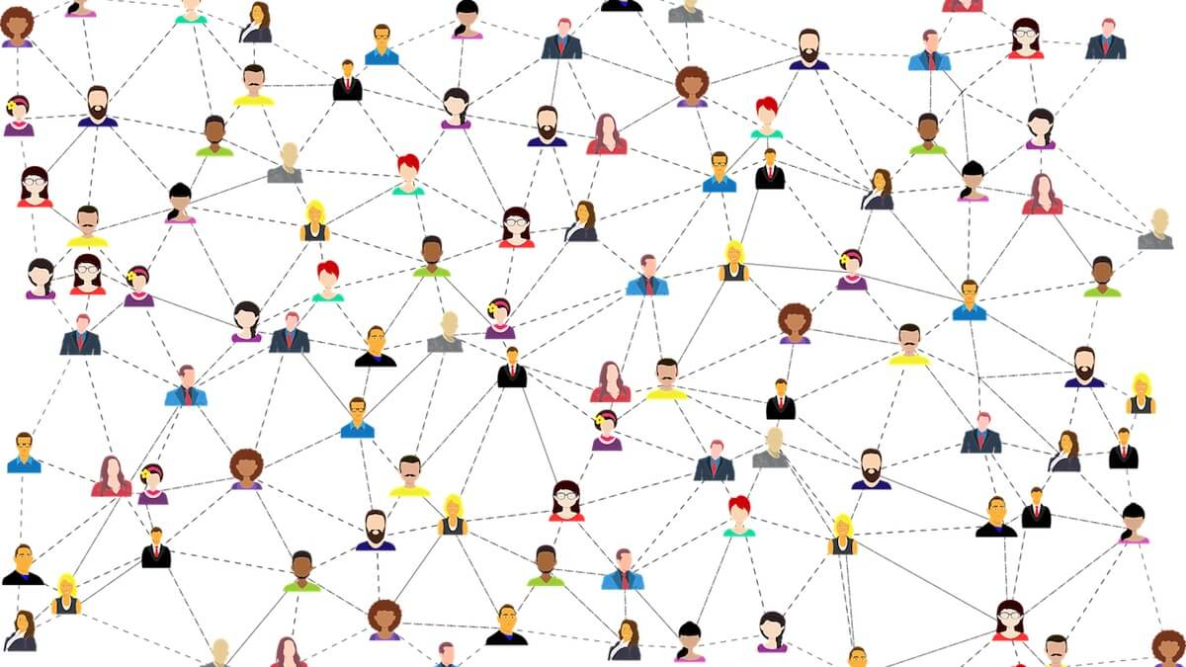
Chapter
05
I. Digital Sociality :
Activities mediated by digital technologies such as social media services have an impact on people’s life and identity.
Digital media foster new forms of interaction and enrich the social life of individuals.

Slide 5
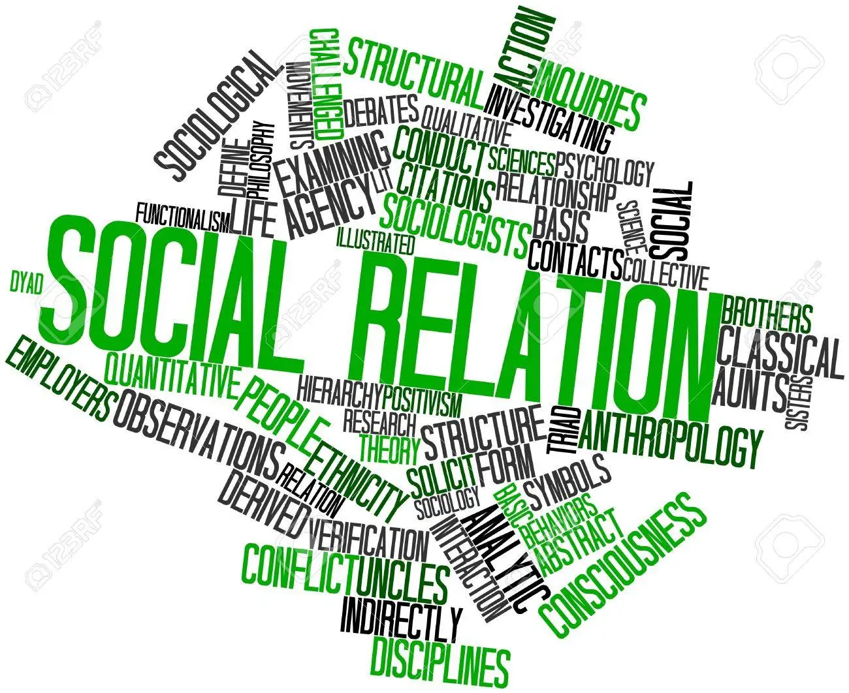
Chapter
05
I. Digital Sociality :
Yet the social relations these technologies mediate are not neutral, but rather depend on uneven power dynamics, as well as on cultural and identity factors.
Digital media can challenge, but also contribute to cementing such factors.

Slide 6
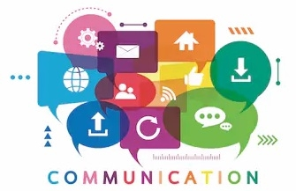
Chapter
05
I. Digital Sociality :
Social relations have always been influenced by communication technologies.
The first political organizations, such as the city‐states of antiquity, were born in parallel with writing.
Without a means of communication able to cross physical distances and maintain communications over time it would be very difficult to organize a complex social system, collect taxes, and ensure the continuity of the laws or religious customs.

Slide 7
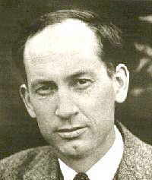
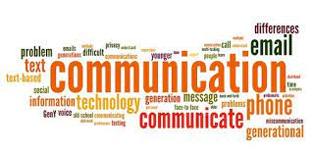
Chapter
05
I. Digital Sociality :
The same is true for modern organizations.
The invention of printing has changed in depth the forms of production and transmission of culture and knowledge by allowing for social relations to be built across space and time.
In the mid‐twentieth century, Canadian media theorist Harold Innis studied how modern bureaucratic organizations, such as a state, could not emerge without effective and codified communication systems for the creation and reproduction of documents (1950).

Slide 8


Chapter
05
I. Digital Sociality :
Yet media are also essential for creating and maintaining informal groups, as well as for the construction of individual identity.
The boom of 1960s youth cultures depended to a significant degree on technologies such as the portable turntable, which allowed people to listen to music outside the home, television, which made possible the almost global and immediate spread of trends and fashions (think of the success of the Beatles), and the phone, which allowed teenagers to interact and communicate with peers.

Slide 9
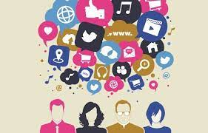
Chapter
05
I. Digital Sociality :
The arrival of digital media and mobile technologies asks for a renewed attention to the relationship between media technologies and social relations as part of the evolution of contemporary information societies.
Digital media have had an unprecedented speed and rate of penetration, as they grew from having a few thousand to several billion users in just two decades.
They have also been characterized by the rapid succession of new communication platforms.
This differentiation makes it necessary to evaluate different digital technologies in depth, avoiding a simplistic focus on an alleged link between somewhat abstract overall effects of digital technologies and social relations.

Slide 10
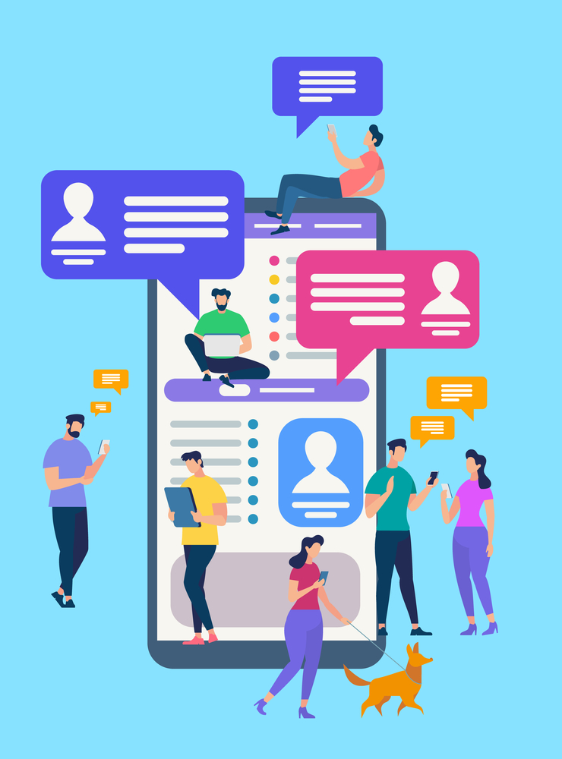
Chapter
05
I. Digital Sociality :
In the last decades of the twentieth century, two opposing visions seemed to dominate the debate on digital media:
on the one hand, they were said to be separated from the social world of everyday “real‐life” interactions.
On the other hand, many maintained that they had disruptive effects on all forms of sociality .
However, today’s digital media are characterized by a strong integration between online and offline lives, up to the point that these distinctions seem to lose meaning.

Slide 11

Chapter
05
I. Digital Sociality :
In the 1990s, when the internet was accessed via telephone modems, and when the most important platforms were web pages, mailing lists, forums, and Bulletin Board Systems (BBSs), one could reasonably speak of an experience of networks that was distinct from that of the real world: definitions such as “virtual” world or “cyberspace” described a place where it was possible to hide one’s real identity by using alternative names or identities.

Slide 12

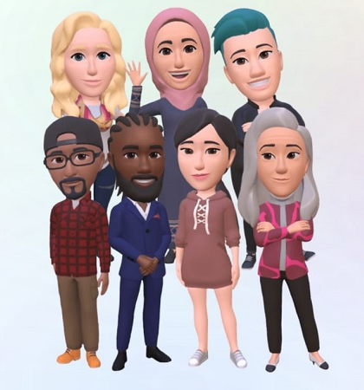
Chapter
05
I. Digital Sociality :
For example, media theorist Lisa Nakamura described “identity tourism” as a fluid process in which internet users use avatars to perform, swap, and even buy identity.
Through such processes, Nakamura claimed, “our ideas about race, ethnicity, and identity continue to be shaped and reshaped every time we log on” (2002).

Slide 13


Chapter
05
I. Digital Sociality :
According to American psychologist Sherry Turkle, in the 1990s users could “experiment with identity by playing out parallel lives” in which they would “shift age, gender, race, and class” (2008).

Slide 14
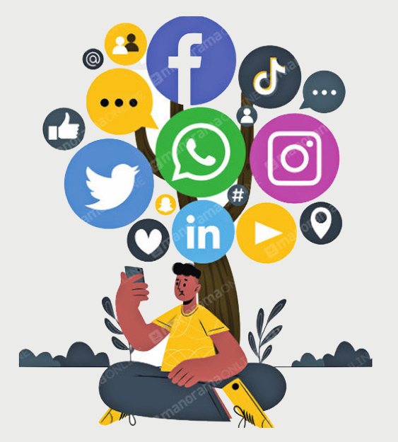
Chapter
05
I. Digital Sociality :
Today, social media users tend to post content related to activities, emotions, and events which belong to their daily lives.
Mobile technologies such as smartphones and tablets provide access to services like Twitter, Tumblr, or Snapchat anywhere, in a variety of different situations – in the classroom, on the bus, in the office, or at home.
Mobile technologies promote an “always on” lifestyle, that is, continuously connected.

Slide 15

Chapter
05
I. Digital Sociality :
Therefore, social relationships seem to always be mediated, but that does not make them less significant.
Mobile technologies have a crucial role in these processes, as they move the internet into everyday environments – think of carrying a smartphone – thus blending mediated space and material space in the experience of the user .

Slide 16
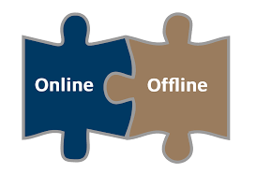

Chapter
05
I. Digital Sociality :
In this sense the difference between online and offline tends to disappear:
online activities, albeit mediated by digital technologies, are fully integrated in everyday social life and social media profiles have a crucial role in people’s overall identities.
Finally, social media tend to weaken the distinction between public and private, since users share details of their private life publicly via digital platforms.
These details become part of individuals’ communicative strategies, which thus take place in the context of continuous connection through ubiquitous media (Deuze 2012).

Slide 17
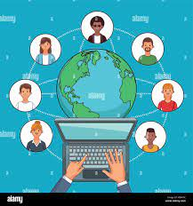
Chapter
05
II. Social media :
As part of the increased mediatization of everyday social practices and relations, the services that dominate the digital media landscape are social media platforms.
Social media are websites based on the ability to build and maintain social ties they provide to users.
Many scholars studying social media have proposed that these technologies have assumed a central role in structuring new forms of social relations and contribute crucially to the construction of personal and group identity .

Slide 18
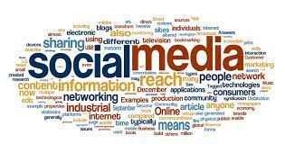
Chapter
05
II. Social media :
Early scholarship described social media as web services that allow their users to create a public profile, build a network of contacts whose content and profile information one can see and interact with, and create or join thematic communities or groups .

Slide 19




Chapter
05
II. Social media :
According to this definition, the first social network was SixDegrees, launched in the US in 1997, although the first service with a mass diffusion was Friendster, which in 2003 had 300 000 users.
MySpace was launched in the same year, while the birth of Facebook dates to 2004, although it reached a mass level in 2006.
Indeed, during the 2000s, these services experienced a true commercial explosion that placed them among the most important intermediaries between individuals and digital content.

Slide 20
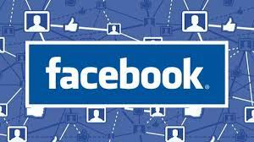
Chapter
05
II. Social media :
In the last decade, social media have proliferated and have occupied an ever‐growing position in information societies, both for the massive number of people they reach, and for their continuous and ubiquitous everyday use .
It is estimated that, Facebook alone, which in recent years has become by far the largest social network, has exceeded two billion active users.

Slide 21
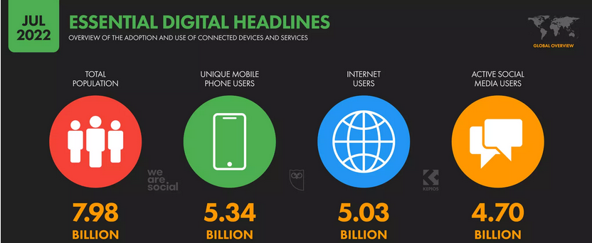
Chapter
05
II. Social media :

Slide 22
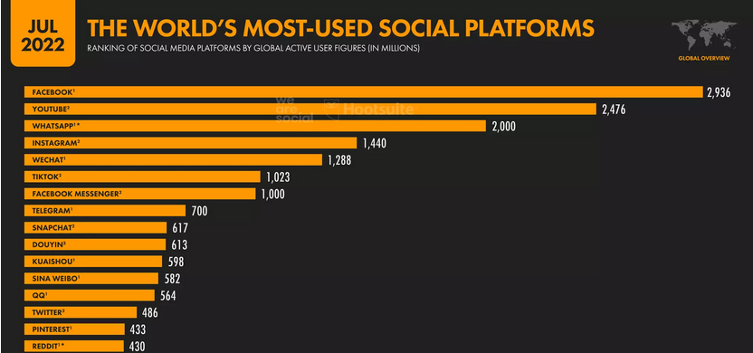

Chapter
05
II. Social media :

Slide 23
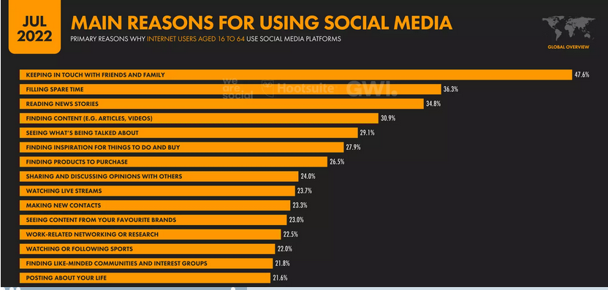
Chapter
05
II. Social media :

Slide 24

Chapter
05
II. Social media :
Many of these platforms have been developed to facilitate the organization of social relationships around common interests and are at least partly the effect and not just the cause of the emergence of new forms of grassroots sociality .
This follows a path that has been taken by digital services of the past.
For example, the same happened with the first BBS networks, that in the 1980s grew thanks to the groups of users who used them to discuss art, or music.

Slide 25

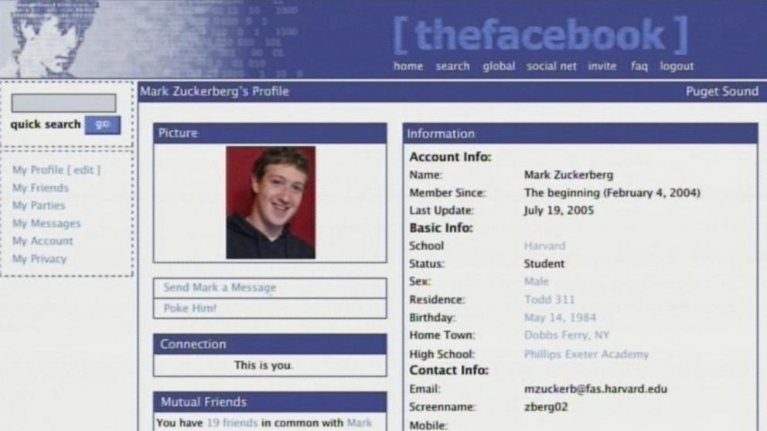
Chapter
05
II. Social media :
Facebook itself was initially developed to put in touch students at Harvard University, and only at a later stage did it raise the capital that turned it into a commercial enterprise.

Slide 26
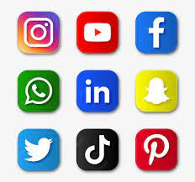
Chapter
05
II. Social media :
There are of course many different platforms, used to organize different social groups, for the most various purposes and in an array of heterogeneous modalities.
If some social media are generalist, meaning they are based primarily on the sharing of a variety of content, others are dedicated to specific purposes, media typologies, or demographics.

Slide 27

Chapter
05
II. Social media :
LinkedIn, for example, targets job seekers as well as human resource managers, and is used for professional reasons as a sort of social curriculum vitae.

Slide 28
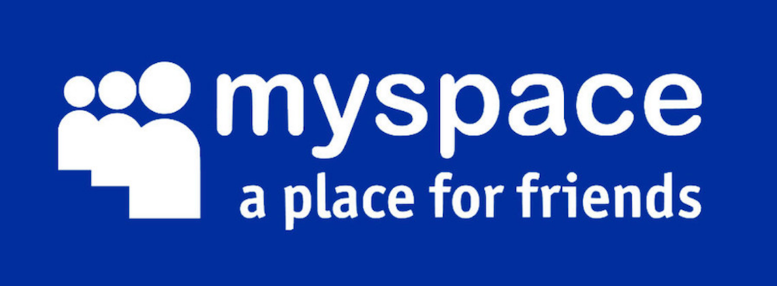
Chapter
05
II. Social media :
MySpace emerged as a social media service for adolescents but has long been populated almost exclusively by musicians and bands, which use it to target an audience of teenagers.

Slide 29

Chapter
05
II. Social media :
Social media can also be shaped by gender‐based differences.
For example, Pinterest tends to have a female user base as it facilitates gendered activities, such as craft and fashion.

Slide 30

Chapter
05
II. Social media :
Some exploit geolocalization technologies to locate users’ activities and strengthen the relation between physical space and platform interactions.
On Foursquare, users receive personalized recommendations of shops to go to near their current location and based on their previous activities or purchases.

Slide 31
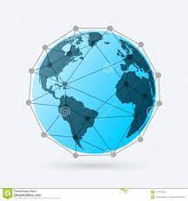
Chapter
05
II. Social media :
Finally, social networks are not necessarily global, but rather tend to be divided across geographical and linguistic lines.
Even if the largest platforms, such as Facebook and Twitter, are used almost everywhere, similar services provided by different actors may be more prevalent in certain geographical areas.

Slide 32
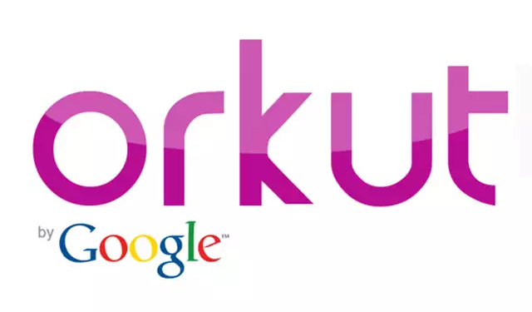


Chapter
05
II. Social media :
This was the case of Orkut, a Google‐owned platform that was widely spread in Brazil before being ousted by Facebook.
Today, Renren, an Asian platform similar to Facebook, and Sina Weibo, the Chinese equivalent of Twitter, reach hundreds of millions of users.

Slide 33
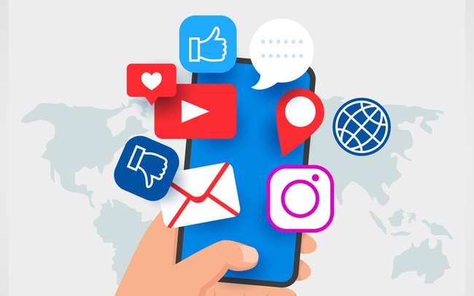
Chapter
05
II. Social media :
Social media platforms typically integrate services that go beyond the publication of content on their boards or timelines.
For example, many of these sites provide chats, instant messaging, email, and telephony, as well as commenting and rating systems.

Slide 34
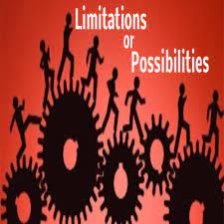
Chapter
05
II. Social media :
Social media facilitate and structure social relations and interpersonal communications, as they have the power to shape the type of actions that occur within their services.
In fact, the affordances that characterize their technological features offer precise possibilities and at the same time set the limits within which they can be used.

Slide 35

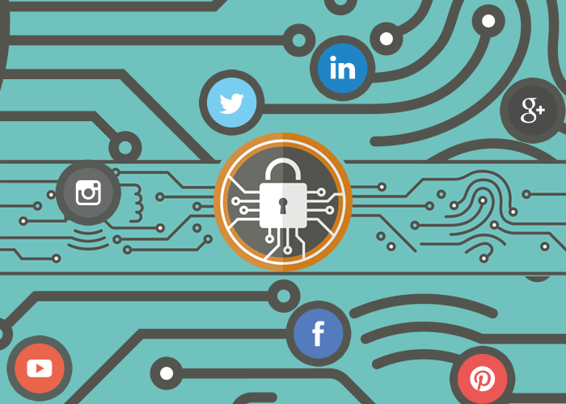
Chapter
05
III. Sociality Algorithms :
As media theorist José van Dijck put it, they do so by “coding relationships between people, things and ideas into algorithms.”
In turn, “sociality coded by technology renders people’s activities formal, manageable, and manipulable, enabling platforms to engineer the sociality in people’s everyday routines” .

Slide 36
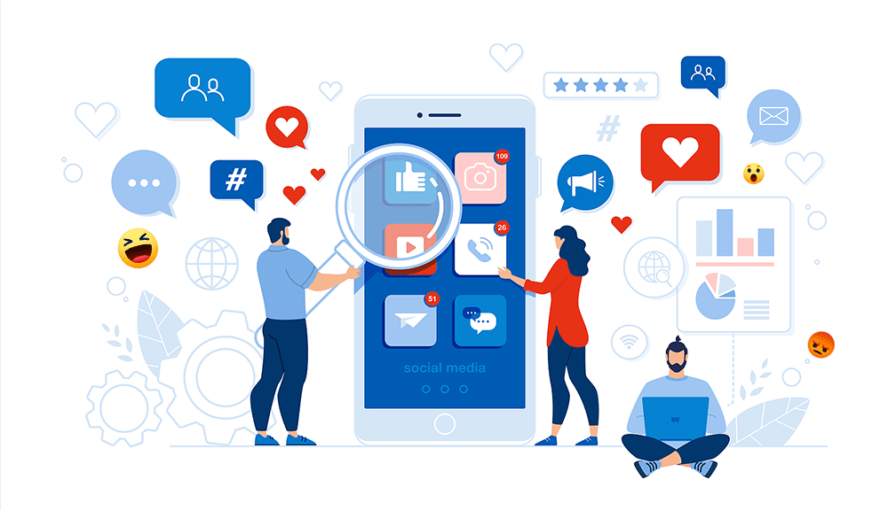
Chapter
05
III. Sociality Algorithms :
On social media platforms, all activities generate data which are then analyzed by algorithms and used to shape and organize platform sociality.
For example, Facebook is based on the creation of a “social graph,” that is, a map of all social interactions among individual users.
The generation and analysis of such a map is key for the platform to offer a richer online experience.

Slide 37
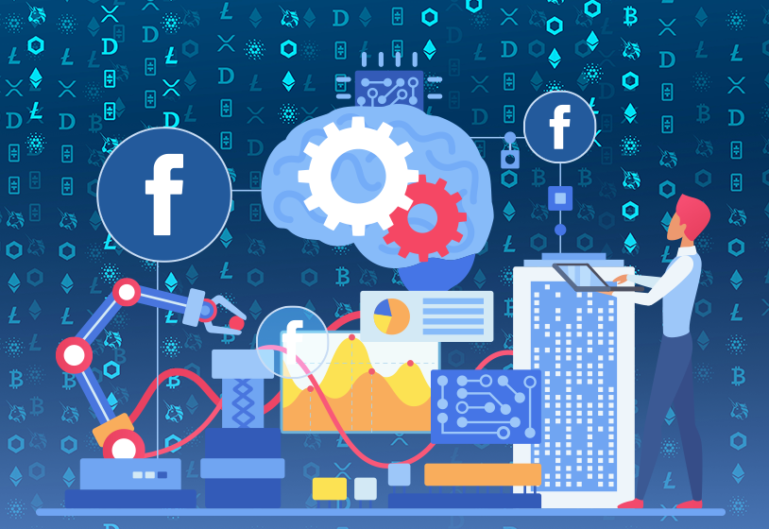
Chapter
05
III. Sociality Algorithms :
Facebook uses its data to algorithmically sort out which content is most likely to be interesting for a specific user, and thus generate interactions.
This means that it analyzes past interactions in order to predict future behavior .
Facebook estimates how likely it is that a user will interact with another user’s post.

Slide 38
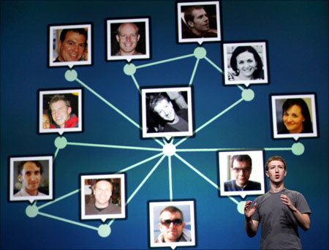
Chapter
05
III. Sociality Algorithms :
For example, its algorithms analyze user A’s social graph to estimate how likely it is that she will comment on or share a post by user B if that post has already received comments from users C and D.
Platforms use this ability in order to foster and increase user participation and sociality, and therefore extract more data .

Slide 39

Chapter
05
III. Sociality Algorithms :
We should note that this feature of social media services is inextricable from their business model: for these platforms, the generation and analysis of data is not a byproduct of online sociality, but rather their primary and most important goal.
Their ability not only to mediate sociality but also to “datafy” social interactions is at the core of social media platforms’ emergence as key social, political, and economic actors .

Slide 40

Chapter
05
III. Sociality Algorithms :
Indeed, social media are overwhelmingly owned and managed by private corporations.
These companies have developed business models that allow them to extract profits from the information they manage.

Slide 41
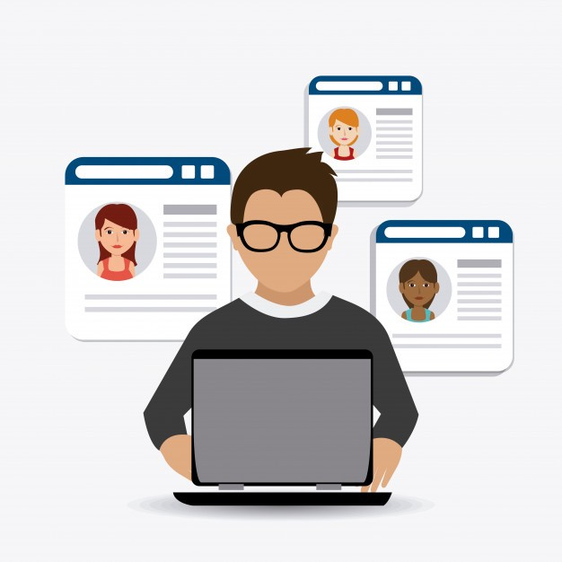
Chapter
05
III. Sociality Algorithms :
For the user, most of these services are free, and platforms’ revenues do not derive from user fees, but rather from their ability to capture, analyze, and valorize the information users provide to the site.
User data is aggregated by software that creates user profiles based on their interests and communications, the pages they visit, and their networks of friends .

Slide 42
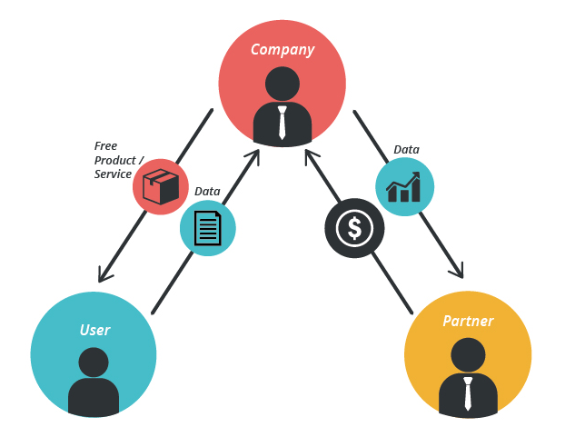
Chapter
05
III. Sociality Algorithms :
The information collected by social media platforms can be sold to third parties, for example marketing agencies, or used directly on the service to provide targeted advertising.
Indeed, social media platforms thrive on their ability to create advertisements that are compatible with the interests and lifestyles of a user and integrate them as natural components of the communicative environments in which one’s relational life develops .

Slide 43

Chapter
05
III. Sociality Algorithms :
Not all social media are for profit, but non‐profit services have struggled to emerge.
An example is Diaspora, a Facebook‐like service built on free software and on a network of distributed servers.
Thanks to its decentralized architecture, no single user or entity can control the system, which depends on many machines on which each user can store their information.

Slide 44

Chapter
05
III. Sociality Algorithms :
Moreover, Diaspora allows for encrypted communications and thus seeks to protect the privacy of its users .
This and other similar alternative social media tend to be limited by their inability to reach the critical mass of users which would make them competitive with commercial services.

Slide 45

Chapter
05
V. Conclusion
Digital media foster new forms of interaction and enrich the social life of individuals.
Therefore, social relationships seem to always be mediated.
Yet the social relations these technologies mediate are not neutral, but rather depend on uneven power dynamics, as well as on cultural and identity factors.
Social media are “coding relationships between people, things and ideas into algorithms.”
This means that it analyzes past interactions in order to predict future behavior .
These companies have developed business models that allow them to extract profits from the information they manage.
The information collected by social media platforms can be sold to third parties.

Slide 46
Thank you for listening
DGM 711
Introduction to Digital Media

