Slide 2
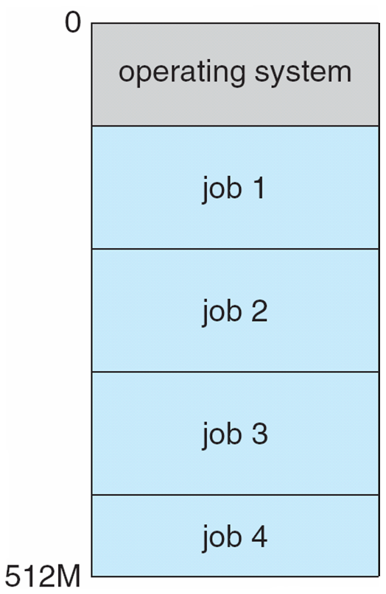
Job Scheduling for Multiprogramed System
How OS switches between jobs
OS keeps multiple jobs in memory. Jobs are loaded at a specific address in memory
OS gives each job multiple slots of CPU time until they finish their task.
choose one of them to get CPU for a period of time. How? FIFO, Priority…
  If that job finishes its task during the allotted time, this job is halted
  If that job does not finish its task and need more CPU time, it will be preempted (ready) and another job will be selected and given the CPU. The suspended job will later get another slot of CPU time
  If that job does I/O operation, this job will be waiting and CPU will be taken from that job and given to another selected job. The waiting job on I/O operation will resume operation later and get CPU only when the I/O is complete and the device interrupts OS

Slide 3
Operating-System Operations
Interrupt driven by hardware
Software error or request creates exception or trap
  Division by zero, request for operating system service
Other process problems include infinite loop, processes modifying each other or the operating system
Dual-mode operation allows OS to protect itself and other system components
  User mode and kernel mode
  Mode bit provided by hardware
    Provides ability to distinguish when system is running user code or kernel code
    Some instructions designated as privileged, only executable in kernel mode
    System call changes mode to kernel, return from call resets it to user

Slide 4
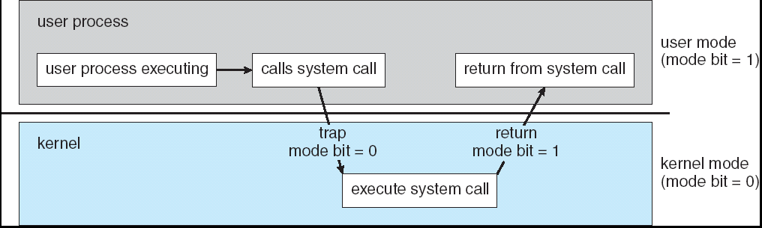
Transition from User to Kernel Mode
Timer to prevent infinite loop / process hogging resources
  Set interrupt after specific period
  Operating system decrements counter
  When counter zero generate an interrupt
  Set up before scheduling process to regain control or terminate program that exceeds allotted time

Slide 5
Process Management
A process is a program in execution. It is a unit of work within the system. Program is a passive entity, process is an active entity.
Process needs resources to accomplish its task
  CPU, memory, I/O, files
  Initialization data
Process termination requires reclaim of any reusable resources
Single-threaded process has one program counter specifying location of next instruction to execute
  Process executes instructions sequentially, one at a time, until completion
Multi-threaded process has one program counter per thread
Typically system has many processes, some user, some operating system running concurrently on one or more CPUs
  Concurrency by multiplexing the CPUs among the processes / threads

Slide 6
Process Management Activities
The operating system is responsible for the following activities in connection with process management:
Creating and deleting both user and system processes
Suspending and resuming processes
Providing mechanisms for process synchronization
Providing mechanisms for process communication
Providing mechanisms for deadlock handling

Slide 7
Memory Management
All data in memory before and after processing
All instructions in memory in order to execute
Memory management determines what is in memory when
  Optimizing CPU utilization and computer response to users
Memory management activities
  Keeping track of which parts of memory are currently being used and by whom
  Deciding which processes (or parts thereof) and data to move into and out of memory
  Allocating and deallocating memory space as needed

Slide 8
Storage Management
OS provides uniform, logical view of information storage
  Abstracts physical properties to logical storage unit - file
  Each medium is controlled by device (i.e., disk drive, tape drive)
    Varying properties include access speed, capacity, data-transfer rate, access method (sequential or random)
File-System management
  Files usually organized into directories
  Access control on most systems to determine who can access what
  OS activities include
    Creating and deleting files and directories
    Primitives to manipulate files and dirs
    Mapping files onto secondary storage
    Backup files onto stable (non-volatile) storage media

Slide 9
Mass-Storage Management
Usually disks used to store data that does not fit in main memory or data that must be kept for a “long” period of time.
Proper management is of central importance
Entire speed of computer operation hinges on disk subsystem and its algorithms
OS activities
  Free-space management
  Storage allocation
  Disk scheduling
Some storage need not be fast
  Tertiary storage includes optical storage, magnetic tape
  Still must be managed
  Varies between WORM (write-once, read-many-times) and RW (read-write)

Slide 10
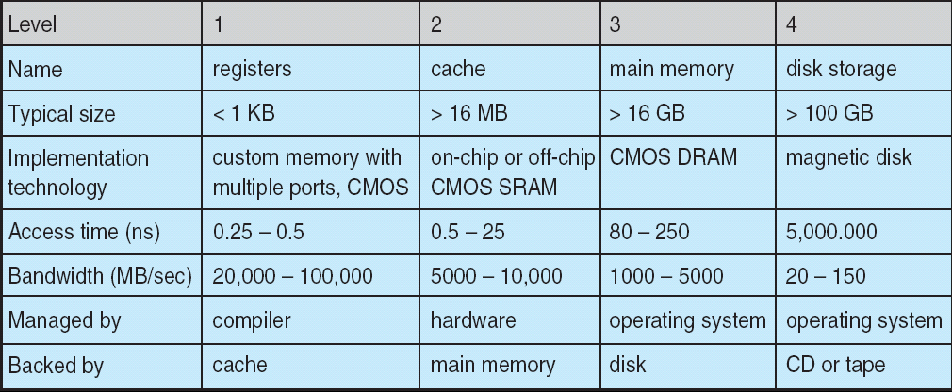
Performance of Various Levels of Storage
Movement between levels of storage hierarchy can be explicit or implicit

Slide 11
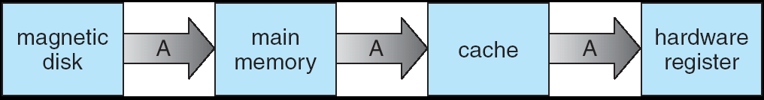
Migration of Integer A from Disk to Register
Multitasking environments must be careful to use most recent value, not matter where it is stored in the storage hierarchy
Multiprocessor environment must provide cache coherency in hardware such that all CPUs have the most recent value in their cache
Distributed environment situation even more complex
  Several copies of a datum can exist

Slide 12
I/O Subsystem
One purpose of OS is to hide peculiarities of hardware devices from the user
I/O subsystem responsible for
  Memory management of I/O including buffering (storing data temporarily while it is being transferred), caching (storing parts of data in faster storage for performance), spooling (the overlapping of output of one job with input of other jobs)
  General device-driver interface
  Drivers for specific hardware devices

Slide 13
Protection and Security
Protection – any mechanism for controlling access of processes or users to resources defined by the OS
Security – defense of the system against internal and external attacks
  Huge range, including denial-of-service, worms, viruses, identity theft, theft of service
Systems generally first distinguish among users, to determine who can do what
  User identities (user IDs, security IDs) include name and associated number, one per user
  User ID then associated with all files, processes of that user to determine access control
  Group identifier (group ID) allows set of users to be defined and controls managed, then also associated with each process, file

Slide 14
Chapter 3: Processes
Process Concept
Process Scheduling
Operations on Processes
Cooperating Processes
Interprocess Communication
Communication in Client-Server Systems

Slide 15
Process Concept
An operating system executes a variety of programs:
  Batch system – jobs
  Time-shared systems – user programs or tasks
Textbook uses the terms job and process almost interchangeably
Process – a program in execution; process execution must progress in sequential fashion
A process includes:
  program counter
  stack
  data section

Slide 16
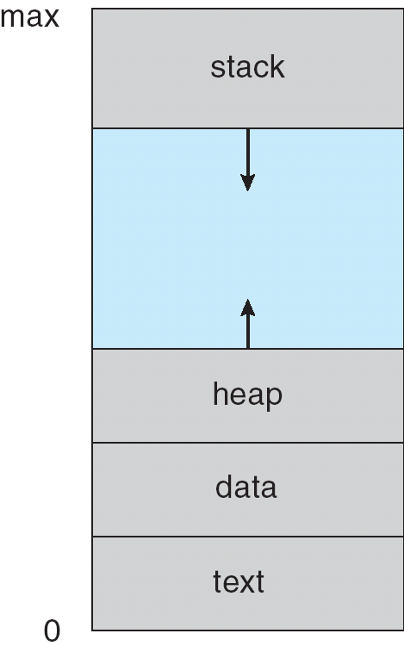
Process in Memory

Slide 17
Process State
As a process executes, it changes state
  new: The process is being created
  running: Instructions are being executed
  waiting: The process is waiting for some event to occur
  ready: The process is waiting to be assigned to a process
  terminated: The process has finished execution

Slide 18
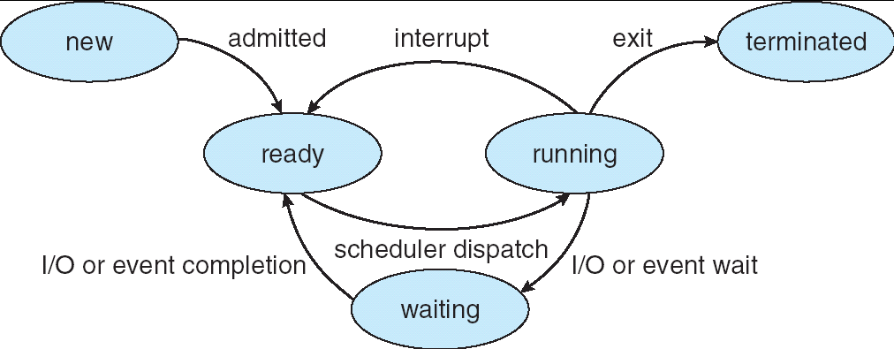
Diagram of Process State

Slide 19
Process Control Block (PCB)
Information associated with each process
Process state
Program counter
CPU registers
CPU scheduling information
Memory-management information
Accounting information
I/O status information

Slide 20
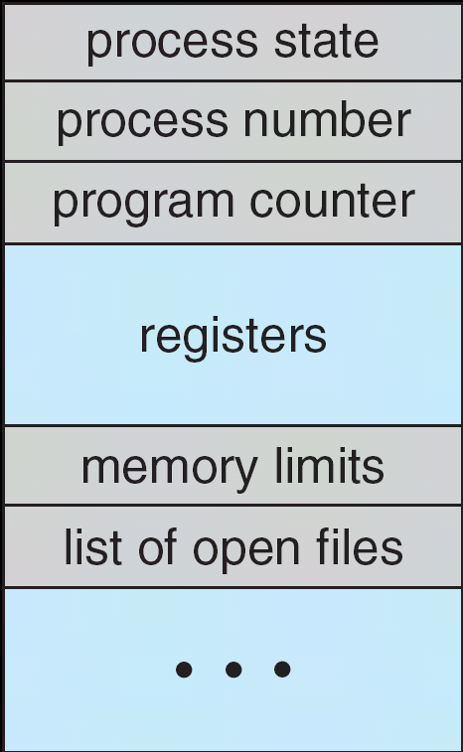
Process Control Block (PCB)

Slide 21
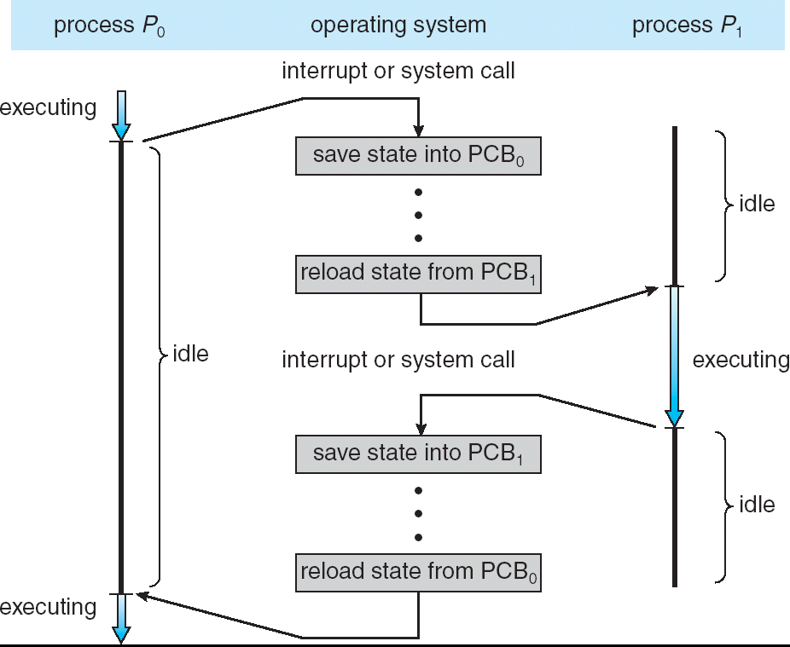
CPU Switch From Process to Process

Slide 22
Process Scheduling Queues
Job queue – set of all processes in the system
Ready queue – set of all processes residing in main memory, ready and waiting to execute
Device queues – set of processes waiting for an I/O device
Processes migrate among the various queues

Slide 23
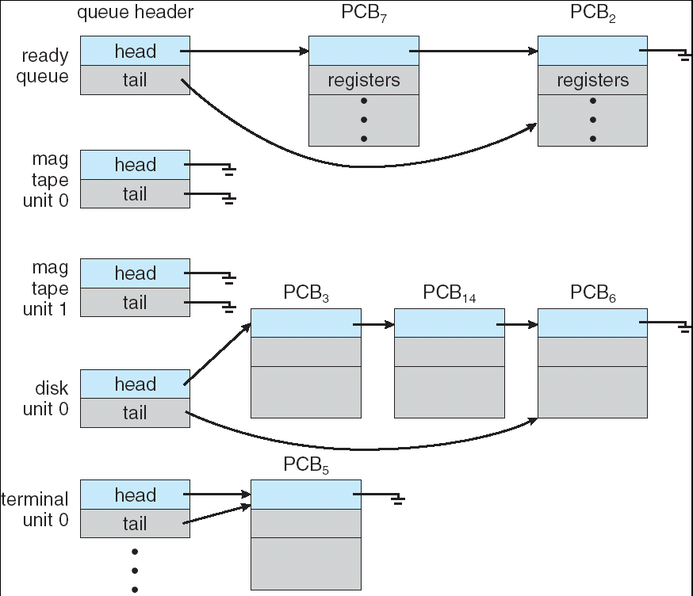
Ready Queue And Various I/O Device Queues

Slide 24
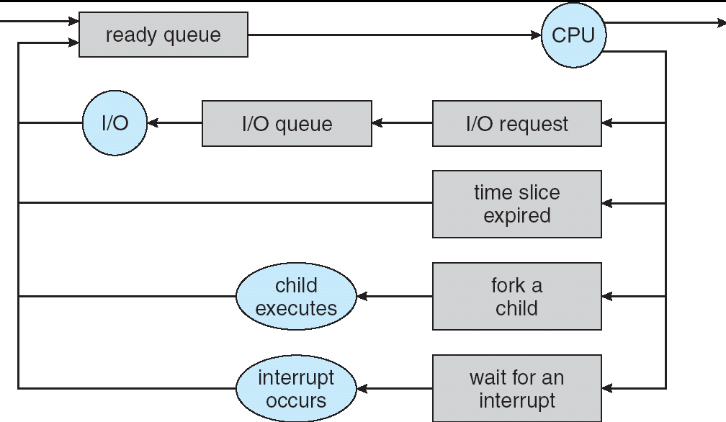
Representation of Process Scheduling

Slide 25
Schedulers
Long-term scheduler (or job scheduler) – selects which processes should be brought into the ready queue
Short-term scheduler (or CPU scheduler) – selects which process should be executed next and allocates CPU

Slide 26
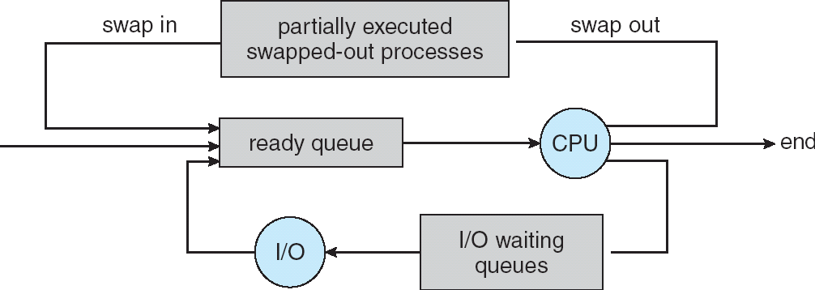
Addition of Medium Term Scheduling

Slide 27
Schedulers (Cont.)
Short-term scheduler is invoked very frequently (milliseconds) ⇒ (must be fast)
Long-term scheduler is invoked very infrequently (seconds, minutes) ⇒ (may be slow)
The long-term scheduler controls the degree of multiprogramming
Processes can be described as either:
  I/O-bound process – spends more time doing I/O than computations, many short CPU bursts
  CPU-bound process – spends more time doing computations; few very long CPU bursts

Slide 28
Context Switch
When CPU switches to another process, the system must save the state of the old process and load the saved state for the new process
Context-switch time is overhead; the system does no useful work while switching
Time dependent on hardware support

Slide 29
Process Creation
Parent process create children processes, which, in turn create other processes, forming a tree of processes
Resource sharing
  Parent and children share all resources
  Children share subset of parent’s resources
  Parent and child share no resources
Execution
  Parent and children execute concurrently
  Parent waits until children terminate

Slide 30
Process Creation (Cont.)
Address space
  Child duplicate of parent
  Child has a program loaded into it
UNIX examples
  fork system call creates new process
  exec system call used after a fork to replace the process’ memory space with a new program

Slide 31
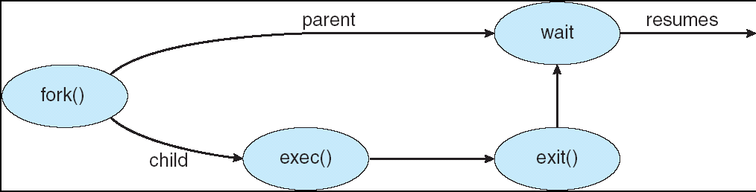
Process Creation

Slide 32
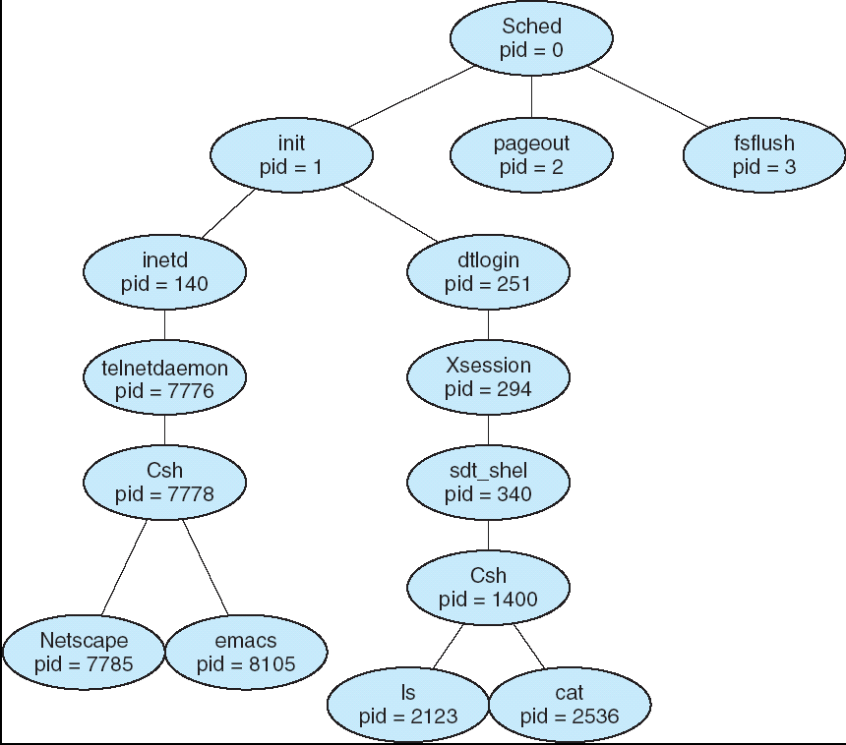
A tree of processes on a typical Solaris

Slide 33
Process Termination
Process executes last statement and asks the operating system to delete it (exit)
  Output data from child to parent (via wait)
  Process’ resources are deallocated by operating system
Parent may terminate execution of children processes (abort)
  Child has exceeded allocated resources
  Task assigned to child is no longer required
  If parent is exiting
    Some operating system do not allow child to continue if its parent terminates
      All children terminated - cascading termination

Slide 34
Cooperating Processes
Independent process cannot affect or be affected by the execution of another process
Cooperating process can affect or be affected by the execution of another process
Advantages of process cooperation
  Information sharing
  Computation speed-up
  Modularity
  Convenience

Slide 35
Producer-Consumer Problem
Paradigm for cooperating processes, producer process produces information that is consumed by a consumer process
  unbounded-buffer places no practical limit on the size of the buffer
  bounded-buffer assumes that there is a fixed buffer size

Slide 36
Bounded-Buffer – Shared-Memory Solution
Shared data
      #define BUFFER_SIZE 10
      Typedef struct {
      . . .
      } item;
      item buffer[BUFFER_SIZE];
      int in = 0;
      int out = 0;
Solution is correct, but can only use BUFFER_SIZE-1 elements

Slide 37
Bounded-Buffer – Insert() Method
while (true) {
/* Produce an item */
while (((in = (in + 1) % BUFFER SIZE count) == out)
; /* do nothing -- no free buffers */
buffer[in] = item;
in = (in + 1) % BUFFER SIZE;
{

Slide 38
Bounded Buffer – Remove() Method
while (true) {
while (in == out)
; // do nothing -- nothing to consume
// remove an item from the buffer
item = buffer[out];
out = (out + 1) % BUFFER SIZE;
return item;
{

Slide 39
Interprocess Communication (IPC)
Mechanism for processes to communicate and to synchronize their actions
Message system – processes communicate with each other without resorting to shared variables
IPC facility provides two operations:
  send(message) – message size fixed or variable
  receive(message)
If P and Q wish to communicate, they need to:
  establish a communication link between them
  exchange messages via send/receive
Implementation of communication link
  physical (e.g., shared memory, hardware bus)
  logical (e.g., logical properties)

Slide 40
Implementation Questions
How are links established?
Can a link be associated with more than two processes?
How many links can there be between every pair of communicating processes?
What is the capacity of a link?
Is the size of a message that the link can accommodate fixed or variable?
Is a link unidirectional or bi-directional?

Slide 41
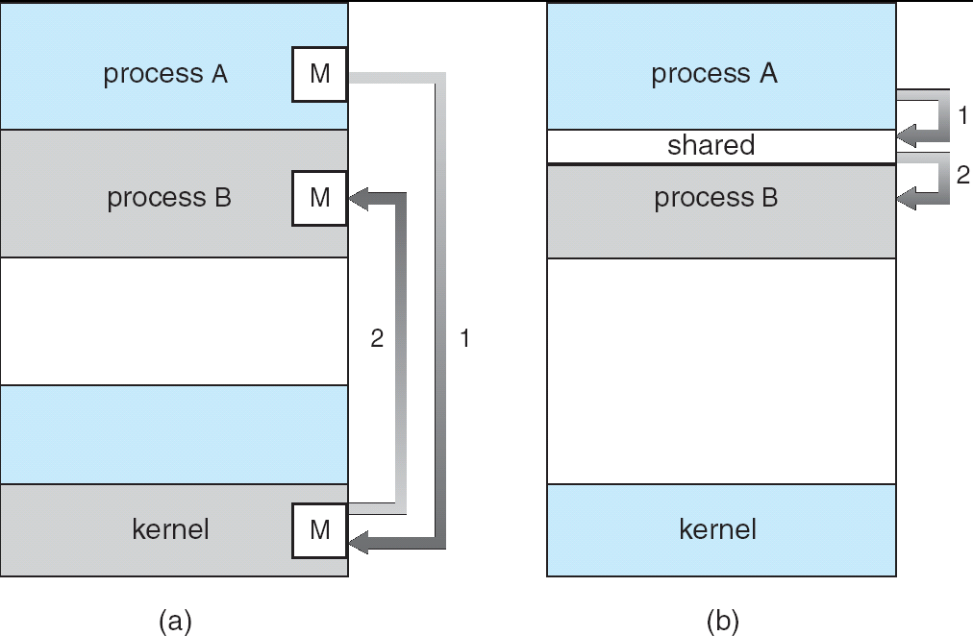
Communications Models

Slide 42
Direct Communication
Processes must name each other explicitly:
  send (P, message) – send a message to process P
  receive(Q, message) – receive a message from process Q
Properties of communication link
  Links are established automatically
  A link is associated with exactly one pair of communicating processes
  Between each pair there exists exactly one link
  The link may be unidirectional, but is usually bi-directional

Slide 43
Indirect Communication
Messages are directed and received from mailboxes (also referred to as ports)
  Each mailbox has a unique id
  Processes can communicate only if they share a mailbox
Properties of communication link
  Link established only if processes share a common mailbox
  A link may be associated with many processes
  Each pair of processes may share several communication links
  Link may be unidirectional or bi-directional

Slide 44
Indirect Communication
Operations
  create a new mailbox
  send and receive messages through mailbox
  destroy a mailbox
Primitives are defined as:
send(A, message) – send a message to mailbox A
receive(A, message) – receive a message from mailbox A

Slide 45
Indirect Communication
Mailbox sharing
  P₁, P₂, and P₃ share mailbox A
  P₁, sends; P₂ and P₃ receive
  Who gets the message?
Solutions
  Allow a link to be associated with at most two processes
  Allow only one process at a time to execute a receive operation
  Allow the system to select arbitrarily the receiver. Sender is notified who the receiver was.

Slide 46
Synchronization
Message passing may be either blocking or non-blocking
Blocking is considered synchronous
  Blocking send has the sender block until the message is received
  Blocking receive has the receiver block until a message is available
Non-blocking is considered asynchronous
  Non-blocking send has the sender send the message and continue
  Non-blocking receive has the receiver receive a valid message or null

Slide 47
End lecture 2
Thank You

