Slide 1


Slide 2
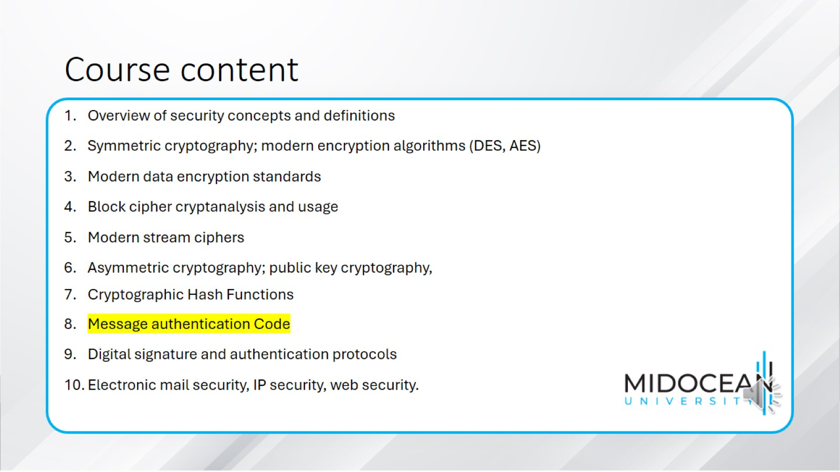
Course content

Slide 3
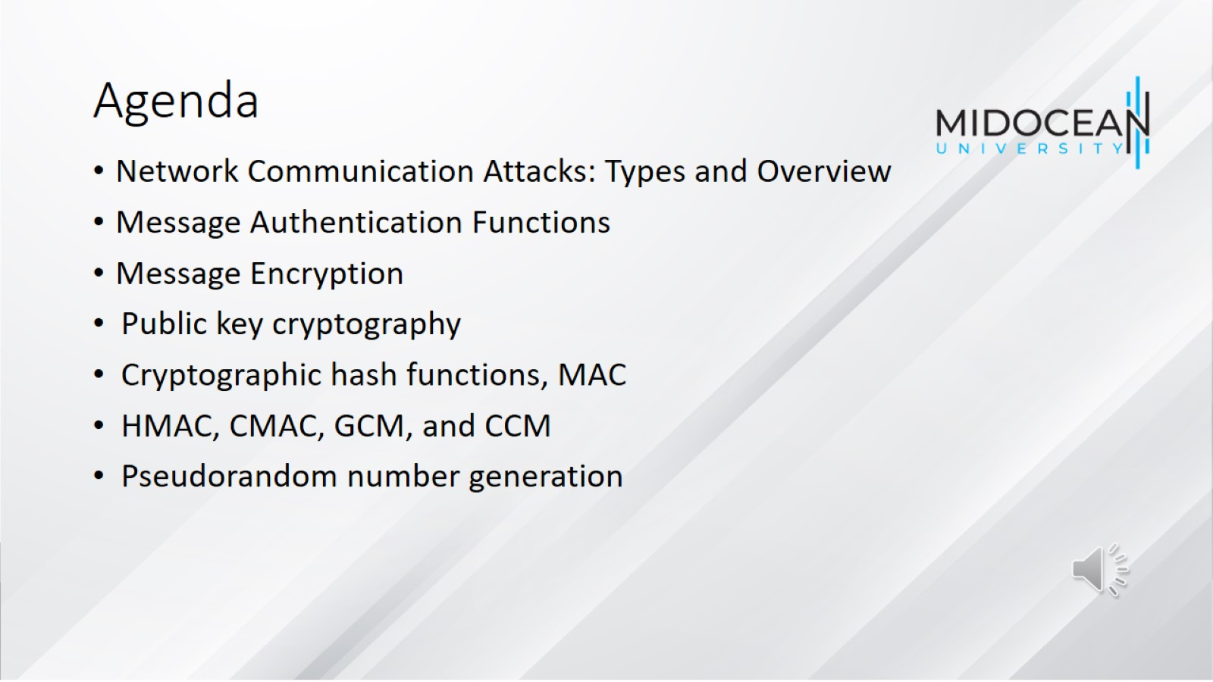
Agenda

Slide 4
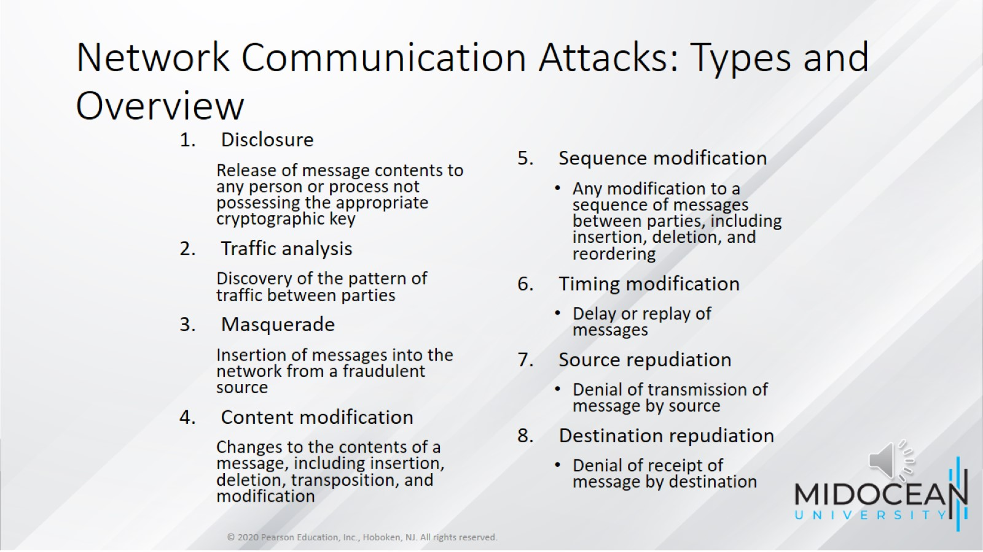
Network Communication Attacks: Types and Overview

Slide 5
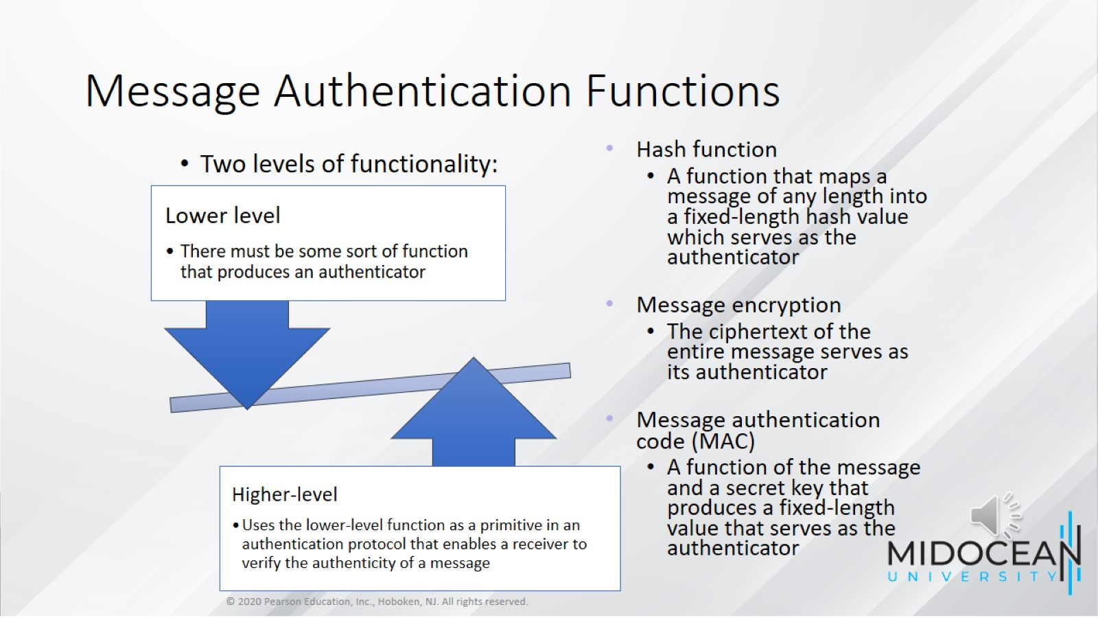
Message Authentication Functions

Slide 6
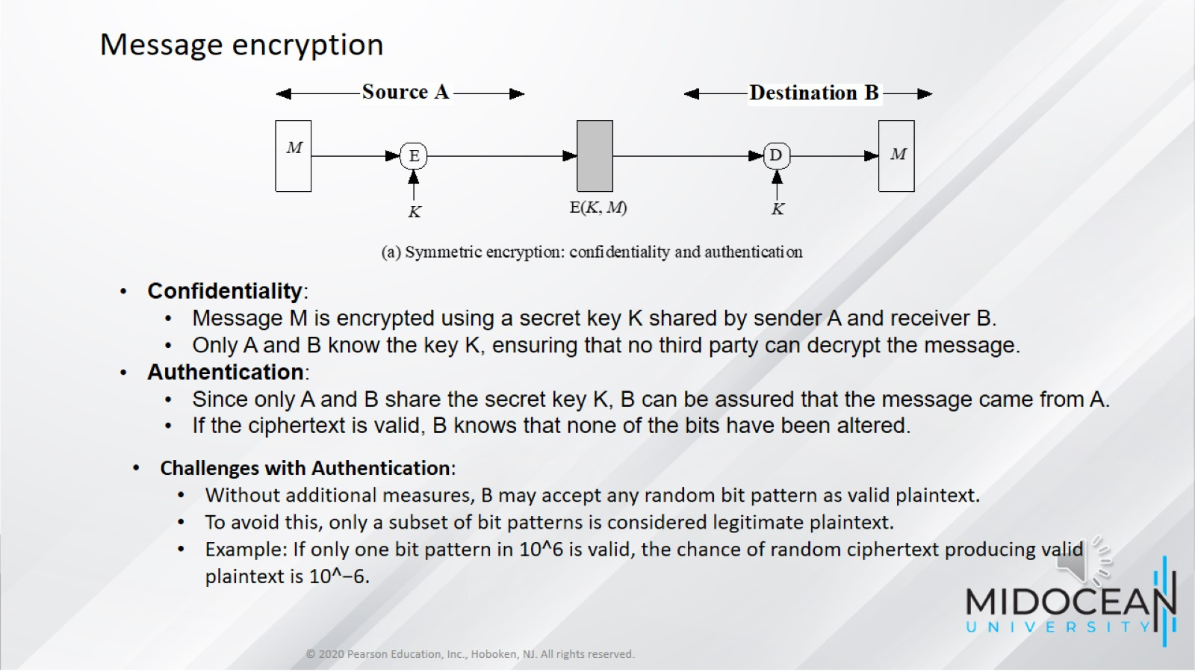

Slide 7
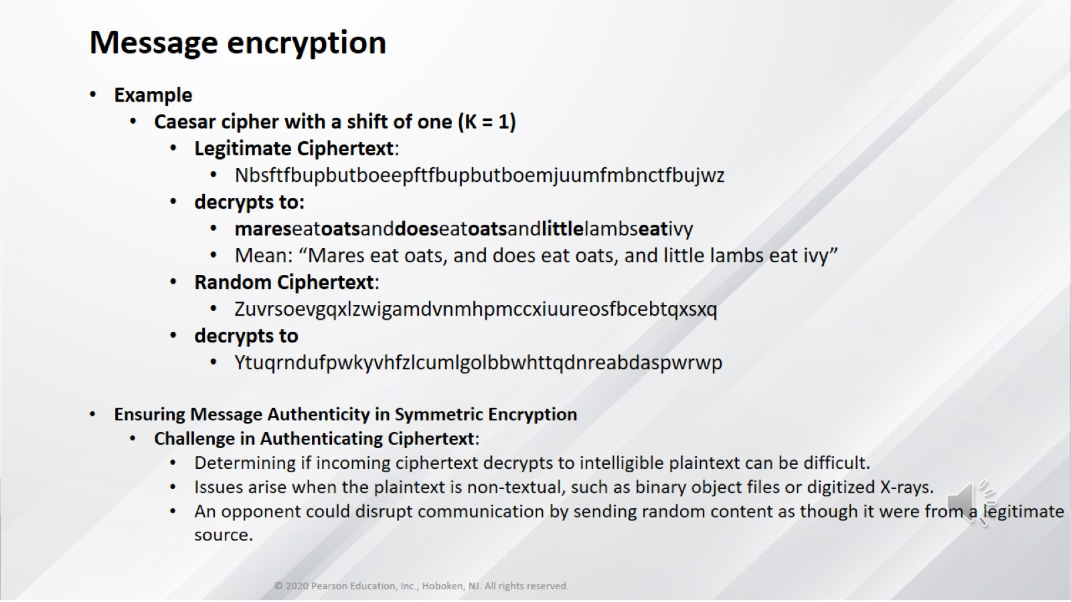

Slide 8
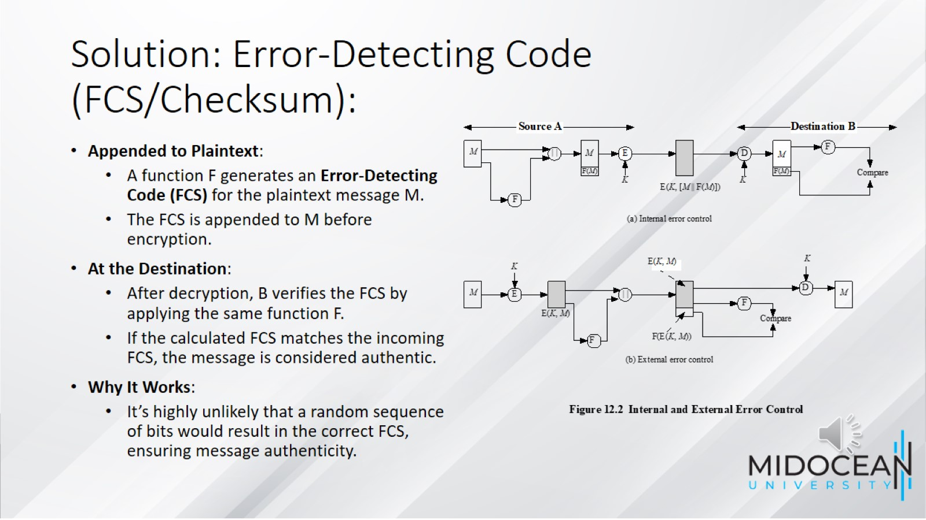
Solution: Error-Detecting Code (FCS/Checksum):

Slide 9
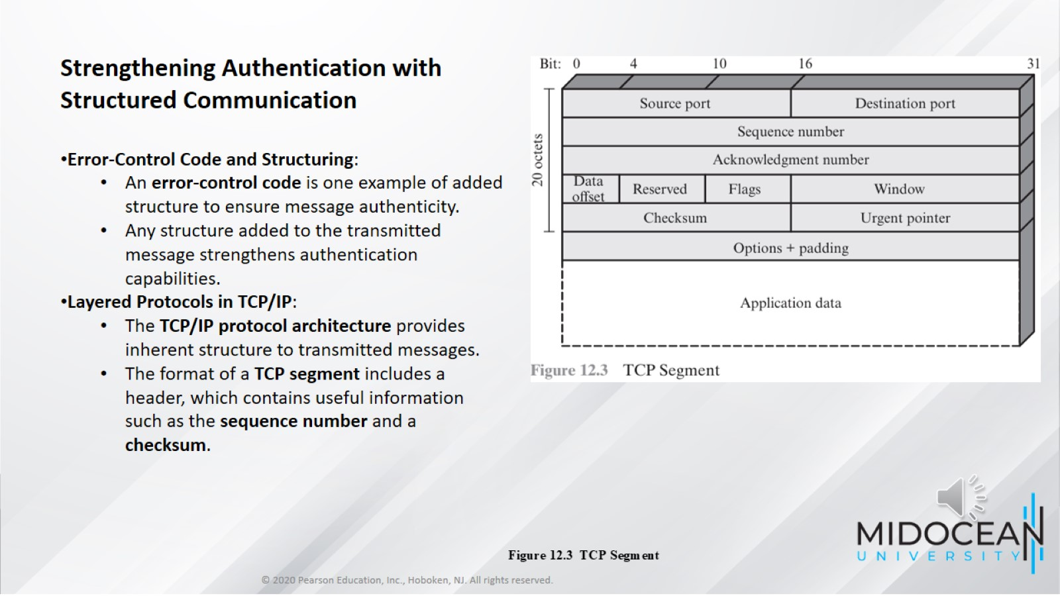

Slide 10
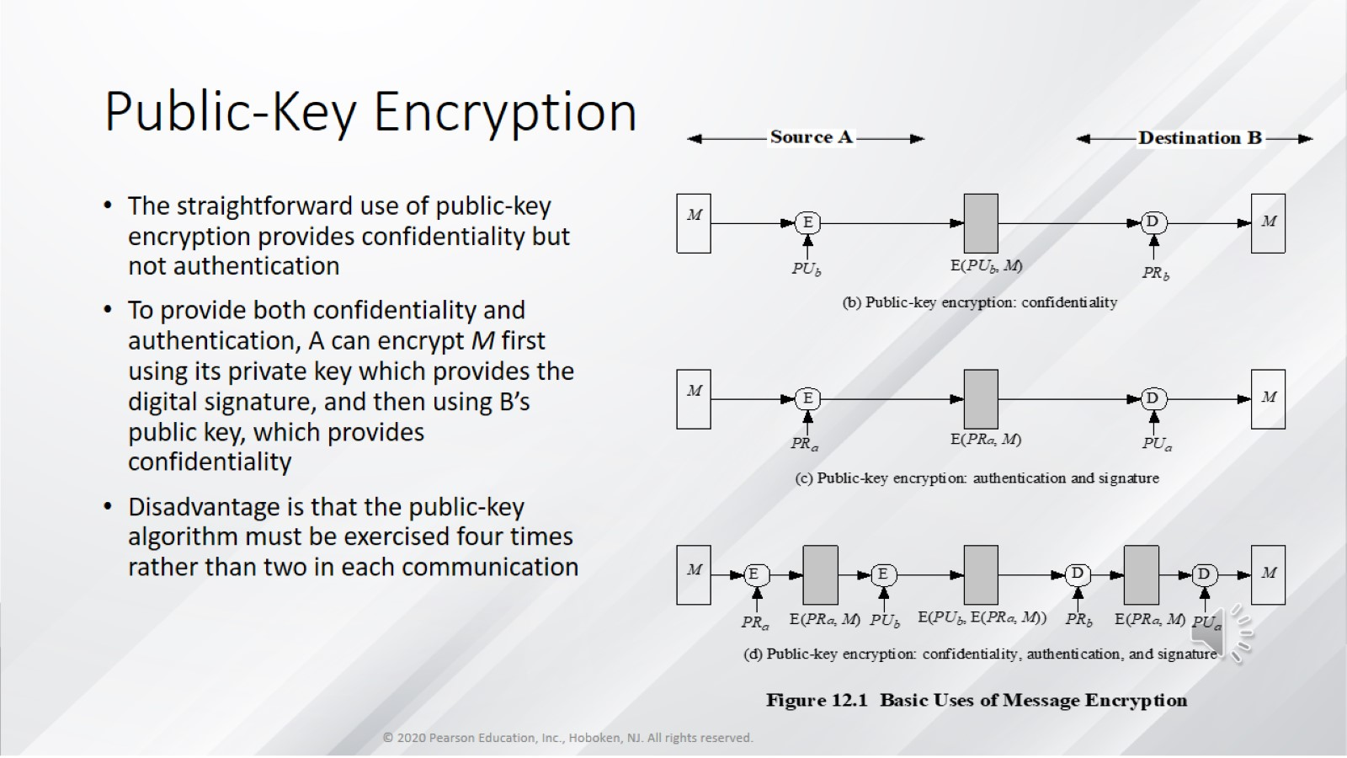
Public-Key Encryption

Slide 11
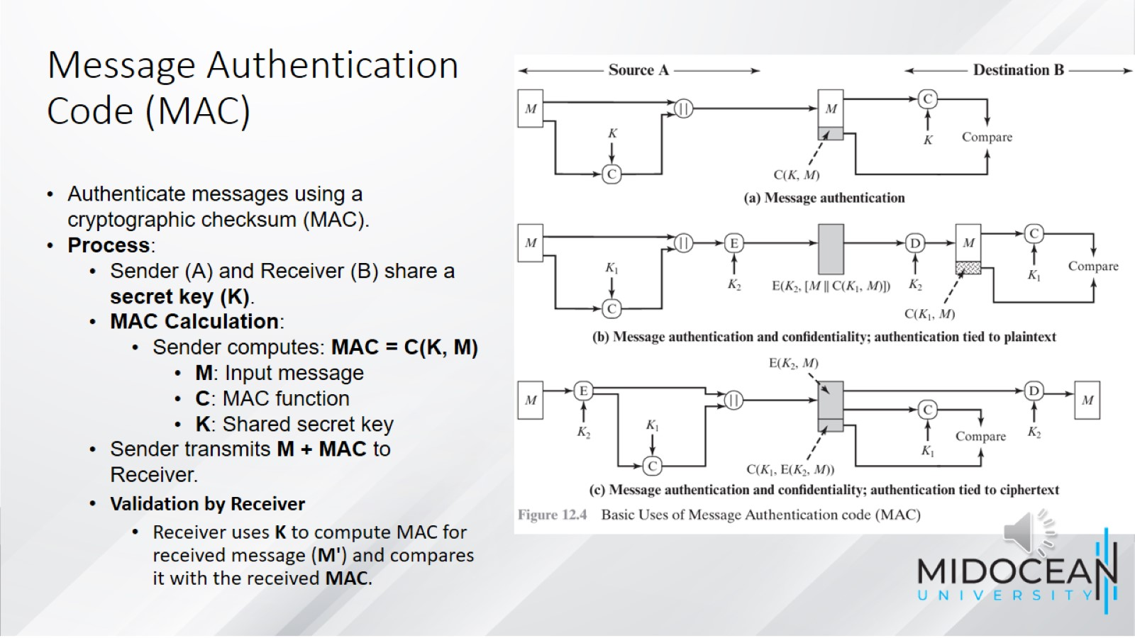
Message Authentication Code (MAC)

Slide 12
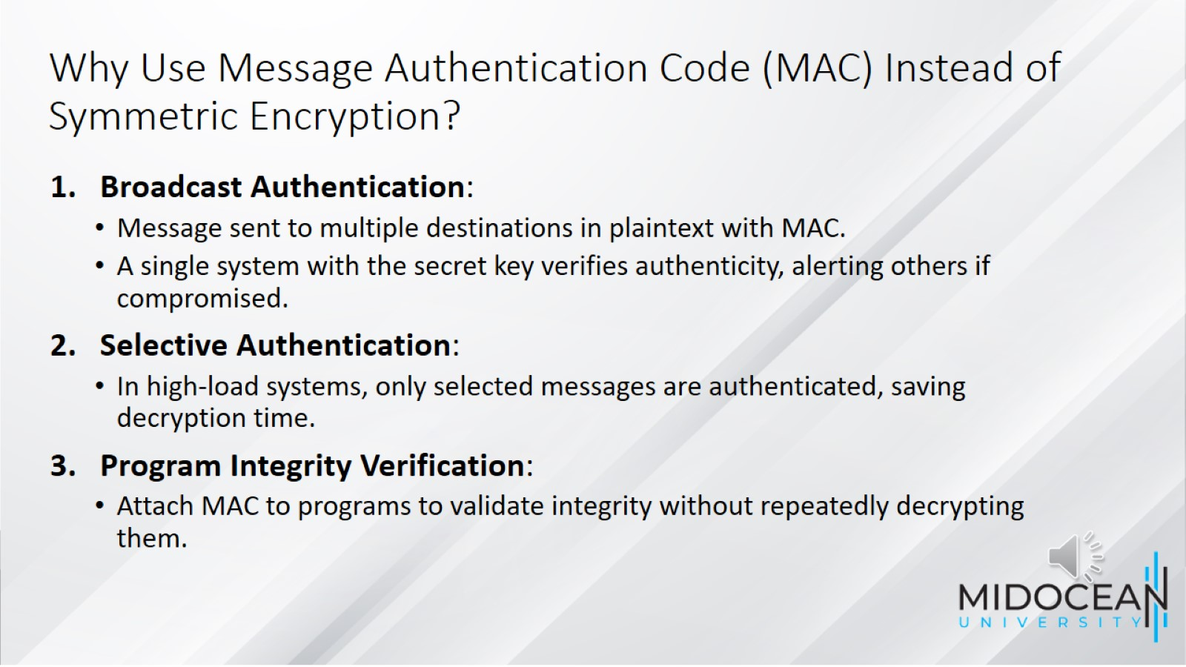
Why Use Message Authentication Code (MAC) Instead of Symmetric Encryption?

Slide 13
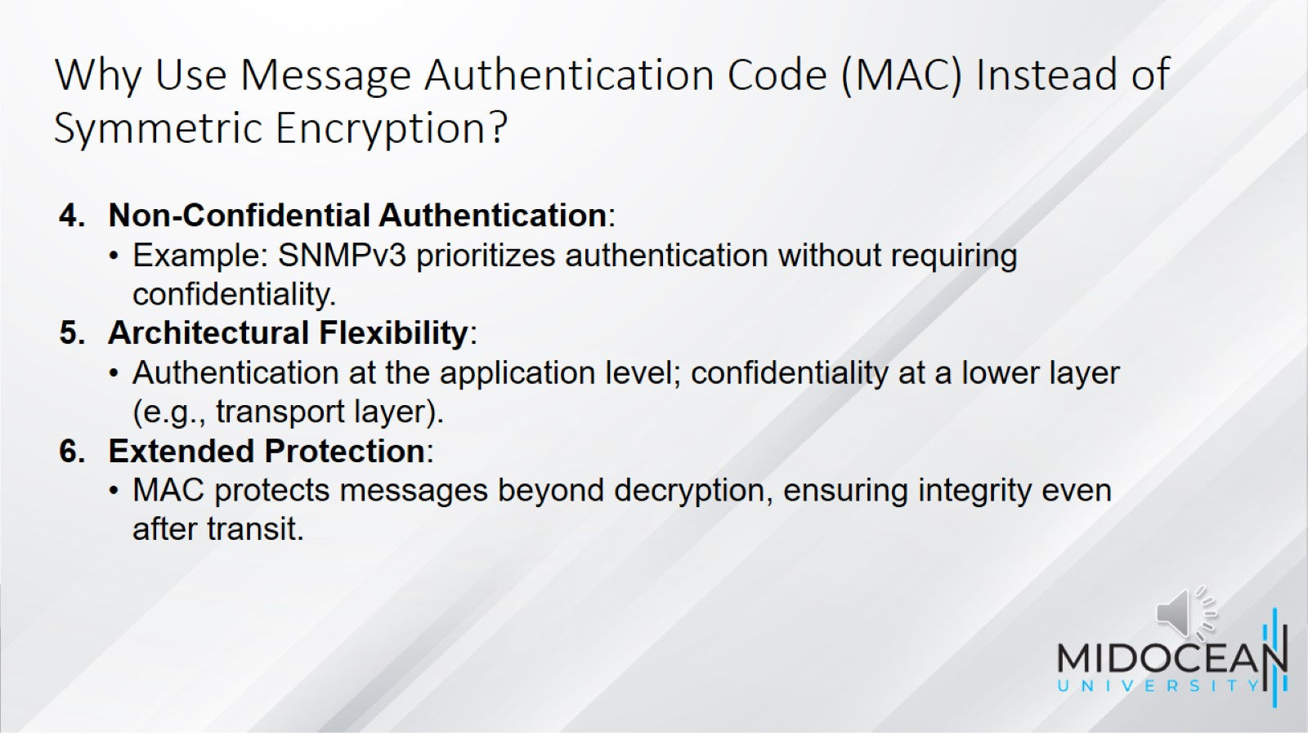
Why Use Message Authentication Code (MAC) Instead of Symmetric Encryption?

Slide 14
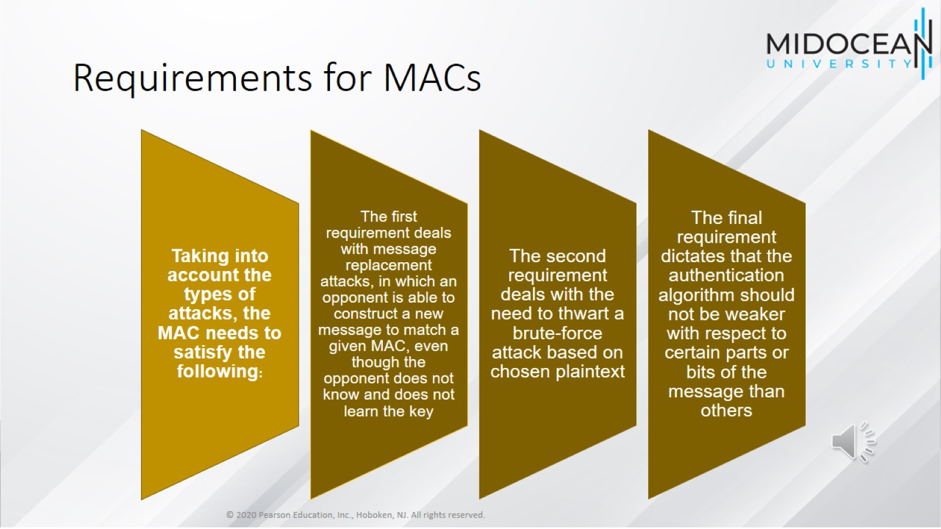
Requirements for MACs

Slide 15
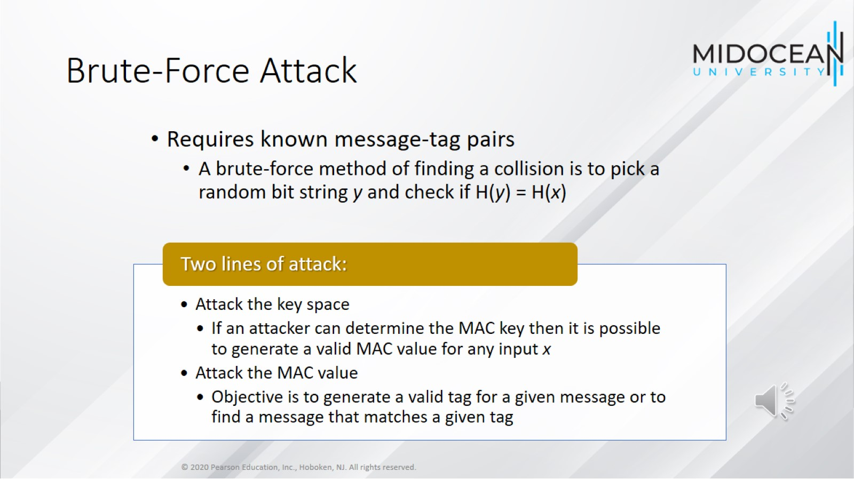
Brute-Force Attack

Slide 16
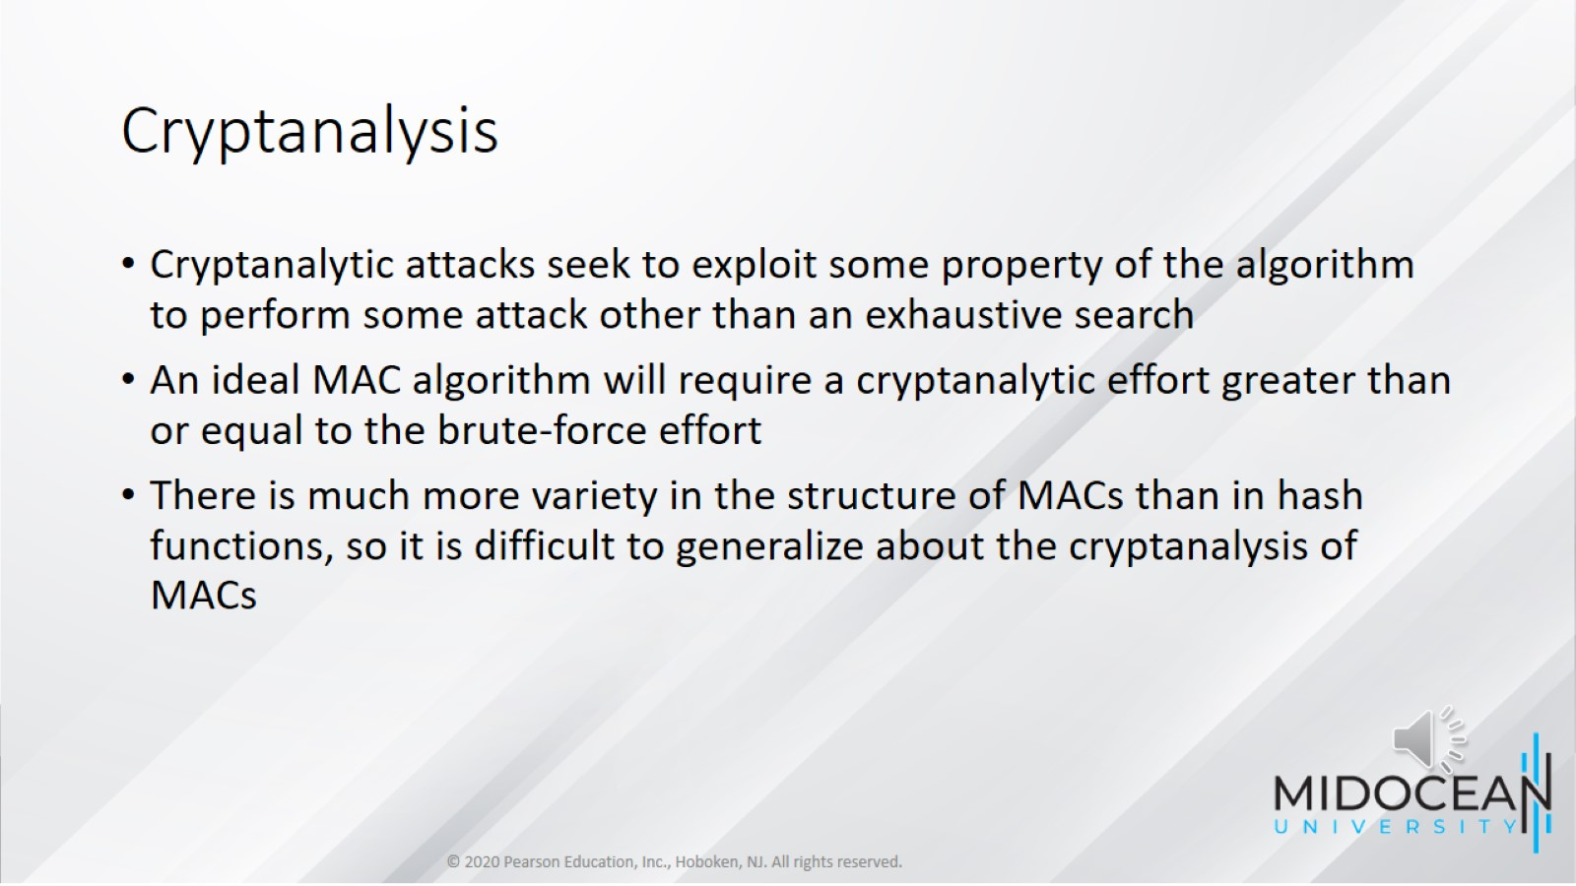
Cryptanalysis

Slide 17
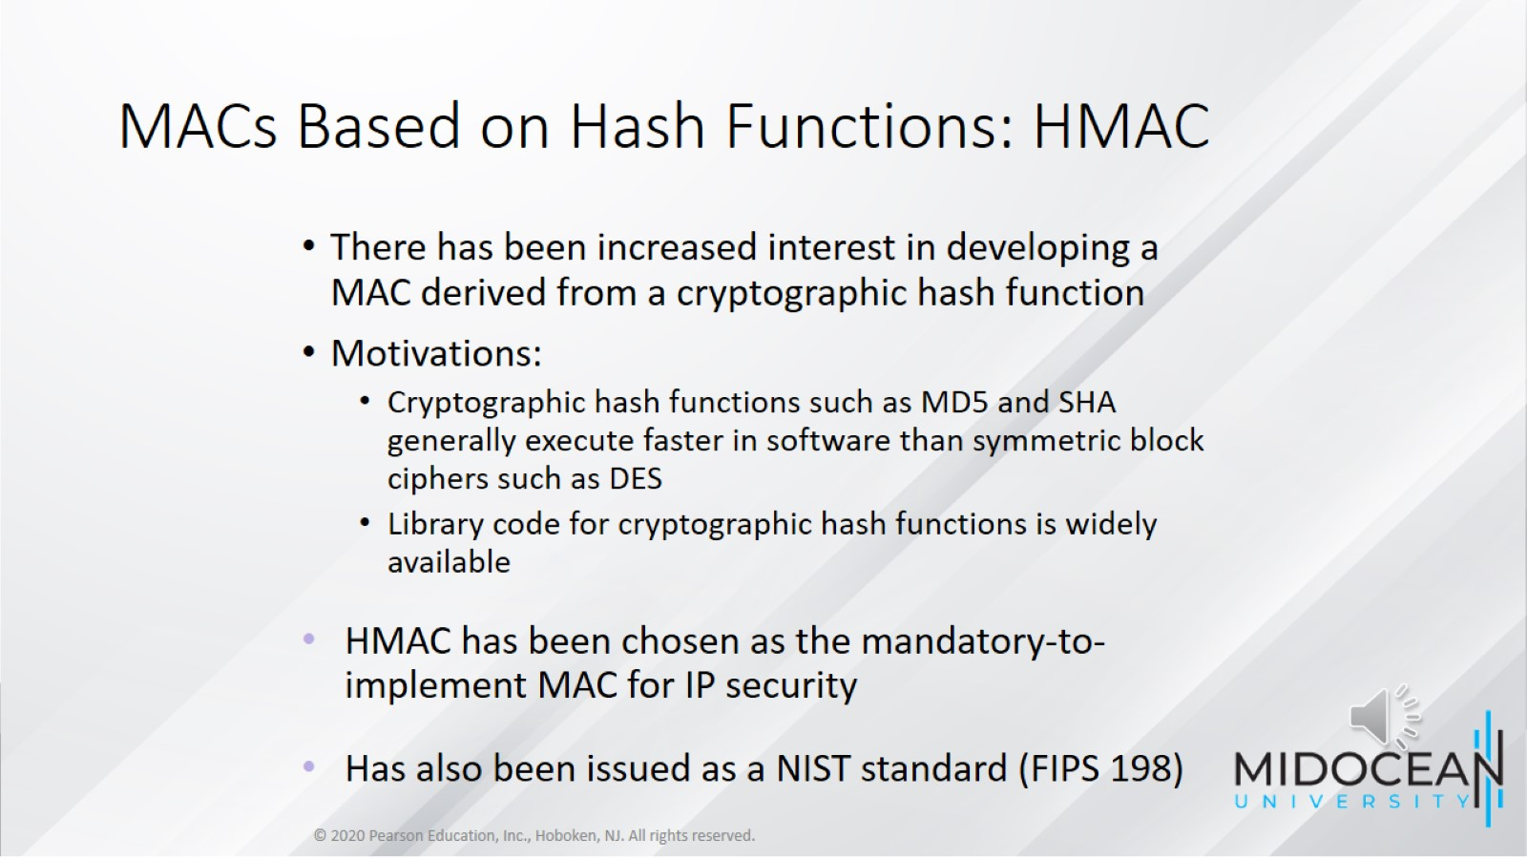
MACs Based on Hash Functions: HMAC

Slide 18
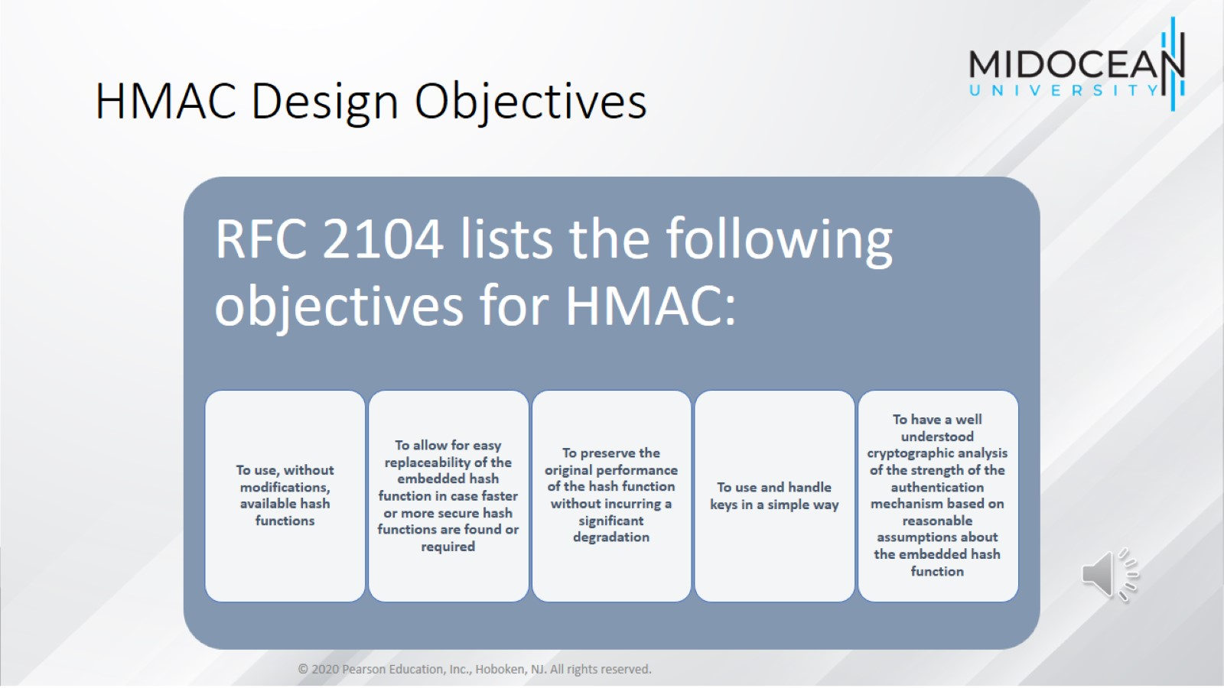
HMAC Design Objectives

Slide 19
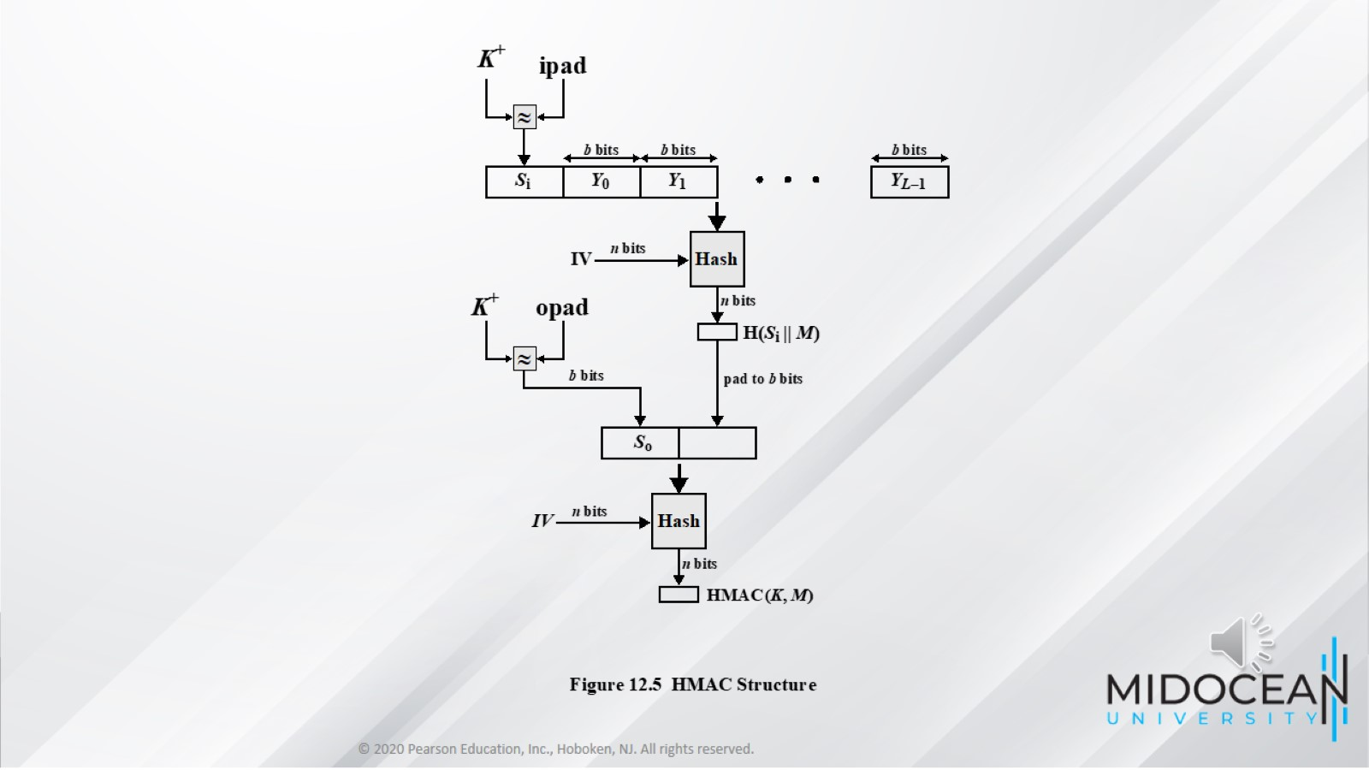

Slide 20
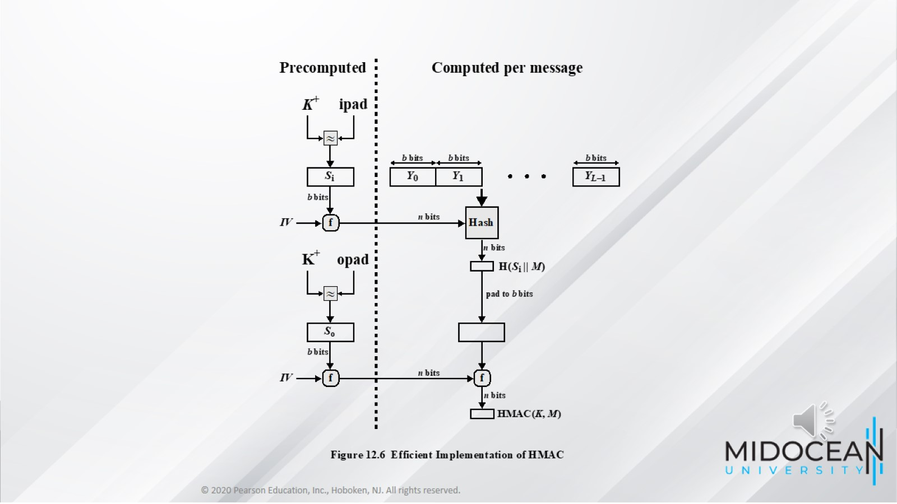

Slide 21
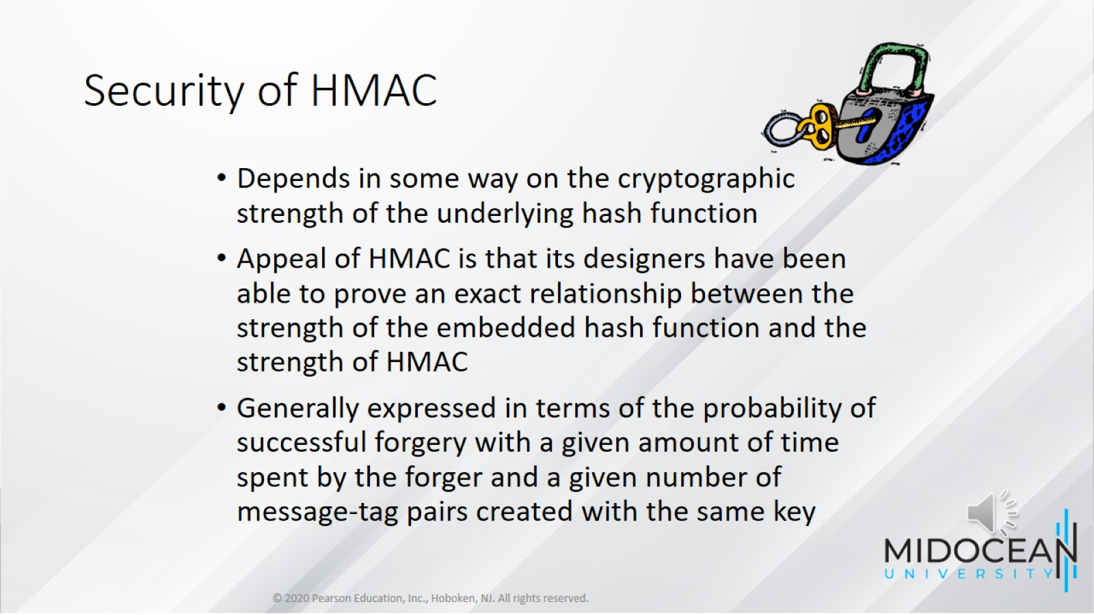
Security of HMAC

Slide 22
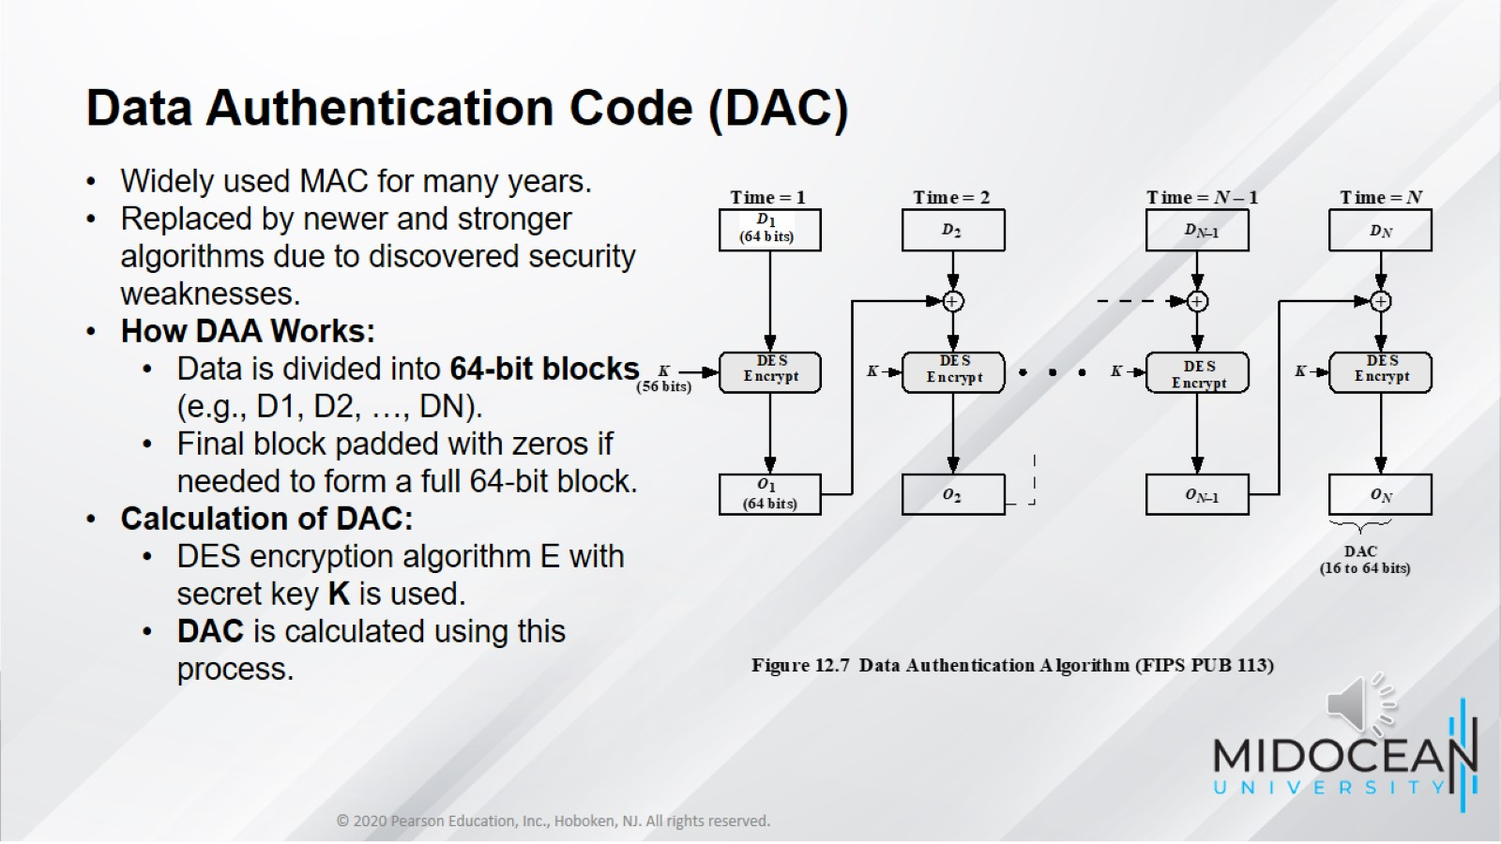

Slide 23
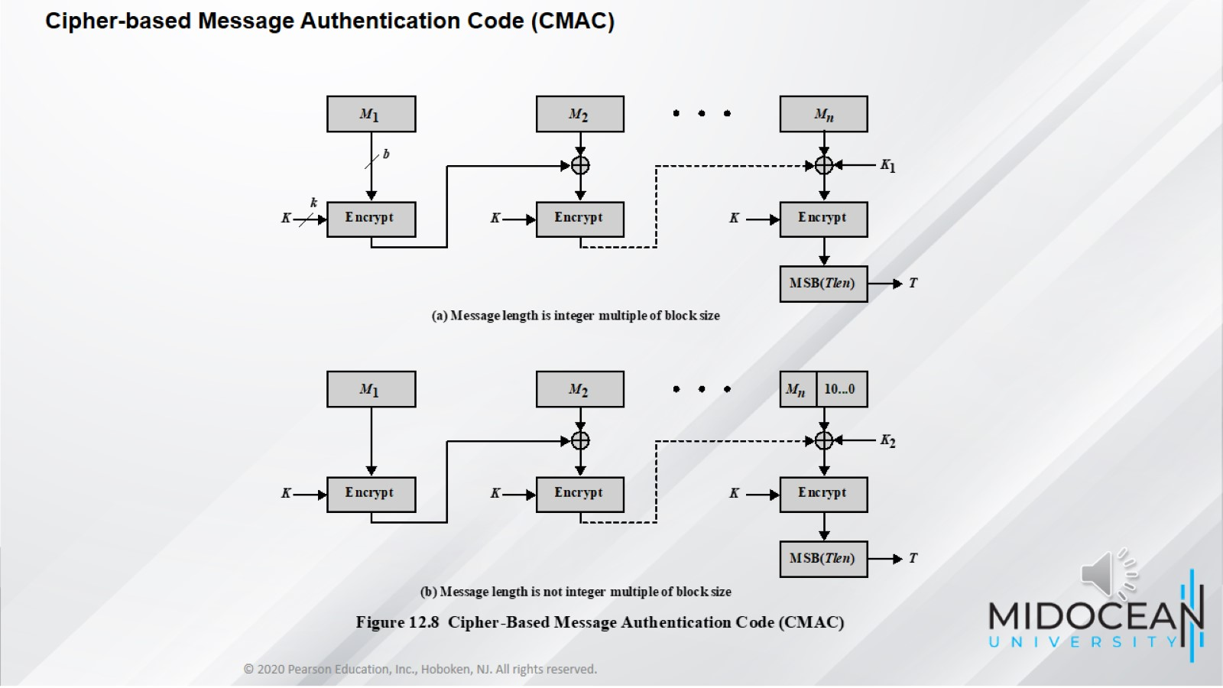

Slide 24
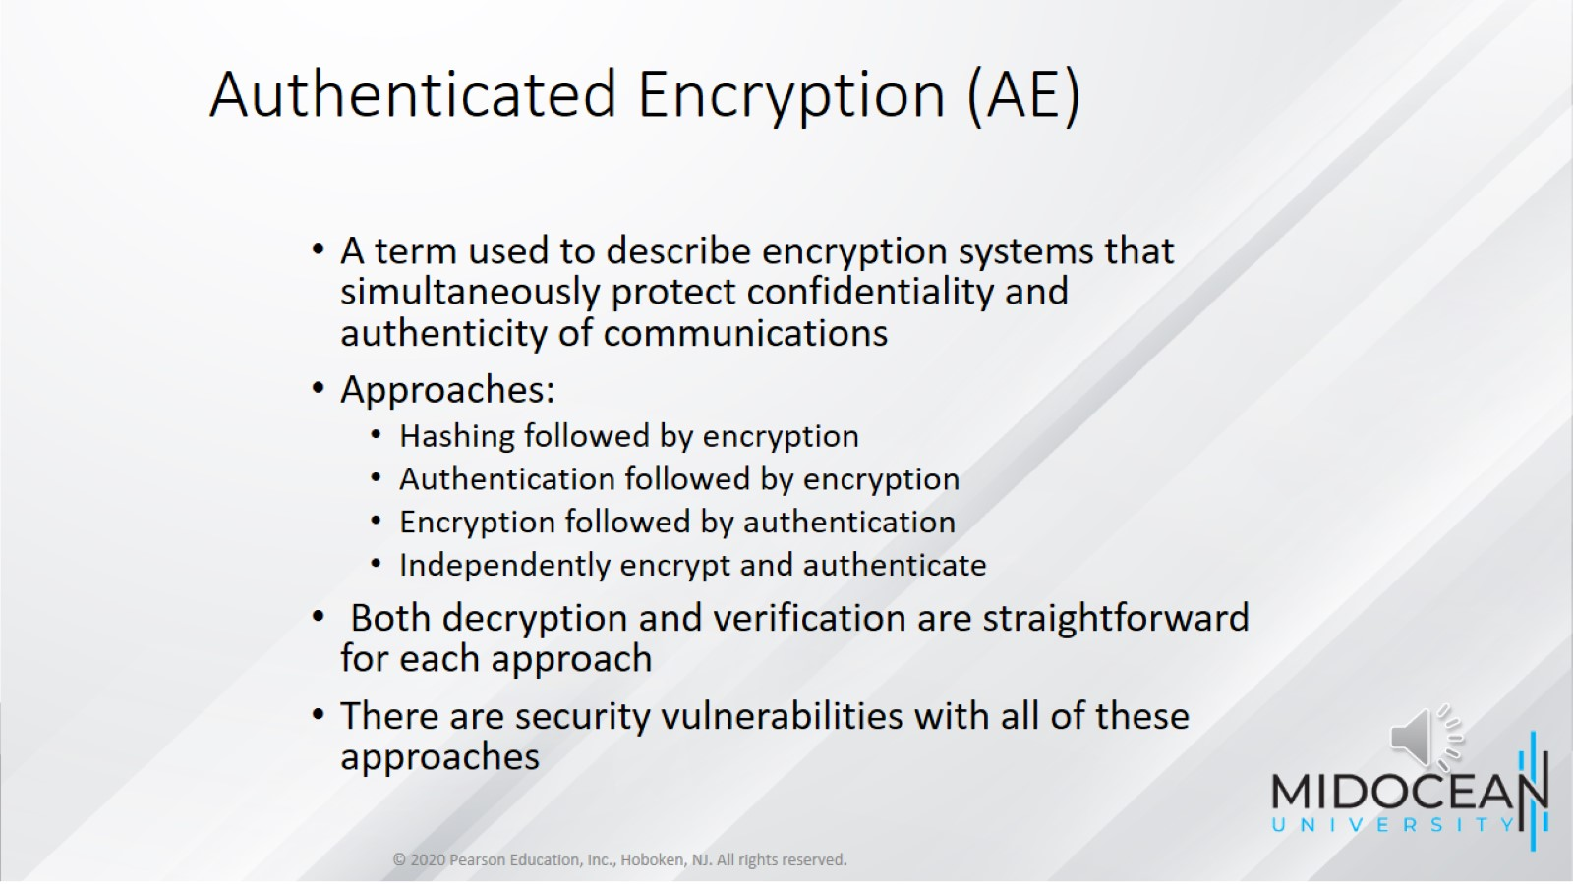
Authenticated Encryption (AE)

Slide 25
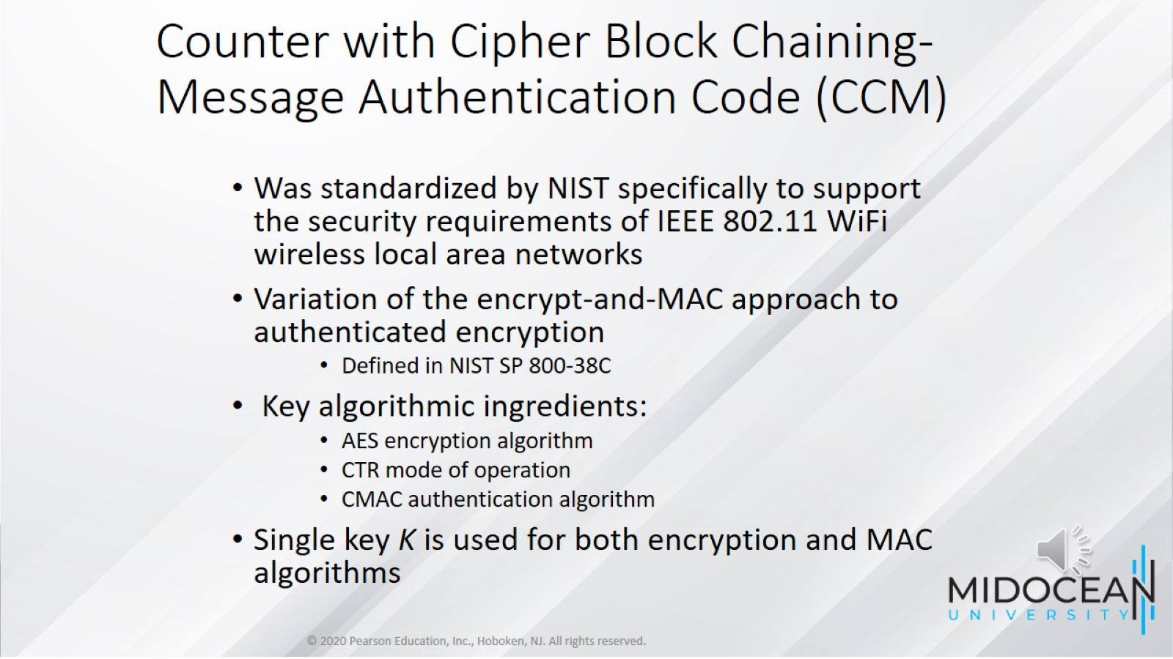
Counter with Cipher Block Chaining-Message Authentication Code (CCM)

Slide 26
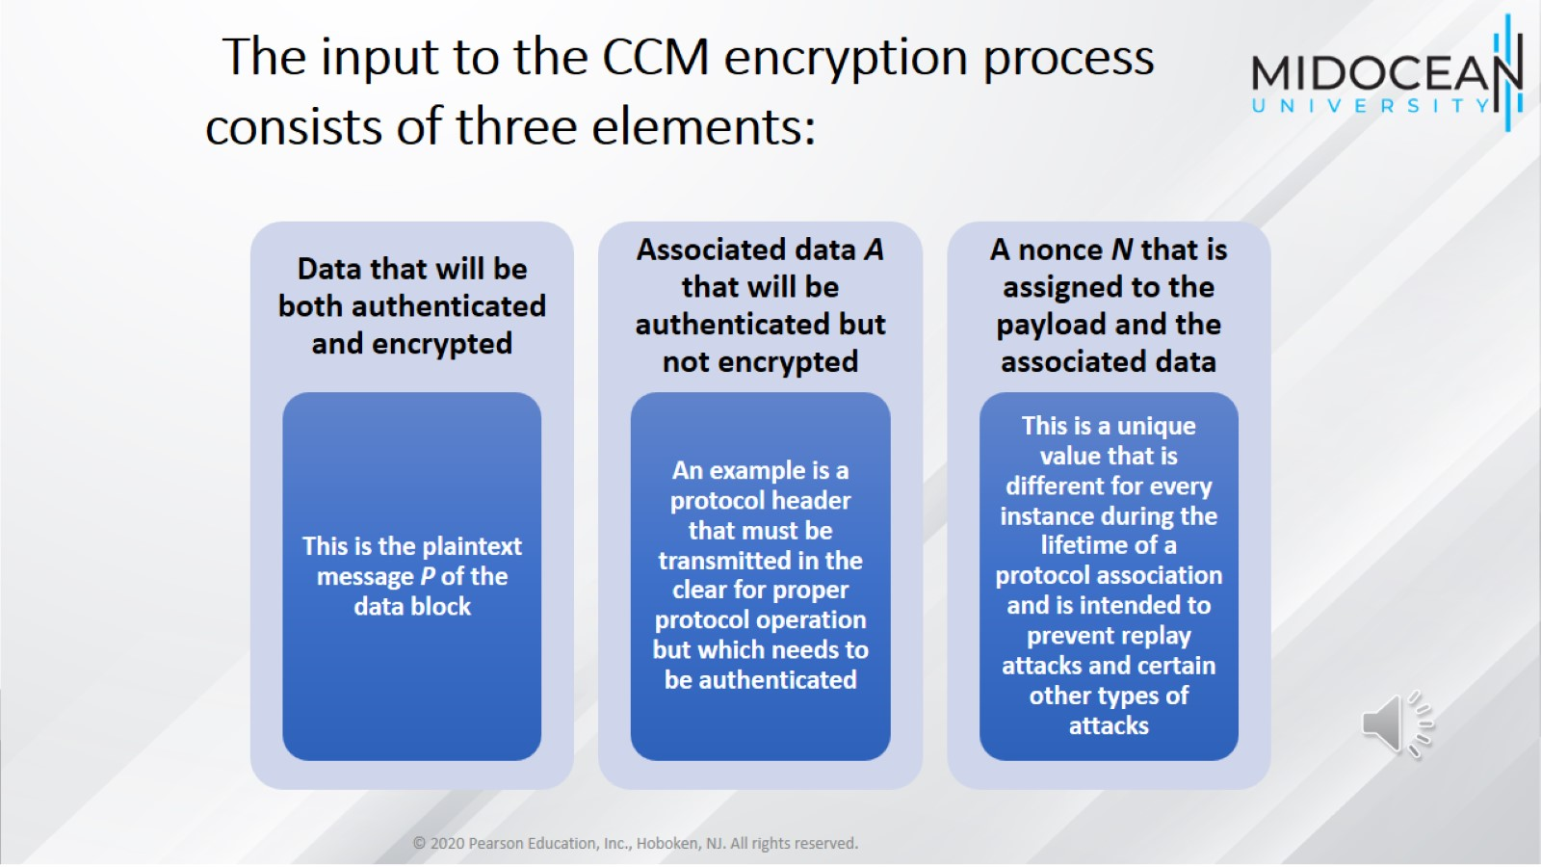
The input to the CCM encryption process consists of three elements:

Slide 27
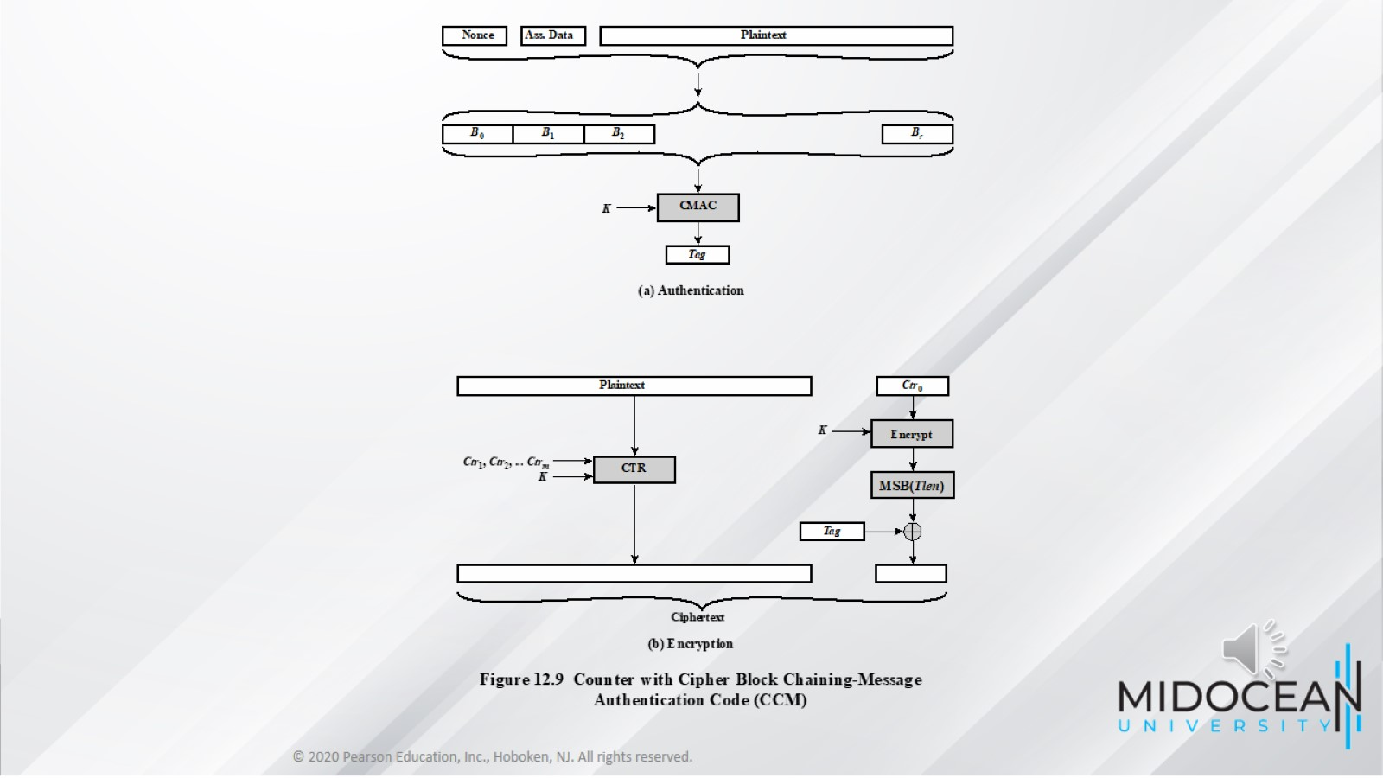

Slide 28
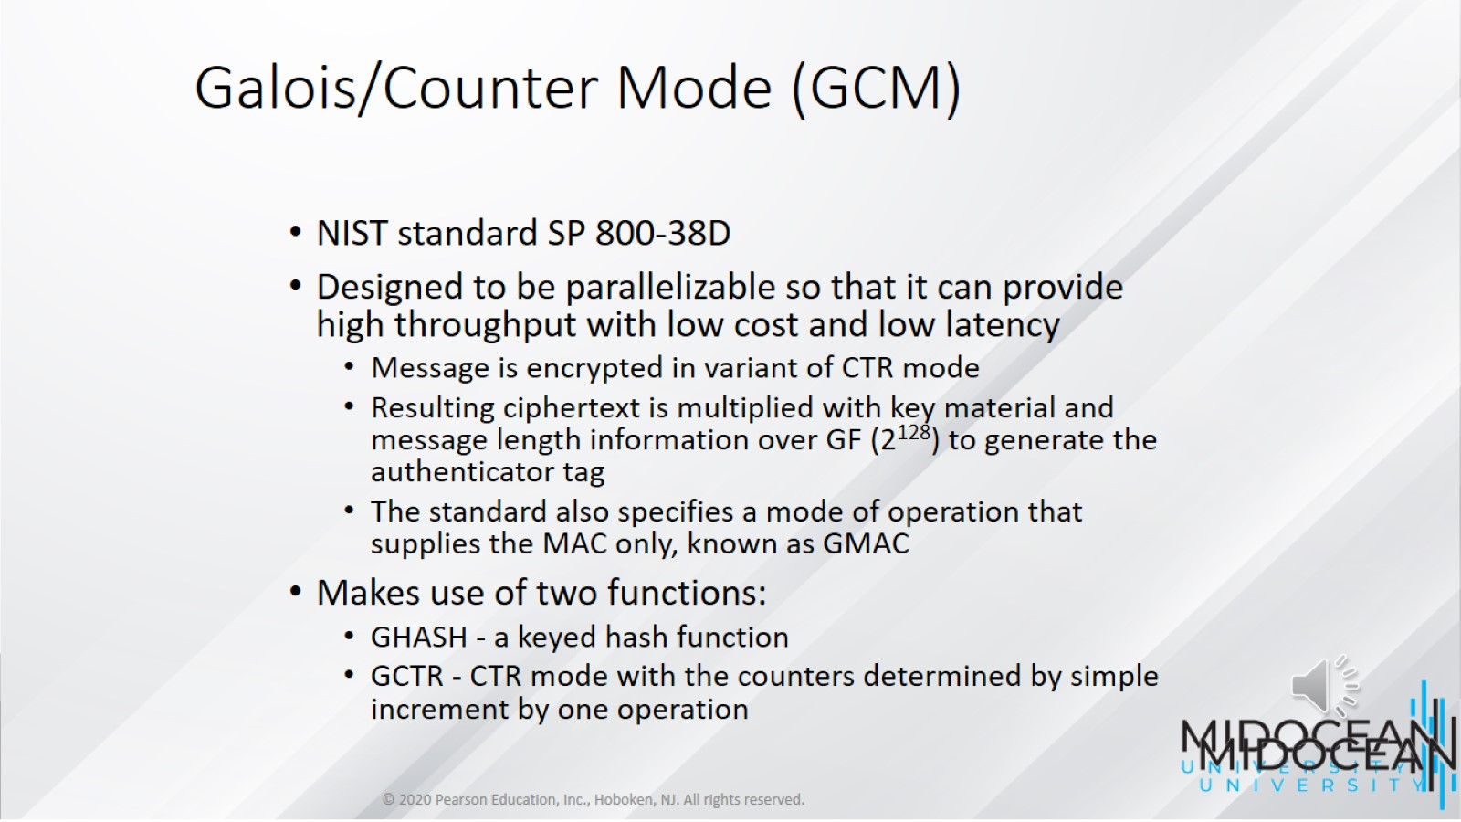
Galois/Counter Mode (GCM)

Slide 29
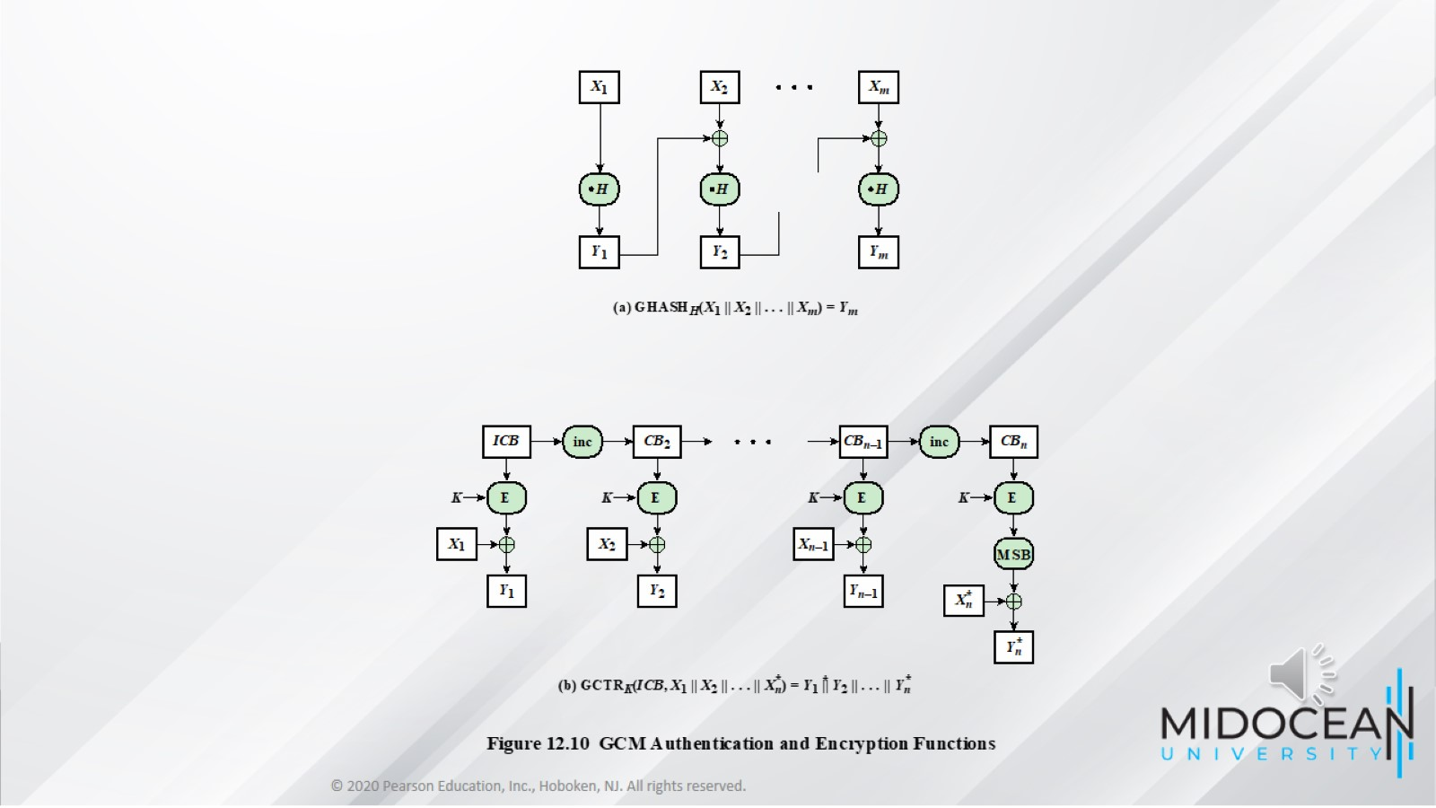

Slide 30
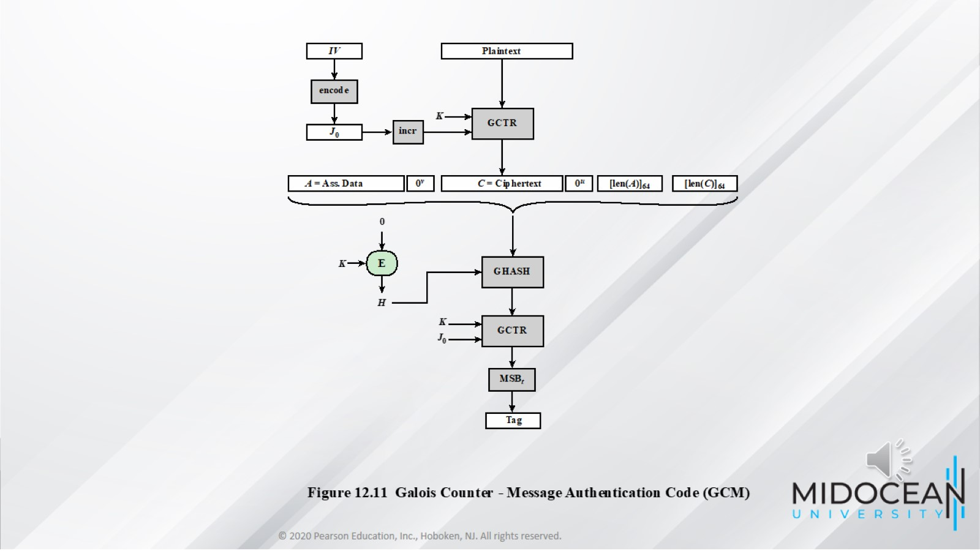

Slide 31
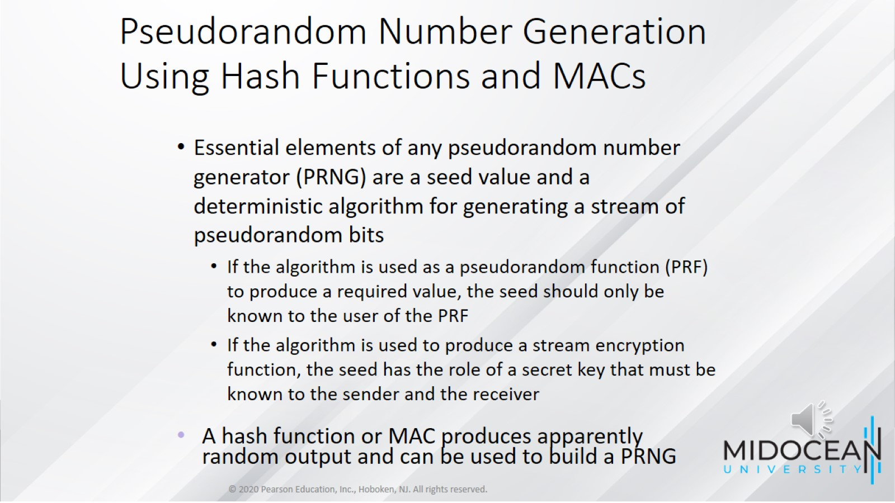
Pseudorandom Number Generation Using Hash Functions and MACs

Slide 32
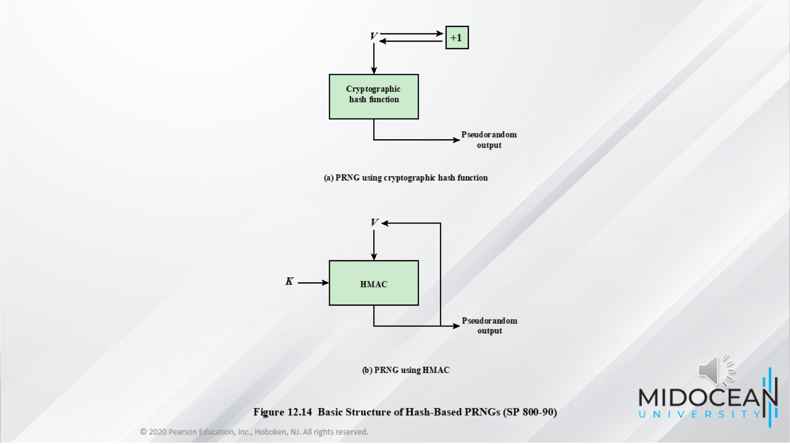

Slide 33
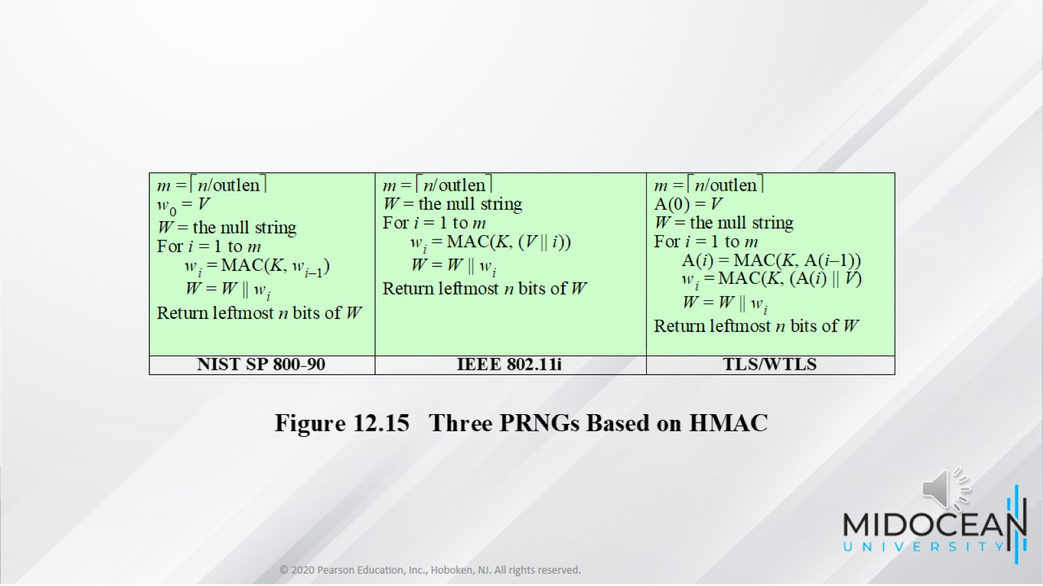

Slide 34
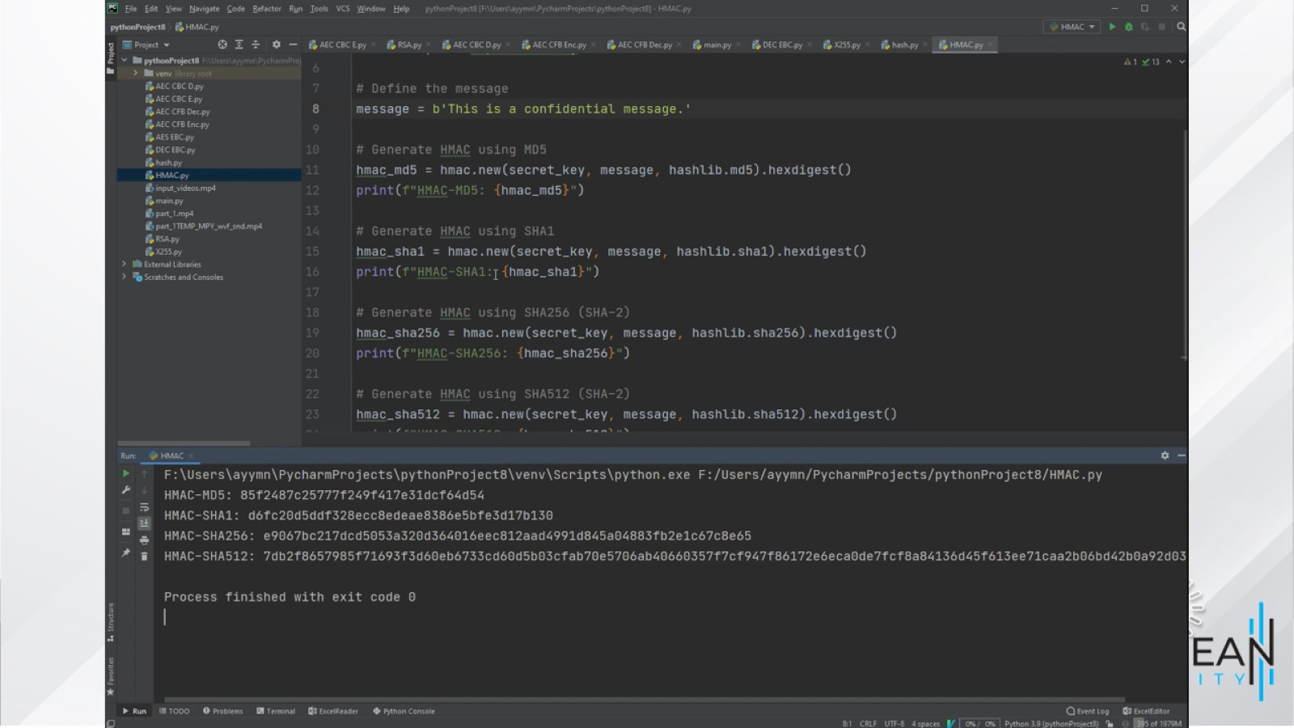

Slide 35
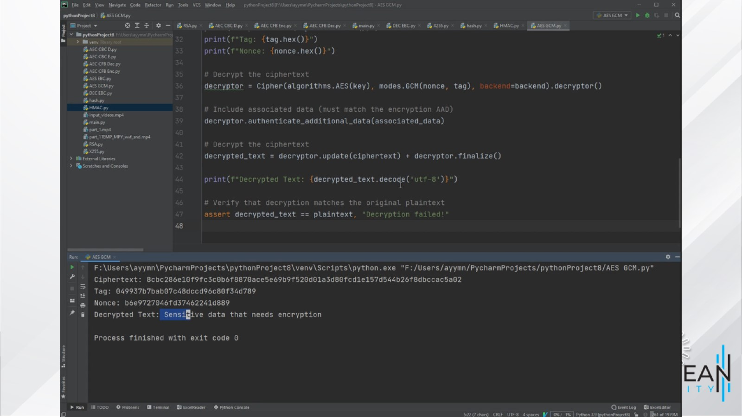

Slide 36
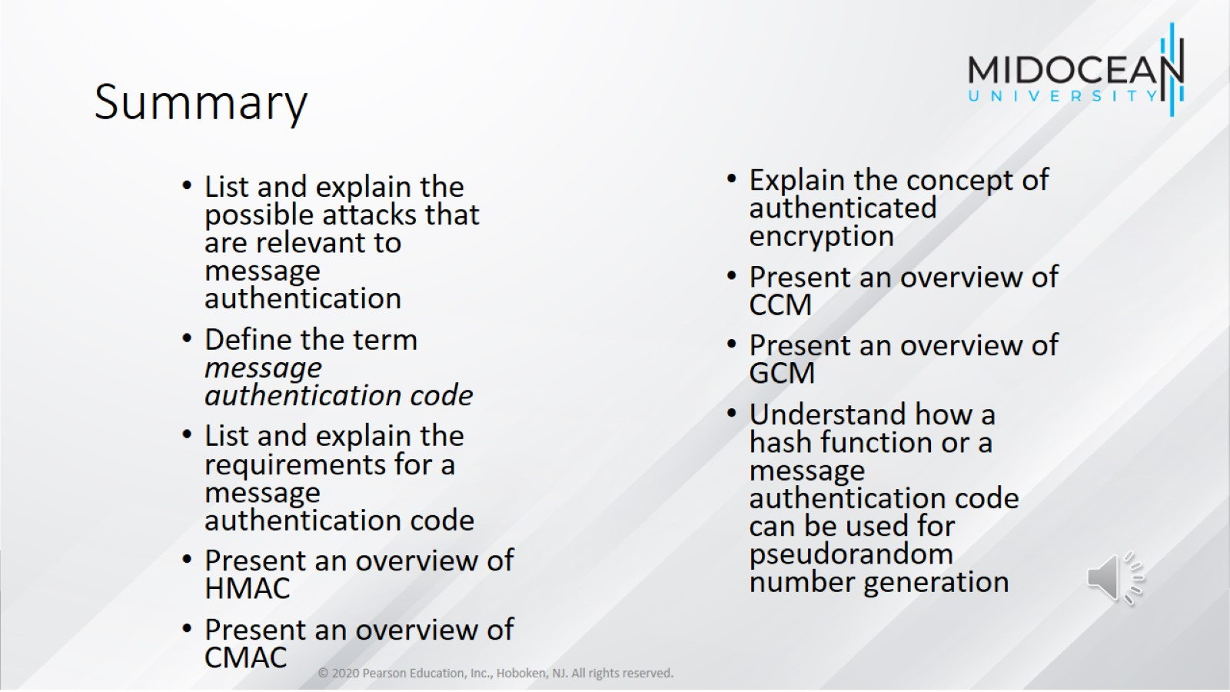
Summary

Slide 37


