Slide 1



Time Management
lecture-5
Principle of Management
MGM111
Dr. Magdy Alhaj

Slide 2

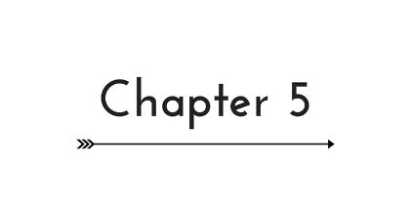
Time Management

Slide 3
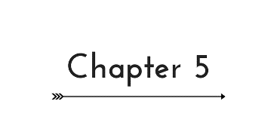
Learning outcomes
Time Define
Value of Time
Time Management Skills
Time Management System
Time management techniques
Time preferences – planning
Project Time Management Processes

Slide 4
Time Define
Time is the period between two events or during which something exists, happens or acts.
Time is finite, instant, constant and, in a sense, an illusion.
“The only reason for time is so that everything does not happen at once.” Albert Einstein

Slide 5
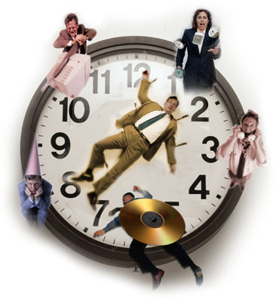
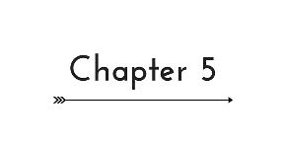
What is Time Management?
The act or process of exercising conscious control over the amount of time spent on specific activities, especially to increase productivity and efficiency.

Slide 6

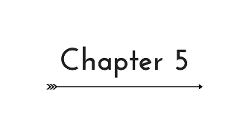
Value of Time
Time is the greatest management resource.
All other resources can be increased, but time is fixed.
What is your time worth in ?
Ironically, good managers of time are often given more to do…

Slide 7
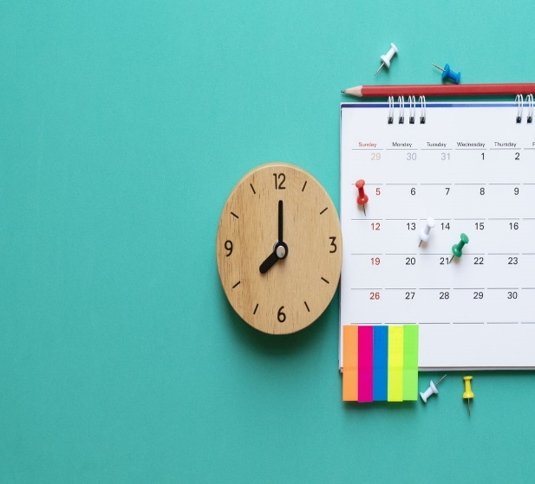
Goals and Time Management
Goals are the heart of time management.
They should:
  Be written in specific terms
  Have a time frame
  Be measurable, important and in line with agencies organizational goals
  Be challenging yet achievable.

Slide 8
Stephen Covey Approaches Habits of Highly Effective People
First Generation | Clocks, watches, computers to let you know when task is completed
Second Generation | Planning & preparation based on calendar and appointment books; setting goals
Third Generation | Planning, prioritizing, controlling (using personal organizer, other paper-based objects, or computer or PDA-based systems) activities on a daily basis
Fourth generation | Being efficient and proactive using any of the above tools; places goals and roles as the controlling element of the system and favors the importance of urgency.

Slide 9

Time Management Skills
At the heart of time management is an important shift in focus:
  Concentrate on results, not on being busy.
80 : 20 Rule
  Summed up in Pareto Principle
    Typically 80% of unfocused time effort generates only 20% of results
    Remaining 80% of results are achieved with only 20% of effort.

Slide 10

How Good is Your Time Management?
How often do you find yourself running out of time?
  Weekly
  Daily?
  Hourly?
For many there just doesn’t seem to be enough time to accomplish everything that has to be done.
(Time Management Survey)

Slide 11

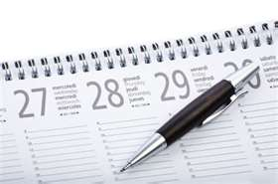
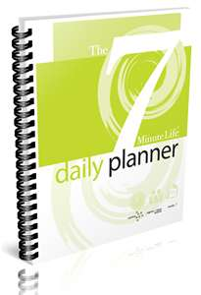
Time Management System
A time management system is a designed combination of processes, tools, techniques, and methods

Slide 12

Ten Common Time Management Mistakes
Failing to keep a To-Do list.
Not setting personal goals
Not prioritizing
Failing to manage distractions
Procrastination
Taking on too much
Thriving on “Busy”
Multitasking
Not taking breaks
Ineffectively scheduling tasks

Slide 13
The "Three Ps" of Effective Time Management
Developed by Andrew Berner
1.Planning.
2.Priorities.
3.Procrastination.
Notes:
Priorities:
Not everything you do is of equal importance.
Priorities are not constant, they must e re-evaluated.
Procrastination:
The anti-Nike – just don’t do it.

Slide 14
Ten Myths about Time
Myth: Time can be managed.
Myth: The longer or harder you work the more you accomplish.
Myth: If you want something done right, do it yourself.
Myth: You aren’t supposed to enjoy work.
Myth: We should take pride in working hard.
Notes:
It’s better to work efficiently.
You have to delegate. You can’t do it all.
If you don’t enjoy it, find something else to do.
We should take pride in working smart.

Slide 15
Ten Myths about Time
Myth: You should try to do the most in the least amount of time.
Myth: Technology will help you do it better, faster.
Myth: Do one thing at a time.
Myth: Handle paper only once.
Myth: Get more done and you’ll be happier.

Slide 16
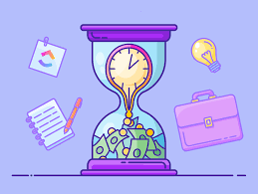
Time Wasters
Attempting too much.
Not saying no.
Incomplete information.
Management by crisis, fire fighting.
Interruptions.

Slide 17
External time wasters
Be aware of ways others or the environment waste your time:
  Interruptions, especially email
  Office socializing
  Too many meetings
  Unscheduled visitors
  Poor work environment
  Unclear goals
  Trying to get other’s cooperation
  Bureaucratic “red tape”
  Others you can think of

Slide 18
Internal time wasters
Be aware of ways in which you waste your own time:
  Procrastination
  Lack of planning
  Lack of priorities
  Indecision
  Slow reading skills
  Physical or mental exhaustion
  Not being able to say “no”
  Messy work areas
  Low motivation
  Others you can think of

Slide 19
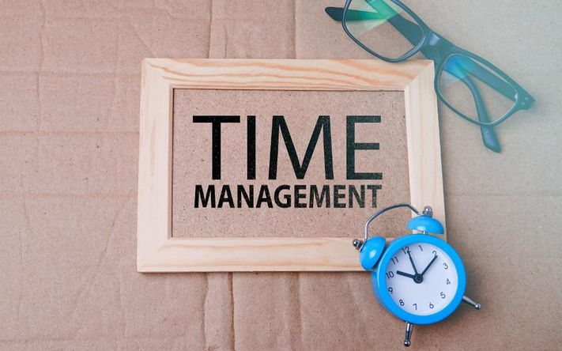
Making the Best Use of Time
Decide that you don’t have to please everyone.
Let go–don’t be a perfectionist.
Resist the temptation to do small, insignificant tasks too well.
Outsource what you can.

Slide 20
Timing
Knowing when not to work is as important as knowing when to work.
Save the easiest tasks for the end of the day.

Slide 21

Time management techniques
What do you currently use?
Are they effective/not effective?
What are their advantages and/or disadvantages?

Slide 22
Time preferences - planning
Do you plan or go with the flow?
Planners – how do you feel when you have to leave things undecided or make changes at the last minute?
Go with the flow – how do you feel having to account to others for what you are doing and when?

Slide 23
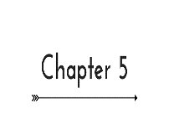
Time preferences
Your preference will influence how you want to spend your time
Both planning and going with the flow have their strengths but you need to be aware that working with others you need to be flexible
Pressure to be planners and planning is a key task in time management
If you need to be responsive to others you may not be able to plan you whole day ahead of time
Having a fixed plan can sometimes make it difficult to take advantage of new opportunities

Slide 24
In order to manage our time effectively we need to know what we have to do
Urgent/Important | Not urgent/Important
Crises Fire fighting Unplanned activities | Major projects Planned tasks
Urgent/Not important | Not important/Not urgent
Emails Interruptions Other expectations | Socialising Pleasant distractions

Slide 25
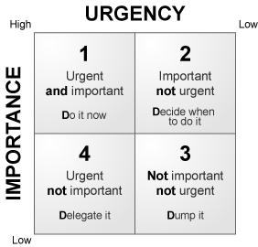
Another way of looking at this…

Slide 26
And one more way!
 | Urgent | Not urgent
Important | NECESSITY Your key action Manage Activities Crisis Deadline driven activities “True emergencies” Pressing problems Last minute preparation | QUALITY & PERSONAL LEADERSHIP Your key action Focus Activities Preparation and planning Empowerment Relationship building Delegation
Not important | DECEPTION Your key action Use caution or avoid Activities Meeting other people’s priorities and expectations Frequent interruptions Most emails, some calls Urgency masquerading as importance | WASTE Your key action Avoid Activities Escapist activities Busy work Junk mail Some emails Some calls

Slide 27
Time Management Summary
Key Issues:
Key Points:
Goal Setting
Prioritization
Managing Interruptions
Procrastination
Scheduling
Time management is an essential skill that helps keep your work under control, at the same time that it helps you keep stress to a minimum

Slide 28
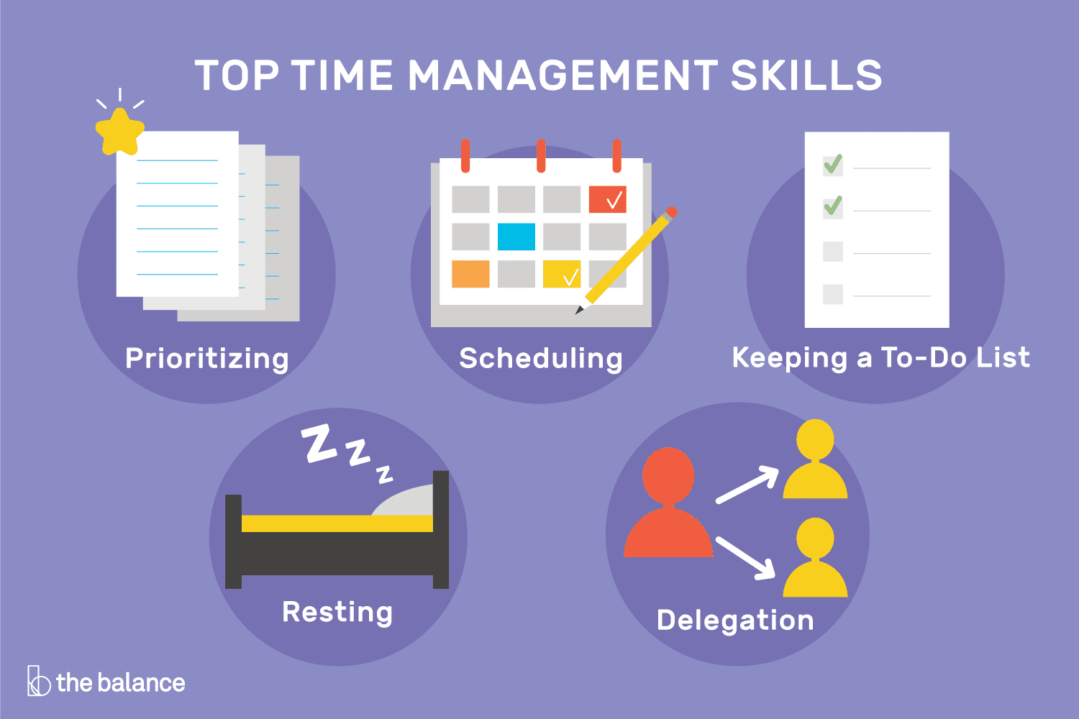


Slide 29
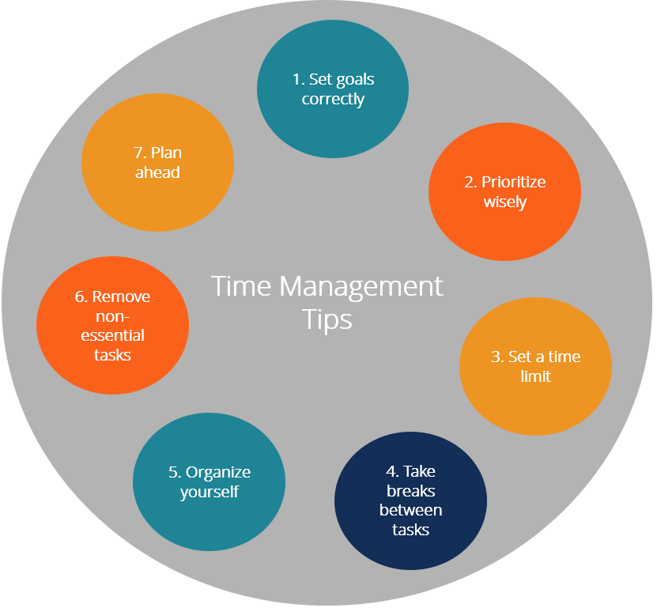

Slide 30
Project Time Management Processes
1. Define Activities
4. Estimate Activity Durations
5. Develop Schedule
6. Control Schedule
2. Sequence Activities
3. Estimate Activity Resources
30
Notes:
30

Slide 31
THANKS

