Slide 1





Project Time Management
Prepared by Dr. Nael Zabel
Lecture 9
PMG 212
Acceleration and Schedule
Compression

Slide 2


Lecture 9
Agenda
Case study
Case study – Create WBS
Case study – Create activity
Case study – Scheduling
Project duration versus cost
Acceleration and Schedule Compression

Slide 3
Lecture 9
Agenda
Case study
Case study – Create WBS
Case study – Create activity
Case study – Scheduling
Project duration versus cost
Acceleration and Schedule Compression

Slide 4

Lecture9
Case study
Road Network
D
C
B
A
3
2
1
4
3
2
1
3
2
1
3
2
1

Slide 5
Lecture 9
Agenda
Case study
Case study – Create WBS
Case study – Create activity
Case study – Scheduling
Project duration versus cost
Acceleration and Schedule Compression

Slide 6
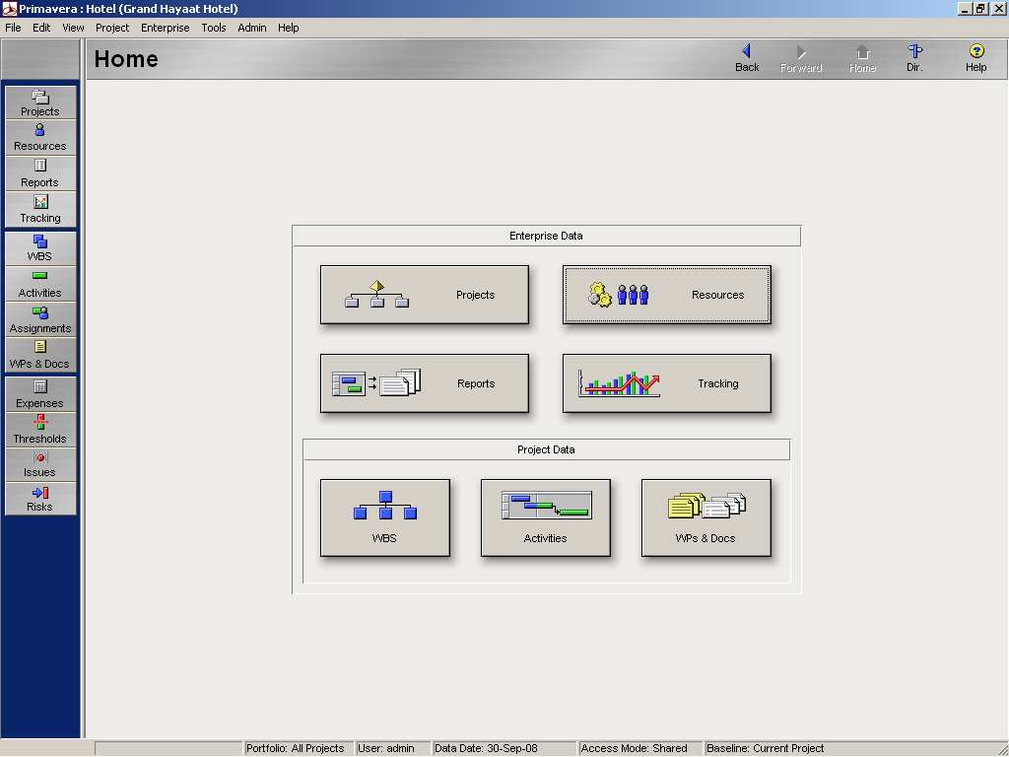
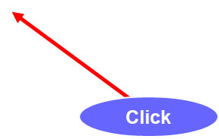
Lecture9
Case study – Create WBS

Slide 7
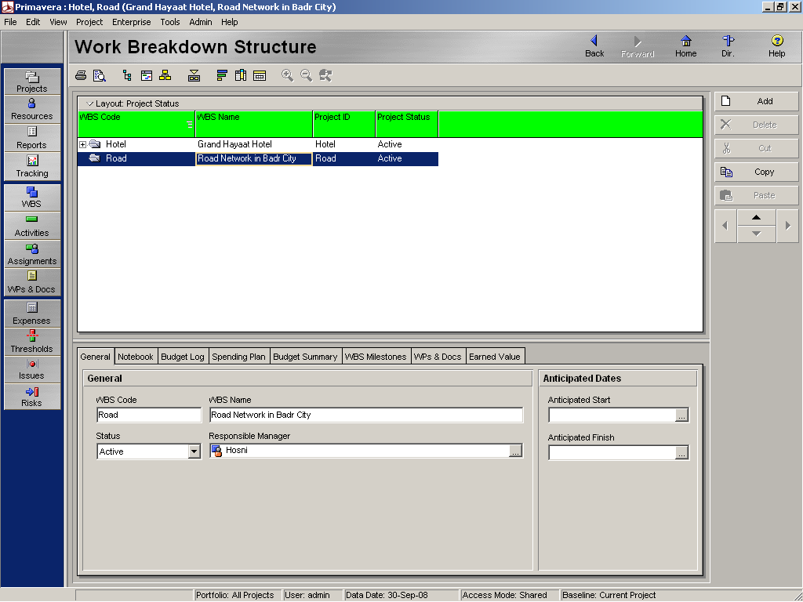
Lecture9
Case study – Create WBS
Click

Slide 8
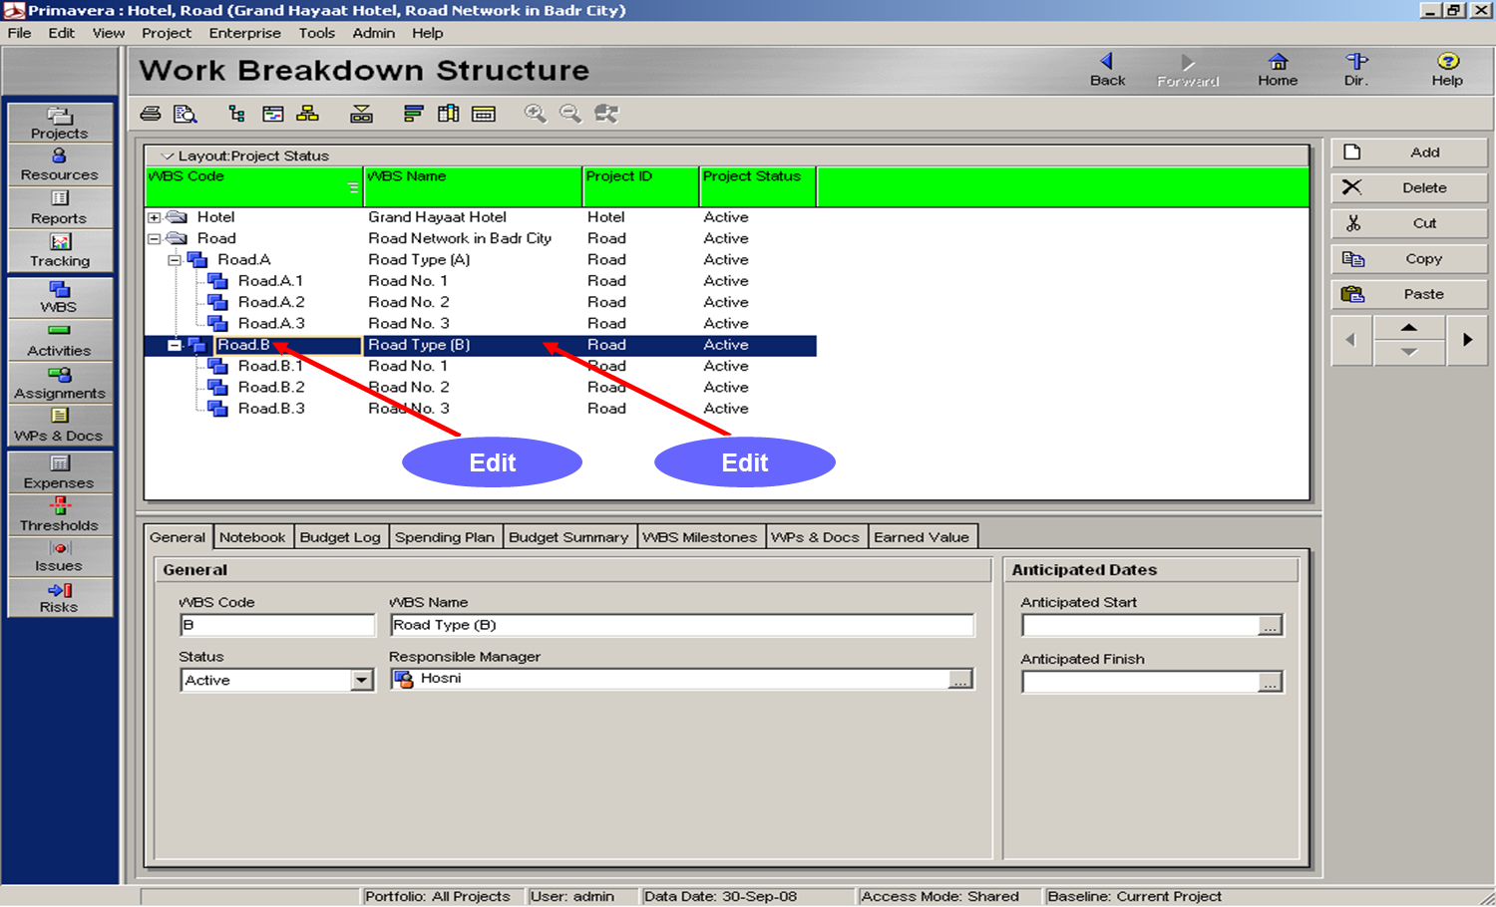
Lecture9
Case study – Create WBS

Slide 9
Lecture 9
Agenda
Case study
Case study – Create WBS
Case study – Create activity
Case study – Scheduling
Project duration versus cost
Acceleration and Schedule Compression

Slide 10

Lecture9
Case study – Create activity code
Activity | Code
Excavation | EX
Replacement | RE
Ferma Layer | FR
Base Layer | BA
Prime Coat | PR
Layer Bond | LB
Tack Coat | TA
Asphalt Layer | AS
Curbs | CU
Sign Traffic | ST
Draw Axis | DR
Pavement Layer | PV

Slide 11
Lecture 9
Agenda
Case study
Case study – Create WBS
Case study – Create activity
Case study – Scheduling
Project duration versus cost
Acceleration and Schedule Compression

Slide 12
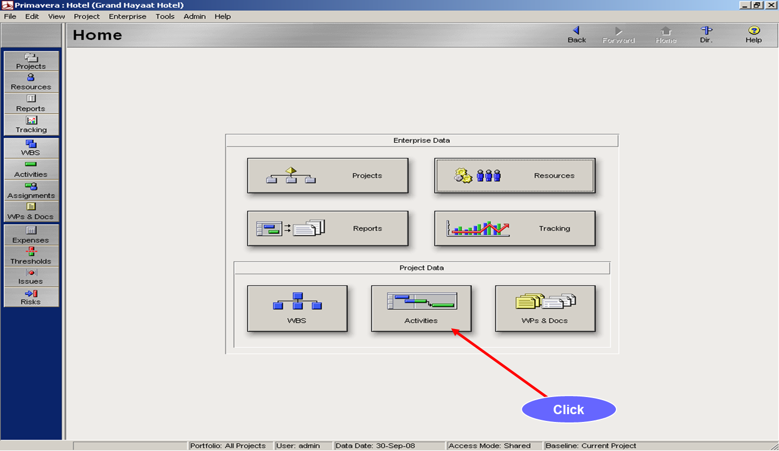
Lecture9
Case study – Create activity

Slide 13
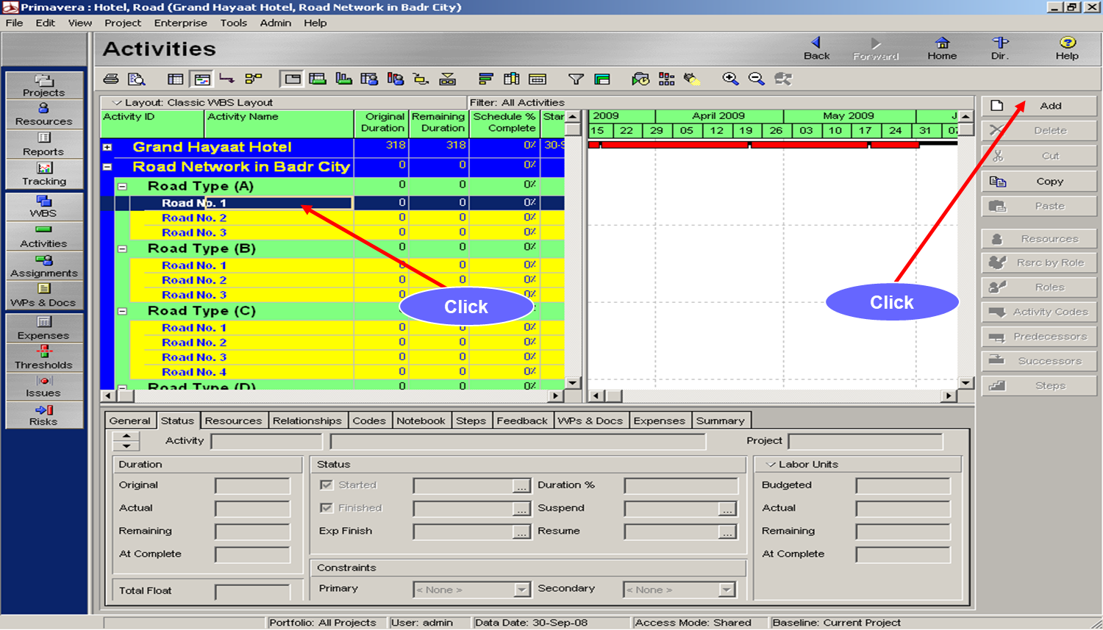
Lecture9
Case study – Create activity

Slide 14
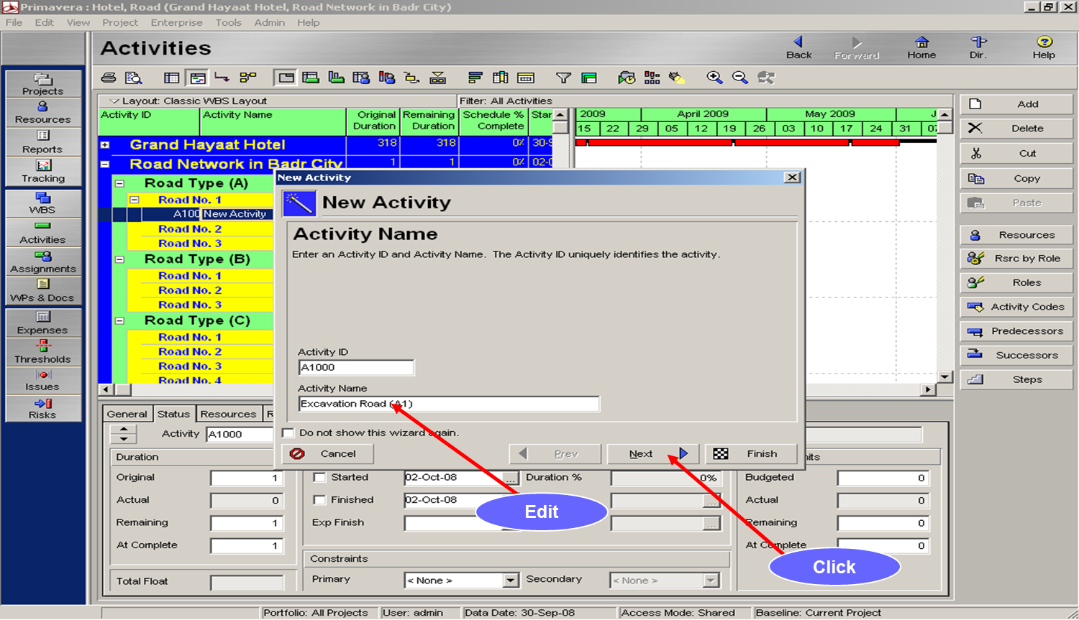
Lecture9
Case study – Create activity

Slide 15
Lecture 9
Agenda
Case study
Case study – Create WBS
Case study – Create activity
Case study – Scheduling
Project duration versus cost
Acceleration and Schedule Compression

Slide 16
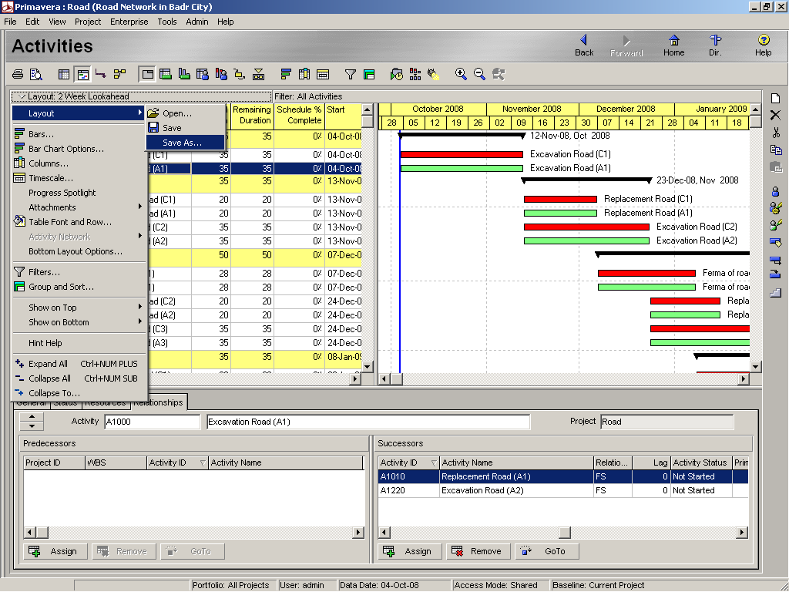
Lecture9
Case study – Scheduling

Slide 17
Lecture 9
Agenda
Case study
Case study – Create WBS
Case study – Create activity
Case study – Scheduling
Project duration versus cost
Acceleration and Schedule Compression

Slide 18

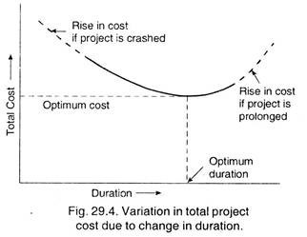
Lecture9
Project duration versus cost

Slide 19
Lecture 9
Agenda
Case study
Case study – Create WBS
Case study – Create activity
Case study – Scheduling
Project duration versus cost
Acceleration and Schedule Compression

Slide 20
Lecture9
Acceleration and Schedule Compression
Construction projects always have delivery dates. Some are dictated by the owner, and some are dictated by the contractor.
Most delivery dates are contractual.
There are a multitude of reasons, but the most prominent one is that a project needs a delivery date for control.
Without a delivery date, there is no goal and human nature’s proclivity toward procrastination takes over.

Slide 21

Lecture9
Acceleration
Delivering on time or ahead of schedule is important for all parties, from subcontractors all the way up to the owner.
Finishing within or under budget is another important goal.
The real achievement, however, is doing both simultaneously. Unfortunately, this may not always be possible.

Slide 22
Lecture9
Acceleration
At the point where an accelerated pace of the work is diagnosed as the cure
for delay, the project manager may have to make the decision to spend money.
Acceleration is defined as the addition of resources or work hours to a task
or project.
Acceleration results in schedule compression or reducing the duration of the task or shortening the entire project without diminishing the scope of the
project.

Slide 23
Lecture9
Acceleration
The acceleration must be applied to the critical path or a critical task.
To accelerate a noncritical task rarely benefits the schedule.
There are three different types of acceleration that the average project may potentially encounter.
Acceleration is issued in the form of written direction from the owner to the contractor and can be classified in three categories: actual, constructive, and forced.

Slide 24
Lecture9
Actual Acceleration
Actual acceleration is the directive to complete the project ahead of the accepted or contractual schedule.
This directive comes from the owner to the contractor through the architect, and is then passed on to the subcontractors.

Slide 25
Lecture9
Constructive Acceleration
Constructive acceleration occurs when the contractor requests an extension of time and is denied.
If the delay that resulted in the request for an extension of time is an excusable delay, the extension should be granted.

Slide 26
Lecture9
Constructive Acceleration
Constructive acceleration exists when the following conditions occur:
  ● There is an excusable delay to the project.
  ● The contractor requests a justifiable extension of time for the excusable delay.
  ● The request for an extension is denied.

Slide 27
Lecture9
Constructive Acceleration
Constructive acceleration exists when the following conditions occur:
  ● The contractor is directed to achieve the original completion date.
  ● The contractor actually accelerates the work to meet the original date.
  ● The contractor incurs additional costs for acceleration.

Slide 28
Lecture9
Forced Acceleration
There is also a need for acceleration when delay occurs as a result of nonperformance.
This type of acceleration is sometimes referred to as forced acceleration.
This occurs frequently when a subcontractor on the critical path is falling behind.
While this is not acceleration in the truest sense of the definition, it does require an increase in production.

Slide 29
Lecture9
Schedule Compression
The decision to accelerate work and incur costs must have a tangible benefit to the project.
Schedule compression is not always about the shortest duration of the task.
It is more about the balance of getting the shortest duration for the least
cost.

Slide 30
Lecture9
Schedule Compression
Schedule compression is generally defined as modifying the plan and/or schedule to complete critical tasks or the project early.
Schedule compression is the resequencing or rescheduling of tasks with minimal or no cost impact.

Slide 31

Lecture 9
Thank You

