Slide 1

Risk analysis and evaluation
Lecture 7
Everyone’s Smart
University
PMG510
Project Risk Management

Slide 2

Application of a risk matrix
The use of a risk matrix is a very simple way of demonstrating the level of risk that a particular event represents to an organization.
When the risk matrix is used to illustrate the current level of risk, the vertical axis will normally be labelled as impact.
However, the risk matrix can also be used to represent gross or inherent level of risk, which is the level of risk before controls are applied. When the risk matrix is used to illustrate the inherent level of risk, the vertical axis may sometimes be labelled magnitude.

Slide 3
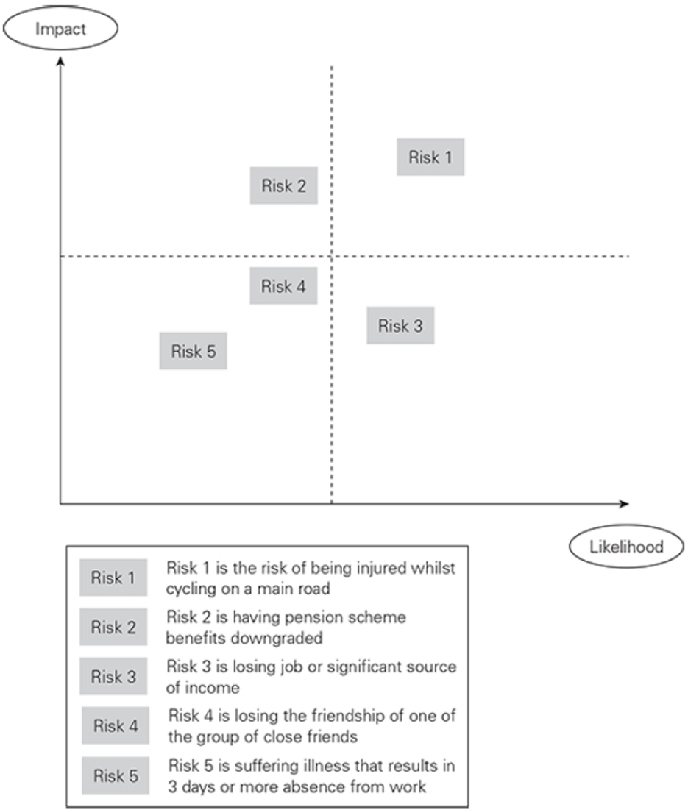
Example of personal risk matrix

Slide 4
Application of a risk matrix
Large organizations frequently make use of a risk matrix as a means of summarizing their risk profile.
It can also be used to identify the type of risk response that is most likely to be employed.
Impact is not the same as magnitude, because a risk may have a high magnitude in terms of the size of the event, but the impact and consequences may be smaller.

Slide 5
Inherent and current level of risk
Many risk management practitioners assess risk at its current (also referred to as residual) level. However, internal auditors prefer to undertake an assessment of the risk at its inherent level.
There are advantages in considering the inherent level of a risk when undertaking a risk assessment. Considering the inherent level will enable the effect of individual control measures to be identified

Slide 6
Inherent and current level of risk
The figure below illustrates the effect of controls on the level of risk.
Control 1 is an existing control and it reduces the risk from the inherent level to the current (or residual) level and it can be seen that this control has its main effect on the likelihood of the risk materializing.

Slide 7
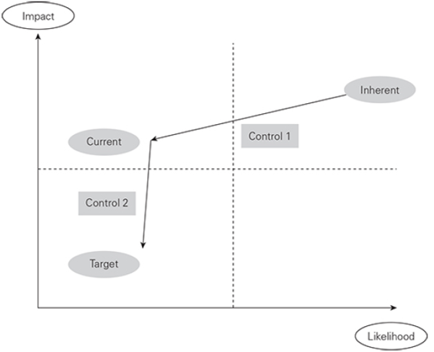
Inherent and current level of risk

Slide 8
Inherent and current level of risk
Control 2 is an additional control that will be introduced to reduce the risk from the current level to the target level. It is intended to have a significant effect on the impact of the risk. but little effect on the likelihood of it materializing.
There are three levels of risk that are important on the risk matrix shown:
The inherent or gross level is the level of risk that would be present if there were no controls in place.
The current level is the level at which the risk exists at the time of the risk assessment, when only Control 1 is in place. This is often referred to as the residual level of risk.

Slide 9
Inherent and current level of risk
The level of risk that is of interest to risk managers is the target level.
which is intended to reduce the impact of the risk, so that the target level of risk is within the bottom left-hand quadrant of the risk matrix, or the tolerate/comfort zone.
When seeking to establish the target level of risk, a concept that is often used by health and safety practitioners is seeking to reduce the risk to the level that is ‘as low as reasonably practicable’ (ALARP). ALARP is one of the fundamental principles of risk management for health and safety risks.

Slide 10
Inherent and current level of risk
It is not necessary to manage risk to the point where it is eliminated, but to the point where the cost of additional controls would exceed the benefits.

Slide 11
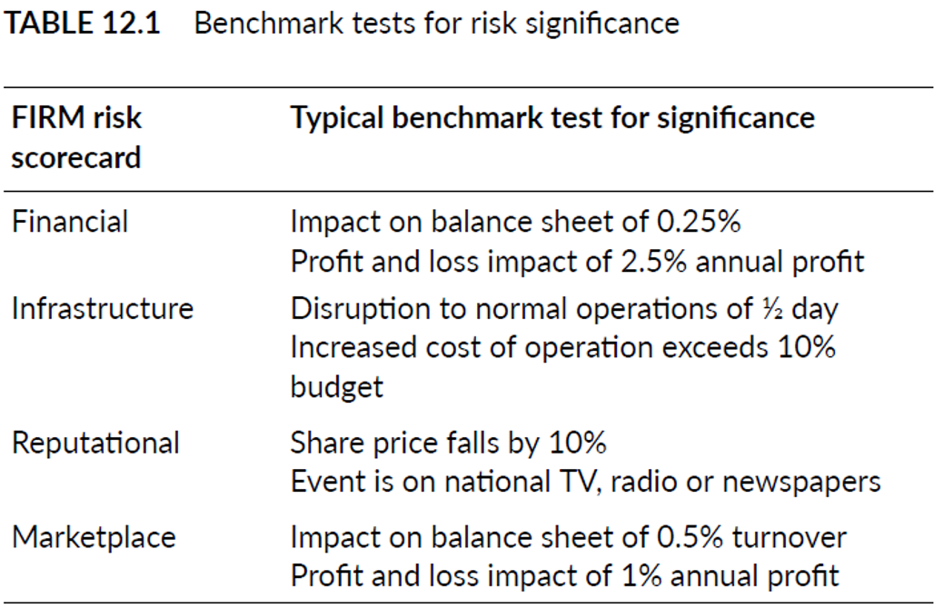
Inherent and current level of risk

Slide 12
Control confidence
The intended effect of an individual control measure is illustrated in the figure above. It is not possible for an organization to be absolutely confident that controls will always be fully implemented and will be as effective as expected or required. Controls will need to be audited in order to allow confidence that the control selected has been properly designed and implemented and is producing the desired effect.

Slide 13
Control confidence
Placed on a particular control. Two questions need to be asked: ‘How confident are we that this is the correct control?’ and ‘How confident are we that it is fully implemented and effective in practice?’ When there is limited confidence in the effectiveness of a control, it will be the role of internal audit to test the control and provide information on the likely level of variability of outcome, should the risk materialize

Slide 14
Control confidence
It is the responsibility of internal auditors to check that the correct controls have been selected and that they are working correctly in practice. Internal auditors refer to effective and efficient controls respectively when reviewing these points. The use of effective and efficient is also included in this book in relation to core processes of the organization. Undertaking the testing of controls is a key function fulfilled by internal audit and the importance of the testing of controls should also be recognized by risk management practitioners.

Slide 15
Control confidence
Management needs to receive assurance of adequate control and this can come from internal audit activities, or measurement of the outputs of activities and projects, as well as from management reports. The responsibility for designing and implementing controls and auditing the effectiveness and efficiency of controls should be allocated within the risk management documentation.

Slide 16
4 Ts of hazard risk response
The options presented for risk response can be described as the 4Ts of hazard management, which are: tolerate, treat, transfer and terminate.
It is possible to illustrate the 4Ts of risk response on a simple risk matrix and this is done in the figure below. This figure suggests that in each of the four quadrants of the risk matrix, one of the 4Ts will be dominant, as follows:

Slide 17
4 Ts of hazard risk response
Tolerate will be the dominant response for the low-likelihood/low impact risks.
Treat will be the dominant response for high-likelihood/low-impact risks.
Transfer will be the dominant response for high-impact/low-likelihood risks.
Terminate will be the dominant response for high-impact/high likelihood risks.

Slide 18
4 Ts of hazard risk response
It is important to note that these responses are represented as the dominant or most likely response in each quadrant, but circumstances may dictate that another response may be required as well, or instead.

Slide 19
Risk significance
When undertaking a risk assessment, it is quite common to identify a hundred or more risks that could impact the objective, core process or key dependency that is being considered.
In order for an organization to concentrate on significant risks, a test for risk significance is required. The Table above provides suggestions on the nature of the benchmark tests that could be used to decide whether a risk is significant.

Slide 20
Risk significance
Applying this test during a risk assessment workshop could reduce the number of risks for further consideration to about 20. The next stage would be to identify how likely each of the 20 potentially significant risks would be to materialize at or above the financial threshold level.
A risk matrix could be used to record and display the results.

Slide 21
Risk significance
Applying this test during a risk assessment workshop could reduce the number of risks for further consideration to about 20. The next stage would be to identify how likely each of the 20 potentially significant risks would be to materialize at or above the financial threshold level.
A risk matrix could be used to record and display the results.
The more rapidly the marketplace is changing, the greater capacity for risk the organization is required to have available.

