Slide 1


Master of Financial Technology
Prepared by Dr. Omar Al-kasasbeh
FNT628
Blockchain and Cryptocurrencies
Lecture 8

Slide 2



Blockchain and Cryptocurrencies
FNT 628
Blockchain and Cryptocurrencies
Prepared by
Dr. Omar Al-kasasbeh

Slide 3
Lecture
8
Cryptocurrency and Monetary Policy

Slide 4
Lecture
8
Table of contents
1- Cryptocurrency and Monetary Policy
2- Challenges in Monetary Policy
3- Key Differences: Cryptocurrency vs Traditional Money
4- Impact of Cryptocurrencies on Monetary Policy
5- Central Bank Digital Currencies (CBDCs)
6- Will Cryptocurrencies Replace Traditional Money?

Slide 5
Lecture
8
Overview of Monetary Policy
Monetary policy refers to the set of actions undertaken by a central bank to manage a country’s money supply and credit conditions in order to achieve macroeconomic objectives such as price stability, economic growth, and financial stability. Central banks such as the Federal Reserve System, the European Central Bank, and the Central Bank of Jordan play a pivotal role in designing and implementing these policies.

Slide 6
Lecture
8
Objectives of Monetary Policy
Price Stability: Maintaining low and stable inflation is the central goal of most monetary authorities. High inflation erodes purchasing power, while deflation can suppress economic activity.
Economic Growth: Monetary policy supports stable and sustainable economic expansion by facilitating investment and consumption.
Full Employment: Although not always a direct target, many central banks consider employment levels when formulating policy decisions.
Financial Stability: Ensuring the resilience of the financial system, particularly during periods of crisis or volatility.

Slide 7
Lecture
Types of Monetary Policy
8
Expansionary Monetary Policy: Implemented during economic slowdowns or recessions. It involves increasing the money supply and lowering interest rates to stimulate borrowing, investment, and consumption.
Contractionary Monetary Policy: Used to combat inflation by reducing the money supply and increasing interest rates, thereby slowing down economic activity.

Slide 8
Lecture
8
Key Instruments of Monetary Policy
Interest Rate Policy: Adjusting policy rates (such as the discount rate or policy rate) influences borrowing costs across the economy.
Open Market Operations (OMO): Buying and selling government securities to control liquidity in the banking system.
Reserve Requirements: Setting the minimum reserves that commercial banks must hold, which directly affects their lending capacity.
Quantitative Easing (QE): An unconventional tool used during crises, involving large-scale asset purchases to inject liquidity into the economy.

Slide 9
Lecture
Transmission Mechanism of Monetary Policy
8
The effectiveness of monetary policy depends on how changes in policy instruments affect the real economy. This occurs through several channels:
Interest Rate Channel → affects investment and consumption
Credit Channel → influences bank lending behavior
Exchange Rate Channel → impacts exports and imports
Expectations Channel → shapes inflation and economic expectations

Slide 10
Lecture
8
Challenges in Monetary Policy
- Time lags between policy implementation and its effects
- Uncertainty in economic forecasting
- Global financial integration reducing policy independence
- Structural changes such as digital currencies and financial innovation

Slide 11
Lecture
8
How Central Banks Work
Central banks are the backbone of every modern national economy. They are government-affiliated (but typically independent) institutions responsible for managing a country's monetary system, ensuring price stability, and promoting sustainable economic growth. Unlike commercial banks that serve individuals and businesses, central banks serve the entire financial system acting as the ultimate authority over money itself.

Slide 12
Lecture
8
The Role of Central Banks
1. Issuing and Managing the National Currency
2. Setting Interest Rates to Control Borrowing
3. Acting as Lender of Last Resort
4. Maintaining Financial Stability and Regulating Banks

Slide 13
Lecture
8
5. Managing Foreign Exchange Reserves
6. Implementing Monetary Policy to Target Inflation
7. The Independence of Central Banks
8. Monetary Policy Transmission Mechanism

Slide 14
Lecture
8
Key Differences: Cryptocurrency vs Traditional Money
NATURE & FORM
Traditional Money (Fiat Currency)
Traditional money exists in two forms: physical (banknotes and coins) and digital (numbers in bank accounts). The physical form is tangible you can hold a dollar bill, fold it, lose it, or burn it. The digital form, which represents the vast majority of money in circulation today, exists as accounting entries in commercial bank databases.
Cryptocurrency
Cryptocurrency exists purely in digital form there is no physical equivalent. However, unlike a bank deposit, a cryptocurrency balance is not a liability of any institution. When you hold one Bitcoin, no company owes you that Bitcoin. It is not a promise or an IOU. It is a cryptographically verified entry on a decentralized public ledger called the blockchain.

Slide 15
Lecture
8
ISSUANCE & SUPPLY CONTROL
Traditional Money
Fiat currency is issued by central banks and has no hard limit on supply. Central banks can create new money through several mechanisms: direct currency printing, quantitative easing (purchasing assets and crediting bank reserves), and through the fractional reserve banking system where commercial banks create money by issuing loans.
Cryptocurrency
Most cryptocurrencies have either a fixed or algorithmically determined supply schedule that is enforced by the protocol's code not by any human institution. Bitcoin's supply is capped at exactly 21 million coins, a limit hardcoded into the protocol that cannot be changed without consensus from the entire network.

Slide 16
Lecture
8
TRANSACTION MECHANICS
Traditional Money
You initiate a transfer; your bank verifies your identity and account balance; it sends a message through interbank messaging systems (SWIFT for international, Fedwire or CHAPS for domestic); the receiving bank receives the message and credits the recipient's account; the actual settlement between banks happens separately, often at the end of the business day through central bank systems.
Cryptocurrency
The sender uses their private key to cryptographically sign a transaction message essentially proving they have the right to spend those funds. This message is broadcast to the entire network of nodes simultaneously. Miners (or validators in Proof-of-Stake systems) collect unconfirmed transactions into blocks, verify their validity, and add them to the blockchain.

Slide 17
Lecture
8
PROGRAMMABILITY
Traditional Money
Traditional money is fundamentally dumb; it has no inherent programmability. A dollar is a dollar; it cannot contain conditions, rules, or automated behaviors within itself.
Cryptocurrency
Ethereum and many other blockchain platforms introduced the concept of smart contracts, self-executing code stored on the blockchain that automatically enforces agreements when predefined conditions are met. This makes money programmable for the first time in history.

Slide 18
Lecture
8
Impact of Cryptocurrencies on Monetary Policy

Slide 19
Lecture
8
A. Loss of Monetary Control: For most of modern economic history, central banks have operated with a reasonable degree of confidence that they could see, measure, and influence the money flowing through their economies. That confidence is now being quietly eroded. When a significant portion of economic activity begins to migrate onto blockchain networks outside the banking system entirely, central banks face a genuinely new problem: they are trying to steer an economy while being partially blind to what is happening inside it.
B. Interest Rate Challenges: Raising interest rates is perhaps the most powerful conventional weapon a central bank possesses. The logic is elegant in its simplicity: make borrowing expensive, reduce spending, cool demand, bring inflation down. For decades, this mechanism worked with reasonable reliability. Cryptocurrency is beginning to complicate it.

Slide 20
Lecture
8
C. Threat to Monetary Sovereignty
This is perhaps the most politically charged dimension of the entire debate, and it is also where the real-world consequences are most visible, not in New York or Frankfurt, but in Caracas, Buenos Aires, and Lagos.
D. New Opportunities for Monetary Policy
Cryptocurrency, and more specifically, the technology underlying it is also handing central banks tools they never previously had. The most significant of these is the Central Bank Digital Currency.
A well-designed CBDC gives a central bank the ability to implement monetary policy with a directness and speed that was previously impossible.

Slide 21
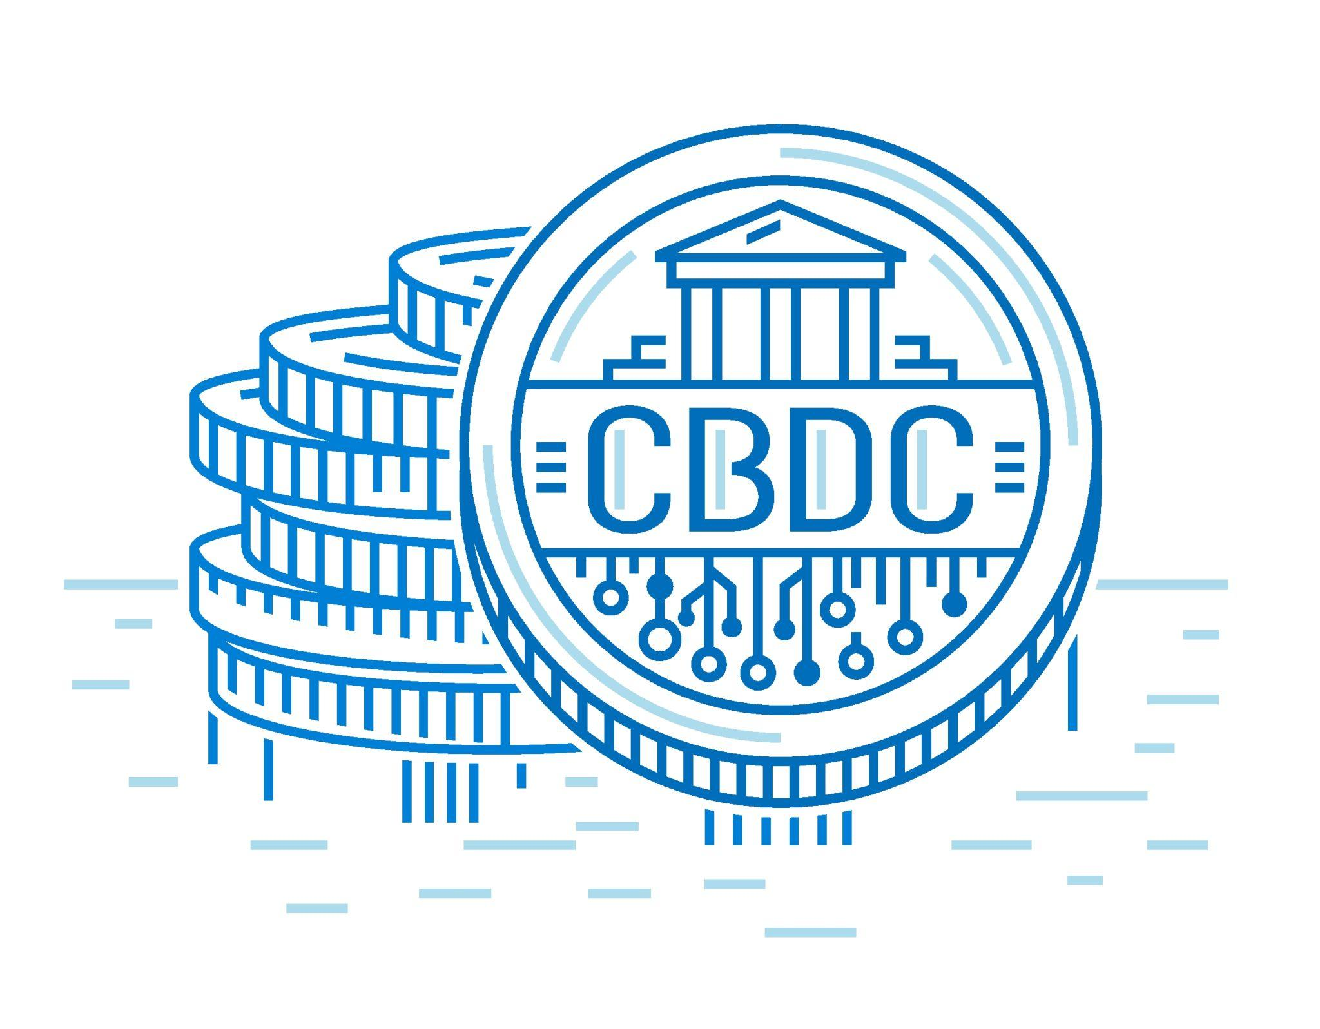
Lecture
Central Bank Digital Currencies (CBDCs)
8

Slide 22
Lecture
Definition
8
Central Bank Digital Currencies (CBDCs) are digital versions of a country’s official currency issued directly by the central bank. They are designed to function as legal tender, just like physical cash, but in a purely electronic form. What makes CBDCs particularly important is that they combine the safety and trust associated with central bank money with the convenience of digital payments. In a world where financial transactions are increasingly moving online, CBDCs represent an attempt to modernize the monetary system without fundamentally changing its structure.

Slide 23
Lecture
8
Difference Between CBDCs and Cryptocurrencies
Although both CBDCs and cryptocurrencies exist in digital form, they are fundamentally different in nature. Cryptocurrencies operate on decentralized systems without any central authority, which means their value is determined entirely by market forces and can fluctuate significantly. In contrast, CBDCs are issued and controlled by central banks, making them stable and legally recognized. While cryptocurrencies aim to provide an alternative to traditional financial systems, CBDCs are designed to strengthen and adapt the existing system rather than replace it.

Slide 24
Lecture
Objectives of CBDCs
8
a. Maintaining Monetary Control
One of the main motivations behind introducing CBDCs is to preserve the central bank’s control over the monetary system. As private digital currencies and alternative payment systems grow, central banks risk losing their influence over money supply and financial stability. CBDCs allow them to remain at the center of the financial system by providing a secure, state-backed digital alternative.
b. Improving Financial System Efficiency
Another key objective is to enhance the efficiency of the financial system. CBDCs can make transactions faster, cheaper, and more secure by reducing reliance on intermediaries. They also have the potential to simplify cross-border payments and improve access to financial services, especially for individuals who are underserved by traditional banking systems.

Slide 25
Lecture
Examples of CBDCs
8
A prominent example of a CBDC is the Digital Yuan, which has been developed by the People's Bank of China and is already being tested in real-world transactions across several cities. It represents one of the most advanced implementations of a central bank digital currency.
In Europe, the Digital Euro is still under study by the European Central Bank. The project reflects a more cautious approach, focusing on research, design, and policy considerations before full implementation.

Slide 26
Lecture
Policy Responses and Regulation
8
Regulating Cryptocurrencies
Regulating cryptocurrencies has become a central concern for policymakers as digital assets continue to expand in both scale and influence. Governments and central banks face the challenge of balancing innovation with financial stability, as cryptocurrencies operate in a decentralized environment that often lies outside traditional regulatory frameworks. The absence of a central authority makes it difficult to apply conventional financial regulations, which were originally designed for banks and other regulated institutions.

Slide 27
Lecture
8
Taxation of Cryptocurrencies
Taxation represents one of the most important tools governments use to manage the economic impact of cryptocurrencies. As individuals and institutions increasingly engage in crypto trading and investment, authorities have recognized the need to establish clear tax rules to ensure fairness and prevent tax evasion. In most jurisdictions, cryptocurrencies are treated as taxable assets rather than legal tender, meaning that transactions involving digital currencies may trigger tax obligations.

Slide 28
Lecture
8
Monitoring Cryptocurrency Trading
Monitoring cryptocurrency trading is essential for maintaining market integrity and preventing illegal activities. Due to the decentralized and global nature of crypto markets, transactions can occur across borders with minimal oversight, increasing the risk of fraud, money laundering, and market manipulation. As a result, regulators and financial institutions are investing in advanced monitoring systems to track trading activity and identify suspicious behavior.

Slide 29
Lecture
8
International Cooperation (IMF, BIS)
Given the global nature of cryptocurrencies, effective regulation cannot be achieved by individual countries acting alone. This has led to an increasing emphasis on international cooperation among financial institutions and regulatory bodies. Organizations such as the International Monetary Fund and the Bank for International Settlements play a crucial role in coordinating policy responses and providing guidance on best practices.

Slide 30
Lecture
8
The rise of cryptocurrencies and digital financial technologies presents a complex set of implications for developing countries, combining both promising opportunities and significant risks. These economies often face structural challenges such as limited access to banking services, weak financial infrastructure, and high transaction costs. In this context, digital currencies and fintech innovations can play a transformative role, but they may also introduce new vulnerabilities if not properly managed.

Slide 31
Lecture
8
As people begin to rely more on cryptocurrencies or foreign digital assets, demand for the national currency may decline. This can lead to depreciation pressures, increased inflation, and reduced confidence in the domestic monetary system. In extreme cases, this phenomenon may contribute to a form of “digital dollarization,” where alternative currencies partially replace the national currency in everyday transactions.

Slide 32
Lecture
8
Will Cryptocurrencies Replace Traditional Money?

Slide 33
Lecture
8
The role of central banks in the future
The most significant development in this space is the rapid global spread of Central Bank Digital Currencies (CBDCs), essentially, state-issued digital money that combines the trust of traditional currency with the programmability of a blockchain. China's digital yuan has already been used in transactions totaling hundreds of billions of dollars. The Bahamas launched the Sand Dollar. The European Central Bank is advancing the digital euro.
Think of a CBDC not as a competitor to crypto, but as the establishment's answer to it, a way of saying, We can give you the convenience and innovation you want without surrendering monetary sovereignty.

Slide 34
Lecture
8
The integration of fintech and monetary policy
For most of the twentieth century, monetary policy and financial technology existed in entirely separate rooms. Central banks set interest rates in marble buildings; engineers-built payment apps in glass offices. The idea that the two could be integrated, that a central bank's policy decision could be executed instantly, directly, and with surgical precision through a digital monetary network, would have sounded like science fiction. It no longer does. The integration of fintech and monetary policy opens up capabilities that simply didn't exist before.

Slide 35
Lecture
8
A central bank raises interest rates, and the effects ripple through the economy over 12 to 18 months, too slow to respond to rapidly changing conditions. A world where every significant transaction flows through a digital monetary network would give central banks something they have never had: near-real-time visibility into economic activity. Inflation rising in a specific sector? A targeted policy response could be deployed within days, not quarters.
Then there is the inclusion dividend. Today, monetary policy benefits flow unevenly. When a central bank cuts rates to stimulate an economy, the primary beneficiaries are those who already have mortgages, investment portfolios, and business loans, people already inside the financial system. The unbanked get almost nothing.

Slide 36
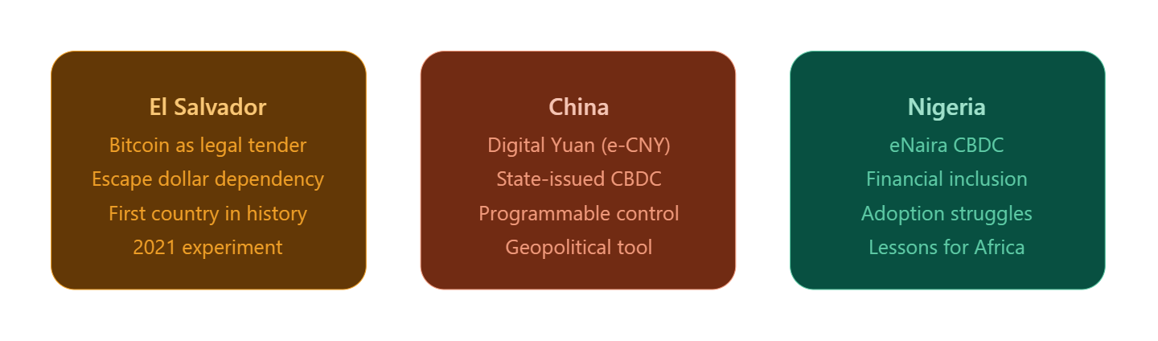
Lecture
8
Case Studies: Three Countries, Three Experiments. Three very different problems. Three very different bets on the future of money. What's remarkable is that El Salvador, China, and Nigeria arrived at roughly the same crossroads, the intersection of digital technology and national currency, from entirely opposite directions. One was escaping dependency, one was asserting dominance, and one was chasing inclusion. Each story teaches us something the others cannot.

Slide 37
Lecture
El Salvador: The Bitcoin Experiment
8
In September 2021, El Salvador became the first country to adopt Bitcoin as legal tender, marking a historic and controversial shift in monetary policy. The country had already been using the US dollar since 2001, meaning it lacked control over its own monetary policy. President Nayib Bukele viewed Bitcoin as an opportunity to regain some financial flexibility and reduce the high costs of remittances, which account for about 24% of the country’s GDP.
To promote adoption, the government launched the “Chivo Wallet” and offered a $30 incentive to users. Initially, adoption appeared strong, with millions downloading the app and increased global attention boosting tourism, particularly in areas like “Bitcoin Beach.” However, this early success was largely superficial.

Slide 38
Lecture
China's Digital Yuan: Control by Design
8
China developed the e-CNY as a centralized digital currency controlled by the People's Bank of China, aiming to enhance monetary control and reduce reliance on the US dollar. Unlike cryptocurrencies, it is fully traceable and programmable, allowing the government to monitor and influence how money is used. Despite its advanced design and strong government support, adoption has been slower than expected, as users continue to prefer familiar platforms like WeChat Pay and Alipay.
Key insight: strong technology and government backing alone are not enough user convenience and trust are critical for adoption.

Slide 39
Lecture
8
Nigeria launched the eNaira in 2021 through the Central Bank of Nigeria as one of the world’s first Central Bank Digital Currencies (CBDCs), aiming to improve financial inclusion and reduce remittance costs in Africa’s largest economy. Despite strong potential and clear economic need, adoption remained extremely low, with less than 0.5% of the population using it in its first year.
The main issue was not technology, but trust. Many Nigerians were skeptical of government control over digital money, especially after restrictions on cryptocurrencies shortly before the eNaira launch. In addition, the system failed to offer clear advantages over existing mobile money solutions and required smartphones and internet access, limiting its usefulness for the unbanked population.

Slide 40
Lecture
8
Summary

Slide 41


Thank You

