Slide 1


Assessment of
Healthcare Systems
Prepared by Dr. Abdulaziz Alsaedi
MHA611
Healthcare Systems
Lecture 05

Slide 2

Outlines:
Overview of the assessment of Healthcare systems.
Different approaches used in healthcare systems measurement.
Benefits of measuring healthcare systems.
What should be measured?
Functions of the healthcare systems.
Healthcare systems measurement tools.

Slide 3

Chapter
Learning Objectives
05
Understanding how we can measure healthcare systems.
Understanding the different methods for measuring healthcare systems.
Understanding the benefits of measuring healthcare systems.
Understanding the functions of healthcare systems and how they can be measured.
Understanding the different tools used in measuring healthcare systems.
Understanding the different domains and indicators for measuring healthcare systems.

Slide 4

Chapter
Assessment of Healthcare Systems
05
Structure
How can healthcare systems be measured?

Slide 5
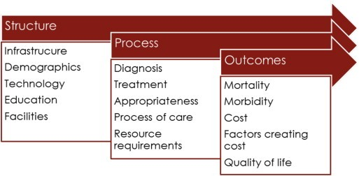
Chapter
Assessment of Healthcare Systems
05
Structure
The healthcare system can be measured using various frameworks and approaches.
One of the most influential and widely used is the Donabedian model, which provides a comprehensive framework for evaluating healthcare quality across three key domains:
Structure
Process
Outcomes

Slide 6
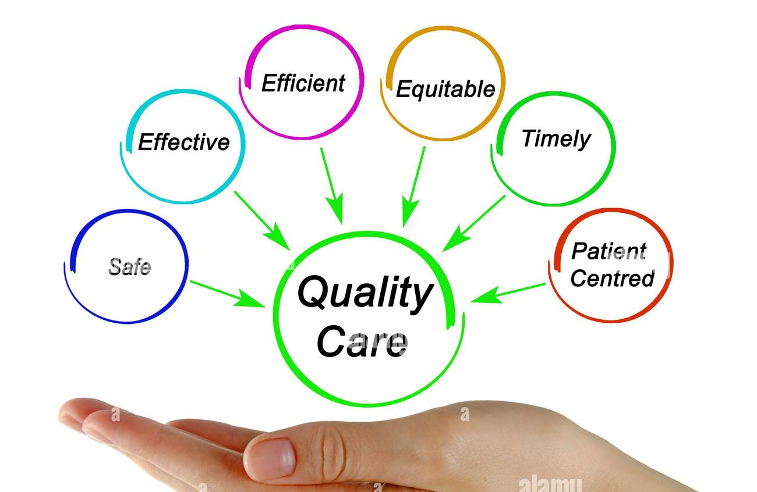
Chapter
Assessment of Healthcare Systems
05
Structure
The Institute of Medicine expanded on the Donabedian model by identifying six key aims for healthcare quality (STEEEP):
Safety
Timeliness
Efficiency
Effectiveness
Equity
Patient-centeredness

Slide 7

Chapter
Assessment of Healthcare Systems
05
Structure
Why are healthcare systems being measured?

Slide 8
Chapter
Assessment of Healthcare Systems
05
Structure
Why are healthcare systems being measured?
1. Quality Assurance and Improvement:
Identifying Best Practices: By analyzing variations in quality measures, healthcare providers can identify and adopt best practices in care delivery.
Standardization: Quality improvement seeks to standardize processes and structures to reduce variation and achieve predictable results, ultimately improving patient outcomes.
Continuous Improvement: Regular measurement allows healthcare organizations to track progress and make data-driven decisions for ongoing enhancements in care delivery.

Slide 9
Chapter
Assessment of Healthcare Systems
05
Structure
Why are healthcare systems being measured?
2. Accountability and Transparency
Public Reporting: Systematic reporting of quality measures provides transparency to patients, policymakers, and the public about healthcare system performance.
Benchmarking: Measurement enables comparison of performance across providers, regions, and even countries, fostering accountability and healthy competition.
Policy Decisions: Policymakers use quality measurements to inform healthcare policies and resource allocation decisions.

Slide 10
Chapter
Assessment of Healthcare Systems
05
Structure
Why are healthcare systems being measured?
3. Patient-Centered Care
Patient Choice: Quality measures help patients make informed decisions about their healthcare providers and treatment option.
Patient-Reported Outcomes: Incorporating patient-reported outcome measures (PROMs) ensures that care quality is assessed from the patient's perspective.
Holistic Evaluation: Measurement frameworks like the Quadruple Aim focus on improving patient experience alongside other crucial aspects of healthcare.

Slide 11
Chapter
Assessment of Healthcare Systems
05
Structure
Why are healthcare systems being measured?
4. Cost-Effectiveness and Efficiency
Resource Allocation: Measuring outcomes in relation to costs helps healthcare systems allocate resources more efficiently.
Value-Based Healthcare: Outcome measurements are crucial for implementing value-based care models that aim to maximize health outcomes per dollar spent.
Identifying Inefficiencies: Comprehensive measurement can reveal areas of waste or inefficiency in the healthcare system.

Slide 12
Chapter
Assessment of Healthcare Systems
05
Structure
Why are healthcare systems being measured?
5. Regulatory Compliance and Accreditation
Meeting Standards: Healthcare organizations use quality measures to demonstrate compliance with regulatory requirements and accreditation standards.
Risk Management: Systematic measurement helps identify potential risks and areas for improvement before they lead to adverse events.

Slide 13
Chapter
Assessment of Healthcare Systems
05
Structure
Why are healthcare systems being measured?
6. Advancing Medical Knowledge
Research Opportunities: Analysis of quality measures can identify areas where further research is needed to improve care practices.
Evidence-Based Practice: Measurement supports the development and refinement of evidence-based guidelines and protocols.

Slide 14

Chapter
Assessment of Healthcare Systems
05
Structure
What should be measured?

Slide 15
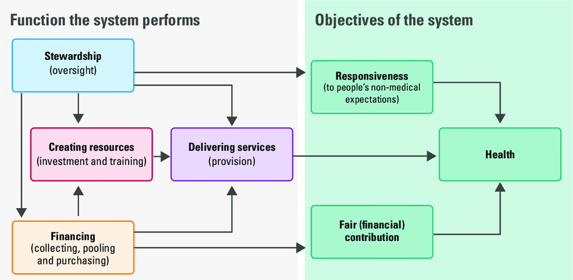
Chapter
Assessment of Healthcare Systems
05
Healthcare systems comprise all organizations, people, and actions whose primary intent is to promote, restore, or maintain health. (WHO)

Slide 16
Chapter
Assessment of Healthcare Systems
05
Function of the Healthcare Systems:
Governance (Stewardship)
Creating resources
Financing
Service Delivery

Slide 17
Chapter
Functions of the Healthcare Systems:
05
1. Governance
They encompass the core actions of steering the sector with a clear policy direction (policy and vision); ensuring that all stakeholders, including the public, communities and civil society, are meaningfully included in policy decisions (stakeholder voice); fostering a culture of data-driven, evidence-based decision-making (information and intelligence); and leveraging legal frameworks to protect the population’s health and ensure progress on health system goals (legislation and regulation).
Each of these sub-functions is further associated with clearly defined assessment areas, which are areas whose appraisal is needed to grasp function-level performance.

Slide 18
Chapter
Functions of the Healthcare Systems:
05
2. Resource generation:
The resource generation function is purposefully placed in the HSPA Framework for UHC between governance and service delivery, indicating that the governance function enables the resource generation function, and resource generation feeds into, and enables the service delivery function.
Resource generation sub-functions are health workforce; infrastructure and medical equipment; and pharmaceuticals and other consumables, representing the principal inputs that need to come together in the right mix at the right place at the right time within the service delivery function, underpinned by governance and financing.

Slide 19
Chapter
Functions of the Healthcare Systems:
05
3. Financing:
The financing function includes the sub-functions of revenue raising, pooling, and purchasing. Revenue raising refers to the ways in which money is brought into the health system. Pooling refers to the accumulation of prepaid funds that can be used to purchase goods and services on behalf of a population. The pooling function is largely intended to ensure that resources are distributed in an equitable way and also to enable efficiency through economies of scale. Purchasing refers to payers using funds to pay for health care on behalf of a population. It is mainly concerned with getting resources to those who need them most and doing this efficiently by minimizing costs. As a result, purchasing can have a major impact on intermediate objectives such as quality and health outcomes.

Slide 20
Chapter
Functions of the Healthcare Systems:
05
4. Service delivery:
Service delivery is a broad concept and difficult to separate into discrete sub-functions that match organizational structures (for example, levels: primary, secondary, tertiary; OR purpose: preventive, curative, rehabilitative, long-term care) of health systems globally.
Assessment areas of all service delivery sub-functions coincide with intermediate health system objectives and include aspects of quality (effectiveness, safety, user experience, as well as efficiency and equity of service delivery) and access to services.

Slide 21
Chapter
Functions of the Healthcare Systems:
05
1. Governance

Slide 22

Chapter
Functions of the Healthcare Systems:
05
Governance:
The four governance sub-functions are:
Policy and vision,
Stakeholder voice,
Information and intelligence, and
Regulation and legislation.

Slide 23
Chapter
Function: Governance
05
1. Policy and Vision
The policy and vision sub-function centers on having the capability and resourced capacity to provide a clearly articulated strategic vision for the health sector. The assessment seeks to identify whether this is available in a written and traceable form, such as a single document, a set of policies, laws and/or guidelines to which governments can be held accountable.
At the core of shaping health policy and providing a vision for the health sector is intersectoral collaboration; hence, the existence and quality of multisectoral collaboration will be a key focus of assessment.

Slide 24
Chapter
Function: Governance
05
2. Stakeholder Voice
The stakeholder voice sub-function revolves around the real possibility for key stakeholders – such as civil society organizations, vulnerable and marginalized communities, the public, academia, and provider associations – to contribute meaningfully to health policy decisions (assessment area “stakeholder participation in policy-making”).
This sub-function therefore requires solid government capacity to initiate, steer and sustain long-term participatory processes for purposes of capturing the stakeholder voice as part of the regular health sector modus operandi (assessment area “stakeholder participation as a government priority”).

Slide 25
Chapter
Function: Governance
05
3. Information and Intelligence
The information and intelligence sub-function is essentially about data governance. It involves the managerial culture and political will needed to support an environment where evidence generation and use are the norm, where changes within the health system and their effects on systems performance are constantly monitored, learned from and acted upon (assessment area “collection of relevant data”).
A well-functioning information system that is accessible to a wide range of health system stakeholders is therefore crucial for data-driven decision-making (assessment area “evidence-driven decision-making”).

Slide 26
Chapter
Function: Governance
05
4. Legislation and Regulation
Legislation and regulation are powerful levers for the achievement of health system goals. For example, rights-based health laws or regulatory frameworks for private sector service provision can have a profound enabling effect on the performance of further health system functions, and subsequently on health system outcomes.
Assessment areas here are “capacity to legislate” and “ensuring compliance with legislation”.

Slide 27
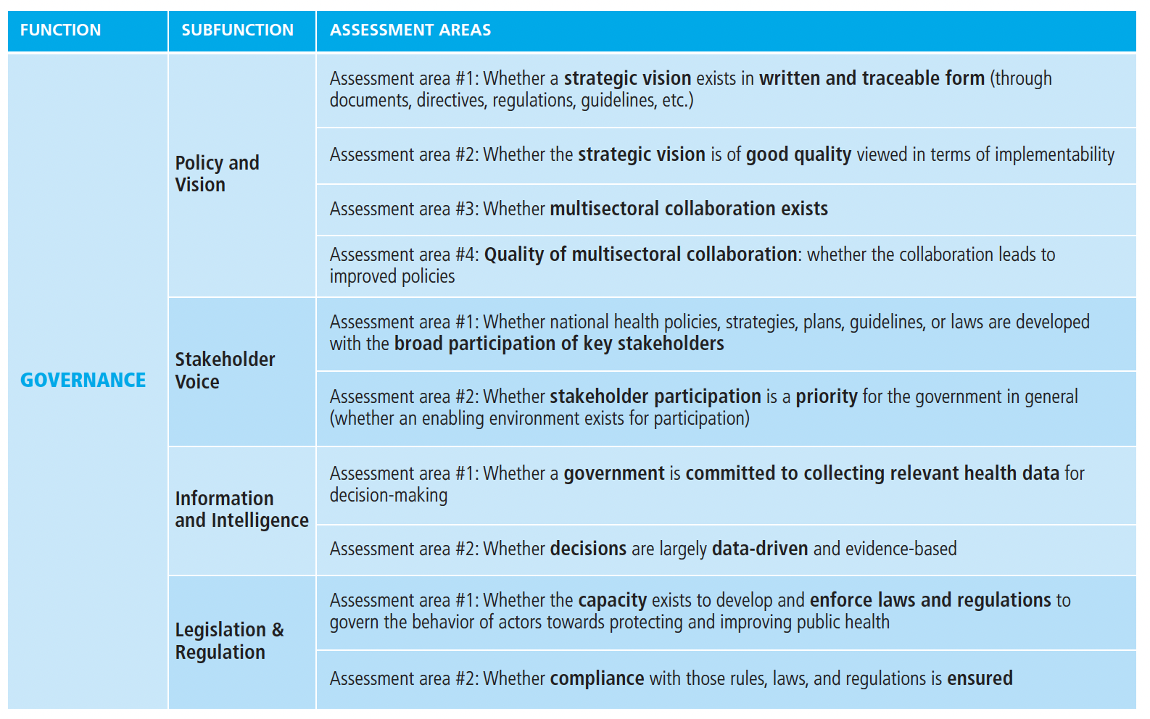
Chapter
Function: Governance
05

Slide 28
Chapter
Functions of the Healthcare Systems:
05
2. Resource Generation

Slide 29
Chapter
Function: Resource Generation
05
1. Health Workforce
The Health Workforce is defined by the WHO as all persons engaged in actions whose primary intent is to enhance health.
The assessment areas are similar across the resource generation sub-functions: availability, mix/distribution and a measure of upkeep, that is, education in the case of the health workforce. Availability and mix/distribution are essentially about human resources which are made available at the right place and right time, thereby enabling the service delivery function.

Slide 30
Chapter
Function: Resource Generation
05
2. Infrastructure and Medical Equipment
Infrastructure and medical equipment are physical resources that give health providers, and users, the tools needed to provide effective and efficient health services.
Resource generation achieves its maximum performance through the interplay of a large, qualified health workforce, equipped with drugs and consumables, working in adequately built and equipped health facilities.
Infrastructure and medical equipment are characterized by the large capital investments required to build health infrastructure and to equip health facilities with medical equipment.

Slide 31
Chapter
Function: Resource Generation
05
3. Pharmaceutical and other consumables
WHO defines the characteristics of pharmaceuticals as products that should be “safe, effective, and of good quality” as well as “prescribed and used rationally” (WHO, 2021). Consumables are described in the World Health Report 2000 as an umbrella term that includes pharmaceutical products (WHO, 2000).
In short, the sub-function labelled pharmaceuticals and consumables focuses on the manufacturing and procurement processes needed to ensure that these products are available where and when they are needed.

Slide 32
Chapter
Function: Resource Generation
05
4. Governance of resource generation
The point of intersection between governance and resource generation is called the governance of resource generation. This intersection includes governance matters that are specific to resource generation, as opposed to those involved with the overall system governance functions.
The governance of elements of resource generation focuses on a wide range of tasks associated with planning for resources. These include health workforce planning and forecasting; setting quality standards, such as self-regulation of health providers by professional associations; and monitoring those standards, through regular inventory management of large medical equipment.

Slide 33
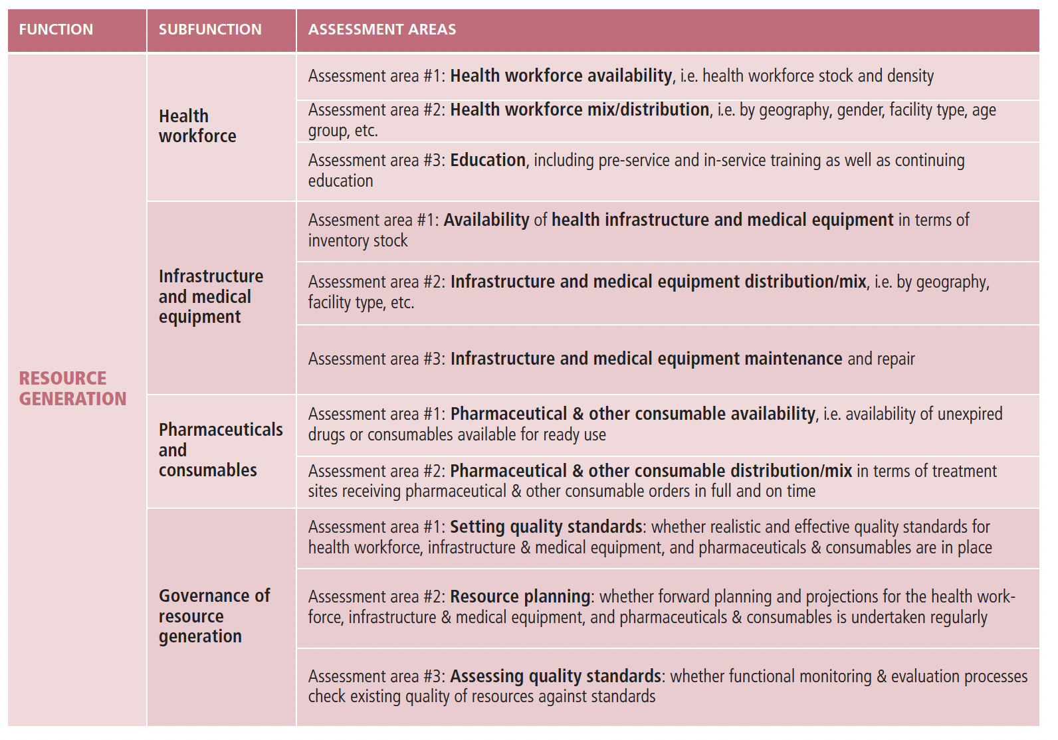
Chapter
Function: Resource Generation
05

Slide 34
Chapter
Functions of the Healthcare Systems:
05
3. Financing

Slide 35
Chapter
Function: Financing
05
1. Revenue raising
Revenue raising refers to the ways in which how money is brought into the health system. A well-performing revenue-raising sub-function should ensure that the health system has sufficient resources to meet the healthcare needs of the population; that those resources are stable, predictable and able to cope with shocks; and that they are collected in an equitable manner to ensure the burden of health system financing does not fall on the poor or sick.

Slide 36
Chapter
Function: Financing
05
2. Pooling
Pooling refers to the accumulation of prepaid funds, which can be used to purchase goods and services on behalf of a population. The pooling function is largely intended to ensure that resources are distributed in an equitable way and also to enable efficiency through economies of scale.

Slide 37
Chapter
Function: Financing
05
3. Purchasing
Purchasing refers to payers using funds to pay for health care on behalf of a population. It is mainly concerned with getting resources to those who need them most and doing this efficiently by minimizing costs. As a result, purchasing can have a major impact on intermediate objectives such as quality and, ultimately, health outcomes.

Slide 38
Chapter
Function: Financing
05
4. Governance of financing
The governance of financing sub-function covers choices and factors that determine if the flow of funds in the health system is fit for purpose and performs adequately. The key aspects of governance of financing are policies relating to benefits design and service coverage, as well as Public Financial Management.
Benefit design and coverage policies determine who is covered, what services are covered, and any restrictions or conditions of access. Public Financial Management is the set of rules that govern the allocation, use and accountability of public funds.

Slide 39
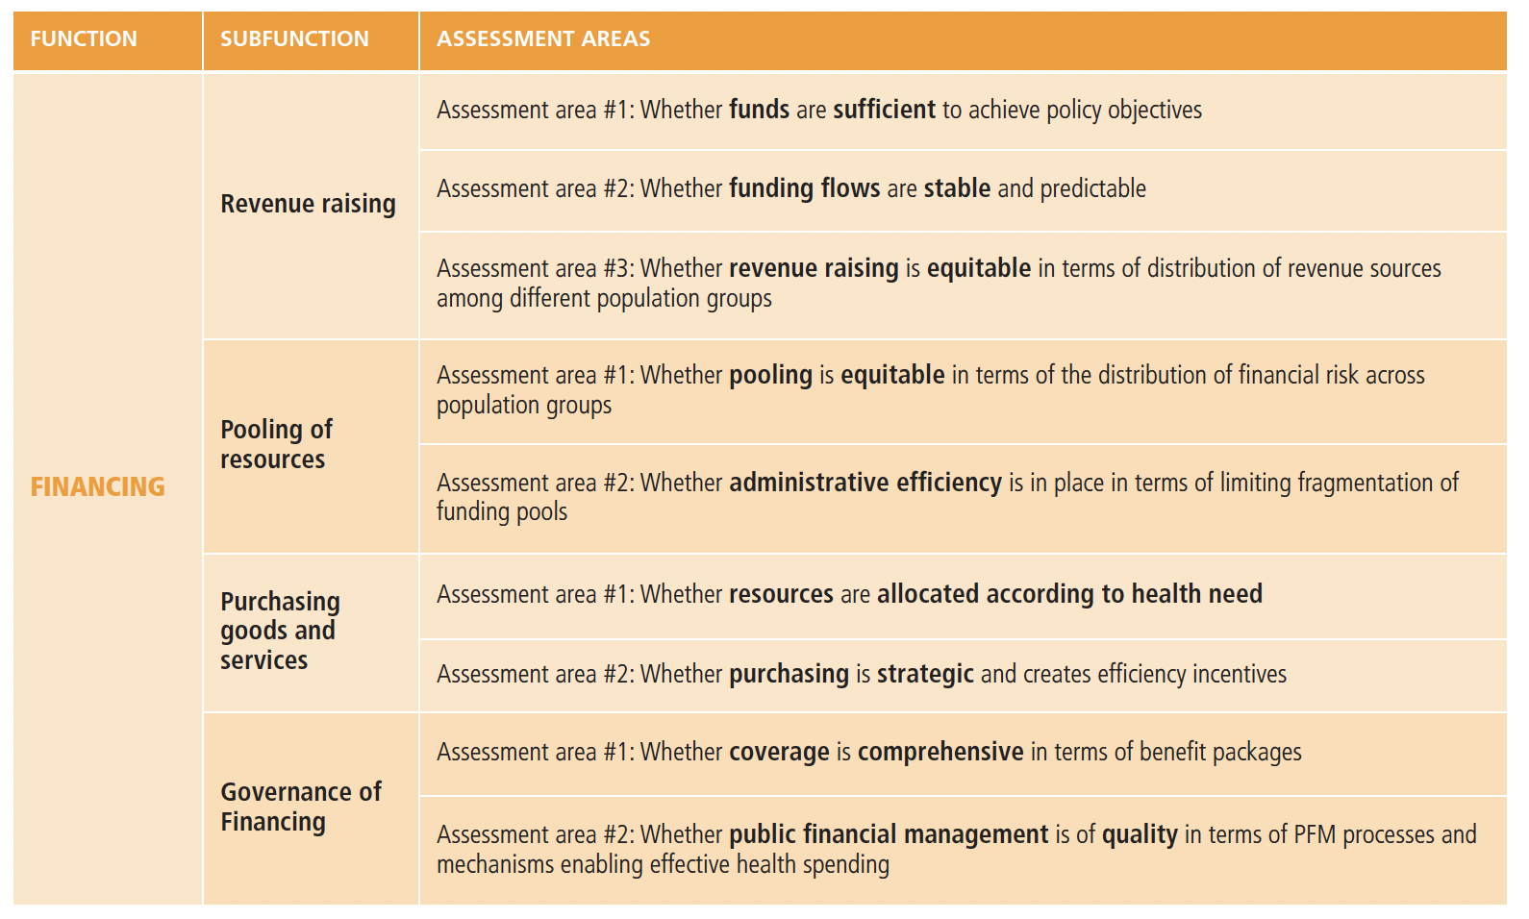
Chapter
Function: Financing
05

Slide 40
Chapter
Functions of the Healthcare Systems:
05
4. Service Delivery

Slide 41
Chapter
Function: Service Delivery
05
1. Public Health
The public health sub-function aims to fulfil the preventive care needs of the population, although where the boundaries lying between prevention and care are often blurred. Considerable variation can be seen in this sub-function in terms of the operational areas and activities covered, ranging from disease prevention, health care, emergency preparedness, social participation and communication. This may reflect differences in perspectives on what constitutes public health, particularly in relation to universal health coverage and to what degree health care should be considered a public health operation.

Slide 42
Chapter
Function: Service Delivery
05
2. Primary Care
Primary care represents the first point of contact for unspecified and common health problems. Here also, however, boundaries can vary widely between the other service delivery sub-functions, depending on setting, organizational history and approach. For example, services that fulfil a wider public health function are often provided in primary care settings (for example, vaccination and family planning), whereas in some countries primary care entities may host specialized care practitioners.

Slide 43
Chapter
Function: Service Delivery
05
3. Specialist Care
Specialist care is care that is provided beyond the first contact triage and generally requires specialist skills. In many countries, specialist care may be distinguished into secondary care (often provided in local hospitals) and tertiary care (often provided in highly specialized centers).
The expansion of medical technologies and e-health solutions has blurred the boundaries between the service delivery sub-functions further, bringing specialized diagnostic and therapeutic interventions closer to patients in ambulatory settings or even people’s homes.

Slide 44
Chapter
Function: Service Delivery
05
4. Governance of service delivery
Governance of service delivery relates to planning and decision-making for health services, including ensuring health service integration and quality assurance mechanisms in service provision.
The delineation towards overall systems governance lies in the specificity of the decision-making – when it is for the delivery of health services, and not for the system as a whole, then it would be part of the governance of service delivery.

Slide 45
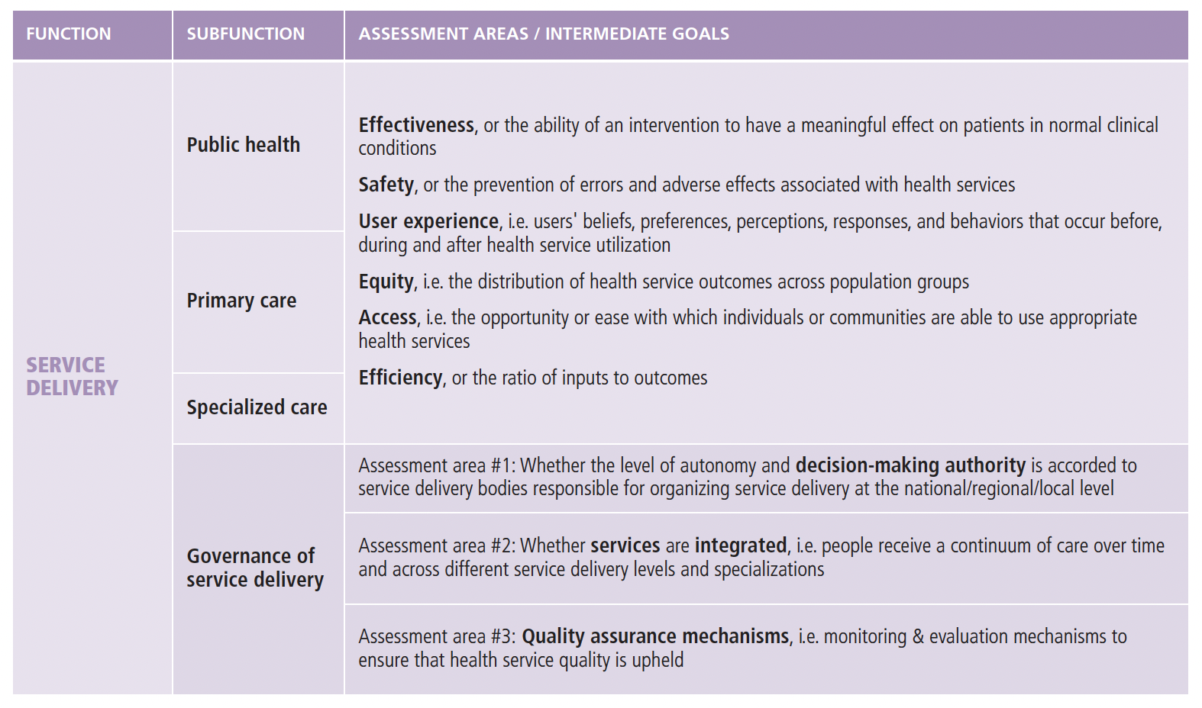
Chapter
Function: Service Delivery
05
Structure

Slide 46

Chapter
Healthcare Systems Measurement Tools
05
Structure
Tools used in HCS measurement

Slide 47
Chapter
Healthcare Systems Measurement Tools
05
Over the years, assessments of health systems and their performance have been given different labels, including “health system profile”, “health sector situation analysis”, “health system monitoring”, “health system analysis”, “health system assessment” and “health systems performance assessment”.
In part, the vast terminology reflects the different, yet overlapping, objectives of assessment efforts, which include describing the health system’s structures, evaluating distinct health system functions, measuring health system performance and supporting health reform efforts.
Although all of these efforts are geared towards health system strengthening, they are varied with regard to their objective, scope and focus.

Slide 48
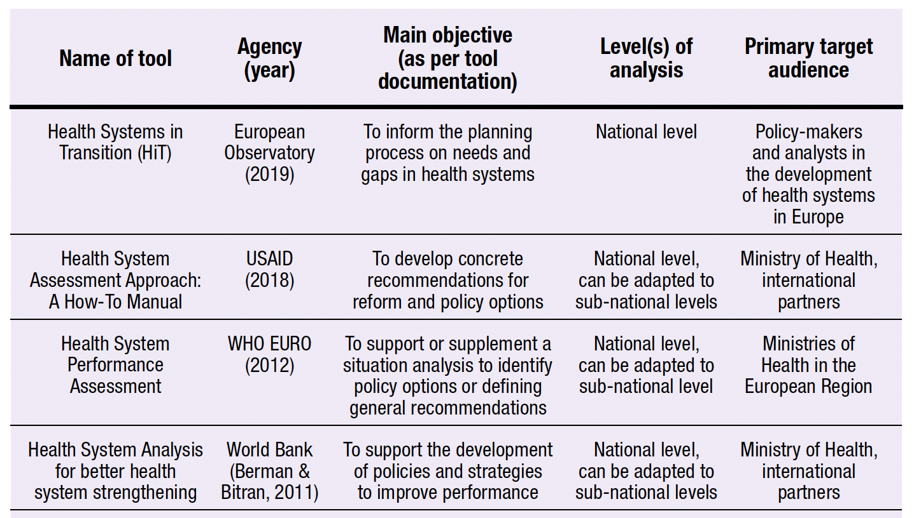
Chapter
Healthcare Systems Measurement Tools
05
Here are examples of different HSA tools reviewed here.

Slide 49
Chapter
Healthcare Systems Measurement Tools
05
Framework/ Tool | Intermediate objectives | Final Health System Goals
WHO Performance Framework (2000) | Access Coverage Quality Safety | Level and distribution of health Level and distribution of responsiveness Fairness in financing Efficiency
Control Knobs Framework (2003) | Efficiency Quality Access | Health status Citizen satisfaction Risk protection
Health System Performance Assessment (WHO/EURO) | Equity Efficiency | Health improvement Risk protection Responsiveness

Slide 50
Chapter
Healthcare Systems Measurement Tools
05
Framework/ Tool | Intermediate objectives | Final Health System Goals
Health System Assessment Approach: A How-To Manual (USAID) | Equity Efficiency Access Quality Sustainability | Improved health Responsiveness Risk protection
Health System Analysis For a better health system strengthening (World Bank) | Access Quality Efficiency | Health status Financial protection Customer satisfaction
HQSS High-Quality Health System Framework (2018) | Processes of care: Competent care and systems Positive user experience | Quality impacts: Better health Confidence in the system Economic benefit

Slide 51
Chapter
Summary
05
Measuring healthcare systems is essential to ensuring achieving their key objectives.
Donabedian model is one of the most common methods which can be used to measure healthcare systems.
The IOM quality domains (STEEEP) are highly recommended to be used for measuring different healthcare systems.
Healthcare systems can be measured through their main functions.
Many tools are available which can be used for measuring healthcare systems.

Slide 52



Thank You

Slide 53
Chapter
References:
05
Wang, H. (2016). Comparative Health Systems: A Global Perspective. In International Encyclopedia of Public Health. Jones & Bartlett Learning. https://doi.org/10.1016/B978-0-12-803678-5.00085-0
Rivki, M., Bachtiar, A. M., Informatika, T., Teknik, F., & Indonesia, U. K. (2013). Health Care Systems Around The World (Issue 112).
Rajan, Dheepa; Papanicolas, Irene ; Karanikolos, Marina ; Koch, Kira ;Rohrer-Herold, Katja ; Figueras, J. (2022). Health system performance assessment: A primer for policy-makers. 1–39.

